Slide 1

ISZE · NORWAY · NORWAY
Norway Sales Review
& FY2027 Target
Rutebileiernes Standardisering · August 2026

Slide 2
NORWAY MEETING
Agenda
— Parts Performance — category movers
— Parts Performance — Brake parts
— Parts Performance — Air conditioning
— Parts Performance — Exhaust
— Parts Performance — where volume grew
— New Business — validation queue
— Sales-to-Dealer Outlook
— GPS Capture
— Service-Parts Coverage
— IDS 2026 — Dealer Standard
— Fleet & FY2027 Target
— SPA — status
— R&M — market discussion
— Data request: part-level Sales-to-Dealer
— Next steps
2

Slide 3
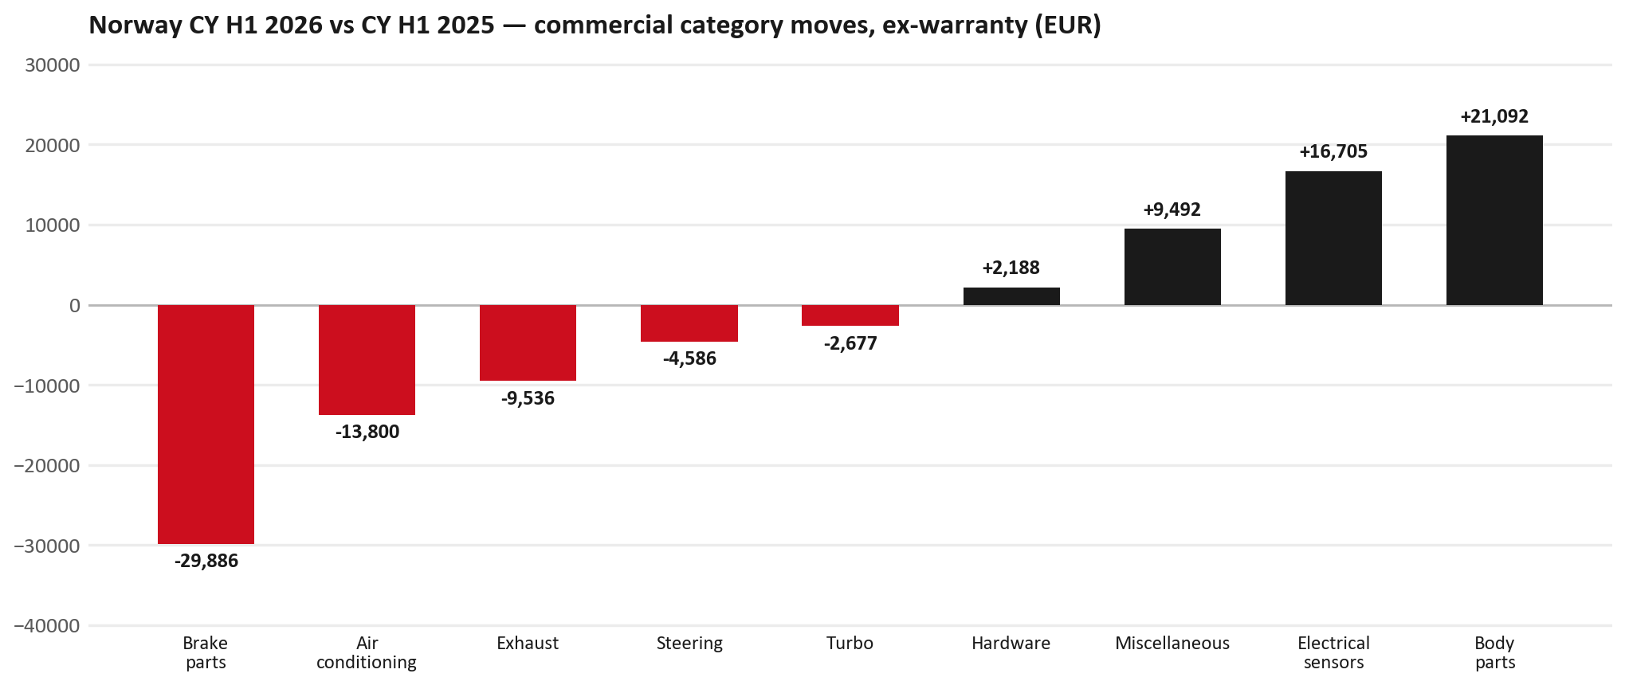
PARTS PERFORMANCE
Parts Performance — CY H1 2026 vs CY H1 2025 (commercial, ex-warranty)
TAKEAWAYS
— Commercial parts billing (warranty/campaign excluded) EUR 456K against EUR 386K a year earlier — +18.4% (CY H1 2026 vs CY H1 2025, Jan–Jun).
— Largest PN drops: 8976526220 (PAD KIT; CALIPER,DIS) EUR -12K, 200 fewer pcs; 8975546610 (PAD KIT; CALIPER,DIS) [TF*] EUR -12K, 150 fewer pcs; 8981405904 (SILENCER ASM; EXH) EUR -9K, 64 fewer pcs.
— Largest PN gains: 8974993681 (SENSOR; TIRE INFLATI) EUR 11K, 391 more pcs; 8975509392 (BUMPER ASM; FRT) EUR 3K, 32 more pcs; 8982705240 (ELEMENT; OIL FILTER) [NHR,NLR,NMR,TF*,UC*] EUR 3K, 200 more pcs.
— Credit notes of EUR 47K stay on the net bridge (net EUR 734K); not in the movers.
3

Slide 4
PARTS PERFORMANCE — BRAKE PARTS
Brake parts — CY H1 2026 vs CY H1 2025 (commercial, ex-warranty)
— EUR 67,440 (CY H1 2025) to EUR 37,554 (CY H1 2026), down EUR 29,886 (-44%).
— Largest part numbers driving the decline (by EUR):
— 8976526220 (PAD KIT; CALIPER,DISC BRK,FRT): EUR 12,392 to EUR 0, 200 fewer pieces.
— 8975546610 (PAD KIT; CALIPER,DISC BRK,FRT · TF*): EUR 40,065 to EUR 27,886, 150 fewer pieces.
— 8980618131 (DRUM; BRK,RR): EUR 3,701 to EUR 139, 53 fewer pieces.
— 8980303850 (DRUM; BRK,RR): EUR 948 to EUR 0, 13 fewer pieces.
Questions for us to work through together
— Is pad and rotor pricing competitive against what the dealers can buy locally?
— Is any of this stock timing on your side rather than end demand?
— Are dealers still quoting these part numbers, or have they dropped off the workshop menu?
4

Slide 5
PARTS PERFORMANCE — AIR CONDITIONING
Air conditioning — CY H1 2026 vs CY H1 2025 (commercial, ex-warranty)
— EUR 49,483 (CY H1 2025) to EUR 35,683 (CY H1 2026), down EUR 13,800 (-28%).
— Largest part numbers driving the decline (by EUR):
— 8975554500 (FILTER; BLOWER UNIT · TF*,UC*): EUR 16,138 to EUR 9,534, 400 fewer pieces.
— 8974995480 (FILTER; ACL · TFR,TFS,UCR,UCS): EUR 14,448 to EUR 10,180, 200 fewer pieces.
— 8981394280 (FILTER; BLOWER UNIT · TF*,UC*): EUR 8,636 to EUR 5,452, 150 fewer pieces.
— 8981402650 (FILTER; ACL · TFR,TFS,UCR,UCS): EUR 6,604 to EUR 4,953, 100 fewer pieces.
Questions for us to work through together
— Is the seasonal pattern different this year, or is this a real shift?
— Are cabin filters and A/C service being sold as a package?
5

Slide 6
PARTS PERFORMANCE — EXHAUST
Exhaust — CY H1 2026 vs CY H1 2025 (commercial, ex-warranty)
— EUR 24,416 (CY H1 2025) to EUR 14,880 (CY H1 2026), down EUR 9,536 (-39%).
— Largest part numbers driving the decline (by EUR):
— 8981405904 (SILENCER ASM; EXH): EUR 12,912 to EUR 4,338, 64 fewer pieces.
— 8982114012 (PIPE; EXH): EUR 3,596 to EUR 951, 14 fewer pieces.
— 8981776324 (DPD ASM): EUR 2,477 to EUR 0, 2 fewer pieces.
— 8972630520 (GASKET; EXH PIPE): EUR 511 to EUR 96, 148 fewer pieces.
Questions for us to work through together
— Is this pricing against what the dealers can buy locally?
— Is any of this stock timing on your side rather than end demand?
— What would make the biggest difference to keep this business with us?
6

Slide 7
PARTS PERFORMANCE — GROWTH
Where volume grew — CY H1 2026 vs CY H1 2025 (commercial, ex-warranty)
Part | Description | Model | CY H1 2025 | CY H1 2026 | Δ EUR
8974993681 | SENSOR; TIRE INFLATION | — | EUR 2,694 | EUR 13,476 | EUR 10,782
8975509392 | BUMPER ASM; FRT | — | EUR 4,653 | EUR 8,122 | EUR 3,469
8982705240 | ELEMENT; OIL FILTER | NHR,NLR,NMR,TF*, | EUR 8,640 | EUR 11,688 | EUR 3,048
8975595830 | PANEL; SIDE GATE | — | EUR 619 | EUR 2,879 | EUR 2,260
8983621213 | BAR; FRT BUMPER | — | EUR 260 | EUR 2,008 | EUR 1,748
8983314120 | SENSOR; PRESSURE,DPD | — | EUR 381 | EUR 1,705 | EUR 1,325
— Body parts +25%, Electrical sensors +59%, Miscellaneous +83% — where the commercial volume went.
— Claim-matched PNs (207 distinct) and campaign/recall text matches are already excluded from this growth list. Residual warranty on unmapped PNs can remain.
— PNs ranked by largest EUR increase (prior-period sales > 0). Worth agreeing which of these are repeatable and which were one-off.
7

Slide 8
PARTS PERFORMANCE
New Business — validation queue (CY H1 2026)
Part | Description | Current sales | Review
7552105216 | CABLE; BATTERY CHARGER | EUR 9,092 | Validate
8978461152 | GLASS; WINDSHIELD | EUR 6,573 | Validate
5874123812 | INTERFACE MX2-T | EUR 5,762 | Validate
8978249025 | LAMP ASM; HEAD | EUR 3,866 | Validate
8983939000 | TRANSMISSION ASM; AUTO | EUR 3,515 | Validate
8983287647 | LAMP ASM; HEAD | EUR 3,511 | Warranty / campaign
— These lines had no prior-period sales, so they are kept out of the incremental-growth table.
— A first sale can be a new model, a supersession, timing, or a warranty campaign. It is not treated as a commercial win until that cause is confirmed.
8

Slide 9
SALES-TO-DEALER
Sales-to-Dealer outlook — FY2027
— FY2026 Sales-to-Dealer is EUR 5,248,795 (reported KPI).
— The working fleet movement into FY2027 is -7.0%.
— Applying fleet movement, the 5% price adjustment and 1.8% additional growth gives a FY2027 Sales-to-Dealer target of EUR 5,217,728.
— The discussion is held in Sales-to-Dealer amounts; ISZE billing remains an internal reconciliation measure.
9

Slide 10
GPS
GPS Capture: 69.5%
— GPS measures your actual parts purchases against the full potential of your fleet.
— Norway today: 69.5% (FY2026 purchases against the CY2025 fleet potential).
— Fleet potential: EUR 1,982K on 7,929 vehicles.
— Real, sustained headroom above 69.5% — the service-parts and SPA discussion are both direct levers on it.
10

Slide 11
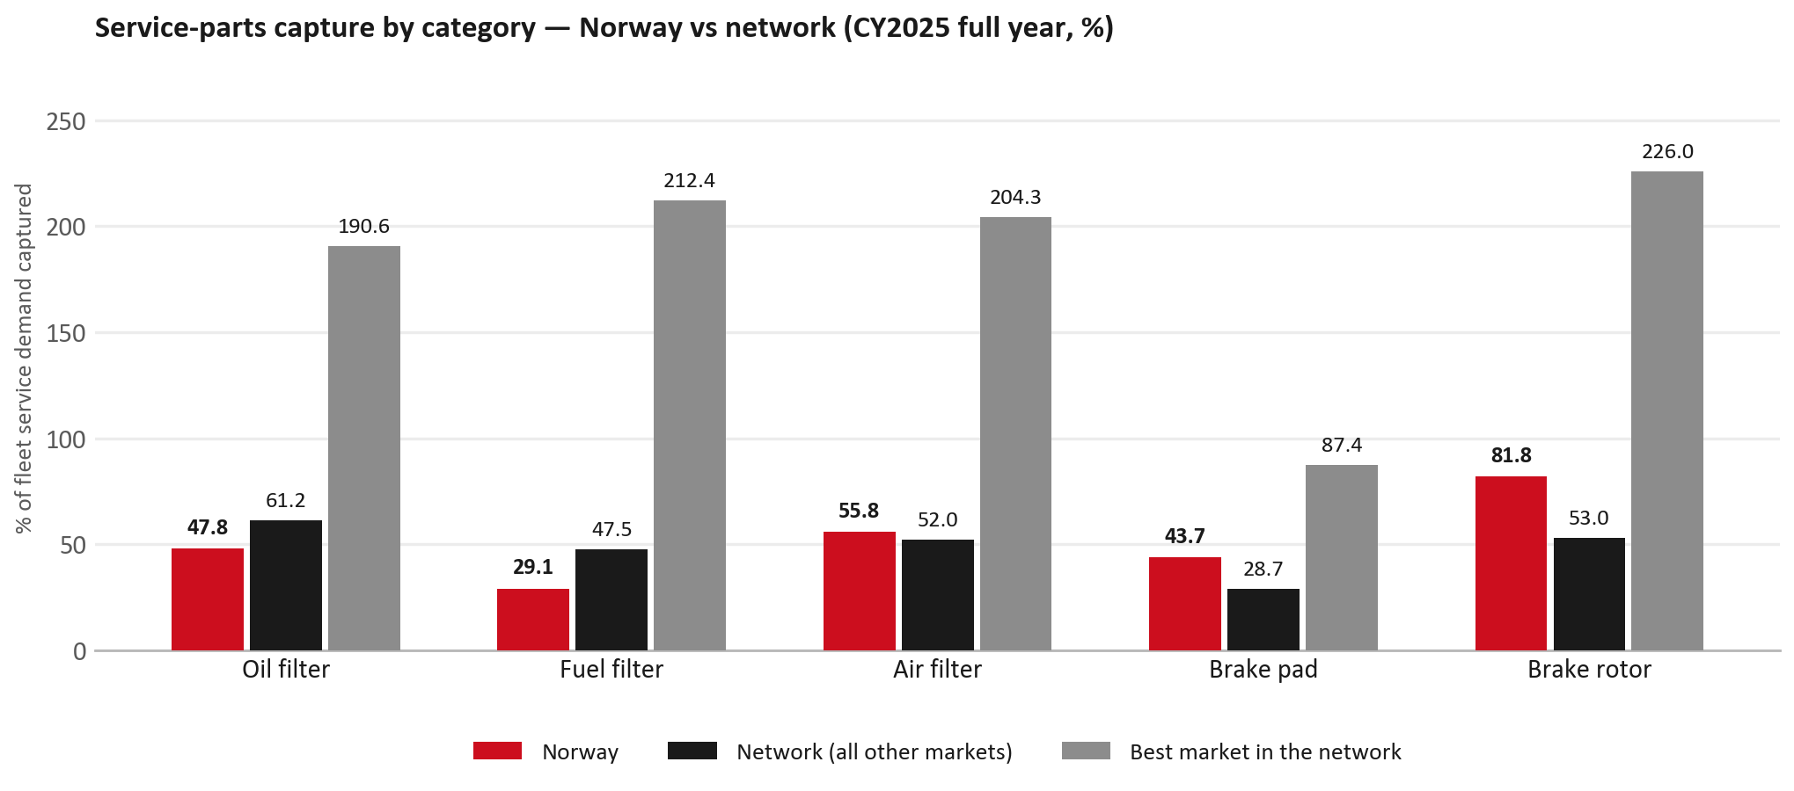
SERVICE-PARTS COVERAGE
Service-parts coverage: fuel filter is the clear gap
TAKEAWAYS
— Fuel filter 29.1% against 47.5% for the rest of the network.
— Oil filter 47.8% against 61.2% for the rest of the network.
— Every market here is measured on the same fleet-and-interval model, so the comparison is like-for-like even where the underlying interval assumption is debatable.
— Worth agreeing which category we tackle first, and what the joint action is.
11

Slide 12
IDS 2026 — DEALER STANDARD
IDS 2026: Norway averages 75.2%, above the 74.8% network benchmark
Dealer | Total % | Global rank
Rsa Bil Tromsø | 92.9% | #56
Mobile Hamar As | 92.5% | #62
Rsa Bil Arendal | 92.1% | #66
Norway country average | 75.2% | —
Network average (all IDS 2026) | 74.8% | —
Blakstad Auto As | 33.2% | #482
Star Bil As | 0.7% | #489
Alta Motorsenter | 0.0% | #518
— 38 dealers assessed across Premises, Organisation, Service, Parts and Vehicle Sales.
— The country average sits 0.4 points above the network.
— The spread is the point: 93 points between the strongest and weakest dealer.
— Dealer-by-dealer detail and individual feedback are available as a separate pack — worth agreeing which dealers to visit, and when.
12

Slide 13
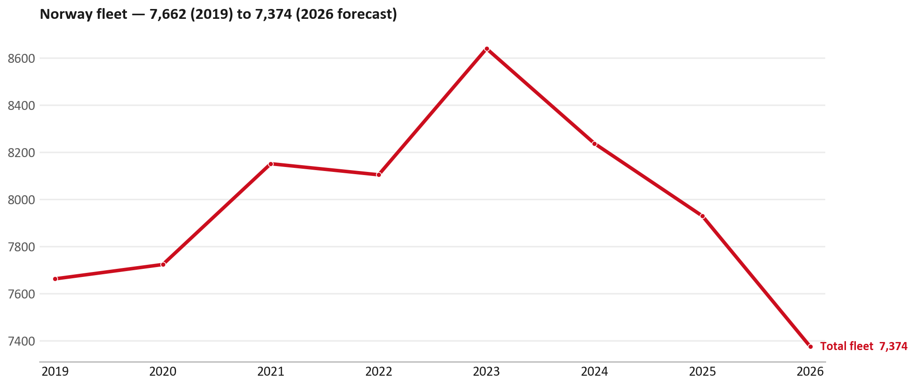
FLEET & FY2027 TARGET
The fleet is expected to decline in 2026
WHAT THIS MEANS FOR FY2027
— Fleet size (calendar year): 7,929 vehicles in 2025 → 7,374 working estimate for end-2026 (-7.0%).
— The chart is calendar years 2019–2026 only. 2026 is a working year-end estimate, not a fiscal-year figure.
— End-2026 mix: LCV / D-Max 7,374; CV — LD 0.
— The FY2027 Sales-to-Dealer target starts from that fleet change, then applies a 5% price adjustment and 1.8% additional growth.
— So the target is built from a slightly smaller fleet — not from an assumed growth story.
13

Slide 14
FLEET & FY2027 TARGET
How the FY2027 target is built
Sales-to-Dealer amount bridge
Step | Amount
FY2026 Sales-to-Dealer (reported KPI) | EUR 5,248,795
After fleet movement (-7.0%) | EUR 4,881,399
After price adjustment (+5%) | EUR 5,125,469
FY2027 target after additional growth (+1.8%) | EUR 5,217,728
— The FY2027 target is -0.6% versus the FY2026 Sales-to-Dealer base.
— The FY2026 base is the reported Sales-to-Dealer KPI.
14

Slide 15
FY2027 TARGET
What the FY2027 target reflects
1
Your fleet
2
The price move
— The working fleet movement used in the target is -7.0%.
— ISZE is applying a 5% price adjustment for FY2027, consistent with every ISZE market this year.
— It is built into the per-vehicle rate above, not added separately on top.
What it means for your target
 | Value
FY2027 Sales-to-Dealer target | EUR 5,217,728
vs FY2026 Sales-to-Dealer (EUR 5,248,795) | -0.6%
— As in previous cycles we would expect an incentive to sit alongside this adjustment — that approval is still pending on our side.
— Until the incentive is confirmed, treat the FY2027 target as the working bridge (fleet × price × additional growth), not a locked commercial commitment.
15

Slide 16
SPA
SPA
1
NORWAY proposal
2
ISZE review
3
Counter-proposal
4
Final approval
— Rutebileiernes Standardisering submits a proposed parts list.
— ISZE reviews the proposal against network data and fit.
— ISZE returns a counter-proposal where needed.
— Signed off by ISZE management.
Purpose: higher turnover for both sides.
16

Slide 17
R&M
R&M — let's align on the market
M
Market
S
Servicing & R&M
— How is the market moving for you right now?
— How much of your volume is fleet business rather than retail?
— Where do you see the biggest hurdles this year?
— Where are your real strengths in this segment?
— Do you offer an R&M or service-plan product today?
— What share of the parc do you retain for servicing after year three?
— Does R&M business come bundled with fleet tenders — roughly what share?
— What would it take to bring more out-of-network servicing back?
17

Slide 18
ASK
Part-level Sales-to-Dealer Data
1
Already halfway there
2
Sharper insight
3
Shared benefit
— You already report Sales-to-Dealer monthly. The ask is the same data at part-number level.
— Part-by-part visibility separates a stock movement from a lost job — and tells us where the volume actually went.
— Better availability on your fast movers, a sharper target for us, and a factual basis for the SPA — same data, both sides gain.
Requested from 01/01/2025, part number level, monthly.
18

Slide 19
SUMMARY
Next steps
— Align on the FY2027 Sales-to-Dealer bridge (fleet, price, additional growth) — working figure EUR 5,217,728 (-0.6% vs FY2026 base).
— Confirm the incentive alongside the price adjustment; lock the target once that approval is through.
— Brake parts / Air conditioning / Exhaust: agree which category we tackle first, and what the joint action is.
— Agree part-level Sales-to-Dealer data sharing, effective 01/01/2025.
— SPA: NORWAY proposal, ISZE review and counter-proposal cycle to follow.
— IDS 2026: agree dealer visit dates, starting with the lower-scoring dealers.
19

Slide 20
Moving the World – for You

