Slide 1

ISZE · VEHICLE PARTS & ACCESSORIES · PRICING
FY2027 Pricing Revision
Margin model across the three lists — PR00 · Israel (ZPR1) · CIS | ISZE internal

Slide 2
COST BASIS
The IML formula is untouched
SP_EUR = FOB_EUR / class_factor · FOB_EUR = BP_JPY / FX × source_discount
ISZE has no pricing discretion — pass-through of IML base prices in JPY.
Input | Value | Basis
FX rate | 163.7 JPY/EUR | FY2026, Oct 2025
Source J discount | 0.62 | Japan / IML sourced
Source T discount | 0.611 | Thailand / IMIT sourced
Class factor | 0.44 – 0.80 | Sets gross margin per class (next slide)
FX symmetry: prices were not reduced when JPY weakened without IML instruction.
2

Slide 3
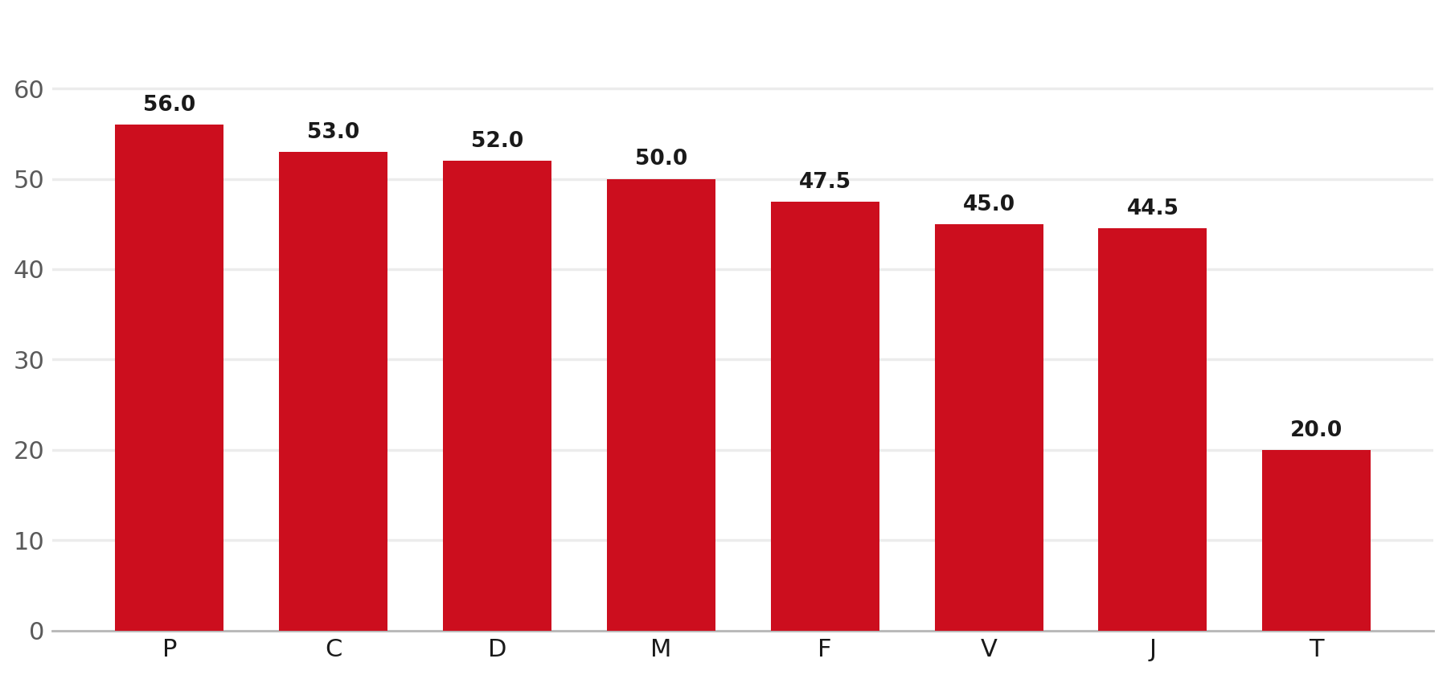
PR00 · MAIN EU LIST
PR00 — gross margin by class factor
Class | Factor | GM
P | 0.440 | 56.0%
C | 0.470 | 53.0%
D | 0.480 | 52.0%
M | 0.500 | 50.0%
F | 0.525 | 47.5%
V | 0.550 | 45.0%
J | 0.555 | 44.5%
T | 0.800 | 20.0%
GM = 1 − class_factor. P (56%) prices the most aggressively; T (20%) is the lowest-margin class.
3

Slide 4
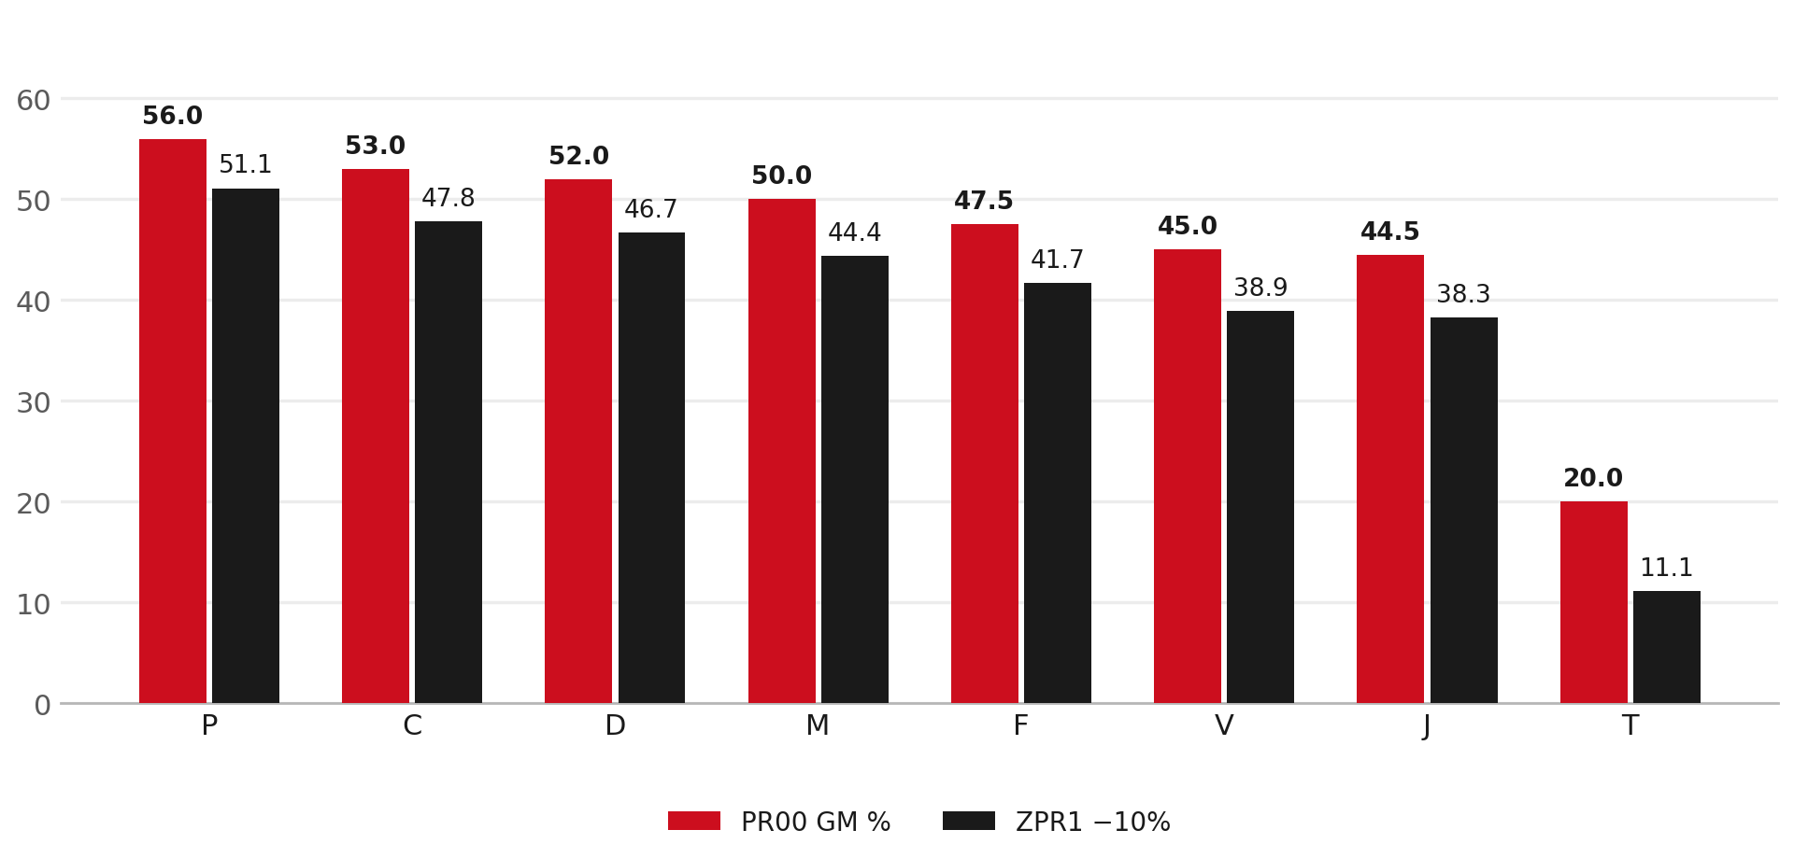
ZPR1 · UMI 1797 / UTI 1799
Israel (ZPR1) — flat −10% on PR00
Class | PR00 | ZPR1 −10%
P | 56.0% | 51.1%
C | 53.0% | 47.8%
D | 52.0% | 46.7%
M | 50.0% | 44.4%
F | 47.5% | 41.7%
V | 45.0% | 38.9%
J | 44.5% | 38.3%
T | 20.0% | 11.1%
Same 8 class factors, then −10% on the PR00 list. Realized ~40.8% GP vs 44.3% network (CY2024).
4

Slide 5
CIS · GA ARMENIA / CBC KAZAKHSTAN
CIS — flat 60% GM, class-independent
SP = FOB / 0.40 → 60% gross margin
Applied to every class. The highest margin in the system.
— Recommended: make CIS class-dependent (end the flat 0.40).
— Segment by Qingling grey-import overlap: 40–45% GM where a Chinese equivalent exists.
— Hold 60% GM where it cannot be followed (Euro 6/7 aftertreatment, electronics, safety).
— EAEU customs union — goods landing in Kazakhstan circulate to Armenia duty-free.
You cannot beat Qingling on price — protect margin on parts they cannot follow.
5

Slide 6
SUMMARY
Three lists, three margin regimes
PR00 · EU
ZPR1 · Israel
CIS · GA / CBC
Class-implied
PR00 − 10% flat
Flat 60% GM
— GM 20% – 56% by class
— P highest (56%), T lowest (20%)
— FY2026 realised +5.3% net
— Same class factors
— UMI 1797 · UTI 1799
— Realised ~40.8% GP
— Class-independent
— Highest margin in system
— Qingling grey-import at risk
6

Slide 7
DATA GAPS
Parts still missing from the revision
— 522 PNs billed with no PR00 entry — €4.96M, 15.1% of CY2025 revenue. Outside the reach of any list-price action.
— 800 PNs billed on superseded numbers — €1.82M. Route to successor, exclude from the delta.
— 31 Spec C4 PNs still no PR00 in SAP (~€592k) — flagged NO_PR00_IN_SAP, do not re-request.
— UMI Shell/lubricants ~€526k parked (business off).
— Revision exception queue: 20,572 PN × DB rows flagged leakage / overstock / IAM undercut / high list exposure.
These are data fixes, not pricing levers — close them before the alloc run ships.
7

Slide 8
Moving the World – for You

