Slide 1

ISZE · NORWAY · NORWAY
Norway Sales Review
& FY2027 Target
Rutebileiernes Standardisering · August 2026

Slide 2
NORWAY MEETING
Agenda
— FY2027 YTD (Apr–Jul) Sales Review
— Parts Performance — category movers
— Parts Performance — Brake parts
— Parts Performance — Air conditioning
— Parts Performance — Exhaust
— Parts Performance — where volume grew
— New Business — validation queue
— Service-Parts Coverage
— IDS 2026 — Dealer Standard
— Fleet & FY2027 Target
— SPA — status
— R&M — market discussion
— Data request: part-level Sales-to-Dealer
— Next steps
2

Slide 3
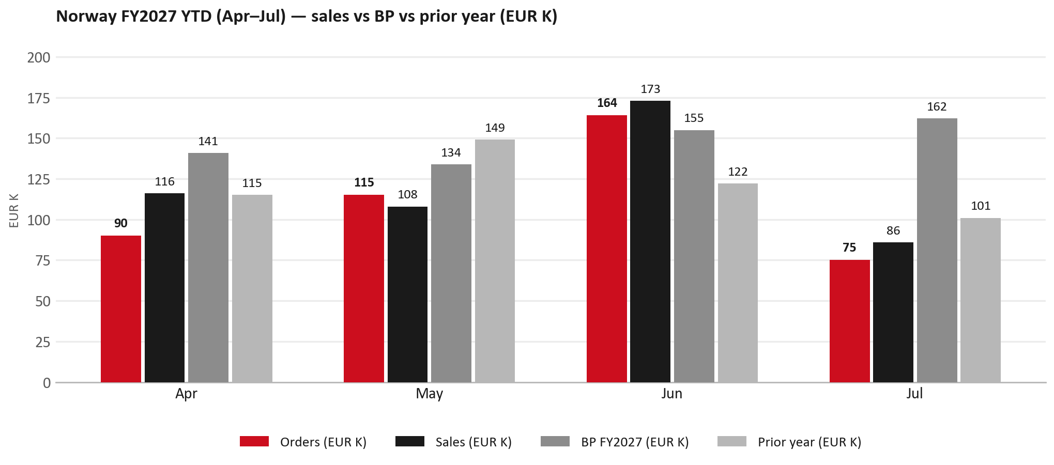
POWER BI — OFFICIAL CUT
FY2027 YTD (Apr–Jul): EUR 483K, -18% vs BP
TAKEAWAYS
— Sales EUR 483K against BP EUR 591K — -18%, and -1% on last year's EUR 487K.
— Order intake EUR 444K against EUR 483K billed (orders ~92% of shipments).
— The beat is entirely Jun: EUR 173K against EUR 155K. Apr -18%, May -19% and Jul -47% are below BP.
— Worth walking through the shape of the period together.
3

Slide 4
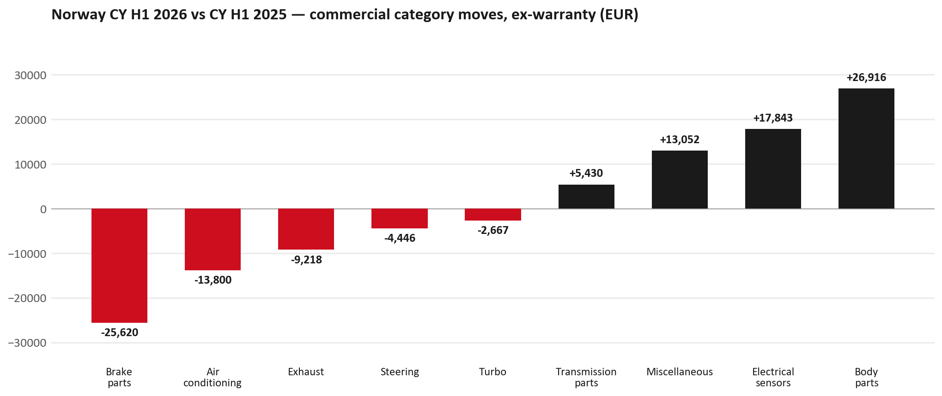
PARTS PERFORMANCE
Parts Performance — CY H1 2026 vs CY H1 2025 (commercial, ex-warranty)
TAKEAWAYS
— Commercial parts billing (warranty/campaign excluded) EUR 405K against EUR 386K a year earlier — +4.9% (CY H1 2026 vs CY H1 2025, Jan–Jun).
— Largest PN drops (all categories): 8975546610 (PAD KIT; CALIPER,DIS) [TF*] EUR -12K, 150 fewer pcs; 8976526220 (PAD KIT; CALIPER,DIS) EUR -9K, 145 fewer pcs; 8981405904 (SILENCER ASM; EXH) EUR -9K, 64 fewer pcs.
— Largest PN gains (all categories): 8974993681 (SENSOR; TIRE INFLATI) EUR 11K, 391 more pcs; 8975509392 (BUMPER ASM; FRT) EUR 3K, 32 more pcs; 8982705240 (ELEMENT; OIL FILTER) [NHR,NLR,NMR,TF*,UC*] EUR 3K, 200 more pcs.
— Within Body parts (EUR 27K, +32%): 8978461152 (GLASS; WINDSHIELD) EUR 7K, 32 more pcs; 8975509392 (BUMPER ASM; FRT) EUR 3K, 32 more pcs; 8975595830 (PANEL; SIDE GATE) EUR 2K, 11 more pcs.
4

Slide 5
PARTS PERFORMANCE — BRAKE PARTS
Brake parts — CY H1 2026 vs CY H1 2025 (commercial, ex-warranty)
— EUR 67,440 (CY H1 2025) to EUR 41,820 (CY H1 2026), down EUR 25,620 (-38%).
— Largest part numbers driving the decline (by EUR):
— 8975546610 (PAD KIT; CALIPER,DISC BRK,FRT · TF*): EUR 40,065 to EUR 27,886, 150 fewer pieces.
— 8976526220 (PAD KIT; CALIPER,DISC BRK,FRT): EUR 12,392 to EUR 3,408, 145 fewer pieces.
— 8980618131 (DRUM; BRK,RR): EUR 3,701 to EUR 139, 53 fewer pieces.
— 8980303850 (DRUM; BRK,RR): EUR 948 to EUR 0, 13 fewer pieces.
Questions for us to work through together
— Is pad and rotor pricing competitive against what the dealers can buy locally?
— Is any of this stock timing on your side rather than end demand?
— Are dealers still quoting these part numbers, or have they dropped off the workshop menu?
5

Slide 6
PARTS PERFORMANCE — AIR CONDITIONING
Air conditioning — CY H1 2026 vs CY H1 2025 (commercial, ex-warranty)
— EUR 49,483 (CY H1 2025) to EUR 35,683 (CY H1 2026), down EUR 13,800 (-28%).
— Largest part numbers driving the decline (by EUR):
— 8975554500 (FILTER; BLOWER UNIT · TF*,UC*): EUR 16,138 to EUR 9,534, 400 fewer pieces.
— 8974995480 (FILTER; ACL · TFR,TFS,UCR,UCS): EUR 14,448 to EUR 10,180, 200 fewer pieces.
— 8981394280 (FILTER; BLOWER UNIT · TF*,UC*): EUR 8,636 to EUR 5,452, 150 fewer pieces.
— 8981402650 (FILTER; ACL · TFR,TFS,UCR,UCS): EUR 6,604 to EUR 4,953, 100 fewer pieces.
Questions for us to work through together
— Is the seasonal pattern different this year, or is this a real shift?
— Are cabin filters and A/C service being sold as a package?
6

Slide 7
PARTS PERFORMANCE — EXHAUST
Exhaust — CY H1 2026 vs CY H1 2025 (commercial, ex-warranty)
— EUR 24,416 (CY H1 2025) to EUR 15,198 (CY H1 2026), down EUR 9,218 (-38%).
— Largest part numbers driving the decline (by EUR):
— 8981405904 (SILENCER ASM; EXH): EUR 12,912 to EUR 4,338, 64 fewer pieces.
— 8982114012 (PIPE; EXH): EUR 3,596 to EUR 951, 14 fewer pieces.
— 8981776324 (DPD ASM): EUR 2,477 to EUR 0, 2 fewer pieces.
— 8972630520 (GASKET; EXH PIPE): EUR 511 to EUR 96, 148 fewer pieces.
Questions for us to work through together
— Is this pricing against what the dealers can buy locally?
— Is any of this stock timing on your side rather than end demand?
— What would make the biggest difference to keep this business with us?
7

Slide 8
PARTS PERFORMANCE — GROWTH
Where volume grew — CY H1 2026 vs CY H1 2025 (commercial, ex-warranty)
Part | Description | Model | CY H1 2025 | CY H1 2026 | Δ EUR
8974993681 | SENSOR; TIRE INFLATION | — | EUR 2,694 | EUR 13,476 | EUR 10,782
8975509392 | BUMPER ASM; FRT | — | EUR 4,653 | EUR 8,122 | EUR 3,469
8982705240 | ELEMENT; OIL FILTER | NHR,NLR,NMR,TF*, | EUR 8,640 | EUR 11,688 | EUR 3,048
8984890171 | PUMP ASM; FUEL,SUPPLY | — | EUR 661 | EUR 3,264 | EUR 2,604
8975595830 | PANEL; SIDE GATE | — | EUR 619 | EUR 2,879 | EUR 2,260
7552172691 | BUMPER ASM; FRT | — | EUR 812 | EUR 2,646 | EUR 1,834
— Body parts +32%, Electrical sensors +63%, Miscellaneous +114% — where the commercial volume went.
— Claim-matched PNs (207 distinct) and campaign/recall text matches are already excluded from this growth list. Residual warranty on unmapped PNs can remain.
— PNs ranked by largest EUR increase (prior-period sales > 0). Worth agreeing which of these are repeatable and which were one-off.
8

Slide 9
PARTS PERFORMANCE
New Business — validation queue (CY H1 2026)
Part | Description | Current sales | Review
7552105216 | CABLE; BATTERY CHARGER | EUR 9,092 | Validate
8983939000 | TRANSMISSION ASM; AUTO | EUR 7,030 | Validate
8978461152 | GLASS; WINDSHIELD | EUR 6,573 | Validate
5874123812 | INTERFACE MX2-T | EUR 5,762 | Validate
8978249025 | LAMP ASM; HEAD | EUR 3,866 | Validate
8983287647 | LAMP ASM; HEAD | EUR 3,511 | Warranty / campaign
— These lines had no prior-period sales, so they are kept out of the incremental-growth table.
— A first sale can be a new model, a supersession, timing, or a warranty campaign. It is not treated as a commercial win until that cause is confirmed.
9

Slide 10
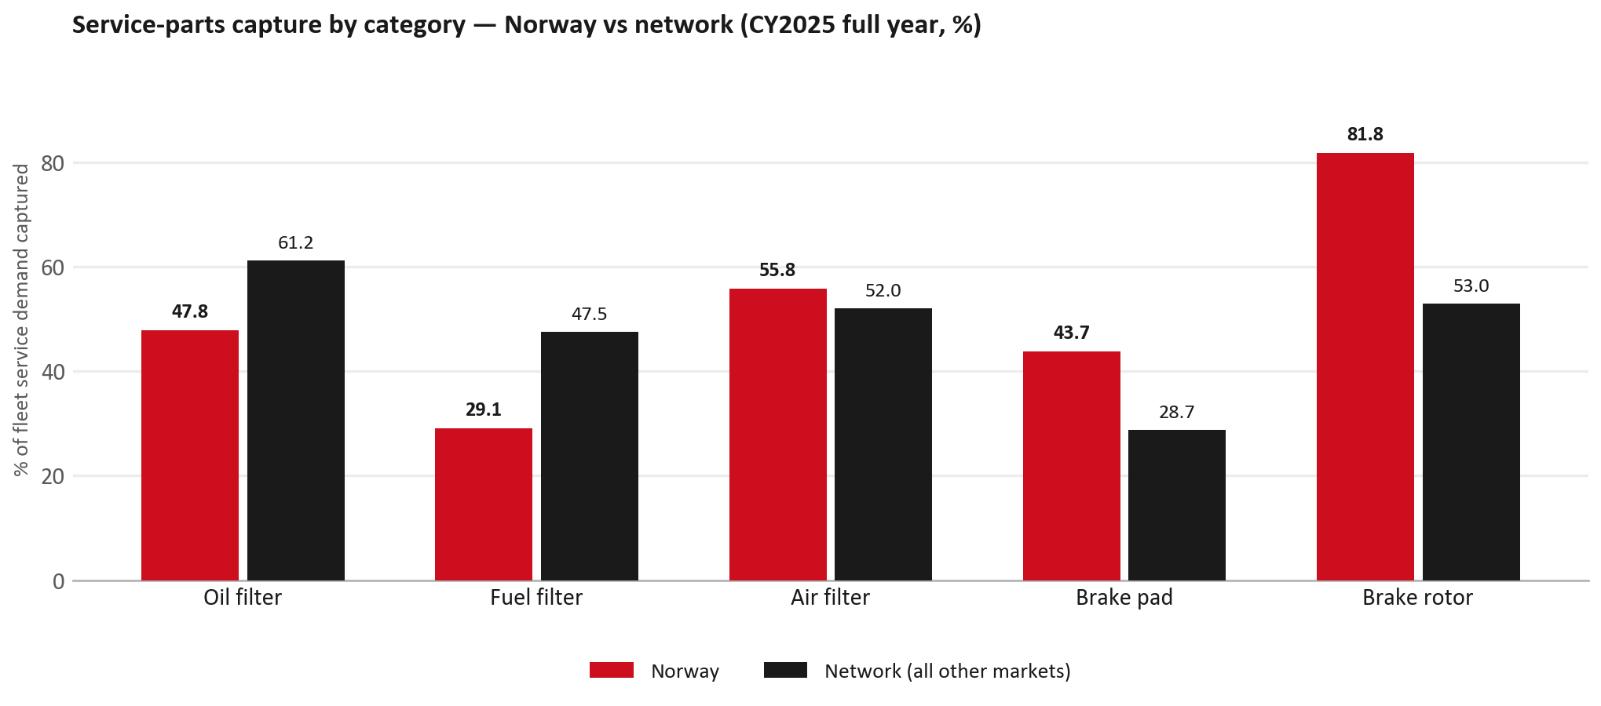
SERVICE-PARTS COVERAGE
Service-parts coverage: fuel filter is the clear gap
TAKEAWAYS
— Fuel filter 29.1% against 47.5% for the rest of the network.
— Oil filter 47.8% against 61.2% for the rest of the network.
— Every market here is measured on the same fleet-and-interval model, so the comparison is like-for-like even where the underlying interval assumption is debatable.
— Worth agreeing which category we tackle first, and what the joint action is.
10

Slide 11
IDS 2026 — DEALER STANDARD
IDS 2026: Norway averages 79.4%, in line with the 79.4% network benchmark
Dealer | Total % | Global rank
Rsa Bil Tromsø | 92.9% | #56
Mobile Hamar As | 92.5% | #62
Rsa Bil Arendal | 92.1% | #66
Norway country average | 79.4% | —
Network average (all IDS 2026) | 79.4% | —
Rsa Bil Forus | 62.9% | #450
Gjermundsen Bilsenter A/S | 39.6% | #478
Blakstad Auto As | 33.2% | #482
— 36 dealers assessed across Premises, Organisation, Service, Parts and Vehicle Sales. 2 further dealers did not return an assessment and are excluded from every figure on this slide.
— The country average is level with the network — both averages are taken on assessed dealers only.
— The spread is the point: 60 points between the strongest and weakest assessed dealer.
— Dealer-by-dealer detail and individual feedback are available as a separate pack — worth agreeing which dealers to visit, and when.
11

Slide 12
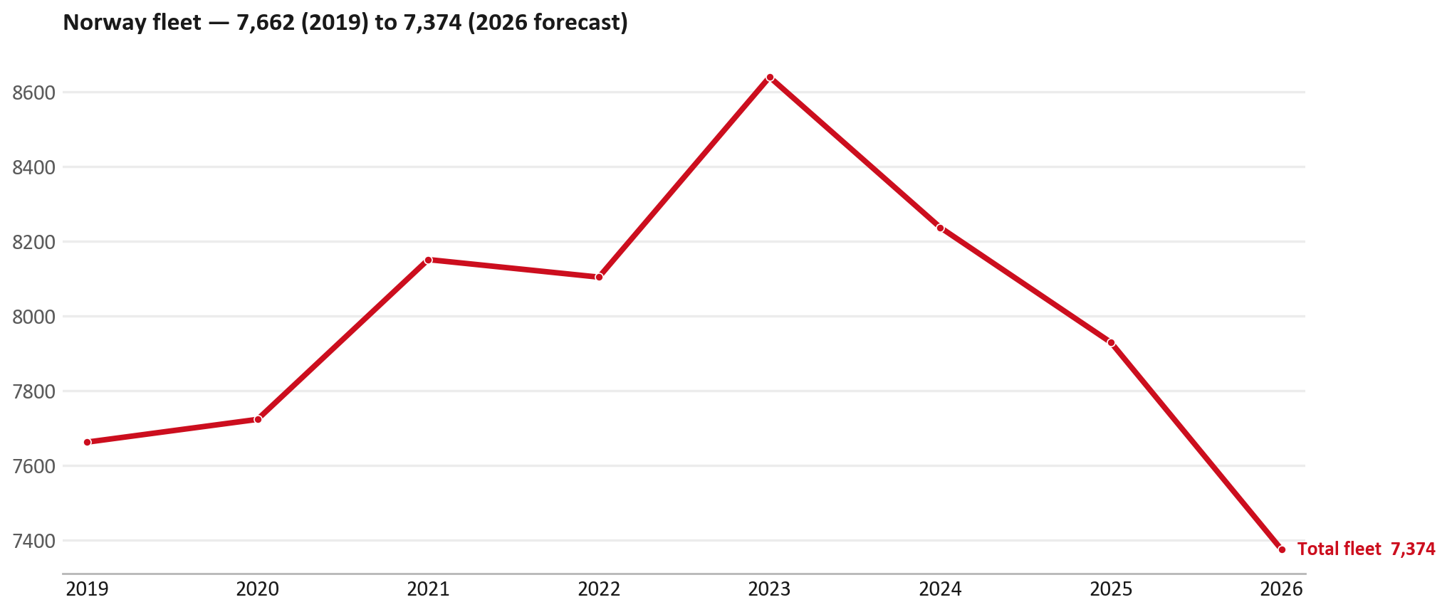
FLEET & FY2027 TARGET
The fleet is expected to decline in 2026
WHAT THIS MEANS FOR FY2027
— Fleet size (calendar year): 7,929 vehicles in 2025 → 7,374 working estimate for end-2026 (-7.0%).
— The chart is calendar years 2019–2026 only. 2026 is a working year-end estimate, not a fiscal-year figure.
— End-2026 mix: LCV / D-Max 7,374; CV — LD 0.
— The FY2027 extended target (ISZE→DB) applies a 5% price adjustment and 1.8% stretch — locked at EUR 1,798,459 from GPS Extended Target V3.1 (Dashboard column I).
— So the target is built from a slightly smaller fleet — not from an assumed growth story.
12

Slide 13
FLEET & FY2027 TARGET
How the FY2027 extended target is built
ISZE → DB extended target (V3.1 Dashboard column I)
Step | Amount
Business Plan / actual FY27 base | EUR 1,764,800
Market potential (max spend FY27) | EUR 1,869,935
Stretch (+1.8% of max spend) | EUR 33,659
FY2027 EXTENDED TARGET (locked) | EUR 1,798,459
— Extended target = BP + stretch; stretch default is 1.8% (network rule from GPS Extended Target V3.1).
— Figure locked from GPS Extended Target FY27 V3.1, Dashboard column I (NORWAY): EUR 1,798,459.
13

Slide 14
FY2027 TARGET
What the FY2027 target reflects
1
The FY2027 business plan
2
The price move
— The target starts from the FY2027 Business Plan for this market, EUR 1,764,800.
— Your fleet outlook (-7.0%) sets the market potential the stretch is measured against.
— ISZE is applying a 5% price adjustment for FY2027, consistent with every ISZE market this year.
— It is built into the per-vehicle rate above, not added separately on top.
What it means for your target
 | Value
FY2027 extended target (V3.1 col I) | EUR 1,798,459
vs BP FY27 (EUR 1,764,800) | +1.9%
Stretch included | +1.8%
— As in previous cycles we would expect an incentive to sit alongside this adjustment — that approval is still pending on our side.
— Until the incentive is confirmed, treat the FY2027 extended target as the working figure (BP + stretch), not a locked commercial commitment.
14

Slide 15
SPA
SPA
1
NORWAY proposal
2
ISZE review
3
Counter-proposal
4
Final approval
— Rutebileiernes Standardisering submits a proposed parts list.
— ISZE reviews the proposal against network data and fit.
— ISZE returns a counter-proposal where needed.
— Signed off by ISZE management.
Purpose: higher turnover for both sides.
15

Slide 16
R&M
R&M — let's align on the market
M
Market
S
Servicing & R&M
— How is the market moving for you right now?
— How much of your volume is fleet business rather than retail?
— Where do you see the biggest hurdles this year?
— Where are your real strengths in this segment?
— Do you offer an R&M or service-plan product today?
— What share of the parc do you retain for servicing after year three?
— Does R&M business come bundled with fleet tenders — roughly what share?
— What would it take to bring more out-of-network servicing back?
16

Slide 17
ASK
Part-level Sales-to-Dealer Data
1
Already halfway there
2
Sharper insight
3
Shared benefit
— You already report Sales-to-Dealer monthly. The ask is the same data at part-number level.
— Part-by-part visibility separates a stock movement from a lost job — and tells us where the volume actually went.
— Better availability on your fast movers, a sharper target for us, and a factual basis for the SPA — same data, both sides gain.
Requested from 01/01/2025, part number level, monthly.
17

Slide 18
SUMMARY
Next steps
— Confirm FY2027 extended target: EUR 1,798,459 (V3.1 Dashboard column I, +1.8% stretch).
— Confirm the incentive alongside the price adjustment once approved on our side.
— Brake parts / Air conditioning / Exhaust: agree which category we tackle first, and what the joint action is.
— Agree part-level Sales-to-Dealer data sharing, effective 01/01/2025.
— SPA: NORWAY proposal, ISZE review and counter-proposal cycle to follow.
— IDS 2026: agree dealer visit dates, starting with the lower-scoring dealers.
— Outlook: review the order book against the recent shipment pattern.
18

Slide 19
Moving the World – for You

Slide 20
NORWAY · RUTEBILEIERNES STANDARDISERING
Deep dive — detail behind the Mode A story
— Extra detail for meeting prep — pick which slides to share with Rutebileiernes Standardisering.
— Mode A ends on the previous closing slide.
— Label in all charts: “Genuine with BVP alternative” (not “genuine contested”).
20

Slide 21
AGENDA
Deep-dive agenda
— GPS — fiscal year (headline vs excl. warranty; max two lines)
— FY2025 → FY2026 wallet mix (Genuine / Genuine with BVP alternative / BVP)
— Where the money went — outside the service-parts basket (FY)
— Service parts: CY capture vs network + FY billing (capture % is CY-only by design)
— Brake pads — BVP share of total brake pad sales (FY)
— AIM exposure
— Warranty — two lenses
— How to use this in the meeting
21

Slide 22
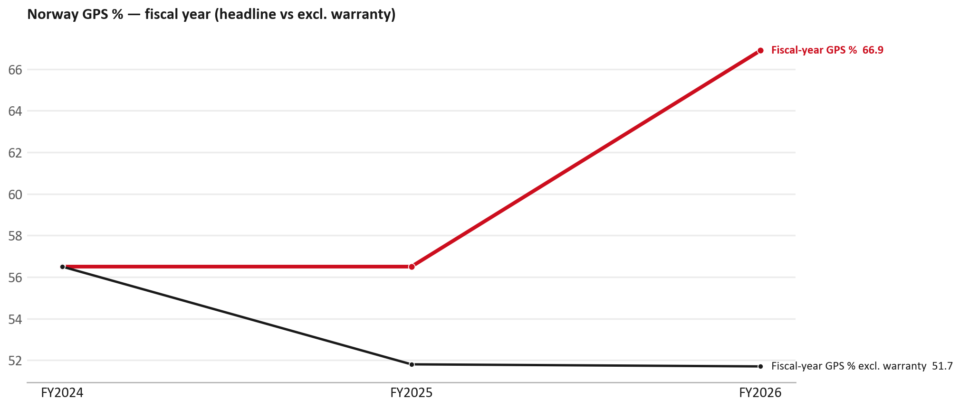
GPS
GPS: fiscal year headline vs after warranty
TAKEAWAYS
— Red = fiscal-year GPS (frozen CY2025 wallet). FY25 56.5% → FY26 66.9%.
— Black = the same GPS after removing warranty parts (€). FY26 ≈ 51.7% (warranty EUR 407,230 ≈ 30% of FY26 billing).
— Both lines divide by the same wallet (EUR 2,059,250), so the gap between them is warranty and nothing else.
22

Slide 23
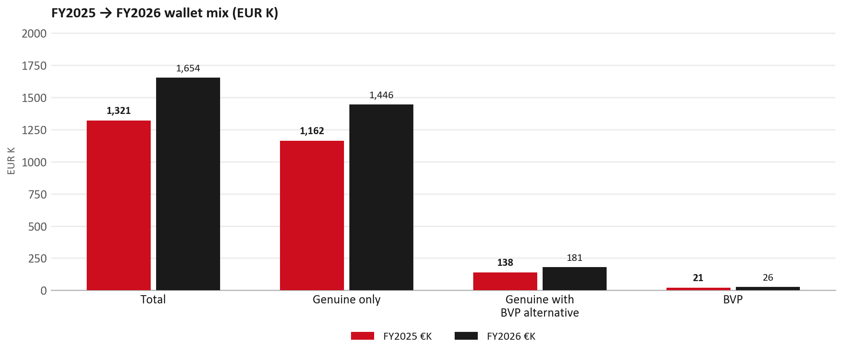
WALLET MIX
FY2025 → FY2026 wallet mix
— Total EUR 1,321,111 → EUR 1,653,639 (+25.2%).
— Genuine only EUR 284,197.
— Genuine with BVP alternative EUR 42,938; BVP EUR 5,393 (1.6% of FY26 wallet).
— Display label locked: Genuine with BVP alternative.
23

Slide 24
WALLET MIX
FY wallet mix — detail
 | FY2025 | FY2026 | Δ
Total | EUR 1,321,111 | EUR 1,653,639 | EUR 332,528
Genuine only | EUR 1,162,270 | EUR 1,446,467 | EUR 284,197
Genuine with BVP alternative | EUR 138,054 | EUR 180,993 | EUR 42,938
BVP | EUR 20,787 | EUR 26,179 | EUR 5,393
BVP % of wallet | 1.6% | 1.6% | +0.0 pp
24

Slide 25
DRIVERS
Where the genuine drop sits (FY2025 → FY2026)
— Genuine-only sales moved EUR 284,197 from FY2025 to FY2026.
— Of that, the routine service basket (filters, pads, rotors) moved EUR 39,513 on genuine-only; BVP in that basket moved EUR 4,606.
— Genuine-only did not fall on this FY cut — check category movers and H1 for pressure points.
— Meeting line: check high-value assemblies / sensors before blaming the filter or pad menu.
25

Slide 26
DRIVERS
Largest part-number drops (FY24→FY25) — outside service filters
Part | Description | Δ EUR
8977998750 | STEERING UNIT | -37,353
8976526220 | PAD KIT; CALIPER,DISC BRK,FRT | -30,680
8983550720 | partikel sensor | -23,807
8981405904 | SILENCER ASM; EXH | -13,957
8981901150 | DRIVE ASM; FINAL,RR | -10,911
8982330922 | LAMP ASM; RR COMB | -7,486
8982330912 | LAMP ASM; RR COMB | -7,439
— Check warranty / campaign coding before calling competitive leakage.
26

Slide 27
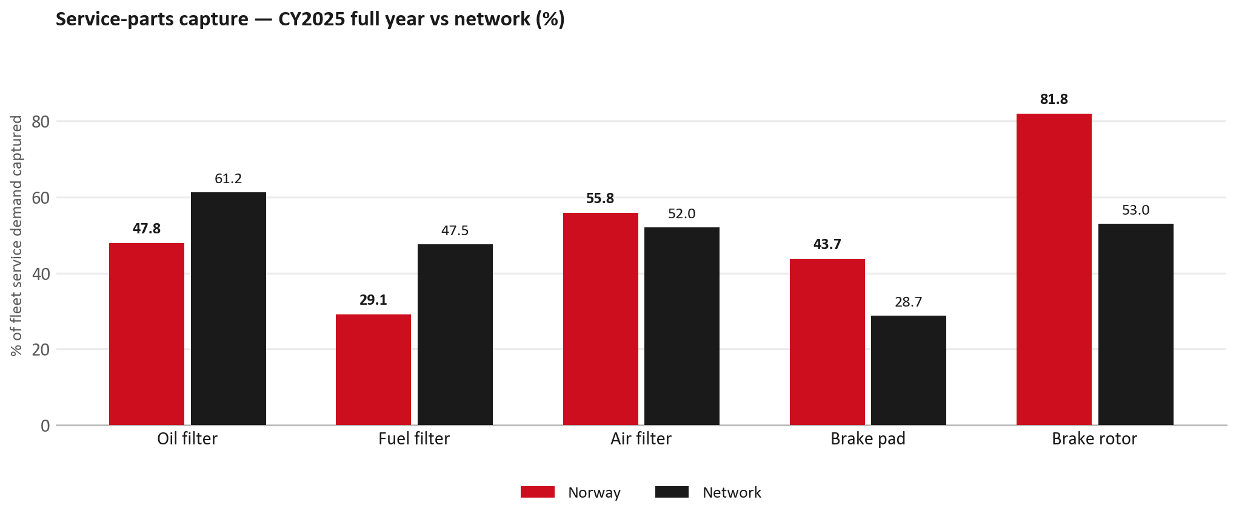
SERVICE PARTS
Service-parts capture vs network (calendar year)
TAKEAWAYS
— Capture % is calendar-year (full CY2025). Fleet demand is modelled on calendar years — there is no matching fiscal-year capture %.
— Oil filter 47.8% vs network 61.2%; Fuel filter 29.1% vs network 47.5%; Air filter 55.8% vs network 52.0%.
— Next slide: fiscal-year € billing in the same 5 categories.
— Primary lens = total capture (not genuine-only).
27

Slide 28
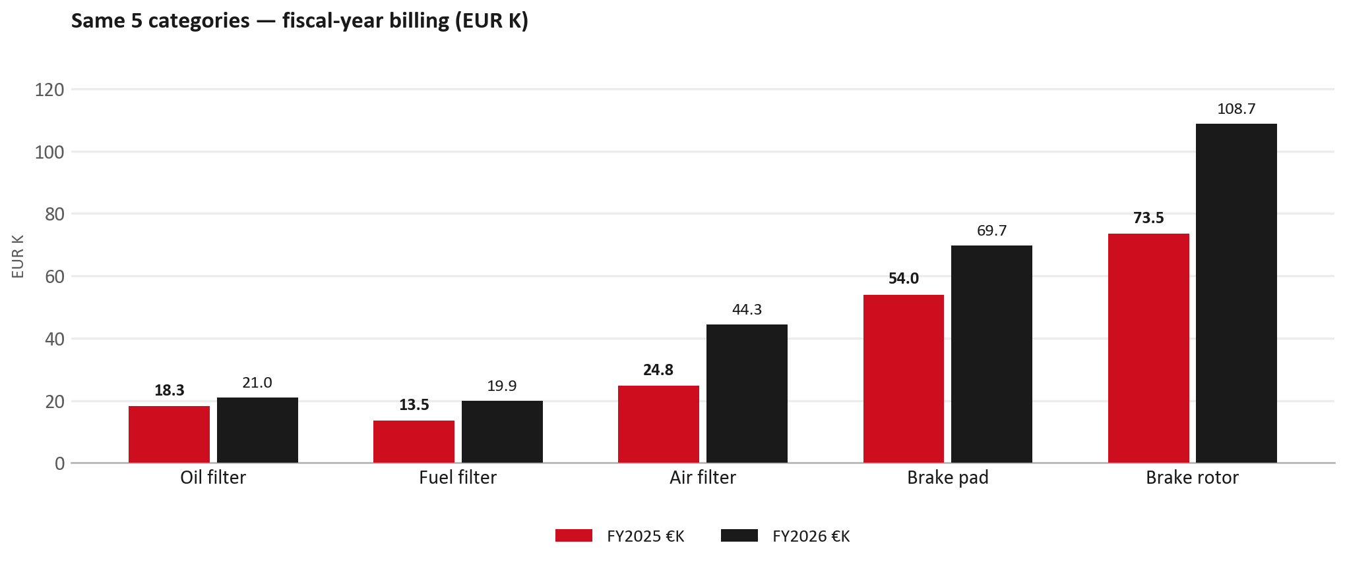
SERVICE PARTS · FY
Service-parts billing by fiscal year (same 5 lines)
TAKEAWAYS
— This is Sales-to-Rutebileiernes Standardisering € in fiscal years — not capture % of fleet demand.
— Use both lenses — do not mix % capture with € billing.
— Primary = total sales in the basket.
28

Slide 29
BRAKES
Brake pads — BVP share of total brake pad sales (FY)
 | FY2025 | FY2026
Genuine pad sales (€) | EUR 53,987 | EUR 69,722
BVP pad sales (€) | EUR 0 | EUR 0
Genuine qty | 755 | 892
BVP qty | 0 | 0
BVP share of pad sales (€) | 0% | 0%
— BVP share = BVP € ÷ all brake-pad € billed (genuine + BVP). Not a PMS capture %.
— Rutebileiernes Standardisering pad sales are genuine-only in this cut (~EUR 70K FY26) — no BVP pad lines billed.
— Wallet-level BVP is still only ~1.6% of FY26 — do not generalise a pad story to the whole wallet.
29

Slide 30
AIM
AIM exposure
Year | High-risk € | High-risk % | Quadrant
2023 | EUR 53,707 | 4.9% | Wallet gap (low GPS - high capture)
2024 | EUR 28,882 | 2.5% | Priority target (low GPS - low capture)
2025 | EUR 29,580 | 2.1% | Priority target (low GPS - low capture)
— High-risk € is catalogue AIM exposure, not proven walk-out.
— Open on jobs not bought through the distributor — not a street IAM war alone.
30

Slide 31
WARRANTY
Warranty — two real lenses
1
CY2025 claim-price parts
2
Fiscal GPS expense
— EUR 290,712 (claim-price basis).
— Calendar-year claim price basis.
— LCV warranty; keep separate from Greece payer-label issue.
— FY24 EUR 0 · FY25 EUR 96,904 · FY26 EUR 407,230.
— Source row: RSA.
— Ex-warranty GPS = (net − warranty) ÷ frozen CY25 wallet.
— Both numbers are real — never mix them on one slide without labels.
31

Slide 32
BRIDGE
How to use this in the meeting
If they say… | You know…
BVP is eating genuine | Wallet BVP ~1.6%. Check pads as a local exception only.
GPS looks fine / too high | FY26 headline 66.9%; excl. warranty ≈ 51.7%.
Service parts are fine | CY2025 capture vs network (previous slides) + FY billing lens.
32

Slide 33
Moving the World – for You

