Slide 1

ISZE · ROMANIA · ROMANIA
Romania Sales Review
& FY2027 Target
Isuzu Rom Auto · August 2026

Slide 2
ROMANIA MEETING
Agenda
— FY2027 YTD (Apr–Jul) Sales Review
— Parts Performance — category movers
— Parts Performance — Hydraulic / mechanical
— Parts Performance — Brake parts
— Parts Performance — Lighting
— Parts Performance — where volume grew
— New Business — validation queue
— Service-Parts Coverage
— IDS 2026 — Dealer Standard
— Fleet & FY2027 Target
— SPA — status
— R&M — market discussion
— Data request: part-level Sales-to-Dealer
— Next steps
2

Slide 3
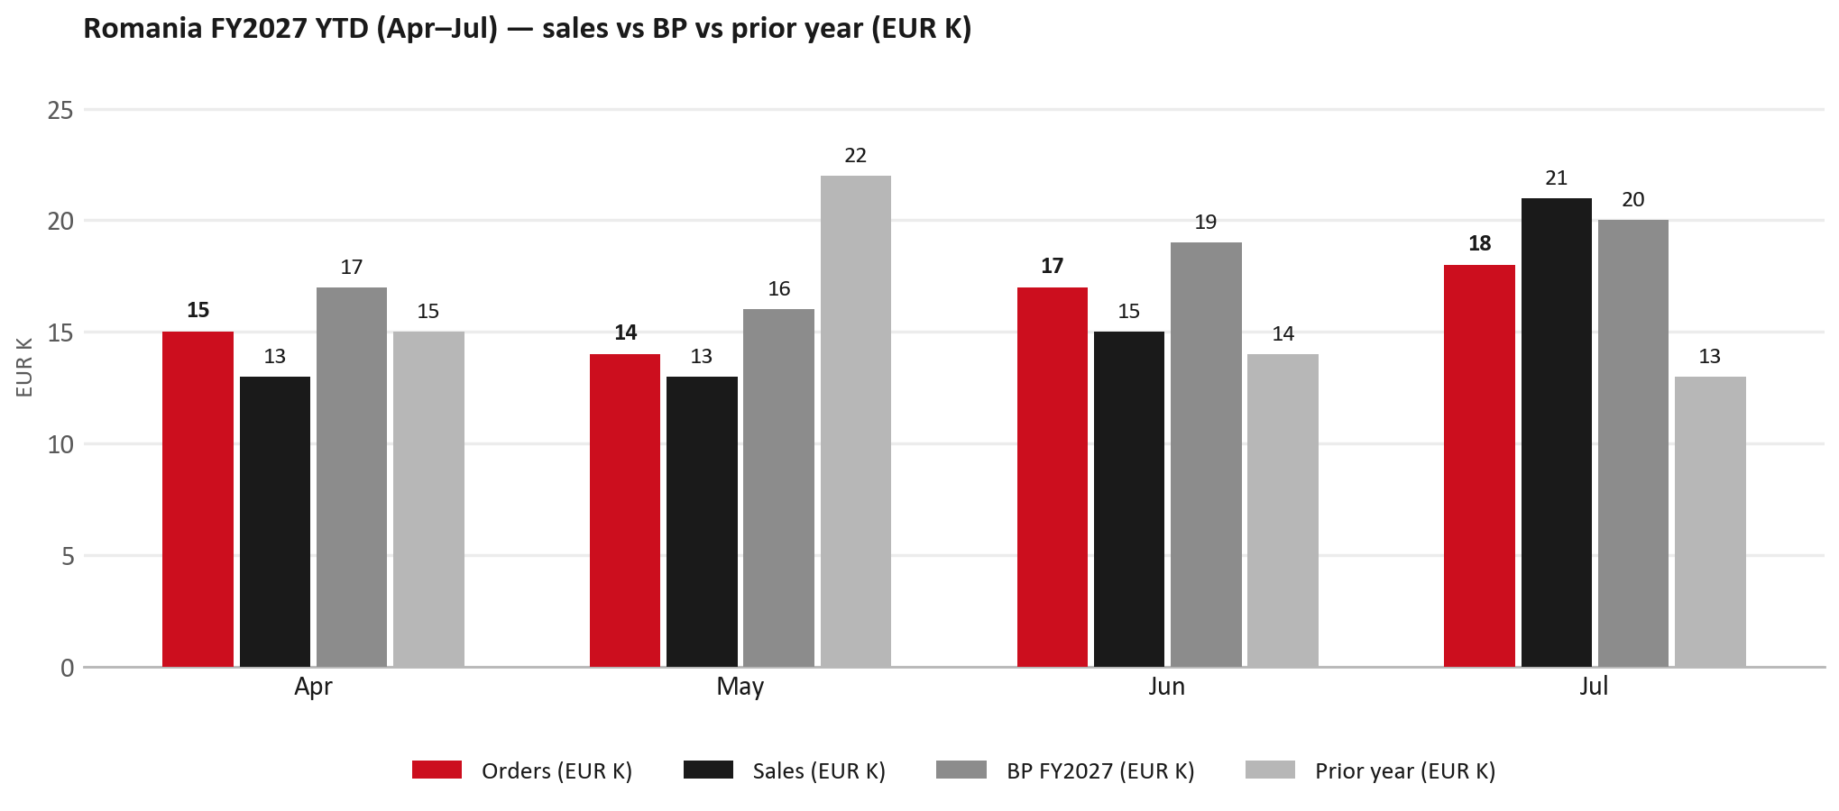
POWER BI — OFFICIAL CUT
FY2027 YTD (Apr–Jul): EUR 62K, -14% vs BP
TAKEAWAYS
— Sales EUR 62K against BP EUR 72K — -14%, and -3% on last year's EUR 64K.
— Order intake EUR 64K against EUR 62K billed (orders ~103% of shipments).
— The beat is entirely Jul: EUR 21K against EUR 20K. Apr -24%, May -20% and Jun -21% are below BP.
— Worth walking through the shape of the period together.
3

Slide 4
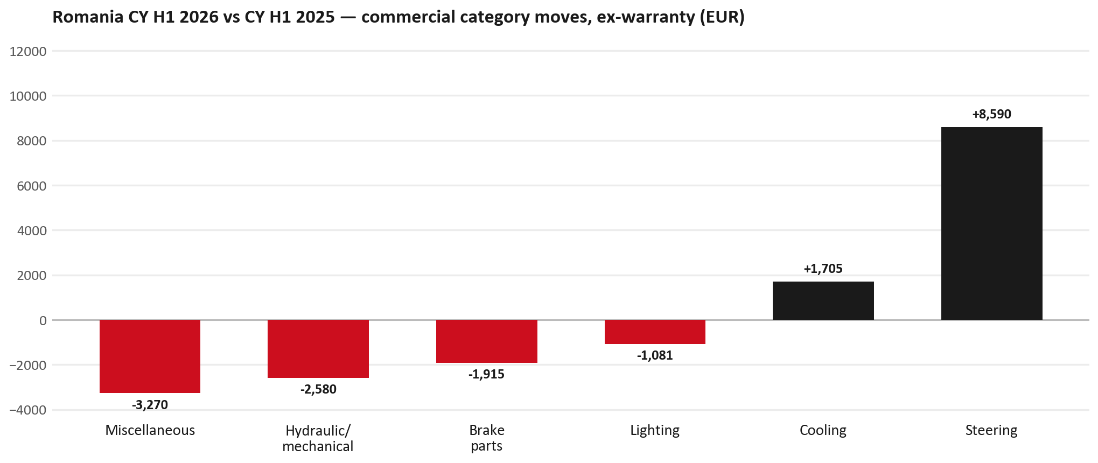
PARTS PERFORMANCE
Parts Performance — CY H1 2026 vs CY H1 2025 (commercial, ex-warranty)
TAKEAWAYS
— Commercial parts billing (warranty/campaign excluded) EUR 79K against EUR 80K a year earlier — -1.4% (CY H1 2026 vs CY H1 2025, Jan–Jun).
— Largest PN drops (all categories): 5874123812 (INTERFACE MX2-T) EUR -2K, 2 fewer pcs; 8981470623 (TRANSMISSION ASM; MA) EUR -2K, 1 fewer pcs; 8975056801 (PAD KIT; CALIPER,DIS) EUR -2K, 20 fewer pcs.
— Largest PN gains (all categories): 7552348290 (STEERING UNIT) EUR 8K, 4 more pcs; 8975488420 (FILTER; BLOWER UNIT) [TF*,UC*] EUR 1K, 60 more pcs; 8974995480 (FILTER; ACL) [TFR,TFS,UCR,UCS] EUR 1K, 30 more pcs.
— Within Steering (EUR 9K, +272%): 7552348290 (STEERING UNIT) EUR 8K, 4 more pcs; 8983730791 (PUMP ASM; OIL,P/S) EUR 0K, 1 more pcs; 8981649670 (REPAIR KIT; STRG UNI) EUR 0K, 11 more pcs.
4

Slide 5
PARTS PERFORMANCE — HYDRAULIC / MECHANICAL
Hydraulic / mechanical — CY H1 2026 vs CY H1 2025 (commercial, ex-warranty)
— EUR 7,956 (CY H1 2025) to EUR 5,377 (CY H1 2026), down EUR 2,580 (-32%).
— Largest part numbers driving the decline (by EUR):
— 7552259810 (WHEEL; DISC): EUR 1,314 to EUR 0, 12 fewer pieces.
— 8981472452 (SHAFT ASM; FRT DRIVE): EUR 1,288 to EUR 0, 4 fewer pieces.
— 8981480632 (FLYWHEEL): EUR 516 to EUR 0, 2 fewer pieces.
— 8980058750 (JOINT ASM; BALL,LWR CONT ARM): EUR 313 to EUR 0, 10 fewer pieces.
Questions for us to work through together
— Is this pricing against what the dealers can buy locally?
— Is any of this stock timing on your side rather than end demand?
— What would make the biggest difference to keep this business with us?
5

Slide 6
PARTS PERFORMANCE — BRAKE PARTS
Brake parts — CY H1 2026 vs CY H1 2025 (commercial, ex-warranty)
— EUR 8,078 (CY H1 2025) to EUR 6,163 (CY H1 2026), down EUR 1,915 (-24%).
— Largest part numbers driving the decline (by EUR):
— 8975056801 (PAD KIT; CALIPER,DISC BRK,FRT): EUR 4,268 to EUR 2,564, 20 fewer pieces.
— 8980618131 (DRUM; BRK,RR): EUR 1,436 to EUR 1,179, 4 fewer pieces.
— 8978348260 (SHOE KIT; BRK,RR · TFR,TFS (RT,RG)): EUR 248 to EUR 0, 6 fewer pieces.
— 1476012180 (CYLINDER; WHEEL,RR BRK): EUR 196 to EUR 0, 1 fewer pieces.
Questions for us to work through together
— Is pad and rotor pricing competitive against what the dealers can buy locally?
— Is any of this stock timing on your side rather than end demand?
— Are dealers still quoting these part numbers, or have they dropped off the workshop menu?
6

Slide 7
PARTS PERFORMANCE — LIGHTING
Lighting — CY H1 2026 vs CY H1 2025 (commercial, ex-warranty)
— EUR 5,642 (CY H1 2025) to EUR 4,561 (CY H1 2026), down EUR 1,081 (-19%).
— Largest part numbers driving the decline (by EUR):
— 8978429890 (LAMP ASM; RR COMB): EUR 491 to EUR 0, 3 fewer pieces.
— 8983287885 (LAMP ASM; HEAD): EUR 476 to EUR 0, 4 fewer pieces.
— 8977950000 (LAMP UNIT; RR COMB): EUR 582 to EUR 119, 4 fewer pieces.
— 8978486410 (LAMP UNIT; RR COMB): EUR 446 to EUR 0, 3 fewer pieces.
Questions for us to work through together
— Is this availability, pricing, or genuinely fewer accident repairs?
— Are the bodyshops in your network sourcing lamps elsewhere?
7

Slide 8
PARTS PERFORMANCE — GROWTH
Where volume grew — CY H1 2026 vs CY H1 2025 (commercial, ex-warranty)
Part | Description | Model | CY H1 2025 | CY H1 2026 | Δ EUR
7552348290 | STEERING UNIT | — | EUR 2,043 | EUR 10,296 | EUR 8,253
8975488420 | FILTER; BLOWER UNIT | TF*,UC* | EUR 1,714 | EUR 2,725 | EUR 1,011
8974995480 | FILTER; ACL | TFR,TFS,UCR,UCS | EUR 4,371 | EUR 5,033 | EUR 662
7552070241 | GRILLE; INNER,RAD | — | EUR 304 | EUR 915 | EUR 611
8982705240 | ELEMENT; OIL FILTER | NHR,NLR,NMR,TF*, | EUR 1,527 | EUR 2,124 | EUR 597
8975391990 | ROD END ASM; OUTER | — | EUR 117 | EUR 712 | EUR 595
— Steering +272%, Cooling +172% — where the commercial volume went.
— Claim-matched PNs (24 distinct) and campaign/recall text matches are already excluded from this growth list. Residual warranty on unmapped PNs can remain.
— PNs ranked by largest EUR increase (prior-period sales > 0). Worth agreeing which of these are repeatable and which were one-off.
8

Slide 9
PARTS PERFORMANCE
New Business — validation queue (CY H1 2026)
Part | Description | Current sales | Review
8983682091 | PIPE; EXH | EUR 1,312 | Validate
5877030010 | ISUZU ATF WSI 4L | EUR 1,001 | Validate
8981532774 | BUMPER; RR | EUR 740 | Validate
8983989321 | PLATE ASM; PRESSURE,CLU | EUR 727 | Validate
8975435900 | DISC; CLUTCH | EUR 654 | Validate
8978248633 | LAMP ASM; RR COMB | EUR 651 | Validate
— These lines had no prior-period sales, so they are kept out of the incremental-growth table.
— A first sale can be a new model, a supersession, timing, or a warranty campaign. It is not treated as a commercial win until that cause is confirmed.
9

Slide 10
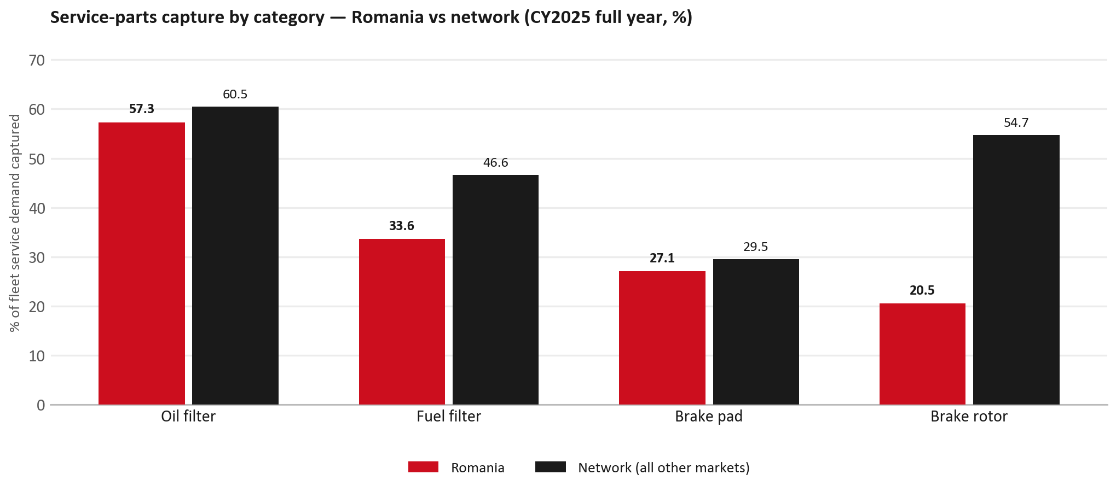
SERVICE-PARTS COVERAGE
Service-parts coverage sits below the network on every routine category
TAKEAWAYS
— Brake rotor 20.5% against 54.7% for the rest of the network.
— Fuel filter 33.6% against 46.6% for the rest of the network.
— Every market here is measured on the same fleet-and-interval model, so the comparison is like-for-like even where the underlying interval assumption is debatable.
— Air filter is not shown: the modelled demand base for that category does not hold for this market, so the rate is not quotable.
10

Slide 11
IDS 2026 — DEALER STANDARD
IDS 2026: Romania averages 79.6%, above the 79.4% network benchmark
Dealer | Total % | Global rank
Rodav | 92.5% | #61
Mit Motors | 89.6% | #103
Autocomo | 87.5% | #144
Romania country average | 79.6% | —
Network average (all IDS 2026) | 79.4% | —
Anvelo Center Oradea | 72.1% | #386
Marshal | 69.3% | #412
Simode Craiova | 54.6% | #473
— 15 dealers assessed across Premises, Organisation, Service, Parts and Vehicle Sales.
— The country average sits 0.2 points above the network — both averages are taken on assessed dealers only.
— The spread is the point: 38 points between the strongest and weakest assessed dealer.
— Dealer-by-dealer detail and individual feedback are available as a separate pack — worth agreeing which dealers to visit, and when.
11

Slide 12
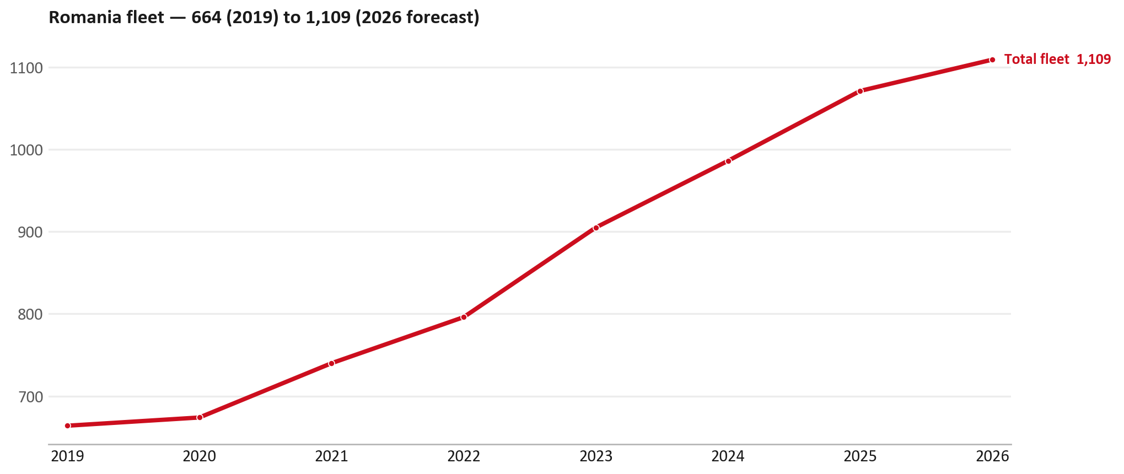
FLEET & FY2027 TARGET
The fleet is expected to grow in 2026
WHAT THIS MEANS FOR FY2027
— Fleet size (calendar year): 1,071 vehicles in 2025 → 1,109 working estimate for end-2026 (+3.5%).
— The chart is calendar years 2019–2026 only. 2026 is a working year-end estimate, not a fiscal-year figure.
— End-2026 mix: LCV / D-Max 1,109.
— The FY2027 extended target (ISZE→DB) applies a 5% price adjustment and 1.8% stretch — locked at EUR 204,605 from GPS Extended Target V3.1 (Dashboard column I).
— The target reflects the working fleet outlook without extending the chart beyond 2026.
12

Slide 13
FLEET & FY2027 TARGET
How the FY2027 extended target is built
ISZE → DB extended target (V3.1 Dashboard column I)
Step | Amount
Business Plan / actual FY27 base | EUR 199,588
Market potential (max spend FY27) | EUR 278,727
Stretch (+1.8% of max spend) | EUR 5,017
FY2027 EXTENDED TARGET (locked) | EUR 204,605
— Extended target = BP + stretch; stretch default is 1.8% (network rule from GPS Extended Target V3.1).
— Figure locked from GPS Extended Target FY27 V3.1, Dashboard column I (ROMANIA): EUR 204,605.
13

Slide 14
FY2027 TARGET
What the FY2027 target reflects
1
The FY2027 business plan
2
The price move
— The target starts from the FY2027 Business Plan for this market, EUR 199,588.
— Your fleet outlook (+3.5%) sets the market potential the stretch is measured against.
— ISZE is applying a 5% price adjustment for FY2027, consistent with every ISZE market this year.
— It is built into the per-vehicle rate above, not added separately on top.
What it means for your target
 | Value
FY2027 extended target (V3.1 col I) | EUR 204,605
vs BP FY27 (EUR 199,588) | +2.5%
Stretch included | +1.8%
— As in previous cycles we would expect an incentive to sit alongside this adjustment — that approval is still pending on our side.
— Until the incentive is confirmed, treat the FY2027 extended target as the working figure (BP + stretch), not a locked commercial commitment.
14

Slide 15
SPA
SPA
1
ROMANIA proposal
2
ISZE review
3
Counter-proposal
4
Final approval
— Isuzu Rom Auto submits a proposed parts list.
— ISZE reviews the proposal against network data and fit.
— ISZE returns a counter-proposal where needed.
— Signed off by ISZE management.
Purpose: higher turnover for both sides.
15

Slide 16
R&M
R&M — let's align on the market
M
Market
S
Servicing & R&M
— How is the market moving for you right now?
— How much of your volume is fleet business rather than retail?
— Where do you see the biggest hurdles this year?
— Where are your real strengths in this segment?
— Do you offer an R&M or service-plan product today?
— What share of the parc do you retain for servicing after year three?
— Does R&M business come bundled with fleet tenders — roughly what share?
— What would it take to bring more out-of-network servicing back?
16

Slide 17
ASK
Part-level Sales-to-Dealer Data
1
Already halfway there
2
Sharper insight
3
Shared benefit
— You already report Sales-to-Dealer monthly. The ask is the same data at part-number level.
— Part-by-part visibility separates a stock movement from a lost job — and tells us where the volume actually went.
— Better availability on your fast movers, a sharper target for us, and a factual basis for the SPA — same data, both sides gain.
Requested from 01/01/2025, part number level, monthly.
17

Slide 18
SUMMARY
Next steps
— Confirm FY2027 extended target: EUR 204,605 (V3.1 Dashboard column I, +1.8% stretch).
— Confirm the incentive alongside the price adjustment once approved on our side.
— Hydraulic / mechanical / Brake parts / Lighting: agree which category we tackle first, and what the joint action is.
— Agree part-level Sales-to-Dealer data sharing, effective 01/01/2025.
— SPA: ROMANIA proposal, ISZE review and counter-proposal cycle to follow.
— IDS 2026: agree dealer visit dates, starting with the lower-scoring dealers.
— Outlook: review the order book against the recent shipment pattern.
18

Slide 19
Moving the World – for You

Slide 20
ROMANIA · ISUZU ROM AUTO
Deep dive — detail behind the Mode A story
— Extra detail for meeting prep — pick which slides to share with Isuzu Rom Auto.
— Mode A ends on the previous closing slide.
— Label in all charts: “Genuine with BVP alternative” (not “genuine contested”).
20

Slide 21
AGENDA
Deep-dive agenda
— GPS — fiscal year (headline vs excl. warranty; max two lines)
— FY2025 → FY2026 wallet mix (Genuine / Genuine with BVP alternative / BVP)
— Where the money went — outside the service-parts basket (FY)
— Service parts: CY capture vs network + FY billing (capture % is CY-only by design)
— Brake pads — BVP share of total brake pad sales (FY)
— AIM exposure
— Warranty — two lenses
— How to use this in the meeting
21

Slide 22
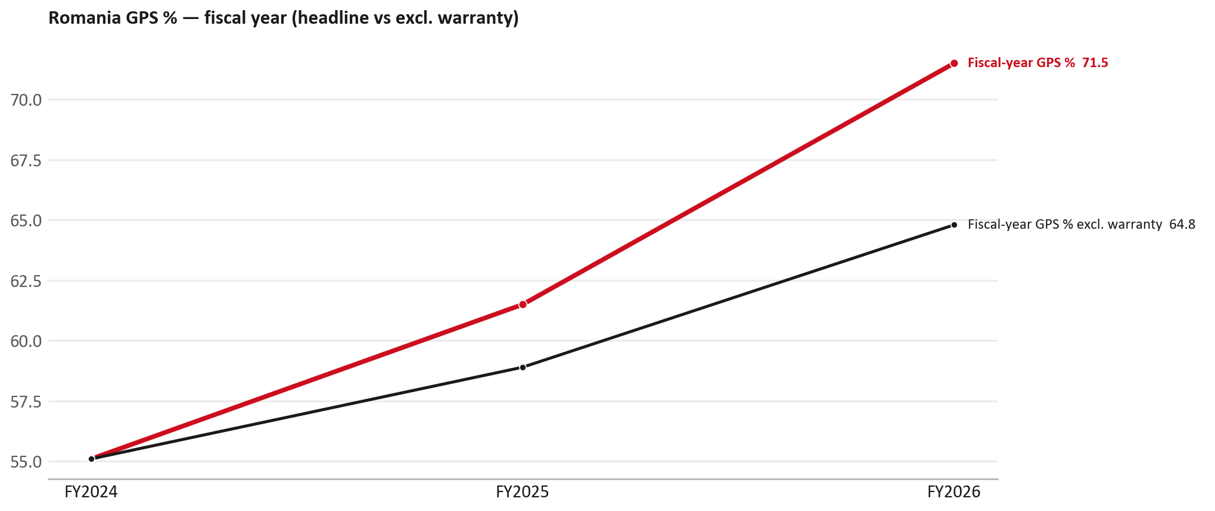
GPS
GPS: fiscal year headline vs after warranty
TAKEAWAYS
— Red = fiscal-year GPS (frozen CY2025 wallet). FY25 61.5% → FY26 71.5%.
— Black = the same GPS after removing warranty parts (€). FY26 ≈ 64.8% (warranty EUR 20,558 ≈ 12% of FY26 billing).
— Both lines divide by the same wallet (EUR 246,500), so the gap between them is warranty and nothing else.
22

Slide 23
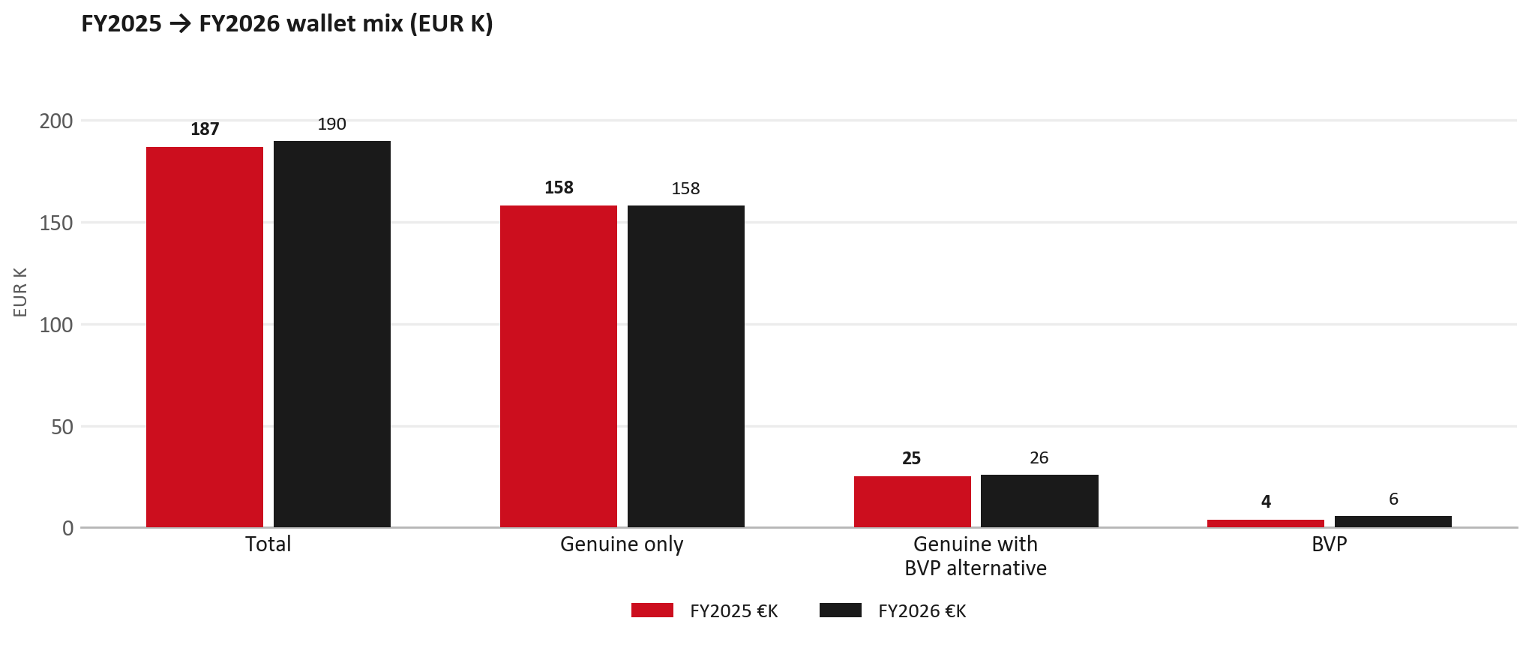
WALLET MIX
FY2025 → FY2026 wallet mix
— Total EUR 186,855 → EUR 189,715 (+1.5%).
— Genuine only EUR 94.
— Genuine with BVP alternative EUR 769; BVP EUR 1,998 (3.0% of FY26 wallet).
— Display label locked: Genuine with BVP alternative.
23

Slide 24
WALLET MIX
FY wallet mix — detail
 | FY2025 | FY2026 | Δ
Total | EUR 186,855 | EUR 189,715 | EUR 2,861
Genuine only | EUR 157,972 | EUR 158,066 | EUR 94
Genuine with BVP alternative | EUR 25,169 | EUR 25,937 | EUR 769
BVP | EUR 3,714 | EUR 5,712 | EUR 1,998
BVP % of wallet | 2.0% | 3.0% | +1.0 pp
24

Slide 25
DRIVERS
Where the genuine drop sits (FY2025 → FY2026)
— Genuine-only sales moved EUR 94 from FY2025 to FY2026.
— Of that, the routine service basket (filters, pads, rotors) moved EUR -1,579 on genuine-only; BVP in that basket moved EUR 2,402.
— Genuine-only did not fall on this FY cut — check category movers and H1 for pressure points.
— Meeting line: check high-value assemblies / sensors before blaming the filter or pad menu.
25

Slide 26
DRIVERS
Largest part-number drops (FY24→FY25) — outside service filters
Part | Description | Δ EUR
8977998750 | STEERING UNIT | -4,576
5873114080 | ENGINE ASM; PARTIAL | -3,241
TRANSPORT | Transporting Cost | -1,895
8983550720 | partikel sensor | -1,710
8982395150 | SPRING ASM; LEAF,RR | -1,587
8975435760 | COMPRESSOR ASM; A/C | -1,067
8980879851 | NOZZLE ASM; INJ | -882
— Check warranty / campaign coding before calling competitive leakage.
26

Slide 27
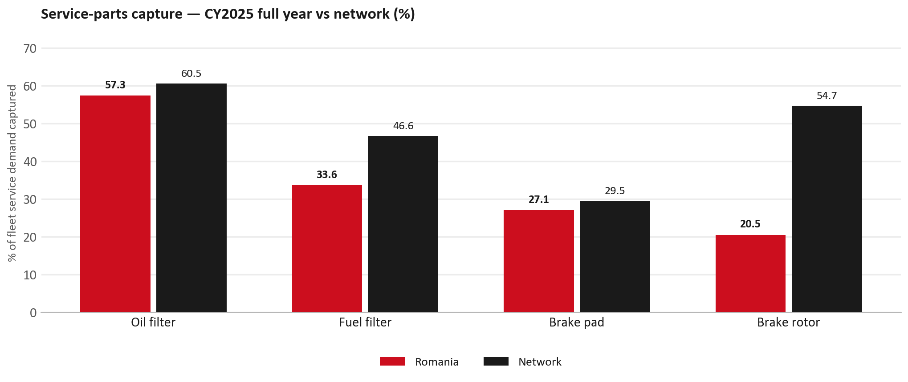
SERVICE PARTS
Service-parts capture vs network (calendar year)
TAKEAWAYS
— Capture % is calendar-year (full CY2025). Fleet demand is modelled on calendar years — there is no matching fiscal-year capture %.
— Oil filter 57.3% vs network 60.5%; Fuel filter 33.6% vs network 46.6%; Brake pad 27.1% vs network 29.5%.
— Next slide: fiscal-year € billing in the same 4 categories.
— Air filter withheld — the modelled demand base does not hold for this market, so the rate is not quotable.
27

Slide 28
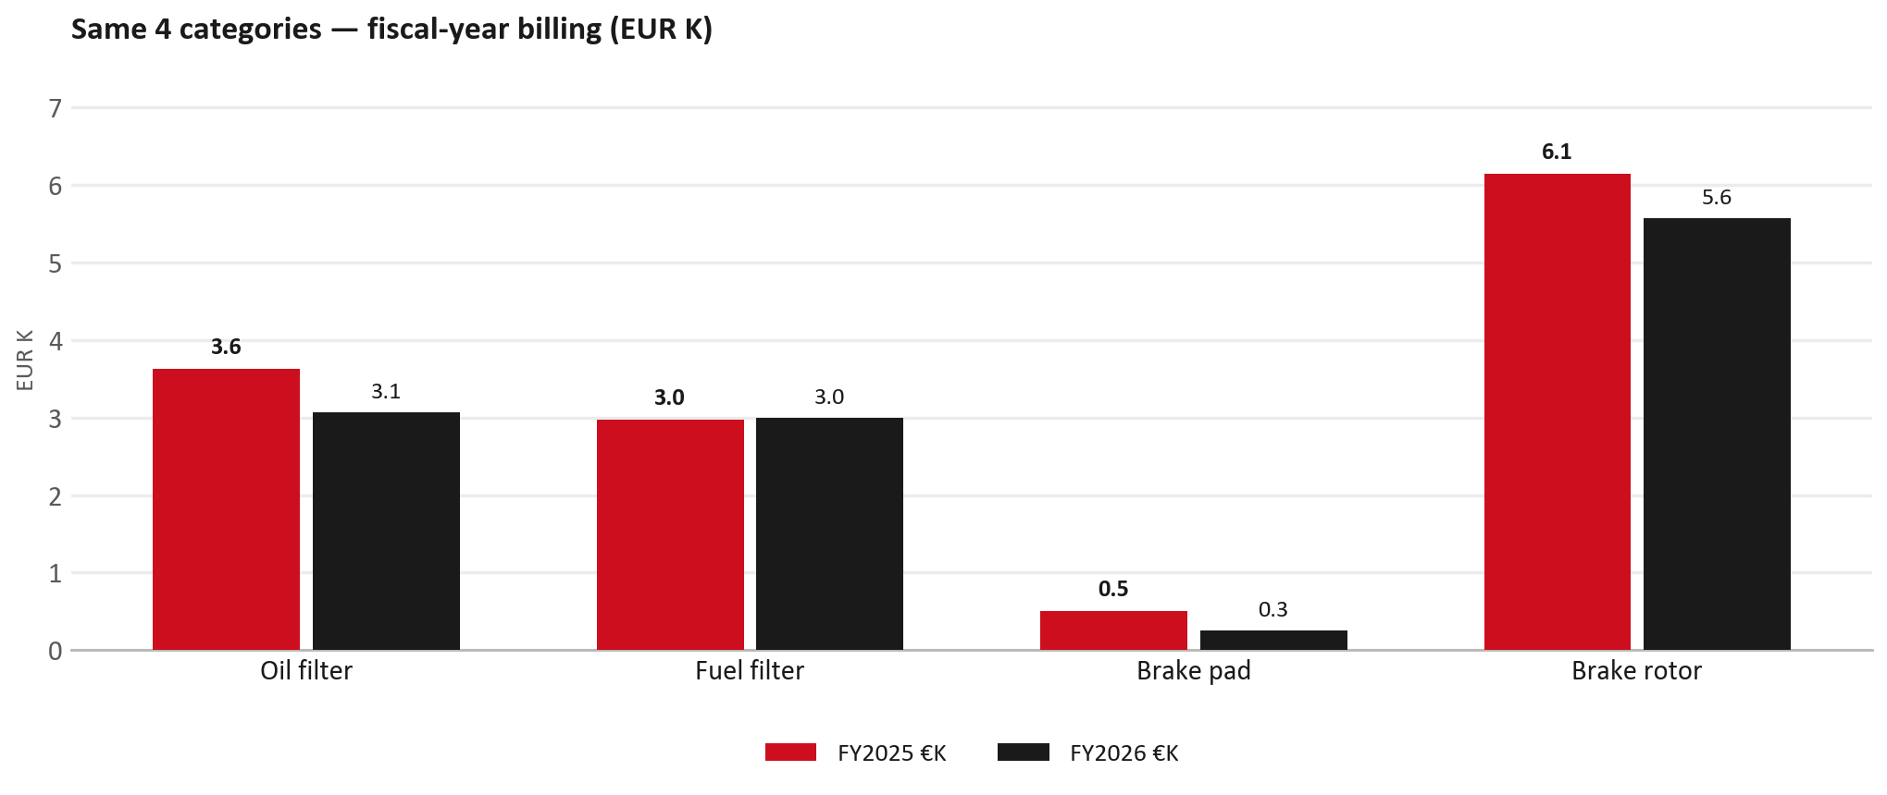
SERVICE PARTS · FY
Service-parts billing by fiscal year (same 4 lines)
TAKEAWAYS
— This is Sales-to-Isuzu Rom Auto € in fiscal years — not capture % of fleet demand.
— Use both lenses — do not mix % capture with € billing.
— Primary = total sales in the basket.
28

Slide 29
BRAKES
Brake pads — BVP share of total brake pad sales (FY)
 | FY2025 | FY2026
Genuine pad sales (€) | EUR 502 | EUR 258
BVP pad sales (€) | EUR 0 | EUR 0
Genuine qty | 8 | 3
BVP qty | 0 | 0
BVP share of pad sales (€) | 0% | 0%
— BVP share = BVP € ÷ all brake-pad € billed (genuine + BVP). Not a PMS capture %.
— Isuzu Rom Auto pad sales are genuine-only in this cut (~EUR 0K FY26) — no BVP pad lines billed.
— Wallet-level BVP is still only ~3.0% of FY26 — do not generalise a pad story to the whole wallet.
29

Slide 30
AIM
AIM exposure
Year | High-risk € | High-risk % | Quadrant
2023 | EUR 1,961 | 1.4% | Wallet gap (low GPS - high capture)
2024 | EUR 589 | 0.4% | Wallet gap (low GPS - high capture)
2025 | EUR 1,419 | 0.8% | Wallet gap (low GPS - high capture)
— High-risk € is catalogue AIM exposure, not proven walk-out.
— Open on jobs not bought through the distributor — not a street IAM war alone.
30

Slide 31
WARRANTY
Warranty — two real lenses
1
CY2025 claim-price parts
2
Fiscal GPS expense
— EUR 19,377 (claim-price basis).
— Calendar-year claim price basis.
— LCV warranty.
— FY24 EUR 0 · FY25 EUR 6,459 · FY26 EUR 20,558.
— Source row: ROM Auto.
— Ex-warranty GPS = (net − warranty) ÷ frozen CY25 wallet.
— Both numbers are real — never mix them on one slide without labels.
31

Slide 32
BRIDGE
How to use this in the meeting
If they say… | You know…
BVP is eating genuine | Wallet BVP ~3.0%. Check pads as a local exception only.
GPS looks fine / too high | FY26 headline 71.5%; excl. warranty ≈ 64.8%.
Service parts are fine | CY2025 capture vs network (previous slides) + FY billing lens.
32

Slide 33
Moving the World – for You

