Slide 1
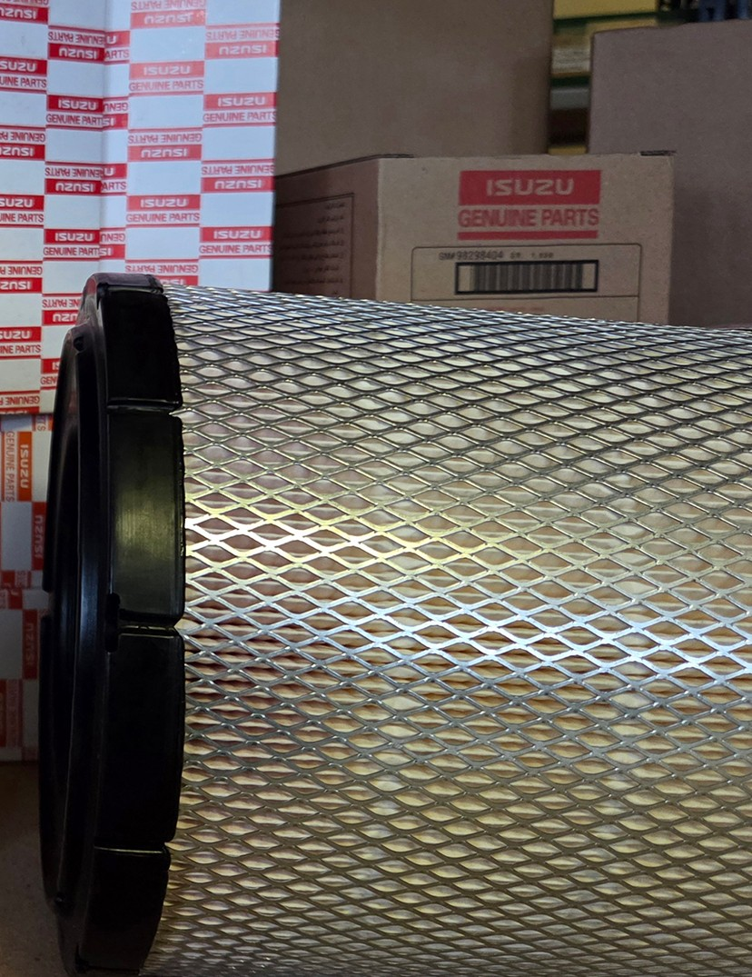
ISUZU EUROPE · AFTERSALES · MANAGEMENT PRESENTATION
We bill €35 million of parts a year.
Now we can see what they are.
AIM, our new parts classification, shows what is selling, where it is selling, and how each product range should be priced.
October 2026
€35.0M = parts billed to our distributors, July 2025 – June 2026. Photo: Isuzu Genuine Parts, Isuzu Truck (UK) Ltd.
ISUZU
Notes:
Open with the money, not the method. We bill about €35 million of parts a year to our distributors (the price revision basis, July 2025 – June 2026, 15,872 part numbers). The question this presentation answers: what are those parts, and what can we do once we know?
Photo credit: Isuzu Genuine Parts shelf, Isuzu Truck (UK) Ltd website; internal use.

Slide 2
THE PROBLEM
Our old classification sorted €35 million of parts by how we thought they compete, not by what they are
Five of its seven top-level labels were commercial opinions. None of them named a product.
Old top level: share of what we billed
AIM top level: the ten largest of 22 families
€14.6M, 42% of what we billed, sat under one label. Steering units, brake discs, brake pads, air filters and EGR valves all read “Competitive parts”.
Base: parts billed to distributors used for the 2026 price revision, July 2025 – June 2026 (€35.0M, 15,872 part numbers). Old top level: price-list classification. AIM: approved release of 7 October 2026.
ISUZU
EUROPE / AIM / THE PROBLEM
02
Notes:
The old tree had 7 top-level labels. Five of them describe a commercial opinion (competitive, repair, accident, high value repair, comfort), not a product. 41.6% of what we billed (€14.57M) sat in 'Competitive parts'. Inside it, by AIM part type: Steering Unit €1.26M, Brake Rotor €1.15M, Brake Pad Kit €0.92M, Air Cleaner Filter €0.80M, EGR Component €0.67M. AIM has 22 families, 116 product groups and 239 part types on this basis; the old tree had 7 / 27 / 171.

Slide 3
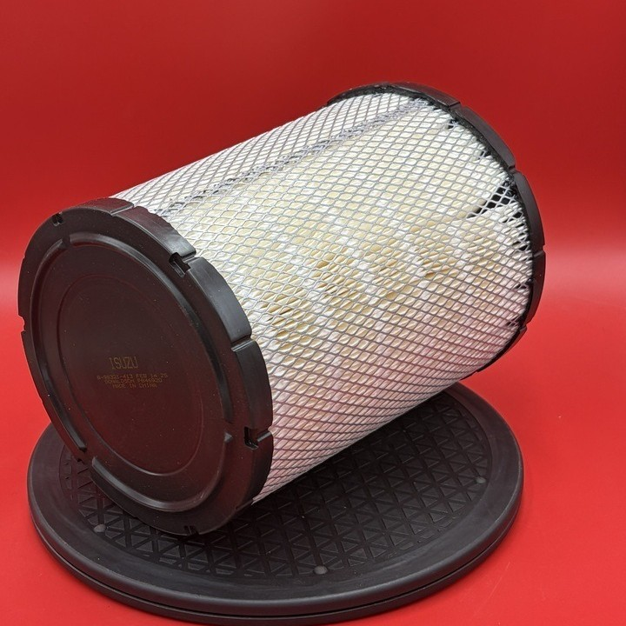
THE PROBLEM
€1.1M a year sat in families the parts have nothing to do with
The old rule read only the price-list text. It could not know that “ACL” means air cleaner.
PART
WHAT WE BILLED
OLD RULE FILED IT AS
AIM PLACES IT
Engine air cleaner elements
€672k
Air conditioning
Maintenance service › Air filter
King pin kits
€150k
Hardware › Pin
Steering › Knuckle & king pin
Steering drag links
€125k
Linkage (hydraulic / mechanical)
Steering › Linkage
Bumper bars
€99k
Suspension › Leaf spring
Accident & body › Bumper
Ball joints
€86k
Linkage (hydraulic / mechanical)
Suspension › Suspension arm
Price list: FILTER; ACL. An engine air cleaner element, filed under air conditioning.
Total €1.13M a year
Ask “how are our air filters selling?” and the old tree missed €0.67M of the €0.80M answer.
Old placements: classification audit of 20 September 2026, each confirmed against Isuzu's parts catalogue figures. Euro: price revision basis, July 2025 – June 2026. Photo: Isuzu Truck UK dealer listing.
ISUZU
EUROPE / AIM / THE PROBLEM
03
Notes:
Five classes where the price-list text names the system beyond argument and the old rule still filed the part somewhere physically unrelated. Euro on this basis: Engine air cleaner elements €672k (28 part numbers); King pin kits €150k (37 part numbers); Steering drag links €125k (18 part numbers); Front and rear bumper bars €99k (20 part numbers); Suspension ball joints €86k (11 part numbers). The old placements and their check against Isuzu catalogue figures (1-30 Air Cleaner, 4-10 Front Axle) are in the classification audit of 20 September 2026. Air cleaner elements under AIM today: €0.80M, of which FILTER; ACL lines €0.67M.

Slide 4
THE PROBLEM
For pricing, the old “Competitive” label was wrong half the time
We tested it against the independent-brand prices we collect ourselves.
48%
What that does to a price revision
Raise a “repair part” and you may be raising it where the customer already has a cheaper choice.
Hold a “competitive part” and you may be giving away margin where nobody competes.
Of every 100 parts where we found an independent-brand alternative, only 48 carried the “Competitive” label. The other 52 were filed as something else.
labelled “Competitive”
labelled repair, accident, comfort or hardware
A label cannot tell us where we compete. Price evidence can, and it needs a real product to attach to. That is what AIM provides.
Classification audit, 20 September 2026: share of part numbers with a confirmed independent-brand alternative in our own price checks that carried the old “Competitive parts” label (48.2%).
ISUZU
EUROPE / AIM / THE PROBLEM
04
Notes:
Measured in the classification audit of 20 September 2026 against our own independent-brand price scrapes: parts labelled Competitive were 1.43 times more likely to have an aftermarket rival, but of the parts where a rival was confirmed only 48.2% carried the Competitive label. Counted on part numbers. Competition depends on the market, not on the part's name; AIM fixes the product, and the competition check sits beside it per market.

Slide 5
THE ANSWER
AIM gives every part a family, a product group and a part type
It reads five facts about each part together, not just its name.
FAMILY
€3.39M
Five facts, read together
Brakes
1
Part number links sales, prices and the catalogue
PRODUCT GROUP
€1.19M
2
Description what the price list calls the part
Pads & shoes
3
Catalogue figure where Isuzu draws it on the vehicle
PART TYPE
€0.93M
Brake pad kit
Customs code an independent check on the product
4
PART NUMBER
€0.34M
5
Price separates a €11 element from a €154 housing
8982447940 · front disc brake pad kit
+ Japan's code kept on every part (next page)
Billed July 2025 – June 2026, price revision basis.
98% of what we bill has a family, group and part type
22 · 116 · 239 families · product groups · part types
7 Oct 2026 latest approved release, maintained by Vehicle Parts Sales
ISUZU
EUROPE / AIM / THE ANSWER
05
Notes:
AIM (our parts classification) gives three levels: family, product group, part type. Example path with billed euro: Brakes €3.39M > Pads & shoes €1.19M > Brake pad kit €0.93M > part 8982447940 (PAD KIT; CALIPER,DISC BRK,FRT) €0.34M. The five facts are read together; where they disagree the part goes to review instead of being guessed. Coverage on this basis: 98.15% of billed euro; 1,342 part numbers (€647k) still open. Approved releases: 4 and 7 October 2026.

Slide 6
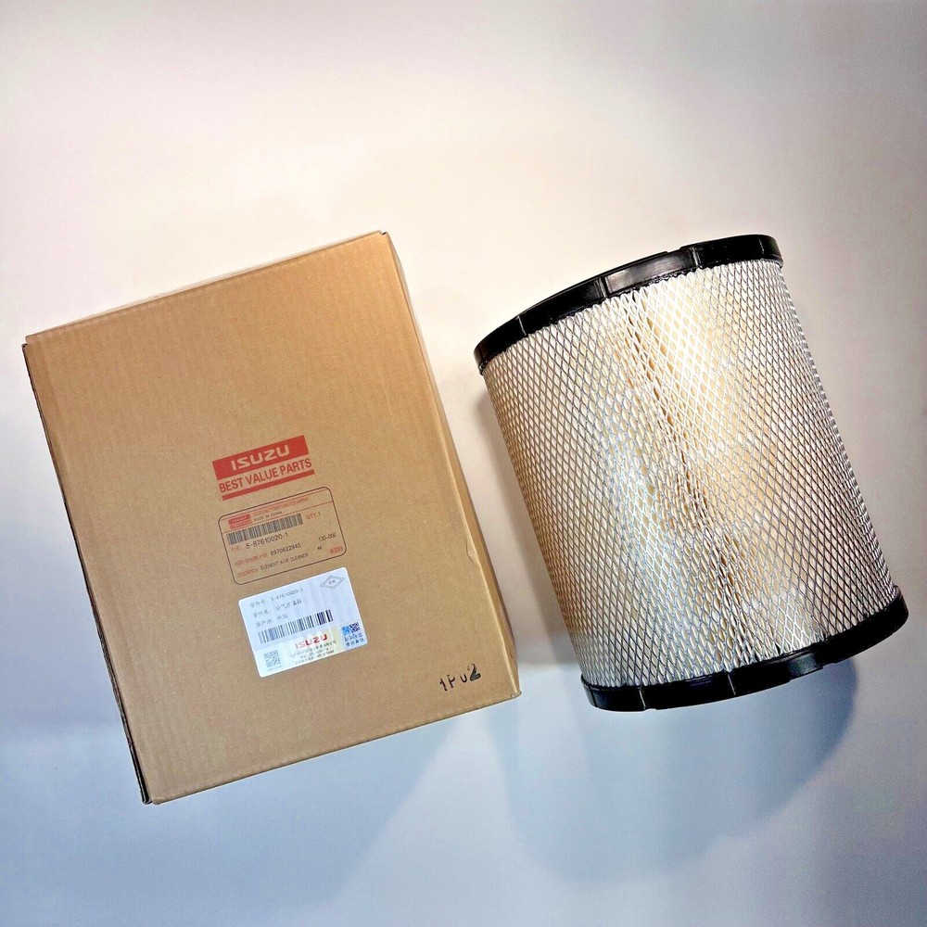
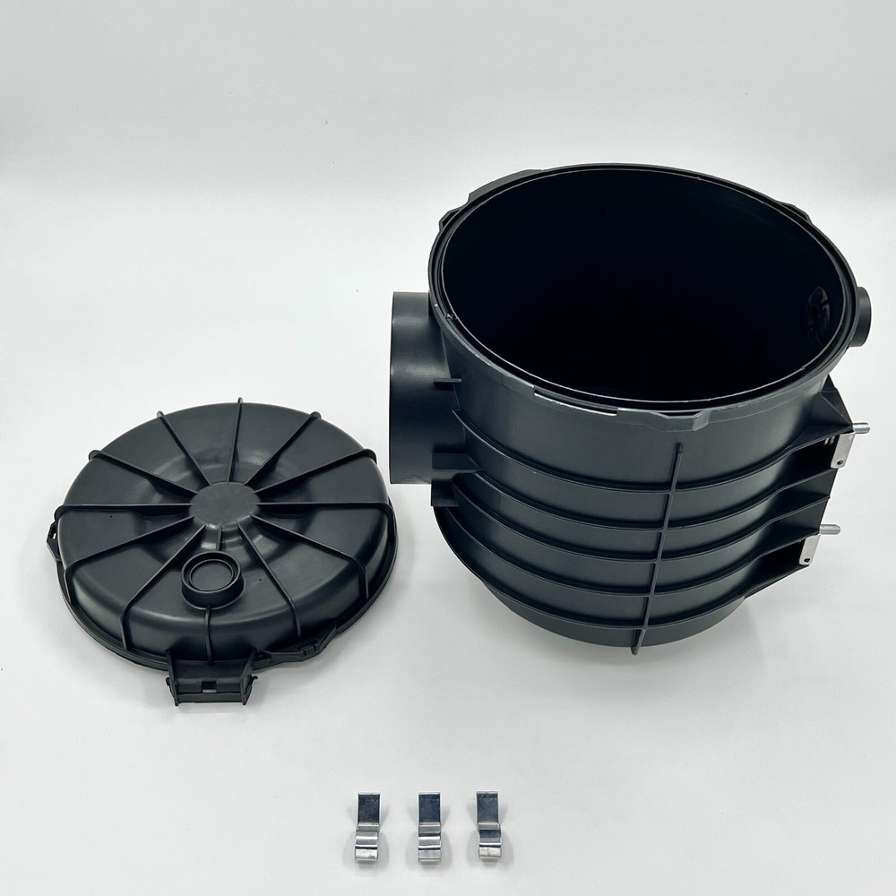
PRECISION
An element and a housing share a family, not a price
AIM keeps them apart, so every price and sales comparison is like for like.
FILTER ELEMENTS
FILTER HOUSINGS AND ASSEMBLIES
€11.01
average per unit
€154.47
average per unit
14×
€2.79M billed
131 part numbers
€0.73M billed
59 part numbers
Replaced at every service. A routine purchase, bought again and again.
Replaced after damage or failure. A repair purchase, not a service one.
Product form only; not a specific part number.
Product form only; not a specific part number.
Averaged together, a “filter” costs €13.64 per unit, a price that describes neither product.
Billed July 2025 – June 2026, price revision basis, all filter part numbers marked element or housing / assembly in AIM. Photos: dealer and supplier listings, product form only.
ISUZU
EUROPE / AIM / PRECISION
06
Notes:
Filter elements: €2.79M billed, 253,009 units, 131 part numbers, €11.01 per unit. Housings and assemblies: €0.73M, 4,727 units, 59 part numbers, €154.47 per unit, 14.0 times the element. Blended: €13.64. The element photo is an Isuzu Best Value element in its box; the housing photo is a supplier listing. Both show product form only.

Slide 7
JAPAN'S CODE
Japan's code stays on every part, but it cannot replace AIM
The code says where Japan files a part. AIM says what the part is. We need both.
One Japan code, many products
Code 275 holds 42% of what we bill, across 197 different part types
One product, many Japan codes
Number of different Japan codes on the same part type
8
Japan codes for brake pad kits
11
Japan codes for air cleaner elements
29
Japan codes for doors
How the code reinforces AIM
A bridge to Japan. Every AIM result translates back into Japan's own codes, so we can discuss it with Japan in their terms.
A completeness check. 89% of what we bill carries a Japan code. The other €3.9M is missing from Japan's file: a question for Japan, not a gap in AIM.
Japan's catalogue code (ZKK) from Japan's parts-code file of 12 September 2025. Euro: price revision basis, July 2025 – June 2026.
ISUZU
EUROPE / AIM / JAPAN'S CODE
07
Notes:
ZKK is Japan's catalogue code: three characters, carried on 88.9% of billed euro in this basis. Code 275 alone holds €14.67M (41.9%) across 197 AIM part types, so a sales chart by Japan code cannot separate brakes from body panels. The other way round, one AIM part type sits under many codes: Air Cleaner Filter 11, Brake Pad Kit 8, Brake Rotor 5, Door 29. So we keep Japan's code as a reference on every part (traceability to Japan, completeness check) and use AIM for analysis. Settled position on the Japan codes: 90_INBOX/SETTLED_POSITION_JP_CODES_2026-09-20.md.

Slide 8
SALES ANALYSIS
Norway brings in €22 more per vehicle than Sweden. AIM traces it to two products
Similar light-commercial fleets: 7,929 vehicles in service in Norway, 8,443 in Sweden.
€209 against €187 per vehicle
Difference by family, Norway minus Sweden, € per vehicle
STEERING UNITS
€19.56 vs €2.09 per vehicle
Norway bought 82, almost all one part number on stock orders every two months. Sweden bought 10. A repair pattern in Norway, or demand Sweden is not getting?
BRAKE PAD KITS
€10.72 vs €4.64 per vehicle
Norway buys 14 kits per 100 vehicles a year, Sweden 6. Where do Swedish owners buy their brake pads?
Without families this is one number: Norway is 12% ahead. With AIM it is two concrete distributor conversations.
Parts billed July 2025 – June 2026, price revision basis. Vehicles in service: 2025 estimates for both markets.
ISUZU
EUROPE / AIM / SALES ANALYSIS
08
Notes:
Norway €1.66M on 7,929 vehicles = €209.4; Sweden €1.58M on 8,443 = €187.0. Steering: Norway 82 steering units (€155k, 2 part numbers; 81 of them part 7552348290 on stock orders of 15 to 20 every two months) against Sweden 10 (€18k). Brake pad kits: Norway 1138 (€85k), Sweden 492 (€39k). Both fleets are light commercial vehicles; the 2025 fleet counts are estimates. These are questions to take to the two distributors, not conclusions.

Slide 9
PRICE REVISIONS
The 2026 base-price increase averages 6.0%. By product group it runs from 0.6% to 10.3%
IML and IMIT base prices, weighted on what we billed July 2025 – June 2026.
What one flat increase would do
Steering gear: base price +0.6%
A flat 6% lifts our price about ten times more than our cost moved.
Air and fuel filters: +2.2 to +2.7%
A flat 6% makes the most frequent service parts dearer than the cost requires.
Brake pads and shoes: +10.3%
A flat 6% leaves four points unrecovered. The full 10% lands on a wear part where independent brands compete.
AIM turns one network percentage into a decision per product group.
Base-price move weighted on billed quantities, not a revenue or margin forecast. Worth €1.65M at last year's volumes. Product groups with at least €0.5M billed.
ISUZU
EUROPE / AIM / PRICE REVISIONS
09
Notes:
Weighted base-price increase 5.96% on the price revision basis (priced lines €32.60M), worth €1.65M on last year's quantities. By AIM product group (groups with at least €0.5M billed): Steering Gear +0.55%; Air Filter +2.16%; Fuel Filter +2.72%; Filters (unspecified) +3.52%; Injection Pump +3.73%; Fuel Control +4.78%; Final Drive +5.00%; Lamps +5.10%; Oil Filter +5.12%; DEF System +5.96%; Turbo +6.03%; Discs & Drums +6.28%; Instruments +6.47%; Radiator +6.62%; Wheel Rim +6.78%; DPF/DPD +6.89%; Sensors +7.00%; HVAC Filters +7.04%; EGR +7.10%; Bumpers +7.27%; Panels +7.30%; Pads & Shoes +10.33%. This is a base-price move on billed quantities, not revenue, margin or demand response. Same basis as the price revision workbook (5.9616%, €1,652,140.71).

Slide 10
WHAT AIM GIVES US
Six things we can do now that we could not do before
Each one is shown with real numbers earlier in this presentation.
1
Explain sales to the part
2
Price per product group
3
Compare like with like
Norway against Sweden: a 12% gap traced to one steering unit and to brake pads.
Base-price increases from 0.6% to 10.3%, instead of one 6.0% average.
A €11 filter element is no longer averaged with a €154 housing.
4
See every product range
5
One language for every distributor
6
Talk to Japan in its own codes
€1.1M a year back in the family it belongs to. Air filters are complete again.
22 families, 116 product groups and 239 part types, the same in every market.
Japan's catalogue code is kept on every part. 89% of billed euro is already linked.
Next: link old and new part numbers, so a superseded part no longer looks like lost business.
ISUZU
EUROPE / AIM / WHAT AIM GIVES US
10
Notes:
The six advantages, each tied to a page: 1 Norway against Sweden (page 8); 2 base-price increase by product group (page 9); 3 element against housing (page 6); 4 parts back in the right family (page 3); 5 one structure for every market (22/116/239); 6 Japan's code kept on every part (page 7). Next step: interchangeability, linking superseded part numbers to their replacements once the source file is supplied.

Slide 11
THE DECISION WE ASK FOR
From a label
to a product.
From a product
to a decision.
USE
AIM as the one product language for distributor sales reviews and price revisions.
OWN
Maintenance stays in Vehicle Parts Sales, through approved releases.
PROVE
Take the two Nordic findings into the next distributor reviews and report the outcome.
AIM: one parts classification for sales analysis and price revisions.
ISUZU
EUROPE / AIM / THE DECISION
11
Notes:
Management is asked to endorse three things: use AIM as the one product language for sales reviews and price revisions; keep maintenance local in Vehicle Parts Sales through approved, dated releases; and prove it on two real cases from page 8 (steering units in Norway, brake pad kits in Sweden). No catalogue-wide automatic price change is proposed.

