Slide 1
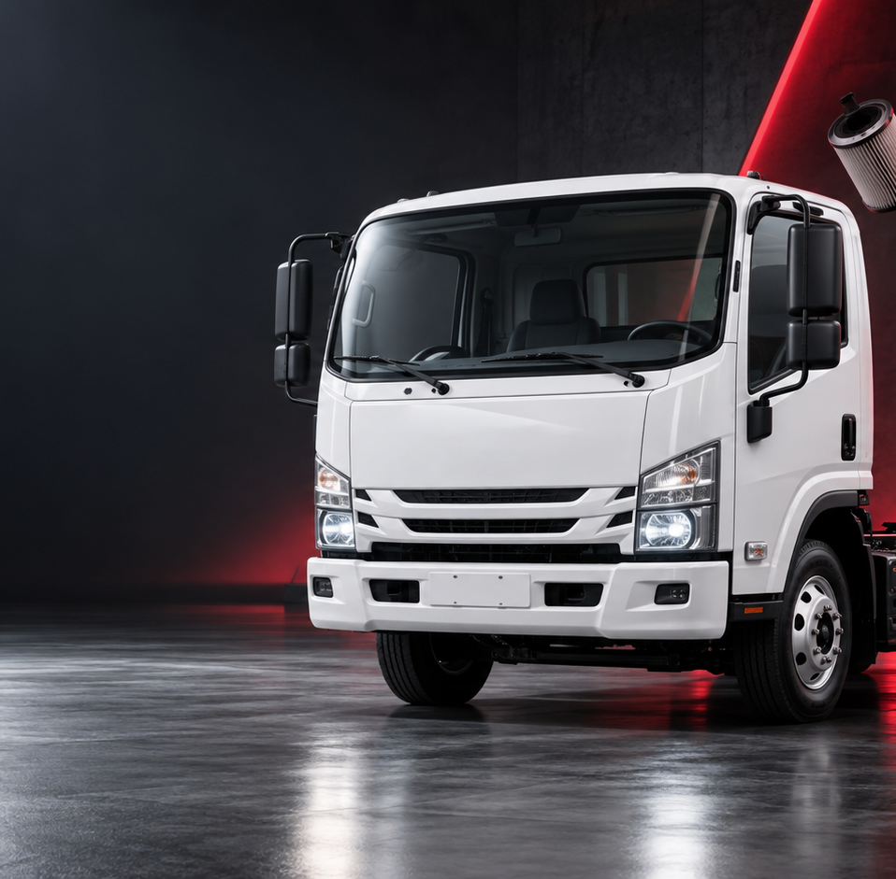
ISUZU
ISUZU
ISZE · AFTERSALES BOARDROOM PACK
Parts performance
from fleet to demand
CY2025 view · 18 core markets · aggregates only
163k
EUR 55.3M
EUR 30.8M
trucks in service
target spend ceiling
parts billed
Aggregated commercial data · 2026-09-19
01
Notes:
Sources
User-provided ISZE commercial data pack: wallet_waterfall.csv, gps_spu_by_distributor.csv, pms_capture_by_db_year.csv, pms_opportunity_matrix.csv, capture_recovery_model.csv, mix_genuine_bvp_pms.csv; README.md states aggregates only and no raw billing lines/full price list.
Data definitions: parts billed = measured ISZE billing aggregate; target spend = modelled spend ceiling. UTI and UMI are separate distributors and are not blended.

Slide 2
BOARDROOM THESIS
ISUZU
The story is no longer a percentage; it is a fleet-to-euro bridge
Measured billing meets a modelled target-spend ceiling. The gap then has to become market and service-family specific.
163k
EUR 55.3M
EUR 30.8M
EUR 24.7M
5
Trucks in service
Target spend ceiling
Parts billed
Uncaptured opportunity
Main action markets
18 core markets
modelled ceiling
measured ISZE billing
not a forecast
81% of market gap
One rule for the rebuild
What the previous deck missed
Every later gap carries three things on the same frame: euro value, service family, and trucks in service. A rate by itself is not a finding.
Different chart forms were not enough. The page architecture also had to change: map as story, bridge as argument, market pages as diagnosis.
Source: User-provided commercial data pack; CY2025 full-year aggregate.
ISZE · Parts performance
02
Notes:
Sources
Opening numbers calculated from wallet_waterfall.csv: trucks in service, theoretical target spend, captured total and uncaptured opportunity for CY2025. README.md hard rules: gaps must show euro + service family + trucks in service; use spoken names, not pipeline filenames.
Data definitions: parts billed = measured ISZE billing aggregate; target spend = modelled spend ceiling. UTI and UMI are separate distributors and are not blended.

Slide 3
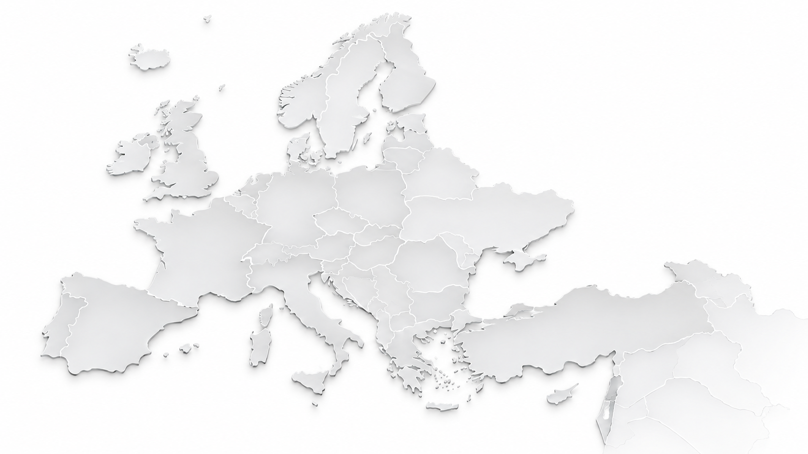
EUROPEAN FOOTPRINT
ISUZU
Show the network honestly: 18 core markets plus an extended parts network
Core markets have the full fleet × target-spend × service-demand model. Extended markets have parts activity but not the same model coverage.
Extended parts network
A map should explain data coverage, not just decorate the title.
Armenia · Ukraine · Kazakhstan · Palestine
The core performance network is where the full model joins. CIS/East markets should be shown as an extended parts network when they are outside the comparable bridge.
ITUK
EUR 6.6M gap
IUK
GERMANY
EUR 5.8M gap
EUR 1.3M gap
Core performance markets
HUNGARY
EUR 603K gap
Extended parts network
18
4
PORTUGAL
core markets
shown as extended
EUR 1.3M gap
UMI
EUR 1.3M gap
UTI
EUR 4.9M gap
Source: wallet_waterfall.csv for core markets; README/File Catalog for extended parts-network treatment.
ISZE · Parts performance
03
Notes:
Sources
Map uses CY2025 core market model from wallet_waterfall.csv. Extended parts-network markets are shown separately because the README/catalog states the performance bridge should not be forced where the model coverage differs. Armenia, Ukraine, Kazakhstan and Palestine are treated as extended view only.
Data definitions: parts billed = measured ISZE billing aggregate; target spend = modelled spend ceiling. UTI and UMI are separate distributors and are not blended.

Slide 4
FLEET TO EURO BRIDGE
ISUZU
CY2025: EUR 24.7M is the space between a modelled ceiling and measured billing
The bridge gives the 55.7% coverage rate its commercial meaning.
Parts billed
Target spend ceiling
EUR 30.8M
EUR 24.7M
EUR 55.3M
measured parts billed
uncaptured opportunity
modelled target spend ceiling
Same bridge over time
Why 2025 matters
2023
EUR 28.3M billed / EUR 51.0M target
55.5%
Fleet and target spend increased, but parts billed moved down versus 2024.
2024
EUR 32.0M billed / EUR 54.1M target
59.0%
2025
EUR 30.8M billed / EUR 55.3M target
55.7%
Source: wallet_waterfall.csv, CY2023–CY2025. Target spend is modelled; parts billed is measured.
ISZE · Parts performance
04
Notes:
Sources
Calculated from wallet_waterfall.csv for 18 core markets. CY2025: 163,198 trucks in service, EUR 55.253M target spend ceiling, EUR 30.757M parts billed, EUR 24.728M uncaptured opportunity, 55.7% coverage.
Data definitions: parts billed = measured ISZE billing aggregate; target spend = modelled spend ceiling. UTI and UMI are separate distributors and are not blended.

Slide 5
MARKET CONCENTRATION
ISUZU
Five markets hold 81% of the market-level uncaptured opportunity
Rank by euro first; rate alone hides where the commercial work sits.
81%
Isuzu Truck UK
EUR 6.6M
23k trucks
45.6% billed
of the CY2025 gap is in the first five markets
Isuzu UK
EUR 5.8M
48k trucks
51.3% billed
This is the commercial reason to stop reading Europe as one network average.
Universal Trucks Israel
EUR 4.9M
10k trucks
40.3% billed
Portugal
EUR 1.3M
7.2k trucks
56.0% billed
Universal Motors Israel
EUR 1.3M
19k trucks
71.6% billed
Remaining 13 markets: EUR 4.7M combined
Source: wallet_waterfall.csv, CY2025, 18 core markets.
ISZE · Parts performance
05
Notes:
Sources
Top market gaps calculated from wallet_waterfall.csv, CY2025. ITUK EUR 6.65M, IUK EUR 5.81M, UTI EUR 4.94M, Portugal EUR 1.34M, UMI EUR 1.32M. Top five sum is 81% of the CY2025 market-level gap.
Data definitions: parts billed = measured ISZE billing aggregate; target spend = modelled spend ceiling. UTI and UMI are separate distributors and are not blended.

Slide 6
MARKET ARCHETYPES
ISUZU
IUK is a scale problem; UTI is an intensity problem
Plotting gap per truck against the share billed separates very different management conversations.
Do not give IUK and UTI the same treatment.
gap per truck
UTI
IUK has the largest light-commercial fleet. Universal Trucks Israel has a smaller fleet but the missing euro per truck is much higher.
EUR 400
ITUK
EUR 250
EUR 122
EUR 478
PORTUGAL
IUK gap / truck
UTI gap / truck
HUNGARY
IUK
EUR 100
UMI
50%
60%
70%
share of target spend billed
Source: wallet_waterfall.csv, CY2025. Bubble size = trucks in service.
ISZE · Parts performance
06
Notes:
Sources
Bubble plot from wallet_waterfall.csv, CY2025. X-axis is gps_pct / 100; Y-axis is uncaptured_eur / uio_units. Bubble size reflects uio_units. IUK and UTI are not blended; they are highlighted because their management problems differ.
Data definitions: parts billed = measured ISZE billing aggregate; target spend = modelled spend ceiling. UTI and UMI are separate distributors and are not blended.

Slide 7
NETWORK MOTION
ISUZU
2025 did not fail on fleet; it failed on turning the larger fleet into billed parts
The modelled opportunity rises from 2023 to 2025, while parts billed falls back from the 2024 peak.
EUR 60M
target spend ceiling
parts billed
EUR 45M
EUR 30M
EUR 15M
EUR 0M
2023
2024
2025
152k
160k
163k
Plain reading
The network carries 11.5k more trucks than in 2023. The commercial question is why the 2024 billing peak did not hold while the target ceiling continued to rise.
Source: wallet_waterfall.csv, CY2023–CY2025.
ISZE · Parts performance
07
Notes:
Sources
Network motion calculated from wallet_waterfall.csv for 18 core markets. Shows target spend ceiling and measured parts billed for CY2023, CY2024, CY2025, plus trucks in service.
Data definitions: parts billed = measured ISZE billing aggregate; target spend = modelled spend ceiling. UTI and UMI are separate distributors and are not blended.

Slide 8
SERVICE-FAMILY LANDSCAPE
ISUZU
The big gaps are clutch and brake, not a generic “filters” story
PMS should lead with total parts sales and total coverage; original vs value-parts is the second lens.
coverage dot
Clutch Disc
EUR 3.3M
Brake Pad
EUR 3.0M
Brake Shoe
EUR 2.6M
Clutch Pressure Plate
EUR 2.1M
Blower Unit Filter
EUR 1.4M
Brake Rotor
EUR 1.4M
Clutch Kit
EUR 1.0M
Fuel Filter
EUR 1.0M
Clutch Booster
EUR 0.8M
Air Filter
EUR 0.7M
0%
100% total coverage
Four service families carry EUR 11.0M of the total service-demand gap.
This is why the action story must start in service bays: clutch disc, brake pad, brake shoe, and clutch pressure plate.
Source: pms_capture_by_db_year.csv, CY2025, line_type = total.
ISZE · Parts performance
08
Notes:
Sources
Family gaps calculated from pms_capture_by_db_year.csv with year=2025 and line_type=total. Top categories are clutch disc, brake pad, brake shoe, clutch pressure plate. Use total PMS first per README hard rule.
Data definitions: parts billed = measured ISZE billing aggregate; target spend = modelled spend ceiling. UTI and UMI are separate distributors and are not blended.

Slide 9
WHERE THE SERVICE-FAMILY WORK SITS
ISUZU
The same families recur, but the market priority is not the same
A heatmap makes the action list more legible than another ranked bar chart.
Clutch Disc
Brake Pad
Brake Shoe
Clutch Pressure
Brake Rotor
Fuel Filter
Oil Filter
Blower Filter
IUK
1.3
0.8
0.7
0.6
0.5
0.5
0.5
ITUK
0.3
0.3
UTI
0.5
UMI
0.3
PORTUGAL
GERMANY
0.3
BELGIUM
0.3
HUNGARY
darker = larger euro gap
Read this as an action map: IUK is broad and large, UTI is intense in brake/clutch, and UMI still matters despite higher overall GPS coverage.
Source: pms_opportunity_matrix.csv, CY2025. Values shown are EUR gaps by market and PMS family.
ISZE · Parts performance
09
Notes:
Sources
Heatmap from pms_opportunity_matrix.csv for CY2025. Market rows are selected action markets. Categories selected from top PMS gap families and filters. Each cell is revenue_gap_eur; labels only appear on cells above about EUR 0.3M to avoid clutter.
Data definitions: parts billed = measured ISZE billing aggregate; target spend = modelled spend ceiling. UTI and UMI are separate distributors and are not blended.

Slide 10
IUK FORENSIC
ISUZU
IUK is the scale problem: 47.8k trucks and EUR 5.8M gap
The question is not whether the rate is the lowest; it is where the light-commercial fleet converts poorly into billed parts.
48k
EUR 5.8M
51.3%
trucks in service
uncaptured opportunity
of target spend billed
Commercial interpretation
IUK needs a service-family recovery plan, not a general “sell more parts” message.
Clutch Disc
EUR 1.3M
Brake Pad
EUR 807K
First page of the plan
Clutch disc · brake pad · brake shoe · clutch pressure plate. Keep the fleet figure on the same page so the scale is impossible to miss.
Brake Shoe
EUR 694K
Clutch Pressure Plate
EUR 565K
Fuel Filter
EUR 485K
Blower Filter
EUR 470K
Source: wallet_waterfall.csv and pms_opportunity_matrix.csv, CY2025.
Focus market · IUK
10
Notes:
Sources
IUK metrics from wallet_waterfall.csv CY2025. PMS category gaps from pms_opportunity_matrix.csv CY2025 for IUK. The slide intentionally leads with euro gap and fleet, not a standalone capture percentage.
Data definitions: parts billed = measured ISZE billing aggregate; target spend = modelled spend ceiling. UTI and UMI are separate distributors and are not blended.

Slide 11
ISRAEL IS TWO OPERATING CONVERSATIONS
ISUZU
Universal Trucks Israel and Universal Motors Israel must not be blended
Same country, different fleets, different gaps, different service-family patterns.
Universal Trucks Israel
Universal Motors Israel
N+F commercial vehicles
TF / pickup
10k
EUR 4.9M
40.3%
19k
EUR 1.3M
71.6%
trucks in service
uncaptured opportunity
of target spend billed
trucks in service
uncaptured opportunity
of target spend billed
Brake Pad
EUR 456K
Brake Pad
EUR 332K
Clutch Booster
EUR 388K
Clutch Disc
EUR 274K
Clutch Pressure Plate
EUR 251K
Blower Filter
EUR 247K
Brake Rotor
EUR 216K
Brake Shoe
EUR 225K
Source: wallet_waterfall.csv and pms_opportunity_matrix.csv, CY2025. UTI and UMI kept separate.
Focus market · Israel split
11
Notes:
Sources
Israel split based on README hard rule and wallet/PMS data. UTI and UMI are separate distributors. UTI: Universal Trucks Israel, N+F commercial vehicles. UMI: Universal Motors Israel, TF/pickup. Metrics from wallet_waterfall.csv; PMS top gaps from pms_opportunity_matrix.csv.
Data definitions: parts billed = measured ISZE billing aggregate; target spend = modelled spend ceiling. UTI and UMI are separate distributors and are not blended.

Slide 12
ORIGINAL VS VALUE-PARTS
ISUZU
Value-parts mix is not one signal; it is a market strategy lens
Israel behaves very differently from UK and northern markets, so the deck should not rank all markets against one artificial answer.
Universal Trucks Israel
86.5% value-parts
Universal Motors Israel
81.6% value-parts
Second lens only
Service-demand coverage remains the main PMS story. Original vs value-parts explains how the billed euro is being won.
Portugal
58.1% value-parts
Belgium
41.3% value-parts
Isuzu UK
23.0% value-parts
53%
Isuzu Truck UK
15.3% value-parts
of clutch original + value-parts sales are value-parts
Germany
26.4% value-parts
Sweden
11.6% value-parts
Source: mix_genuine_bvp_pms.csv, CY2025. “Value-parts” = BVP in data; “original” = genuine in data.
ISZE · Parts performance
12
Notes:
Sources
Market value-parts shares from mix_genuine_bvp_pms.csv, CY2025, aggregated across product families. Slide uses spoken terms original and value-parts per README, avoiding BVP as slide headline.
Data definitions: parts billed = measured ISZE billing aggregate; target spend = modelled spend ceiling. UTI and UMI are separate distributors and are not blended.

Slide 13
RECOVERY MODEL
ISUZU
The gap splits into under-service, substitution and catalogue-type effects
This is useful because Sales, Planning and technical/product teams do not solve the same gap in the same way.
Under Service · EUR 10.1M
Substitution · EUR 9.1M
Catalog Gap · EUR 1.4M
Largest market × gap-type blocks
IUK · Under Service
EUR 3.7M
How to use it
IUK · Substitution
EUR 2.2M
BELGIUM · Substitution
EUR 1.5M
Under-service: service demand not turning into billed parts.
Substitution: value-parts or alternatives are already involved.
Catalogue-type gap: product / matching issue to investigate.
GERMANY · Substitution
EUR 1.2M
ITUK · Under Service
EUR 1.2M
UMI · Substitution
EUR 1.2M
GERMANY · Under Service
EUR 1.1M
UTI · Under Service
EUR 1.1M
UMI · Under Service
EUR 616K
UTI · Substitution
EUR 590K
Source: capture_recovery_model.csv, CY2025.
ISZE · Parts performance
13
Notes:
Sources
Recovery model from capture_recovery_model.csv, CY2025. gap_revenue_at_genuine is summed by gap_type and by distributor/gap_type. Labels use plain English but keep the distinction of under-service, substitution and catalogue-type gaps.
Data definitions: parts billed = measured ISZE billing aggregate; target spend = modelled spend ceiling. UTI and UMI are separate distributors and are not blended.

Slide 14
EXECUTIVE FOCUS
ISUZU
The next euro of attention should go where fleet, euro gap and service family overlap
This page is deliberately operational, but phrased in boardroom English. No pipeline wording, no analyst shorthand.
Sales
IUK
Open the light-commercial recovery conversation on clutch and brake, using EUR gap and 47.8k trucks on the same page.
Sales
UTI
Treat Universal Trucks Israel as an intensity case: smaller fleet, much higher missing euro per truck.
Planning
IUK / UTI
Align stock planning to the first wear-part list: clutch disc, brake pad, brake shoe, clutch pressure plate.
Distributor review
UMI
Keep Universal Motors Israel separate: higher overall share billed, but material brake and clutch gaps remain.
Quality rule for every future slide
Export PNG, inspect the actual rendered slide, and fix every clipped label, crowded map, weak composition and empty percentage before delivery.
Source: wallet_waterfall.csv, pms_opportunity_matrix.csv, capture_recovery_model.csv, mix_genuine_bvp_pms.csv, CY2025.
Executive focus
14
Notes:
Sources
Focus rows derive from market concentration and PMS family analyses: wallet_waterfall.csv for fleet/gap; pms_opportunity_matrix.csv for family gaps; capture_recovery_model.csv for gap types. Language follows README wording rules.
Data definitions: parts billed = measured ISZE billing aggregate; target spend = modelled spend ceiling. UTI and UMI are separate distributors and are not blended.

Slide 15
BASIS AND CAVEATS
ISUZU
Measured billing and modelled target spend are deliberately kept separate
This is a boardroom working pack, not a raw-data extract.
Measured
Parts billed is measured from ISZE aggregate billing data. No raw billing lines or full price list are used in this deck.
Modelled
Target spend is a ceiling based on target spend per truck. It is not a forecast and not an automatic recoverable amount.
Comparable network
The core bridge uses 18 markets with joined fleet, target-spend and PMS logic. Extended parts-network markets are shown separately.
Israel
UTI and UMI are separate distributors. UMI can use IDS Israel dealer geography; UTI needs a public/other dealer source if a dealer map is required.
Language
Slides use parts billed, target spend per truck, sales to dealer, reference dealer price, trucks in service. Pipeline filenames are not slide language.
Source: README.md and FILE_CATALOG.csv from the ISZE commercial data pack.
Definitions and caveats
15
Notes:
Sources
Basis and caveats summarized from README.md and FILE_CATALOG.csv in user-provided commercial data pack. These notes should stay available if the deck is shared internally.
Data definitions: parts billed = measured ISZE billing aggregate; target spend = modelled spend ceiling. UTI and UMI are separate distributors and are not blended.

