Slide 1

ISZE · ISRAEL · UMI
UMI Sales Review
& FY2027 Target
Universal Motors Israel · August 2026

Slide 2
EXECUTIVE STORYLINE
The meeting should align three commercial facts and three joint decisions
YTD sales
Commercial parts
FY2027 target
EUR 875K
+33.6%
EUR 3,052K
-12% vs BP; -14% vs LY
CY H1 2026 vs CY H1 2025
Extended target (locked)
Commercial parts billing moved +33.6%, but Lighting, Hydraulic / mechanical, Filters still need a joint recovery plan.
1
Close the lubricant blocker
2
Choose the first recovery category
3
Unlock part-level sales-to-dealer data
— Agree when Shell price discussion closes and whether any volume is moving outside ISZE while the hold continues.
— Start with Lighting; make the action visible dealer-by-dealer.
— Monthly sales to dealer at part number level from 01/01/2025 to separate stock movements from lost jobs.
2

Slide 3
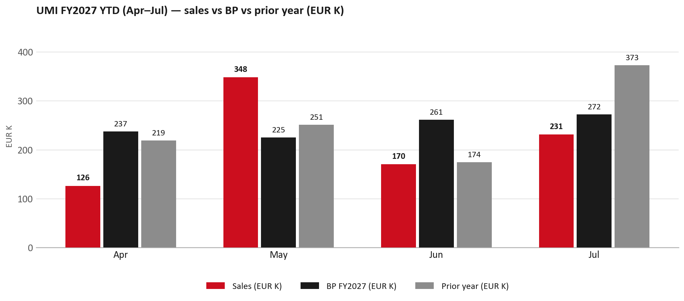
PERFORMANCE
FY2027 YTD (Apr–Jul): EUR 875K, -12% vs BP
TAKEAWAYS
— Sales EUR 875K against BP EUR 995K — -12%, and -14% on last year's EUR 1,017K.
— Jul is -38% YoY — Shell lubricants on hold (price not agreed) is the stated turnover gap into August.
— The beat is entirely May: EUR 348K against EUR 225K. Apr -47%, Jun -35% and Jul -15% are below BP.
— The conversation should move quickly from what happened to which lever we jointly pull first.
3

Slide 4
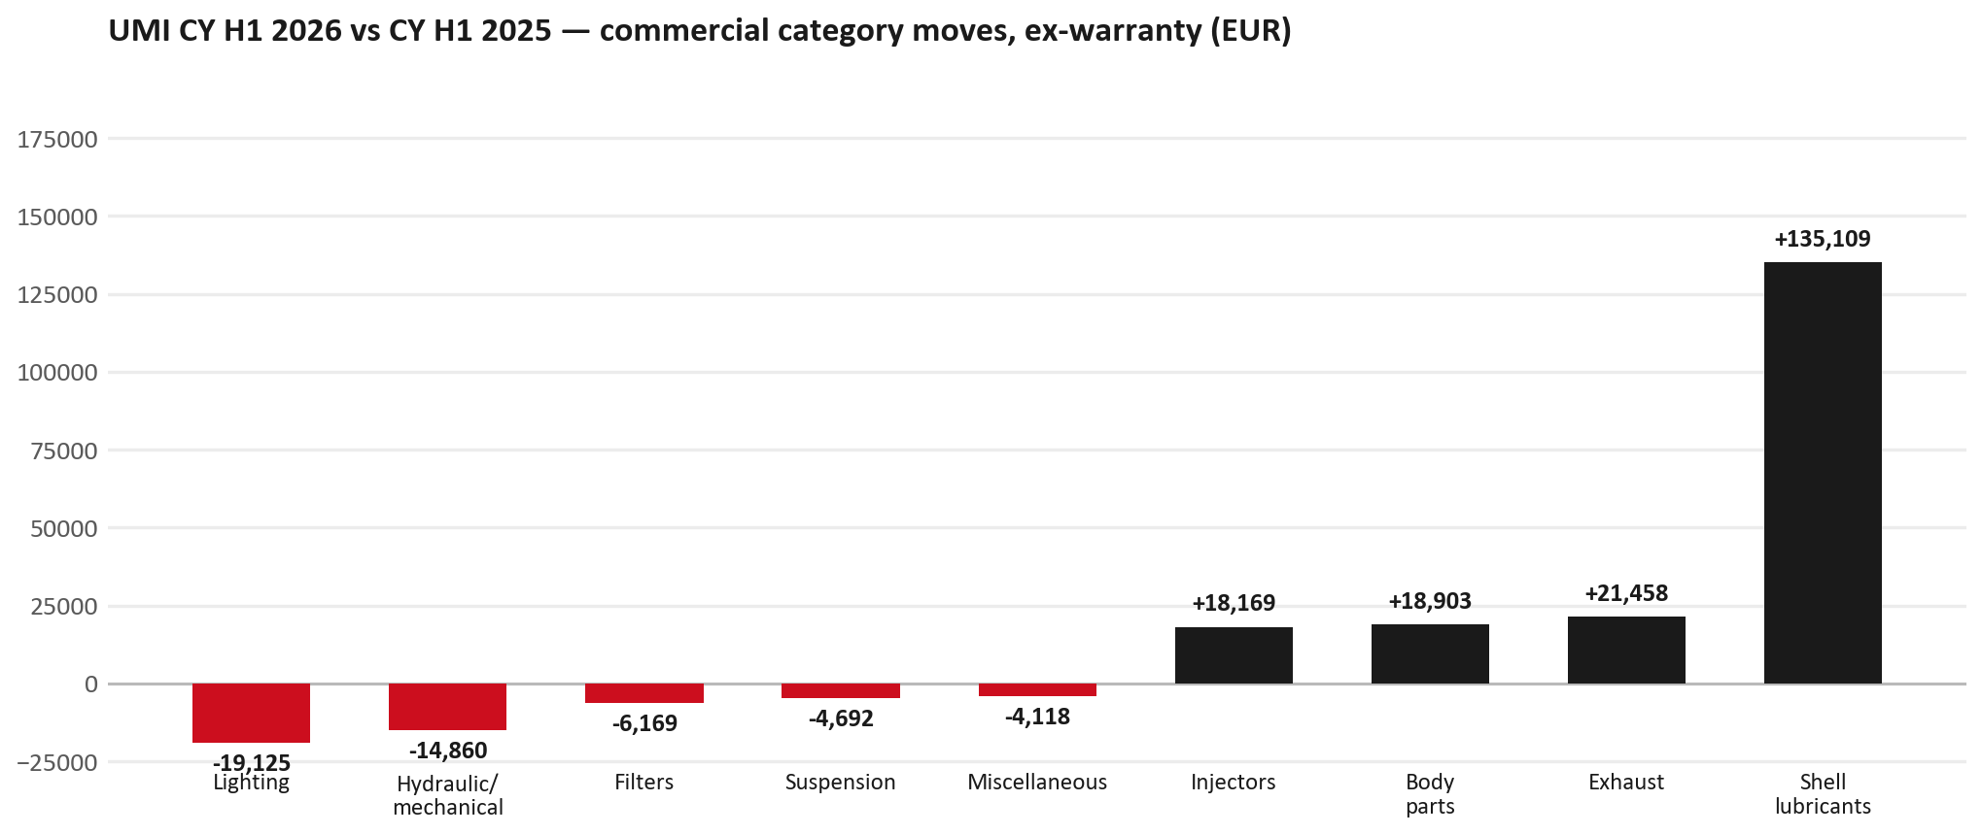
MIX
Commercial parts grew +33.6% — the leaks sit in specific families
TAKEAWAYS
— Commercial parts billing (warranty/campaign excluded) EUR 665K against EUR 498K a year earlier — +33.6% (CY H1 2026 vs CY H1 2025, Jan–Jun).
— Largest PN drops (all categories): 8980565510 (ROD END ASM; OUTER) EUR -7K, 185 fewer pcs; 1884057860 (GEAR OIL LSD) EUR -6K, 203 fewer pcs; 8982457540 (NOZZLE ASM; INJ) EUR -5K, 20 fewer pcs.
— Largest PN gains (all categories): 8982601090 (NOZZLE ASM; INJ) EUR 22K, 96 more pcs; 5876150640 (PAD KIT; DISC BRK,W/) EUR 6K, 150 more pcs; 8978461132 (GLASS; WINDSHIELD) EUR 5K, 25 more pcs.
— Within Shell lubricants (EUR 135K): 550047337 (Rim R4L15W40 CK4_3*5) EUR 106K, 2,371 more pcs; 550047252 (Rim R4 L 15W40 CJ4_1) EUR 17K, 24 more pcs; 550070445 (Rim R4L 15W40 CK4_1*) EUR 9K, 120 more pcs.
4

Slide 5
LEAKAGE
Category gaps that deserve a direct customer conversation
Lighting
Hydraulic / mechanical
Filters
EUR 66K → EUR 47K (-29%)
EUR 43K → EUR 28K (-35%)
EUR 23K → EUR 16K (-27%)
Is this availability, pricing, or genuinely fewer accident repairs?
Is this pricing against what the dealers can buy locally?
Are dealers stocking filters, or ordering line-by-line against each job?
Recommended first action: Lamps
Recommended first action: Pricing / availability
Recommended first action: Service pack
Full part-number detail is in the appendix — use this page to decide what we do.
5

Slide 6
OPPORTUNITIES
Use the growth list as a repeatability discussion, not just a table
NOZZLE ASM; INJ
8982601090
+EUR 22K
PAD KIT; DISC BRK,W/O SHIM &
5876150640
+EUR 6K
GLASS; WINDSHIELD
8978461132
+EUR 5K
LAMP ASM; RR COMB
8978248633
+EUR 4K
BUMPER ASM; FRT
7552172681
+EUR 4K
GRILLE; INNER,RAD
7552070241
+EUR 4K
Decision lens
1
Repeatable?
2
Protectable?
3
Actionable?
— Which lines reflect structural dealer demand rather than one-off accident or stock movements?
— Which lines are most exposed to IAM or parallel sourcing if we do nothing?
— Which lines can be supported through SPA, service packs or availability focus within 90 days?
6

Slide 7
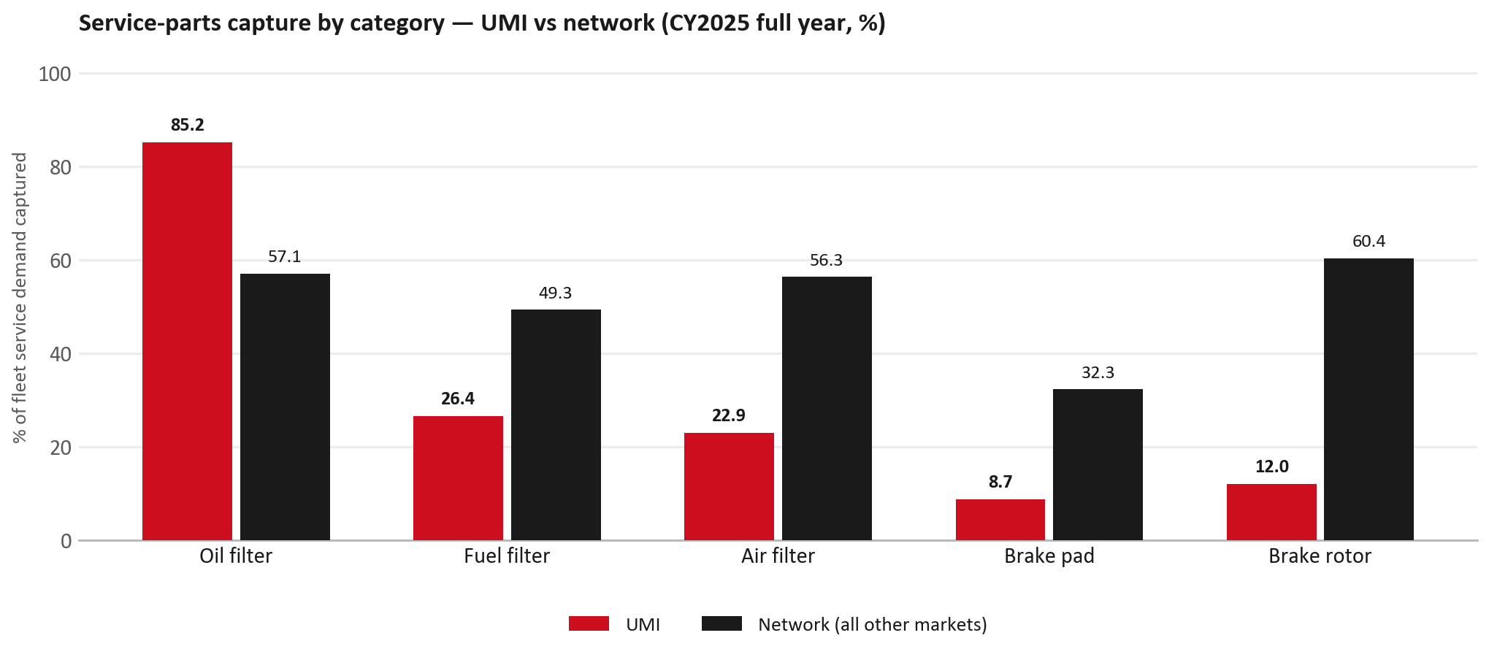
SERVICE-PARTS COVERAGE
Service-parts coverage: brake rotor is the clear gap
TAKEAWAYS
— Brake rotor 12.0% against 60.4% for the rest of the network.
— Air filter 22.9% against 56.3% for the rest of the network.
— Every market here is measured on the same fleet-and-interval model, so the comparison is like-for-like even where the underlying interval assumption is debatable.
— Worth agreeing which category we tackle first, and what the joint action is.
7

Slide 8
IDS 2026 — DEALER STANDARD
IDS 2026: UMI averages 60.9%, below the 74.8% network benchmark
Dealer | Total % | Global rank
Kfir Yaud | 69.6% | #406
Eden Garage Rishon | 68.6% | #415
Tel Hanan Haifa | 68.6% | #416
UMI country average | 60.9% | —
Network average (all IDS 2026) | 74.8% | —
Asayag Jerusalem | 44.3% | #476
Ram Raanana | 43.2% | #477
Zarfati Jerusalem | 39.3% | #479
— 29 dealers assessed across Premises, Organisation, Service, Parts and Vehicle Sales.
— The country average sits 13.9 points below the network — both averages are taken on assessed dealers only.
— The spread is the point: 30 points between the strongest and weakest assessed dealer.
— Dealer-by-dealer detail and individual feedback are available as a separate pack — worth agreeing which dealers to visit, and when.
8

Slide 9
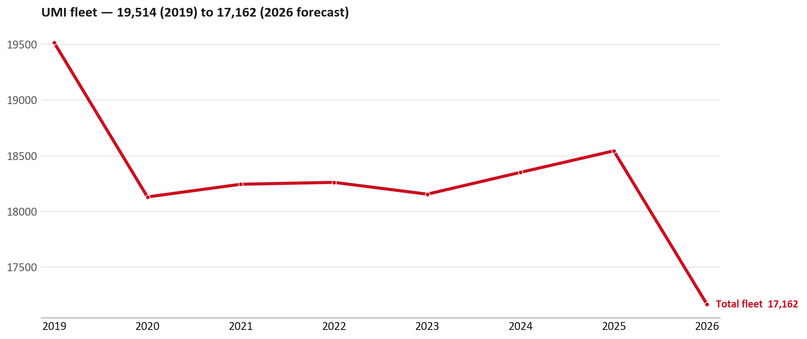
FLEET & FY2027 TARGET
The fleet is expected to decline in 2026
WHAT THIS MEANS FOR FY2027
— Fleet size (calendar year): 18,542 vehicles in 2025 → 17,162 working estimate for end-2026 (-7.4%).
— The chart is calendar years 2019–2026 only. 2026 is a working year-end estimate, not a fiscal-year figure.
— End-2026 mix: LCV / D-Max 17,162.
— The FY2027 extended target (ISZE→DB) applies a 5% price adjustment and 1.8% stretch — locked at EUR 3,051,652 from GPS Extended Target V3.1 (Dashboard column I).
— So the target is built from a slightly smaller fleet — not from an assumed growth story.
9

Slide 10
FLEET & FY2027 TARGET
How the FY2027 extended target is built
ISZE → DB extended target (V3.1 Dashboard column I)
Step | Amount
Business Plan / actual FY27 base | EUR 2,973,279
Market potential (max spend FY27) | EUR 4,354,036
Stretch (+1.8% of max spend) | EUR 78,373
FY2027 EXTENDED TARGET (locked) | EUR 3,051,652
— Extended target = BP + stretch; stretch default is 1.8% (network rule from GPS Extended Target V3.1).
— Figure locked from V3.1 Dashboard col I UMI: EUR 3,051,652.
10

Slide 11
FY2027 TARGET
What the FY2027 target reflects
1
The FY2027 business plan
2
The price move
— The target starts from the FY2027 Business Plan for this market, EUR 2,973,279.
— Your fleet outlook (-7.4%) sets the market potential the stretch is measured against.
— ISZE is applying a 5% price adjustment for FY2027, consistent with every ISZE market this year.
— It is built into the per-vehicle rate above, not added separately on top.
What it means for your target
 | Value
FY2027 extended target (V3.1 col I) | EUR 3,051,652
vs BP FY27 (EUR 2,973,279) | +2.6%
Stretch included | +1.8%
— As in previous cycles we would expect an incentive to sit alongside this adjustment — that approval is still pending on our side.
— Until the incentive is confirmed, treat the FY2027 extended target as the working figure (BP + stretch), not a locked commercial commitment.
11

Slide 12
JOINT PLAN
End the customer meeting with clear workstreams and owners
1
FY2027 target
2
Lubricants
3
Service-parts pilot
4
SPA list
— Confirm extended target EUR 3,051,652 and incentive status.
— Close Shell price agreement; confirm restart timing and any temporary leakage.
— Pick Lighting as the first joint recovery category.
— Universal Motors Israel submits a target list; ISZE counters with network data and margin logic.
Fewer slides in the room, clearer decisions, and a direct link between Universal Motors Israel's asks and ISZE support.
12

Slide 13
Moving the World – for You

Slide 14
UMI · UNIVERSAL MOTORS ISRAEL
Appendix — detail behind the meeting story
— Part-number declines, growth deep dives, New Business validation, SPA process, R&M questions and the data request.
— Use selectively — the spoken meeting ends on the previous closing slide.
13

Slide 15
APPENDIX — LIGHTING
Lighting — CY H1 2026 vs CY H1 2025 (commercial, ex-warranty)
— EUR 66,473 (CY H1 2025) to EUR 47,348 (CY H1 2026), down EUR 19,125 (-29%).
— Largest part numbers driving the decline (by EUR):
— 8977993773 (LAMP ASM; HEAD): EUR 4,162 to EUR 0, 14 fewer pieces.
— 8977993763 (LAMP ASM; HEAD): EUR 3,865 to EUR 0, 13 fewer pieces.
— 8983287885 (LAMP ASM; HEAD): EUR 4,013 to EUR 1,086, 28 fewer pieces.
— 8976830212 (LAMP ASM; RR COMB): EUR 7,066 to EUR 4,159, 25 fewer pieces.
Questions for us to work through together
— Is this availability, pricing, or genuinely fewer accident repairs?
— Are the bodyshops in your network sourcing lamps elsewhere?
14

Slide 16
APPENDIX — HYDRAULIC / MECHANICAL
Hydraulic / mechanical — CY H1 2026 vs CY H1 2025 (commercial, ex-warranty)
— EUR 43,066 (CY H1 2025) to EUR 28,206 (CY H1 2026), down EUR 14,860 (-35%).
— Largest part numbers driving the decline (by EUR):
— 8980565510 (ROD END ASM; OUTER): EUR 9,604 to EUR 2,988, 185 fewer pieces.
— 1884057860 (GEAR OIL LSD): EUR 8,956 to EUR 3,066, 203 fewer pieces.
— 8979458422 (ARM; UPR CONT): EUR 2,319 to EUR 0, 20 fewer pieces.
— 8979458441 (ARM; LWR CONT): EUR 1,188 to EUR 0, 8 fewer pieces.
Questions for us to work through together
— Is this pricing against what the dealers can buy locally?
— Is any of this stock timing on your side rather than end demand?
— What would make the biggest difference to keep this business with us?
15

Slide 17
APPENDIX — FILTERS
Filters — CY H1 2026 vs CY H1 2025 (commercial, ex-warranty)
— EUR 22,637 (CY H1 2025) to EUR 16,468 (CY H1 2026), down EUR 6,169 (-27%).
— Largest part numbers driving the decline (by EUR):
— 5876150050 (ELEMENT; OIL FILTER · TFR,TFS,UCR,UCS): EUR 7,435 to EUR 2,545, 920 fewer pieces.
— 8978770040 (FILTER ASM): EUR 3,152 to EUR 0, 2 fewer pieces.
— 5876100190 (CARTRIDGE;OIL FILTER · UBS): EUR 1,130 to EUR 426, 230 fewer pieces.
— 5876100170 (CARTRIDGE;OIL FILTER · UBS): EUR 1,128 to EUR 664, 90 fewer pieces.
Questions for us to work through together
— Are dealers stocking filters, or ordering line-by-line against each job?
— How much servicing do you estimate is happening outside the franchised network?
— Would a service-pack offer on oil and fuel filters be workable for your dealers?
16

Slide 18
APPENDIX — SHELL LUBRICANTS
Shell lubricants — CY H1 2026 vs CY H1 2025 (commercial, ex-warranty)
— EUR 0 (CY H1 2025) to EUR 135,109 (CY H1 2026), up EUR 135,109.
— Largest part numbers driving the increase (by EUR):
— 550047337 (Rim R4L15W40 CK4_3*5L): EUR 0 to EUR 105,984, +2,371 pcs.
— 550047252 (Rim R4 L 15W40 CJ4_1*209L): EUR 0 to EUR 17,493, +24 pcs.
— 550070445 (Rim R4L 15W40 CK4_1*20L JC_A246): EUR 0 to EUR 8,640, +120 pcs.
— 550070643 (RimulaR6LM10W40CK-4_1*20L JC_A246): EUR 0 to EUR 2,992, +40 pcs.
Questions for us to work through together
— When can the Shell price discussion close so lubricant orders restart?
— How much of the Original BP gap is lubricants vs the rest of the basket?
— Is any Shell volume moving outside ISZE while the hold continues?
17

Slide 19
APPENDIX — SPA
SPA
1
UMI proposal
2
ISZE review
3
Counter-proposal
4
Final approval
— Universal Motors Israel submits a proposed parts list.
— ISZE reviews the proposal against network data and fit.
— ISZE returns a counter-proposal where needed.
— Signed off by ISZE management.
Purpose: higher turnover for both sides.
18

Slide 20
APPENDIX — R&M
R&M — let's align on the market
M
Market
S
Servicing & R&M
— How is the market moving for you right now?
— How much of your volume is fleet business rather than retail?
— Where do you see the biggest hurdles this year?
— Where are your real strengths in this segment?
— Do you offer an R&M or service-plan product today?
— What share of the trucks in service do you retain for servicing after year three?
— Does R&M business come bundled with fleet tenders — roughly what share?
— What would it take to bring more out-of-network servicing back?
19

Slide 21
APPENDIX — ASK
Part-level sales-to-dealer data
1
The starting point
2
Sharper insight
3
Shared benefit
— We have no sales-to-dealer figures from you for FY2026. The ask is monthly sales to dealer, at part-number level.
— Part-by-part visibility separates a stock movement from a lost job — and tells us where the volume actually went.
— Better availability on your fast movers, a sharper target for us, and a factual basis for the SPA — same data, both sides gain.
Requested from 01/01/2025, part number level, monthly.
20

