Slide 1

ISZE · CYPRUS · CYPRUS
Cyprus Sales Review
& FY2027 Target
Loutsios & Sons · July 2026

Slide 2
CYPRUS MEETING
Agenda
— Parts Performance — category movers
— Parts Performance — Body parts
— Parts Performance — Brake parts
— Parts Performance — where volume grew
— New Business — validation queue
— Sales-to-Dealer Outlook
— GPS Capture
— Service-Parts Coverage
— IDS 2026 — Dealer Standard
— Fleet & FY2027 Target
— SPA — status
— R&M — market discussion
— Data request: part-level Sales-to-Dealer
— Next steps
2

Slide 3
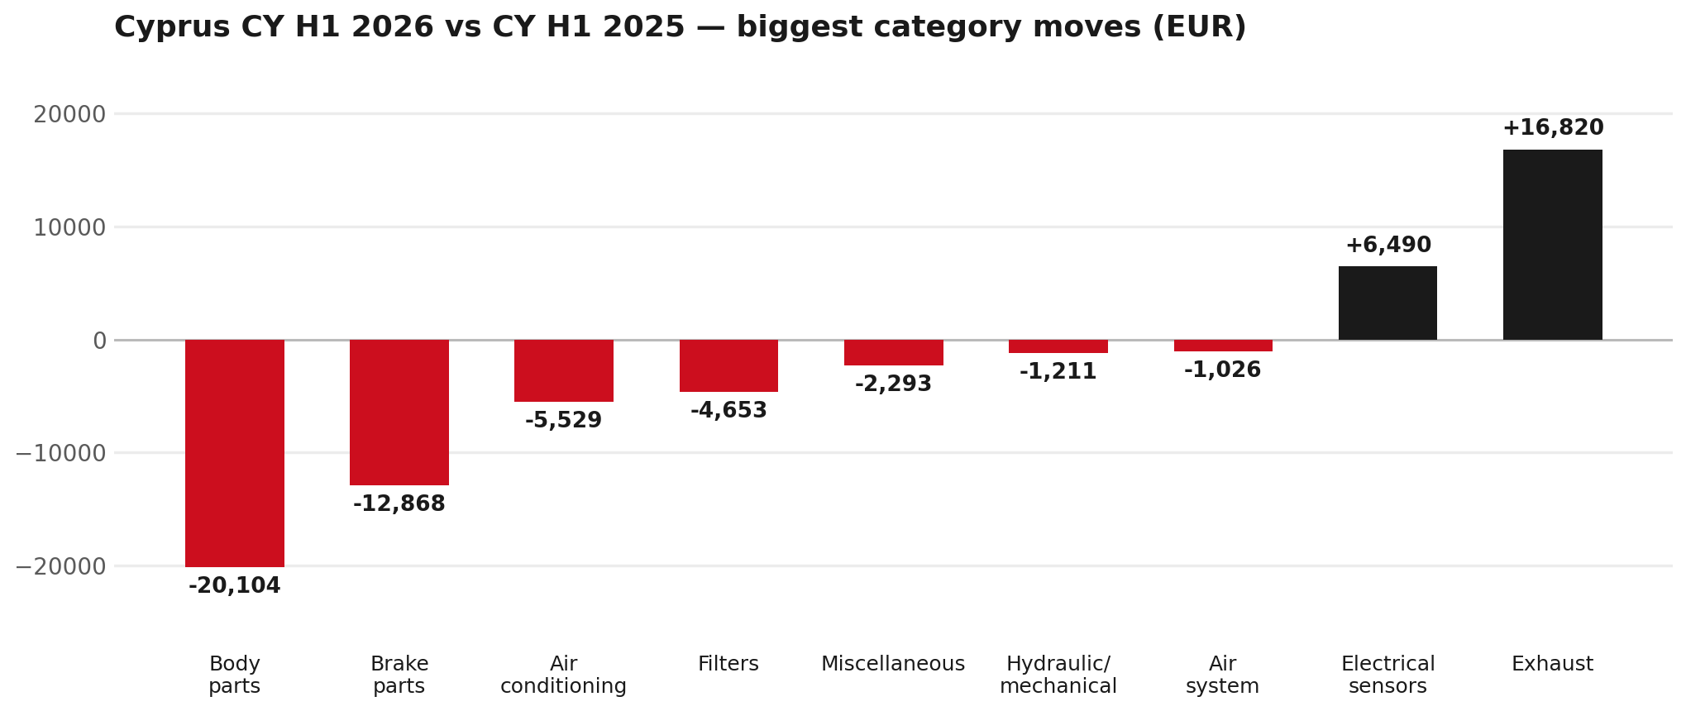
PARTS PERFORMANCE
Parts Performance — CY H1 2026 vs CY H1 2025
TAKEAWAYS
— Parts billing EUR 176K against EUR 200K a year earlier — -11.7%.
— Biggest declines: Body parts EUR -20K; Brake parts EUR -13K.
— Growing: Exhaust +654%, Electrical sensors +38%.
— CY H1 2026 against CY H1 2025 (calendar Jan–Jun, Q1+Q2) — like-for-like half-year cut.
3

Slide 4
PARTS PERFORMANCE — BODY PARTS
Body parts — CY H1 2026 vs CY H1 2025
— EUR 49,142 (CY H1 2025) to EUR 29,038 (CY H1 2026), down EUR 20,104 (-41%).
— 8974725284 (RAIL; ROOF): EUR 8,915 to EUR 753, 65 fewer pieces.
— 8974725274 (RAIL; ROOF): EUR 9,543 to EUR 1,507, 64 fewer pieces.
— 8974725301 (RAIL; ROOF): EUR 1,305 to EUR 206, 48 fewer pieces.
— The value-tier range moved the same way, not the other way: BVP billing went from EUR 45,394 to EUR 33,043 across the window. So this does not read as a switch from genuine to value tier.
Questions for us to work through together
— Is this pricing against what the dealers can buy locally?
— Is any of this stock timing on your side rather than end demand?
— What would make the biggest difference to keep this business with us?
4

Slide 5
PARTS PERFORMANCE — BRAKE PARTS
Brake parts — CY H1 2026 vs CY H1 2025
— EUR 25,224 (CY H1 2025) to EUR 12,356 (CY H1 2026), down EUR 12,868 (-51%).
— 8983767550 (ROTOR; DISC BRK,FRT): EUR 7,908 to EUR 793, 90 fewer pieces.
— 8978279610 (PAD KIT; DISC BRK,W/O SHIM & CLIP): EUR 4,317 to EUR 1,371, 42 fewer pieces.
— 5876150260 (PAD KIT; CALIPER,DISC BRK,FRT): EUR 1,175 to EUR 0, 30 fewer pieces.
Questions for us to work through together
— Is pad and rotor pricing competitive against what the dealers can buy locally?
— Is any of this stock timing on your side rather than end demand?
— Are dealers still quoting these part numbers, or have they dropped off the workshop menu?
5

Slide 6
PARTS PERFORMANCE — GROWTH
Where volume grew — CY H1 2026 vs CY H1 2025
Part | Description | CY H1 2025 | CY H1 2026
8972666504 | DISPLAY; MULTI | EUR 1,405 | EUR 5,614
8975554500 | FILTER; BLOWER UNIT | EUR 2,959 | EUR 5,447
8983320160 | VALVE; EGR | EUR 283 | EUR 2,437
8982473952 | THROTTLE ASM; INT | EUR 156 | EUR 1,360
5876150610 | PAD KIT; CALIPER,DISC BRK,FRT | EUR 1,167 | EUR 2,303
7552689700 | PUMP; WATER | EUR 374 | EUR 1,287
— Exhaust +654%, Electrical sensors +38% — where the volume went.
— Several of these are the kind of item that also moves on a campaign or claim. Cyprus warranty parts ran to EUR 28K across CY2025, so we would not read this list as purely commercial growth without checking it against claims together.
— Worth agreeing which of these are repeatable and which were one-off.
6

Slide 7
PARTS PERFORMANCE
New Business — validation queue (CY H1 2026)
Part | Description | Current sales | Review
8975359391 | DPD ASM | EUR 6,942 | Validate
8972666511 | DISPLAY; MULTI | EUR 1,668 | Validate
8972666502 | DISPLAY; MULTI | EUR 1,399 | Validate
7552689700 | PUMP; WATER | EUR 1,287 | Validate
8983682091 | PIPE; EXH | EUR 1,277 | Validate
8978461162 | GLASS; WINDSHIELD | EUR 1,246 | Validate
— These lines had no prior-period sales, so they are kept out of the incremental-growth table.
— A first sale can be a new model, a supersession, timing, or a warranty campaign. It is not treated as a commercial win until that cause is confirmed.
7

Slide 8
SALES-TO-DEALER
Sales-to-Dealer outlook — FY2027
— FY2026 Sales-to-Dealer is EUR 618,085 (working estimate).
— The working fleet movement into FY2027 is +5.0%.
— Applying fleet movement, the 5% price adjustment and 1.8% additional growth gives a FY2027 Sales-to-Dealer target of EUR 693,590.
— The discussion is held in Sales-to-Dealer amounts; ISZE billing remains an internal reconciliation measure.
8

Slide 9
GPS
GPS Capture: 58.8%
— GPS measures your actual parts purchases against the full potential of your fleet.
— Cyprus today: 58.8% (FY2026 purchases against the CY2025 fleet potential).
— Fleet potential: EUR 676K on 2,308 vehicles.
— Real, sustained headroom above 58.8% — the service-parts and SPA discussion are both direct levers on it.
9

Slide 10
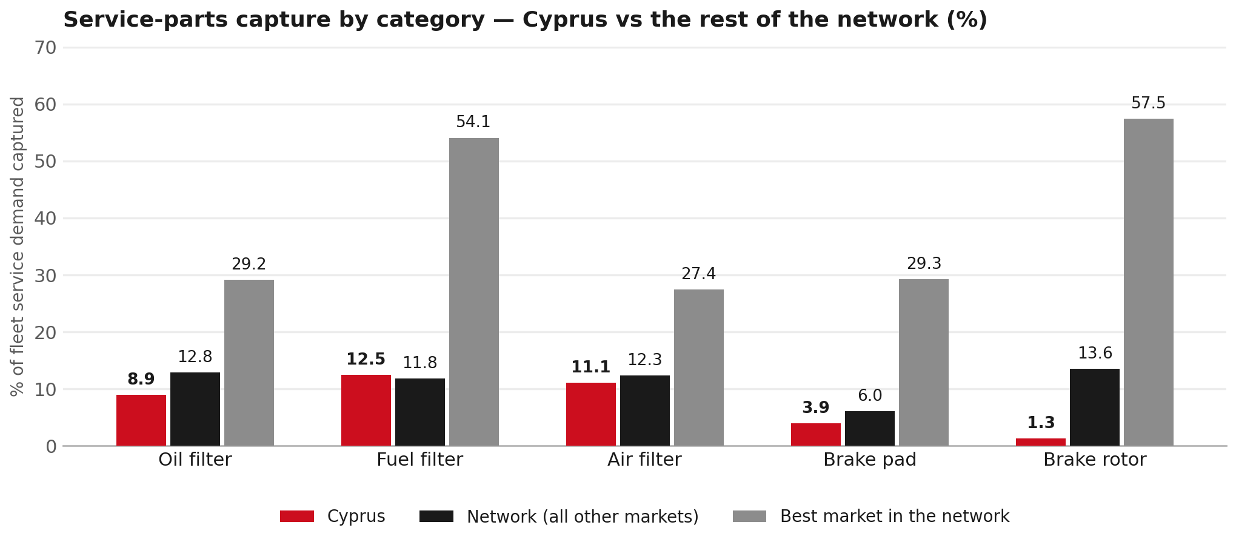
SERVICE-PARTS COVERAGE
Service-parts coverage: brake rotor is the clear gap
TAKEAWAYS
— Brake rotor 1.3% against 13.6% for the rest of the network.
— Oil filter 8.9% against 12.8% for the rest of the network.
— Every market here is measured on the same fleet-and-interval model, so the comparison is like-for-like even where the underlying interval assumption is debatable.
— Worth agreeing which category we tackle first, and what the joint action is.
10

Slide 11
IDS 2026 — DEALER STANDARD
IDS 2026: Cyprus averages 75.0%, above the 74.8% network benchmark
Dealer | Total % | Global rank
A. Loutsios And Sons Ltd | 75.0% | #340
Cyprus country average | 75.0% | —
Network average (all IDS 2026) | 74.8% | —
A. Loutsios And Sons Ltd | 75.0% | #340
— 1 dealers assessed across Premises, Organisation, Service, Parts and Vehicle Sales.
— The country average sits 0.2 points above the network.
— The spread is the point: 0 points between the strongest and weakest dealer.
— Dealer-by-dealer detail and individual feedback are available as a separate pack — worth agreeing which dealers to visit, and when.
11

Slide 12
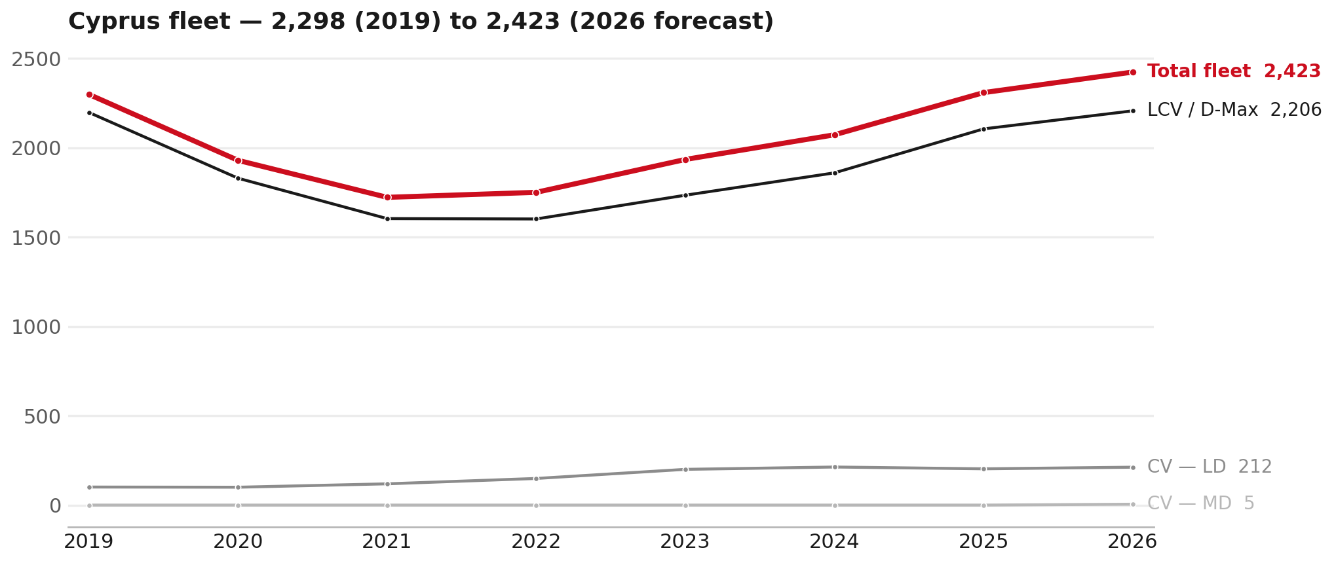
FLEET & FY2027 TARGET
The fleet is expected to grow in 2026
WHAT THIS MEANS FOR FY2027
— Parc 2,308 in 2025 and 2,423 in the 2026 working year-end estimate — +5.0%.
— The chart shows 2019–2026 only. The 2026 point is a working year-end estimate.
— The FY2027 Sales-to-Dealer target applies this fleet movement, a 5% price adjustment and 1.8% additional growth.
— The target reflects the working fleet outlook without extending the chart beyond 2026.
12

Slide 13
FLEET & FY2027 TARGET
How the FY2027 target is built
Sales-to-Dealer amount bridge
Step | Amount
FY2026 Sales-to-Dealer (working estimate) | EUR 618,085
After fleet movement (+5.0%) | EUR 648,882
After price adjustment (+5%) | EUR 681,326
FY2027 target after additional growth (+1.8%) | EUR 693,590
— The FY2027 target is +12.2% versus the FY2026 Sales-to-Dealer base.
— The FY2026 base is imputed from ISZE billing divided by 0.65 because no usable Sales-to-Dealer KPI was available.
13

Slide 14
FY2027 TARGET
What the FY2027 target reflects
1
Your fleet
2
The price move
— The working fleet movement used in the target is +5.0%.
— ISZE is applying a 5% price adjustment for FY2027, consistent with every ISZE market this year.
— It is built into the per-vehicle rate above, not added separately on top.
What it means for your target
 | Value
FY2027 Sales-to-Dealer target | EUR 693,590
vs FY2026 Sales-to-Dealer (EUR 618,085) | +12.2%
— As in previous cycles we would expect an incentive to sit alongside this adjustment — that approval is still pending on our side. We will confirm as soon as we have it.
14

Slide 15
SPA
SPA
1
CYPRUS proposal
2
ISZE review
3
Counter-proposal
4
Final approval
— Loutsios & Sons submits a proposed parts list.
— ISZE reviews the proposal against network data and fit.
— ISZE returns a counter-proposal where needed.
— Signed off by ISZE management.
Purpose: higher turnover for both sides.
15

Slide 16
R&M
R&M — let's align on the market
M
Market
S
Servicing & R&M
— How is the market moving for you right now?
— How much of your volume is fleet business rather than retail?
— Where do you see the biggest hurdles this year?
— Where are your real strengths in this segment?
— Do you offer an R&M or service-plan product today?
— What share of the parc do you retain for servicing after year three?
— Does R&M business come bundled with fleet tenders — roughly what share?
— What would it take to bring more out-of-network servicing back?
16

Slide 17
ASK
Part-level Sales-to-Dealer Data
1
The starting point
2
Sharper insight
3
Shared benefit
— We have no Sales-to-Dealer figures from you for FY2026. The ask is monthly Sales-to-Dealer, at part-number level.
— Part-by-part visibility separates a stock movement from a lost job — and tells us where the volume actually went.
— Better availability on your fast movers, a sharper target for us, and a factual basis for the SPA — same data, both sides gain.
Requested from 01/01/2025, part number level, monthly.
17

Slide 18
SUMMARY
Next steps
— Confirm FY2027 Sales-to-Dealer target: EUR 693,590 (+12.2% vs FY2026 Sales-to-Dealer).
— Confirm the incentive alongside the price adjustment once approved on our side.
— Body parts and Brake parts: agree which category we tackle first, and what the joint action is.
— Agree part-level Sales-to-Dealer data sharing, effective 01/01/2025.
— SPA: CYPRUS proposal, ISZE review and counter-proposal cycle to follow.
— IDS 2026: agree dealer visit dates, starting with the lower-scoring dealers.
18

Slide 19
Moving the World – for You

