Slide 1

ISZE · DENMARK · DENMARK
Denmark Sales Review
& FY2027 Target
Isuzu Danmark · July 2026

Slide 2
DENMARK MEETING
Agenda
— Parts Performance — category movers
— Parts Performance — Brake parts
— Parts Performance — Electrical sensors
— Parts Performance — where volume grew
— New Business — validation queue
— Sales-to-Dealer Outlook
— GPS Capture
— Service-Parts Coverage
— IDS 2026 — Dealer Standard
— Fleet & FY2027 Target
— SPA — status
— R&M — market discussion
— Data request: part-level Sales-to-Dealer
— Next steps
2

Slide 3
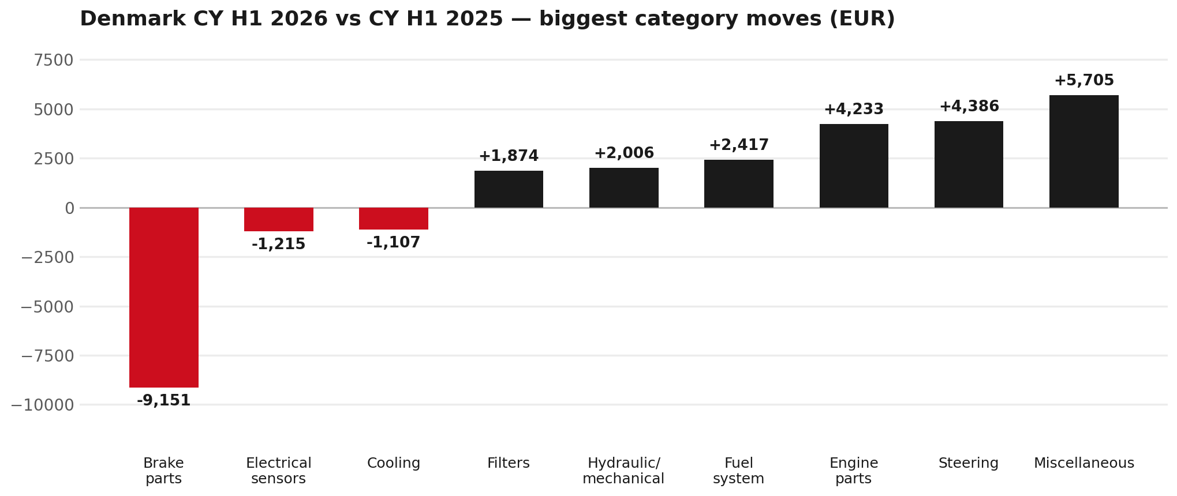
PARTS PERFORMANCE
Parts Performance — CY H1 2026 vs CY H1 2025
TAKEAWAYS
— Parts billing EUR 94K against EUR 69K a year earlier — +37.2%.
— Biggest declines: Brake parts EUR -9K; Electrical sensors EUR -1K.
— Growing: Miscellaneous +191%, Steering +3455%, Engine parts +2232%.
— CY H1 2026 against CY H1 2025 (calendar Jan–Jun, Q1+Q2) — like-for-like half-year cut.
3

Slide 4
PARTS PERFORMANCE — BRAKE PARTS
Brake parts — CY H1 2026 vs CY H1 2025
— EUR 14,818 (CY H1 2025) to EUR 5,667 (CY H1 2026), down EUR 9,151 (-62%).
— 8983767550 (ROTOR; DISC BRK,FRT): EUR 6,625 to EUR 1,583, 62 fewer pieces.
— 8975546610 (PAD KIT; CALIPER,DISC BRK,FRT): EUR 4,268 to EUR 834, 41 fewer pieces.
— 8983767530 (ROTOR; DISC BRK,FRT): EUR 1,076 to EUR 0, 12 fewer pieces.
— The value-tier range moved the same way, not the other way: BVP billing went from EUR 13,529 to EUR 13,173 across the window. So this does not read as a switch from genuine to value tier.
Questions for us to work through together
— Is pad and rotor pricing competitive against what the dealers can buy locally?
— Is any of this stock timing on your side rather than end demand?
— Are dealers still quoting these part numbers, or have they dropped off the workshop menu?
4

Slide 5
PARTS PERFORMANCE — ELECTRICAL SENSORS
Electrical sensors — CY H1 2026 vs CY H1 2025
— EUR 8,307 (CY H1 2025) to EUR 7,091 (CY H1 2026), down EUR 1,215 (-15%).
— 8983712150 (SENSOR; SPD,RR WHEEL): EUR 782 to EUR 196, 3 fewer pieces.
Questions for us to work through together
— Is this pricing against what the dealers can buy locally?
— Is any of this stock timing on your side rather than end demand?
— What would make the biggest difference to keep this business with us?
5

Slide 6
PARTS PERFORMANCE — GROWTH
Where volume grew — CY H1 2026 vs CY H1 2025
Part | Description | CY H1 2025 | CY H1 2026
8983980531 | CAMERA; REAR | EUR 190 | EUR 1,521
8972746690 | TANK ASM; DEF | EUR 1,298 | EUR 2,600
8983282070 | ELEMENT; OIL FILTER | EUR 846 | EUR 1,918
8983320160 | VALVE; EGR | EUR 527 | EUR 1,508
8982330922 | LAMP ASM; RR COMB | EUR 565 | EUR 1,200
8978279610 | PAD KIT; DISC BRK,W/O SHIM & CLIP | EUR 1,042 | EUR 1,649
— Miscellaneous +191%, Steering +3455%, Engine parts +2232% — where the volume went.
— Several of these are the kind of item that also moves on a campaign or claim. Denmark warranty parts ran to EUR 9K across CY2025, so we would not read this list as purely commercial growth without checking it against claims together.
— Worth agreeing which of these are repeatable and which were one-off.
6

Slide 7
PARTS PERFORMANCE
New Business — validation queue (CY H1 2026)
Part | Description | Current sales | Review
TRANSPORT | Transporting Cost | EUR 10,254 | Validate
7551846320 | TRANSFER ASM | EUR 2,333 | Validate
7552348290 | STEERING UNIT | EUR 2,123 | Validate
8983320621 | PUMP ASM; FUEL,SUPPLY | EUR 2,053 | Validate
8982599691 | TURBOCHARGER ASM | EUR 2,005 | Validate
8981901180 | DRIVE ASM; FINAL,RR | EUR 1,546 | Validate
— These lines had no prior-period sales, so they are kept out of the incremental-growth table.
— A first sale can be a new model, a supersession, timing, or a warranty campaign. It is not treated as a commercial win until that cause is confirmed.
7

Slide 8
SALES-TO-DEALER
Sales-to-Dealer outlook — FY2027
— FY2026 Sales-to-Dealer is EUR 572,864 (reported KPI).
— The working fleet movement into FY2027 is +1.8%.
— Applying fleet movement, the 5% price adjustment and 1.8% additional growth gives a FY2027 Sales-to-Dealer target of EUR 623,128.
— The discussion is held in Sales-to-Dealer amounts; ISZE billing remains an internal reconciliation measure.
8

Slide 9
GPS
GPS Capture: 71.0%
— GPS measures your actual parts purchases against the full potential of your fleet.
— Denmark today: 71.0% (FY2026 purchases against the CY2025 fleet potential).
— Fleet potential: EUR 213K on 851 vehicles.
— Real, sustained headroom above 71.0% — the service-parts and SPA discussion are both direct levers on it.
9

Slide 10
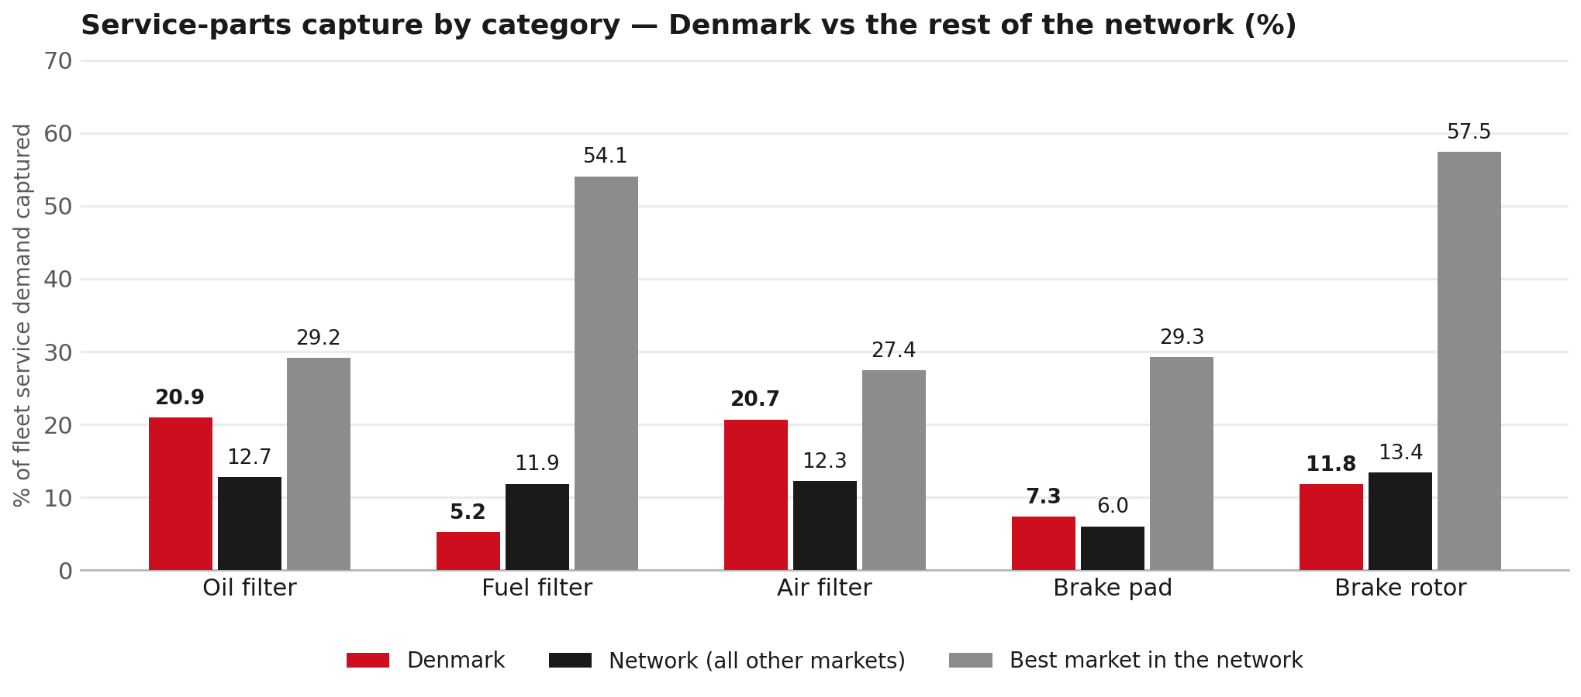
SERVICE-PARTS COVERAGE
Service-parts coverage: fuel filter is the clear gap
TAKEAWAYS
— Fuel filter 5.2% against 11.9% for the rest of the network.
— Brake rotor 11.8% against 13.4% for the rest of the network.
— Every market here is measured on the same fleet-and-interval model, so the comparison is like-for-like even where the underlying interval assumption is debatable.
— Worth agreeing which category we tackle first, and what the joint action is.
10

Slide 11
IDS 2026 — DEALER STANDARD
IDS 2026: Denmark averages 75.7%, above the 74.8% network benchmark
Dealer | Total % | Global rank
Anders Hansen Automobiler | 97.5% | #11
Fyns-Bilsalg A/S | 86.1% | #164
Thybo Biler | 85.7% | #172
Denmark country average | 75.7% | —
Network average (all IDS 2026) | 74.8% | —
Pedersen Og Nielsen Aabenraa | 74.6% | #348
Varebil-Leasing Kolding | 66.4% | #430
Kjerulff A/S | 0.0% | #490
— 20 dealers assessed across Premises, Organisation, Service, Parts and Vehicle Sales.
— The country average sits 0.9 points above the network.
— The spread is the point: 98 points between the strongest and weakest dealer.
— Dealer-by-dealer detail and individual feedback are available as a separate pack — worth agreeing which dealers to visit, and when.
11

Slide 12
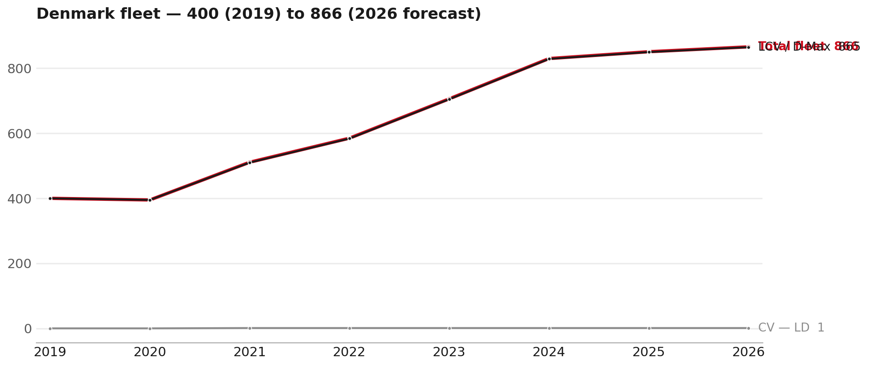
FLEET & FY2027 TARGET
The fleet is expected to grow in 2026
WHAT THIS MEANS FOR FY2027
— Parc 851 in 2025 and 866 in the 2026 working year-end estimate — +1.8%.
— The chart shows 2019–2026 only. The 2026 point is a working year-end estimate.
— The FY2027 Sales-to-Dealer target applies this fleet movement, a 5% price adjustment and 1.8% additional growth.
— The target reflects the working fleet outlook without extending the chart beyond 2026.
12

Slide 13
FLEET & FY2027 TARGET
How the FY2027 target is built
Sales-to-Dealer amount bridge
Step | Amount
FY2026 Sales-to-Dealer (reported KPI) | EUR 572,864
After fleet movement (+1.8%) | EUR 582,961
After price adjustment (+5%) | EUR 612,110
FY2027 target after additional growth (+1.8%) | EUR 623,128
— The FY2027 target is +8.8% versus the FY2026 Sales-to-Dealer base.
— The FY2026 base is the reported Sales-to-Dealer KPI.
13

Slide 14
FY2027 TARGET
What the FY2027 target reflects
1
Your fleet
2
The price move
— The working fleet movement used in the target is +1.8%.
— ISZE is applying a 5% price adjustment for FY2027, consistent with every ISZE market this year.
— It is built into the per-vehicle rate above, not added separately on top.
What it means for your target
 | Value
FY2027 Sales-to-Dealer target | EUR 623,128
vs FY2026 Sales-to-Dealer (EUR 572,864) | +8.8%
— As in previous cycles we would expect an incentive to sit alongside this adjustment — that approval is still pending on our side. We will confirm as soon as we have it.
14

Slide 15
SPA
SPA
1
DENMARK proposal
2
ISZE review
3
Counter-proposal
4
Final approval
— Isuzu Danmark submits a proposed parts list.
— ISZE reviews the proposal against network data and fit.
— ISZE returns a counter-proposal where needed.
— Signed off by ISZE management.
Purpose: higher turnover for both sides.
15

Slide 16
R&M
R&M — let's align on the market
M
Market
S
Servicing & R&M
— How is the market moving for you right now?
— How much of your volume is fleet business rather than retail?
— Where do you see the biggest hurdles this year?
— Where are your real strengths in this segment?
— Do you offer an R&M or service-plan product today?
— What share of the parc do you retain for servicing after year three?
— Does R&M business come bundled with fleet tenders — roughly what share?
— What would it take to bring more out-of-network servicing back?
16

Slide 17
ASK
Part-level Sales-to-Dealer Data
1
Already halfway there
2
Sharper insight
3
Shared benefit
— You already report Sales-to-Dealer monthly. The ask is the same data at part-number level.
— Part-by-part visibility separates a stock movement from a lost job — and tells us where the volume actually went.
— Better availability on your fast movers, a sharper target for us, and a factual basis for the SPA — same data, both sides gain.
Requested from 01/01/2025, part number level, monthly.
17

Slide 18
SUMMARY
Next steps
— Confirm FY2027 Sales-to-Dealer target: EUR 623,128 (+8.8% vs FY2026 Sales-to-Dealer).
— Confirm the incentive alongside the price adjustment once approved on our side.
— Brake parts and Electrical sensors: agree which category we tackle first, and what the joint action is.
— Agree part-level Sales-to-Dealer data sharing, effective 01/01/2025.
— SPA: DENMARK proposal, ISZE review and counter-proposal cycle to follow.
— IDS 2026: agree dealer visit dates, starting with the lower-scoring dealers.
18

Slide 19
Moving the World – for You

