Slide 1

ISZE · HUNGARY · HUNGARY
Hungary Sales Review
& FY2027 Target
AutoWallis Distribution · August 2026

Slide 2
HUNGARY MEETING
Agenda
— Parts Performance — category movers
— Parts Performance — Brake parts
— Parts Performance — Injectors
— Parts Performance — Turbo
— Parts Performance — where volume grew
— New Business — validation queue
— Sales-to-Dealer Outlook
— GPS Capture
— Service-Parts Coverage
— IDS 2026 — Dealer Standard
— Fleet & FY2027 Target
— SPA — status
— R&M — market discussion
— Data request: part-level Sales-to-Dealer
— Next steps
2

Slide 3
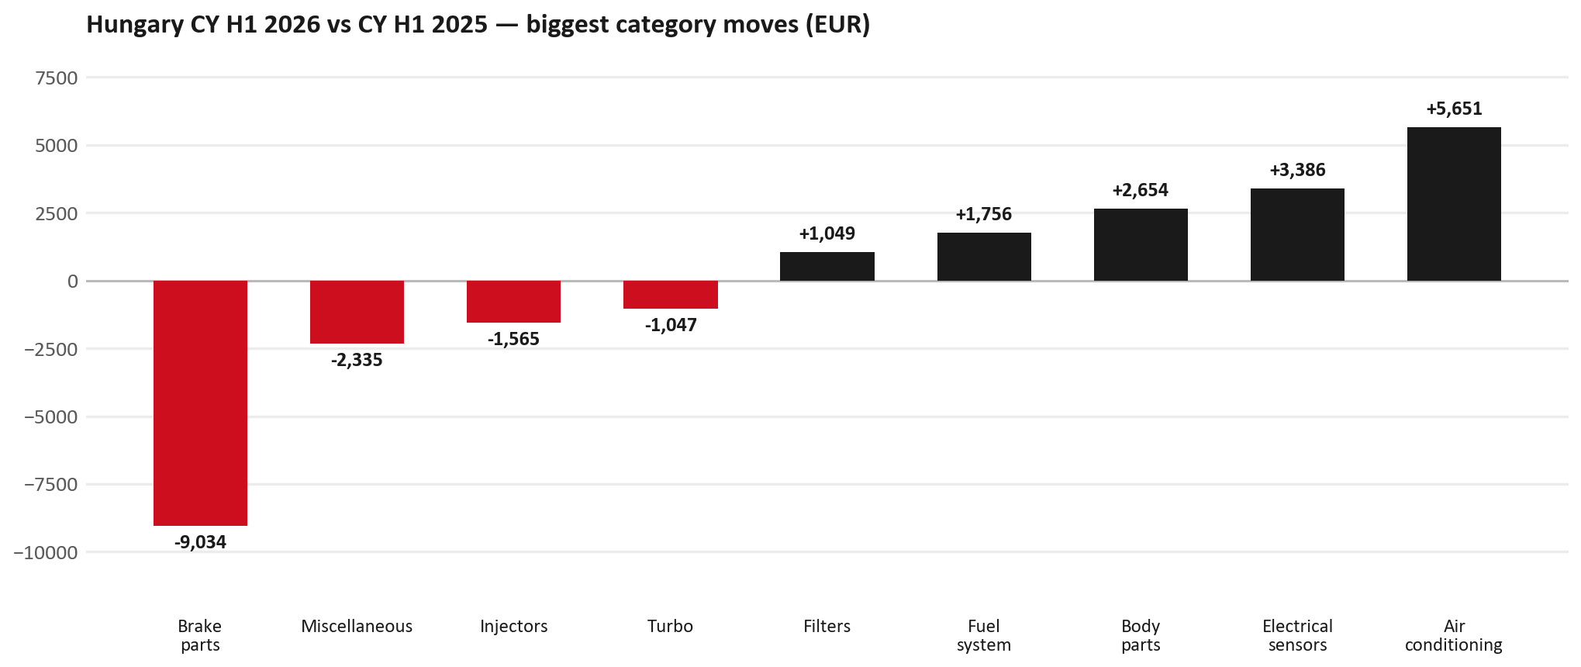
PARTS PERFORMANCE
Parts Performance — CY H1 2026 vs CY H1 2025
TAKEAWAYS
— Parts billing EUR 171K against EUR 169K a year earlier — +0.9%. After EUR 1K of credit notes the net figure is EUR 170K.
— Biggest declines: Brake parts EUR -9K; Injectors EUR -2K; Turbo EUR -1K.
— Growing: Air conditioning +39%, Electrical sensors +20%, Body parts +9%.
— CY H1 2026 against CY H1 2025 (calendar Jan–Jun, Q1+Q2) — like-for-like half-year cut.
3

Slide 4
PARTS PERFORMANCE — BRAKE PARTS
Brake parts — CY H1 2026 vs CY H1 2025
— EUR 22,944 (CY H1 2025) to EUR 13,910 (CY H1 2026), down EUR 9,034 (-39%).
— 8983767550 (ROTOR; DISC BRK,FRT): EUR 11,764 to EUR 5,544, 79 fewer pieces.
— 8975056801 (PAD KIT; CALIPER,DISC BRK,FRT): EUR 4,501 to EUR 2,561, 23 fewer pieces.
— 8975546610 (PAD KIT; CALIPER,DISC BRK,FRT): EUR 2,500 to EUR 742, 21 fewer pieces.
Questions for us to work through together
— Is pad and rotor pricing competitive against what the dealers can buy locally?
— Is any of this stock timing on your side rather than end demand?
— Are dealers still quoting these part numbers, or have they dropped off the workshop menu?
4

Slide 5
PARTS PERFORMANCE — INJECTORS
Injectors — CY H1 2026 vs CY H1 2025
— EUR 3,090 (CY H1 2025) to EUR 1,525 (CY H1 2026), down EUR 1,565 (-51%).
— 8983842670 (INJECTOR ASM; DEF DCM): EUR 2,051 to EUR 632, 9 fewer pieces.
Questions for us to work through together
— Is this fewer failures, or repairs moving out of the network?
— Is the exchange/reman route competing with new parts here?
— Are dealers still quoting these part numbers, or have they dropped off the workshop menu?
5

Slide 6
PARTS PERFORMANCE — TURBO
Turbo — CY H1 2026 vs CY H1 2025
— EUR 1,059 (CY H1 2025) to EUR 12 (CY H1 2026), down EUR 1,047 (-99%).
Questions for us to work through together
— Is this fewer turbo failures, or jobs moving to independents?
— Is reman / exchange competing with new units on price or lead time?
— Any availability problems on the fast-moving turbo lines?
6

Slide 7
PARTS PERFORMANCE — GROWTH
Where volume grew — CY H1 2026 vs CY H1 2025
Part | Description | CY H1 2025 | CY H1 2026
8974995480 | FILTER; ACL | EUR 5,153 | EUR 8,390
1884057520 | T AXLE OIL 20L | EUR 1,703 | EUR 3,801
7552348290 | STEERING UNIT | EUR 19,839 | EUR 21,823
8975595830 | PANEL; SIDE GATE | EUR 430 | EUR 2,130
8983320160 | VALVE; EGR | EUR 220 | EUR 1,397
8978249035 | LAMP ASM; HEAD | EUR 338 | EUR 1,313
— Air conditioning +39%, Electrical sensors +20%, Body parts +9% — where the volume went.
— Several of these are the kind of item that also moves on a campaign or claim. Hungary CY2025 warranty parts (claim-price basis) were EUR 77K — separate from fiscal GPS warranty expense. Do not read this growth list as purely commercial without checking claims together.
— Worth agreeing which of these are repeatable and which were one-off.
7

Slide 8
PARTS PERFORMANCE
New Business — validation queue (CY H1 2026)
Part | Description | Current sales | Review
8984890171 | PUMP ASM; FUEL,SUPPLY | EUR 1,955 | Validate
7552689700 | PUMP; WATER | EUR 1,751 | Validate
8978725102 | PANEL; SIDE OUTER | EUR 1,422 | Validate
8983842610 | COMPRESSOR ASM; A/C | EUR 1,195 | Validate
8980803191 | GUARD ASM; RR | EUR 1,185 | Validate
5876150610 | PAD KIT; CALIPER,DISC BRK,FRT | EUR 1,152 | Validate
— These lines had no prior-period sales, so they are kept out of the incremental-growth table.
— A first sale can be a new model, a supersession, timing, or a warranty campaign. It is not treated as a commercial win until that cause is confirmed.
8

Slide 9
SALES-TO-DEALER
Sales-to-Dealer outlook — FY2027
— FY2026 Sales-to-Dealer is EUR 532,687 (working estimate).
— The working fleet movement into FY2027 is -2.4%.
— Applying fleet movement, the 5% price adjustment and 1.8% additional growth gives a FY2027 Sales-to-Dealer target of EUR 555,817.
— The discussion is held in Sales-to-Dealer amounts; ISZE billing remains an internal reconciliation measure.
9

Slide 10
GPS
GPS Capture: 37.1%
— GPS measures your actual parts purchases against the full potential of your fleet.
— Hungary today: 37.1% (FY2026 purchases against the CY2025 fleet potential).
— Fleet potential: EUR 934K on 3,734 vehicles.
— Real, sustained headroom above 37.1% — the service-parts and SPA discussion are both direct levers on it.
10

Slide 11
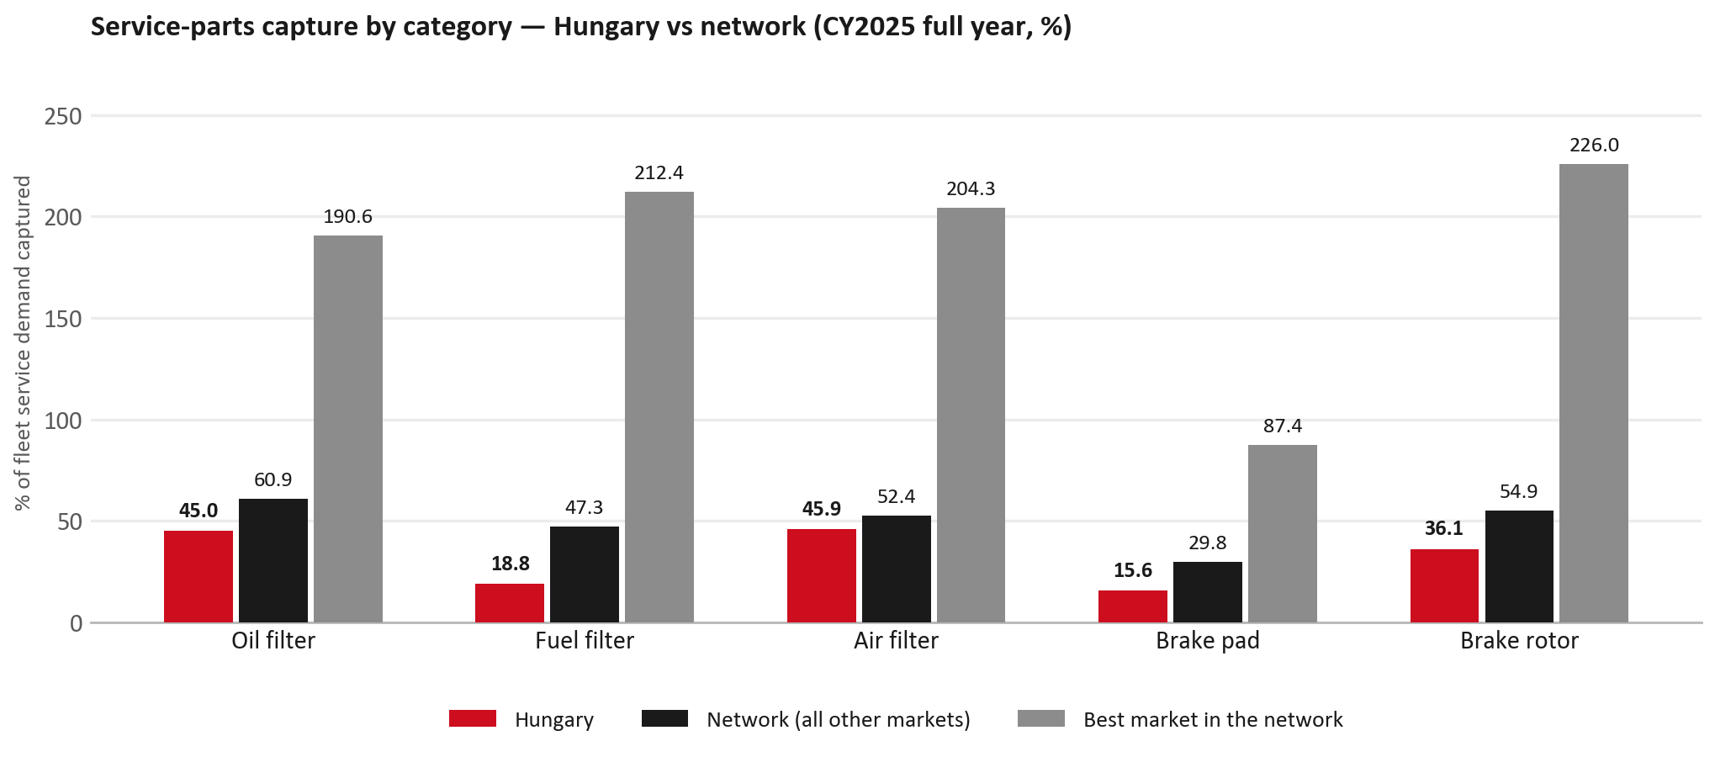
SERVICE-PARTS COVERAGE
Service-parts coverage sits below the network on every routine category
TAKEAWAYS
— Fuel filter 18.8% against 47.3% for the rest of the network.
— Brake rotor 36.1% against 54.9% for the rest of the network.
— Every market here is measured on the same fleet-and-interval model, so the comparison is like-for-like even where the underlying interval assumption is debatable.
— Worth agreeing which category we tackle first, and what the joint action is.
11

Slide 12
IDS 2026 — DEALER STANDARD
IDS 2026: Hungary averages 86.2%, above the 74.8% network benchmark
Dealer | Total % | Global rank
Zakar | 99.3% | #3
Csősz | 96.4% | #18
Tipp-Autó | 95.0% | #27
Hungary country average | 86.2% | —
Network average (all IDS 2026) | 74.8% | —
Autó Caro | 74.3% | #358
Marsal | 69.3% | #409
Bonus Kft. | 66.8% | #425
— 19 dealers assessed across Premises, Organisation, Service, Parts and Vehicle Sales.
— The country average sits 11.4 points above the network.
— The spread is the point: 32 points between the strongest and weakest dealer.
— Dealer-by-dealer detail and individual feedback are available as a separate pack — worth agreeing which dealers to visit, and when.
12

Slide 13
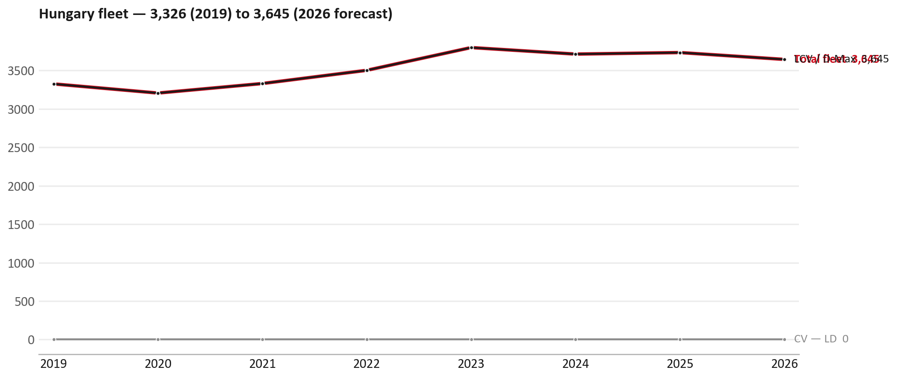
FLEET & FY2027 TARGET
The fleet is expected to decline in 2026
WHAT THIS MEANS FOR FY2027
— Fleet size (calendar year): 3,734 vehicles in 2025 → 3,645 working estimate for end-2026 (-2.4%).
— The chart is calendar years 2019–2026 only. 2026 is a working year-end estimate, not a fiscal-year figure.
— The FY2027 Sales-to-Dealer target starts from that fleet change, then applies a 5% price adjustment and 1.8% additional growth.
— So the target is built from a slightly smaller fleet — not from an assumed growth story.
13

Slide 14
FLEET & FY2027 TARGET
How the FY2027 target is built
Sales-to-Dealer amount bridge
Step | Amount
FY2026 Sales-to-Dealer (working estimate) | EUR 532,687
After fleet movement (-2.4%) | EUR 519,990
After price adjustment (+5%) | EUR 545,989
FY2027 target after additional growth (+1.8%) | EUR 555,817
— The FY2027 target is +4.3% versus the FY2026 Sales-to-Dealer base.
— The FY2026 base is a working estimate (ISZE billing ÷ 0.65): the KPI Dashboard has no usable Sales-to-Dealer row for this market.
14

Slide 15
FY2027 TARGET
What the FY2027 target reflects
1
Your fleet
2
The price move
— The working fleet movement used in the target is -2.4%.
— ISZE is applying a 5% price adjustment for FY2027, consistent with every ISZE market this year.
— It is built into the per-vehicle rate above, not added separately on top.
What it means for your target
 | Value
FY2027 Sales-to-Dealer target | EUR 555,817
vs FY2026 Sales-to-Dealer (EUR 532,687) | +4.3%
— As in previous cycles we would expect an incentive to sit alongside this adjustment — that approval is still pending on our side.
— Until the incentive is confirmed, treat the FY2027 target as the working bridge (fleet × price × additional growth), not a locked commercial commitment.
15

Slide 16
SPA
SPA
1
HUNGARY proposal
2
ISZE review
3
Counter-proposal
4
Final approval
— AutoWallis Distribution submits a proposed parts list.
— ISZE reviews the proposal against network data and fit.
— ISZE returns a counter-proposal where needed.
— Signed off by ISZE management.
Purpose: higher turnover for both sides.
16

Slide 17
R&M
R&M — let's align on the market
M
Market
S
Servicing & R&M
— How is the market moving for you right now?
— How much of your volume is fleet business rather than retail?
— Where do you see the biggest hurdles this year?
— Where are your real strengths in this segment?
— Do you offer an R&M or service-plan product today?
— What share of the parc do you retain for servicing after year three?
— Does R&M business come bundled with fleet tenders — roughly what share?
— What would it take to bring more out-of-network servicing back?
17

Slide 18
ASK
Part-level Sales-to-Dealer Data
1
The starting point
2
Sharper insight
3
Shared benefit
— We have no Sales-to-Dealer figures from you for FY2026. The ask is monthly Sales-to-Dealer, at part-number level.
— Part-by-part visibility separates a stock movement from a lost job — and tells us where the volume actually went.
— Better availability on your fast movers, a sharper target for us, and a factual basis for the SPA — same data, both sides gain.
Requested from 01/01/2025, part number level, monthly.
18

Slide 19
SUMMARY
Next steps
— Align on the FY2027 Sales-to-Dealer bridge (fleet, price, additional growth) — working figure EUR 555,817 (+4.3% vs FY2026 base).
— Confirm the incentive alongside the price adjustment; lock the target once that approval is through.
— Brake parts / Injectors / Turbo: agree which category we tackle first, and what the joint action is.
— Agree part-level Sales-to-Dealer data sharing, effective 01/01/2025.
— SPA: HUNGARY proposal, ISZE review and counter-proposal cycle to follow.
— IDS 2026: agree dealer visit dates, starting with the lower-scoring dealers.
19

Slide 20
Moving the World – for You

Slide 21
HUNGARY · AUTOWALLIS
Deep dive — detail behind the Mode A story
— Extra detail for the meeting prep — pick which slides to share with AutoWallis.
— Mode A ends on the previous closing slide.
— Label in all charts: “Genuine with BVP alternative” (not “genuine contested”).
21

Slide 22
AGENDA
Deep-dive agenda
— GPS & fleet — calendar year and fiscal year on one chart (incl. warranty)
— FY2025 → FY2026 wallet mix (Genuine / Genuine with BVP alternative / BVP)
— Where the money went — outside the service-parts basket
— Service parts: calendar-year capture vs network + our fiscal-year billing
— Brake pads — local BVP substitution (BVP share of pad sales)
— AIM is not the open
— Warranty — two lenses
— How to use this in the meeting
22

Slide 23
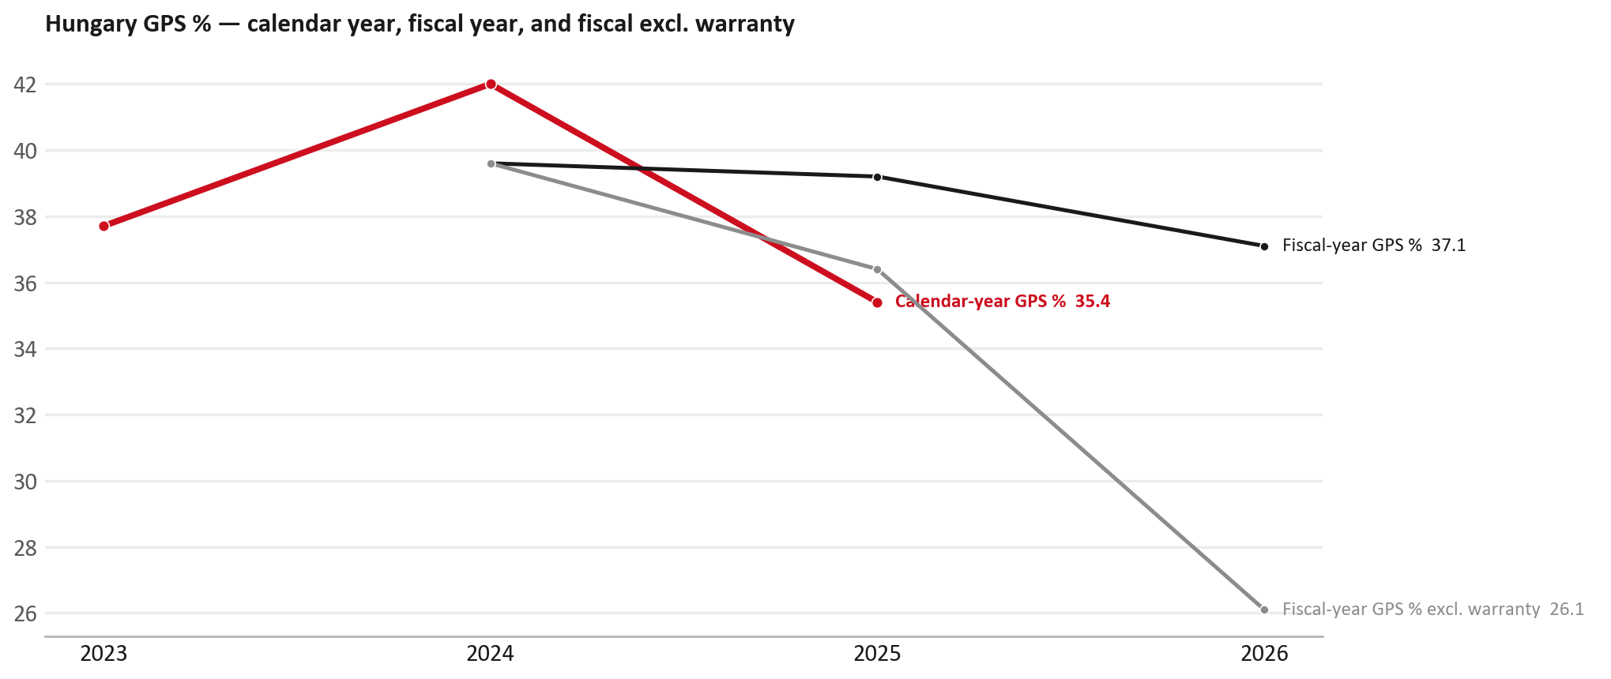
GPS
GPS: calendar year, fiscal year, and after warranty
TAKEAWAYS
— Red line = calendar-year GPS (wallet). Peaked at 42.0% in 2024, then 35.4% in 2025.
— Black line = fiscal-year GPS (same frozen CY2025 wallet). FY26 headline is 37.1%.
— Grey line = fiscal GPS after removing warranty parts (€). FY26 falls to ≈26% — that is the commercial capture behind the 37% headline.
— Fleet stayed ~3.7k vehicles — we sold less into the same park, not a bigger park.
23

Slide 24
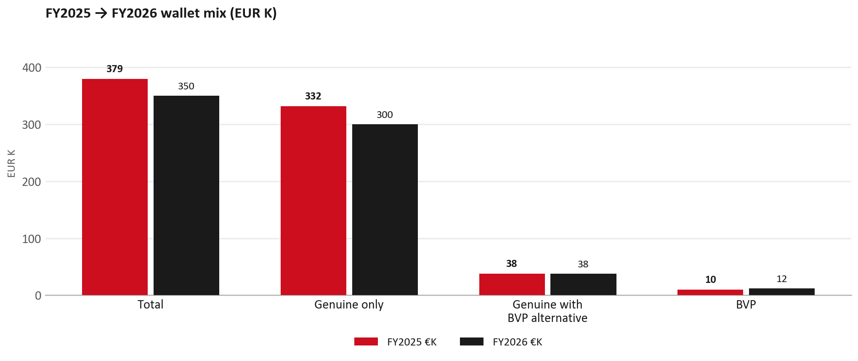
WALLET MIX
FY2025 → FY2026: drop is Genuine only
— Total EUR 379,407 → EUR 349,882 (-7.8%).
— Genuine only EUR -31,719 — essentially the whole drop.
— Genuine with BVP alternative flat; BVP +€2K (3.5% of wallet).
— Not a wallet-wide trade-down into BVP.
24

Slide 25
WALLET MIX
FY wallet mix — detail
 | FY2025 | FY2026 | Δ
Total | EUR 379,407 | EUR 349,882 | EUR -29,525
Genuine only | EUR 331,753 | EUR 300,034 | EUR -31,719
Genuine with BVP alternative | EUR 37,959 | EUR 37,733 | EUR -226
BVP | EUR 9,694 | EUR 12,115 | EUR 2,420
BVP % of wallet | 2.6% | 3.5% | +0.9 pp
— Display label locked: Genuine with BVP alternative (catalogue pair exists) — never “genuine contested” in slides.
— FY totals are sales_fact all-parts (slightly above GPS-filtered net).
25

Slide 26
DRIVERS
Almost all of the genuine drop sits outside routine service parts
— In calendar 2025 we lost about €64K of genuine-only sales vs the year before. Only ~€1.7K of that sat in the routine service basket (filters, pads, rotors).
— Inside that service basket, Best Value Parts (BVP) actually grew (+€5.8K) and the basket as a whole was up — filters and brakes are not the hole.
— The big losses were elsewhere: soot / PM sensors (−€19K), engine assemblies (−€21K), and steering / transmission / DPD (−€13K).
— Meanwhile brakes were up +31% in fiscal year, filters +6%, body +3%, AC +16%.
— Meeting line: the money left on sensors and big assemblies — not on the oil-filter / pad menu.
26

Slide 27
DRIVERS
Largest part-number drops (FY24 → FY25) — not service filters
Part | Description | Δ EUR
8975293230 | ENGINE ASM | −14,759
8978808250 | SENSOR; PM | −9,624
8978808270 | SENSOR; PM | −9,356
8976671380 | ENGINE ASM; PARTIAL | −5,874
8977998750 | STEERING UNIT | −4,596
8983939000 | TRANSMISSION ASM; AUTO | −3,485
8975359391 / 8983320764 | DPD ASM | −4,372
— These are lumpy, high-value lines. Check warranty / campaign coding before calling them competitive leakage.
27

Slide 28
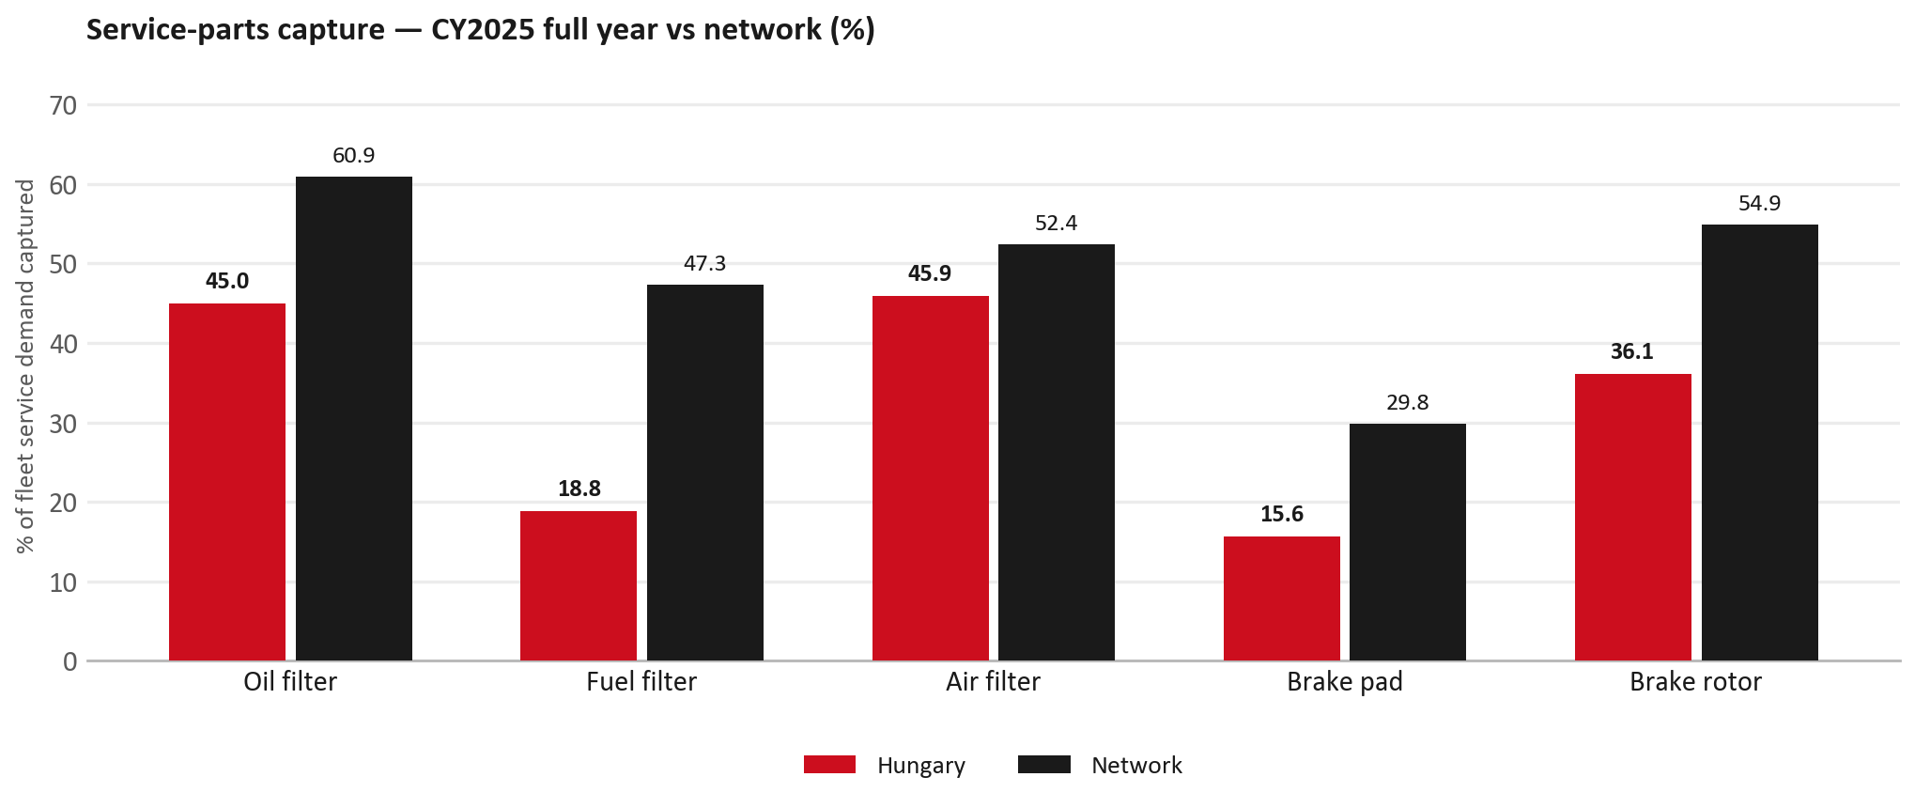
SERVICE PARTS
Service-parts capture still trails the network (calendar year)
TAKEAWAYS
— Capture % is a calendar-year measure (full CY2025). We do not have a matching fiscal-year capture % — fleet demand is modelled on calendar years.
— Fuel filter 18.8% vs network 47.3%; pad 15.6% vs 29.8%; rotor 36.1% vs 54.9%.
— Next slide: our fiscal-year € billing in the same five categories — so you still see FY25 vs FY26 for what we actually invoiced.
— Primary lens = total capture (everything sold in the basket), not genuine-only.
28

Slide 29
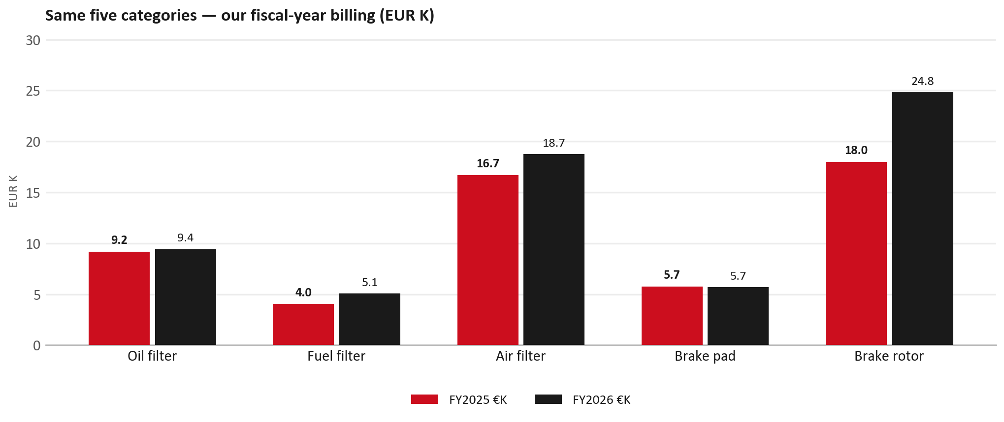
SERVICE PARTS · FY
Service-parts billing by fiscal year (same five lines)
TAKEAWAYS
— This is Sales-to-AutoWallis € in fiscal years — not capture % of fleet demand.
— Most of these lines held or grew in FY26 (rotors especially) even while calendar-year capture still sits below the network.
— So: short on share of jobs vs peers (previous slide); not a collapse of our filter/brake invoice book in FY.
— Use both lenses in the meeting — do not mix % capture with € billing.
29

Slide 30
BRAKES
Brake pads — local BVP substitution (exception)
 | 2024 | 2025
Genuine qty | 53 | 33
BVP qty | 7 | 70
BVP share of total brake pad sales (€) | 9% | 63%
— Total pad volume rose — demand did not disappear.
— Genuine traded into BVP inside our catalogue on pads.
— BVP share here = BVP € ÷ all brake-pad € we billed (genuine + BVP). Not a PMS capture %.
— Do not generalise to the whole wallet: BVP is still only ~3.5% of FY26.
— H1’26 genuine brake billing (−39%) is a separate, later cut — keep FY and H1 distinct.
30

Slide 31
AIM
AIM is not the open
Year | High-risk € | High-risk % | Quadrant
2023 | €12.8K | 3.7% | Priority target
2024 | €10.3K | 2.6% | Priority target
2025 | €7.0K | 2.1% | Priority target
— Priority target = low GPS × low PMS capture — every year.
— Eucon undercut exposure (~€86K) is catalogue risk, not observed walk-out.
— leakage_band ≈ €42K. No Hungary dealer-sellout AIM layer exists.
— Open on jobs not bought through AutoWallis — not a street IAM war.
31

Slide 32
WARRANTY
Warranty — two real lenses
1
CY2025 claim-price parts
2
Fiscal GPS expense
— €77,434 (Warranty_CY2025_by_DB).
— Used on Mode A growth caveat.
— Calendar-year claim price basis.
— FY24 €225 · FY25 €26K · FY26 €102K.
— ≈30% of FY26 billing.
— Ex-warranty GPS ≈ 26% on CY25 wallet.
— Both numbers are real — never mix them on one slide without labels.
— PM-sensor collapse (CY25) + warranty spike (FY26): ask claims/logging before asserting quality.
32

Slide 33
BRIDGE
How to use this in the meeting
If they say… | You know…
BVP is eating genuine | Wallet BVP ~3.5%. Drop is Genuine only. Pads = local exception (BVP share of pad sales).
IAM / AIM is killing us | High-risk €7K / 2.1%. Priority target = capture failure.
37% GPS looks OK | Ex-warranty ~26%. Warranty €102K = 30% of FY26 bill.
The fleet is growing | Working estimate 3,645 (−2.4%). Never the old 3,992 figure.
Service parts are fine | CY capture still short vs network; FY billing in filters/brakes held — 2025 wallet hole was sensors/assemblies.
33

Slide 34
Moving the World – for You

