Slide 1

ISZE · IRELAND · IRELAND
Ireland Sales Review
& FY2027 Target
Isuzu Ireland · July 2026

Slide 2
IRELAND MEETING
Agenda
— Parts Performance — category movers
— Parts Performance — Electrical sensors
— Parts Performance — Filters
— Parts Performance — where volume grew
— New Business — validation queue
— Sales-to-Dealer Outlook
— GPS Capture
— Service-Parts Coverage
— Fleet & FY2027 Target
— SPA — status
— R&M — market discussion
— Data request: part-level Sales-to-Dealer
— Next steps
2

Slide 3
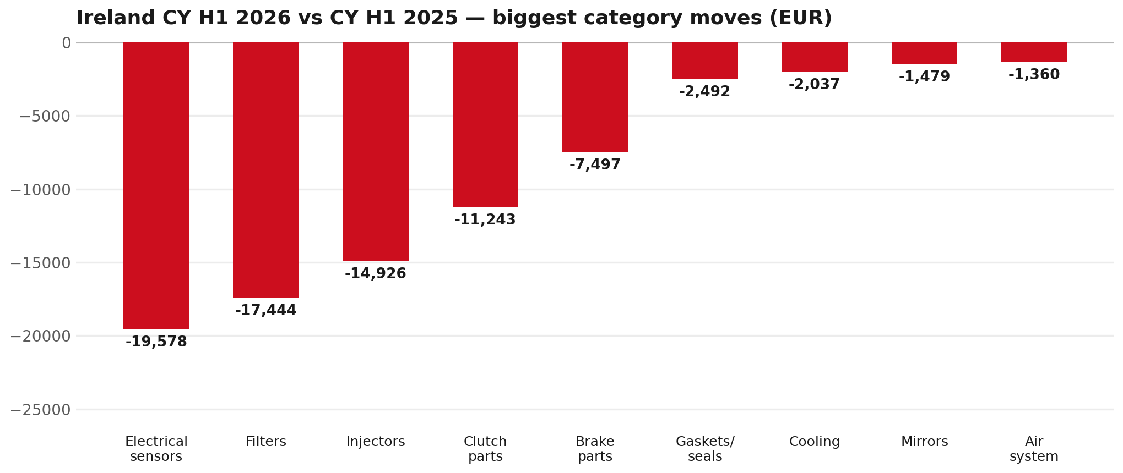
PARTS PERFORMANCE
Parts Performance — CY H1 2026 vs CY H1 2025
TAKEAWAYS
— Parts billing EUR 507K against EUR 620K a year earlier — -18.3%.
— Biggest declines: Electrical sensors EUR -20K; Filters EUR -17K.
— CY H1 2026 against CY H1 2025 (calendar Jan–Jun, Q1+Q2) — like-for-like half-year cut.
3

Slide 4
PARTS PERFORMANCE — ELECTRICAL SENSORS
Electrical sensors — CY H1 2026 vs CY H1 2025
— EUR 86,503 (CY H1 2025) to EUR 66,925 (CY H1 2026), down EUR 19,578 (-23%).
— 8983528481 (SENSOR; NOX): EUR 16,129 to EUR 10,240, 22 fewer pieces.
— 8976695331 (METER COMPL; CLUSTER): EUR 4,616 to EUR 318, 13 fewer pieces.
— 8978808270 (SENSOR; PM): EUR 9,428 to EUR 5,580, 15 fewer pieces.
— The value-tier range moved the same way, not the other way: BVP billing went from EUR 112,635 to EUR 77,972 across the window. So this does not read as a switch from genuine to value tier.
Questions for us to work through together
— Is this pricing against what the dealers can buy locally?
— Is any of this stock timing on your side rather than end demand?
— What would make the biggest difference to keep this business with us?
4

Slide 5
PARTS PERFORMANCE — FILTERS
Filters — CY H1 2026 vs CY H1 2025
— EUR 45,977 (CY H1 2025) to EUR 28,533 (CY H1 2026), down EUR 17,444 (-38%).
— 8980329082 (FILTER ASM): EUR 3,366 to EUR 0, 4 fewer pieces.
— 8983282070 (ELEMENT; OIL FILTER): EUR 4,666 to EUR 1,568, 212 fewer pieces.
— 8975425400 (ELEMENT; FUEL FILTER): EUR 3,649 to EUR 996, 209 fewer pieces.
Questions for us to work through together
— Are dealers stocking filters, or ordering line-by-line against each job?
— How much servicing do you estimate is happening outside the franchised network?
— Would a service-pack offer on oil and fuel filters be workable for your dealers?
5

Slide 6
PARTS PERFORMANCE — GROWTH
Where volume grew — CY H1 2026 vs CY H1 2025
Part | Description | CY H1 2025 | CY H1 2026
5874123812 | INTERFACE MX2-T | EUR 3,996 | EUR 11,408
8982688122 | PUMP ASM; DEF,DCM SPLY | EUR 4,329 | EUR 9,896
8982404570 | DRIVE ASM; FINAL,RR | EUR 1,289 | EUR 4,109
8974985741 | TURBOCHARGER ASM | EUR 891 | EUR 3,510
8980959830 | ELEMENT KIT; FUEL FILTER | EUR 4,480 | EUR 6,786
8983922341 | SPRING ASM; LEAF,RR | EUR 790 | EUR 2,319
— Several of these are the kind of item that also moves on a campaign or claim. Ireland warranty parts ran to EUR 35K across CY2025, so we would not read this list as purely commercial growth without checking it against claims together.
— Worth agreeing which of these are repeatable and which were one-off.
6

Slide 7
PARTS PERFORMANCE
New Business — validation queue (CY H1 2026)
Part | Description | Current sales | Review
TRANSPORT | Transporting Cost | EUR 10,737 | Validate
8981580081 | HYDRAULIC UNIT; ANTI LOCK BRK | EUR 6,005 | Validate
8971345174 | FLYWHEEL | EUR 4,473 | Validate
8976882230 | HYDRAULIC UNIT; ANTI LOCK BRK | EUR 3,995 | Validate
8974842450 | TRANSMISSION ASM; MANUAL | EUR 3,966 | Validate
8980830414 | TURBOCHARGER ASM | EUR 3,345 | Validate
— These lines had no prior-period sales, so they are kept out of the incremental-growth table.
— A first sale can be a new model, a supersession, timing, or a warranty campaign. It is not treated as a commercial win until that cause is confirmed.
7

Slide 8
SALES-TO-DEALER
Sales-to-Dealer outlook — FY2027
— FY2026 Sales-to-Dealer is EUR 2,833,637 (reported KPI).
— The working fleet movement into FY2027 is +18.4%.
— Applying fleet movement, the 5% price adjustment and 1.8% additional growth gives a FY2027 Sales-to-Dealer target of EUR 3,585,313.
— The discussion is held in Sales-to-Dealer amounts; ISZE billing remains an internal reconciliation measure.
8

Slide 9
GPS
GPS — amount view
— GPS compares actual parts purchases to the theoretical potential of the fleet.
— FY2026 purchases: EUR 1,103K.
— CY2025 fleet potential: EUR 956K (2,161 vehicles).
— Purchases sit above that theoretical potential — we discuss the amount and the per-vehicle rate, not a capture percentage.
9

Slide 10
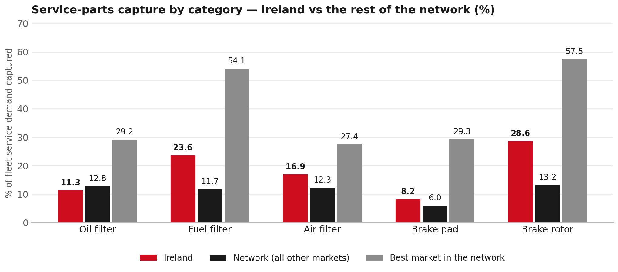
SERVICE-PARTS COVERAGE
Service-parts coverage: oil filter is the clear gap
TAKEAWAYS
— Oil filter 11.3% against 12.8% for the rest of the network.
— Brake pad 8.2% against 6.0% for the rest of the network.
— Every market here is measured on the same fleet-and-interval model, so the comparison is like-for-like even where the underlying interval assumption is debatable.
— Worth agreeing which category we tackle first, and what the joint action is.
10

Slide 11
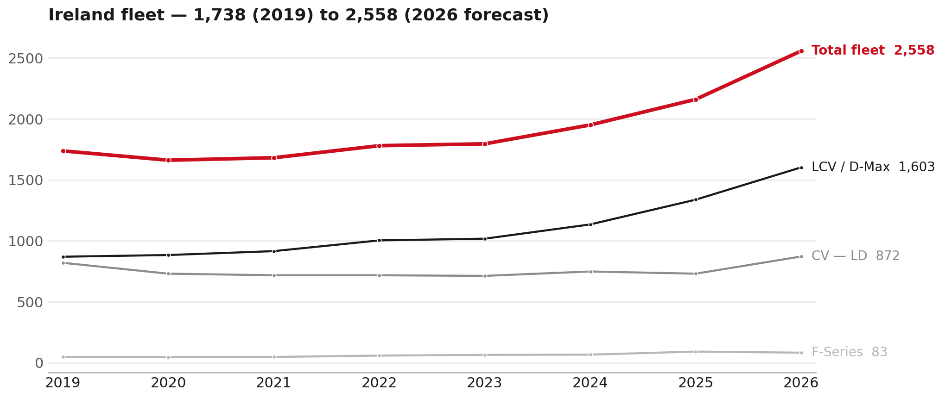
FLEET & FY2027 TARGET
The fleet is expected to grow in 2026
WHAT THIS MEANS FOR FY2027
— Parc 2,161 in 2025 and 2,558 in the 2026 working year-end estimate — +18.4%.
— The chart shows 2019–2026 only. The 2026 point is a working year-end estimate.
— The FY2027 Sales-to-Dealer target applies this fleet movement, a 5% price adjustment and 1.8% additional growth.
— The target reflects the working fleet outlook without extending the chart beyond 2026.
11

Slide 12
FLEET & FY2027 TARGET
How the FY2027 target is built
Sales-to-Dealer amount bridge
Step | Amount
FY2026 Sales-to-Dealer (reported KPI) | EUR 2,833,637
After fleet movement (+18.4%) | EUR 3,354,208
After price adjustment (+5%) | EUR 3,521,918
FY2027 target after additional growth (+1.8%) | EUR 3,585,313
— The FY2027 target is +26.5% versus the FY2026 Sales-to-Dealer base.
— The FY2026 base is the reported Sales-to-Dealer KPI.
12

Slide 13
FY2027 TARGET
What the FY2027 target reflects
1
Your fleet
2
The price move
— The working fleet movement used in the target is +18.4%.
— ISZE is applying a 5% price adjustment for FY2027, consistent with every ISZE market this year.
— It is built into the per-vehicle rate above, not added separately on top.
What it means for your target
 | Value
FY2027 Sales-to-Dealer target | EUR 3,585,313
vs FY2026 Sales-to-Dealer (EUR 2,833,637) | +26.5%
— As in previous cycles we would expect an incentive to sit alongside this adjustment — that approval is still pending on our side. We will confirm as soon as we have it.
13

Slide 14
SPA
SPA
1
IRELAND proposal
2
ISZE review
3
Counter-proposal
4
Final approval
— Isuzu Ireland submits a proposed parts list.
— ISZE reviews the proposal against network data and fit.
— ISZE returns a counter-proposal where needed.
— Signed off by ISZE management.
Purpose: higher turnover for both sides.
14

Slide 15
R&M
R&M — let's align on the market
M
Market
S
Servicing & R&M
— How is the market moving for you right now?
— How much of your volume is fleet business rather than retail?
— Where do you see the biggest hurdles this year?
— Where are your real strengths in this segment?
— Do you offer an R&M or service-plan product today?
— What share of the parc do you retain for servicing after year three?
— Does R&M business come bundled with fleet tenders — roughly what share?
— What would it take to bring more out-of-network servicing back?
15

Slide 16
ASK
Part-level Sales-to-Dealer Data
1
Already halfway there
2
Sharper insight
3
Shared benefit
— You already report Sales-to-Dealer monthly. The ask is the same data at part-number level.
— Part-by-part visibility separates a stock movement from a lost job — and tells us where the volume actually went.
— Better availability on your fast movers, a sharper target for us, and a factual basis for the SPA — same data, both sides gain.
Requested from 01/01/2025, part number level, monthly.
16

Slide 17
SUMMARY
Next steps
— Confirm FY2027 Sales-to-Dealer target: EUR 3,585,313 (+26.5% vs FY2026 Sales-to-Dealer).
— Confirm the incentive alongside the price adjustment once approved on our side.
— Electrical sensors and Filters: agree which category we tackle first, and what the joint action is.
— Agree part-level Sales-to-Dealer data sharing, effective 01/01/2025.
— SPA: IRELAND proposal, ISZE review and counter-proposal cycle to follow.
17

Slide 18
Moving the World – for You

