Slide 1

ISZE · GERMANY · ISD
Germany Sales Review
& FY2027 Target
Isuzu Sales Deutschland · July 2026

Slide 2
ISD MEETING
Agenda
— Parts Performance — category movers
— Parts Performance — Brake parts
— Parts Performance — Electrical sensors
— Parts Performance — where volume grew
— New Business — validation queue
— Sales-to-Dealer Outlook
— GPS Capture
— Service-Parts Coverage
— Fleet & FY2027 Target
— SPA — status
— R&M — market discussion
— Data request: part-level Sales-to-Dealer
— Next steps
2

Slide 3
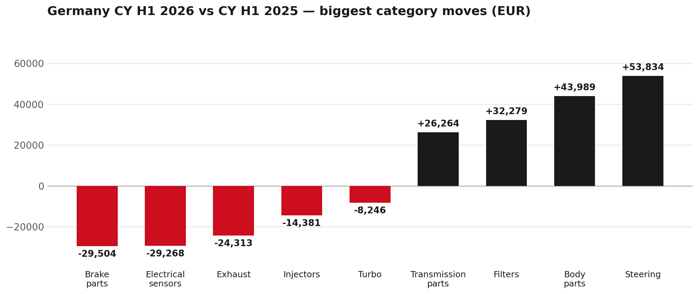
PARTS PERFORMANCE
Parts Performance — CY H1 2026 vs CY H1 2025
TAKEAWAYS
— Parts billing EUR 1,310K against EUR 1,182K a year earlier — +10.8%. After EUR 30K of credit notes the net figure is EUR 1,280K.
— Biggest declines: Brake parts EUR -30K; Electrical sensors EUR -29K.
— Growing: Steering +46%, Body parts +23%, Filters +119%.
— CY H1 2026 against CY H1 2025 (calendar Jan–Jun, Q1+Q2) — like-for-like half-year cut.
3

Slide 4
PARTS PERFORMANCE — BRAKE PARTS
Brake parts — CY H1 2026 vs CY H1 2025
— EUR 137,639 (CY H1 2025) to EUR 108,135 (CY H1 2026), down EUR 29,504 (-21%).
— 8975056801 (PAD KIT; CALIPER,DISC BRK,FRT): EUR 30,006 to EUR 0, 360 fewer pieces.
— 5876150610 (PAD KIT; CALIPER,DISC BRK,FRT): EUR 9,893 to EUR 0, 240 fewer pieces.
— BVP billing rose over the same window (EUR 90,618 to EUR 120,434) — worth checking how much of this is a move to the value tier rather than lost business.
Questions for us to work through together
— Is pad and rotor pricing competitive against what the dealers can buy locally?
— Is any of this stock timing on your side rather than end demand?
— Are dealers still quoting these part numbers, or have they dropped off the workshop menu?
4

Slide 5
PARTS PERFORMANCE — ELECTRICAL SENSORS
Electrical sensors — CY H1 2026 vs CY H1 2025
— EUR 140,186 (CY H1 2025) to EUR 110,918 (CY H1 2026), down EUR 29,268 (-21%).
— 8978808270 (SENSOR; PM): EUR 34,094 to EUR 12,090, 90 fewer pieces.
— 8974993681 (SENSOR; TIRE INFLATION): EUR 14,689 to EUR 0, 1,213 fewer pieces.
— 8978808250 (SENSOR; PM): EUR 24,858 to EUR 14,507, 42 fewer pieces.
Questions for us to work through together
— Is this pricing against what the dealers can buy locally?
— Is any of this stock timing on your side rather than end demand?
— What would make the biggest difference to keep this business with us?
5

Slide 6
PARTS PERFORMANCE — GROWTH
Where volume grew — CY H1 2026 vs CY H1 2025
Part | Description | CY H1 2025 | CY H1 2026
7552348290 | STEERING UNIT | EUR 96,598 | EUR 137,802
8983767550 | ROTOR; DISC BRK,FRT | EUR 23,724 | EUR 47,502
8981596930 | ELEMENT KIT; FUEL FILTER | EUR 14,872 | EUR 30,140
8978461152 | GLASS; WINDSHIELD | EUR 535 | EUR 14,313
8984890171 | PUMP ASM; FUEL,SUPPLY | EUR 2,463 | EUR 12,187
7552469080 | COMPRESSOR ASM; A/C | EUR 1,857 | EUR 8,487
— Steering +46%, Body parts +23%, Filters +119% — where the volume went.
— Several of these are the kind of item that also moves on a campaign or claim. Germany warranty parts ran to EUR 260K across CY2025, so we would not read this list as purely commercial growth without checking it against claims together.
— Worth agreeing which of these are repeatable and which were one-off.
6

Slide 7
PARTS PERFORMANCE
New Business — validation queue (CY H1 2026)
Part | Description | Current sales | Review
7553149600 | DRIVE ASM; FINAL,FRT | EUR 28,349 | Validate
8982705240 | ELEMENT; OIL FILTER | EUR 15,645 | Validate
8974995480 | FILTER; ACL | EUR 10,735 | Validate
8981472452 | SHAFT ASM; FRT DRIVE | EUR 9,929 | Validate
8975554500 | FILTER; BLOWER UNIT | EUR 9,798 | Validate
8974807976 | RADIO CONTROL ASM; STEREO,AM-F | EUR 8,888 | Validate
— These lines had no prior-period sales, so they are kept out of the incremental-growth table.
— A first sale can be a new model, a supersession, timing, or a warranty campaign. It is not treated as a commercial win until that cause is confirmed.
7

Slide 8
SALES-TO-DEALER
Sales-to-Dealer outlook — FY2027
— FY2026 Sales-to-Dealer is EUR 4,072,917 (working estimate).
— The working fleet movement into FY2027 is -2.1%.
— Applying fleet movement, the 5% price adjustment and 1.8% additional growth gives a FY2027 Sales-to-Dealer target of EUR 4,261,921.
— The discussion is held in Sales-to-Dealer amounts; ISZE billing remains an internal reconciliation measure.
8

Slide 9
GPS
GPS Capture: 65.9%
— GPS measures your actual parts purchases against the full potential of your fleet.
— Germany today: 65.9% (FY2026 purchases against the CY2025 fleet potential).
— Fleet potential: EUR 3,808K on 13,780 vehicles.
— Real, sustained headroom above 65.9% — the service-parts and SPA discussion are both direct levers on it.
9

Slide 10
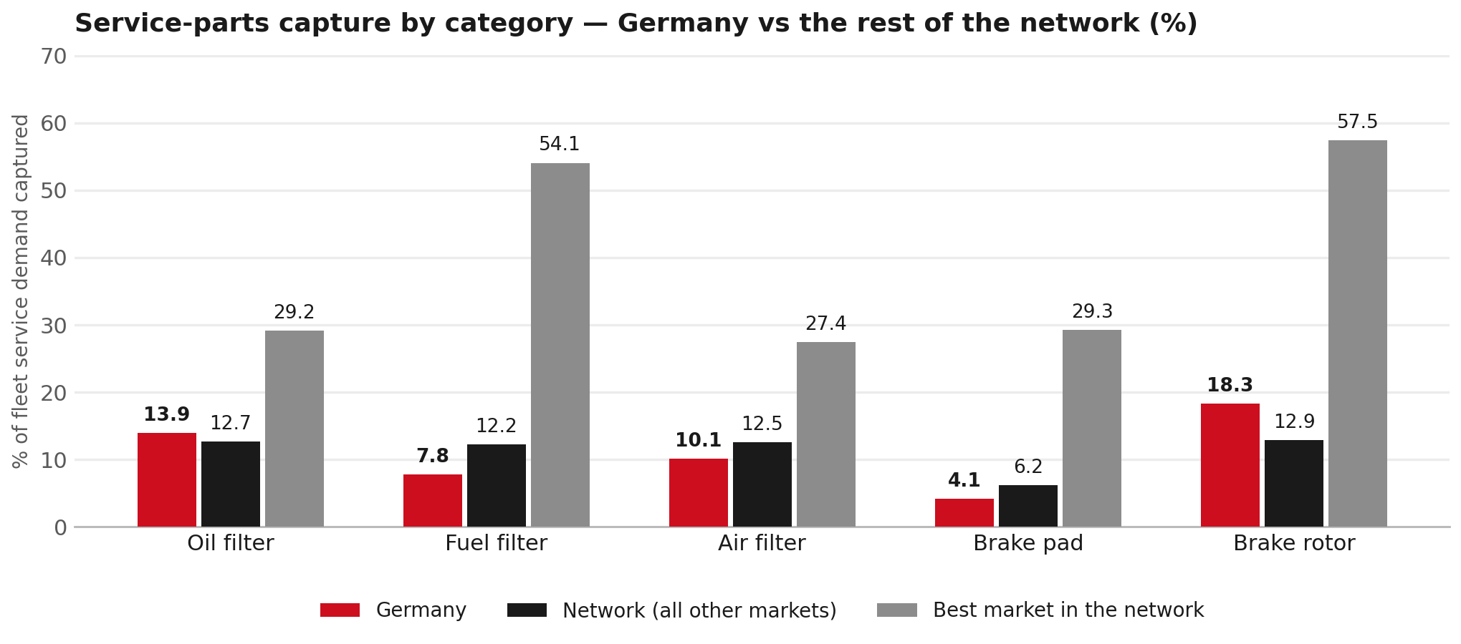
SERVICE-PARTS COVERAGE
Service-parts coverage: fuel filter is the clear gap
TAKEAWAYS
— Fuel filter 7.8% against 12.2% for the rest of the network.
— Air filter 10.1% against 12.5% for the rest of the network.
— Every market here is measured on the same fleet-and-interval model, so the comparison is like-for-like even where the underlying interval assumption is debatable.
— Worth agreeing which category we tackle first, and what the joint action is.
10

Slide 11
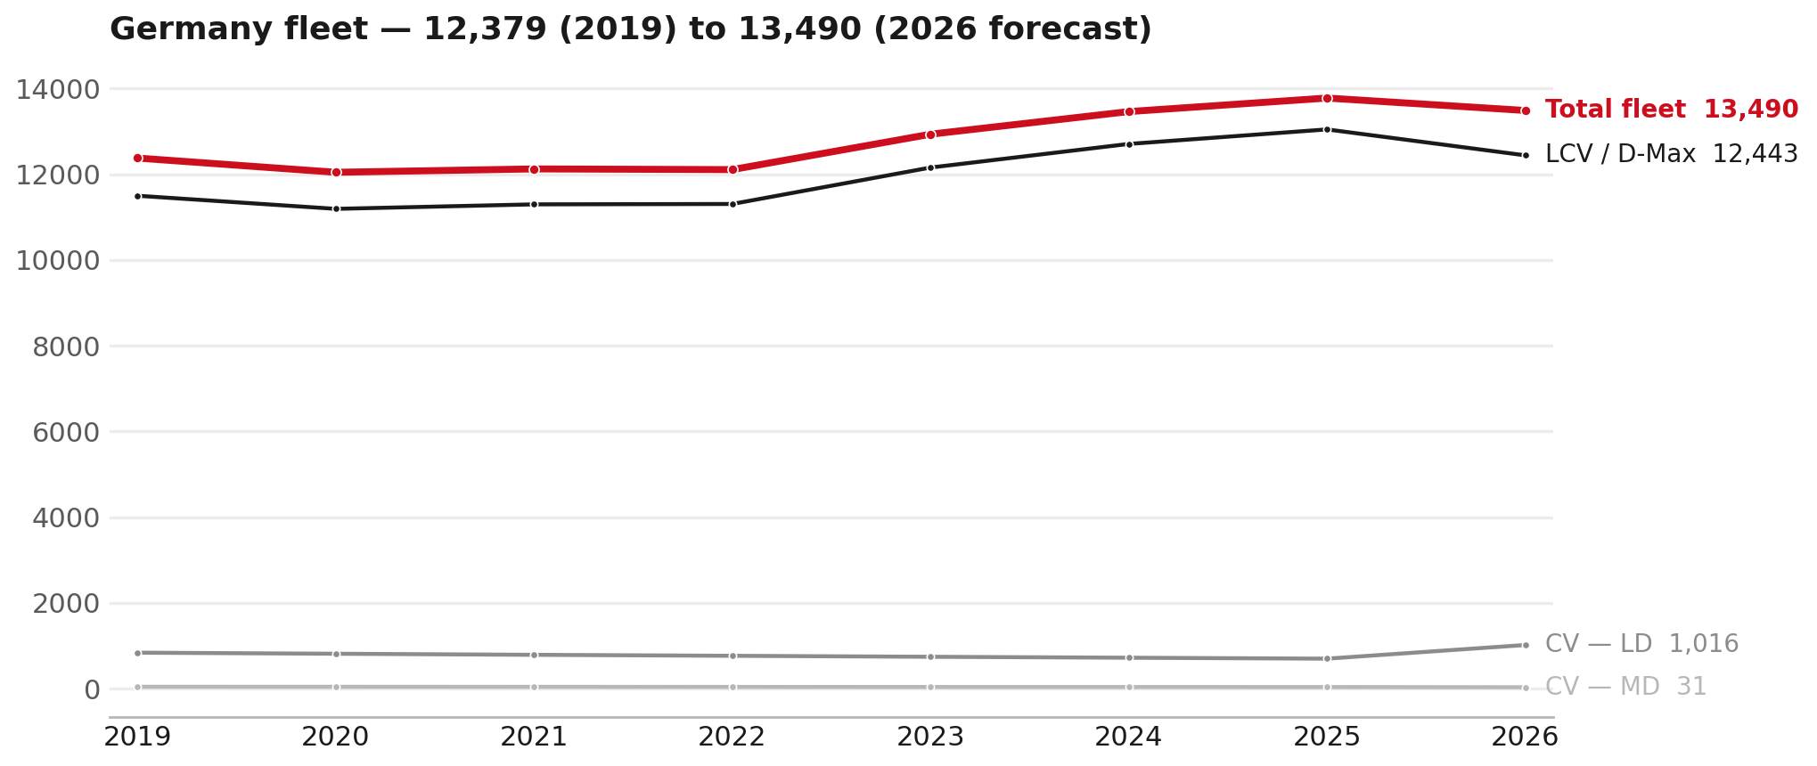
FLEET & FY2027 TARGET
The fleet is expected to decline in 2026
WHAT THIS MEANS FOR FY2027
— Parc 13,780 in 2025 and 13,490 in the 2026 working year-end estimate — -2.1%.
— The chart shows 2019–2026 only. The 2026 point is a working year-end estimate.
— The FY2027 Sales-to-Dealer target applies this fleet movement, a 5% price adjustment and 1.8% additional growth.
— The target therefore starts from a contracting fleet, not an assumed growth story.
11

Slide 12
FLEET & FY2027 TARGET
How the FY2027 target is built
Sales-to-Dealer amount bridge
Step | Amount
FY2026 Sales-to-Dealer (working estimate) | EUR 4,072,917
After fleet movement (-2.1%) | EUR 3,987,203
After price adjustment (+5%) | EUR 4,186,563
FY2027 target after additional growth (+1.8%) | EUR 4,261,921
— The FY2027 target is +4.6% versus the FY2026 Sales-to-Dealer base.
— The FY2026 base is imputed from ISZE billing divided by 0.65 because no usable Sales-to-Dealer KPI was available.
12

Slide 13
FY2027 TARGET
What the FY2027 target reflects
1
Your fleet
2
The price move
— The working fleet movement used in the target is -2.1%.
— ISZE is applying a 5% price adjustment for FY2027, consistent with every ISZE market this year.
— It is built into the per-vehicle rate above, not added separately on top.
What it means for your target
 | Value
FY2027 Sales-to-Dealer target | EUR 4,261,921
vs FY2026 Sales-to-Dealer (EUR 4,072,917) | +4.6%
— As in previous cycles we would expect an incentive to sit alongside this adjustment — that approval is still pending on our side. We will confirm as soon as we have it.
13

Slide 14
SPA
SPA
1
ISD proposal
2
ISZE review
3
Counter-proposal
4
Final approval
— Isuzu Sales Deutschland submits a proposed parts list.
— ISZE reviews the proposal against network data and fit.
— ISZE returns a counter-proposal where needed.
— Signed off by ISZE management.
Purpose: higher turnover for both sides.
14

Slide 15
R&M
R&M — let's align on the market
M
Market
S
Servicing & R&M
— How is the market moving for you right now?
— How much of your volume is fleet business rather than retail?
— Where do you see the biggest hurdles this year?
— Where are your real strengths in this segment?
— Do you offer an R&M or service-plan product today?
— What share of the parc do you retain for servicing after year three?
— Does R&M business come bundled with fleet tenders — roughly what share?
— What would it take to bring more out-of-network servicing back?
15

Slide 16
ASK
Part-level Sales-to-Dealer Data
1
The starting point
2
Sharper insight
3
Shared benefit
— We have no Sales-to-Dealer figures from you for FY2026. The ask is monthly Sales-to-Dealer, at part-number level.
— Part-by-part visibility separates a stock movement from a lost job — and tells us where the volume actually went.
— Better availability on your fast movers, a sharper target for us, and a factual basis for the SPA — same data, both sides gain.
Requested from 01/01/2025, part number level, monthly.
16

Slide 17
SUMMARY
Next steps
— Confirm FY2027 Sales-to-Dealer target: EUR 4,261,921 (+4.6% vs FY2026 Sales-to-Dealer).
— Confirm the incentive alongside the price adjustment once approved on our side.
— Brake parts and Electrical sensors: agree which category we tackle first, and what the joint action is.
— Agree part-level Sales-to-Dealer data sharing, effective 01/01/2025.
— SPA: ISD proposal, ISZE review and counter-proposal cycle to follow.
17

Slide 18
Moving the World – for You

