Slide 1

ISZE · UNITED KINGDOM · ITUK
UK Truck Sales Review
& FY2027 Target
Isuzu Truck UK · August 2026

Slide 2
ITUK MEETING
Agenda
— Parts Performance — category movers
— Parts Performance — Air conditioning
— Parts Performance — Mirrors
— Parts Performance — where volume grew
— New Business — validation queue
— Sales-to-Dealer Outlook
— GPS Capture
— Fleet & FY2027 Target
— SPA — status
— R&M — market discussion
— Data request: part-level Sales-to-Dealer
— Next steps
2

Slide 3
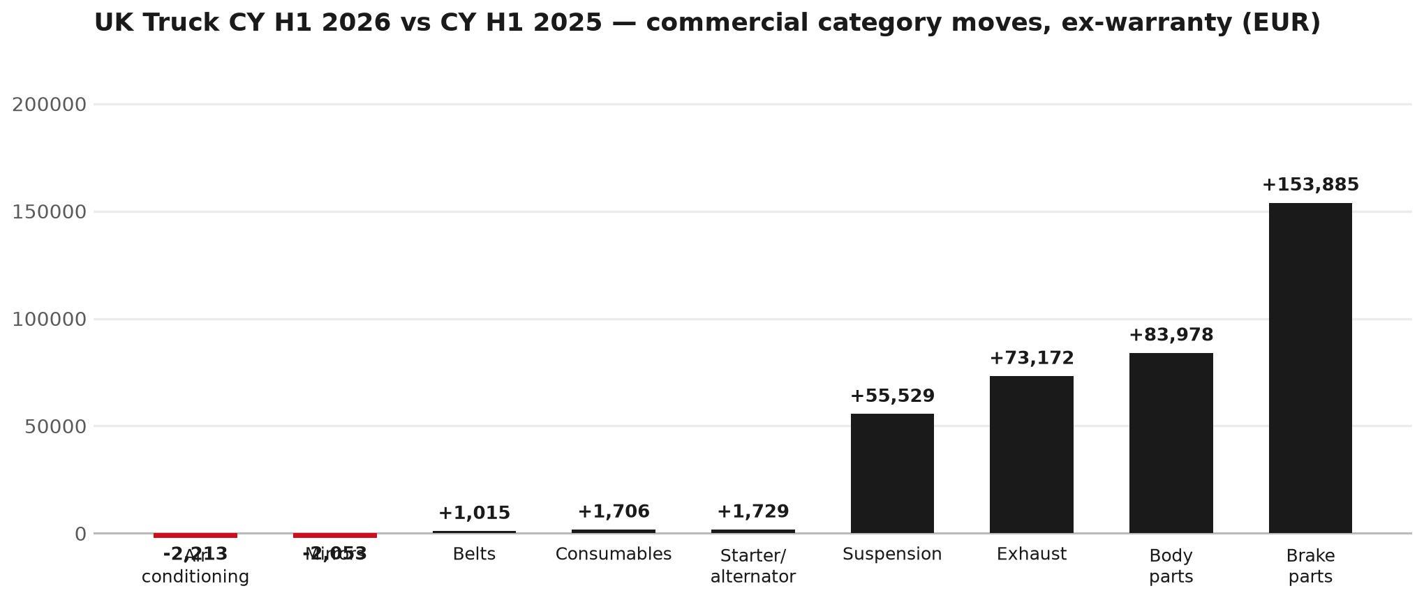
PARTS PERFORMANCE
Parts Performance — CY H1 2026 vs CY H1 2025 (commercial, ex-warranty)
TAKEAWAYS
— Commercial parts billing (warranty/campaign excluded) EUR 2,376K against EUR 1,671K a year earlier — +42.2% (CY H1 2026 vs CY H1 2025, Jan–Jun).
— Largest PN drops (all categories): 8982490280 (ENGINE ASM) EUR -27K, 3 fewer pcs; 5878323990 (KING PIN KIT) [NNR,NPR] EUR -10K, 98 fewer pcs; 8983214130 (FILTER; ACL) [N*R,NPS] EUR -7K, 237 fewer pcs.
— Largest PN gains (all categories): 8982447940 (PAD KIT; CALIPER,DIS) EUR 30K, 369 more pcs; 8975074422 (DPD ASM) EUR 16K, 11 more pcs; 8982169220 (PAD KIT; CALIPER,DIS) EUR 15K, 187 more pcs.
— Within Brake parts (EUR 154K, +55%): 8982447940 (PAD KIT; CALIPER,DIS) EUR 30K, 369 more pcs; 8982169220 (PAD KIT; CALIPER,DIS) EUR 15K, 187 more pcs; 8981919560 (ROTOR; DISC BRK,RR) EUR 15K, 65 more pcs.
3

Slide 4
PARTS PERFORMANCE — AIR CONDITIONING
Air conditioning — CY H1 2026 vs CY H1 2025 (commercial, ex-warranty)
— EUR 84,085 (CY H1 2025) to EUR 81,872 (CY H1 2026), down EUR 2,213 (-3%).
— Largest part numbers driving the decline (by EUR):
— 8983214130 (FILTER; ACL · N*R,NPS): EUR 22,002 to EUR 15,012, 237 fewer pieces.
— 8980714210 (FILTER; ACL · FRR,FRS,FSS,FTR,FVM,FVR): EUR 6,611 to EUR 2,173, 124 fewer pieces.
— 8981772710 (FILTER; ACL): EUR 21,192 to EUR 18,198, 96 fewer pieces.
— 5876102900 (FILTER; ACL · N*R,NPS): EUR 4,693 to EUR 3,186, 68 fewer pieces.
Questions for us to work through together
— Is the seasonal pattern different this year, or is this a real shift?
— Are cabin filters and A/C service being sold as a package?
4

Slide 5
PARTS PERFORMANCE — MIRRORS
Mirrors — CY H1 2026 vs CY H1 2025 (commercial, ex-warranty)
— EUR 26,289 (CY H1 2025) to EUR 24,237 (CY H1 2026), down EUR 2,053 (-8%).
— Largest part numbers driving the decline (by EUR):
— 8981882010 (STAY; OUTSIDE MIRROR): EUR 2,651 to EUR 813, 24 fewer pieces.
— 8981882020 (STAY; OUTSIDE MIRROR): EUR 2,105 to EUR 469, 21 fewer pieces.
— 8981661930 (STAY; MIRROR SIDE): EUR 2,683 to EUR 1,076, 25 fewer pieces.
— 8981661920 (STAY; MIRROR SIDE): EUR 2,864 to EUR 1,328, 23 fewer pieces.
Questions for us to work through together
— Is this pricing against what the dealers can buy locally?
— Is any of this stock timing on your side rather than end demand?
— What would make the biggest difference to keep this business with us?
5

Slide 6
PARTS PERFORMANCE — GROWTH
Where volume grew — CY H1 2026 vs CY H1 2025 (commercial, ex-warranty)
Part | Description | CY H1 2025 | CY H1 2026 | Δ EUR
8982447940 | PAD KIT; CALIPER,DISC BRK,FRT | EUR 90,310 | EUR 120,278 | EUR 29,969
8975074422 | DPD ASM | EUR 12,239 | EUR 27,872 | EUR 15,633
8982169220 | PAD KIT; CALIPER,DISC BRK,FRT | EUR 8,651 | EUR 23,452 | EUR 14,801
8981919560 | ROTOR; DISC BRK,RR | EUR 34,534 | EUR 49,123 | EUR 14,589
8975260081 | TURBOCHARGER ASM | EUR 2,008 | EUR 14,858 | EUR 12,850
7552277520 | VALVE; EGR | EUR 6,521 | EUR 18,606 | EUR 12,085
— Brake parts +55%, Body parts +53%, Exhaust +69% — where the commercial volume went.
— Claim-matched PNs (296 distinct) and campaign/recall text matches are already excluded from this growth list. Residual warranty on unmapped PNs can remain.
— PNs ranked by largest EUR increase (prior-period sales > 0). Worth agreeing which of these are repeatable and which were one-off.
6

Slide 7
PARTS PERFORMANCE
New Business — validation queue (CY H1 2026)
Part | Description | Current sales | Review
8983507160 | FILTER KIT; PUMP ASM,DEF DCM S | EUR 38,504 | Validate
8983300950 | SENSOR; PM | EUR 34,954 | Warranty / campaign
8983758410 | SPRING ASM; LEAF,RR | EUR 24,954 | Validate
8983615742 | SENSOR ASM; DEF TANK | EUR 23,919 | Validate
8975452010 | SENSOR ASM; DEF TANK | EUR 22,951 | Warranty / campaign
8978414700 | SPRING; LEAF,NO 1,FRT | EUR 21,392 | Warranty / campaign
— These lines had no prior-period sales, so they are kept out of the incremental-growth table.
— A first sale can be a new model, a supersession, timing, or a warranty campaign. It is not treated as a commercial win until that cause is confirmed.
7

Slide 8
SALES-TO-DEALER
Sales-to-Dealer outlook — FY2027
— FY2026 Sales-to-Dealer is EUR 10,474,745 (working estimate).
— The working fleet movement into FY2027 is +1.2%.
— Applying fleet movement, the 5% price adjustment and 1.8% additional growth gives a FY2027 Sales-to-Dealer target of EUR 11,334,299.
— The discussion is held in Sales-to-Dealer amounts; ISZE billing remains an internal reconciliation measure.
8

Slide 9
GPS
GPS Capture: 38.2%
— GPS measures your actual parts purchases against the full potential of your fleet.
— UK Truck today: 38.2% (FY2026 purchases against the CY2025 fleet potential).
— Fleet potential: EUR 17,177K on 23,068 vehicles.
— Real, sustained headroom above 38.2% — the service-parts and SPA discussion are both direct levers on it.
9

Slide 10
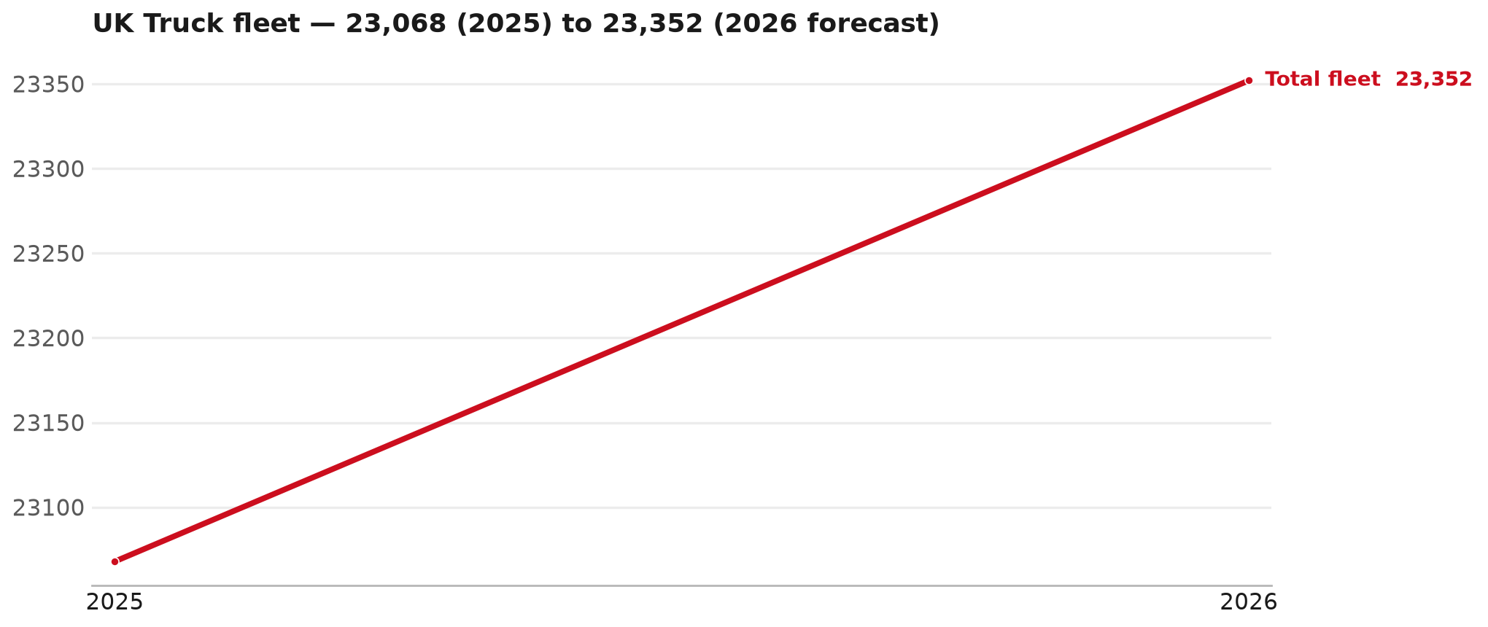
FLEET & FY2027 TARGET
The fleet is expected to grow in 2026
WHAT THIS MEANS FOR FY2027
— Fleet size (calendar year): 23,068 vehicles in 2025 → 23,352 working estimate for end-2026 (+1.2%).
— The chart is calendar years 2019–2026 only. 2026 is a working year-end estimate, not a fiscal-year figure.
— End-2026 mix: CV — LD 22,389; F-Series 963.
— The FY2027 Sales-to-Dealer target starts from that fleet change, then applies a 5% price adjustment and 1.8% additional growth.
— The target reflects the working fleet outlook without extending the chart beyond 2026.
10

Slide 11
FLEET & FY2027 TARGET
How the FY2027 target is built
Sales-to-Dealer amount bridge
Step | Amount
FY2026 Sales-to-Dealer (working estimate) | EUR 10,474,745
After fleet movement (+1.2%) | EUR 10,603,704
After price adjustment (+5%) | EUR 11,133,889
FY2027 target after additional growth (+1.8%) | EUR 11,334,299
— The FY2027 target is +8.2% versus the FY2026 Sales-to-Dealer base.
— The FY2026 base is a working estimate (ISZE billing ÷ 0.65): the KPI Dashboard has no usable Sales-to-Dealer row for this market.
11

Slide 12
FY2027 TARGET
What the FY2027 target reflects
1
Your fleet
2
The price move
— The working fleet movement used in the target is +1.2%.
— ISZE is applying a 5% price adjustment for FY2027, consistent with every ISZE market this year.
— It is built into the per-vehicle rate above, not added separately on top.
What it means for your target
 | Value
FY2027 Sales-to-Dealer target | EUR 11,334,299
vs FY2026 Sales-to-Dealer (EUR 10,474,745) | +8.2%
— As in previous cycles we would expect an incentive to sit alongside this adjustment — that approval is still pending on our side.
— Until the incentive is confirmed, treat the FY2027 target as the working bridge (fleet × price × additional growth), not a locked commercial commitment.
12

Slide 13
SPA
SPA
1
ITUK proposal
2
ISZE review
3
Counter-proposal
4
Final approval
— Isuzu Truck UK submits a proposed parts list.
— ISZE reviews the proposal against network data and fit.
— ISZE returns a counter-proposal where needed.
— Signed off by ISZE management.
Purpose: higher turnover for both sides.
13

Slide 14
R&M
R&M — let's align on the market
M
Market
S
Servicing & R&M
— How is the market moving for you right now?
— How much of your volume is fleet business rather than retail?
— Where do you see the biggest hurdles this year?
— Where are your real strengths in this segment?
— Do you offer an R&M or service-plan product today?
— What share of the parc do you retain for servicing after year three?
— Does R&M business come bundled with fleet tenders — roughly what share?
— What would it take to bring more out-of-network servicing back?
14

Slide 15
ASK
Part-level Sales-to-Dealer Data
1
The starting point
2
Sharper insight
3
Shared benefit
— We have no Sales-to-Dealer figures from you for FY2026. The ask is monthly Sales-to-Dealer, at part-number level.
— Part-by-part visibility separates a stock movement from a lost job — and tells us where the volume actually went.
— Better availability on your fast movers, a sharper target for us, and a factual basis for the SPA — same data, both sides gain.
Requested from 01/01/2025, part number level, monthly.
15

Slide 16
SUMMARY
Next steps
— Align on the FY2027 Sales-to-Dealer bridge (fleet, price, additional growth) — working figure EUR 11,334,299 (+8.2% vs FY2026 base).
— Confirm the incentive alongside the price adjustment; lock the target once that approval is through.
— Air conditioning / Mirrors: agree which category we tackle first, and what the joint action is.
— Agree part-level Sales-to-Dealer data sharing, effective 01/01/2025.
— SPA: ITUK proposal, ISZE review and counter-proposal cycle to follow.
16

Slide 17
Moving the World – for You

Slide 18
UK TRUCK · ISUZU TRUCK UK
Deep dive — detail behind the Mode A story
— Extra detail for meeting prep — pick which slides to share with Isuzu Truck UK.
— Mode A ends on the previous closing slide.
— Label in all charts: “Genuine with BVP alternative” (not “genuine contested”).
18

Slide 19
AGENDA
Deep-dive agenda
— GPS — fiscal year (headline vs excl. warranty; max two lines)
— FY2025 → FY2026 wallet mix (Genuine / Genuine with BVP alternative / BVP)
— Where the money went — outside the service-parts basket (FY)
— Service parts: CY capture vs network + FY billing (capture % is CY-only by design)
— Brake pads — BVP share of total brake pad sales (FY)
— AIM exposure
— Warranty — two lenses
— How to use this in the meeting
19

Slide 20
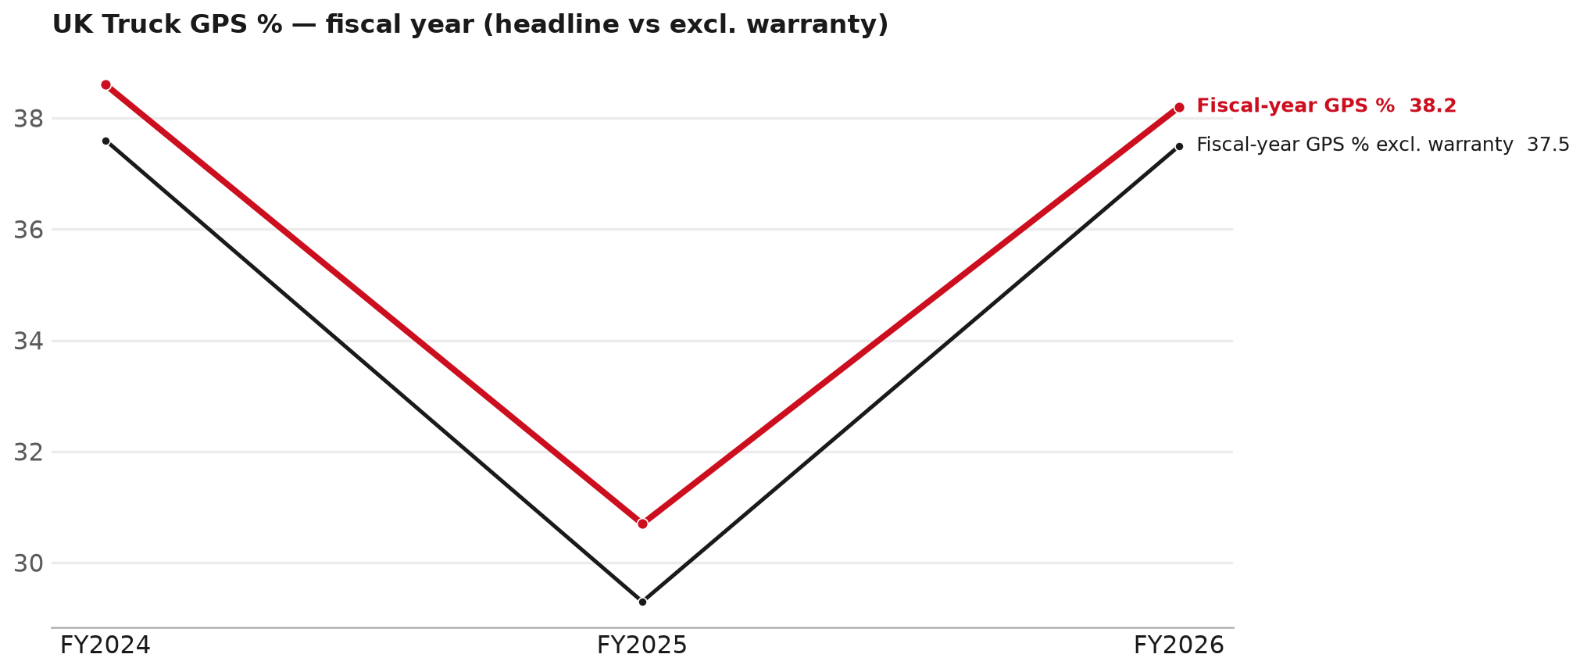
GPS
GPS: fiscal year headline vs after warranty
TAKEAWAYS
— Red = fiscal-year GPS (frozen CY2025 wallet). FY25 30.7% → FY26 38.2%.
— Black = the same GPS after removing warranty parts (€). FY26 ≈ 37.5% (warranty EUR 375,552 ≈ 6% of FY26 billing).
— Both lines divide by the same wallet (EUR 17,176,989), so the gap between them is warranty and nothing else.
— Fleet 23,068 → 24,173 (working year-end estimate under the FY2027 target).
20

Slide 21
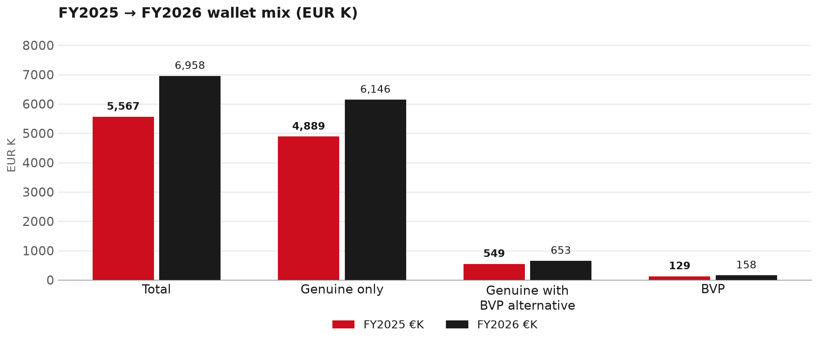
WALLET MIX
FY2025 → FY2026 wallet mix
— Total EUR 5,566,553 → EUR 6,957,525 (+25.0%).
— Genuine only EUR 1,256,962.
— Genuine with BVP alternative EUR 104,488; BVP EUR 29,523 (2.3% of FY26 wallet).
— Display label locked: Genuine with BVP alternative.
21

Slide 22
WALLET MIX
FY wallet mix — detail
 | FY2025 | FY2026 | Δ
Total | EUR 5,566,553 | EUR 6,957,525 | EUR 1,390,973
Genuine only | EUR 4,888,727 | EUR 6,145,688 | EUR 1,256,962
Genuine with BVP alternative | EUR 548,857 | EUR 653,345 | EUR 104,488
BVP | EUR 128,969 | EUR 158,491 | EUR 29,523
BVP % of wallet | 2.3% | 2.3% | -0.0 pp
22

Slide 23
DRIVERS
Where the genuine drop sits (FY2025 → FY2026)
— Genuine-only sales moved EUR 1,256,962 from FY2025 to FY2026.
— Of that, the routine service basket (filters, pads, rotors) moved EUR 261,442 on genuine-only; BVP in that basket moved EUR 17,480.
— Genuine-only did not fall on this FY cut — check category movers and H1 for pressure points.
— Meeting line: check high-value assemblies / sensors before blaming the filter or pad menu.
23

Slide 24
DRIVERS
Largest part-number drops (FY24→FY25) — outside service filters
Part | Description | Δ EUR
8983528480 | SENSOR; NOX | -308,657
REBATE | Rebate Material | -182,097
8982336181 | FILTER ASM | -54,464
8978410420 | SPRING ASM; LEAF,FRT | -43,468
8982404570 | DRIVE ASM; FINAL,RR | -43,464
8975077751 | PUMP ASM; DEF,DCM SPLY | -38,016
5873112438 | ENGINE ASM; PARTIAL | -24,106
— Check warranty / campaign coding before calling competitive leakage.
24

Slide 25
BRAKES
Brake pads — BVP share of total brake pad sales (FY)
 | FY2025 | FY2026
Genuine pad sales (€) | EUR 244,649 | EUR 403,719
BVP pad sales (€) | EUR 0 | EUR 0
Genuine qty | 3324 | 4561
BVP qty | 0 | 0
BVP share of pad sales (€) | 0% | 0%
— BVP share = BVP € ÷ all brake-pad € billed (genuine + BVP). Not a PMS capture %.
— Isuzu Truck UK pad sales are genuine-only in this cut (~EUR 404K FY26) — no BVP pad lines billed.
— Wallet-level BVP is still only ~2.3% of FY26 — do not generalise a pad story to the whole wallet.
25

Slide 26
AIM
AIM exposure
Year | High-risk € | High-risk % | Quadrant
2023 | EUR 13,626 | 0.2% | Defend (high GPS - high capture)
2024 | EUR 21,024 | 0.3% | Defend (high GPS - high capture)
2025 | EUR 9,893 | 0.2% | Defend (high GPS - high capture)
— High-risk € is catalogue AIM exposure, not proven walk-out.
— Open on jobs not bought through the distributor — not only independent-parts competition.
26

Slide 27
WARRANTY
Warranty — two real lenses
1
CY2025 claim-price parts
2
Fiscal GPS expense
— No claim-price figure in profile.
— Calendar-year claim price basis.
— ITUK claim grain is db_name ITUK in warranty_raw_grain. Do not use IUK warranty.
— FY24 EUR 164,315 · FY25 EUR 542,953 · FY26 EUR 375,552.
— Source row: ITUK.
— Ex-warranty GPS = (net − warranty) ÷ frozen CY25 wallet.
— Both numbers are real — never mix them on one slide without labels.
27

Slide 28
BRIDGE
How to use this in the meeting
If they say… | You know…
BVP is eating genuine | Wallet BVP ~2.3%. Check pads as a local exception only.
GPS looks fine / too high | FY26 headline 38.2%; excl. warranty ≈ 37.5%.
Service parts are fine | CY2025 capture vs network (previous slides) + FY billing lens.
28

Slide 29
Moving the World – for You

