Slide 1

ISZE · PORTUGAL · PORTUGAL
Portugal Sales Review
& FY2027 Target
I-Motors · August 2026

Slide 2
PORTUGAL MEETING
Agenda
— Q1 FY2027 Sales Review
— Parts Performance — category movers
— Parts Performance — Clutch parts
— Parts Performance — Steering
— Parts Performance — Air system
— Parts Performance — where volume grew
— New Business — validation queue
— Sales-to-Dealer Outlook
— GPS Capture
— Service-Parts Coverage
— Fleet & FY2027 Target
— SPA — status
— R&M — market discussion
— Data request: part-level Sales-to-Dealer
— Next steps
2

Slide 3
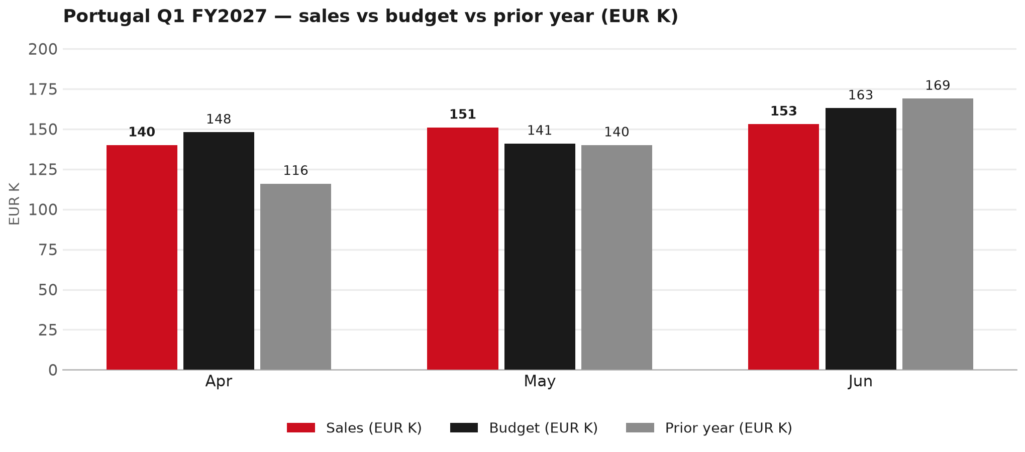
POWER BI — OFFICIAL CUT
Q1 FY2027: EUR 444K, -2% vs budget
TAKEAWAYS
— Sales EUR 444K against budget EUR 452K — -2%, and +4% on last year's EUR 425K.
— The beat is entirely May: EUR 151K against EUR 141K. Apr -5% and Jun -6% are below budget.
— Worth walking through the shape of the period together.
3

Slide 4
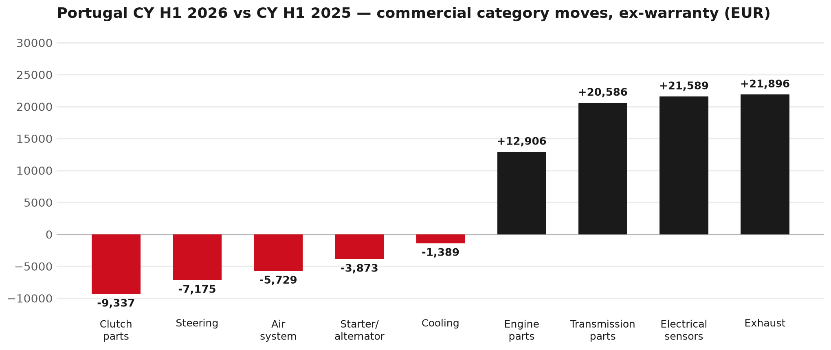
PARTS PERFORMANCE
Parts Performance — CY H1 2026 vs CY H1 2025 (commercial, ex-warranty)
TAKEAWAYS
— Commercial parts billing (warranty/campaign excluded) EUR 772K against EUR 640K a year earlier — +20.5% (CY H1 2026 vs CY H1 2025, Jan–Jun).
— Largest PN drops (all categories): 8982447940 (PAD KIT; CALIPER,DIS) EUR -6K, 72 fewer pcs; 5873113841 (ENGINE ASM; PARTIAL) EUR -4K, 1 fewer pcs; 8983682091 (PIPE; EXH) EUR -4K, 3 fewer pcs.
— Largest PN gains (all categories): 8975359391 (DPD ASM) EUR 9K, 4 more pcs; 8976607440 (TRANSMISSION ASM; MA) EUR 8K, 2 more pcs; 8980921340 (GEAR SET; FINAL DRIV) EUR 6K, 11 more pcs.
— Within Exhaust (EUR 22K, +57%): 8975359391 (DPD ASM) EUR 9K, 4 more pcs; 8983023941 (SENSOR; DEF DCM EXH ) EUR 4K, 14 more pcs; 8982127181 (COOLER ASM; EGR) EUR 3K, 13 more pcs.
4

Slide 5
PARTS PERFORMANCE — CLUTCH PARTS
Clutch parts — CY H1 2026 vs CY H1 2025 (commercial, ex-warranty)
— EUR 36,848 (CY H1 2025) to EUR 27,511 (CY H1 2026), down EUR 9,337 (-25%).
— Largest part numbers driving the decline (by EUR):
— 5876102060 (CLUTCH KIT · N*R,NLS): EUR 5,091 to EUR 1,311, 23 fewer pieces.
— 8978293170 (DISC; CLUTCH): EUR 2,882 to EUR 493, 24 fewer pieces.
— 5876100910 (PLATE ASM; PRESSURE,CLU · NLR,NMR,NNR,NPR,NQR,NPS): EUR 3,379 to EUR 1,607, 23 fewer pieces.
— 8982831940 (PLATE ASM; PRESSURE,CLU): EUR 2,023 to EUR 637, 20 fewer pieces.
Questions for us to work through together
— Is clutch pricing a barrier against local competition for you?
— What would make the biggest difference to keep this business with us?
— Worth a joint look at the specific part numbers together?
5

Slide 6
PARTS PERFORMANCE — STEERING
Steering — CY H1 2026 vs CY H1 2025 (commercial, ex-warranty)
— EUR 26,698 (CY H1 2025) to EUR 19,523 (CY H1 2026), down EUR 7,175 (-27%).
— Largest part numbers driving the decline (by EUR):
— 8983948772 (STEERING UNIT): EUR 4,545 to EUR 2,000, 5 fewer pieces.
— 8978243002 (PUMP ASM; OIL,P/S): EUR 4,737 to EUR 2,250, 10 fewer pieces.
— 8981017801 (STEERING UNIT): EUR 2,314 to EUR 0, 3 fewer pieces.
— 8982519482 (STEERING UNIT): EUR 1,407 to EUR 0, 2 fewer pieces.
Questions for us to work through together
— Is this pricing against what the dealers can buy locally?
— Is any of this stock timing on your side rather than end demand?
— What would make the biggest difference to keep this business with us?
6

Slide 7
PARTS PERFORMANCE — AIR SYSTEM
Air system — CY H1 2026 vs CY H1 2025 (commercial, ex-warranty)
— EUR 17,998 (CY H1 2025) to EUR 12,270 (CY H1 2026), down EUR 5,729 (-32%).
— Largest part numbers driving the decline (by EUR):
— 5876102500 (ELEMENT; AIR CLEANER · N*R,NPS): EUR 5,189 to EUR 3,045, 122 fewer pieces.
— 8974719842 (AIR BAG UNIT): EUR 1,628 to EUR 0, 5 fewer pieces.
— 8983322301 (AIR BAG UNIT): EUR 706 to EUR 0, 2 fewer pieces.
— 8983964240 (GUIDE ASM; AIR): EUR 1,016 to EUR 340, 12 fewer pieces.
Questions for us to work through together
— Is this pricing against what the dealers can buy locally?
— Is any of this stock timing on your side rather than end demand?
— What would make the biggest difference to keep this business with us?
7

Slide 8
PARTS PERFORMANCE — GROWTH
Where volume grew — CY H1 2026 vs CY H1 2025 (commercial, ex-warranty)
Part | Description | CY H1 2025 | CY H1 2026 | Δ EUR
8975359391 | DPD ASM | EUR 2,216 | EUR 10,812 | EUR 8,597
8976607440 | TRANSMISSION ASM; MANUAL | EUR 3,934 | EUR 11,826 | EUR 7,892
8980921340 | GEAR SET; FINAL DRIVE,RR | EUR 3,436 | EUR 9,270 | EUR 5,833
8984890190 | NOZZLE ASM; INJ | EUR 638 | EUR 5,513 | EUR 4,876
8970471004 | CAGE ASM; DIFF,FINAL DRIVE | EUR 1,155 | EUR 4,522 | EUR 3,366
8982127181 | COOLER ASM; EGR | EUR 1,375 | EUR 4,602 | EUR 3,227
— Exhaust +57%, Electrical sensors +64%, Transmission parts +36% — where the commercial volume went.
— Claim-matched PNs (158 distinct) and campaign/recall text matches are already excluded from this growth list. Residual warranty on unmapped PNs can remain.
— PNs ranked by largest EUR increase (prior-period sales > 0). Worth agreeing which of these are repeatable and which were one-off.
8

Slide 9
PARTS PERFORMANCE
New Business — validation queue (CY H1 2026)
Part | Description | Current sales | Review
8983759890 | ENGINE ASM | EUR 10,268 | Validate
8982050610 | FILTER ASM | EUR 7,567 | Validate
7552933240 | METER COMPL; CLUSTER | EUR 5,585 | Validate
7552933280 | METER COMPL; CLUSTER | EUR 5,357 | Validate
7552283740 | TRANSFER ASM | EUR 4,439 | Validate
8983023941 | SENSOR; DEF DCM EXH NOX | EUR 3,874 | Validate
— These lines had no prior-period sales, so they are kept out of the incremental-growth table.
— A first sale can be a new model, a supersession, timing, or a warranty campaign. It is not treated as a commercial win until that cause is confirmed.
9

Slide 10
SALES-TO-DEALER
Sales-to-Dealer outlook — FY2027
— FY2026 Sales-to-Dealer is EUR 2,803,598 (working estimate).
— The working fleet movement into FY2027 is +7.2%.
— Applying fleet movement, the 5% price adjustment and 1.8% additional growth gives a FY2027 Sales-to-Dealer target of EUR 3,213,790.
— The discussion is held in Sales-to-Dealer amounts; ISZE billing remains an internal reconciliation measure.
10

Slide 11
GPS
GPS Capture: 86.0%
— GPS measures your actual parts purchases against the full potential of your fleet.
— Portugal today: 86.0% (FY2026 purchases against the CY2025 fleet potential).
— Fleet potential: EUR 2,005K on 8,019 vehicles.
— Real, sustained headroom above 86.0% — the service-parts and SPA discussion are both direct levers on it.
11

Slide 12
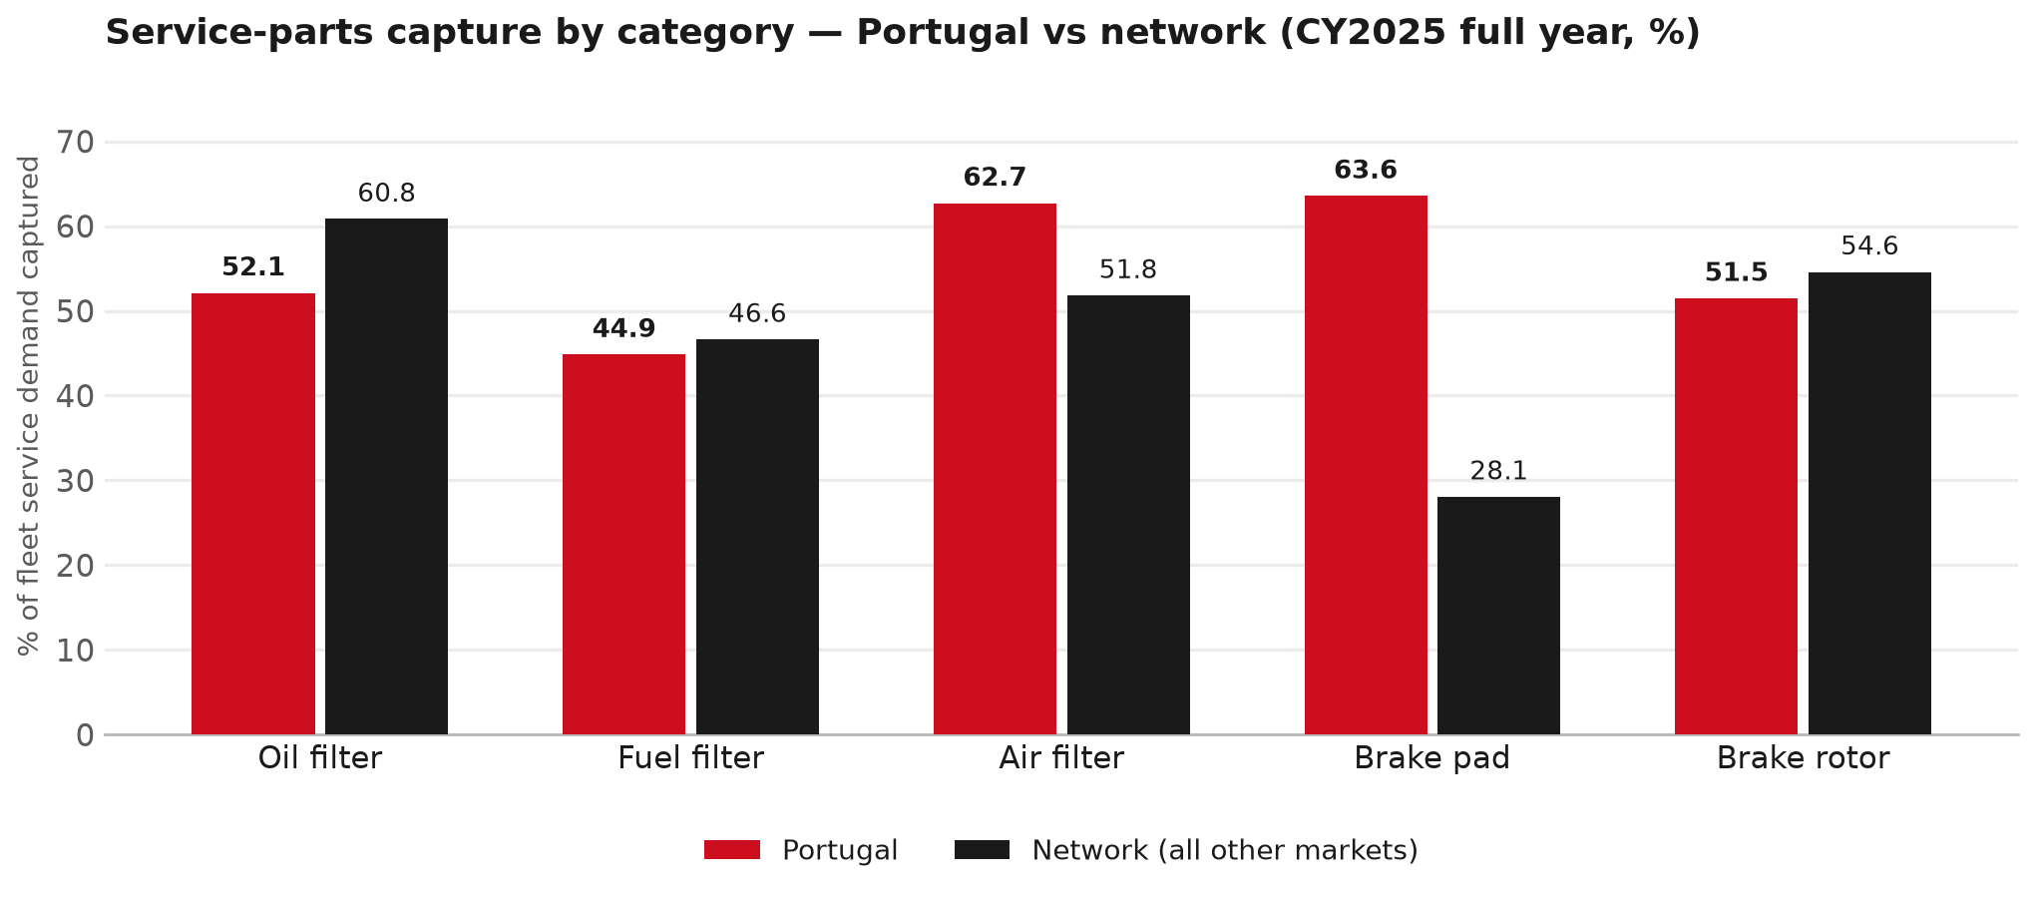
SERVICE-PARTS COVERAGE
Service-parts coverage: oil filter is the clear gap
TAKEAWAYS
— Oil filter 52.1% against 60.8% for the rest of the network.
— Brake rotor 51.5% against 54.6% for the rest of the network.
— Every market here is measured on the same fleet-and-interval model, so the comparison is like-for-like even where the underlying interval assumption is debatable.
— Worth agreeing which category we tackle first, and what the joint action is.
12

Slide 13
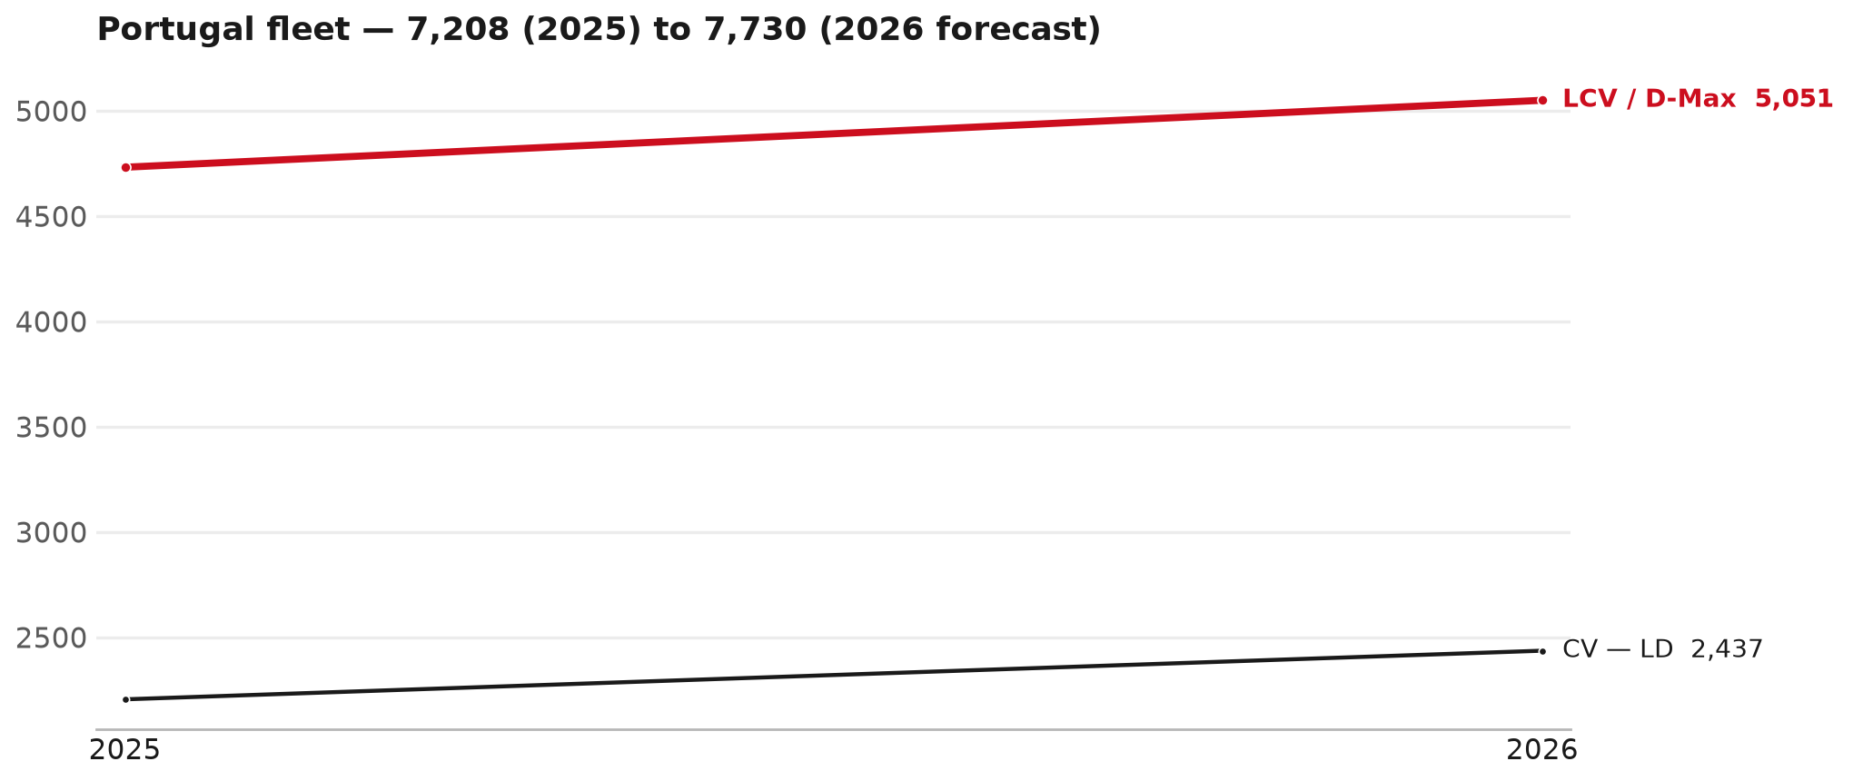
FLEET & FY2027 TARGET
The fleet is expected to grow in 2026
WHAT THIS MEANS FOR FY2027
— Fleet size (calendar year): 7,208 vehicles in 2025 → 7,730 working estimate for end-2026 (+7.2%).
— The chart is calendar years 2019–2026 only. 2026 is a working year-end estimate, not a fiscal-year figure.
— Smaller segments not plotted (<5% of fleet): F-Series 242.
— The FY2027 Sales-to-Dealer target starts from that fleet change, then applies a 5% price adjustment and 1.8% additional growth.
— The target reflects the working fleet outlook without extending the chart beyond 2026.
13

Slide 14
FLEET & FY2027 TARGET
How the FY2027 target is built
Sales-to-Dealer amount bridge
Step | Amount
FY2026 Sales-to-Dealer (working estimate) | EUR 2,803,598
After fleet movement (+7.2%) | EUR 3,006,633
After price adjustment (+5%) | EUR 3,156,965
FY2027 target after additional growth (+1.8%) | EUR 3,213,790
— The FY2027 target is +14.6% versus the FY2026 Sales-to-Dealer base.
— The FY2026 base is a working estimate (ISZE billing ÷ 0.65): the KPI Dashboard has no usable Sales-to-Dealer row for this market.
14

Slide 15
FY2027 TARGET
What the FY2027 target reflects
1
Your fleet
2
The price move
— The working fleet movement used in the target is +7.2%.
— ISZE is applying a 5% price adjustment for FY2027, consistent with every ISZE market this year.
— It is built into the per-vehicle rate above, not added separately on top.
What it means for your target
 | Value
FY2027 Sales-to-Dealer target | EUR 3,213,790
vs FY2026 Sales-to-Dealer (EUR 2,803,598) | +14.6%
— As in previous cycles we would expect an incentive to sit alongside this adjustment — that approval is still pending on our side.
— Until the incentive is confirmed, treat the FY2027 target as the working bridge (fleet × price × additional growth), not a locked commercial commitment.
15

Slide 16
SPA
SPA
1
PORTUGAL proposal
2
ISZE review
3
Counter-proposal
4
Final approval
— I-Motors submits a proposed parts list.
— ISZE reviews the proposal against network data and fit.
— ISZE returns a counter-proposal where needed.
— Signed off by ISZE management.
Purpose: higher turnover for both sides.
16

Slide 17
R&M
R&M — let's align on the market
M
Market
S
Servicing & R&M
— How is the market moving for you right now?
— How much of your volume is fleet business rather than retail?
— Where do you see the biggest hurdles this year?
— Where are your real strengths in this segment?
— Do you offer an R&M or service-plan product today?
— What share of the parc do you retain for servicing after year three?
— Does R&M business come bundled with fleet tenders — roughly what share?
— What would it take to bring more out-of-network servicing back?
17

Slide 18
ASK
Part-level Sales-to-Dealer Data
1
The starting point
2
Sharper insight
3
Shared benefit
— We have no Sales-to-Dealer figures from you for FY2026. The ask is monthly Sales-to-Dealer, at part-number level.
— Part-by-part visibility separates a stock movement from a lost job — and tells us where the volume actually went.
— Better availability on your fast movers, a sharper target for us, and a factual basis for the SPA — same data, both sides gain.
Requested from 01/01/2025, part number level, monthly.
18

Slide 19
SUMMARY
Next steps
— Confirm FY2027 Sales-to-Dealer target: EUR 3,213,790 (+14.6% vs FY2026 Sales-to-Dealer).
— Confirm the incentive alongside the price adjustment once approved on our side.
— Clutch parts / Steering / Air system: agree which category we tackle first, and what the joint action is.
— Agree part-level Sales-to-Dealer data sharing, effective 01/01/2025.
— SPA: PORTUGAL proposal, ISZE review and counter-proposal cycle to follow.
19

Slide 20
Moving the World – for You

