Slide 1

ISZE · VEHICLE PARTS & ACCESSORIES
ISZE Vehicle Parts & Accessories
Business Performance Review
Fiscal 2026 close · Fiscal 2027 to date · Service performance · PRISM and IDS
Prepared 16 September 2026. Billing file runs to 2026-08-31; September figures are month to date and the month is not closed.

Slide 2
CONTENTS
What this review covers, and how to read it
— Where we stand: fiscal 2026 close, the fiscal 2027 plan, and September month to date.
— Service performance: fill rate against the 95% standard, inventory cover, and how much of the network runs on urgent orders.
— Where the money is: spend per truck, the modelled ceiling, and the service families carrying the unbought euro.
— ITUK in detail: the gap at both layers of the chain, taken from the leakage review.
— Genuine against best-value on the same part number, and where parts classification says we are exposed.
— PRISM and the dealer standard: what the platform covers, and what the dealer assessment says about the network.
— Warranty parts as a share of what we bill, kept separate from customer-paid demand.
DATA RULE FOR THIS DECK
Every figure is read from a named ISZE file on its build date. Where a measure is modelled, the slide says so. Where a distributor does not report a KPI, the cell is empty and the coverage is stated — never a zero, never a copy of another market. Month-to-date figures are labelled as such, and a market that filed an old month carries that month's label with its number.
2

Slide 3
01
Where we stand
Fiscal 2026 close, the fiscal 2027 plan, and September to date against last year.
3

Slide 4
FISCAL 2026 AND FISCAL 2027 TO DATE
The headline numbers
FISCAL 2026 PARTS BILLED
LARGEST DISTRIBUTOR
FISCAL 2027 FIRST QUARTER
SEPTEMBER TO DATE
EUR 32.58M
EUR 6.96M
EUR 8.14M
EUR 1.46M
network distributors, full fiscal year to March 2026
ITUK — 21% of the network
April to June 2026, the last closed quarter in the billing file
46% of the month plan at 14 September, the month is not closed
The billing file runs to 2026-08-31, so fiscal 2026 is complete and fiscal 2027 is available only to the end of that quarter. September figures come from the daily sales report dated 14 September 2026 and are month to date. Network parts billed is on the distributor base in the billing file.
4

Slide 5
FISCAL 2027 PLAN
The plan behind the numbers — and two different things both called parts
FISCAL 2027 PLAN
LARGEST PLAN LINE
FIRST QUARTER PLAN PACE
FIRST QUARTER ACTUAL
EUR 35.28M
EUR 6.97M
~EUR 8.8M
EUR 8.14M
BP reviewed April 2026, turnover basis
ITUK, followed by IUK at EUR 6.06M
a quarter of the annual plan
network distributors, April to June 2026
A caution worth carrying: the KPI target workbook also has a line labelled parts target, at roughly EUR 108M. That is a different measure on a different basis — distributor to dealer, twelve months trailing — and it is about three times the turnover plan. The two must never appear on one slide without saying which is which.
5

Slide 6
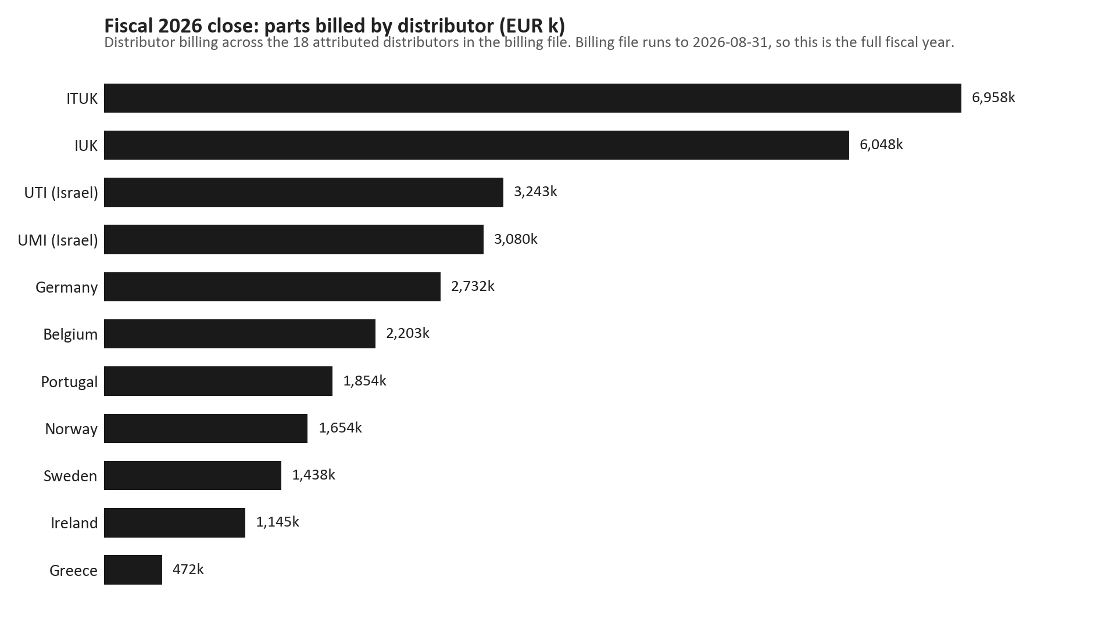
FISCAL 2026 CLOSE
Fiscal 2026 closed with ITUK and IUK carrying a fifth of the network between them
TAKEAWAYS
— Network parts billed EUR 32.58M for the full fiscal year to March 2026.
— Largest: ITUK at EUR 6.96M; second IUK at EUR 6.05M. Together EUR 13.01M.
— The tail of smaller markets sums to a material share, so the network is not a two-market story.
— Attribution resolves the sold-to code first, so Israel's two distributors stay separate on every chart.
6

Slide 7
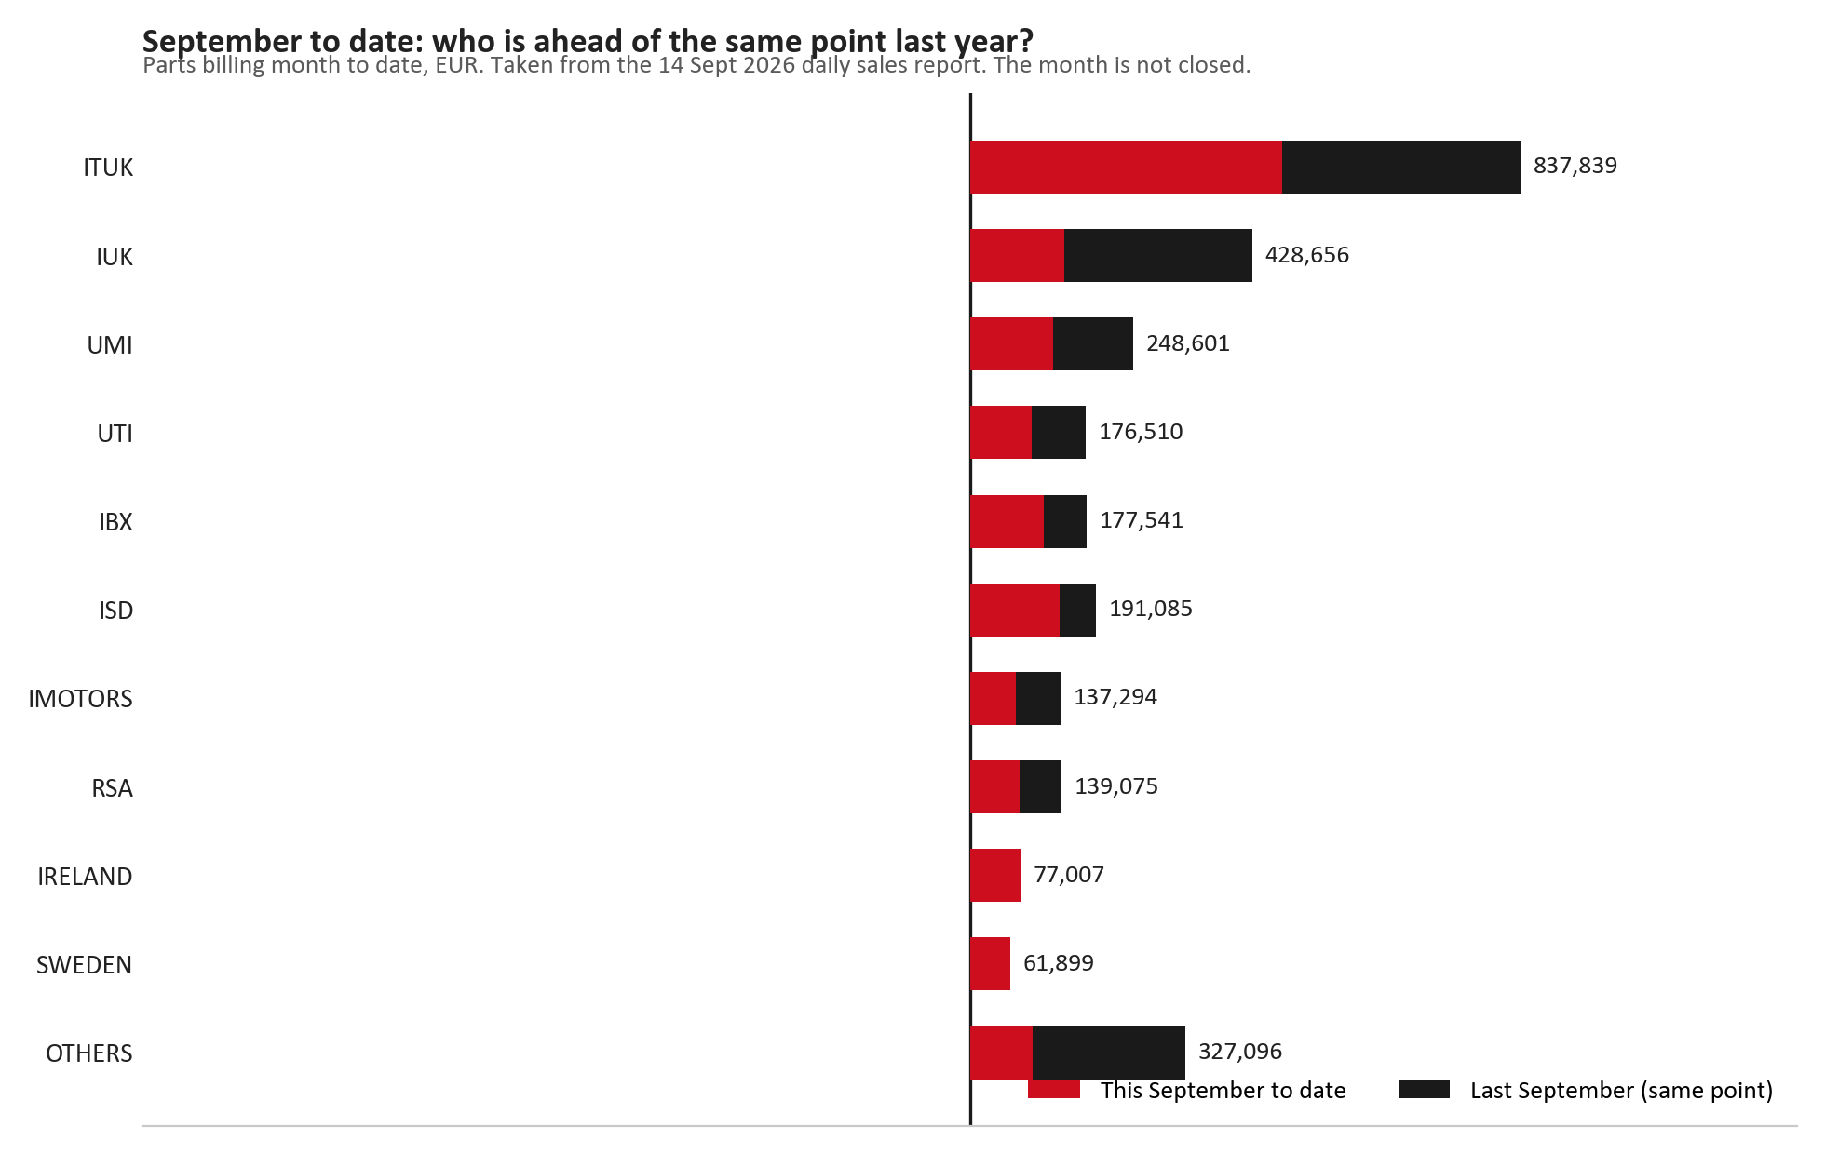
FISCAL 2027 TO DATE
September to date: the network is up on the same point last year
TAKEAWAYS
— Month to date at 14 September, parts billing against the same point last September.
— ITUK, ISD and IBX are each ahead of where they were at this point last year.
— IUK is behind, and that single gap is the largest negative on the page.
— The month is not closed — read this as direction, not as a result.
7

Slide 8
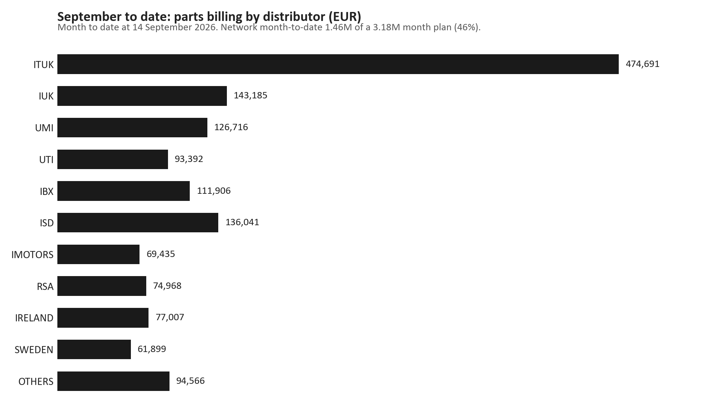
FISCAL 2027 TO DATE
September month to date is running at 46% of the month plan
TAKEAWAYS
— Network month to date EUR 1.46M against a month plan of EUR 3.18M.
— ITUK is the largest single contributor for the month so far.
— Progress varies widely by distributor, which is why the ranking is worth showing rather than the total alone.
— Order intake and work in progress sit in the same report when a forward view is needed.
8

Slide 9
02
Service performance
Parts fill rate, inventory cover, and how much of the network runs on urgent orders.
9

Slide 10
PARTS FILL RATE
Parts fill: 10 of the 19 reporting markets sit below the standard
REPORTING MARKETS
MARKETS BELOW 95%
LOWEST REPORTED
STANDARD AND FLOOR
19 of 22
10
60.0%
95% / 92%
a market that never files is not a zero
latest reported month per market
Petros Petropoulos · Mai 25
target logic in the KPI target sheet
Reported order-line fill from the monthly KPI return, each market shown at the latest month it actually filed. Several of those months are more than a year old, so the month label travels with every number. Two markets have never filed at all.
10

Slide 11
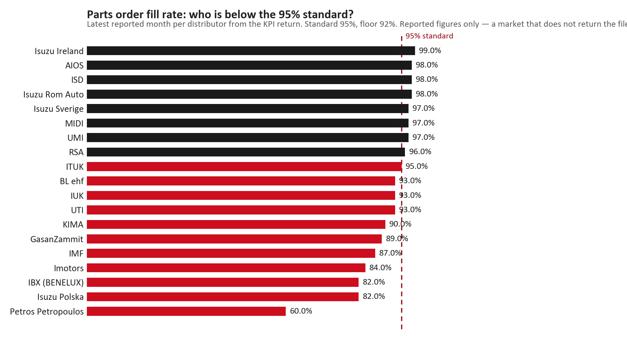
PARTS FILL RATE
Fill rate, latest reported month per market, against the 95% standard
TAKEAWAYS
— Reported order-line fill, latest month each market filed.
— 10 of the 19 reporting markets sit below the standard.
— The lowest reported figure is in the low sixties, which is a service risk rather than a reporting issue.
— Coverage is the real caveat: some of these numbers are from a year ago and are labelled as such.
11

Slide 12
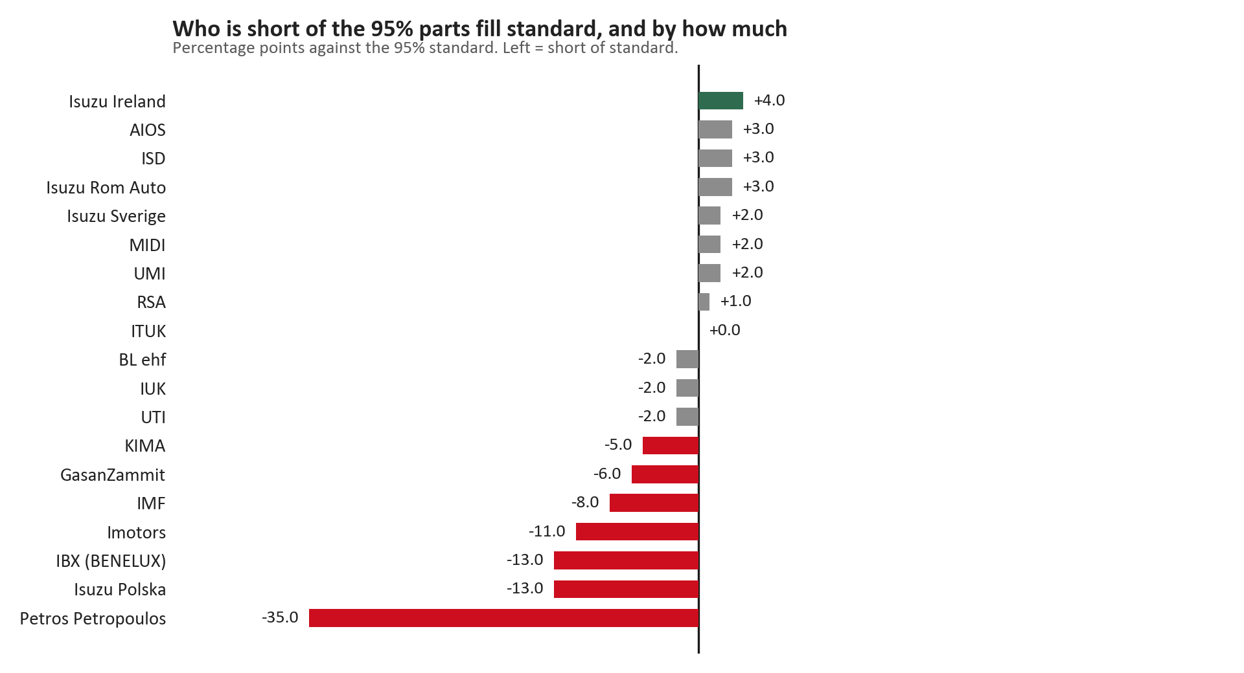
PARTS FILL RATE
Deviation from the 95% fill standard, in percentage points
TAKEAWAYS
— Read left as the size of the service problem and right as headroom.
— A market inside the tolerance band is neither a risk nor an opportunity today.
— The markets outside the band are where a fill-rate conversation is worth having.
— The band is an interpretation of the 95% standard; the underlying numbers are reported, not modelled.
12

Slide 13
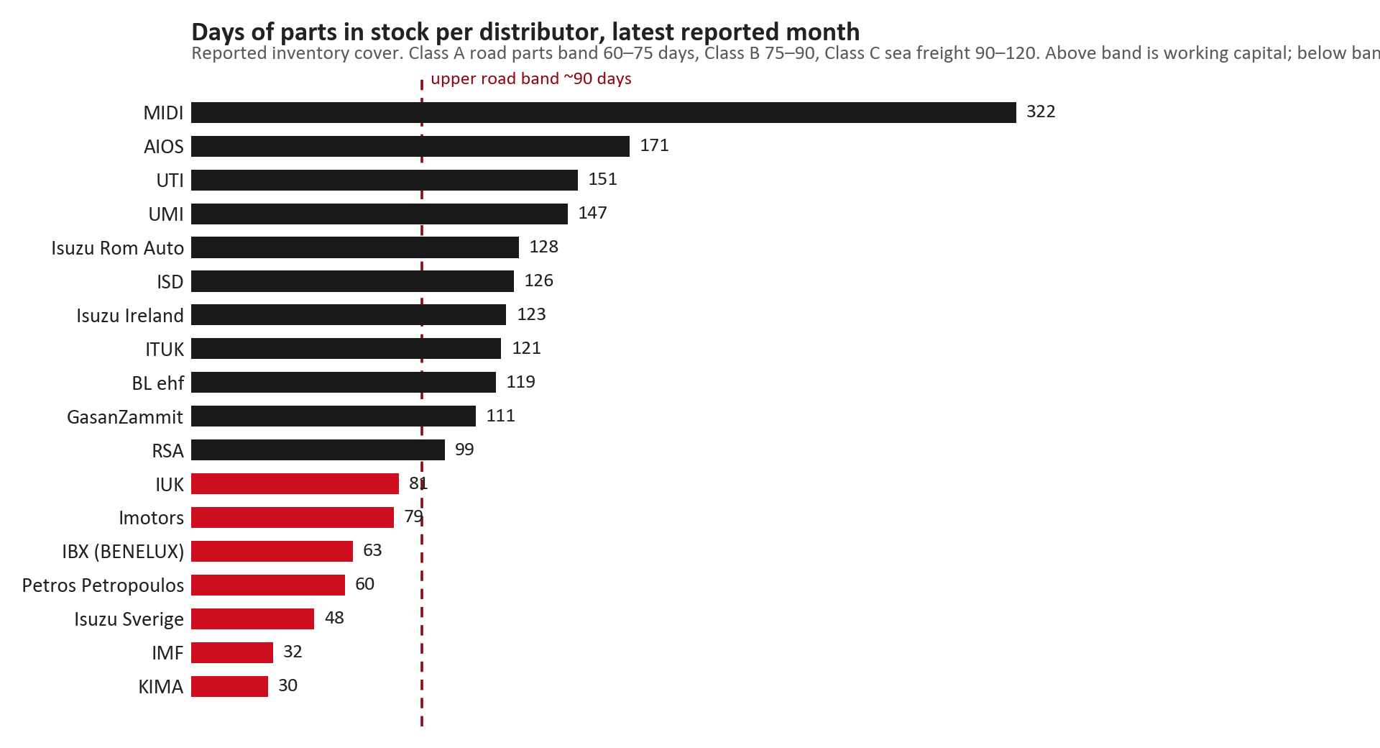
INVENTORY COVER
Inventory cover: several markets hold far more stock than their supply route justifies
TAKEAWAYS
— Days of parts in stock, latest reported month, 18 of 22 markets reporting.
— Road-received markets should sit around 60 to 90 days; sea-freight markets can justify more.
— The longest cover on the page is working capital sitting still rather than a service buffer.
— Very short cover at the other end pairs with the low fill rates on the previous page.
13

Slide 14
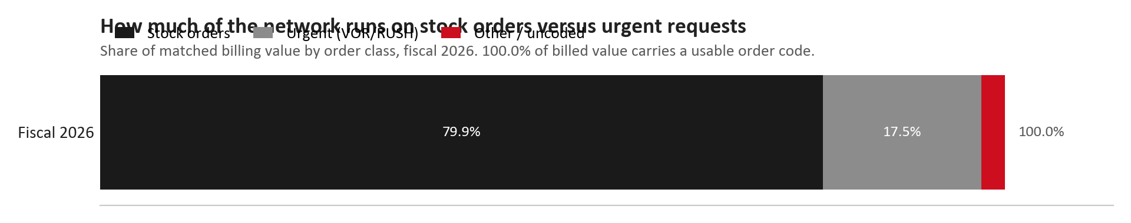
ORDER URGENCY
Roughly 17.5 euro in every hundred runs on an urgent order
TAKEAWAYS
— Urgent share 17.5% of matched billing value, fiscal 2026.
— 100.0% of billed value carries a usable order code, so this is the full picture for the year.
— A high urgent share usually means the dealer network is treating us as a same-day warehouse.
— This is a precondition for the sales-to-dealer conversation, not a result of it.
14

Slide 15
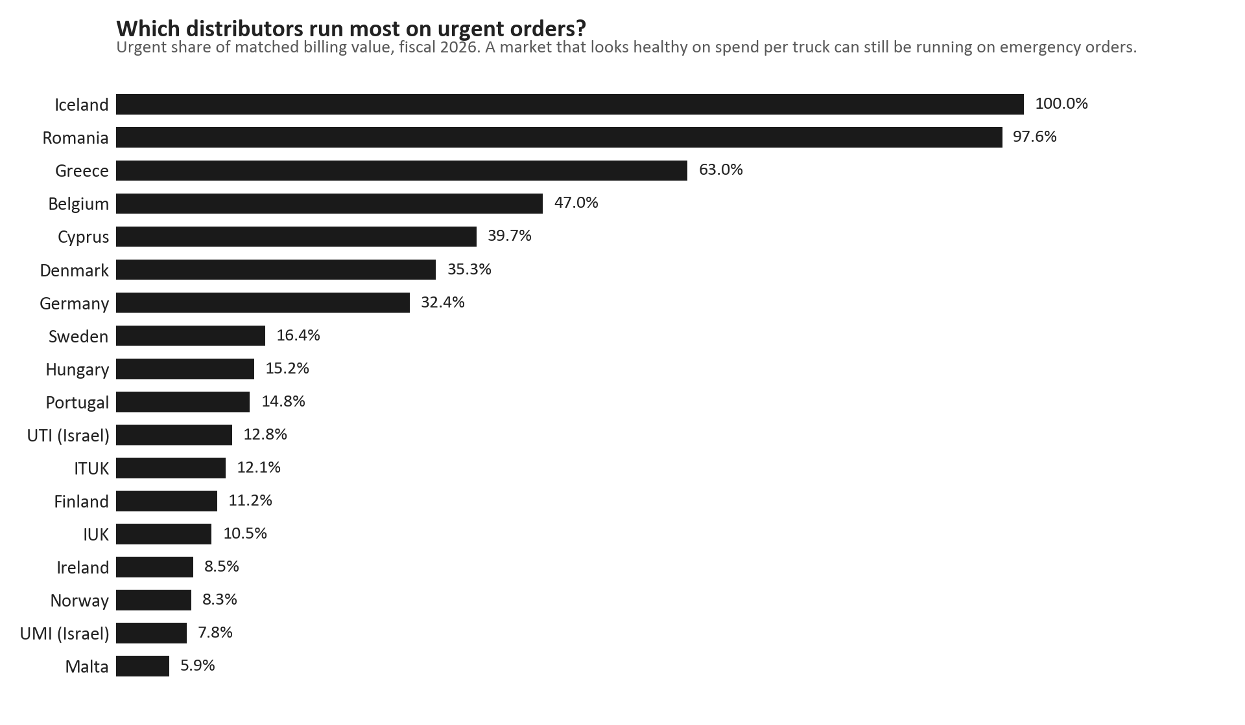
ORDER URGENCY
Urgent-order share by distributor: a healthy spend per truck can still hide an emergency habit
TAKEAWAYS
— Urgent share of matched billing value, by distributor.
— Markets high on this page are buying their availability one emergency order at a time.
— Order coding is uneven, so each bar should be read with its matched-value coverage.
— This measure exposes a market that looks fine on spend per truck.
15

Slide 16
03
Where the money is
Spend per truck, the modelled ceiling, and the service families carrying the unbought euro.
16

Slide 17
THE PARTS OPPORTUNITY
56.6% of the modelled parts ceiling is covered today
TARGET SPEND CEILING
PARTS BILLED
NOT CAPTURED
SPEND PER TRUCK
EUR 54.38M
EUR 30.76M
EUR 23.95M
EUR 188
modelled, calendar 2025
what we billed in the same year
of which addressable EUR 23.95M
median EUR 185 across the network
The ceiling is a model, and part of it rests on a flat per-truck assumption in the smaller markets. The addressable line is the portion of the gap we can realistically contest. Read the coverage figure as a direction with a stated model behind it, not as a measured share of the market.
17

Slide 18
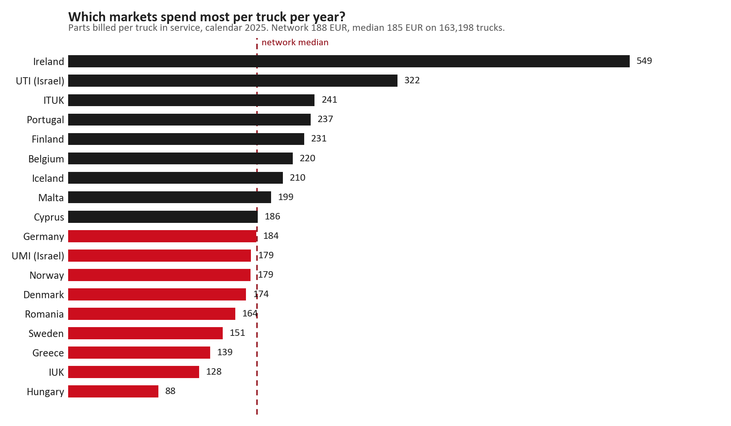
SPEND PER TRUCK
Spend per truck ranges more than four to one across the network
TAKEAWAYS
— Parts billed per truck in service, calendar 2025.
— The spread is the finding: the same service need is being satisfied at very different rates.
— A high figure is not automatically good — it can also mean a market is over-buying against its fleet.
— Each market's denominator is its fleet in service from the same model, and the source is stated until it is not.
18

Slide 19
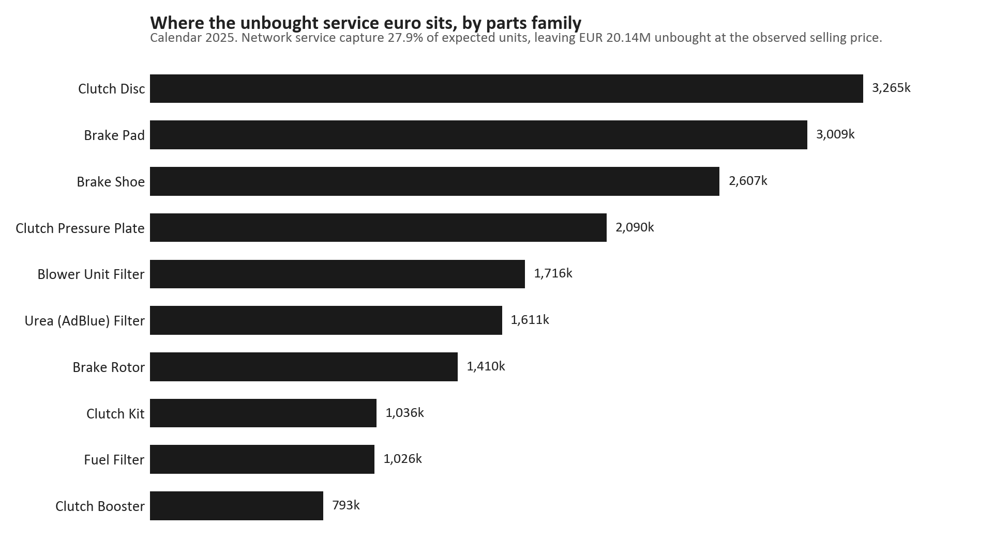
SERVICE CAPTURE
The unbought service euro is concentrated in a handful of families
TAKEAWAYS
— Unbought value EUR 20.14M at observed selling prices, calendar 2025.
— Largest single family: Clutch Disc at EUR 3.26M.
— These are the families where a service-coverage conversation pays first.
— Capture is measured in units against the service model and then valued at the price actually realised.
19

Slide 20
04
ITUK in detail
The gap at both layers of the chain, converted from the sales performance leakage review.
20

Slide 21
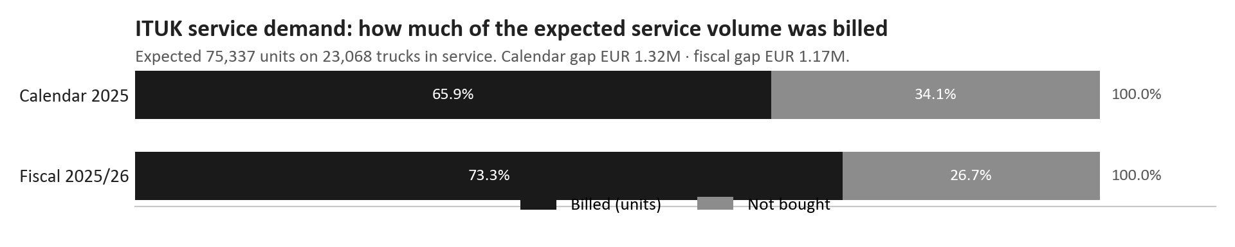
ITUK · SERVICE DEMAND
ITUK: about two thirds of the expected service volume is billed, and the fiscal view is better than the calendar one
TAKEAWAYS
— Expected service units against what was actually billed, on 23,068 trucks in service.
— Calendar 2025: 65.9% billed, leaving EUR 1.32M unbought.
— Fiscal 2025/26: 73.3% billed, leaving EUR 1.17M — the gap narrows on the fiscal basis.
— The difference between the two columns is the year boundary, not a different fleet.
21

Slide 22
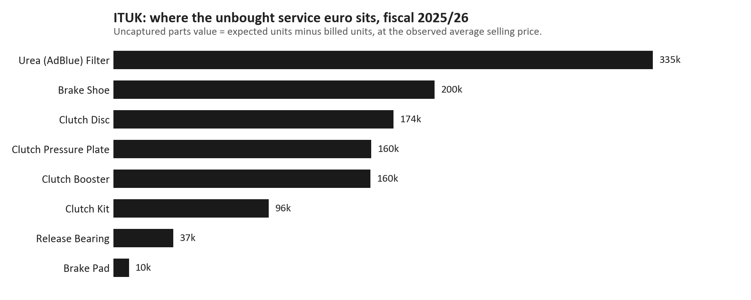
ITUK · GAP BY FAMILY
ITUK: the unbought euro sits in urea filters, brake shoes and clutch components
TAKEAWAYS
— Fiscal 2025/26, valued at the observed selling price.
— Urea filter is the single largest line at EUR 335k.
— Brake shoe at EUR 200k and clutch disc at EUR 174k follow.
— Filters as a group are largely captured, which makes the filter gap a volume question rather than a price one.
22

Slide 23
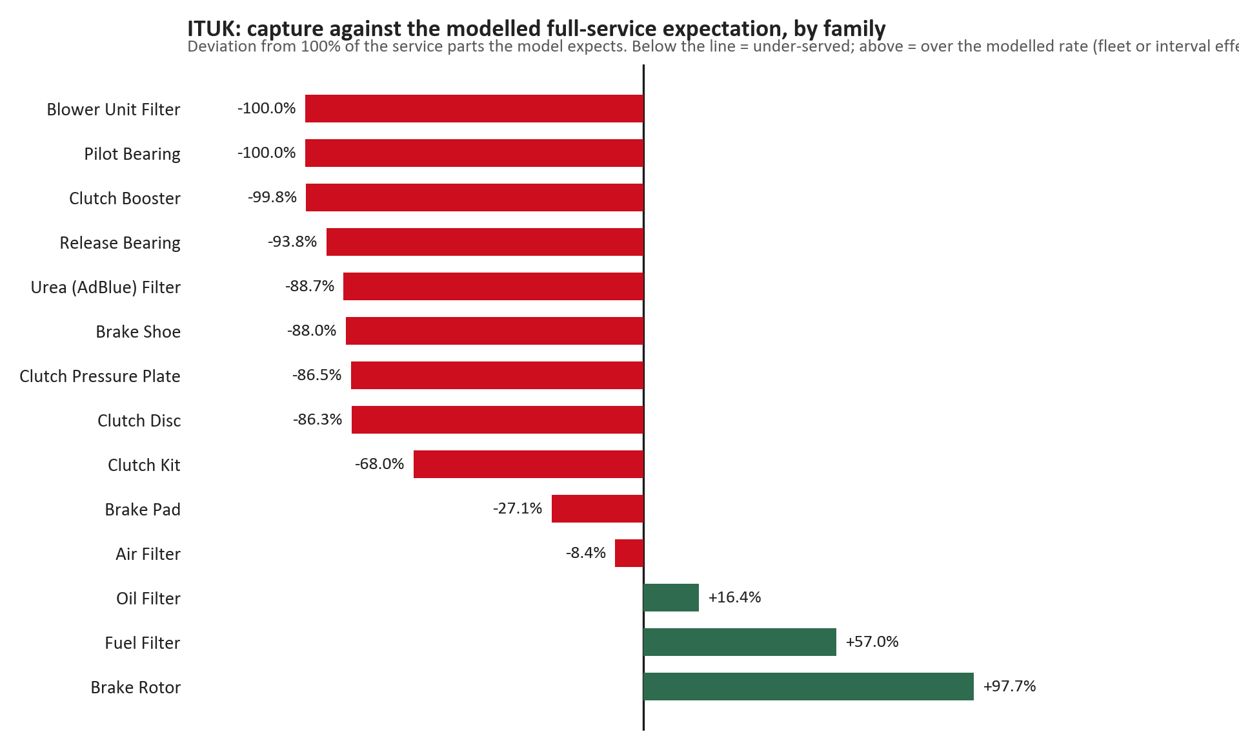
ITUK · CAPTURE AGAINST EXPECTATION
ITUK: capture measured against the full service expectation, by family
TAKEAWAYS
— Deviation from 100% of the service parts the model expects for this fleet.
— Filters sit at or above the modelled rate, so their gap is fleet or service-interval driven.
— Clutch components sit well below, and that is where the recoverable value is.
— Above the line is not automatically a win: it can mean the interval assumption is too low for this fleet.
23

Slide 24
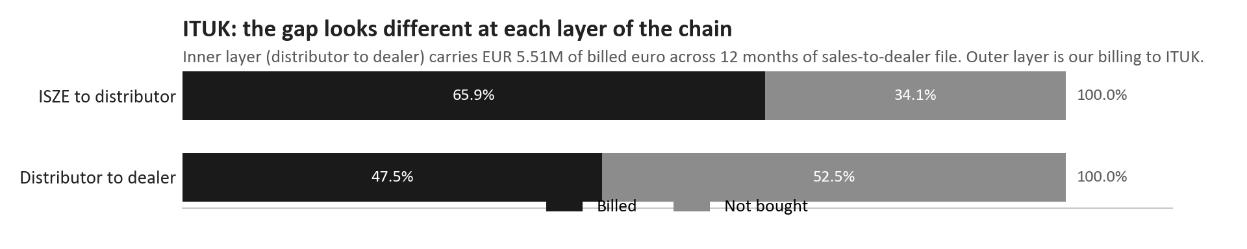
ITUK · BOTH LAYERS
ITUK: the chain looks different at the inner layer than at ours
TAKEAWAYS
— Outer layer is our billing to ITUK; inner layer is what ITUK's dealers buy.
— The dealer layer carries EUR 5.51M of billed euro across twelve months of sales-to-dealer file.
— Dealer-layer capture is 47.5%, materially below our 65.9% to the distributor.
— That difference is what the distributor is holding, and it is the conversation worth having with ITUK.
24

Slide 25
05
Genuine and best-value on the same part number
Where both lines exist for the same reference, which one is moving — and where classification says we are exposed.
25

Slide 26
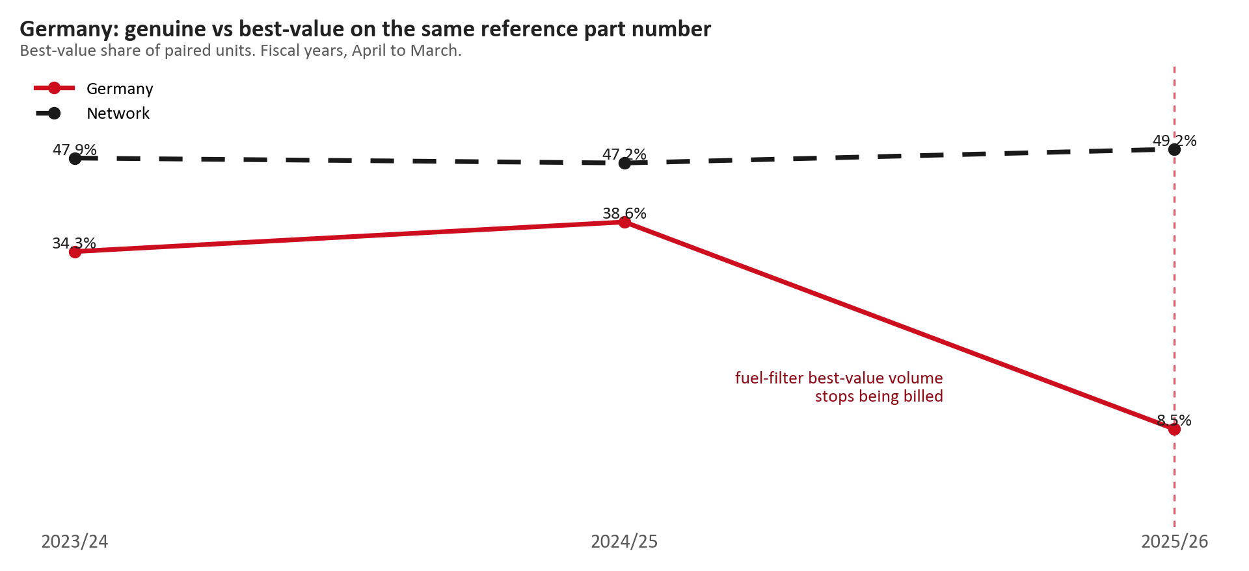
GENUINE AGAINST BEST-VALUE
Germany: best-value share of paired units fell from 38.6% to 8.5% in one fiscal year
TAKEAWAYS
— Best-value share of units on reference pairs, fiscal years, April to March.
— Germany ran at 34.3%, then 38.6%, and fell to 8.5% in 2025/26.
— The network line stayed flat between 47% and 49%, so this is a Germany-specific movement.
— Two fifths of one market's paired volume changing line in a single year deserves a direct question.
26

Slide 27
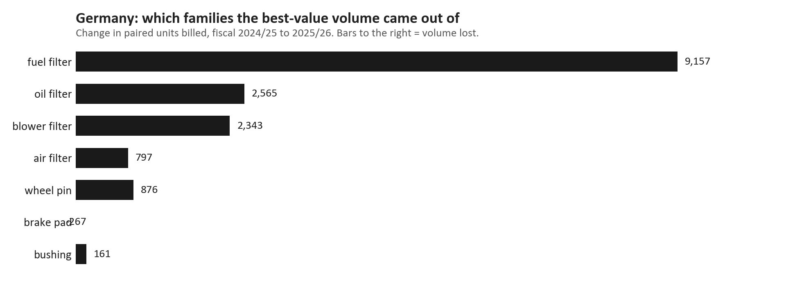
GENUINE AGAINST BEST-VALUE
Germany: the movement is almost entirely fuel-filter best-value volume stopping
TAKEAWAYS
— Change in paired units billed, fiscal 2024/25 to 2025/26.
— Fuel-filter best-value volume fell from roughly ten thousand units to tens of units.
— Genuine fuel-filter volume held at around five thousand units over the same period.
— So this is not Germany buying fewer filters — it is one line leaving the mix.
27

Slide 28
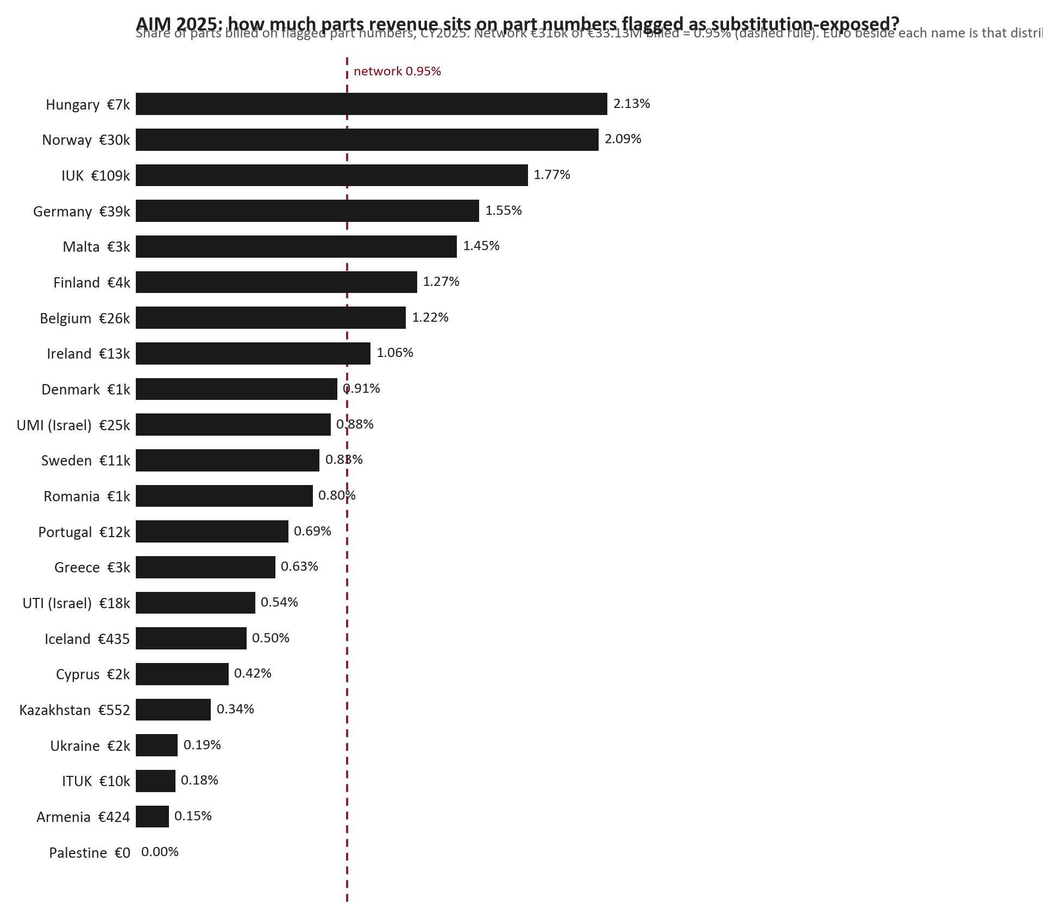
PARTS CLASSIFICATION
Parts classification flags where the independent aftermarket can take the job
TAKEAWAYS
— Share of parts billed on part numbers flagged as substitution-exposed, calendar 2025, with the network rule marked.
— Network flagged revenue is EUR 316k of EUR 33.1M billed — 0.95%, so the flag is narrow by design rather than a broad alarm.
— The largest single flagged book is IUK, which is where a value-line defence pays first.
— Classification match itself sits above 96% of billed euro, so the flag rather than the match is what separates markets.
28

Slide 29
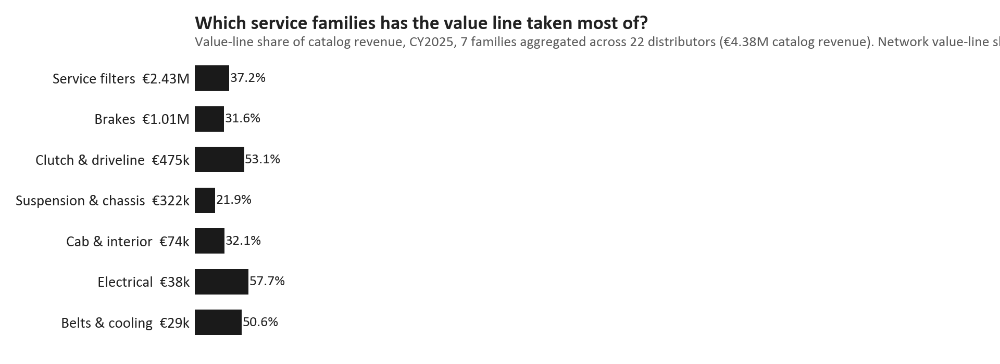
PARTS CLASSIFICATION
Exposure by parts family, with the best-value share beside it
TAKEAWAYS
— Families where the independent aftermarket is most able to substitute.
— Where exposure is high and best-value share is low, we are the ones losing the job.
— Where genuine revenue is already zero, every best-value unit is incremental rather than a trade-down.
— Read the two measures together: exposure alone does not say what to do.
29

Slide 30
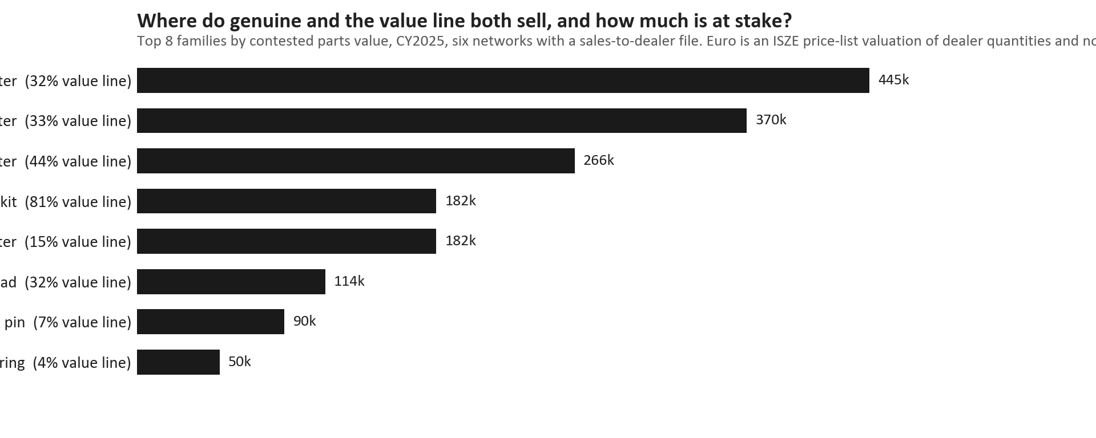
PARTS CLASSIFICATION
The largest classification gaps in euro
TAKEAWAYS
— Ranked by the euro value of the gap.
— The euro basis is stated on the chart — dealer sell-out and our billing are not the same measure.
— Families with no matched classification are excluded rather than estimated.
— Treat this as a target list, not a forecast.
30

Slide 31
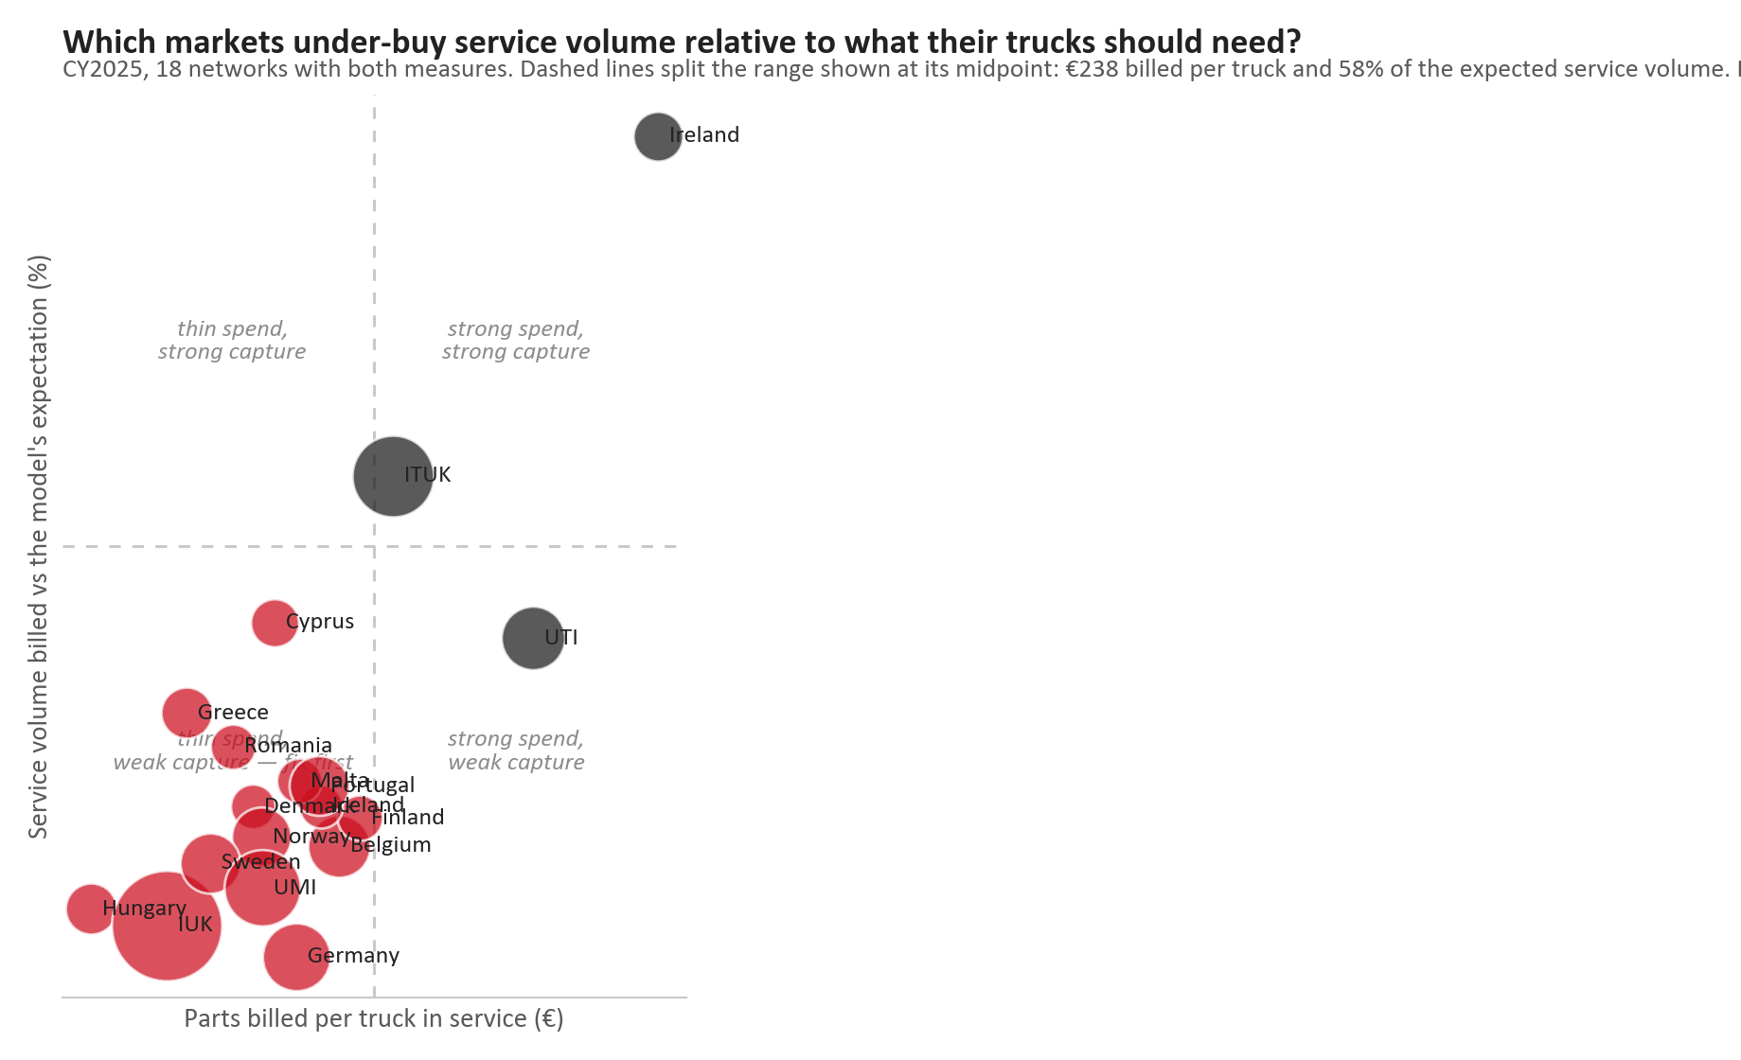
PARTS CLASSIFICATION
Exposure against spend per truck: where each line of defence belongs
TAKEAWAYS
— Each market placed by exposure and by spend per truck, sized by parts billed.
— High exposure with low spend is where a value line is the answer.
— Low exposure with high spend is where genuine margin is worth protecting.
— Bubble size is parts billed, so visual weight matches commercial weight.
31

Slide 32
06
PRISM and the dealer standard
What the analytics platform covers behind these numbers, and what the dealer assessment says about the network.
32

Slide 33
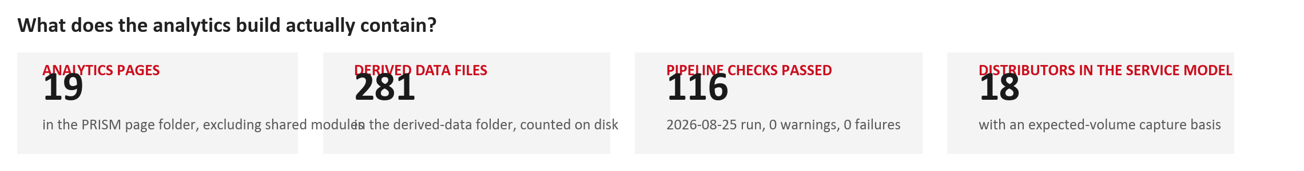
PRISM
PRISM is the reason these numbers can be quoted at all
TAKEAWAYS
— Every figure in this deck traces to a derived file built and checked by the platform.
— Coverage and pass-or-fail state are shown rather than assumed.
— Where a source is weak, the platform records it as an open integrity item instead of quietly correcting it.
— This deck repeats that discipline: a missing market is missing, never zero.
33

Slide 34
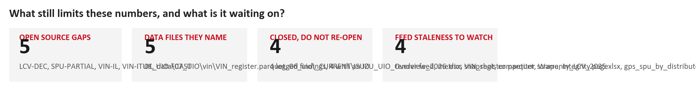
PRISM
Open data issues, stated rather than hidden
TAKEAWAYS
— These are the known limits behind the numbers in this deck.
— They are recorded so a reader can judge how firm any single figure is.
— None of them is corrected silently.
— If a number here is later disputed, this page is where the caveat already lives.
34

Slide 35
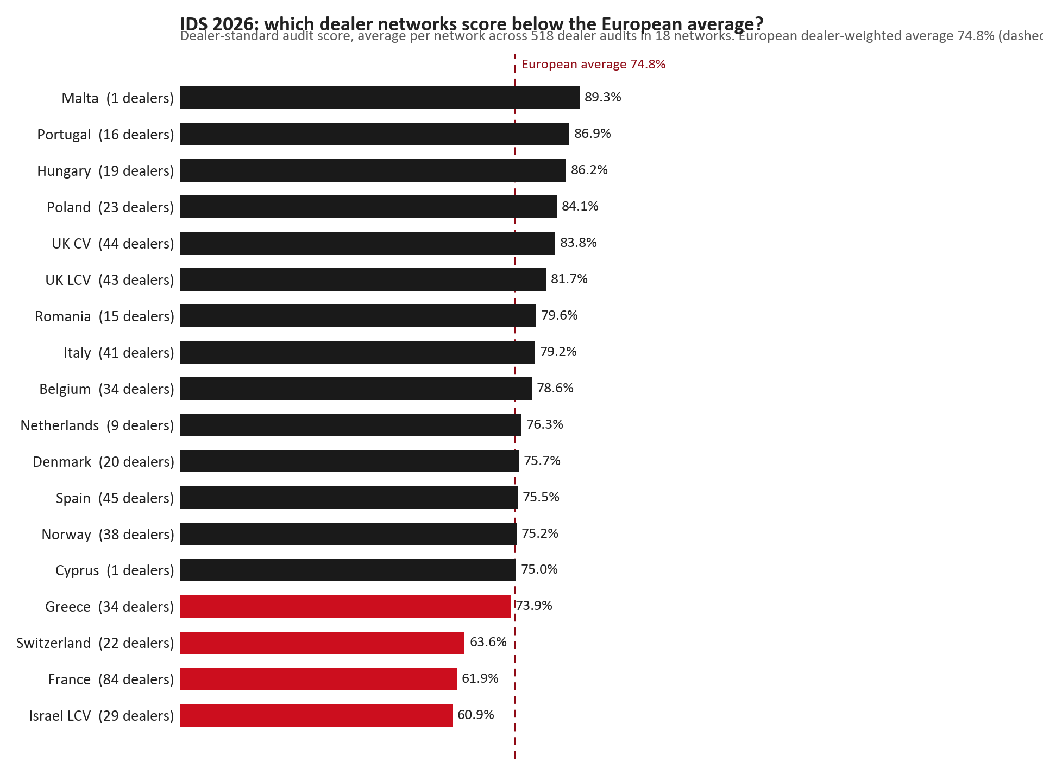
DEALER STANDARD
Dealer standard assessment: how each country scored in 2026
TAKEAWAYS
— Dealer audit scores against the common standard, 2026 evaluation round.
— 518 dealer audits across 18 networks. The European dealer-weighted average is 74.8%.
— The spread runs from about 61% to 89%, and the network average is marked on the chart.
— Small networks move a lot on one dealer — read the audit count beside the name, not the rank alone.
35

Slide 36
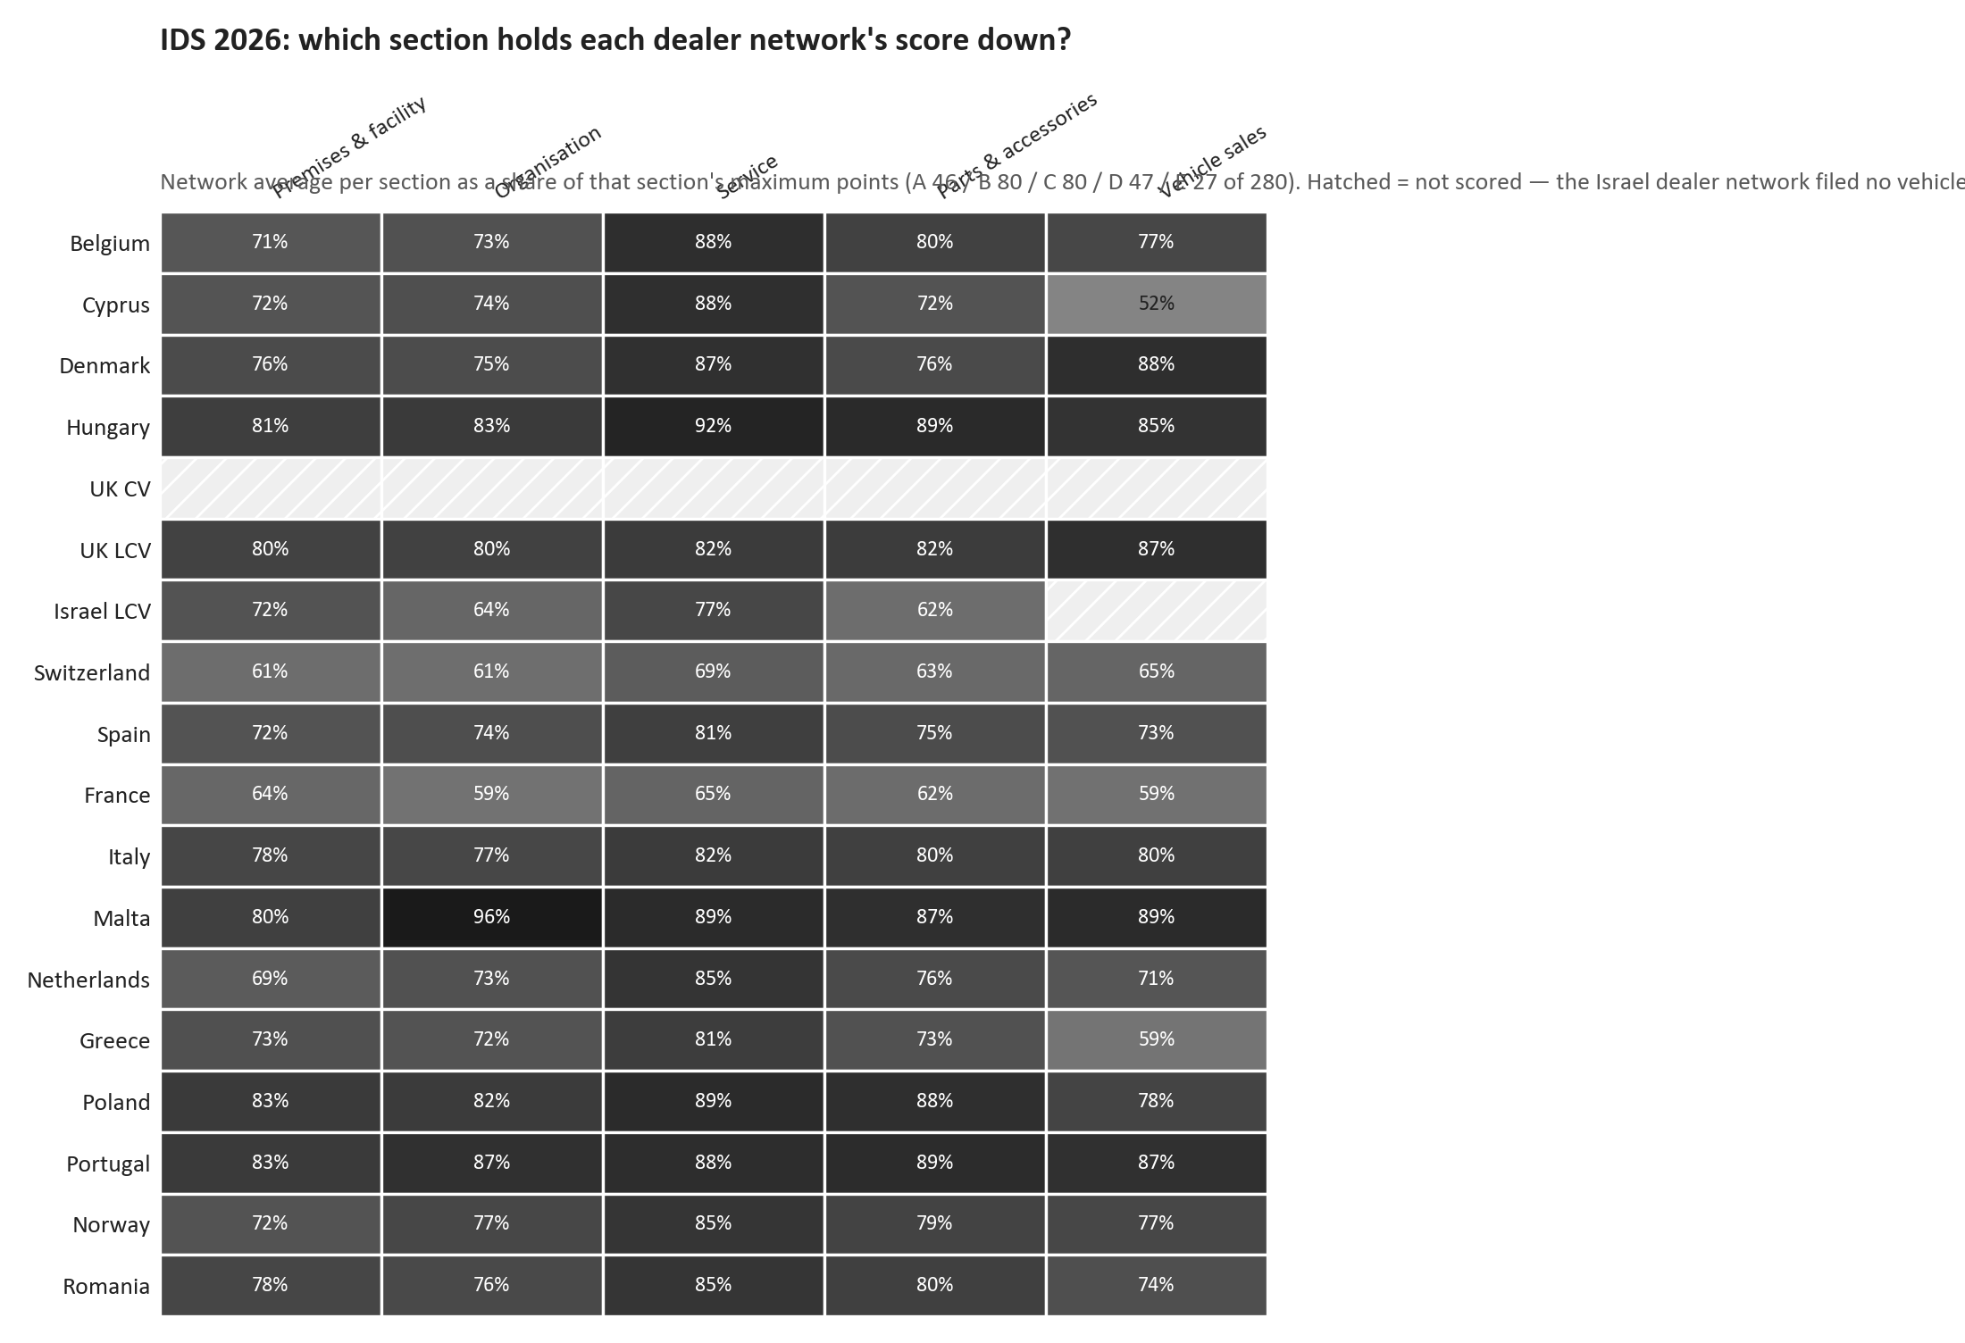
DEALER STANDARD
Dealer standard by section: where each network's score is held down
TAKEAWAYS
— Network average per section as a share of that section's maximum points (A 46 / B 80 / C 80 / D 47 / E 27 of 280).
— Service (C) is the strongest section network-wide at about 83%; premises (A) is the weakest at about 74%.
— Read across a row to see which section holds that particular network down — it differs by market.
— Israel's vehicle-sales column is hatched, not zero: that network filed no vehicle-sales answers and its total is A to D only.
36

Slide 37
07
Warranty and the revenue mix
How much of what we bill is warranty work rather than customer-paid parts.
37

Slide 38
WARRANTY
Warranty is 14.6% of everything we bill
WARRANTY PARTS BILLED
SHARE OF PARTS BILLED
MARKETS WITH A FIGURE
READ IT AS
EUR 4.72M
14.6%
18
claim cost
calendar 2025
warranty against total billed
of the network rows
not as a sales win
Warranty parts are revenue, but they are not customer-paid demand. Reading them inside a growth number overstates the commercial position, which is why they are shown separately here and excluded from the target-spend ceiling.
38

Slide 39
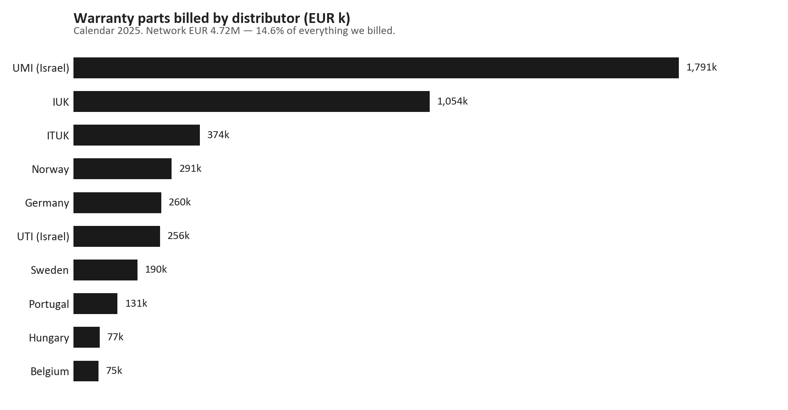
WARRANTY
Warranty parts billed by distributor
TAKEAWAYS
— Calendar 2025, warranty parts value per distributor.
— The concentration follows fleet size, so read the share of billed rather than the absolute value.
— A rising warranty share against falling customer-paid parts is a quality signal worth tracking.
— Warranty sits outside the target-spend ceiling, which covers customer-paid demand only.
39

Slide 40
BEFORE THE NEXT REVIEW
What we are asking for
— A direct question to ITUK on the dealer-layer gap: our billing is at 65.9%, their dealers are at 47.5%, and the difference is demand that reached the distributor but not the workshop.
— Germany: confirm why fuel-filter best-value volume stopped in fiscal 2025/26. It is one line, and it moved a market from 38.6% to 8.5% on paired units.
— Fill rate: bring the 10 markets below the 95% standard into the monthly review with a named owner, and record the markets that never file as a data gap rather than a zero.
— Inventory cover: agree the band per supply route and review the markets holding far more stock than their route justifies.
— Warranty to be reported beside growth from now on, so a warranty-heavy month is never read as commercial growth.
— Keep the exposure lens on every best-value decision, so a value line is deployed where genuine revenue is already lost rather than where it is strong.
THE ONE DECISION WE NEED
Whether the sales-to-dealer layer becomes a standing part of the distributor review. If it does, more markets need to file and the inner-layer gap stops being invisible. If it does not, the ITUK conversation on page 15 cannot be repeated anywhere else.
40

