Slide 1

ISZE · ISRAEL · UMI
UMI Sales Review
& FY2027 Target
Universal Motors Israel · August 2026

Slide 2
EXECUTIVE STORYLINE
The meeting should align three commercial facts and three joint decisions
YTD sales
Commercial parts
FY2027 target
EUR 875K
+33.6%
EUR 3,052K
-12% vs BP; -14% vs LY
CY H1 2026 vs CY H1 2025
Extended target (locked)
Commercial parts billing moved +33.6%, but Lighting, Hydraulic / mechanical, Filters still need a joint recovery plan.
1
Close the lubricant blocker
2
Choose the first recovery category
3
Unlock part-level sales-to-dealer data
— Agree when Shell price discussion closes and whether any volume is moving outside ISZE while the hold continues.
— Start with Lighting; make the action visible dealer-by-dealer.
— Monthly sales to dealer at part number level from 01/01/2025 to separate stock movements from lost jobs.
2

Slide 3
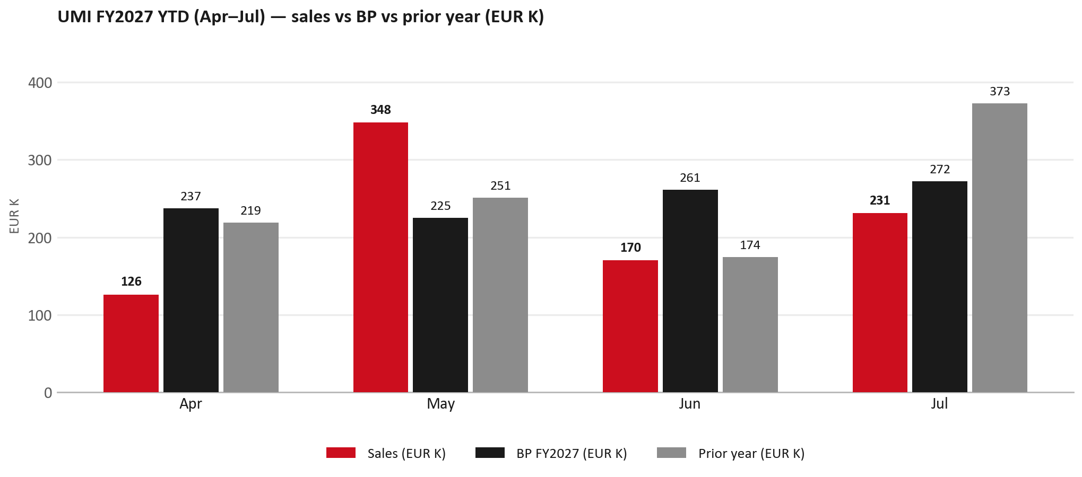
PERFORMANCE
FY2027 YTD (Apr–Jul): EUR 875K, -12% vs BP
TAKEAWAYS
— Sales EUR 875K against BP EUR 995K — -12%, and -14% on last year's EUR 1,017K.
— Jul is -38% YoY — Shell lubricants on hold (price not agreed) is the stated turnover gap into August.
— The beat is entirely May: EUR 348K against EUR 225K. Apr -47%, Jun -35% and Jul -15% are below BP.
— The conversation should move quickly from what happened to which lever we jointly pull first.
3

Slide 4
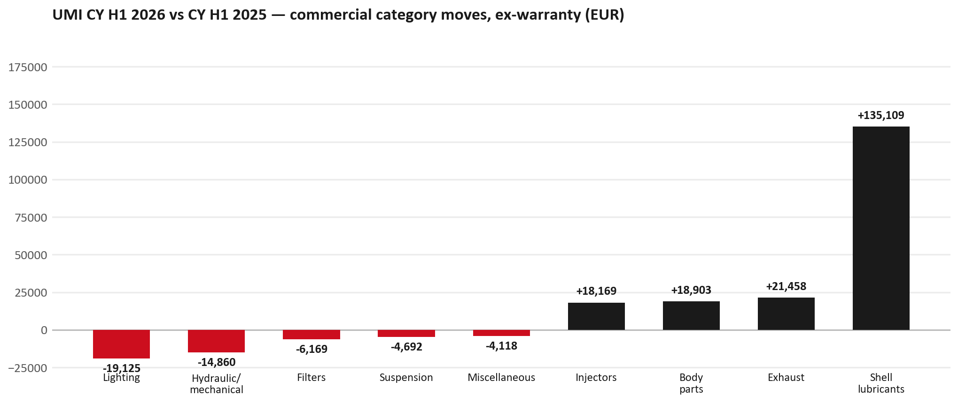
MIX
Commercial parts grew +33.6% — the leaks sit in specific families
TAKEAWAYS
— Commercial parts billing (warranty/campaign excluded) EUR 665K against EUR 498K a year earlier — +33.6% (CY H1 2026 vs CY H1 2025, Jan–Jun).
— Largest PN drops (all categories): 8980565510 (ROD END ASM; OUTER) EUR -7K, 185 fewer pcs; 1884057860 (GEAR OIL LSD) EUR -6K, 203 fewer pcs; 8982457540 (NOZZLE ASM; INJ) EUR -5K, 20 fewer pcs.
— Largest PN gains (all categories): 8982601090 (NOZZLE ASM; INJ) EUR 22K, 96 more pcs; 5876150640 (PAD KIT; DISC BRK,W/) EUR 6K, 150 more pcs; 8978461132 (GLASS; WINDSHIELD) EUR 5K, 25 more pcs.
— Within Shell lubricants (EUR 135K): 550047337 (Rim R4L15W40 CK4_3*5) EUR 106K, 2,371 more pcs; 550047252 (Rim R4 L 15W40 CJ4_1) EUR 17K, 24 more pcs; 550070445 (Rim R4L 15W40 CK4_1*) EUR 9K, 120 more pcs.
4

Slide 5
LEAKAGE
Category gaps that deserve a direct customer conversation
Lighting
Hydraulic / mechanical
Filters
EUR 66K → EUR 47K (-29%)
EUR 43K → EUR 28K (-35%)
EUR 23K → EUR 16K (-27%)
Is this availability, pricing, or genuinely fewer accident repairs?
Is this pricing against what the dealers can buy locally?
Are dealers stocking filters, or ordering line-by-line against each job?
Recommended first action: Lamps
Recommended first action: Pricing / availability
Recommended first action: Service pack
Full part-number detail is in the appendix — use this page to decide what we do.
5

Slide 6
OPPORTUNITIES
Use the growth list as a repeatability discussion, not just a table
NOZZLE ASM; INJ
8982601090
+EUR 22K
PAD KIT; DISC BRK,W/O SHIM &
5876150640
+EUR 6K
GLASS; WINDSHIELD
8978461132
+EUR 5K
LAMP ASM; RR COMB
8978248633
+EUR 4K
BUMPER ASM; FRT
7552172681
+EUR 4K
GRILLE; INNER,RAD
7552070241
+EUR 4K
Decision lens
1
Repeatable?
2
Protectable?
3
Actionable?
— Which lines reflect structural dealer demand rather than one-off accident or stock movements?
— Which lines are most exposed to IAM or parallel sourcing if we do nothing?
— Which lines can be supported through SPA, service packs or availability focus within 90 days?
6

Slide 7
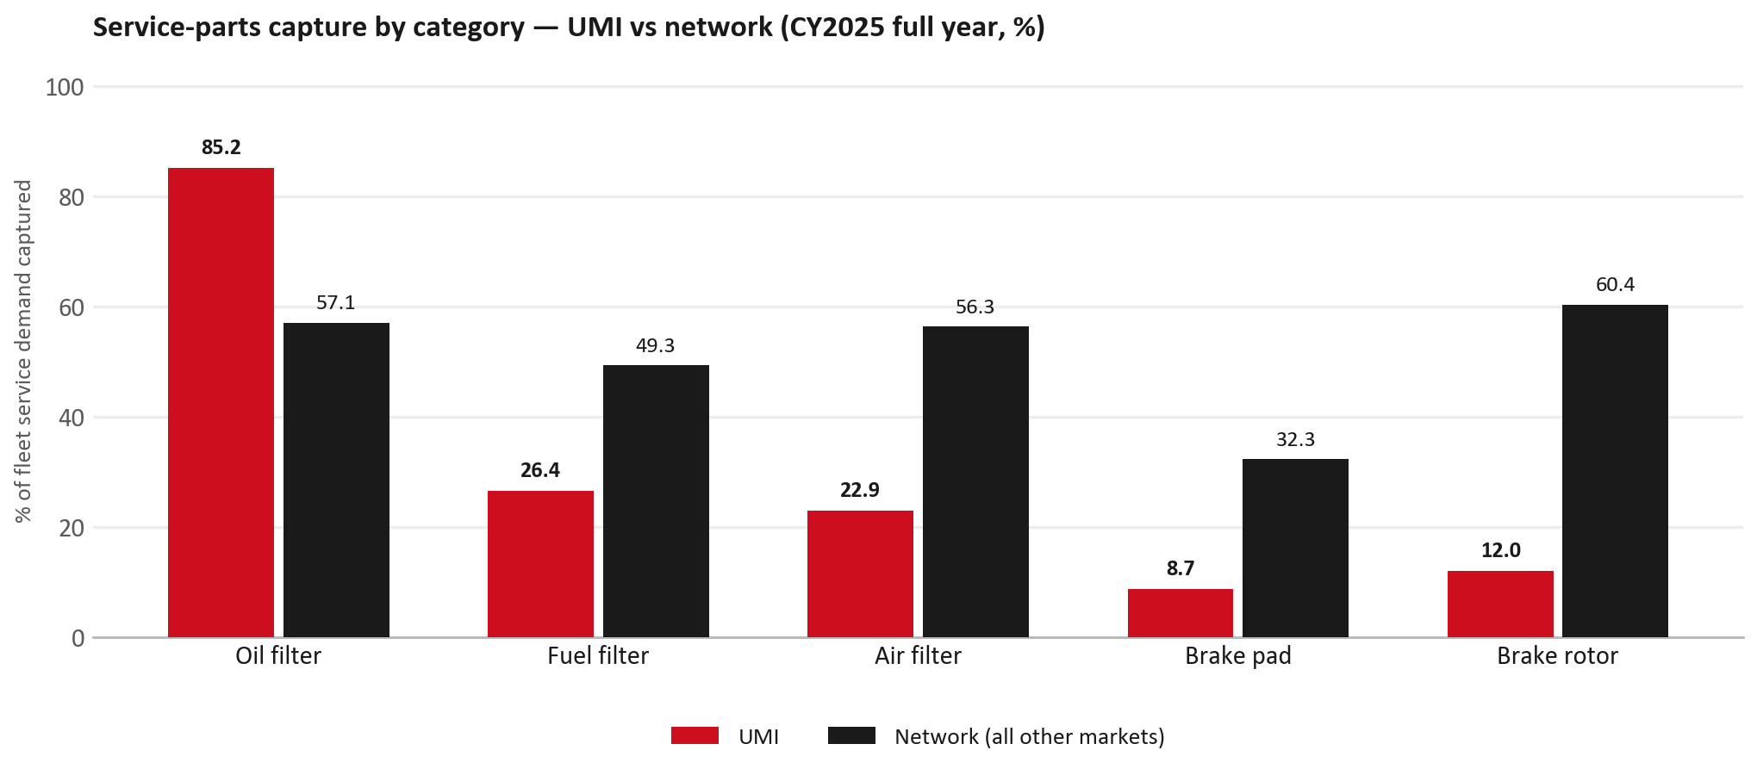
SERVICE-PARTS COVERAGE
Service-parts coverage: brake rotor is the clear gap
TAKEAWAYS
— Brake rotor 12.0% against 60.4% for the rest of the network.
— Air filter 22.9% against 56.3% for the rest of the network.
— Every market here is measured on the same fleet-and-interval model, so the comparison is like-for-like even where the underlying interval assumption is debatable.
— Worth agreeing which category we tackle first, and what the joint action is.
7

Slide 8
IDS 2026 — DEALER STANDARD
IDS 2026: UMI averages 60.9%, below the 74.8% network benchmark
Dealer | Total % | Global rank
Kfir Yaud | 69.6% | #406
Eden Garage Rishon | 68.6% | #415
Tel Hanan Haifa | 68.6% | #416
UMI country average | 60.9% | —
Network average (all IDS 2026) | 74.8% | —
Asayag Jerusalem | 44.3% | #476
Ram Raanana | 43.2% | #477
Zarfati Jerusalem | 39.3% | #479
— 29 dealers assessed across Premises, Organisation, Service, Parts and Vehicle Sales.
— The country average sits 13.9 points below the network — both averages are taken on assessed dealers only.
— The spread is the point: 30 points between the strongest and weakest assessed dealer.
— Dealer-by-dealer detail and individual feedback are available as a separate pack — worth agreeing which dealers to visit, and when.
8

Slide 9
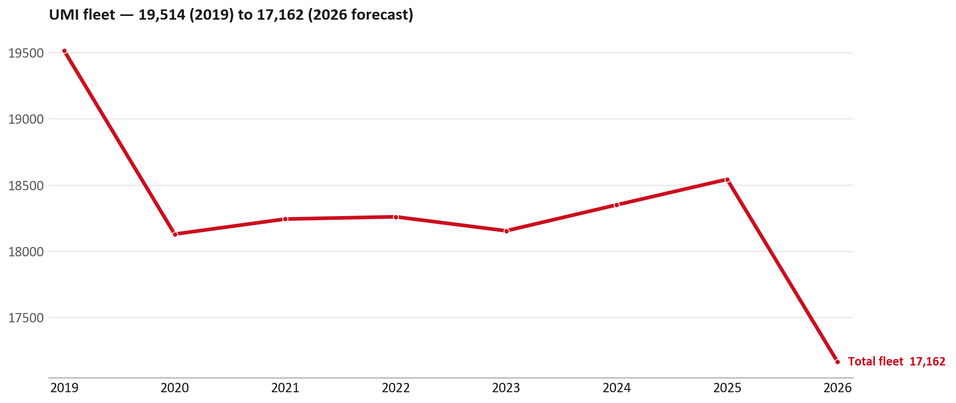
FLEET & FY2027 TARGET
The fleet is expected to decline in 2026
WHAT THIS MEANS FOR FY2027
— Fleet size (calendar year): 18,542 vehicles in 2025 → 17,162 working estimate for end-2026 (-7.4%).
— The chart is calendar years 2019–2026 only. 2026 is a working year-end estimate, not a fiscal-year figure.
— End-2026 mix: LCV / D-Max 17,162.
— The FY2027 extended target (ISZE→DB) applies a 5% price adjustment and 1.8% stretch — locked at EUR 3,051,652 from GPS Extended Target V3.1 (Dashboard column I).
— So the target is built from a slightly smaller fleet — not from an assumed growth story.
9

Slide 10
FLEET & FY2027 TARGET
How the FY2027 extended target is built
ISZE → DB extended target (V3.1 Dashboard column I)
Step | Amount
Business Plan / actual FY27 base | EUR 2,973,279
Market potential (max spend FY27) | EUR 4,354,036
Stretch (+1.8% of max spend) | EUR 78,373
FY2027 EXTENDED TARGET (locked) | EUR 3,051,652
— Extended target = BP + stretch; stretch default is 1.8% (network rule from GPS Extended Target V3.1).
— Figure locked from V3.1 Dashboard col I UMI: EUR 3,051,652.
10

Slide 11
FY2027 TARGET
What the FY2027 target reflects
1
The FY2027 business plan
2
The price move
— The target starts from the FY2027 Business Plan for this market, EUR 2,973,279.
— Your fleet outlook (-7.4%) sets the market potential the stretch is measured against.
— ISZE is applying a 5% price adjustment for FY2027, consistent with every ISZE market this year.
— It is built into the per-vehicle rate above, not added separately on top.
What it means for your target
 | Value
FY2027 extended target (V3.1 col I) | EUR 3,051,652
vs BP FY27 (EUR 2,973,279) | +2.6%
Stretch included | +1.8%
— As in previous cycles we would expect an incentive to sit alongside this adjustment — that approval is still pending on our side.
— Until the incentive is confirmed, treat the FY2027 extended target as the working figure (BP + stretch), not a locked commercial commitment.
11

Slide 12
JOINT PLAN
End the customer meeting with clear workstreams and owners
1
FY2027 target
2
Lubricants
3
Service-parts pilot
4
SPA list
— Confirm extended target EUR 3,051,652 and incentive status.
— Close Shell price agreement; confirm restart timing and any temporary leakage.
— Pick Lighting as the first joint recovery category.
— Universal Motors Israel submits a target list; ISZE counters with network data and margin logic.
Fewer slides in the room, clearer decisions, and a direct link between Universal Motors Israel's asks and ISZE support.
12

Slide 13
Moving the World – for You

Slide 14
UMI · UNIVERSAL MOTORS ISRAEL
Appendix — detail behind the meeting story
— Part-number declines, growth deep dives, New Business validation, SPA process, R&M questions and the data request.
— Use selectively — the spoken meeting ends on the previous closing slide.
13

Slide 15
APPENDIX — LIGHTING
Lighting — CY H1 2026 vs CY H1 2025 (commercial, ex-warranty)
— EUR 66,473 (CY H1 2025) to EUR 47,348 (CY H1 2026), down EUR 19,125 (-29%).
— Largest part numbers driving the decline (by EUR):
— 8977993773 (LAMP ASM; HEAD): EUR 4,162 to EUR 0, 14 fewer pieces.
— 8977993763 (LAMP ASM; HEAD): EUR 3,865 to EUR 0, 13 fewer pieces.
— 8983287885 (LAMP ASM; HEAD): EUR 4,013 to EUR 1,086, 28 fewer pieces.
— 8976830212 (LAMP ASM; RR COMB): EUR 7,066 to EUR 4,159, 25 fewer pieces.
Questions for us to work through together
— Is this availability, pricing, or genuinely fewer accident repairs?
— Are the bodyshops in your network sourcing lamps elsewhere?
14

Slide 16
APPENDIX — HYDRAULIC / MECHANICAL
Hydraulic / mechanical — CY H1 2026 vs CY H1 2025 (commercial, ex-warranty)
— EUR 43,066 (CY H1 2025) to EUR 28,206 (CY H1 2026), down EUR 14,860 (-35%).
— Largest part numbers driving the decline (by EUR):
— 8980565510 (ROD END ASM; OUTER): EUR 9,604 to EUR 2,988, 185 fewer pieces.
— 1884057860 (GEAR OIL LSD): EUR 8,956 to EUR 3,066, 203 fewer pieces.
— 8979458422 (ARM; UPR CONT): EUR 2,319 to EUR 0, 20 fewer pieces.
— 8979458441 (ARM; LWR CONT): EUR 1,188 to EUR 0, 8 fewer pieces.
Questions for us to work through together
— Is this pricing against what the dealers can buy locally?
— Is any of this stock timing on your side rather than end demand?
— What would make the biggest difference to keep this business with us?
15

Slide 17
APPENDIX — FILTERS
Filters — CY H1 2026 vs CY H1 2025 (commercial, ex-warranty)
— EUR 22,637 (CY H1 2025) to EUR 16,468 (CY H1 2026), down EUR 6,169 (-27%).
— Largest part numbers driving the decline (by EUR):
— 5876150050 (ELEMENT; OIL FILTER · TFR,TFS,UCR,UCS): EUR 7,435 to EUR 2,545, 920 fewer pieces.
— 8978770040 (FILTER ASM): EUR 3,152 to EUR 0, 2 fewer pieces.
— 5876100190 (CARTRIDGE;OIL FILTER · UBS): EUR 1,130 to EUR 426, 230 fewer pieces.
— 5876100170 (CARTRIDGE;OIL FILTER · UBS): EUR 1,128 to EUR 664, 90 fewer pieces.
Questions for us to work through together
— Are dealers stocking filters, or ordering line-by-line against each job?
— How much servicing do you estimate is happening outside the franchised network?
— Would a service-pack offer on oil and fuel filters be workable for your dealers?
16

Slide 18
APPENDIX — SHELL LUBRICANTS
Shell lubricants — CY H1 2026 vs CY H1 2025 (commercial, ex-warranty)
— EUR 0 (CY H1 2025) to EUR 135,109 (CY H1 2026), up EUR 135,109.
— Largest part numbers driving the increase (by EUR):
— 550047337 (Rim R4L15W40 CK4_3*5L): EUR 0 to EUR 105,984, +2,371 pcs.
— 550047252 (Rim R4 L 15W40 CJ4_1*209L): EUR 0 to EUR 17,493, +24 pcs.
— 550070445 (Rim R4L 15W40 CK4_1*20L JC_A246): EUR 0 to EUR 8,640, +120 pcs.
— 550070643 (RimulaR6LM10W40CK-4_1*20L JC_A246): EUR 0 to EUR 2,992, +40 pcs.
Questions for us to work through together
— When can the Shell price discussion close so lubricant orders restart?
— How much of the Original BP gap is lubricants vs the rest of the basket?
— Is any Shell volume moving outside ISZE while the hold continues?
17

Slide 19
APPENDIX — SPA
SPA
1
UMI proposal
2
ISZE review
3
Counter-proposal
4
Final approval
— Universal Motors Israel submits a proposed parts list.
— ISZE reviews the proposal against network data and fit.
— ISZE returns a counter-proposal where needed.
— Signed off by ISZE management.
Purpose: higher turnover for both sides.
18

Slide 20
APPENDIX — R&M
R&M — let's align on the market
M
Market
S
Servicing & R&M
— How is the market moving for you right now?
— How much of your volume is fleet business rather than retail?
— Where do you see the biggest hurdles this year?
— Where are your real strengths in this segment?
— Do you offer an R&M or service-plan product today?
— What share of the trucks in service do you retain for servicing after year three?
— Does R&M business come bundled with fleet tenders — roughly what share?
— What would it take to bring more out-of-network servicing back?
19

Slide 21
APPENDIX — ASK
Part-level sales-to-dealer data
1
The starting point
2
Sharper insight
3
Shared benefit
— We have no sales-to-dealer figures from you for FY2026. The ask is monthly sales to dealer, at part-number level.
— Part-by-part visibility separates a stock movement from a lost job — and tells us where the volume actually went.
— Better availability on your fast movers, a sharper target for us, and a factual basis for the SPA — same data, both sides gain.
Requested from 01/01/2025, part number level, monthly.
20

Slide 22
UMI · UNIVERSAL MOTORS ISRAEL
Deep dive — detail behind the shared story
— Extra detail for meeting prep — pick which slides to share with Universal Motors Israel.
— The spoken meeting ends on the earlier closing slide.
— Label in all charts: “Genuine with BVP alternative” (not “genuine contested”).
— UMI only — never blend UTI into these figures or IDS views.
22

Slide 23
AGENDA
Deep-dive agenda
— GPS — fiscal year (headline vs excl. warranty; max two lines)
— FY2025 → FY2026 parts mix (Genuine / Genuine with BVP alternative / BVP)
— Where the money went — outside the service-parts basket (FY)
— Service parts: CY capture vs network + FY billing (capture % is CY-only by design)
— Brake pads — BVP share of total brake pad sales (FY)
— AIM exposure
— Warranty — two lenses
— How to use this in the meeting
23

Slide 24
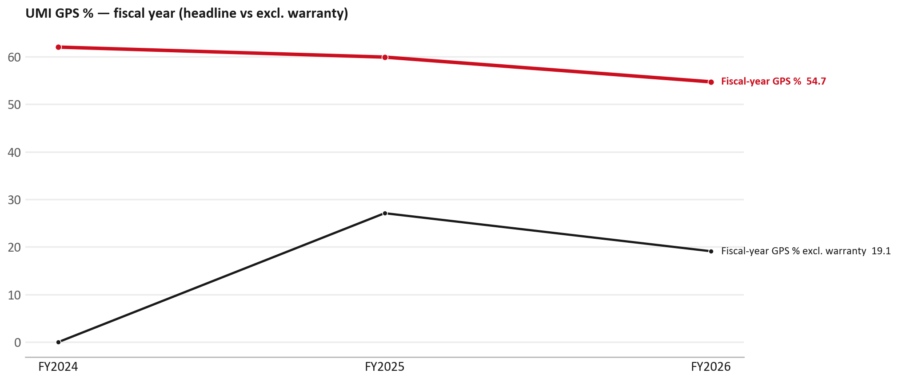
GPS
GPS: fiscal year headline vs after warranty
TAKEAWAYS
— Red = fiscal-year GPS (frozen CY2025 target spend). FY25 59.9% → FY26 54.7%.
— Black = the same GPS after removing warranty parts (€). FY26 ≈ 19.1% (warranty EUR 1,633,086 ≈ 65% of FY26 billing).
— Both lines divide by the same target spend (EUR 4,587,250), so the gap between them is warranty and nothing else.
24

Slide 25
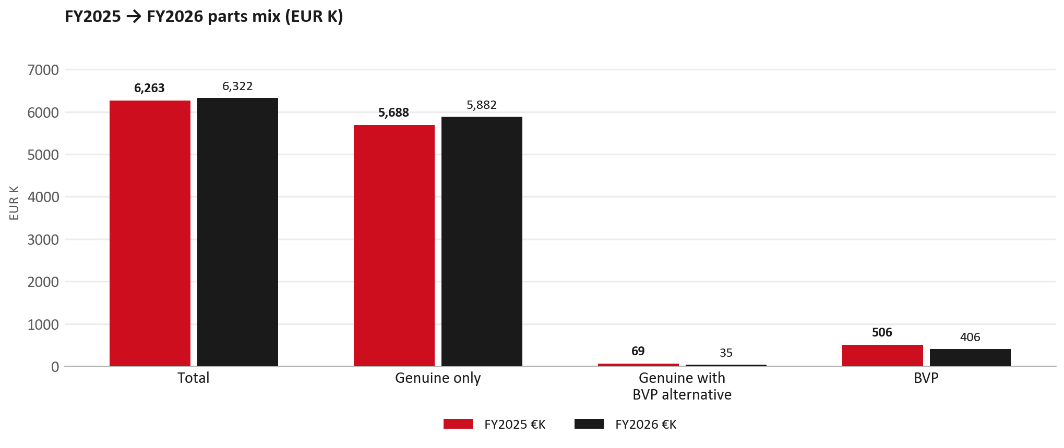
PARTS MIX
FY2025 → FY2026 parts mix
— Total EUR 6,263,047 → EUR 6,322,218 (+0.9%).
— Genuine only EUR 194,105.
— Genuine with BVP alternative EUR -34,824; BVP EUR -100,110 (6.4% of FY26 parts billed).
— Display label locked: Genuine with BVP alternative.
25

Slide 26
PARTS MIX
FY parts mix — detail
 | FY2025 | FY2026 | Δ
Total | EUR 6,263,047 | EUR 6,322,218 | EUR 59,171
Genuine only | EUR 5,687,724 | EUR 5,881,829 | EUR 194,105
Genuine with BVP alternative | EUR 69,463 | EUR 34,638 | EUR -34,824
BVP | EUR 505,861 | EUR 405,751 | EUR -100,110
BVP % of parts billed | 8.1% | 6.4% | -1.7 pp
26

Slide 27
DRIVERS
Where the genuine drop sits (FY2025 → FY2026)
— Genuine-only sales moved EUR 194,105 from FY2025 to FY2026.
— Of that, the routine service basket (filters, pads, rotors) moved EUR -3,606 on genuine-only; BVP in that basket moved EUR -31,193.
— Genuine-only did not fall on this FY cut — check category movers and H1 for pressure points.
— Meeting line: check high-value assemblies / sensors before blaming the filter or pad menu.
27

Slide 28
DRIVERS
Largest part-number drops (FY24→FY25) — outside service filters
Part | Description | Δ EUR
8982878080 | FILTER ASM | -328,202
8982049420 | FILTER ASM | -270,711
8981776324 | DPD ASM | -255,665
8975293230 | ENGINE ASM | -193,288
8983528480 | SENSOR; NOX | -173,207
8982601090 | NOZZLE ASM; INJ | -100,540
8983320763 | DPD ASM | -94,143
— Check warranty / campaign coding before calling competitive leakage.
28

Slide 29
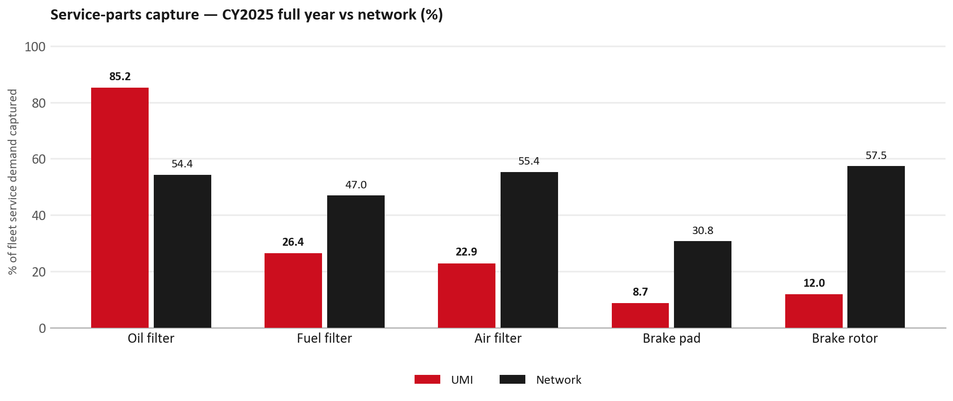
SERVICE PARTS
Service-parts capture vs network (calendar year)
TAKEAWAYS
— Capture % is calendar-year (full CY2025). Fleet demand is modelled on calendar years — there is no matching fiscal-year capture %.
— Oil filter 85.2% vs network 54.4%; Fuel filter 26.4% vs network 47.0%; Air filter 22.9% vs network 55.4%.
— Next slide: fiscal-year € billing in the same 5 categories.
— Primary lens = total capture (not genuine-only).
29

Slide 30
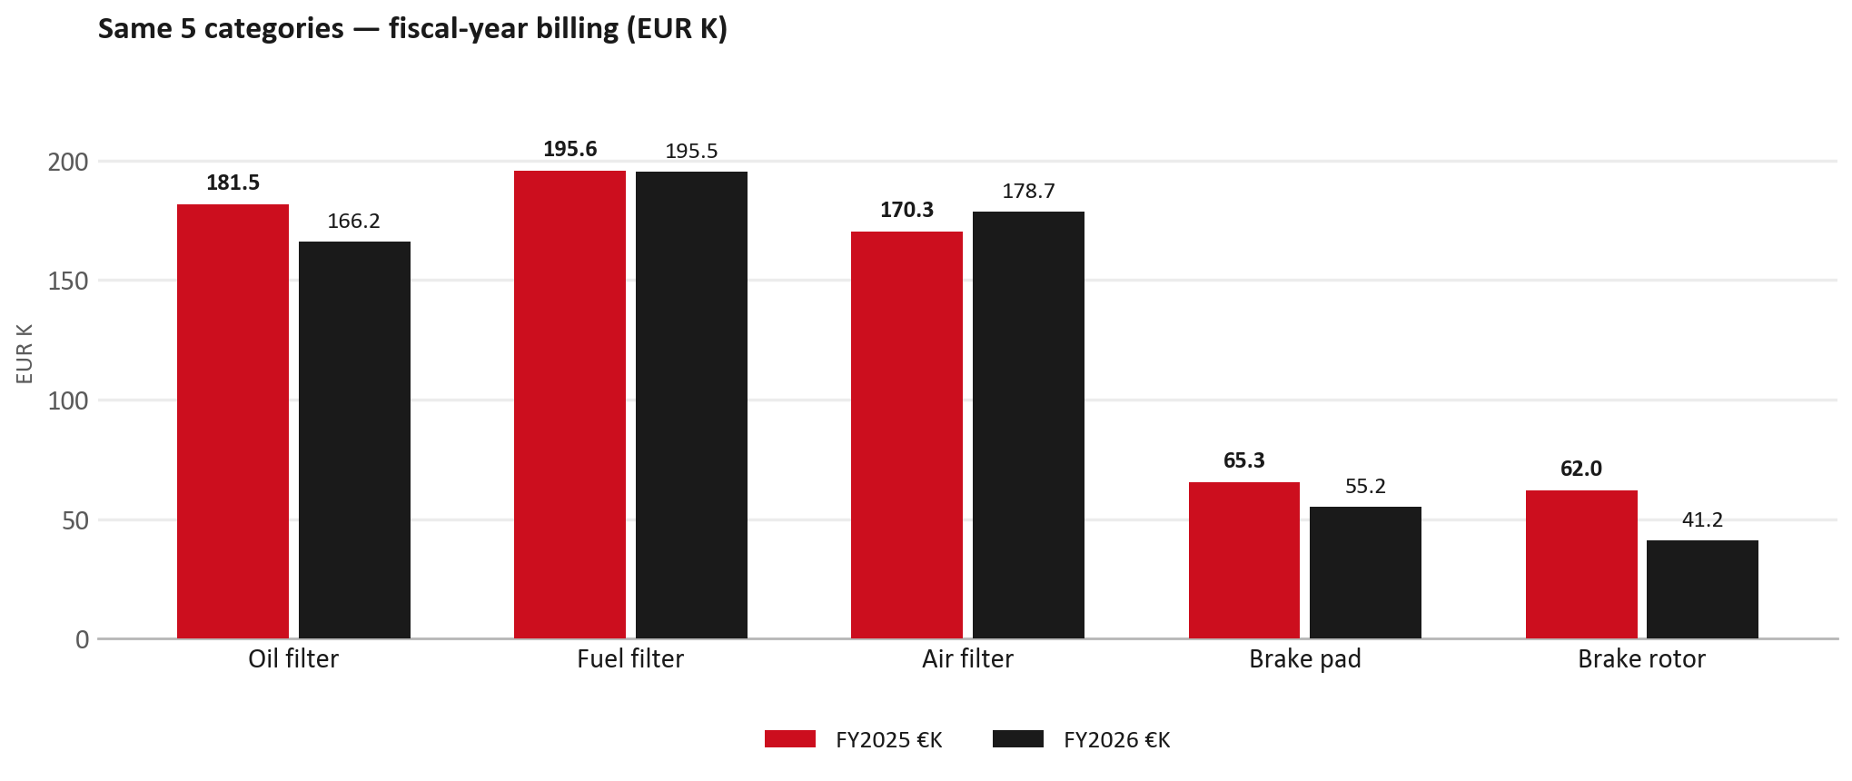
SERVICE PARTS · FY
Service-parts billing by fiscal year (same 5 lines)
TAKEAWAYS
— This is Sales-to-Universal Motors Israel € in fiscal years — not capture % of fleet demand.
— Use both lenses — do not mix % capture with € billing.
— Primary = total sales in the basket.
30

Slide 31
BRAKES
Brake pads — BVP share of total brake pad sales (FY)
 | FY2025 | FY2026
Genuine pad sales (€) | EUR 65,344 | EUR 55,238
BVP pad sales (€) | EUR 0 | EUR 0
Genuine qty | 1062 | 935
BVP qty | 0 | 0
BVP share of pad sales (€) | 0% | 0%
— BVP share = BVP € ÷ all brake-pad € billed (genuine + BVP). Not a PMS capture %.
— Universal Motors Israel pad sales are genuine-only in this cut (~EUR 55K FY26) — no BVP pad lines billed.
— Wallet-level BVP is still only ~6.4% of FY26 — do not generalise a pad story to the whole parts book.
31

Slide 32
AIM
AIM exposure
Year | High-risk € | High-risk % | Quadrant
2023 | EUR 12,441 | 0.4% | Attach gap (high GPS - low capture)
2024 | EUR 20,462 | 0.7% | Priority target (low GPS - low capture)
2025 | EUR 24,726 | 0.9% | Priority target (low GPS - low capture)
— High-risk € is catalogue AIM exposure, not proven walk-out.
— Open on jobs not bought through the distributor — not a street IAM war alone.
32

Slide 33
WARRANTY
Warranty — two real lenses
1
CY2025 claim-price parts
2
Fiscal GPS expense
— EUR 1,791,020 (claim-price basis).
— Calendar-year claim price basis.
— Dedicated UMI claim file; UMI only, never blended with UTI.
— FY24 EUR 2,902,813 · FY25 EUR 1,504,142 · FY26 EUR 1,633,086.
— Source row: UMI.
— Ex-warranty GPS = (net − warranty) ÷ frozen CY25 target spend.
— Both numbers are real — never mix them on one slide without labels.
33

Slide 34
BRIDGE
How to use this in the meeting
If they say… | You know…
BVP is eating genuine | Wallet BVP ~6.4%. Check pads as a local exception only.
GPS looks fine / too high | FY26 headline 54.7%; excl. warranty ≈ 19.1%.
Service parts are fine | CY2025 capture vs network (previous slides) + FY billing lens.
This is Israel network | UMI only — UTI did not sit in IDS Israel.
34

Slide 35
Moving the World – for You

