Slide 1
ISZE · VEHICLE PARTS & ACCESSORIES
FY2027 PLAN
Through August, sales reached 94% of phased plan and orders reached 93%
I Motors | Apr-Aug 2026 | completed months only
94%
93%
OBSERVATIONS / QUESTIONS
ISZE sales vs phased plan
orders vs phased plan
Apr-Jul sales were €591K versus €584K phased plan: 101.2% of plan. The shortfall is concentrated in August.
190
August sales were €109K versus €162K plan: 67.3% of plan. Orders were €101K, so the pipeline did not offset the month.
143
Apr-Aug sales total €700K versus €746K phased plan: 93.8%. Orders total €694K: 93.0%.
95
48
Question for I Motors: what changed in August versus the first four months: dealer demand, stock mix, timing, or availability?
0
Apr
May
Jun
Jul
Aug
Notes:
[Sources]
Source: user-supplied I Motors sales-plan screenshot / imotors_sales.docx page 1; completed months through August only.
[/Sources]

Slide 2
ISZE · VEHICLE PARTS & ACCESSORIES
EXECUTIVE VIEW
The issue is not the first five months; it is the stock and execution risk behind August
I Motors | Apr-Aug 2026 | September deliberately excluded
OBSERVATIONS / QUESTIONS
Sales vs plan
Orders vs plan
94%
Apr-Aug sales vs phased BP
93%
Apr-Aug orders vs phased BP
General observation: sales to dealer is moving well, but ISZE sales and orders were under plan in August.
Sales were close to the phased plan, but August was the clear break.
Orders did not provide enough forward cover after the August sales miss.
The first fill rate remains around 84-85%, well below the 93% target now used for this review.
First fill rate
Days of stock
85%
Aug 2026 vs 93% target
67
Aug 2026 MOS / stock days
MOS / days of stock is down to 67 in August. Low inventory may be the reason the fill rate is not recovering.
The fill-rate target is not being reached; make this a stock-mix discussion.
Inventory looks low. Ask whether this will damage fill rate further.
Question: is I Motors under-stocking the fast-moving service basket, or is the issue concentrated in specific part families?
Notes:
[Sources]
Sources: user-supplied I Motors sales-plan screenshot / imotors_sales.docx page 1; KPI Master File.xlsx, Parts Handling sheet, I Motors rows for First Fill Rate and Days of Parts in Stock.
[/Sources]

Slide 3
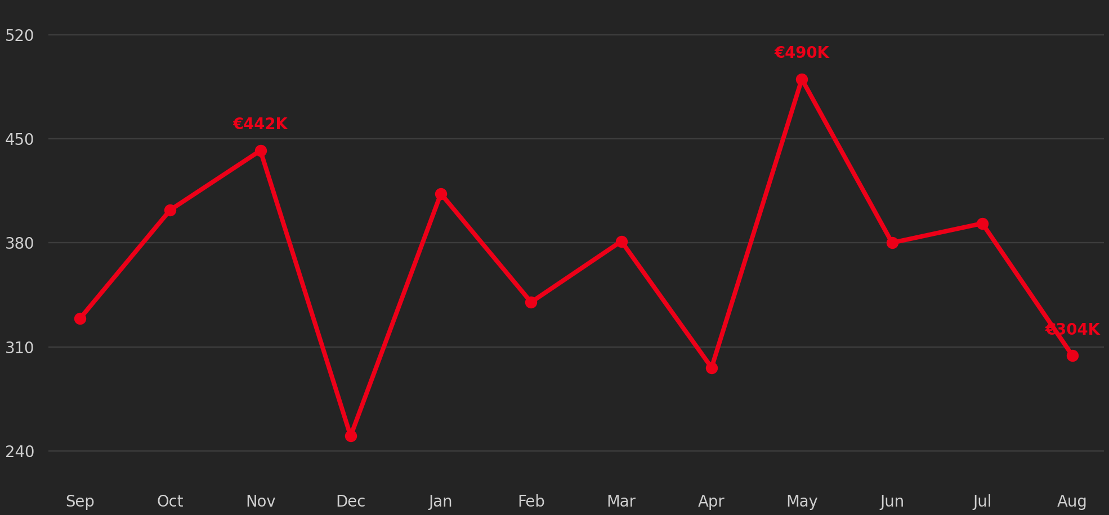
ISZE · VEHICLE PARTS & ACCESSORIES
SALES TO DEALER
Rolling 12-month dealer sales reached €4.42M, up 19% versus the previous 12 months
I Motors reported sales to dealer | Sep 2025-Aug 2026 versus Sep 2024-Aug 2025
OBSERVATIONS / QUESTIONS
Dealer-network sales are materially higher on a rolling basis, not only in one isolated month.
May 2026 is the exceptional spike. Ask which dealers, parts families or campaigns created it.
Month-to-month movement is shown as one connected line so the pattern is visible: strong May, solid Jun-Jul, weaker August.
Question: did I Motors inventory and replenishment follow the stronger dealer-sales trend?
€4.42M
+19%
€490K
last 12 months to Aug 2026
versus previous 12 months (€3.72M)
largest month: May 2026
Notes:
[Sources]
Source: KPI Master File.xlsx, Parts Handling sheet, Parts Sales DB to DLR in EUR, I Motors row. Rolling 12-month calculations by ISZE from reported distributor-to-dealer values.
[/Sources]

Slide 4
ISZE · VEHICLE PARTS & ACCESSORIES
SALES TO DEALER
Apr-Aug dealer-network sales are 25% ahead of the comparable five-month period
I Motors reported sales to dealer | Apr-Aug 2025 versus Apr-Aug 2026
520
OBSERVATIONS / QUESTIONS
Dealer sales increased by €372K versus the same five months last year.
390
May was the largest step-up at €490K; June and July also stayed above 2025.
260
This is distributor-to-dealer activity, not ISZE billing. Do not treat the stages as one demand measure.
130
Question: which dealers and product families explain the increase, and did I Motors reorder the same basket from ISZE?
0
Apr
May
Jun
Jul
Aug
€1.86M
+25%
Apr-Aug 2026 sales to dealer
versus Apr-Aug 2025 (€1.49M)
Notes:
[Sources]
Source: KPI Master File.xlsx, Parts Handling sheet, Parts Sales DB to DLR in EUR, I Motors row. Apr-Aug 2025 and Apr-Aug 2026 selected to match completed FY2027 months through August.
[/Sources]

Slide 5
ISZE · VEHICLE PARTS & ACCESSORIES
FIRST FILL RATE
First fill rate remains below the 93% target across every completed FY2027 month
I Motors | Apr-Aug 2026 | target line now shown in orange
96%
OBSERVATIONS / QUESTIONS
First fill rate is not improving into the target zone; it stays around 84-85% in Apr-Aug 2026.
91%
The target is 93%. The latest reported month is 85.4%, leaving a 7.6-point gap.
86%
This KPI should be discussed together with MOS, not alone: the stock level is falling while fill rate is still weak.
80%
Question: which categories or part numbers make up the missing 7-8 points?
75%
Apr
May
Jun
Jul
Aug
85.4%
93%
7.6 pp
Aug 2026 first fill rate
current target
gap to target in Aug
Notes:
[Sources]
Source: KPI Master File.xlsx, Parts Handling sheet, First Fill Rate, I Motors row. Target updated to 93% per user instruction.
[/Sources]

Slide 6
ISZE · VEHICLE PARTS & ACCESSORIES
STOCK DEPTH AND FILL RATE
Stock days fell to 67 while fill rate stayed below target
I Motors | Apr-Aug 2026 | MOS / days of parts in stock and first fill rate
120
OBSERVATIONS / QUESTIONS
93% fill-rate target
MOS seems low: stock days declined from 88 in April to 67 in August.
100
Fill rate did not improve while inventory became leaner. That is the core operational risk.
80
Question for I Motors: your stock inventory is very low; are you not afraid this will impact your fill rate?
60
Ask for the stock list behind the top missed service parts, not only the aggregate MOS number.
40
Apr
May
Jun
Jul
Aug
Orange bars = MOS / days of stock. Red line = first fill rate.
67
85%
Aug stock days
Aug fill rate
Notes:
[Sources]
Source: KPI Master File.xlsx, Parts Handling sheet, I Motors rows for Days of Parts in Stock and First Fill Rate.
[/Sources]

Slide 7
ISZE · VEHICLE PARTS & ACCESSORIES
BACK ORDERS
Back-order lines improved from May but are not enough to explain the fill-rate gap alone
I Motors | Apr-Aug 2026 | back-order lines and first fill rate
550
OBSERVATIONS / QUESTIONS
Back-order lines fell from 487 in May to 282 in August, but fill rate remained below target.
413
This suggests the issue may be the stocking mix, not only open back orders.
275
Question: are the open back orders concentrated in high-frequency service parts or slow-moving repairs?
138
Use the back-order list together with sales to dealer and MOS to identify the first parts to correct.
0
Apr
May
Jun
Jul
Aug
Notes:
[Sources]
Source: KPI Master File.xlsx, Parts Handling sheet, Back Order Lines and First Fill Rate, I Motors rows.
[/Sources]

Slide 8
ISZE · VEHICLE PARTS & ACCESSORIES
FLEET CONTEXT
The latest usable fleet base is 7,208 vehicles in service for 2025
Portugal / I Motors | latest available fleet model | do not use the 2026 forecast
8
OBSERVATIONS / QUESTIONS
7,208
2025 vehicles in service
Use the latest usable fleet base for the opportunity slides: 2025 vehicles in service = 7,208.
6
6,903
2024 is the latest actual fleet year. The 2025 base is used by the current model and should be labelled as the model base.
4
2024 actual fleet
2
+4.4%
Do not quote the 2026 fleet forecast in this review.
2025 versus 2024
0
Question: does I Motors agree with the scale and mix of this fleet base before we turn the category gaps into actions?
2023
2024
2025
Vehicle base used in the current GPS/PMS model
Notes:
[Sources]
Sources: 01_parts_billed_vs_target_by_market.csv and 07_fleet_trucks_in_service.csv. Current project rules say the fleet forecast beyond 2025 is not usable.
[/Sources]

Slide 9
ISZE · VEHICLE PARTS & ACCESSORIES
GENUINE PARTS SHARE
FY2026 reached 61% of modelled target spend, leaving a large sales gap
I Motors | FY view | ISZE parts billed versus modelled target-spend ceiling
3300
OBSERVATIONS / QUESTIONS
70%
This slide is called Genuine parts share because it is the GPS-style view: ISZE parts billed versus a modelled target-spend ceiling.
2475
64%
Target-spend cover means parts billed divided by the modelled spend the fleet should generate. It is not measured competitor spend.
1650
57%
51%
FY2026 improved versus FY2025, but roughly four tenths of the modelled spend is still outside ISZE billing.
825
45%
FY2024
FY2025
FY2026
Question: which families explain the remaining gap, and where should I Motors receive category support first?
0
FY2024
FY2025
FY2026
61%
€1.20M
FY2026 target-spend cover
modelled remaining gap
Notes:
[Sources]
Sources: 01_all_sales_isze_to_distributor.csv for fiscal-year ISZE parts billed to Portugal sold-to 92 and 519. 01_parts_billed_vs_target_by_market.csv for modelled target-spend ceilings aligned to the latest corresponding fleet model years. Target-spend cover is a modelled ceiling view, not measured market share.
[/Sources]

Slide 10
ISZE · VEHICLE PARTS & ACCESSORIES
PMS SERVICE-DEMAND COVER
Filters and brakes show opposite movements; the denominator is the modelled service demand
Portugal / I Motors | calendar 2023-2025 | current PMS model base
Category
2023
2024
2025
Observation / question
OBSERVATIONS / QUESTIONS
Air filter
27%
48%
56%
Improving; what practice can be copied?
The biggest leakage signal is not the lowest category; it is the reversal in oil and fuel filters after a strong 2024.
Oil filter
46%
71%
46%
2025 reversal; why did it fall back?
Fuel filter
36%
60%
40%
Same reversal as oil filter.
Air filter continues to improve, so the issue is not a general filter weakness.
Brake pad
51%
20%
55%
Recovered strongly; what changed?
Clutch kit
26%
29%
30%
Low but slowly improving.
The denominator is not a higher UIO number. It is expected service units per family on the current model base.
Brake shoe
8%
8%
11%
Persistent underdevelopment.
Denominator note: the PMS denominator is expected replacement units by service family. It is not the same as full GPS target spend, and it uses the 2025 model base consistently in this file.
Question: what changed between 2024 and 2025 for oil/fuel filters: price, BVP availability, dealer stocking, or competitor supply?
Notes:
[Sources]
Source: 03_service_capture_by_market_family.csv, PORTUGAL, total line_type, calendar 2023-2025. The file uses the current PMS model base and expected replacement units by family.
[/Sources]

Slide 11
ISZE · VEHICLE PARTS & ACCESSORIES
GENUINE / BVP MIX
BVP share eased in 2025, but the covered family basket still grew
Portugal / I Motors | Original and BVP covered families | calendar 2023-2025
230
OBSERVATIONS / QUESTIONS
70%
Do not read the 58% BVP share alone. The better question is whether total Original+BVP billing is growing by family.
173
65%
Covered family billing rose from €194K to €211K between 2023 and 2025.
115
60%
55%
The leakage signal is family-specific: filters fell from 2024 to 2025, while clutch kept improving from a low base.
58
50%
0
2023
2024
2025
Question: where is BVP supporting genuine parts share, and where is the full basket being lost despite having a BVP offer?
2023
2024
2025
€211K
58%
covered family billing in 2025
BVP share in 2025
Notes:
[Sources]
Source: 04_original_vs_value_parts_mix.csv, PORTUGAL, calendar 2023-2025; grouped Original and BVP covered families. BVP means Best Value Parts.
[/Sources]

Slide 12
ISZE · VEHICLE PARTS & ACCESSORIES
DISCUSSION WITH I MOTORS
Use the review to agree actions, not to debate isolated KPI numbers
I Motors | proposed meeting flow
MEETING QUESTIONS
Commercial performance
Stock and availability
PMS / leakage
Start with the August shortfall and the stronger sales-to-dealer trend; they are not telling the same story.
Explain August: was it order timing, dealer demand, stock mix or availability?
Ask directly: stock inventory is low; are you afraid this will impact fill rate?
Investigate oil and fuel filters first: they reversed after 2024.
Then move to operational evidence: fill rate, MOS and back orders must explain whether I Motors can support dealer demand.
Link sales to dealer back to ISZE replenishment.
Identify top missed service parts behind the 93% fill-rate target gap.
Treat air filter as the positive benchmark.
End with leakage: oil/fuel filter reversal and clutch/brake-shoe underdevelopment are the first tangible categories.
Track Apr-Aug as completed months only; leave September for the next cut.
Review MOS by family, not only total stock days.
Keep target-spend cover as a modelled ceiling, not as measured lost sales.
Decision needed: which parts will I Motors stock deeper, which categories need ISZE support, and when will we review progress?
Notes:
[Sources]
Synthesis from user-provided I Motors sales screenshot, KPI Master File.xlsx, and ISZE GPS/PMS project files supplied in the workspace.
[/Sources]

