Slide 1

ISZE · VEHICLE PARTS & ACCESSORIES
ISZE Vehicle Parts & Accessories
Quarterly Review
Illustrative demo deck · Template v2 · FY2026

Slide 2
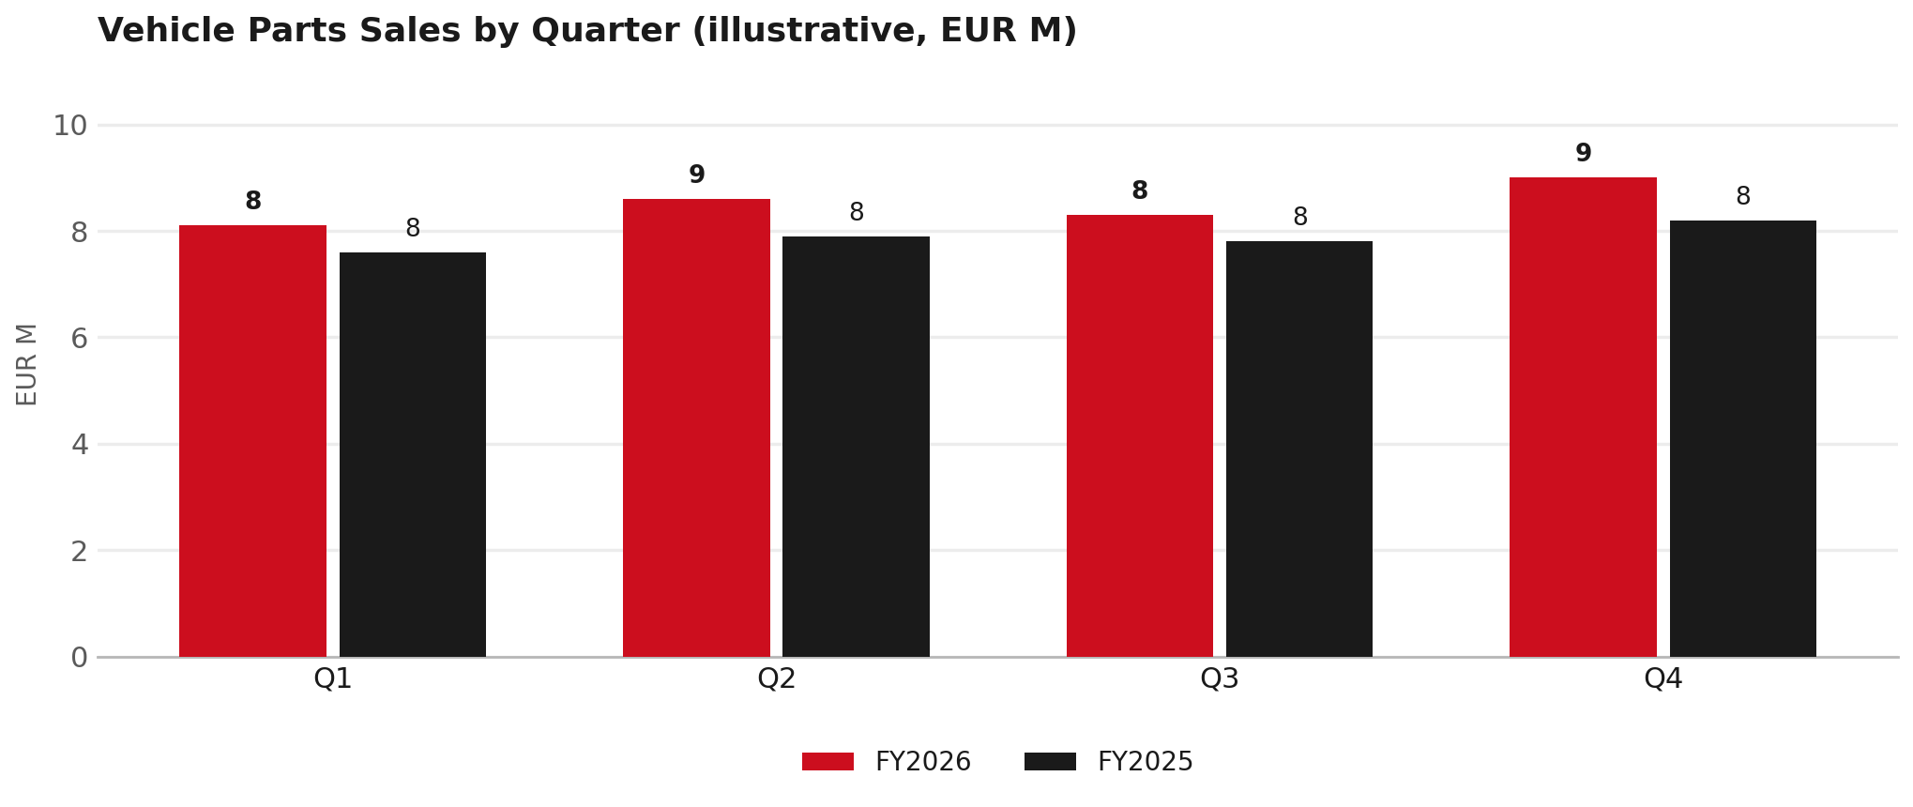
VEHICLE PARTS SALES
Sales tracking ahead of prior year
TAKEAWAYS
— FY2026 running ~8% above FY2025 in every quarter shown (illustrative).
— Q4 is the strongest quarter — consistent with seasonal pattern.
— Gap vs. prior year is widening slightly quarter over quarter.
2

Slide 3
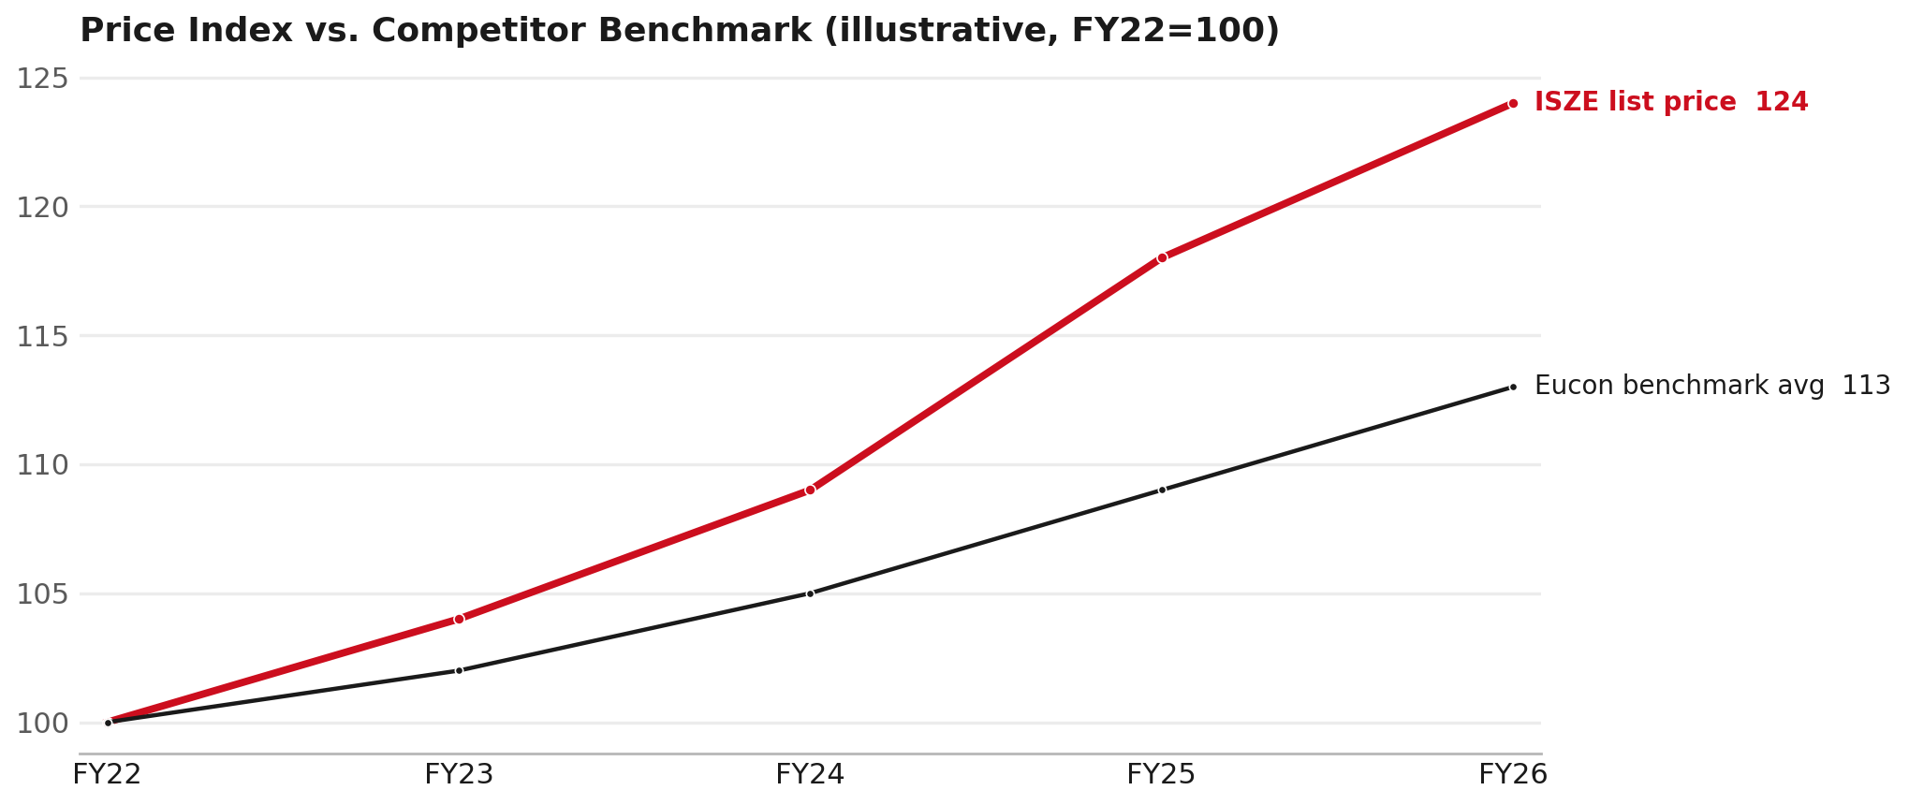
PRICING
Price index has outpaced the competitor benchmark since FY24
TAKEAWAYS
— ISZE list price index at 124 vs. Eucon benchmark at 113 (FY22=100).
— Gap opened mainly in FY25-FY26 — worth checking against the basket bridge.
— This is the shape of chart James Marsh's team will scrutinize line by line.
3

Slide 4
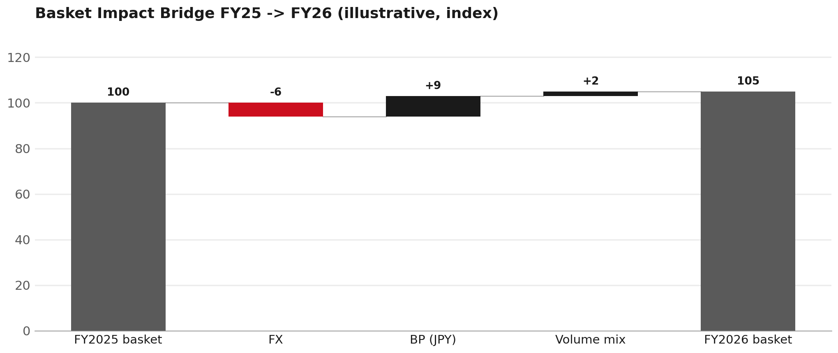
ITUK PRICING DISPUTE
Basket impact bridge: FX vs. BP vs. volume mix
4

Slide 5
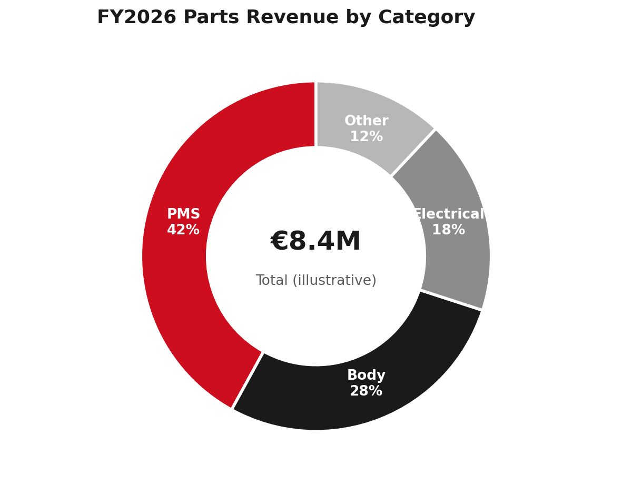
CATEGORY MIX
PMS remains the largest revenue category
TAKEAWAYS
— PMS = 42% of illustrative FY2026 parts revenue.
— Body + Electrical combined = 46% — roughly matches PMS alone.
— 'Other' at 12% is the long tail worth periodic review.
5

Slide 6
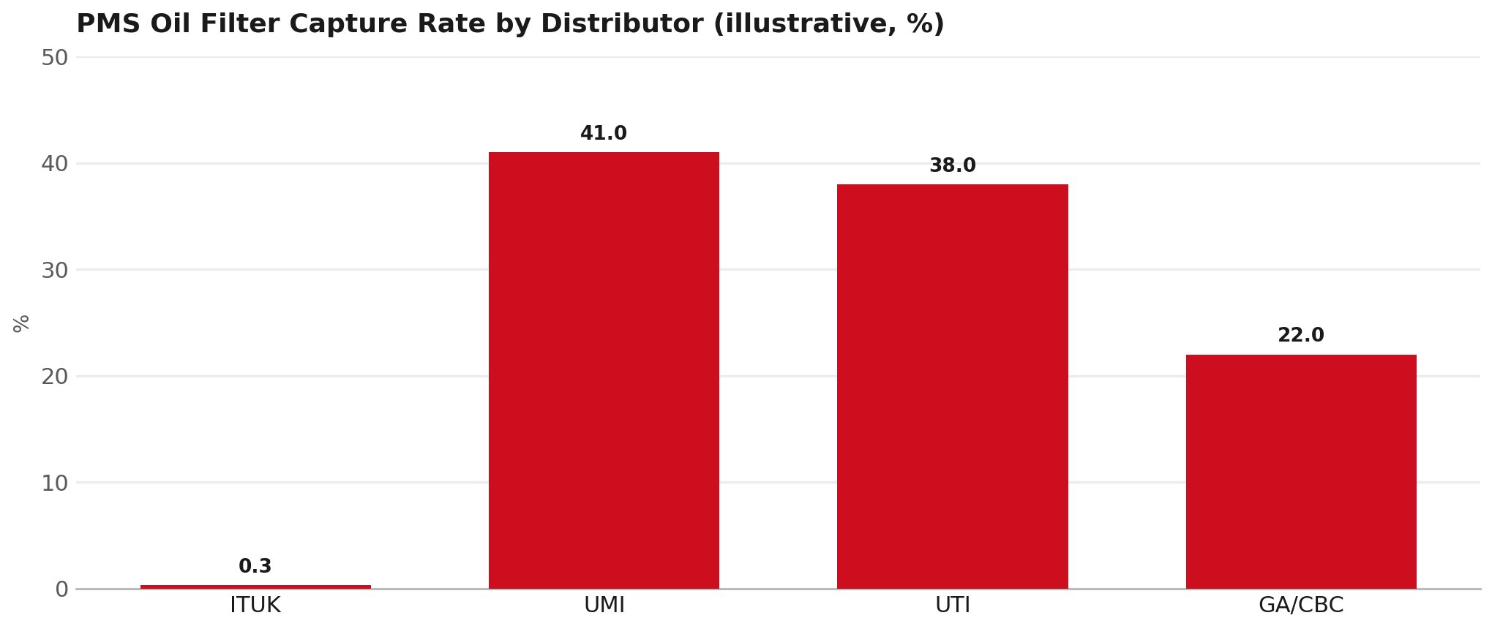
PMS COVERAGE
Oil filter capture rate is critically low at ITUK
6

Slide 7
Moving the World – for You

