Slide 1

ISZE · VEHICLE PARTS & ACCESSORIES
ISZE Template v2
Chart & Layout Demo
Fully generic placeholder data · proves methodology only, not a real analysis

Slide 2
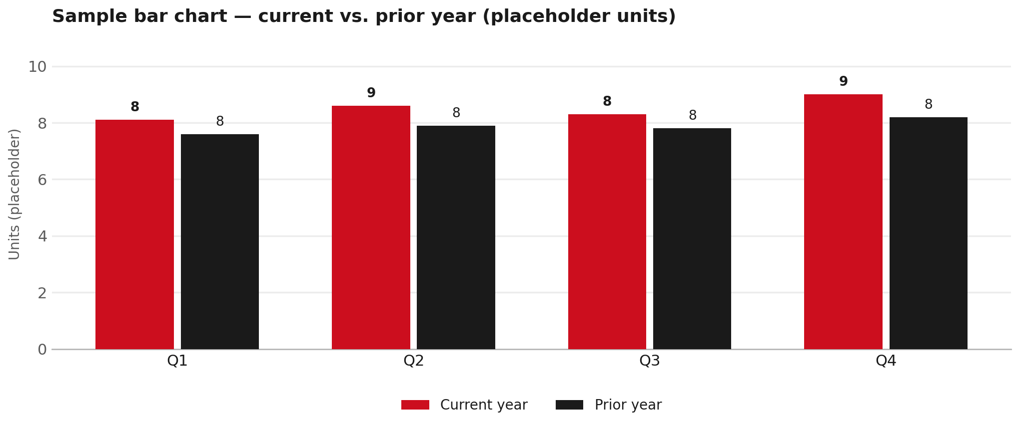
LAYOUT: CHART + TAKEAWAYS
Grouped bar: current vs. prior period
TAKEAWAYS
— Direct value labels on every bar instead of relying on the axis.
— Headline series in brand red, comparison series in charcoal.
— Legend only appears because there are 2 series here.
2

Slide 3
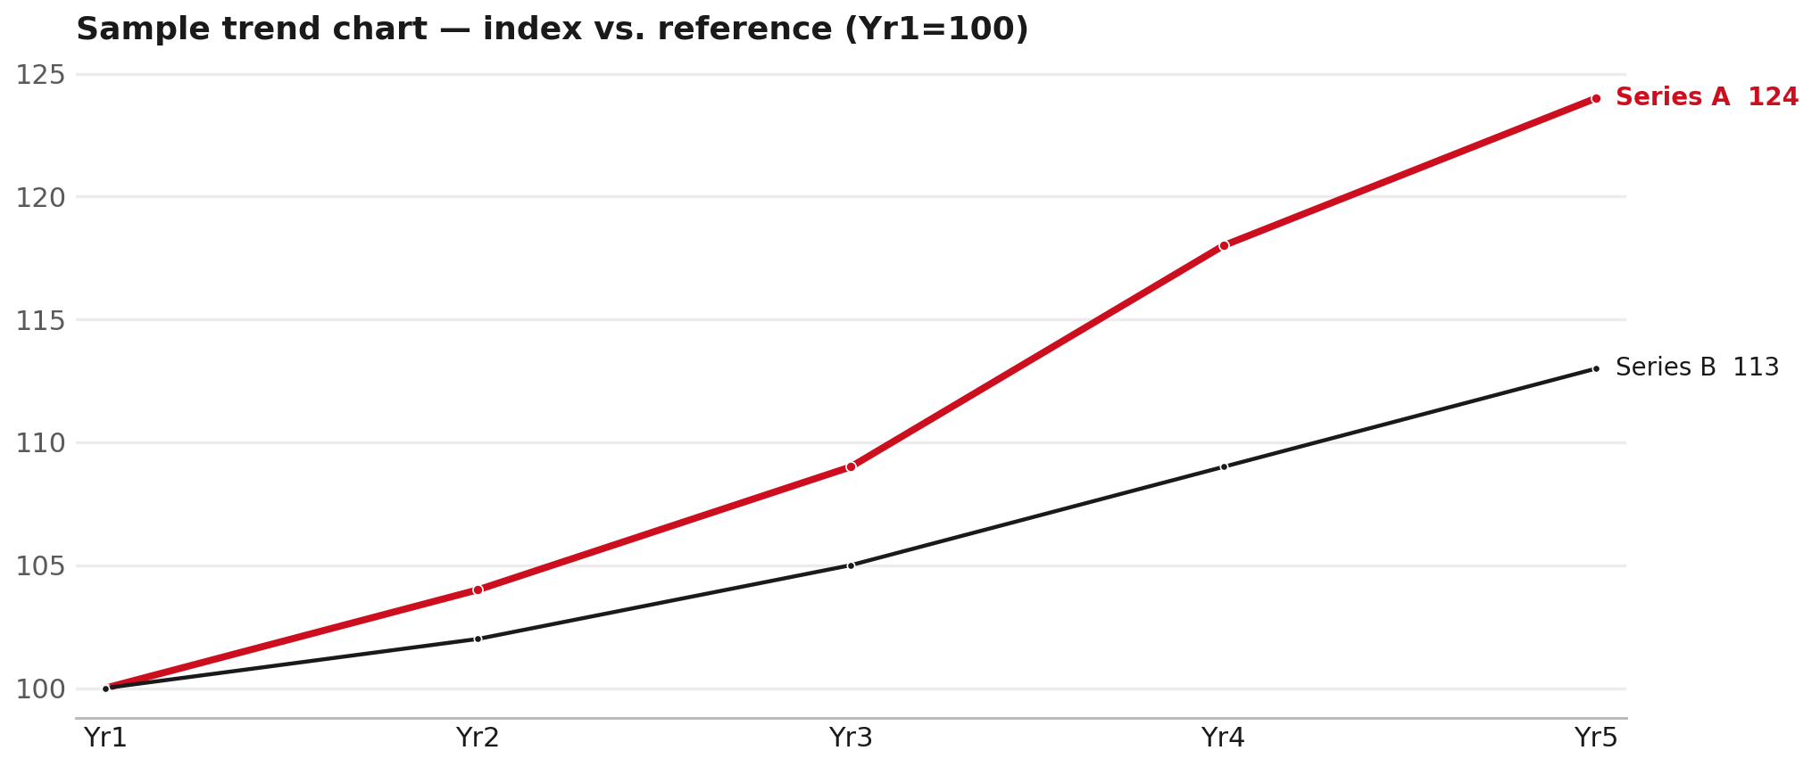
LAYOUT: CHART + TAKEAWAYS
Trend line with end-of-line labels instead of a legend box
TAKEAWAYS
— Labels sit at the end of each line - no legend needed.
— Headline series thicker + red; reference series thin + gray.
— Works well for any 'us vs. benchmark' comparison.
3

Slide 4
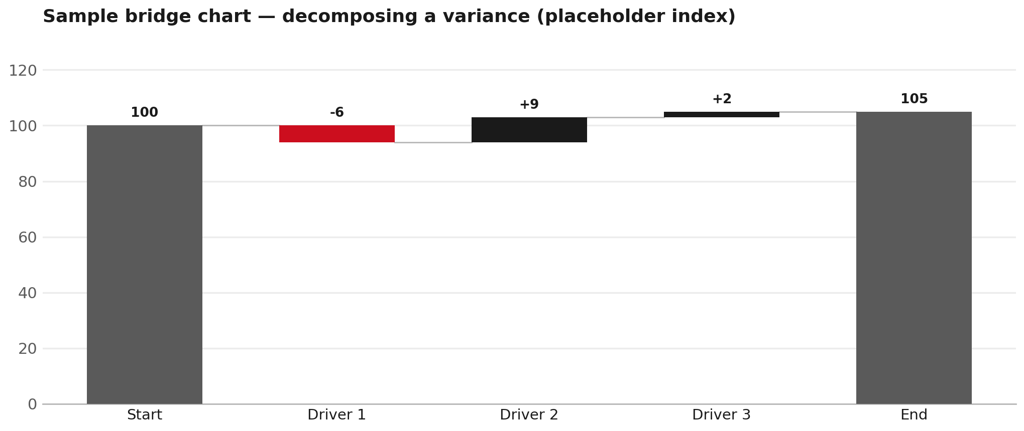
LAYOUT: FULL-WIDTH CHART
Waterfall / bridge for decomposing a variance
4

Slide 5
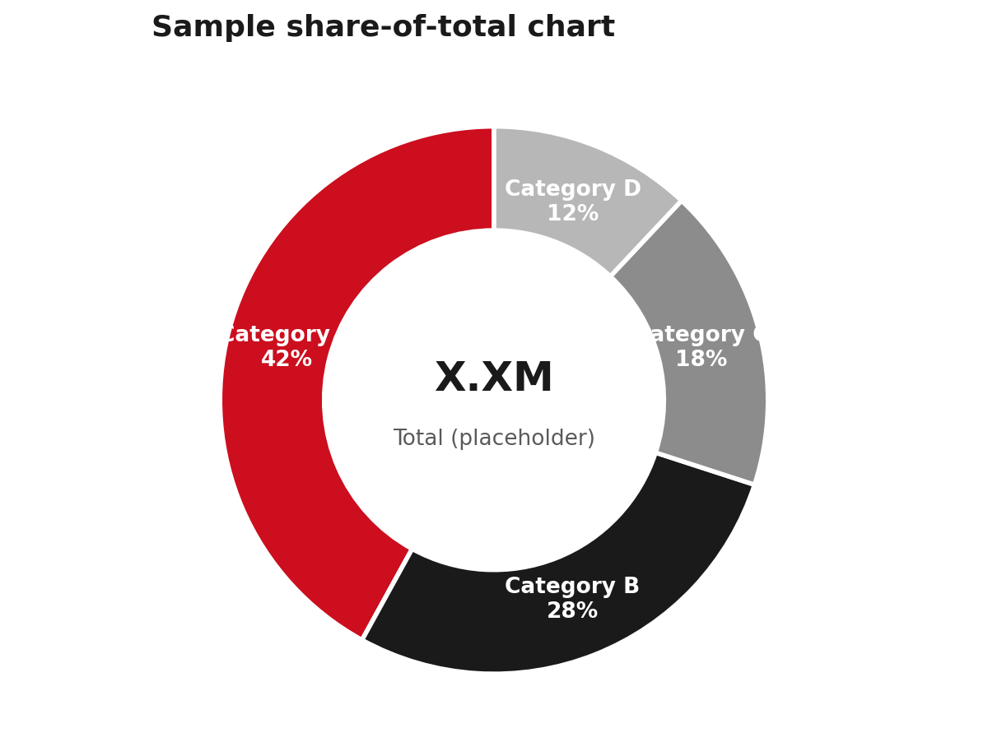
LAYOUT: CHART + TAKEAWAYS
Share-of-total donut with direct labels
TAKEAWAYS
— No legend - labels sit directly on each wedge.
— Center annotation carries the total.
— Ramp always starts red (largest / headline slice).
5

Slide 6
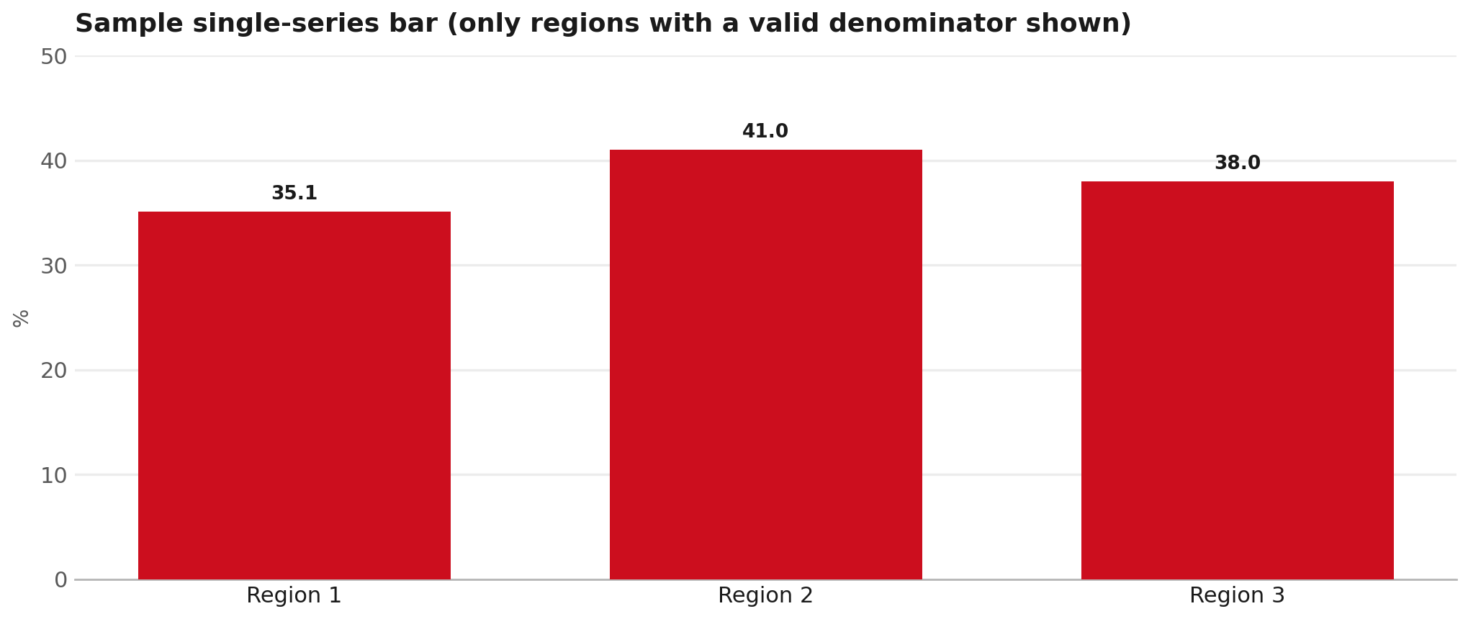
LAYOUT: FULL-WIDTH CHART
Single-series bar - only use this metric where the denominator exists
6

Slide 7
Moving the World – for You

