Slide 1
Interactive Example Set 4
Learning Principle governing questions
  Each slide has questions that allow you to assess your own understanding of the SPSS output and the principles of the course
  The idea is to attempt them yourself to assess your understanding and identify areas of the course where you may need to revise
  The answers are there if you are still stuck
Answers
  The answers can be found in the “notes” section of the PowerPoint slide
    If you are viewing this on PDF and do not have PowerPoint, you can obtain a PowerPoint viewer by typing PowerPoint viewer into Google or going to:
    http://www.microsoft.com/downloads/details.aspx?FamilyId=428D5727-43AB-4F24-90B7-A94784AF71A4&displaylang=en
  If viewing in PDF, it is best to cover the answers with a sheet of paper and only check if you can not do them yourself
Coverage
  These questions do not cover everything you need to know
Corrections?
  Of course, I’d love all the answers to be perfect first time, but if you spot what looks like an error, send me an email: jkanglim@unimelb.edu.au
Notes:
Note that obviously knowledge of my experiment or skill acquisition theory is not assessable
At times I do ask about your expectations for the study and in the answers I share my thoughts. This is purely to round out the experience of the exercise by seeing it in a context of real research.

Slide 2
Interactive Example Additional Practice Material:
Skill Acquisition Data Set
Motivation for research
  Understand relationship between abilities, prior skills and other individual differences with learning a relatively simple psychomotor task
Sample
  Around 116 participants (but varies because not all participants did all tests) – mix of 1st year psychology students and friends and family of researchers
Measures & Design
  Demographic Information (age, gender)
  Background Questionnaire (need for breaks; keyboard experience, etc.)
  Self-report questionnaire on knowledge of text-editing
  Initial motivation Questionnaire
  Multiple choice test of knowledge of text editing
  Typing test
  Battery of nine ability tests
    General cognitive; perceptual speed and reaction time
  Perceptions of ability tests and task motivation questionnaire
  54 trials (on a text editing task (time to complete each trial; strategies used)
  Retrospective perception of experiment Questionnaire
For further info, see: Anglim, J., Langan-Fox, J., & Mahdavi, N. (2005). Modeling the Relationship between Strategies, Abilities and Skilled Performance. CogSci 2005, 27th Annual Meeting of the Cognitive Science Society, July 21-23 Stresa, Italy
web ref: www.psych.unito.it/csc/cogsci05/frame/poster/3/p465-anglim.pdf

Slide 3
Example 4.1
Research Question
  A series of 11 questions were answered at the end of the experiment after the completion of the text editing task.
  Could they be grouped into a smaller set of meaningful constructs?
Which statistical procedure could we use?
Notes:
Principle Components Analysis

Slide 4
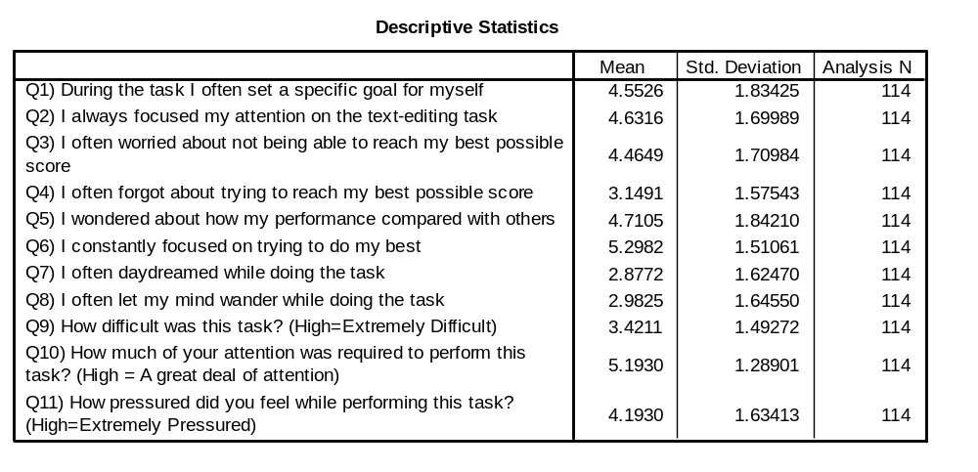
4.1 Descriptive Statistics
Here we see all the 11 items. They were all asked on a 1 to 7 scale.
For items 1 to 8, 7 represented strongly agree; 1 strongly disagree.
For items 9 to 11, the high score is shown
Looking at items 1 to 8, which two variables have the lowest means and what does this suggests?
Looking at items 1 to 8, which two variables have the highest means and what does this suggest?
Notes:
Q7 and Q8; The sample generally reported not letting their mind wander.
Q6 and Q2; The sample generally reported being focused and trying their best.

Slide 5
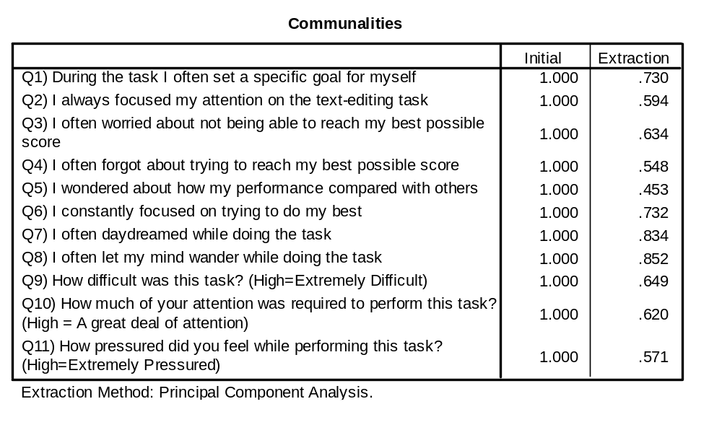
4.1 Communalities
I Extracted 3 components
What is the interpretation of the numbers in the extracted column?
Which variable/s have less than half their variance explained by the extracted components?
How much variance in Q1 was explained by the three components?
Looking at the content of the items, which items might you expect to group together?
Notes:
Percentage of variance explained by the extracted components
Q5
73%
Inherently subjective task but you might say things like q7 and 18 look similar in that they both make reference to letting the mind wander.

Slide 6
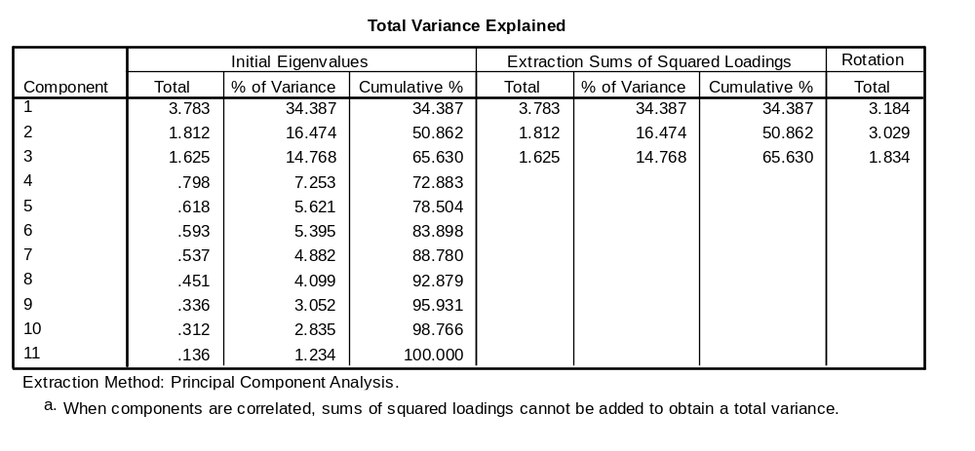
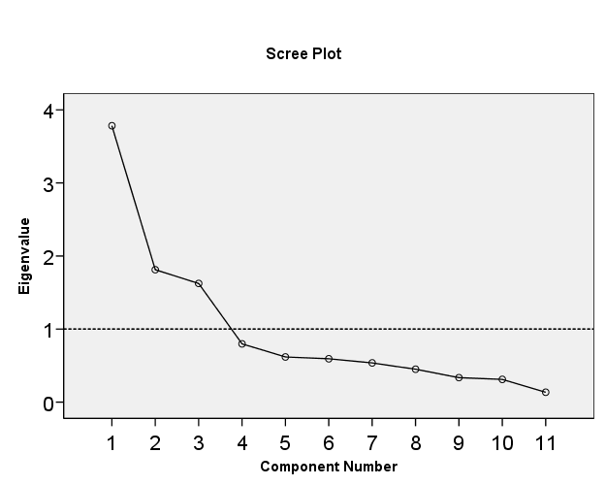
How many factors to extract?
Theory? There was no strong theory
What does the Eigenvalues over 1 rule suggest?
What does the Scree plot suggest?
What’s a reasoned Decision about how many components to extract?
Notes:
3 components
3 components
They both say 3, so 3 components seems reasonable.

Slide 7
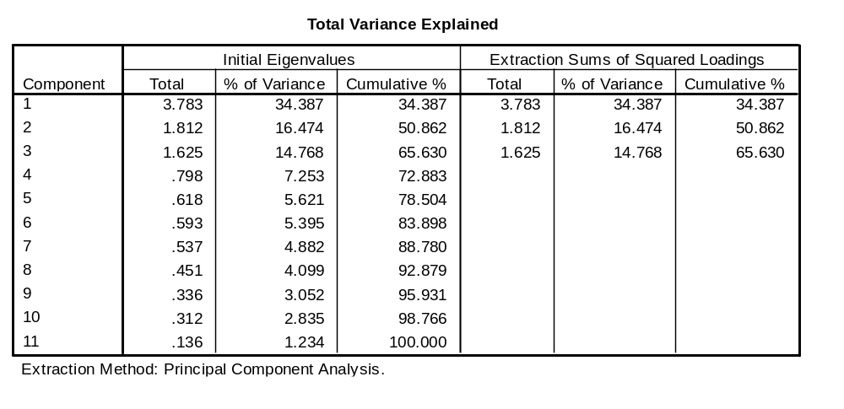
4.1 Variance Explained
How much variance was explained by the 3 components?
What is the sum of all 11 eigenvalues?
What is the sum of the three extracted eigenvalues?
What is 65.63% of 11?
What is 34.387% of 11?
What is 65.63% minus 14.768%?
Notes:
65.63
11
65.63% of 11
The sum of the three extracted eigenvalues
3.783
50.862%

Slide 8
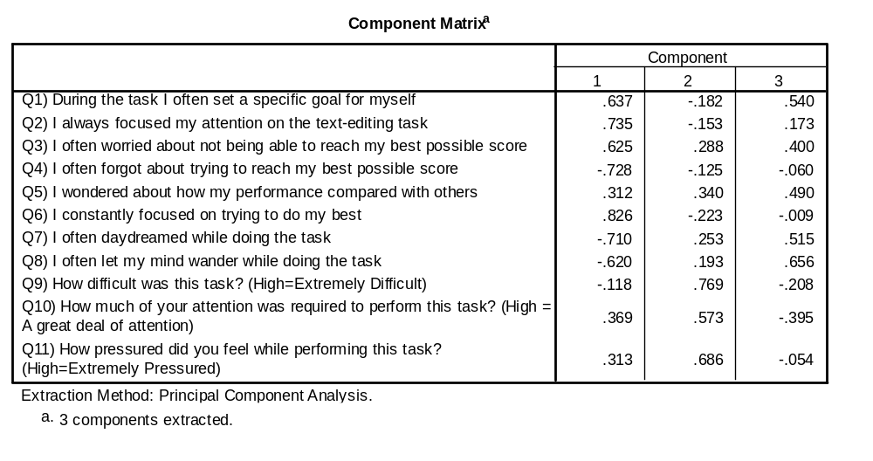
4.1 Unrotated Solution
Which variables load highly on component 1? Which of them are positive and which are negative?
How would you describe someone who was high on component 1?
Which variables load highly on component 2? Which of them are positive and which are negative?
How would you describe someone who was high on component 2?
Which variables load highly on component 3? Which of them are positive and which are negative?
How would you describe someone who was high on component 3?
Notes:
High and positive: 1,2,3,6; High and negative: 4, 7,8
Focused on the task and determined to do well
High and positive: 9, 10, 11
Someone who found the difficult and demanding
High and positive: 3,5,7,8; High and negative: 10
Daydreamer; less task focused

Slide 9
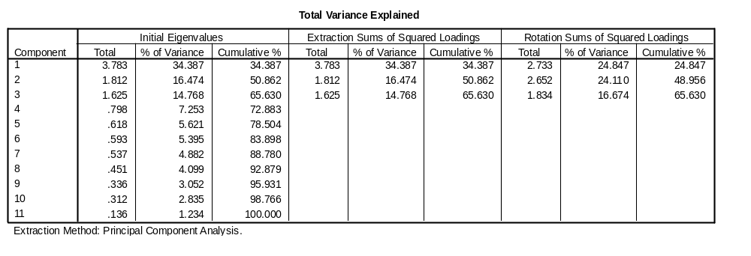
4.1 Rotations & Variance Explained
Which table shows the oblique rotation and which shows the orthogonal rotation?
What is the sum of eigenvalues for three components prior to rotation?
What is the sum of eigenvalues after rotation for the top table?
What is the sum of eigenvalues after rotation for the bottom table?
Why are the two sums different?
Notes:
Oblique = top; Orthogonal = bottom
7.22
7.22
8.047
The oblique rotation leads to correlated components. Thus, some of the variance explained in the variables is shared.

Slide 10
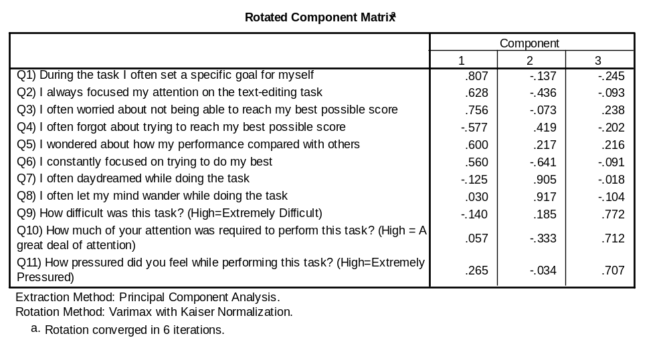
4.1 Orthogonal (Varimax) Rotation
What is the meaning of each of the numbers in this table?
What is the meaning, if you square the number in the table?
What is .807² + .137² + .245²?
Going back to the earlier slide what was the extracted communality for Q1?
If we don’t look at the communalities table, which three numbers are required from the above rotated component matrix to determine the communality for Q2?
Without looking at the communalities table, what is the communality for Q2?
Notes:
It is the correlation between the variable and the component
It is the percentage of variance shared between the item and the variable
.73
73%
.628, -.436, -.093
59.31 %

Slide 11
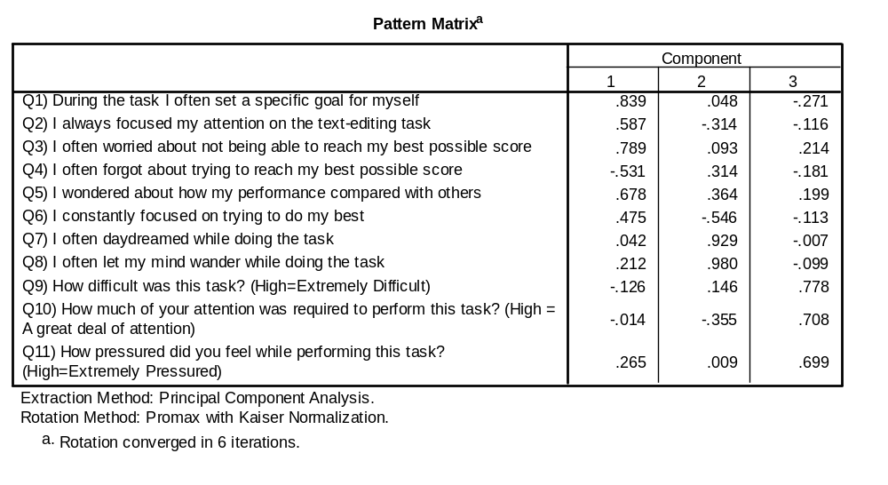
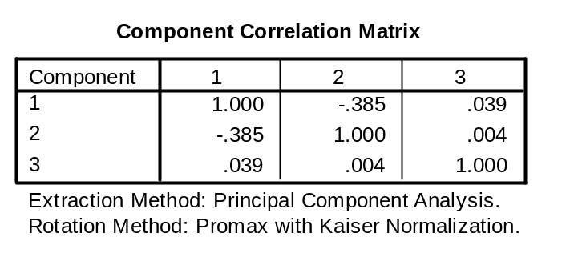
Oblique (Promax) Rotation
What is .839² + .048² + .271²?
Why is it not the same as the communality?
For each of the three components say which variables load highly and what a person who was high on that component would look like?
Give a clever one or two word name to each component that reflects what high scores on the variable represent
Using the names you created state which two components correlated?
Does this correlation make sense based on your understanding of the components?
Notes:
.7797
As a technical point, it is the structure matrix that describes the correlation between component and item (don’t need to know this). But the main point is that when we have a correlated rotation the squared loadings will no longer add up to the communality.
Component 1: Positive: 1,2,3,5,6; Negative: 4 – Focused on the task and striving to do their best
Component 2: Positive: 7,8 and to a lesser extent 4 and 5; Negative: 6 and to a lesser extent 2 and 10 – Not focused on the task with their attention drifting and a tendency to daydream
Component 3: Positive: 9, 10, 11 – Task was perceived as difficult and demanding
Component 1: Task Focused
Component 2: Daydreaming
Component 3: Perceived Difficulty
Component 1 with 2; Task focused was negatively correlated with Daydreaming
Yes. They sound like they are opposites. Someone who is task focused should not be daydreaming while performing the task.

Slide 12
Example 4.2
Research Question
  Now that we have a measure of self-reported Task Focus, we can use it as a dependent variable to think about what might predict it. The variable was created by getting the average score on the items that load on it.
  Is there an effect of gender and/or age group as defined by being either over or under 25 years of age on Task Focus? Do these two variables interact?
Describe the three variables in terms of being binary, nominal, ordinal, interval or ratio?
Which statistical procedure could we use?
What would be the null hypotheses?
What is your expectation?
Notes:
Gender is binary; Age group is binary; Task focus is probably interval.
Factorial ANOVA is the obvious choice, although regression would be possible
No difference in marginal means on task focus for male and females
No difference in marginal means on task focus for those aged under and over 25
No interaction effect
This is subjective or could be based on a literature review. Some might argue the young have shorter attention spans. Others might argue that the old have more things to think about. Some might say that what I just said is all just stereotypes and that gender and age don’t make much, if any, difference.

Slide 13
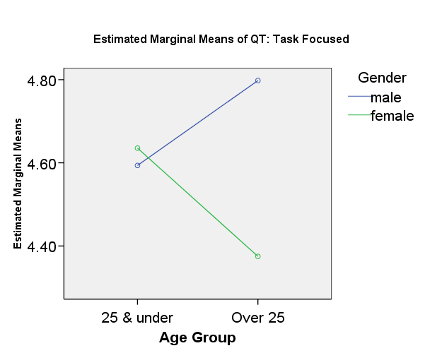
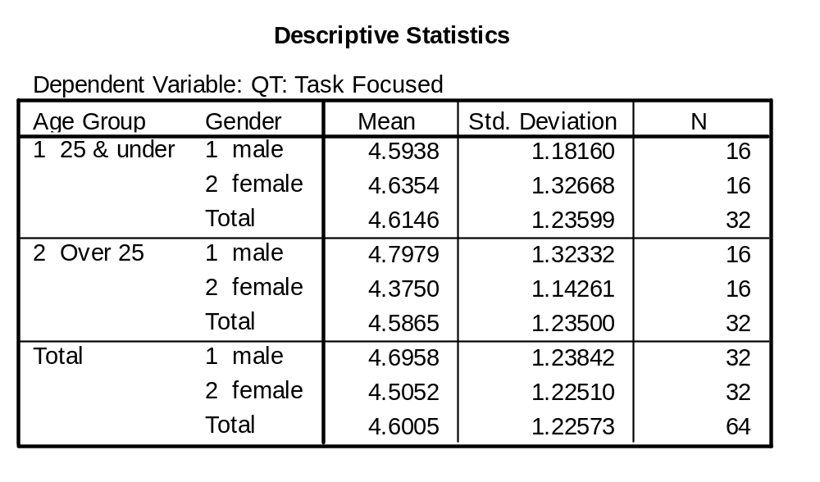
4.2 Descriptive Statistics
UNIANOVA
qt_fac1 BY agegroup gender
/METHOD = SSTYPE(3)
/INTERCEPT = INCLUDE
/PLOT = PROFILE( agegroup*gender )
/PRINT = DESCRIPTIVE HOMOGENEITY
/CRITERIA = ALPHA(.05)
/DESIGN = agegroup gender agegroup*gender .
Looking at the graph, which gender was more task focused? Which age group was more task focused? And does there appear to be an interaction?
What is the marginal mean for males? What is the marginal mean for females? What is the difference between the two?
What is the approximate difference between the marginal means for males and females in terms of one of the standard deviations?
Does the difference between the groups seem large?
What might be deceptive about the default graph from SPSS?
Note that I filtered the cases to give equal group sizes. This would not typically be done in real research but is purely done to make it clearer as a learning tool for you.
Notes:
Males on average look more task focused; Averaging the two age groups visually suggests they look the same; The interaction effect suggests a greater difference between males and females in the over 25 age group.
Males = 4.69; Females = 4.50; difference = .19
.19 / 1.2 = .16
No, it seems small
It has amplified any difference based on the values of the Y axis that it has decided to show.

Slide 14
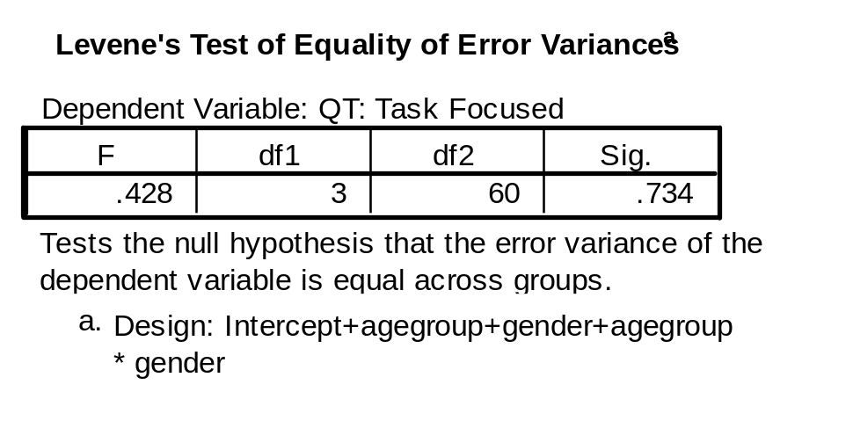
4.2 Homogeneity of Variance
What is the assumption of homogeneity of variance?
What is the relationship between the standard deviation and variance?
What does the standard deviation and variance both describe about a sample?
What is the standard deviation of scores on Task Focus for Males Under 25?
What is the standard deviation of scores in the other three cells of the design?
Are any of the standard deviations twice as big as any of the others?
Which two cells have the most disparate standard deviations?
Are the standard deviations in the different cells very different?
What is the null hypothesis that Levene’s test is testing?
What interpretation do we make about the assumption based on Levene’s test?
Notes:
The assumption is that the variances in the population are the same in all cells of the design
Standard deviation is the square root of variance
The amount scores vary around the mean
Male Under 25, sd = 1.2
Females Under 25, sd = 1.3
Males Over 25, sd = 1.3
Females Over 25, sd = 1.1
No
Females Over 25 with Females Under 25
No
That the variances (or standard deviations) are the same in the population
The assumption of homogeneity of variance has not been violated, because p is not less than .05

Slide 15
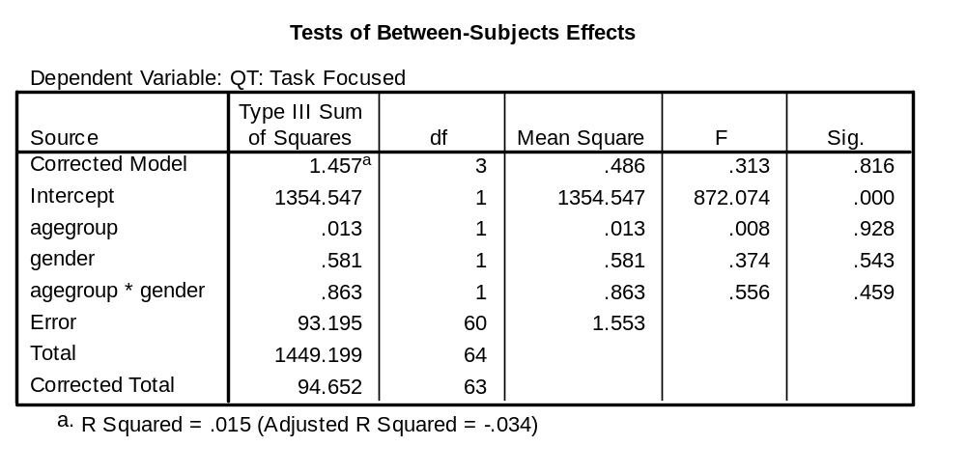
4.2 Significance Test
Write out the F statistics, degrees of freedom and p value for the three effects.
What’s the answer to our research questions?
Using your formula sheet to assist, what three values make up SS between?
What is SS between?
What is SS within?
What is SS between + SS within (i.e., SS Total)?
Which source does SS Total correspond to in the table?
Without looking back at earlier slides, what was the total sample size?
What two values were used to form the F ratio for Gender?
What is the critical F value from Howell’s Table for the hypotheses tested (α=.05)
If all you could see was the F values, and not the significance values, how would you know that all the effects were not statistically significant?
What is the value for MS error?
What is the square root of MS error? How does this value compare to the standard deviations shown on the previous slide?
Notes:
Age Group: F (1, 60) = .008, p = .928
Gender: F(1,60) = .374, p = .374
Interaction: F(1,60) = .556, p = .459
There is no evidence to support the claim that Age Group or Gender influence Task focus or that there is an interaction between these two variables.
.013 + .581 + .863
1.457
93.195
94.652
Corrected Total
64
.581 / 1.553
Df(1,60) F crit .05 = 4.00
They are all less than 1
1.553
1.2462; It is very similar to the standard deviations within cells.

Slide 16
Example 4.3
Research Question
  Do the three abilities (z-scores) and prior learning as defined by typing speed (words per minutes) and knowledge of text editing short cut keys (% correct) predict task performance (seconds) at the end of practice over and above initial performance (seconds)?
Describe the three variables in terms of being binary, nominal, ordinal, interval or ratio?
Which statistical procedure could we use?
What would be the null hypotheses?
What is your expectation?
Notes:
The abilities are interval because they are all z-scores with no absolute zero. Words per minute is ratio. Knowledge of short cut keys is ratio (% correct). Task performance is measured in seconds to complete (i.e., ratio).
The question asks about a set of variables predicting over above another variable. Answer: Hierarchical Regression
There are as many null hypotheses as significance tests including ones for both overall models, the r-square change and the regression coefficients in model 1 and 2. The particular null hypothesis of interest relates to the change in r-square. I.e., the null hypothesis is that there r-square change is zero.
This is subjective, but I would think most of the effect of predicting something might be subsumed by initial performance. Thus, I would expect any incremental prediction to be small. As a general rule, nothing predicts future performance like past performance.

Slide 17
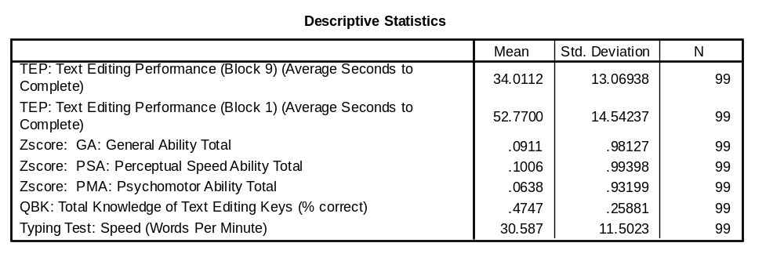
4.3 Descriptive Statistics
What was the average improvement in seconds from block 1 to block 9?
Note that the 54 trials were grouped into blocks made up of six trials each. Thus, initial performance is defined by block 1 (i.e., trials 1 to 6) and block 9 is made up of trials 49 to 54)
Also remember that faster times imply better performance
Notes:
1. 52.7 – 34.0 = 18.7 seconds

Slide 18
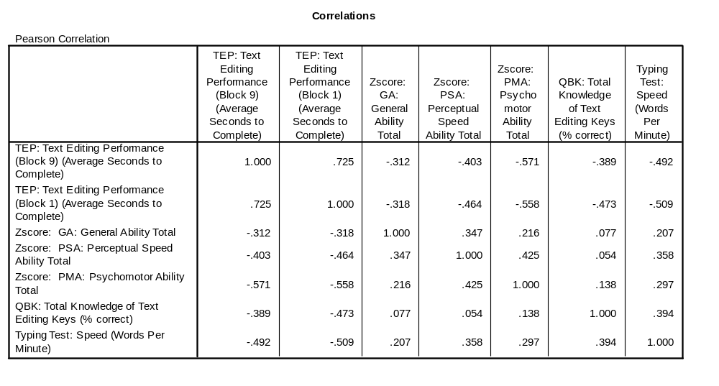
4.3 Correlations & Multicollinearity
Which variable has the largest correlation with block 9 text editing performance?
Do all the variables have moderate or large correlations with the dependent variable?
Give an interpretation to the correlation between typing speed and block 9 text editing performance
Are there any very large correlations between predictors (e.g., above .7)?
Notes:
Block 1 text editing performance
Yes
Typing speed is negative related with time to complete the text editing task (r = -.492).
No very large correlations, although there are some correlations of moderate size such as typing speed with block 1 text editing performance.

Slide 19
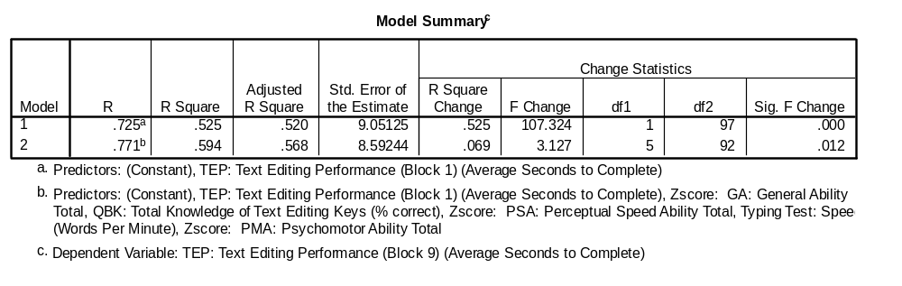
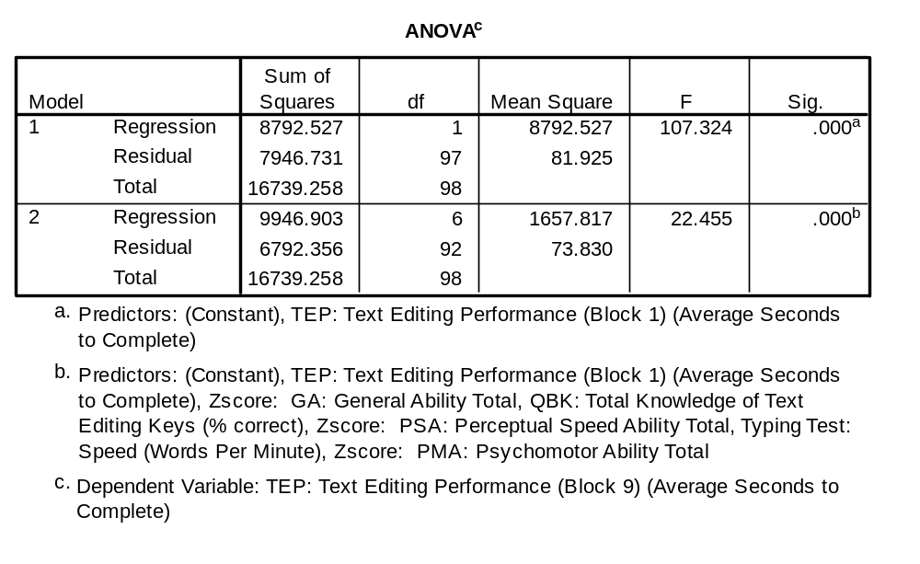
4.3 Model Assessment
What is the r-squared before and after adding the ability and past experience variables?
What was the R-square change?
Was the r-square change statistically significant?
Write out the F statistic for the final model with the r-square?
What’s the answer to the research question?
Notes:
Before: .525; After: .594
.069
Yes
R-square = .594, F (6, 92) = 22.455, p < .001.
Yes, abilities and past experience as measured by typing speed and knowledge of short cut keys predicts final task performance over and above initial task performance. But as expected, the increase is not large in comparison to the prediction made by initial performance.

Slide 20
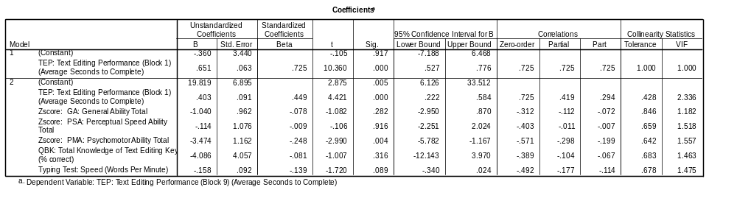
4.3 Regression Equation
Write out the unstandardised regression equation for the final model
Which regression coefficients have lower and upper bound 95% confidence intervals that are either both positive or both negative?
Which regression coefficients are statistically significant?
What is the degrees of freedom associated with the Block 1 text editing performance regression coefficient in model 1? What about model 2?
What is the unstandardised regression coefficient for General Ability? What is the standard error? What is the regression coefficient divided by the standard error?
Look up Howell’s table and see what critical t is associated with 92 degrees of freedom alpha = .05 (two tailed)?
What is 1 - .05 in percentage terms?
What is the critical t (.05 two-tailed) multiplied by the standard error for General ability?
What is -1.04 plus the value you obtained in Q8? What is -1.04 minus the value in Q8?
Notes:
[Predicted Block 9] = 19.8 + .40Block1 – 1.0GA - .1PSA – 3.5PMA – 4.1QBK -.16WPM
Initial Text editing performance; Psychomotor ability
The same as before; Initial Text editing performance; Psychomotor ability
Model 1 df = 97; Model 2 df = 92
Regression coefficient = -1.04; standard error = .962; coefficient divided by se = -1.04 / .962 = -1.08; i.e., the t value
100 df = 1.984
95%
1.984 * .968 = 1.92
-1.04 + 1.92 =.88; -1.04 - 1.92 = -2.96; I.e., the 95% confidence interval

Slide 21
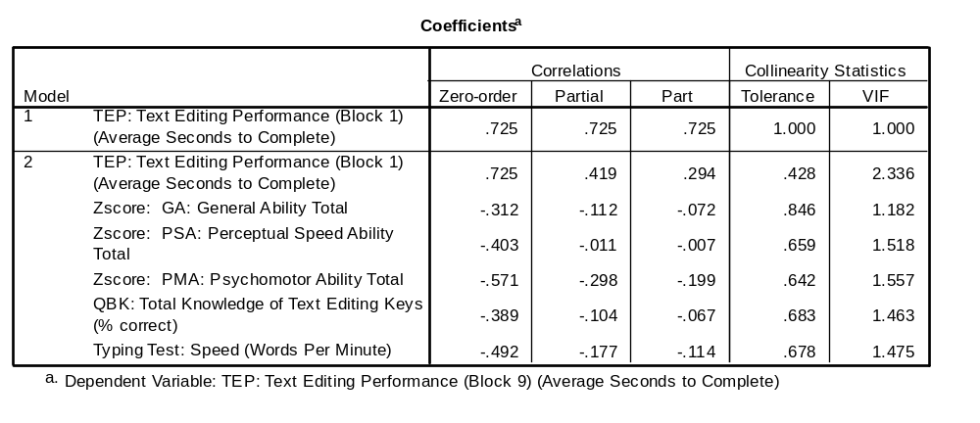
4.3 Correlations & Multicollinearity
Why is tolerance 1 in Model 1?
Are there any concerns with multicollinearity?
What is VIF for psychomotor ability? What is 1 / VIF for psychomotor ability?
In Model 2 which variable has the largest semi-partial correlation? What is it squared? What would be the interpretation of it when it is squared?
Which semi-partial correlations are statistically significant (hint: you may have to look at the previous slide)?
Notes:
There are no other predictors in that model.
Not particularly, no VIF value anywhere near 10.
1.518; 1 / 1.518 = 0.659, i.e., Tolerance
Block 1 Text editing performance; .294 * .294 = .086; 8.6% of variance in final text editing performance uniquely explained by initial text editing performance.
Psychomotor ability and initial text editing performance. The test of significance is the same for semi-partial correlations as the regression coeffient.

Slide 22
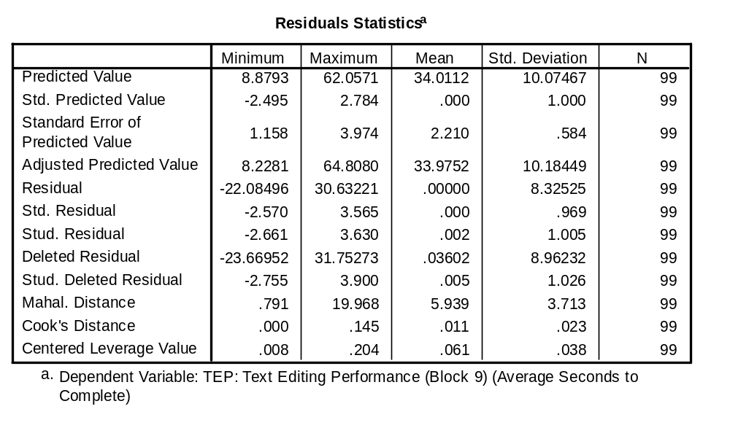
4.3 Casewise Diagnostics
What is the rule of thumb suggested by Paul for studentised residuals in large samples? Are any cases outside that rule of thumb?
What is the rule of thumb suggested by Paul for leverage in large samples? Are any cases outside this rule of thumb?
What is the rule of thumb suggested by Paul for identifying influential cases? Are any cases outside the rule of thumb?
If cases are identified as falling outside the rule of thumb, what is the next step?
What is the mean of the predicted value? Going back to descriptive statistics, what was the mean of the DV?
If leverage is defined by extreme scores on predicted Y, based on the table above, what are the two possible predicted values that correspond to the case with the largest leverage value?
Notes:
Studentised residuals > + or – 3; at least one case has studentised residual greater than 3 (i.e., 3.63)
Leverage > 2*p/N = 2 * 6 / 99 = .12; at least one case has leverage greater than .12 (i.e., .204)
Cook’s D > 1; No cases
Go to the SPSS data file and locate them perhaps by sorting the columns by the variable to highlight extreme cases. Many things could then be done such as thinking more about the cases and why they have the values that they do and possibly deleting the cases from subsequent analyses.
In both cases the answer is 34 seconds
The predicted value for the case with the largest leverage value is either 8.8793 seconds or 62.0571 seconds.

Slide 23
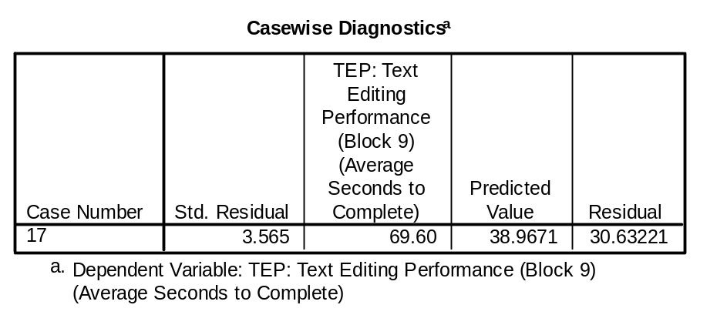
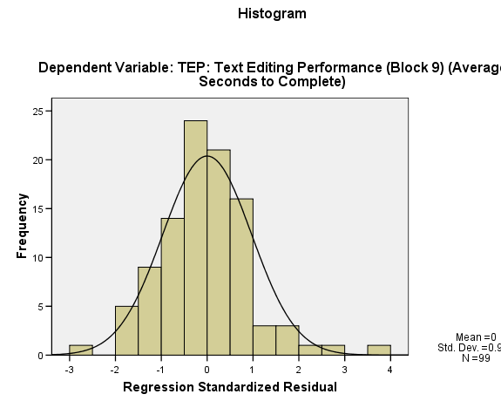
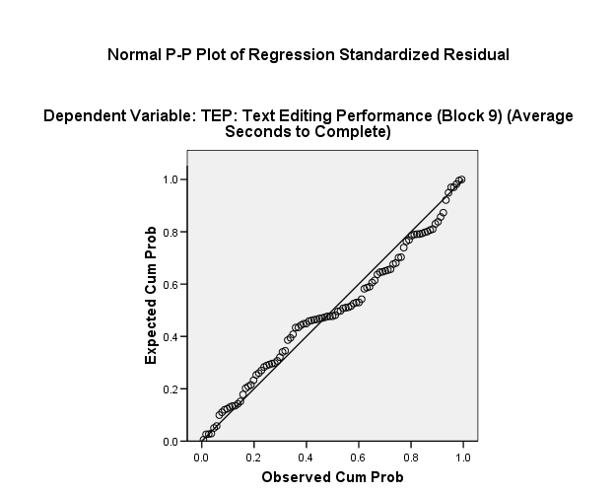
4.3 Residuals
Do the residuals look normally distributed?
What was the observed final text edit time minus the predicted time for case 17?
Is the residual positive or negative? Is the studentised residual positive or negative?
Some people were faster than predicted and some people were slower than predicted. How does this relate to positive and negative residuals?
Notes:
Pretty much. There may be the odd outlier and very slight positive skew.
69.6 – 38.9761 = 30.6239 (i.e., the residual); i.e., the person was about 30 seconds slower than was predicted
They are both positive values
Positive residuals is associated with people who had larger observed than predicted (i.e., they were slower at the task than was expected).
Negative residuals is associated with people who had smaller observed than predicted (i.e., they were faster at the task than was expected).

Slide 24
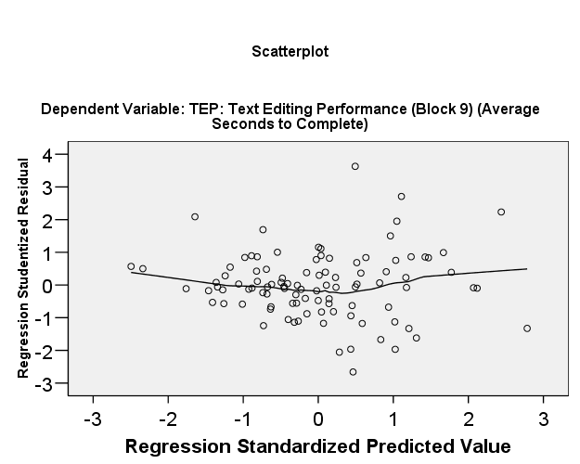
4.3 Linearity & Homogeneity of variance
Going back to the casewise diagnostics what is the mean and standard deviation of the predicted value?
What would be the unstandardised predicted time at minus 1 standardised predicted values? What about plus 1 standardised predicted values
Is there a difference in the spread of residuals at one versus minus one standardised predicted values? What might this mean?
Is there any evidence of non-linearity?
Notes:
Mean = 34 seconds; Standard deviation = 10 seconds
34 – (1*10) = 34 – 10 = 24 seconds
34 + (1*10) = 34 + 10 = 44 seconds
Some tendency in the graph for residuals to be smaller when predicted text-editing time are
Prediction appears a little better at minus 1 standardised predicted values than at plus one standardised predicted values. This suggests that people that are predicted to do well tend to do well, but that people predicted to do poorly vary more and may do really bad or they may do better than we expect based on their scores on the predictors.
Not particularly, although there is a very slight U-shape to the LOESS curve, which if more extreme would suggest non-linearity.

Slide 25
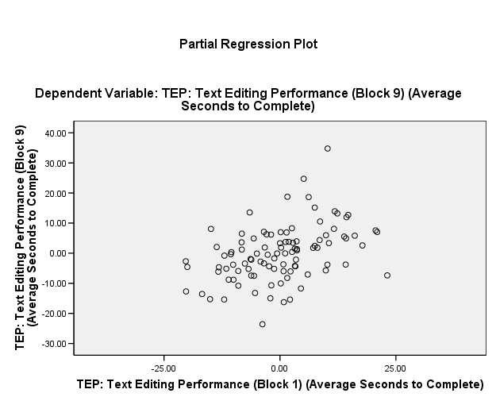
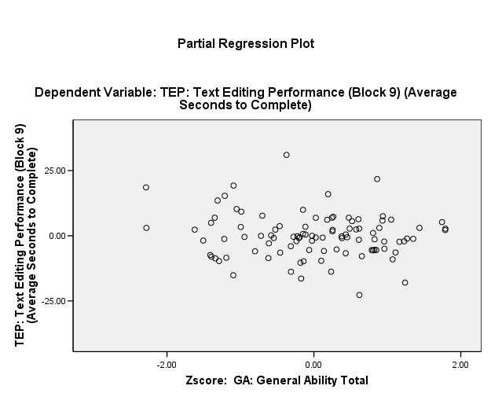
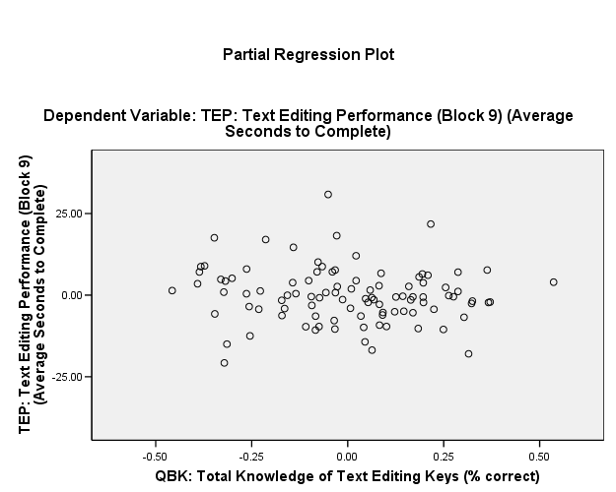
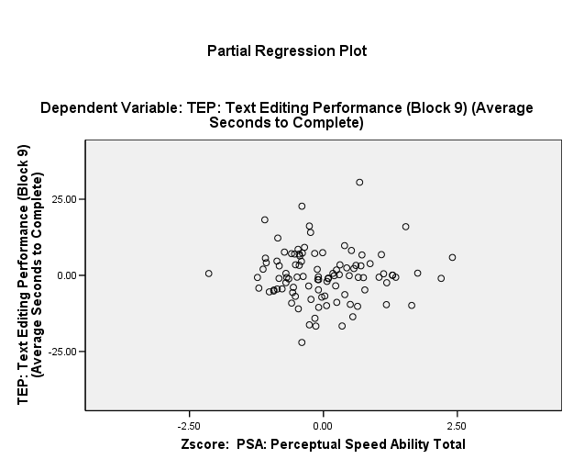
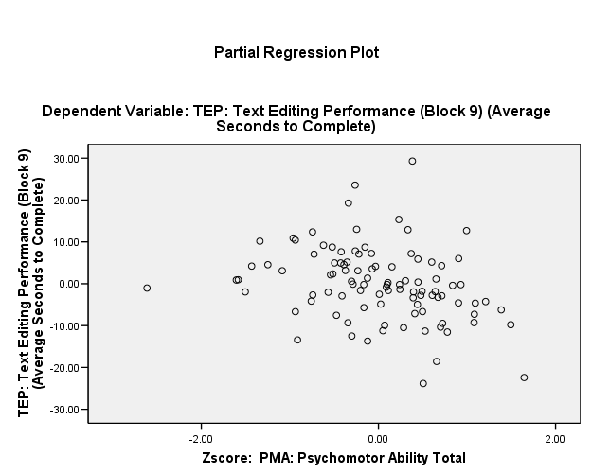
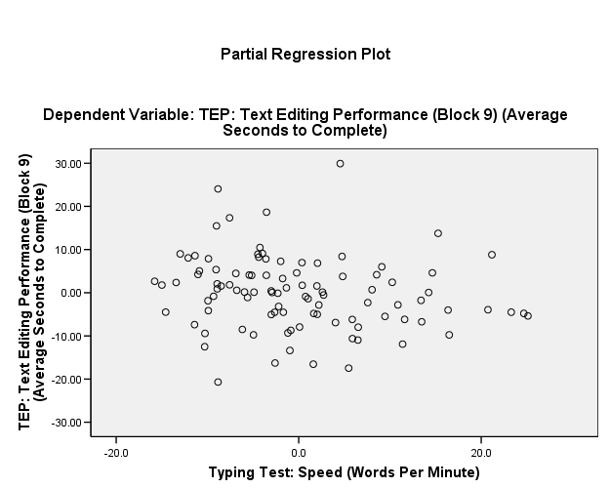
4.3 Linearity
Is there any evidence of non-linearity?
Notes:
1. Not particularly, most of the relationships in the partial regression plots are pretty weak. Thus, most of the relationships look more like no relationship.

Slide 26
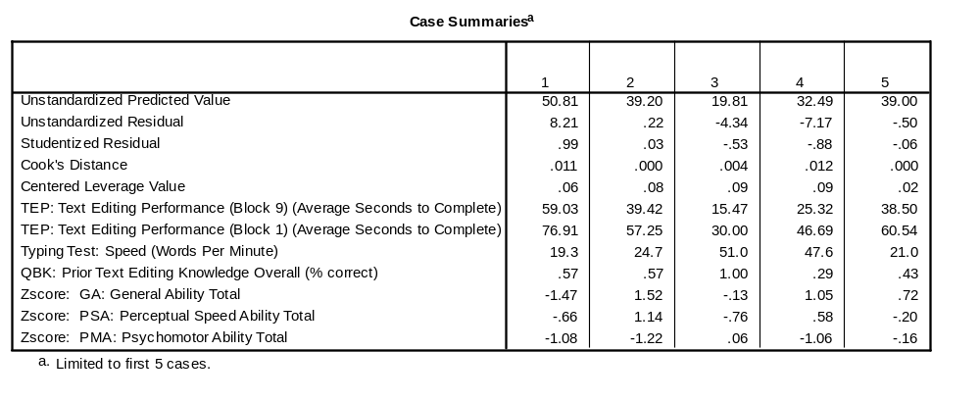
4.3 Looking at Cases
The above table shows 5 cases from the dataset and their associated values for the variables in the model and various outlier values and prediction values
Remember that the model regression equation looked like this:
[Predicted Block 9] = 19.8 + .40Block1 – 1.0GA - .1PSA – 3.5PMA – 4.1QBK -.16WPM
Confirm for a couple of cases that when you apply the model regression equation to the case’s value that it corresponds to the unstandardised predicted value?
Describe case 1 in words, you may wish to make reference to the means and standard deviations in the descriptive statistics
Case 1 and 4 have very different profiles of scores. Compare case 4 to 1? Why do they have similar leverage values, which are clearly larger than cases 2, 3 and 5?
Notes:
Just look at unstandardised predicted value to check answer
This case was very slow on the task to begin with and remained slow at the end of the experiment. The participant was a bit below average on typing speed. They had average knowledge of text editing keys. Their ability scores were below average, particularly on general ability and psychomotor ability. They were predicted to do less well on the task than average on the task by the end of the trials (50.8 seconds). However, their actual performance was worse than predicted.

Slide 27
Example 4.4
Initial Note
    Using a method that you wont learn about until 4th year psychology called cluster analysis, 3 groups of participants were created based on their ability scores.
    3 Ability Groups
      Lower Ability Group
      Higher Ability Group
      Lower General Ability / Higher Psychomotor Ability Group
Research Question
    Do the three groups differ in terms of their overall performance on the text editing task?
    Overall did performance improve from block 1 (i.e., start of the task) to block 9 (i.e., end of the task) on the text editing task?
    Did any of the three groups improve more or less between block 1 and block 9?
Describe the three variables in terms of being binary, nominal, ordinal, interval or ratio?
Which statistical procedure could we use?
What would be the null hypotheses?
What is your expectation?
Notes:
Ability Group: nominal
Time: Just comparing block 1 with 9 so it is binary
Text editing performance: Average seconds to complete the task, so ratio
Ability group is a between subjects variable; Time is a repeated measures variable. Answer: Split plot ANOVA
There are three null hypotheses corresponding to the three research questions:
Main effect of ability group: no difference in marginal mean task performance between the groups
main effect of time: no change in task performance over time
time by ability group interaction: no difference in the effect of time across the three groups
This is subjective, but based on earlier results I would expect the lower ability group to be the worst and the higher ability group to do better.
Ability Group: Psychomotor ability is the most important predictor of task performance on this task because it is highly dependent on pressing keys quickly on a computer. Thus, it is unclear who will perform better out of these two groups.
Time: It is obvious that performance will improve.
Interaction: I have no reason to expect an interaction effect. Participants who start with low performance may have greater potential to improve but equally may be less capable of thinking of ways to improve. Some theory does suggest that psychomotor ability is associated with automating simple tasks, so it is possible that the Lower ability group may improve less. We will see…

Slide 28
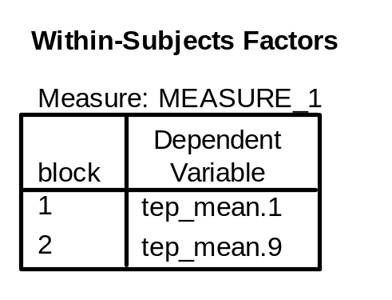
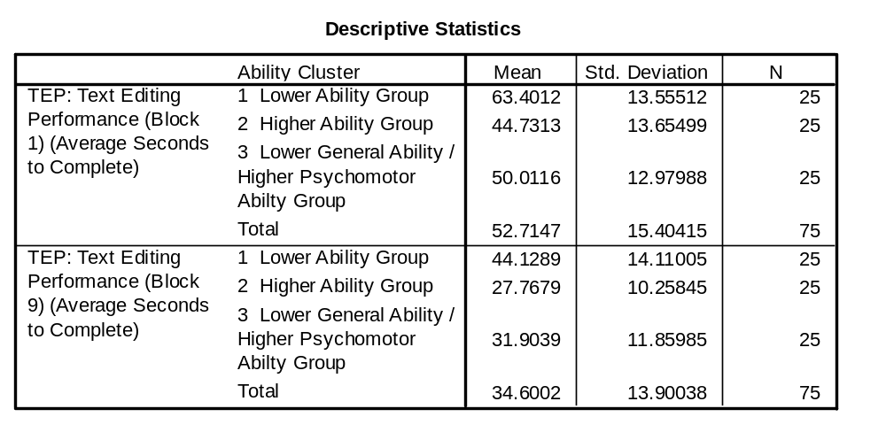
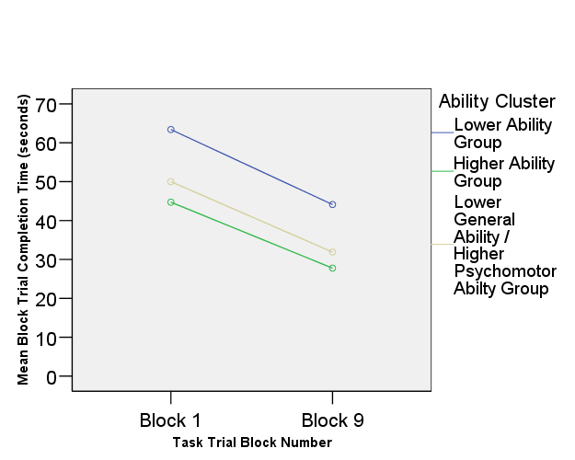
4.4 Descriptives
Note that to simplify the example, I filtered some cases to give equal group sizes.
Looking at mean task performance:
Does it look like there is a difference between the ability groups?
Does it look like people improved over time?
Does it look like there is an interaction?
Notes:
Yes, the lower ability group was about 1 standard deviation slower both at the start and the end.
Yes, all groups improved their completion times by approximately 20 seconds.
The lines look basically parallel. If calculate the mean improvement for the three groups (i.e., lower ability 63-44= 19 second improvement; higher ability = 45 – 27 = 17 second improvement; lower general higher psychomotor = 50 – 32 = 18 second improvement), they all look fairly similar.

Slide 29
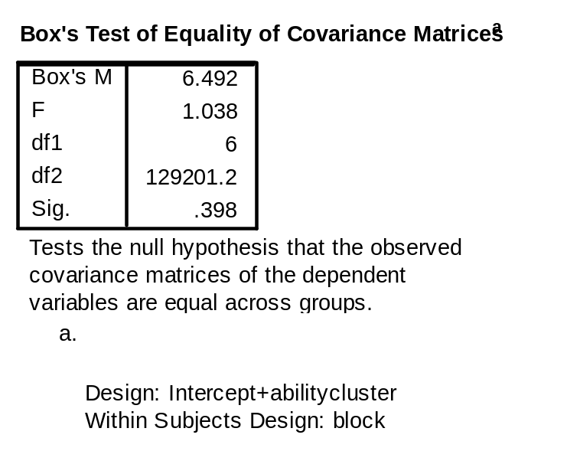
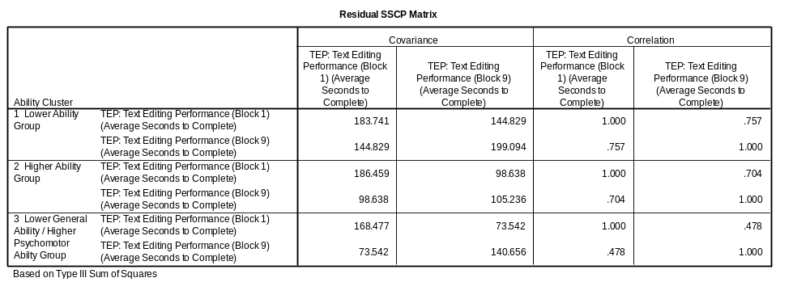
4.4 Homogeneity of covariance matrices
What does covariance mean?
What is the covariance of a variable with itself?
What is the relationship between correlation and covariance?
What is the relationship between variance and the standard deviation?
If covariance was a positive number what would that say about the two variables being covaried? And what if covariance was a negative number?
What is the assumption of homogeneity of variance?
What is the assumption of homogeneity of covariance?
What is the null hypothesis tested with Box’s test?
What are the “two dependent variables” in this example?
Would you expect performance at block 1 (start of task) to be correlated with performance at block 9 (end of task)?
Which group has the largest and which has the smallest covariance between block 1 and block 9? What about correlation?
What is the variance in task performance in the lower ability group at block 1? What about block 2?
Do the 6 variances look similar? Do the 3 covariances look similar?
What does Box’s Test suggest about the status of our assumption?
Note, you are not expected to know how to produce the customised output below: it shows the variance, covariance and correlation between initial and final task performance for the three groups
Notes:
See Philip’s lecture on Split Plot ANOVA for the mathematical formula. Conceptually, it is the average Sums of products. It is unstandardised measure of how two things covary.
Variance
Correlation is just the standardised covariance. If we may both variables z-scores then covariance would equal correlation. Once again, see Philip’s lecture for formula details.
Standard deviation is the square root of variance
Positive covariance: As one variable increases, so does the other
Negative covariance: as one variable increases, the other decreases
Variances are equal across groups in the population
Variances are equal across groups in the population and equivalent covariances are equal in the population
It is set out below the test or see answer 7
Block 1 and block 9 task performance
I would expect this as a general principle is “nothing predicts future performance like past performance”
Largest: Lower ability group (144.8)
smallest: Lower general ability / higher psychomotor ability group (73.5)
Block 1: 183.7
Block 2: 199.1
The six variances range from 105 to 186. They are a bit different, but still not that different.
The 3 covariances range from 74 to 145. They also are a bit different, but still not that different.
P is greater than .05, thus we retain the null hypothesis of equality of variance-covariance matrices

Slide 30
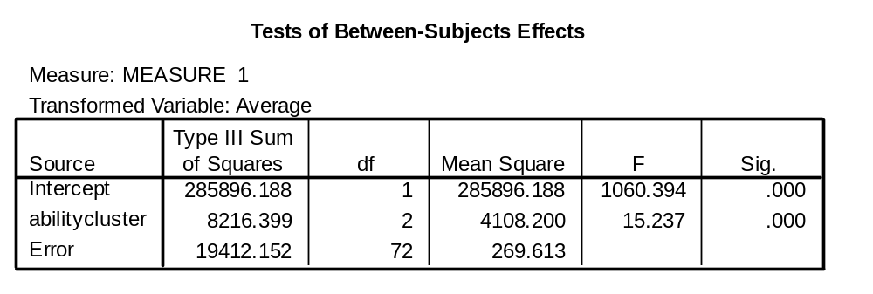
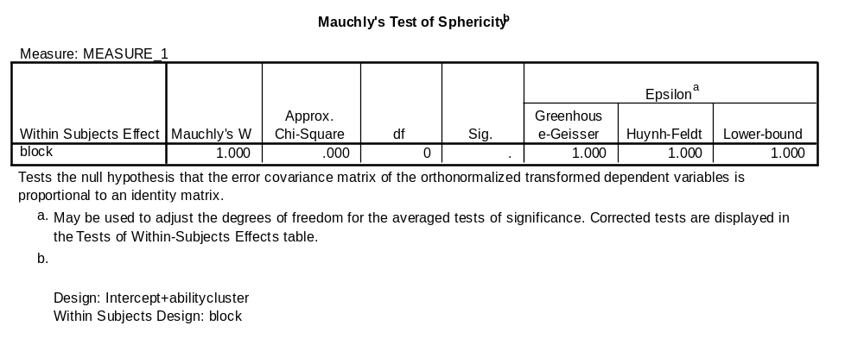
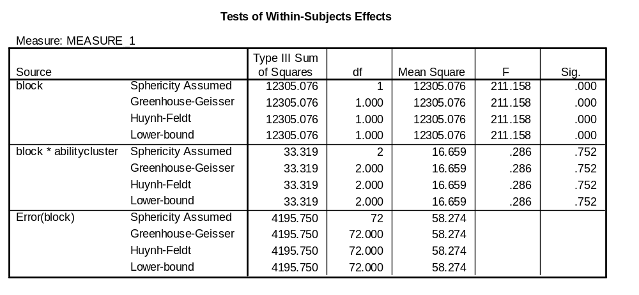
4.4 Significance Tests
Write out the F test and statistical significance for ability group, block and the interaction
If we had three levels to our repeated measures factor, how many covariances could we have between the three levels?
In this case we have two levels, how many covariances could we have?
What is the assumption of compound symmetry that Philip has taught you?
If there are three different covariances, it is possible for them to be different, but what if there is only 1?
Notes:
Ability Group: F (2, 72) = 15.2, p < .001.
Block: F (1, 72) = 211.2, p < .001.
Interaction: F (2, 72), p = .752, ns
Three (1 with 2) (1 with 3) (2 with 3)
Just one.. (block 1 with block 9)
That the covariances between levels of the repeated measures factor are equal
If there is only one covariance, then compound symmetry because there is no other covariance for it to be different from. This is why there is not sphericity test.

Slide 31
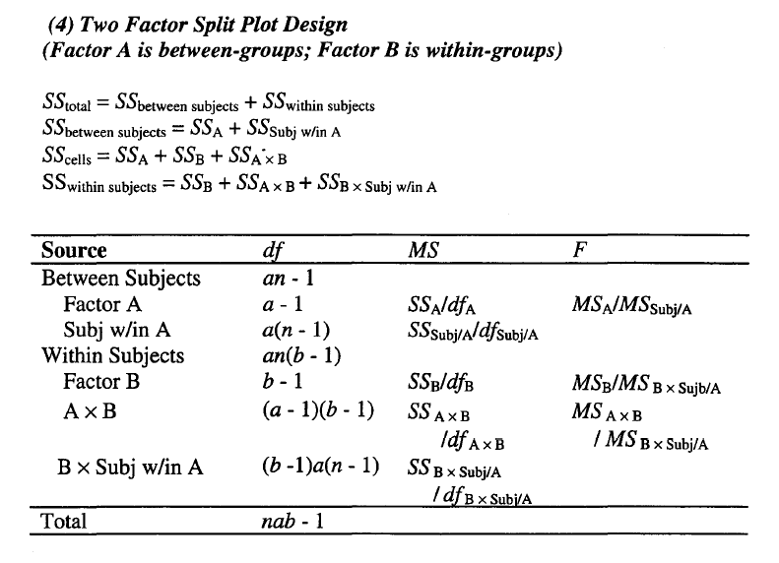
4.4 SPSS Output and Split Plot ANOVA formula
What is a, b and n in the present experiment?
What does Factor A & subj w/in A correspond to in the previous SPSS Output?
What does Factor B, A x B, and B x Subj w/in A correspond to in the previous SPSS output?
Use the rules for adding and subtracting sums of squares and your knowledge from q2 and q3 to work out SS between subjects; SS within subjects; SS total; and SS cells
You may find it useful taking the above Sums of squares and knowledge of the design to fill out the remainder of the ANOVA table and checking your results against the previous slide
Use the previous slide in conjunction with the table taken from your formula sheet below to answer the questions
Notes:
a = number of levels of the between subjects factor = 3
b = number of levels of the within subjects factor = 2
n = number of participants per group = 25
Factor A = line that reads “abilitycluster” from the between subjects effects table
Subj w/in A = line that reads “Error” from the between subjects effects table
Note that sphericity assumed corresponds to what we do when we do the hand calculations ourselves.
Factor B = line that reads “block – sphericity assumed” from the tests of within subjects effects.
A x B = line that reads “block*abilitycluster sphericity assumed” from the tests of within subjects effects.
B x Sub w/in A = line that reads “Error (block) sphericity assumed” from the tests of within subjects effects.
SS between = SS A + SS Subj w/in A = 4108 + 270 = 4378
SS within = SS B + SS A x B + SS B + SS B x Subj w/in A = 12305 + 33 + 4196 = 16534
SS Total = SS between subjects + SS within subjects = 16534 + 4378 = 20912
SS Cells = SS A + SS B + SS A x B = 4108 + 12305 + 33 = 16446

Slide 32
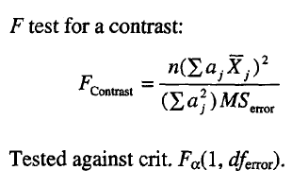
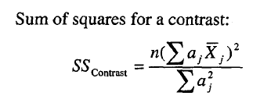
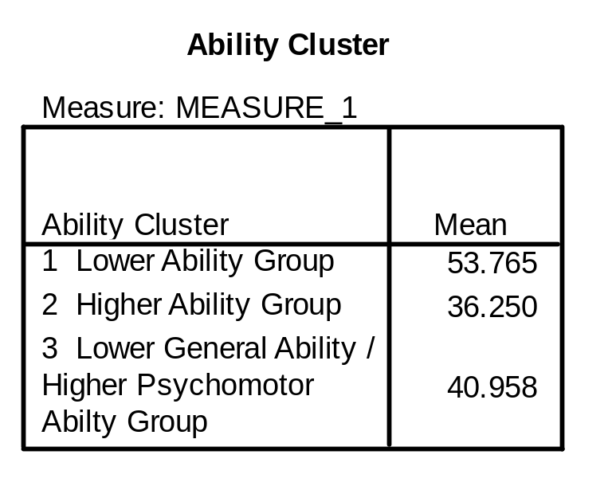
4.4 Between Subjects contrasts
What is the sample size per group (see previous slide)?
How many levels were there to the within subjects variable?
The table on the bottom right represents the marginal means for the groups, how many observations were the means based on?
If we were going to perform a contrast on marginal means for the between subjects factor (Ability Cluster), and apply the formula on the top right, what would n, ms error, df error, and critical F(α = .05) be?
How many orthogonal contrasts are possible on ability cluster?
Test for statistical significance whether mean task performance for the average of group 2 and 3 is different from group 1?
What is the only possible remaining orthogonal contrast?
Test the remaining contrast from Q7 for statistical significance
What was the Sums of Squares for Ability Cluster (see earlier slide)?
If the numerator df = 1, what is the relationship between SS contrast and MS contrast?
What’s the difference between the F contrast formula and the SS contrast formula?
All f ratios are the ratio between what and what?
What is the MS for the two contrasts you solved in Q6 and Q8?
What is the sum of the two SS contrasts for Q6 and Q8?
What is the numerator df for the effect of ability cluster?
What is the numerator df for any contrast?
What is the sum of the numerator dfs in Q6 and Q8?
What would the weights have been, if you had been testing for a linear trend? What about a quadratic trend?
What would our alpha be if we bonferonni corrected for the two contrasts performed?
What would critical F Scheffé .05 be? Would this change the results?
Notes:
25
2
25 ; I guess this is a little confusing because each mean for each participant is based on the average of their performance at the start and at the end. But all the between subjects analyses are based on such averaging already having occurred.
n = 25; MS error = error from test of between subjects effects 269.6; df error = same error as for test of between subjects effects = 72
df = 1, 72, closest value in the table is 1, 60; Thus, Critical F (α=.05) (1, 60) = 4.00
K-1 = 3 – 1 = 2
Weights: -2 1 1; Sum of Squared weights = 6; Sum of weighted means = -30.32; Sum of weighted means squared = 919.47; n=25; MS error = 269.6; F contrast = 14.21; p < .05
Group 2 with Group 3
Weights: 0 1 -1; Sum of Squared weights = 2; Sum of weighted means = -4.708 ; Sum of weighted means squared = 22.167; n=25; MS error = 269.6; F contrast = 1.0278 ; ns
4108 from the tests of between subjects effects
MS contrast = SS contrast / contrast df = SS contrast / 1 = SS contrast. I.e., there the same
F contrast = SS contrast / MS Error
SS contrast = MS Error * F contrast
Treatment (or regression or contrast) variance over error variance
SS contrast = MS Error * F contrast; Q6 SS contrast = 14.21 * 269.6 = 3831; Q7 SS contrast = 1.0278 * 269.6 = 277
3831 + 277 = 4108; Sum of MS k-1 orthogonal contrasts equals MS treatment
2
1
1 + 1 = 2; sum of the degrees of freedom for k-1 orthogonal contrasts equals df for treatment factor
From Howell’s table: linear = -1 0 1; quadratic = 1 -2 1
Using the formula sheet: .05 / 2 = .025
Using the formula sheet and the nearest critical F from Howell’s table F (2,60) .05 = 3.15
Crit F scheffé = 2 * 3.15 = 6.3
This critical F does not change the inferences made for the two contrasts

Slide 33
Fixed & Random Effects - Example
Imagine we were interested in the effect of a drug to reduce depression symptoms. A study was conducted at a particular research centre (Centre A) comparing a group receiving the drug with a group receiving a placebo. Assuming that the only measures obtained were Depression levels after 3 months of treatment, what is the independent and dependent variable? What inferential statistic could we use?
In the language of fixed and random factors, what type of variable is group (treatment vs placebo)? Why?
If the drug is actually effective what effect would increasing our sample size have on statistical power?
How would we operationalise the effectiveness of the drug?
Imagine now that the study is being conducted in 10 randomly selected research sites around the country, of which centre A is only one. Do you think the drug’s underlying effectiveness would vary across research sites? For what reasons might it vary?
Would the assessed effectiveness of the drug vary based on random sampling between sites?
How would we assess empirically if the drug’s underlying effectiveness varies across sites?
If we had only two sites, would we have a good estimate of how much the effectiveness varies across sites?
Would increasing our sample size at each site improve our understanding of the degree of variability in effectiveness across sites?
If you found out that the effectiveness of the drug varied substantially across sites, would you feel confident to generalise the findings from any one site to the population? What about if the effectiveness of the drug was fairly stable across sites?
What does the size of the site by group interaction represent in this context?
If there was no population interaction effect, what would MS interaction represent?
In the language of fixed and random effect variables, what kind of variable is site?
What do the rules tell us we use as our error term for site? What about group?
When the denominator mean square (either MS error or MS interaction) gets bigger what happens to obtained F?
When the denominator df (either df error or df interaction) gets bigger, what happens to critical F?
What happens to the interaction df when the number of sites increases?
If larger interaction effects indicate less certainty about the actual effect of the drug, does it make sense that we would want to incorporate that uncertainty into our significance test (i.e., our F ratio)?
Does it make sense that the more sites we have, the better we are able to assess our interaction effect and therefore that our interaction df will increase and power will increase?
Notes:
IV = group (placebo vs treatment)
DV = Depression Symptoms
We could do a between subjects t-test or a one-way ANOVA; they are the same when there are only two levels
It is a fixed factor because all factors of theoretical interest are represented.
Bigger sample size would mean greater statistical power
It would be the degree to which mean depression symptom levels are lower in the treatment group as compared to the placebo group.
I have no reason to think it would, but it’s possible that it might vary.
It might vary because the people are more or less depressed in one research centre. It might vary because there are different ethnic, age, gender, depression symptom, or other profiles to the patients. It might vary because the administration of the drug is better or worse at varying places. It might vary for a whole range of reasons.
Of course, the exact difference between the placebo and treatment group would vary between sites at least partially because of random sampling.
We would have to measure the effectiveness in several sites and see how much that effectiveness varies. We’d want to
No, with only two sites, it would be hard to say what was the typical effect and what was normal variation around that effect.
Not much. It would improve our estimate of the effectiveness of any one site (in a similar way that having more items in a test improves reliability of our measurements, but we still need large samples of people), but it’s more important to have more sites to assess the variability.
Not really. We’d need to pool the effects over a range of sites in order to get a meaningful estimate.
If it were stable, than any site should give a reasonable indicator of the overall effectiveness of the drug.
The degree to which the effectiveness of the drug varies by site.
MS interaction and MS error are estimating the same quantity when there is no population variability in effectiveness of the drug
Random variable
Site is a random crossed with a fixed, so we use MS within
Group is a fixed crossed with a random, so we use MS group by site interaction
It gets smaller (i.e., less likely get significant results).
Critical f gets smaller (i.e., more likely to get significant results).
The interaction df increases. Interaction df = (2-1) * (number of sites – 1)
I think it does. When there is no interaction effect MS interaction and MS error are estimating the same quantity. When there is an interaction effect, the interaction effect will be estimating a larger quantity than MS error incorporating the uncertainty about estimating the effectiveness of the drug due to the fact that it’s effectiveness appears to vary across sites.
I think it does.

