Slide 1
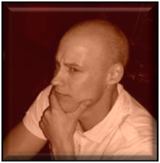
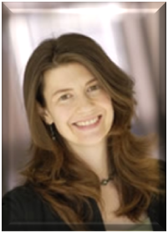

How to conduct a Social Network Analysis: a tool for empowering teams and work groups
Jeromy Anglim
Department of Psychology,
The University of Melbourne
Lea Waters
Department of Management,
The University of melbourne
Correspondence: Jeromy Anglim
Email: jkanglim@unimelb.edu.au
For a copy of the presentation:
Just email me

Slide 2

Why are you here
What do you want to get out of this conference? Why are you here?
What is your I/O psych social network now?
What do you want it to look like at the end of the conference?
What role do social networks play in making this conference a positive experience?

Slide 3
Clichés or Truisms?
“It’s a small world in I/O Psych”
“It’s not what you know; it’s who you know”
“Business is built on relationships”
“We’re living in a networked world”

Slide 4
Overview
Overview of Social Network Analysis
  Some classic examples
  Terminology of Social Network Analysis
Consulting Model
Nuts and bolts
  Questionnaire design
  Software
  Results presentation
Concluding Thoughts

Slide 5
1. Overview of Social Network Analysis

Slide 6
What is social network analysis?
What is Social Network Analysis?
  Set of mathematical, graphical and theoretical tools for modelling networks and the structures therein
  A lens for understanding the social world in a relational way
What social networks are you a part of?

Slide 7
Multiplicity of networks
Official versus Unofficial
Examples
  Advice:
    “Who do you go to for advice?”
    “Who goes to you for advice?”
  Collaboration
    “Who do you collaborate with?”
  Trust
    Who do you trust?
  Friendship
    Who is your friend?
  Conflict

Slide 8
Relevance to I/O
Classic constructs
  Job Satisfaction & Motivation
  Job Performance
  Leadership & Power
  Organisational Culture & Climate
  Job Search, Career Development, Mentoring
What happens when we view these through the lens of social network analysis

Slide 9






Playing Kevin Bacon
What’s the Kevin Bacon number of John Travolta?
Or in social networks language: What is the shortest path (geodesic) between John Travolta and Kevin Bacon?
John Travolta
1. John Lafayette
2. Kevin Bacon
Kevin Bacon Number = 2
http://oracleofbacon.org/cgi-bin/oracle/movielinks?firstname=Bacon%2C+Kevin&game=1&secondname=John+Travolta

Slide 10
Social Networks – Key Terms
  Actor/Node
  Tie/Link/Relationship
  Attribute
  Network
  Relationship properties
    Type of Relationship (e.g., friendship, advice)
    Direction of Relationship (directed vs undirected)
    Strength of Relationship (binary vs weighted)
  Whole Network Properties
    Centralisation
    Density
    Size

Slide 11
Social Networks – Key Terms
Node Network Properties
  Isolate (no ties)
  Outlier (one tie)
  Structural Hole & Brokers
  Degree
  Centrality
Tie Properties
  Reciprocity
  Bridge
Geodesic (shortest distance)
Clique

Slide 12
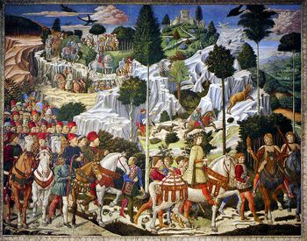
Study of the Medici Family
Portrait of Medici Family
Source: Wikipedia
Rise of the Medici family in medieval Florence
How did the family achieve such influence?
What does this case study tell us about the role of network position and network structure on power relationships?

Slide 13
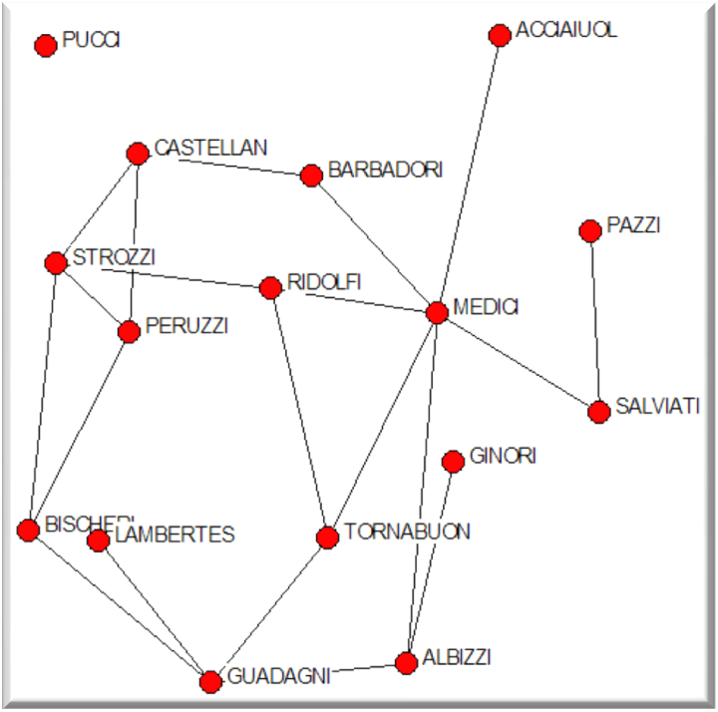
  Actors: Florentine Families (size = 16 families)
  Ties: Undirected unweighted marriage tie
  Density: 16.7% of possible ties present
Isolate
Marriage Network
Central Actor
Broker
Degree = 6
Clique
Outliers
Degree = 1
Breiger & Pattison (1986); Padgett & Ansell (1993)

Slide 14
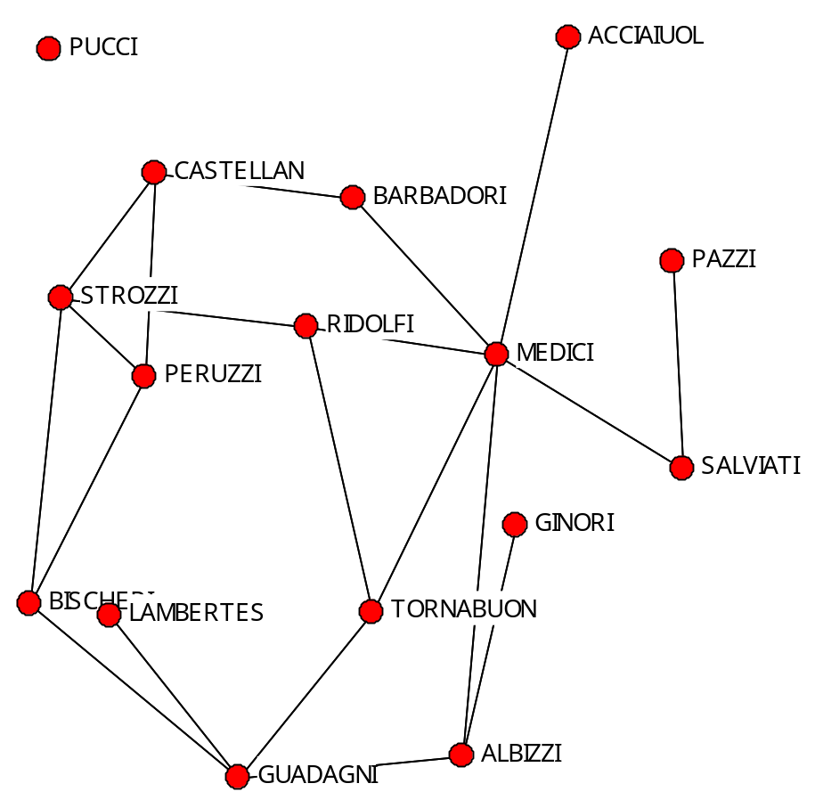
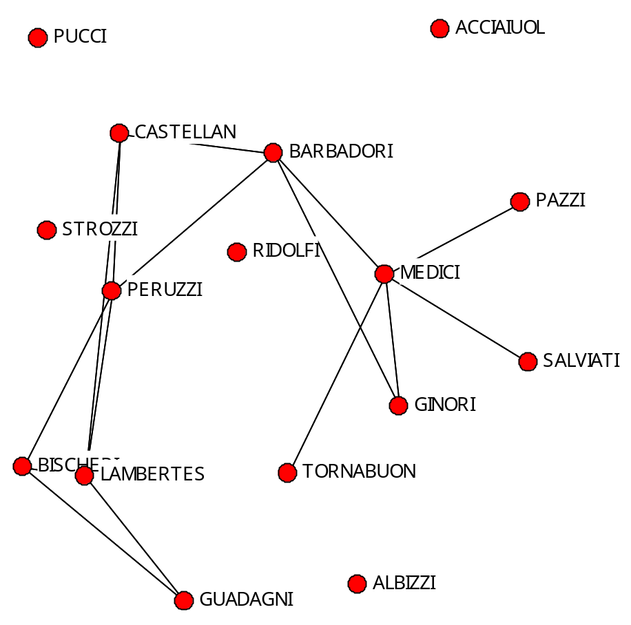
Florence
Which families are central in both networks?
Which families do you think might have more power?
Marriage Network
Business Network

Slide 15
Key players
(Cross & Prusak, 2002)
Boundary spanners
Central connectors
Information brokers
Peripheral specialists

Slide 16
Dynamic network processes
  Changing Node Attributes
  Changing network characteristics
    Adding or removing actors
    Adding or removing relationships
  Examples
    Gossip, ideas, innovation, Attitudes
    Related to the theory of Memes

Slide 17
Applications
Consultants and HR workers
  Employee Opinion Surveys
  Culture Change
  Team development
Personal development

Slide 18
2. Consulting Model
Team Consulting

Slide 19
Social Networks in the Team Context
Internal Team Networks
External Team Networks

Slide 20
Basic Team Theory
Team vs Group
Interdependence
  Pooled, Sequential, Reciprocal
Team Performance
  = Individual Performance + Process Gain – Process Loss
Tuckman’s Stage Model
  Forming > Storming > Norming > Performing > Adjourning
Gersick’s Punctuated Equilibrium Model
Input – Process – Output Model
Team Mental Models (Task & Team)

Slide 21
Consulting Model
Feedback & Awareness
  “If it’s not measured, it doesn’t matter”
Model vs previously conceived network
Model vs Ideal network

Slide 22
3. Nuts & Bolts
  Questionnaire design
  Software
  Results presentation

Slide 23
Questionnaire design
Network Questions
Choice of response scales
Pragmatics

Slide 24
Example Response Scale
Response scale
  0) Never;
  (1) Less than once a month;
  (2) Once or twice a month;
  (3) Once or twice a week;
  (4) About once a day;
  (5) 2 or 3 times a day;
  (6) 4 or more times a day.

Slide 25
Which networks do we model?
Example Questions
Advice
  How often do you give this person advice?
  How often are you given advice by this person?
Information Sharing
  How often do you share information with this person?
  How often does this person share information with you?
Other networks
  Consultation
  Discuss challenging technical matters
  Turn to the person to resolve conflict
  Motivate
  Help, Remind & Clarify Team Goals

Slide 26
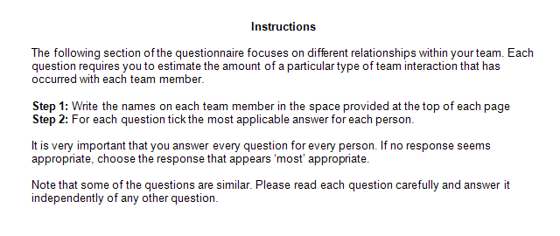

Instructions

Slide 27
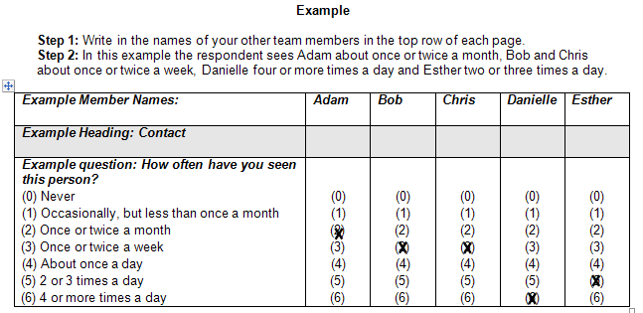
Instructions

Slide 28
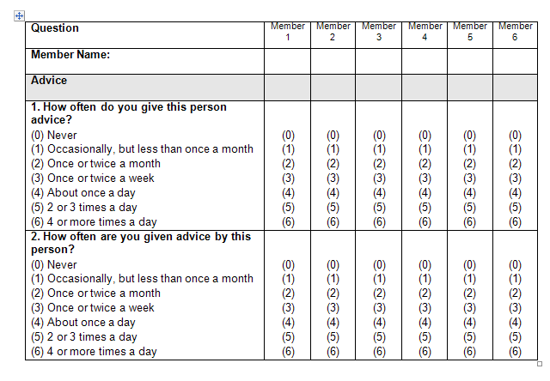
Example

Slide 29
Designing a Social Networks Questionnaire
Lessons learnt
  Ask questions in both directions
  General principles of questionnaire design still apply
    Match response scale and questions to purpose

Slide 30
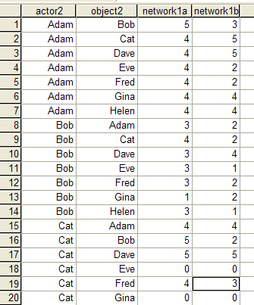
Storing The Data
Different methods:
  Matrix
  List of ties
  All possible ties
Decision
  Depends on software
  Proposed analyses

Slide 31
Simple Analyses
Feeding back the raw data
Summary Statistics
Visual Representations

Slide 32
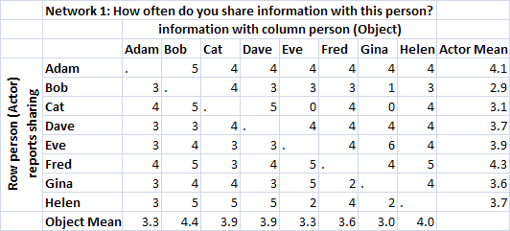


Tables of Values
Overall Mean = 3.7
Who reports sharing the most?
Who do other share the most with?
What’s the overall level of sharing?

Slide 33
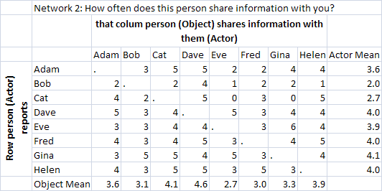
Tables of Values
Overall Mean = 3.7
Overall Mean = 3.5

Slide 34
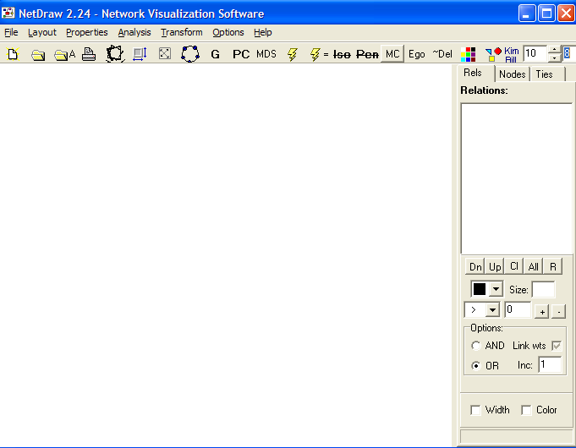
Netdraw

Slide 35
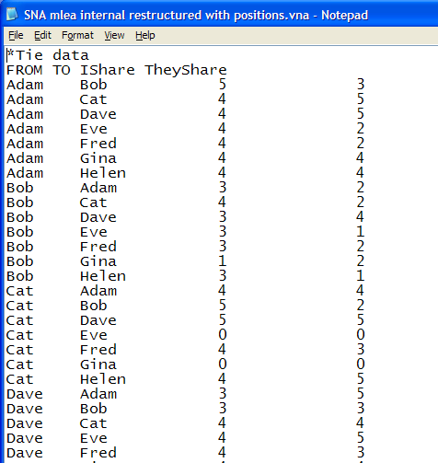
VNA format for NetDraw

Slide 36
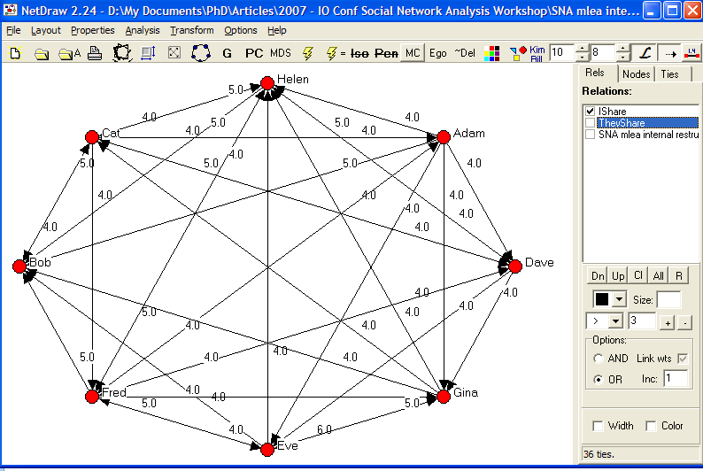

Slide 37
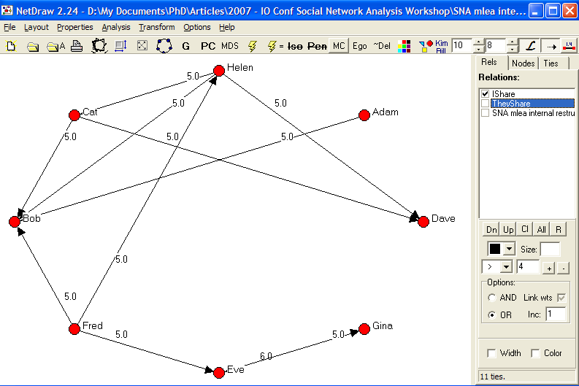

Slide 38
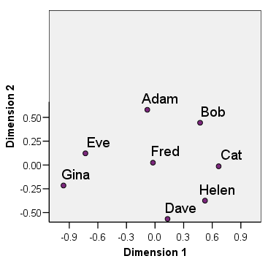
Multidimensional Scaling
Who’s in the centre?
Who’s close?
Who’s distant?
Any spatial cliques?
What does the general configuration suggest?
Using SPSS Proxscal
2000 multiple random starts
Ordinal transformation untied
2 dimensions

Slide 39
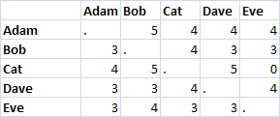
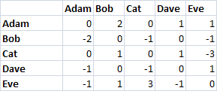
Reciprocity
Directed network minus transpose of directed network
Provides Discussion Points
What’s going on with Cat and Eve?
E.g., 3 – 0 = -3

Slide 40
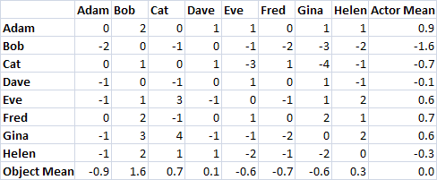
Reciprocity
Who thinks they share more information with others, than others report sharing with them?
OR
The I-Give-but-don’t-Get Index

Slide 41
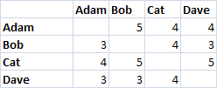
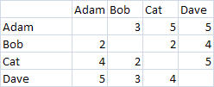
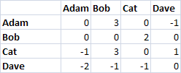
Shared view
I Share Info
Network 1 (I share with you) minus transpose (you share with me)
To what extent do team members see the same relationships the same way
They Share Info
Shared View
E.g., 3 – 5 = -2

Slide 42
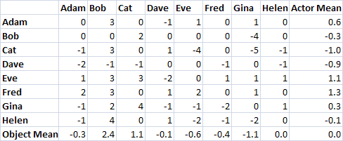
Shared view
Who thinks they share more than others think they share?
OR
The I’m great, but others don’t see it Index…

Slide 43
4. Concluding Thoughts
  Challenges
  Lessons Learnt
  What’s next?

Slide 44
Challenges
Clarity of communication
  Educating about social networks analysis
Confidentiality Concerns
Missing Data

Slide 45
Lessons Learnt
Active process of interpretation
  Critical to know the team in order to interpret the diagram
  Test the meaning with the actors
  Get involvement
Plan ahead & refine tools

Slide 46
The next step
Understanding
  How can social network analysis be made more intuitive?
Actionable Recommendations
  How can descriptive social network analysis be better converted into actionable recommendations?
Relevance
  What situations could you apply social network analysis?

Slide 47



Happy Networking
Good food..
Good wine…
Good conversation…
Questions?
Correspondence: Jeromy Anglim
Email: jkanglim@unimelb.edu.au
For a copy of the presentation:
Just email me

Slide 48
Social Networks Analysis
Example Software
  Netdraw (free software for drawing social networks)
  UCINet (30 day trial; provides information about properties of social networks)
Important Journals
  Social Networks
Websites
  http://www.humax.net/teams.html (easy introduction into networks as applied to teams)
Book
  Wasserman, S., & Faust, K. (1994). Social Networks Analysis: Methods and Applications. United Kingdom: Cambridge University Press.
Example Datasets
  http://vlado.fmf.uni-lj.si/pub/networks/data/UciNet/UciData.htm
The University of Melbourne, Department of Psychology
  Major centre for social networks research: Pip Pattison, Garry Robins

Slide 49
Readings
Baker, 1995 www.humax.net/teams.html
Cross, R., & Prusak, L. (2002). The people who make organisations go – or stop. Harvard Business Review, 104-112

