Slide 1
Interactive Exam Revision Questions
Learning Principle governing questions
  Each slide has questions that allow you to assess your own understanding of the SPSS output and the principles of the course
  The idea is to attempt them yourself to assess your understanding and identify areas of the course where you may need to revise
  The answers are there if you are still stuck
Answers
  The answers can be found in the “notes” section of the PowerPoint slide
    If you are viewing this on PDF and do not have PowerPoint, you can obtain a PowerPoint viewer by typing PowerPoint viewer into Google or going to:
    http://www.microsoft.com/downloads/details.aspx?FamilyId=428D5727-43AB-4F24-90B7-A94784AF71A4&displaylang=en
  If viewing in PDF, it is best to cover the answers with a sheet of paper and only check if you can not do them yourself
Coverage
  These questions do not cover everything you need to know in D&A
Corrections?
  Of course, I’d love all the answers to be perfect first time, but if you spot what looks like an error, send me an email: jkanglim@unimelb.edu.au
Notes:
Note that obviously knowledge of the experiment or skill acquisition theory is not assessable
At times your expectations are sought about the study and in the answers some thoughts are shared. This is purely to round out the experience of the exercise by seeing it in a context of real research.

Slide 2
Interactive Example:
Skill Acquisition Data Set
This dataset forms the basis of the majority of the exercises. Thus, the results reflect actual empirical findings.
Motivation for research
  Understand relationship between abilities, prior skills and other individual differences with learning a relatively simple psychomotor task
Sample
  Around 116 participants (but varies because not all participants did all tests) – mix of 1st year psychology students and friends and family of researchers
Measures & Design
  Demographic Information (age, gender)
  Background Questionnaire (need for breaks; keyboard experience, etc.)
  Self-report questionnaire on knowledge of text-editing
  Initial motivation Questionnaire
  Multiple choice test of knowledge of text editing
  Typing test
  Battery of nine ability tests
    General cognitive; perceptual speed and reaction time
  Perceptions of ability tests and task motivation questionnaire
  54 trials (on a text editing task (time to complete each trial; strategies used)
  Retrospective perception of experiment Questionnaire
For further info, see: Anglim, J., Langan-Fox, J., & Mahdavi, N. (2005). Modeling the Relationship between Strategies, Abilities and Skilled Performance. CogSci 2005, 27th Annual Meeting of the Cognitive Science Society, July 21-23 Stresa, Italy
web ref: www.psych.unito.it/csc/cogsci05/frame/poster/3/p465-anglim.pdf

Slide 3
Example 1
Note
  At the end of the ability tests, participants were asked whether they felt the tests accurately measured their ability (Yes or No)
  Total ability was a z-score of based on a composite of all the individual tests
Research Question
  Did people answering yes or no differ in their measured ability?
Are the two variables discrete or continuous?
Are the two variables nominal, ordinal, interval or ratio scales?
What is the mean and standard deviation of a z-score?
Which statistical procedure could we use to test the research question?
What is the null hypothesis?
What is your expectation?
Note that in order to make the example clearer as a teaching aide, cases were filtered in order to make group sizes equal. This is not something you would do on real data.
Notes:
Self reported ability test accuracy is discrete
Ability is continuous
Self reported ability test accuracy is nominal
ability is interval
Mean = 0
standard deviation = 1
T-test would be the obvious choice; we could also do point biserial correlation or even simple regression or a one-way ANOVA. They would all give the same answer.
No difference between group means
This is subjective, but I would think that people who think that the test did not measure their ability may have been less likely to have been paying attention during the test. They may also have experienced problems of comprehension which they felt prevented them from showing their abilities. In addition, beyond measurement issues, they may actually have lower abilities and be engaging in self-protective behaviours by claiming the tests do not measure their abilities. Equally, people may be critical of the tests because they are intelligent and critical and could see flaws with the test administration. All together I might expect a small difference with those saying “yes” having slightly higher ability scores.

Slide 4
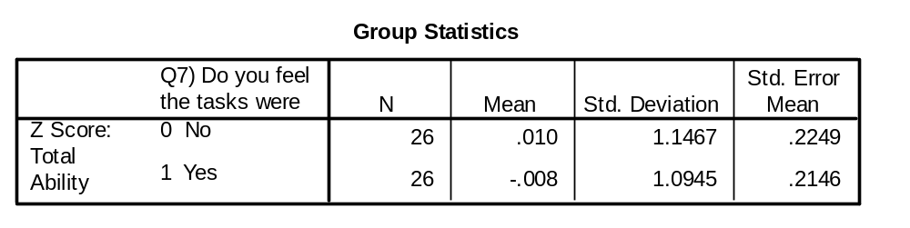
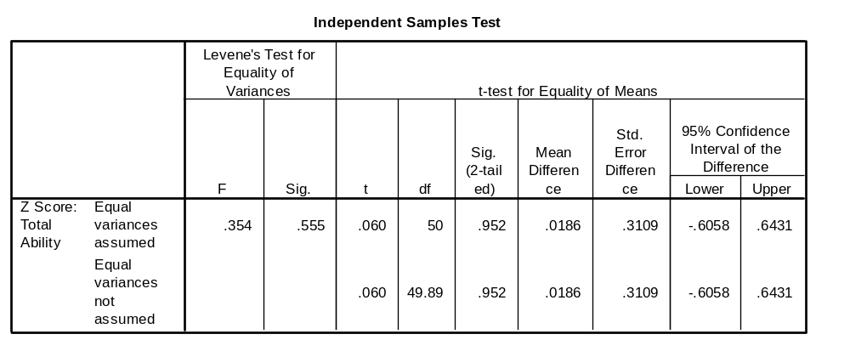
Results
What is the difference between the means?
What is Cohen's d if we use the “no” group’s standard deviation? What is this in terms of his rules of thumb?
Do the standard deviations look similar in the two groups?
What is the standard deviation squared?
Thus, do the variances look similar in the two groups?
What is the null hypothesis for Levene’s test? Is it rejected? And what does this mean?
What is the status of our null hypothesis in relation to whether the means differ in the population ?
Notes:
0.01 – (-.008) = 0.018
.018 / 1.1467 = .016;
rules of thumb for cohen’s d: small (.2); medium (.5); large (.8)
.016 is well below small
Yes
Variance
Yes
That the within group variance is equal in the two groups in the population
it is not rejected at .05; p = .555
We maintain our assumption of homogeneity of variance
We maintain our null hypothesis
t(50) = .060, p = .952, ns

Slide 5
Example 2
Note
  One of the ability tests was called the Clerical Speed and Accuracy test
  Each Question involved selecting a two-letter pair out of five two-letter pairs that corresponded to the two-letter pair in the question booklet
  The test was timed and split into two halves consisting of 100 questions each and lasting 3 minutes each
2 Research Questions
  1. Was average performance in the first part different to performance in the second part?
  2. Was performance in the first part related to performance in the second part?
What are the variables in this study?
Are the variables nominal, ordinal, interval or ratio scales?
Which two statistical procedure could we use to test the two research questions?
What are the null hypotheses for the two research questions?
What kind of reliability measure is research question 2?
What are your expectations?
Notes:
Test performance (time 1 and 2)
Part
Test performance: ratio
Part: only two levels so probably describe as nominal (or binary)
First: repeated measures t-test (or possibly repeated measures ANOVA)
Second: correlation
First: mean performance at time 1 is equal to mean performance at time 2
second: performance at time 1 will be uncorrelated with performance at time 2
Split-half reliability
First: I would expect performance to be fairly similar on both sets, but performance might be slightly better on the second part, because of practice effects. There may be mild boredom or distraction effects on the second set.
Second: the test is a well established measure so it should be fairly stable across the two halves. I would expect a very large correlation.

Slide 6
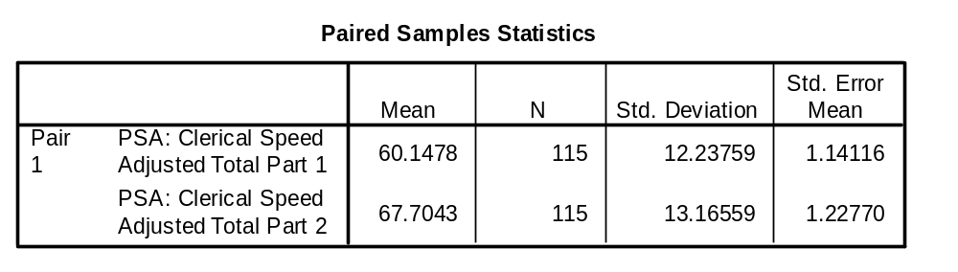
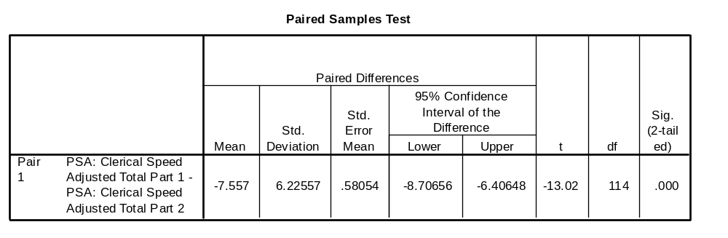
Repeated measures t-test
What is the difference between the two means?
What is the Cohen’s d of the difference taking the part 1 standard deviation?
Which part did people do better on? Was the difference small, medium or large?
Was the observed difference statistically significant? Write it out.
What’s the answer to the research question?
How might you explain such a difference?
What would have happened if we had computed a difference score between their part 1 and part 2 score for each individual and performed a one-sample t-test on this difference score?
If we did adopt this approach of doing a one sample t-test on the difference score, what would be the population mean that we would test our sample mean against?
Notes:
-7.557
-7.557/12.23759 = -0.62
Part 2
Cohen’s rules of thumb for d are that .5 is a medium effect and .8 large: Thus, it represents a “medium” effect
Yes, t (114) =-13.02, p < .001
Participants improved in their performance on the test from part 1 to part 2
Various explanations could be made including practice effects; some people not understanding the instructions on the first trial; etc.
We would get the same result
0

Slide 7
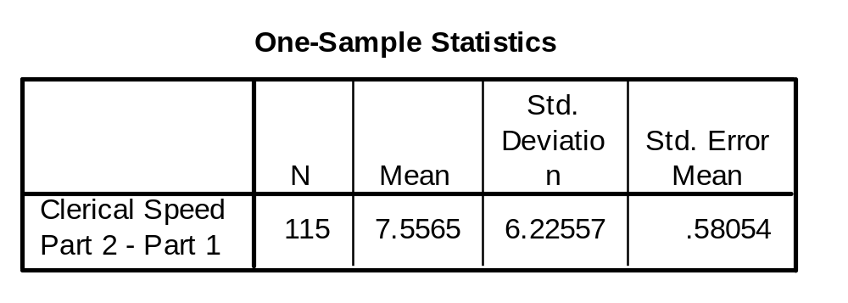
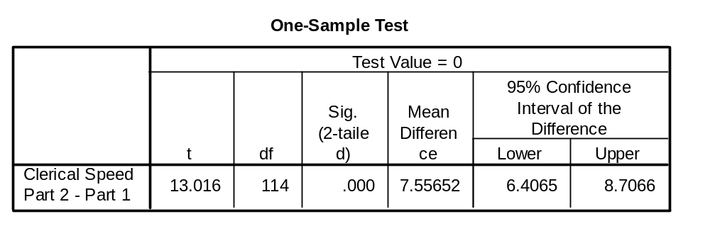
One-sample t-test approach
If a participant answered 60 correctly for part 1 and 80 for part 2, what would their difference score be?
If a participant answered 80 correctly for part 1 and 70 for part 2, what would their difference score be?
If a participant answered 70 correctly for part 1 and 70 for part 2, what would their difference score be?
What is the average of the difference scores between part 2 and part 1?
What does the difference score represent in normal language?
What was the standard deviation of the difference score?
What are the rules relating percentage of a normal distribution covered and the standard deviation?
Assuming a normal distribution to the difference scores and looking at the mean and standard deviation, do you think any of the participants did worse on part 2?
What was t value, df and p?
Were the results any different from the repeated measures t-test appraoch?
Notes:
80-60 = 20
70-80 = -10
70-70 = 0
7.5565
Improvement in score from part 1 to part 2
6.22
1 standard deviation: 68%
2 standard deviations: 97%
3 standard deviations: 99.7%
0 is about one standard deviation away from 7.5
(100% - 68%) / 2 = 32% / 2 = 16%
Thus, approximately 16% of participants are likely to have values less than zero
16% of 115 = 18.4
Thus, we would expect several cases to have performed worse on part 2 than on part 1
t(114) = 13.016, p < .001
No, not really. The t-value changed sign but this is of no consequence and was purely due to the fact that SPSS did part 1 minus part 2 and we did part 2 minus part 1.

Slide 8
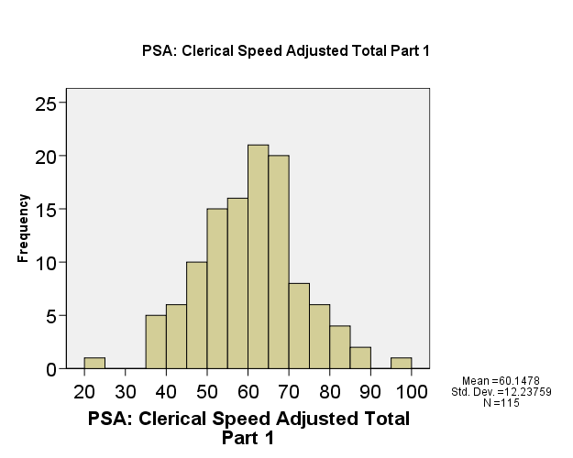
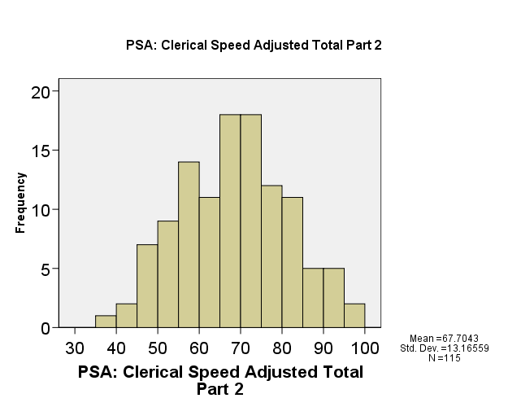
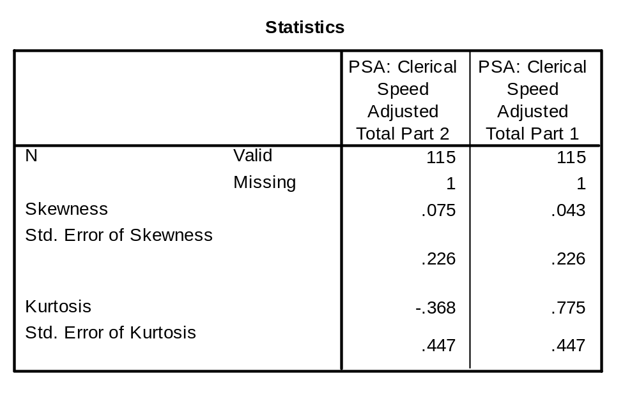
Correlation: Assumption Testing
What are the two assumptions of correlation required in order to obtain accurate p-values for the significance test?
In the histogram, does performance on the two variables look normally distributed?
What is skewness / se skew for the two variables and does? Is it larger than 3 for either variable?
Notes:
Random sample of X and Y values
X and Y are normally distributed
Yes
Part 2: .075 / .226 = .33
Part 1: .043 / .226 = .19
no and no

Slide 9
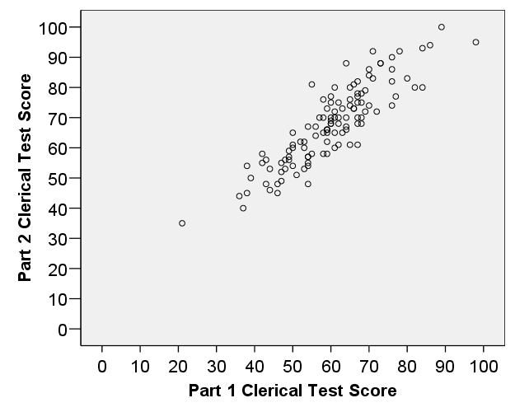
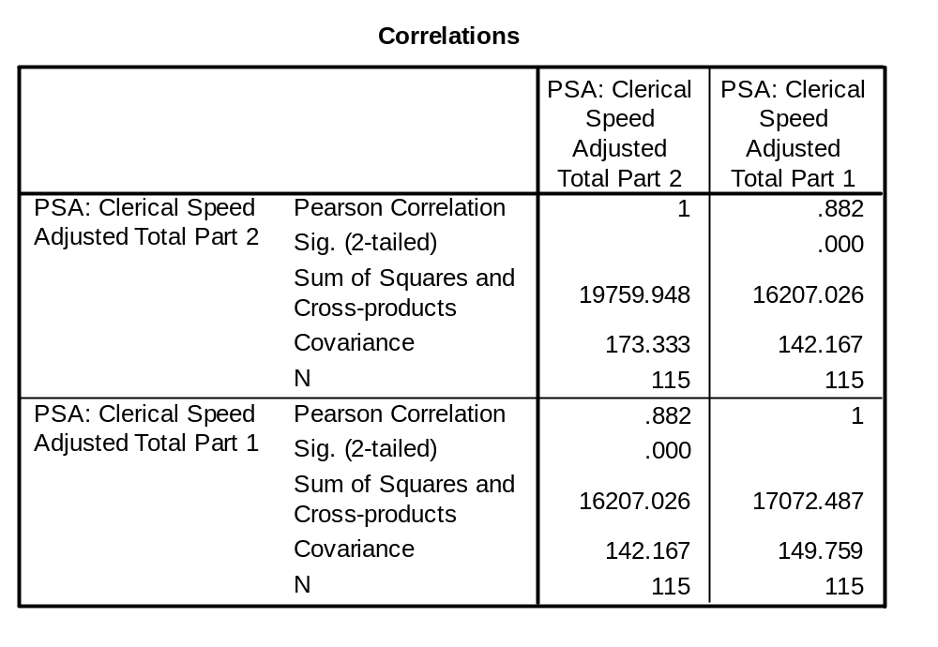
Correlation
Looking at the scatterplot, describe the relationship in terms of direction, form, and degree.
What is the largest absolute value a correlation can take?
Can we justifiably say that part 1 test score caused their part 2 test score?
The sample was made up of roughly 25% first year psychology students and 50% friends of one of the researchers typically aged around 22 and 25% parents of friends of the researchers, do you think restricted range might be an issue here?
Are there any extreme scores?
If instead of using the raw scores, we used the rank of each participant, and performed a correlation on these ranks, what type of correlation would we have?
If we split part 1 scores into high and low groups and correlated it with the raw version of part 2, what type of correlation would we have?
Is the correlation statistically significant? What is our df, what is critical r (two-tailed) in G&W?
Notes:
Direction: positive
Form: linear
Degree: strong
1 – i.e.., the absolute value of -1 is 1
No, not really. This is correlational data with no experimental manipulation. In fact it would be difficult to assign people randomly to ability groups. More realistically is that there is a third variable such as the underlying ability being measured that is causing both test scores.
It is difficult to say. There is an over-representation of young people and university educated people. Thus, there might be a greater range of scores in the population. Without more information about the population spread of scores, it’s difficult to say. The test manual would be one place to look at to find the answer to this question
From the scatterplot, there is one case that obtained about 20 on part 1 and about 35 on part 2 that appears to be a univariate outlier on both parts of the test. They are not a bivariate outlier in the sense that they fit on the regression line.
Spearman’s Rho
Point-Biserial; as a side note – splitting a continuous variable into two categories is generally not an advisable thing to do in practice because you lose a lot of information about individual differences
Yes, significant: p < .001
df = n-2 = 115-2 = 113
G&W’s table is a bit short, but for df=100, critical r (two-tailed)= .195

Slide 10
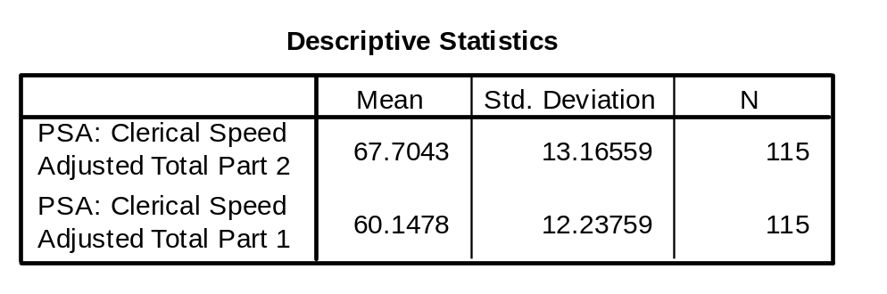
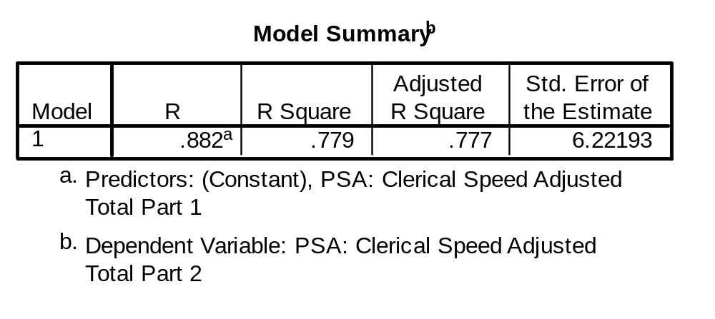
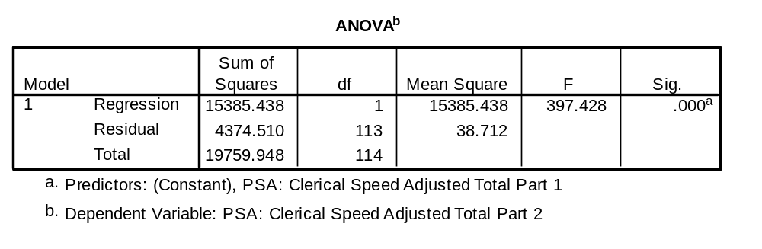
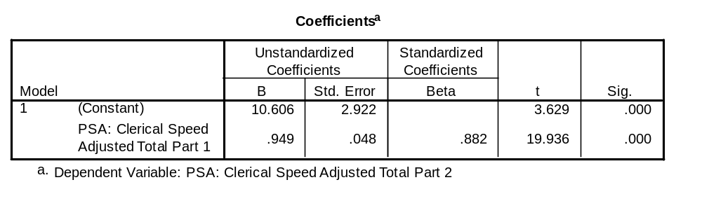
Regression
How much variance was explained in part 2 by part 1?
Was this statistically significant?
What was the unstandardised model regression equation?
What is the standard error of the estimate?
What is our approximate 95% confidence interval of estimates (i.e., it is plus or minus what amount)?
If a participant answered 60 items correctly on part 1, what would we predict for part 2?
7. What is the constant?
8. If all output was shown except for the constant, how could you apply the formula in the exam formula sheet to work out the constant
Notes:
77.9%
Yes, p < .001
Predicted Part 2 = 10.6 + .949[Part1]
6.22
Plus or minus 2*6.22 = 12.44
Predicted Part 2 = 10.6 + .949[60] = 67.54
10.606
A =My – bMx = 67.7 - .949(60.1) = 10.7

Slide 11
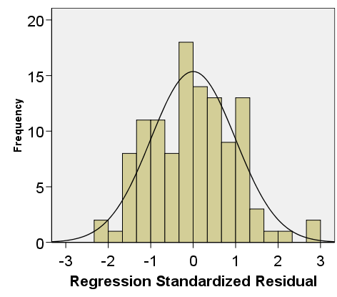
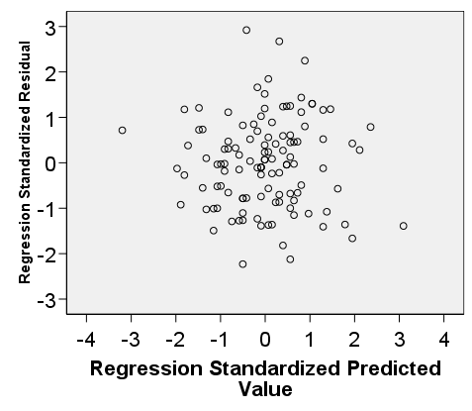
Regression diagnostics
What are three assumption of regression discussed in this course?
What is a residual?
What is a standardised variable (i.e., a z-score)?
What is a standardised residual?
What is a predicted value?
What is a standardised predicted value?
What is the relationship between a participants score on the predictor variable and their predicted value?
If a participant had a standardised residual of +2, did they perform better or worse than we expected on Part 2?
Do the residuals look normally distributed?
In the plot of predicted by residuals, what does it mean for a participant to have a value of 0 on the y axis?
What about 0 on the x axis?
Is the there any systematic pattern in the plot of predicted by residuals? What does this suggest about the status of homogeneity of variance?
What does homogeneity of variance mean in t-tests and ANOVA?
What does homogeneity of variance mean in regression?
Are they the same idea in both regression and ANOVA/t-test?
Notes:
Independence of observations
Normality of residuals
Homogeneity of variance (homoscedasticity)
Observed minus Predicted
Mean = 0, sd = 1
A residual that has been standardised such that it has a mean of 0 and sd of 1
The value predicted by the regression model
Predicted value that has been standardised such that it has a mean of 0 and sd of 1
A participants score is put into the regression equation and this yields a prediction
Better than expected
Yes, pretty much
No difference between observed and predicted
i.e., the prediction was accurate
predicted part 2 performance was the mean of predicted values
No, not that I can see
That the within group variance is equal in the population in all groups
That the spread of scores around prediction in the population is equal for all levels of predicted Y
Yes. In ANOVA/t-tests, predicted Y is the group mean, and in regression predicted Y is based on the regression equation and the score a participant has on the predictor variable

Slide 12
Example 3
Note:
  The sample was made up of roughly 25% first year psychology students and 50% friends of one of the researchers (a female researcher) typically aged around 22 and 25% parents of friends of the researchers
2 Research Questions
  Were males and females equally likely to be sampled based on the sampling procedure?
What is the variables in this study?
Is the variable nominal, ordinal, interval or ratio scales?
What statistical procedure could we use to assess this question?
What are the two types of chi-square tests discussed in this course and how do they differ?
What is the null hypotheses for the research questions?
What might the target population be in this case?
What are your expectations about the result?
Notes:
Gender
Nominal (or binary)
Chi-square goodness of fit
Chi-square goodness of fit and chi-square test of independence
chi-square goodness of fit compares a sample distribution of frequencies to a hypothetical set of frequencies
chi-square test of independence tests whether the frequencies on one nominal variable are related to a second nominal variable
Frequency of males equals frequencies of females in the target population
Perhaps some combination of all friends and family of the researchers and all 1st year psychology students.
1st year psychology students are majority female; Also, the female researcher may have known more females. Thus, I would expect there to be more females.

Slide 13
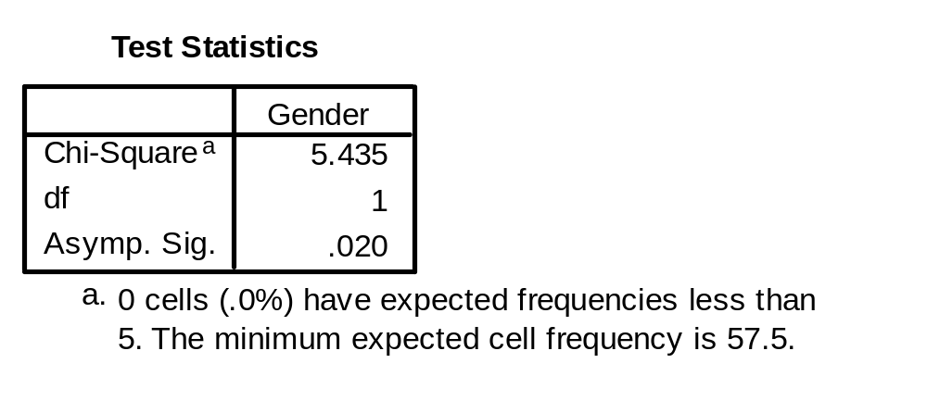
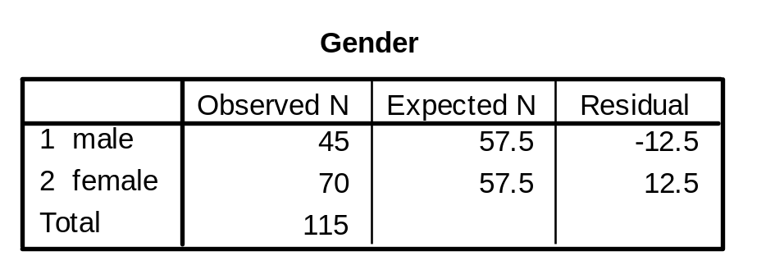
Chi-square
What was the total sample size?
How was the expected n calculated?
What percentage of the sample was male?
What percentage of the sample was female?
Looking at the differences in the percentages, does it look like much of a difference?
What was the difference between observed and expected for males? Females?
What does a positive residual tell us? What does a negative residual tell us?
With two categories, chi-square is the sum of two values, what is the value for male? What is the value for female?
Why does df equal one in this example?
What is the chi-square critical value from G&W using alpha = .05?
What about .01? What about .005?
What effect does reducing alpha have on chi-square?
What if there were three different genders in the study, what would the df be at .05, .01 and .005?
What if there were four different genders in the study, what would the df be at .05, .01 and .005?
What effect does increasing df have on critical chi-square?
Should the null hypothesis be rejected at .05?
Write it up.
Notes:
115
115*50% = 115 * .5 = 57.5
45/115 = 39.1%
70/115 = 60.9%
I think so. There are about one and half more females.
12.5
12.5
Positive: That the frequency for the category is greater than expected
Negative: that the frequency for the category is less than expected
Df = 2-1 = 1
3.84
.01: 6.63
.005: 7.88
It gets bigger
Df = C-1 = 3-1 = 2
.05: 5.99
.01: 9.21
.005: 10.60
Df = C-1 = 4-1 = 3
.05: 7.81
.01: 11.34
.005: 12.84
It increases critical chi-square
Yes
Chi-square (df = 1, n=115) = 5.435, p = .02

Slide 14
Example 4
Research Question
  Is there a difference in simple, 2 choice, 4 choice mean reaction times?
What are the variables in this study?
Are the variables nominal, ordinal, interval or ratio scales?
What statistical procedure could we use to assess this question?
What is the null hypotheses for the research questions?
What are your expectations about the result?
Do you think individual differences would be stable across the three tests?
What effect does stable individual differences across levels of the repeated measures factor have on statistical power?
Notes:
Reaction time
Type of reaction time test
Reaction time – ratio
Type of reaction time test – nominal (or possibly ordinal)
Repeated measures ANOVA
Mean reaction time does not differ across the different types of reaction time tests
I would expect that the more options someone has to choose between, the longer it will take. As it turned out the differences were very large and statistically significant.
Presumably because all three tests are measuring reaction time of some form or another, individuals who are good at one form reaction time test are good at other forms. This expectation is borne out in the data.
Greater stability (e.g., greater correlation between simple, 2 choice and 4 choice RT) means greater power to find a difference between the means where such a difference exists in the population.

Slide 15
Example 5
Note
  Participants were asked the following question:
    Q3) Do you feel eyestrain and have vision problems from looking at a computer screen?
      1 NO, never
      2 Yes, but only after a long period of time
      3 Yes, usually after a few minutes
Research Question
  Was gender related to self-reported eye strain?
Research Question
  Did average trial completion time change over the 9 practice blocks
What are the variables in this study?
Are the two variables discrete or continuous?
Are the two variables nominal, ordinal, interval or ratio scales?
Which statistical procedure could we use to test the research question?
What is the null hypothesis?
What is your expectation?
Notes:
Gender and self-reported eye strain
Discrete
Gender: nominal (or binary)
eye strain: probably ordinal; but could also be thought of as nominal
There are other techniques that we haven’t discussed in this course that look at associations been binary and ordinal variables.
If we are willing to accept that eye strain is nominal, we could do a chi square test of independence?
No association between gender and eye strain
I can’t see any reason why they would be related, but I’m sure arguments could be made. Also, I’m not familiar with the literature on prevalence rates for eye strain. I know that females tend to score higher on neuroticism, and stereotypes do tend to suggest males are less likely to complain about physical discomfort, but these could well just be stereotypes.

Slide 16
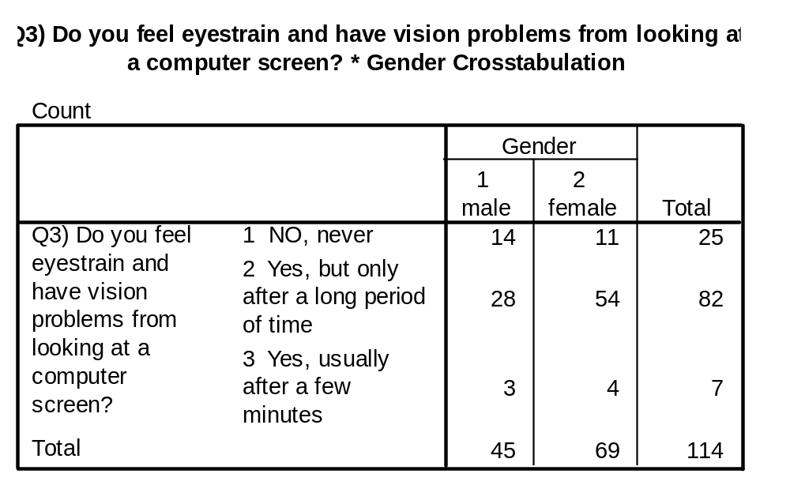
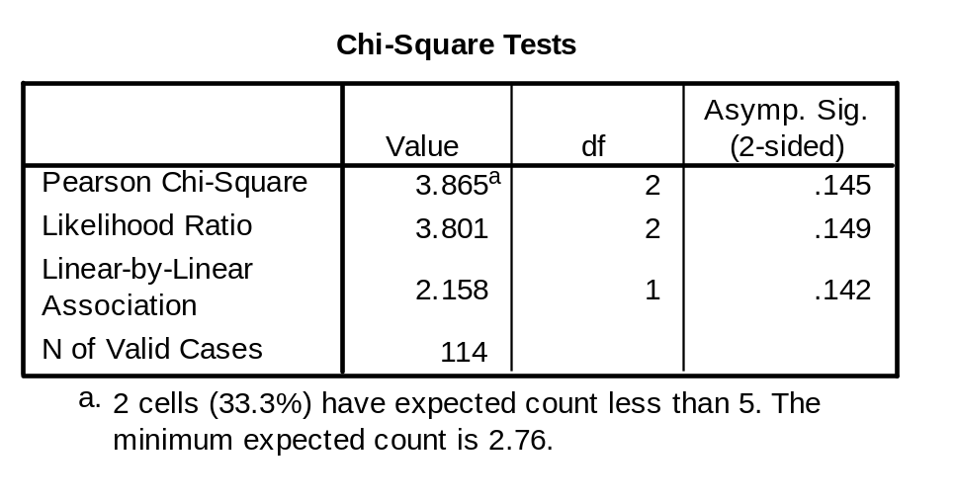
Chi-square test of independence
What was the total sample size?
What percentage of the sample said “no, never”?
What percentage of the sample was male?
What percentage of the sample was male and said “no, never”?
How many would you expect to say male and “no, never” given row and column totals?
What is the difference between observed and expected for males who said “no, never”?
What is the expected count for males “yes, usually”? What about females “yes, usually”?
What is the assumption of chi-square regarding expected counts?
Is the assumption violated in this case?
If it’s violated, what could we do?
Why does the df = 2?
From G&W, what is critical chi-square at .05 in this case?
What would critical chi-square be if we doubled our sample size?
Disregarding problems with assumptions, would we reject our null hypothesis at .05?
You may find it useful to work out chi-square based on this data, applying the formulas in the exam formula sheet
Note: sample size is one less than before because of missing data
Notes:
114
25/114 = .219 = 21.9%
45/114 = .395 = 39.5%
14/114 = .123 = 12.3%
(25*45)/114 = 9.87
14 – 9.87 = 4.13
Males: (7*45)/114 = 2.76
Females: (7*69)/114 = 4.24
both less than 5
All expected cell counts should be greater than 5
Yes
We could collapse categories (e.g., collapse the two yes categories)
or we could try to increase our sample size by collecting more data
(3-1)(2-1)=2*1=2
5.99
5.99; it would not change
No; chi-square (df=2, n=114) = 3.865, p = .145

Slide 17
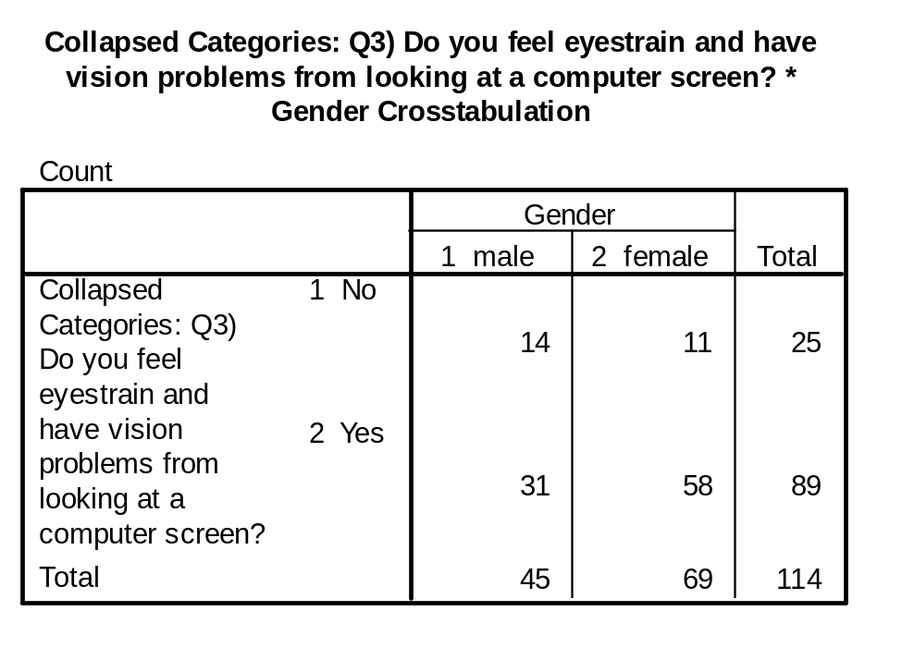
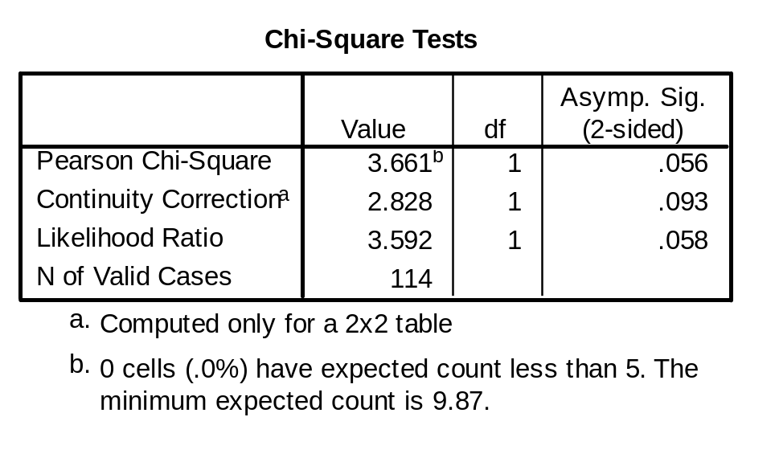
Chi-square after collapsing categories
What percentage of males said yes?
What percentage of females said yes?
Are any of the expected cell counts less than 5?
What is expected for each of the four cells?
What is the sum of expected counts?
Apply the formula of observed minus expected squared divided by expected to each of the four cells?
What is the relationship between chi-square and these four numbers?
Why does df = 1?
Was the chi-square statistically significant at .05?
Categories 2 and 3 were collapsed for this analysis to overcome issue with expected cell counts. Ignore the continuity correction which refers to a special formula for a two by two table that was not discussed in this course
Notes:
31/45=.689 = 68.9%
58/69=.841=84.1%
No. It can be seen from the message at the bottom of the chi-square table or you could work out the expected counts yourself
Male: no: (25*45)/114 = 9.9
Male: yes: (89*45)/114 = 35.1
Female: no: (25*69)/114 = 15.1
Female: yes: (89*69)/114 = 53.9
It should equal Total
9.9+35.1+15.1+53.9 = 114
Male: no: (14-9.9)^2/9.9 = 1.70
Male: yes: (31-35.1)^2/35.1= 0.48
Female: no: (11-15.1)^2/15.1=1.11
Female: yes: (58-53.9)^2/53.9=0.31
It is the sum of these values;
1.70+0.48+1.11+0.31 = 3.6
(2-1)*(2-1)=1*1=1
No, but almost; chi-square (df=1, n=114) = 3.661, p = .056, ns

Slide 18
Example 6
Note
  At the end of the questionnaire there were four questions examining the degree to which the participant was task focused and concerned about performing well on a 1 (strongly disagree) to 7 (strongly agree) scale:
  Q1) During the task I often set a specific goal for myself
  Q2) I always focused my attention on the text-editing task
  Q3) I often worried about not being able to reach my best possible score
  Q6) I constantly focused on trying to do my best
Research Question
  1. What was the pattern of responses, spread and central tendency for the 4 items?
  2. Could these items be combined to form an internally consistent scale?
Are the two variables discrete or continuous?
Are the two variables nominal, ordinal, interval or ratio scales?
What SPSS tools would we use to answer these questions?
Notes:
Discrete
Probably ordinal, but they would often be analysed as if they were interval;
1. obtain the descriptive statistics; obtain various graphs, etc.
2. run reliability analysis

Slide 19
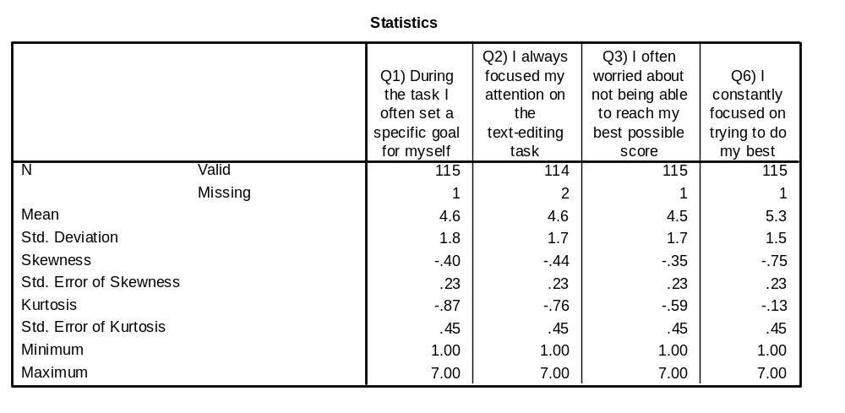
Descriptive Statistics
If 7 is strongly agree and 1 is strongly disagree, based on the mean which item did participants agree with most? What about least?
Are any of the skewness divided by standard error of skewness values larger than plus or minus 3?
Does the sign of the skewness tell us about whether it is positive or negative skew?
What would a skew of zero tell us?
What would a score of 2 on Q1 be if it were converted to a z-score?
What percentage of the distribution of Q1 would be 2 or less based on the unit normal table?
Challenging Question: can you work out what Sums of Squares would have been for Q1 using the standard deviation formula and some algebra?
What is the standard error of the mean for Q3 using the exam formula sheet? First have a guess; then calculate
What is the 95% confidence interval for the mean of Q6?
Notes:
The most agreement: Q6 – mean = 5.3
The least agreement: Q3 – mean = 4.5
Just Q6: -.75 / .23 = -3.26
Negative sign, negative skew
Zero means neither positive nor negative skew
Z = (score – mean) / sd = (2-4.6)/1.8 = -1.44
7.49%
s = sqrt(SS/(n-1))
1.8 = sqrt(SS/(115-1))
1.8^2=SS/115-1
3.24 = SS/114
SS =3.24*114
SS=369.36
checking sqrt(369.36 / 114) = 1.8
If I was going to estimate, I would think that it has to be less than the standard deviation because the formula is the standard deviation divided by the square root of n. I’d also think that the larger n is, the greater the denominator and thus, the small the standard error of the mean is relative to the standard deviation. The square root of 100 is 10, so I would think that it would be ball park about a 10th of the standard deviation.
Se mean = s / sqrt(n)
=1.7 / sqrt(115)
=1.7/10.72
=.159
Mean plus or minus t(n-1)*(s/sqrt(n))
5.3 plus or minus t(115-1)*(1.5/sqrt(115))
5.3 plus or minus t(114)*(1.5/10.72)
5.3 plus or minus t(114)*.140
t for 60df is the closest value that errs on the side of conservatism = 2.000
Thus,
5.3 plus or minus 2*.140
5.3 plus or minus .28
95%CI Lower = 5.02; Upper = 5.58

Slide 20
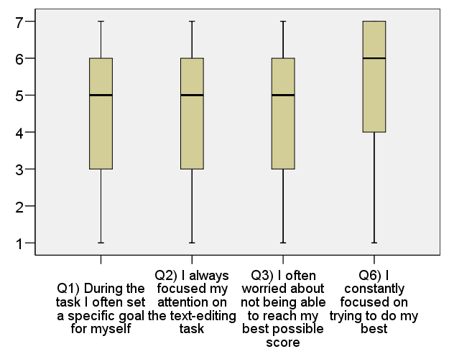
Boxplots
What was the median for each of the four variables?
Based purely on the boxplots, which variable shows the greatest skew? Is it positive or negative?
What is the value of Q₁ (ie., 25th quartile ) and Q₃ (75th percentile) for Q6?
What is the interquartile range for Q1?
What is the semi-interquartile range for Q1?
What is 3 semi-interquartile ranges plus and minus the median of Q1?
What is the minimum and maximum score for each of the four variables?
Notes:
Q1; Q2; Q3 – median = 5
Q6 – median = 6
Q6
negative skew: the long tail points towards negative numbers
Q₁= 4
Q₃= 7
6-3 = 3
3/2 = 1.5
5 plus or minus 3*1.5
5 plus or minus 4.5
0.5 to 9.5
Minimum = 1
maximum = 7

Slide 21
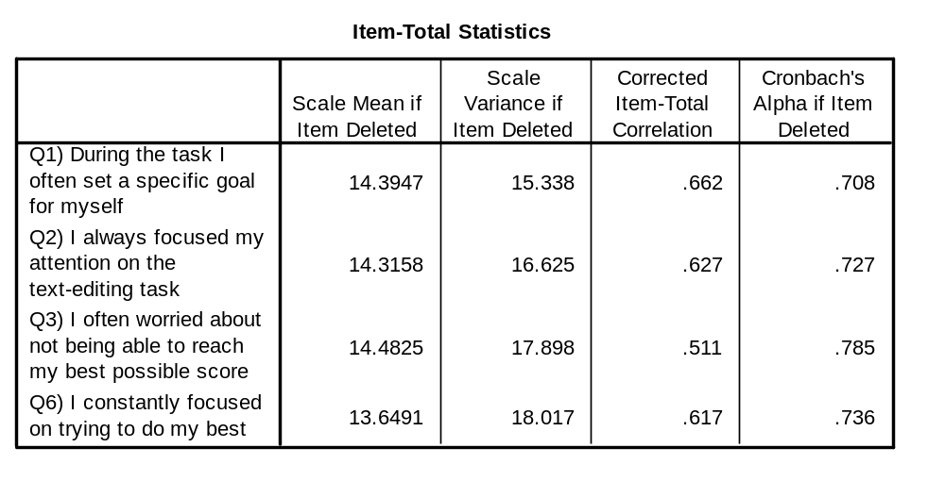
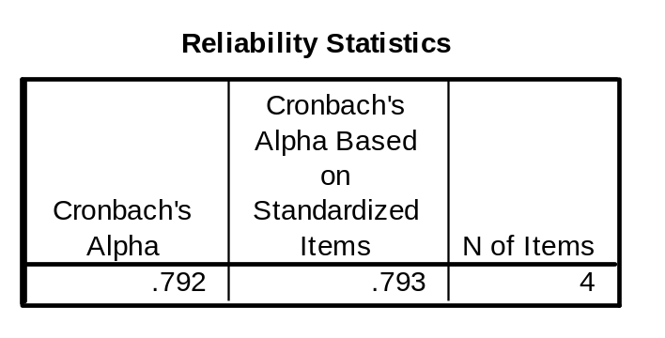
Reliability
What is the Cronbach’s alpha standardised and unstandardised?
From the previous slide, do the items possess comparable variances?
Is there much of a difference between standardised and unstandardised?
Which item is least consistent with other items?
Which item is most consistent with other items?
Would removal of any of the items improve alpha?
If we could only have 3 items, but wanted to keep alpha at the highest level possible, what item would we remove? What would be our resulting alpha?
Looking at the content of the items are you surprised that item 3 is the least related to the others?
Notes:
Unstandardised: .792
standardised: .793
Yes. Variance is square root of standard deviation. Standard deviations look similar
No, not much difference
Least consistent: Q3
Most consistent: Q1
No
Remove Q3
resulting alpha: .785
I would say no. The other three items are focused on achieving goals and doing one’s best. Item 3 has elements of performance anxiety.

Slide 22
Example 7
Note
  Three tests were used to measure general ability
    Vocabulary test
    Inference test
    Cube comparison test (spatial reasoning)
  All three tests were initially scored on the basis of percentage of correct items with some adjustment for incorrect items
Aim
  Explore a few cases and get practice in describing people in terms of their profile of scores
  Gain a better understanding of z-scores
Are the variables discrete or continuous?
Are the variables nominal, ordinal, interval or ratio scales?
Notes:
Technically they are discrete, although there are a large number of possible values
Ratio

Slide 23
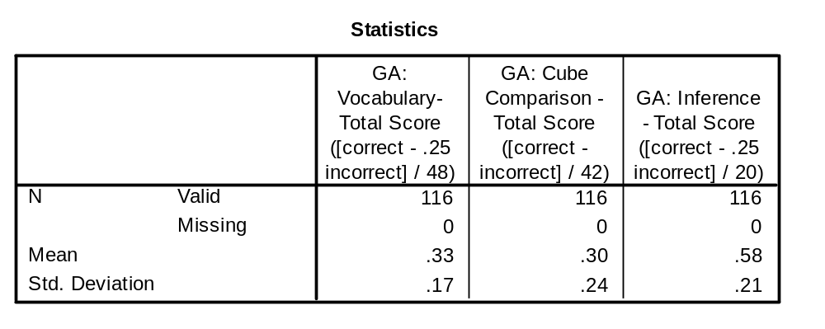
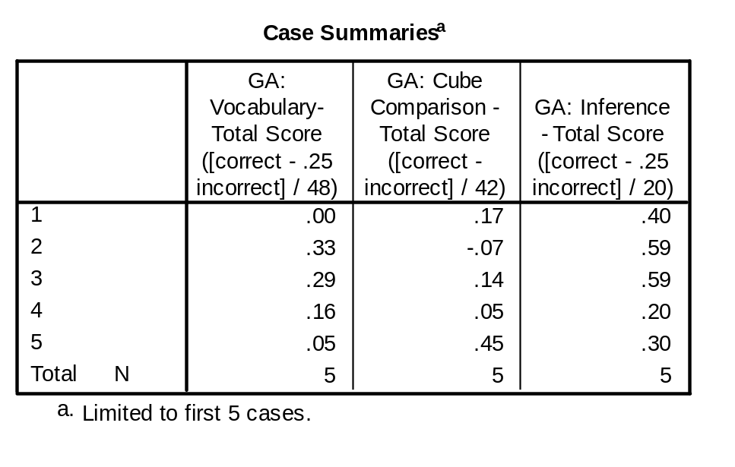
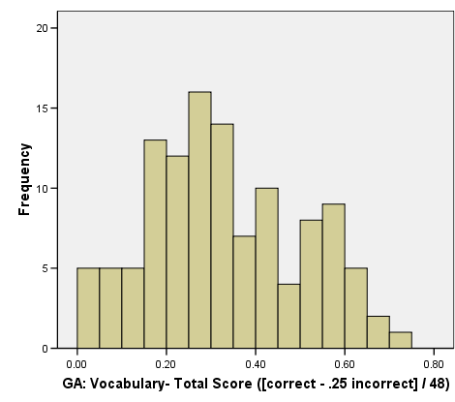
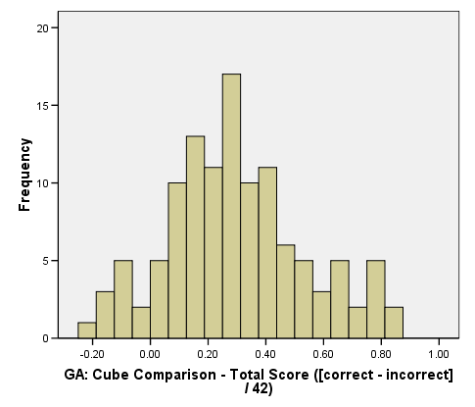
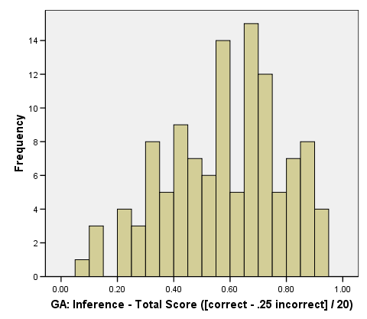
Z-scores
Which test had the highest average percentage of items correct? Which had the lowest?
Case summaries shows the raw test scores for 5 cases in the dataset. For each test say whether case 1’s ability test scores were better, worse or about the same as the sample average?
What are case 1’s z score for each of the three tests using the overall sample mean and standard deviation?
Using the unit normal table, what percentage of the sample would this case expect to be better than or equal to?
Repeat this process for the other four cases
If this was in a selection and recruitment context and it was decided that applicants needed to be higher than the 80th percentile of the unit normal distribution what would be the required z-score? What would be the required raw scores?
Notes:
Highest: inference - 58%
Lowest: Cube Comparison – 30%
Vocabulary – very low
Cube Comparison – Low
Inference – Low
Vocabulary (0-.33)/.17=-.33/.17 = -1.94
Cube Comparison (.17-.30)/.24 = -0.54
Inference (.40 - .58)/.21 = -.86
Vocabulary: 2.62%
Cube Comparison: 29.46%
Inference: 19.49%
I’ll leave this to you
Z-score from the unit normal table: 19.77% in proportion of tail leads to z-score of 0.85
Vocabulary: .33 + .85 * .17 = 0.4745; i.e., 47.45% or more correct
Cube Comparison: .30 + .85 * .24 = .504; i.e., 50.4% or more correct
Inference: .58 + .85 * .21 = .7585; i.e., 75.85% or more correct

Slide 24
Example
Note
  Participants were grouped into three types of ability using a technique called cluster analysis (you’ll learn about it in 4th year)
  Based on the profile of ability scores, these clusters were defined as:
    1) Lower Ability Group (LAG)
    2) Higher Ability Group (HAG)
    3) Lower General Ability/Higher Psychomotor Ability Group (LGAHPAG)
Research Question
  Was ability cluster predictive of overall performance as measured by average text editing task completion times?
What are the variables in this study?
Are the two variables discrete or continuous?
Are the two variables nominal, ordinal, interval or ratio scales?
Which statistical procedure could we use to test the research question?
What is the null hypothesis?
What is your expectation?
Notes:
Ability cluster and average text editing task completion time
Ability Cluster: discrete
Text editing performance: continuous
Ability cluster: nominal
Text editing performance: ratio
One-way between subjects ANOVA
That mean text editing performance time is equal across the three groups in the population
I would expect LAG to do worse than HAG; LGAHPHAG is a bit more mysterious because psychomotor ability is likely to be particularly important in doing the task

Slide 25
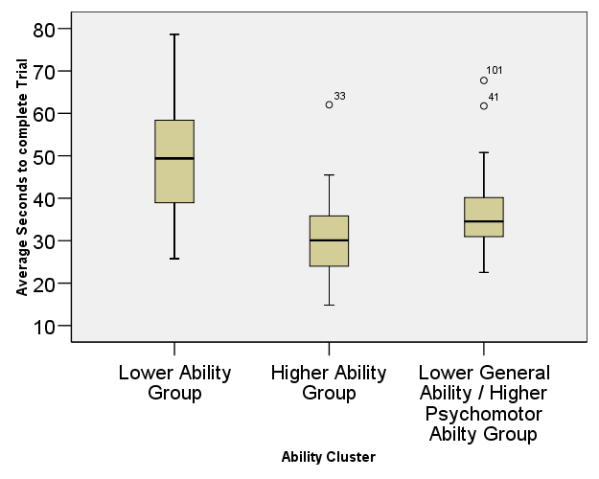
Assumptions
What are the three assumptions of one-way between subjects ANOVA discussed in this course?
Does task performance look normally distributed in the three groups?
Notes:
Homogeneity of variance;
Normality of the DV
Independence of observations
Pretty much; there are a few outliers and some positive skew for some groups

Slide 26
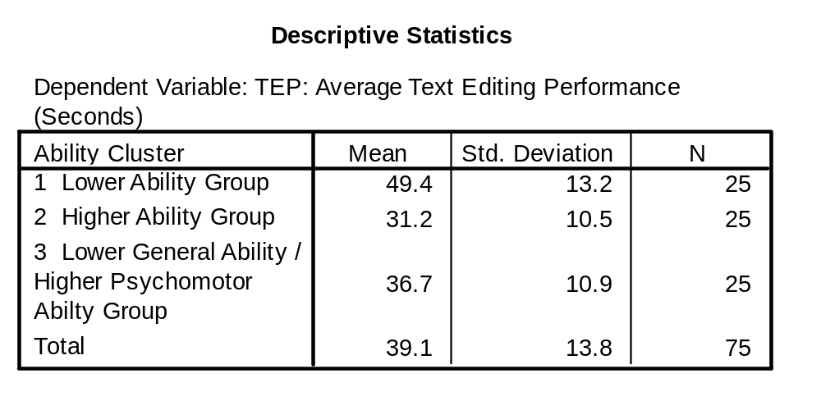
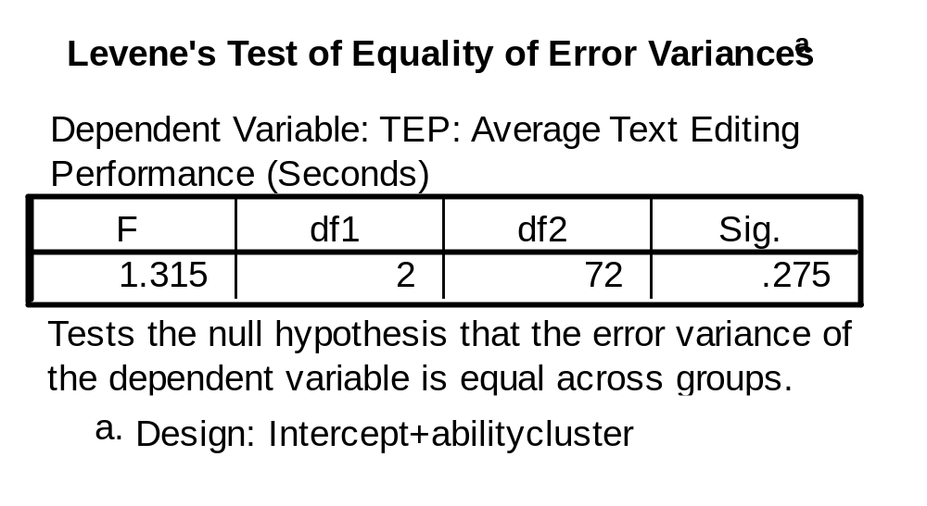
Initial Inspection of means and homogeneity of variance
To what extent do the sample means for the different groups look different?
What’s the Cohen's d between Lower ability and higher ability using the lower ability standard deviation?
Do the standard deviations look similar?
How do we get from standard deviation to variance?
What does Levene’s tell us in this case?
Notes:
This is a deliberately subjective question, which aims to get you thinking about how you determine the size of differences in means. If I were looking at this I would think about the differences between the group means in terms of the standard deviation. I would also think about my knowledge of the domain and think about what a difference of for example 18 seconds or 4 seconds would mean in a practical sense.
(49.4 – 31.2)/13.2 = 1.38; i.e., a very large effect using Cohen’s rules of thumb
Yes
Square the standard deviation
Our assumption of homogeneity of variance has not been rejected

Slide 27
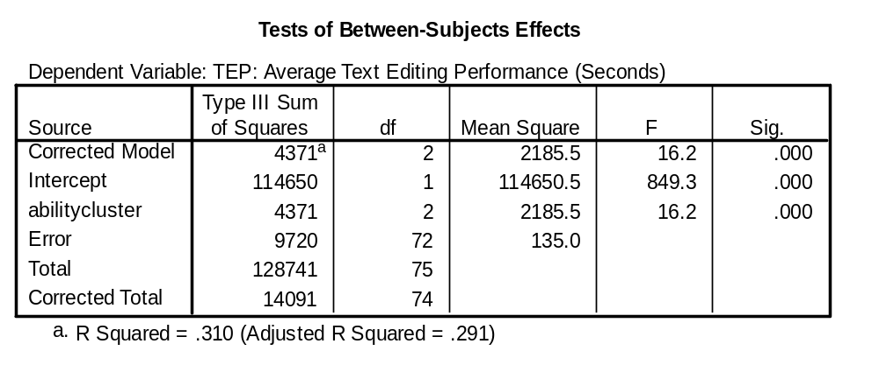
ANOVA Table
Which three rows correspond to our typical: between, within and total sums of squares?
If you did not know the sample size or number of groups, how could you work this out from this table?
What is the overall text editing standard deviation for the entire sample?
What two numbers can be added to give us corrected total?
What two numbers are used to obtain between treatments mean square?
What two numbers are used to obtain within mean square?
What two numbers are used to obtain the F value?
What is critical F at .05? What about .01? What effect does decreasing alpha have on critical F?
What effect does decreasing alpha have on statistical power?
If the sample size was 203, what would critical F .05 be? What about a sample size of 18?
What effect does increasing sample size have on critical F? What effect does it have on power
What if there were 4 groups? What if there were 5 groups? What would critical F be? What effect does increasing the number of groups have on critical F?
Is the obtained F statistically significant at .05? What about .01?
Can we conclude that all three groups differ? If not, what could we do to find out?
Notes:
Between = abilitycluster
Within = error
Total = Corrected total
Ability cluster df = Number of groups – 1
Number of groups = ability cluster df + 1
= 2 + 1 = 3
error df = N-k
N=error df + k
N = 72 + 3 = 75
Sqrt (SS/N-1) = sqrt(14091/75-1) = sqrt(14091/74) = sqrt(190.41) = 13.80 seconds
SS corrected total = SS error + SS ability cluster
4371 / 2
9720 / 72
2185.5/135
No df error = 72; so take next most conservative value df error = 70; F Crit .05(2,70) = 3.13
.01 Fcrit (2, 70) = 4.92
decreasing alpha increases critical F
Decreases statistical power
F crit .05(2, 200) = 3.04
F crit.05 (2,15) = 3.68
Reduces critical F
increases power
F crit.05 (3,70) = 2.74
F crit.05 (4,70) = 2.50
increasing number of groups reduces critical F
Yes and yes
no; we could do post hoc tests to find out

Slide 28
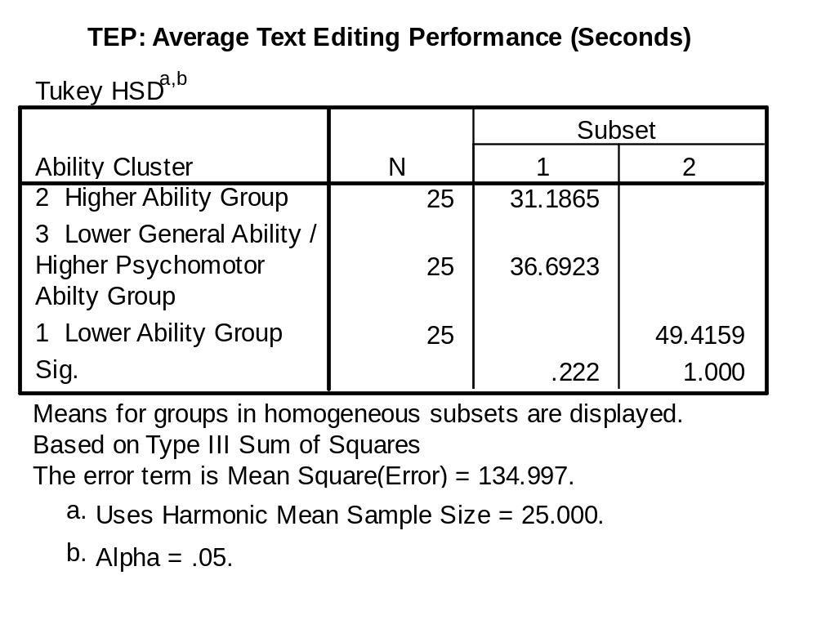
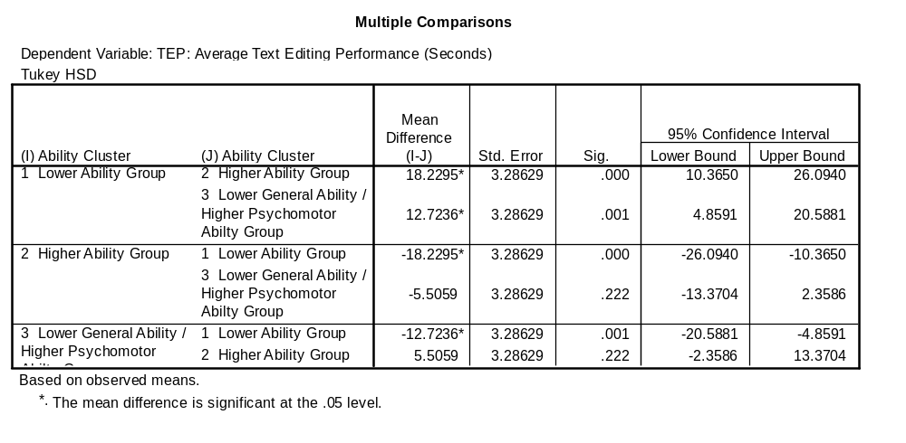
Post hoc tests
What would Tukey’s HSD .05 be using the exam formula sheet?
Which pairs of groups differ by more than this amount?
Looking at the homogenous subsets output, which groups are meant to be homogenous?
Notes:
Actual error df = 72; Nearest conservative error df = 60
q (3 groups, 60 error df) = 3.40
HSD = 3.40*sqrt(134/25)
=3.4*sqrt(5.36)
=3.5*2.315
=8.1
HAG with LAG
LGAHPAG with LAG
LGAHPAG with HAG

Slide 29
Example 8 (Cars)
Research Question
  To what extent does weight of a car in pounds predict miles per gallon in a U.S. dataset of 398 models of cars?
Are the two variables discrete or continuous?
Are the two variables nominal, ordinal, interval or ratio scales?
Which statistical procedure could we use to test the research question?
What is the null hypothesis?
What is your expectation?
(example file in SPSS – ‘Cars.sav’)
Notes:
Continuous
Ratio
Simple regression
That r-squared equals zero
that the regression slope equals zero
This is subjective, but presumably one would think that big cars would use more gas because they have more weight to move

Slide 30
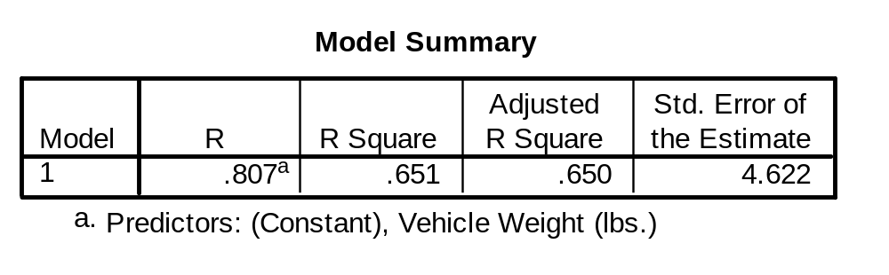
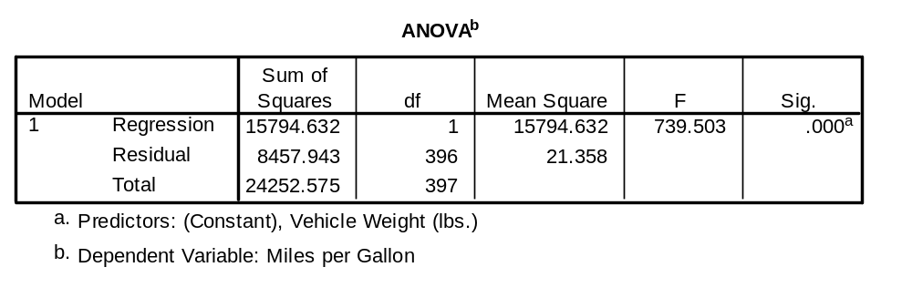
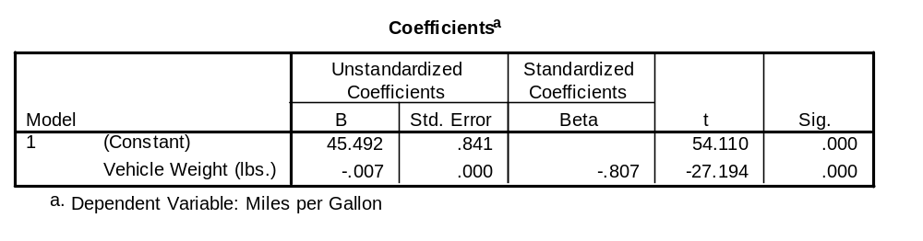
Regression
How much variance in Miles Per Gallon is explained by Car Weight?
Is this variance explained significantly different to 0?
What is the constant
What is the slope?
Is the slope statistically significant?
Write out the model regression equation
What is the standardised regression coefficient for vehicle weight?
If a car weighed 1000 pounds, what would be the predicted miles per gallon?
What is the standard error of the estimate?
What would be the approximate 95% confidence interval of our prediction?
What is our answer to the research Question?
Notes:
65.1%
Yes, p < .001
Constant = 45.492
Slope = -.007
Yes, p < .001
[Predicted miles per gallon] = 45.492 -.007[Vehicle Weight]
-.807
45.492 - .007(1000) = 38.492 Miles Per Gallon
4.622
Prediction plus or minus 4.622 * 2 = 9.244
i.e., 38.492 + 9.244 = 47.736
38.492 - 9.244 = 29.248
95%CI Lower = 29.2, Upper = 47.7
Yes, there is strong relationship between vehicle weight and miles per gallon with heavier cars consumer more gas per mile travelled.

Slide 31
Example 9 (intelligence)
Research Question
  To what extent does intelligence predict verbal ability?
Note: this is not data from the skill acquisition study
Are the two variables discrete or continuous?
Are the two variables nominal, ordinal, interval or ratio scales?
Which statistical procedure could we use to test the research question?
What is the null hypothesis?
What is your expectation?
What if you did not want to predict, but just wanted to speak of the association between the two variables, what technique would you use?
What if instead of having actual measures of intelligence and verbal ability, we only had the ranking of each person in a school, what measure of association might we use?
What if intelligence was measured with only two levels (smart and not smart), but verbal ability was measured in the standard way, what statistical procedure might we use to see the relationship?
Notes:
Continuous (although any one test may have a limited number of discrete possible scores)
Interval
Simple regression
That r-squared equals zero
that the regression slope equals zero
This is subjective, but I would think all abilities tend to be related and under most frameworks verbal ability is a component of intelligence. Thus, I would expect a strong prediction.
Pearson’s Correlation
Spearman’s Rho
T-test; point biserial correlation; or actually you could do simple regression still

Slide 32
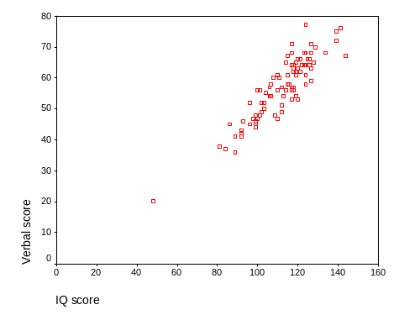
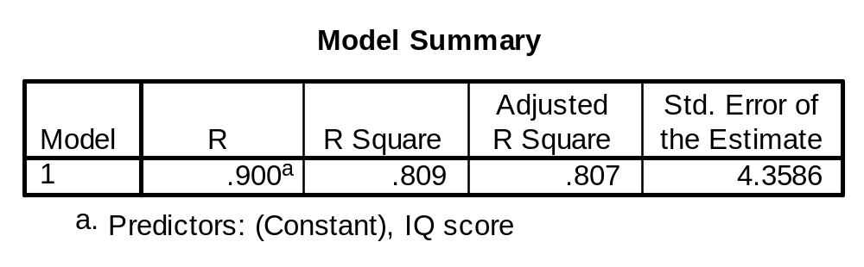
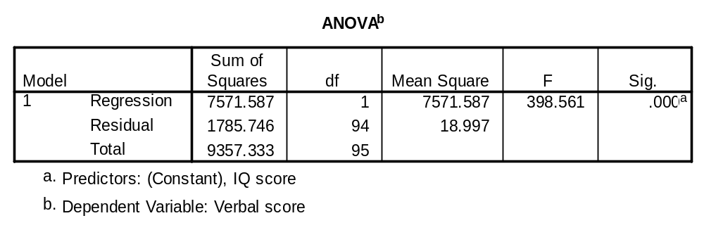
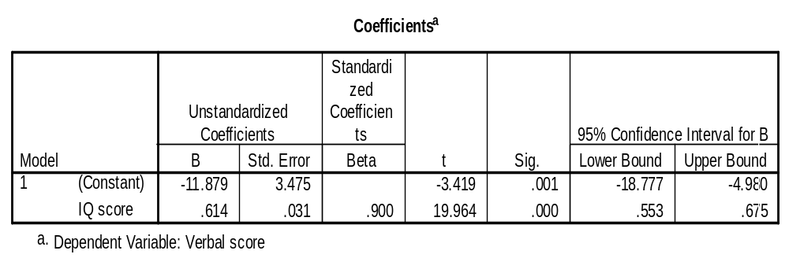
Simple Regression
How would you describe the relationship between the two variables shown in the scatterplot in terms of direction, form, and degree?
How much variance in verbal ability is explained by IQ?
Is this variance explained significantly different to 0?
What is the model regression equation?
What is the slope?
Is the slope significant?
What is the standardised coefficient?
What Verbal score would we predict a child would have if their IQ was 100?
What about 85?
What would be the approximate 95% confidence interval of our predictions?
Interpret the 95% confidence interval of the regression slope.
Notes:
Positive, linear, strong
80.9%
Yes, p < .001
[predicted verbal] = -11.879 + .614 [IQ]
.614
Yes, p < .001
.900
[predicted verbal] = -11.879 + .614 [100] = 49.521
[predicted verbal] = -11.879 + .614 [85] = 40.311
The estimate plus or minus 2 * 4.3586 = 8.7172
e.g., 49.521 + 8.7172 = 58.2382
49.521 + 8.7172 = 40.8038
between 40.8 and 58.2
We can be 95% confident that the population regression slope is between .553 and .675

Slide 33
Example 10 (Baumeister)
Remember this example
Each group completed a personality test and were given feedback about what the test indicated about their future
Independent Variable: Feedback condition
  Future alone (told they would be alone later in life)
  Future belonging (told they would have good relationships)
  Misfortune control (told they were prone to accidents)
  No-feedback control (not told anything about their future).
Participants then performed an unsolvable experimental task
Dependent Variable: length of persistence on unsolvable task
Note: Dataset is a simulated dataset designed to be similar to a replication of Baumeister and colleagues results
What are the variables in this study?
Are the variables discrete or continuous?
Are the variables nominal, ordinal, interval or ratio scales?
Which statistical procedure could we use to test the research question?
What is the null hypothesis?
What is your expectation?
Notes:
Condition and persistence
Condition: discrete
persistence (time): continuous
condition: nominal
persistence: ratio
One-way between subjects ANOVA
Group means in persistence across the four groups do not differ
This is subjective, but I would think that if you have just been told a really negative thing about your future that you might want to get out of the experiment as quickly as possible whether you were just depressed by what the experimenter said or because you thought that they were manipulative and creepy.

Slide 34
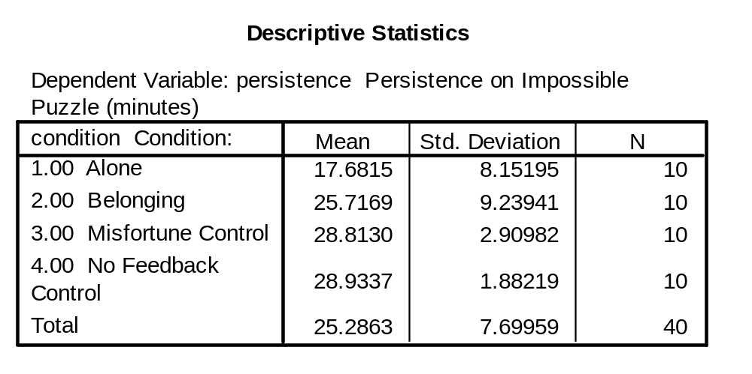
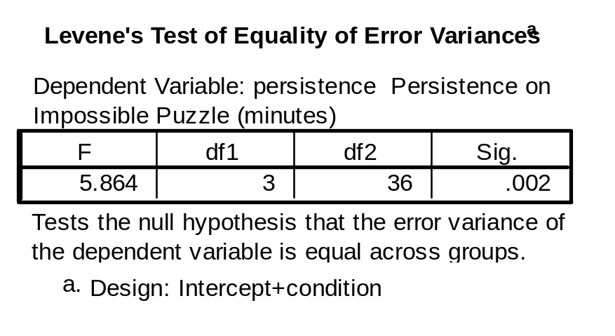
ANOVA Results
Do the means look different?
Do any particular groups stand out as having different means?
Do the standard deviations look similar?
What does Levene’s test tell us?
Is ANOVA robust to violations of homogeneity of variance?
If we were not satisfied that ANOVA was robust in this case, what nonparametric test could we use to analyse the data?
Notes:
The alone group looks a bit different; ten minutes less persistence sounds like a fair bit less in the context and relative to the standard deviation
Alone group
Not especially, the no feedback and misfortune group have particularly small standard deviations relative to belonging and alone.
It suggests the homogeneity of variance assumption is violated?
Generally, yes, especially with bigger samples; this sample is not that big; so we might proceed with caution or consider a non-parametric test
Kruskal-Wallis Test

Slide 35
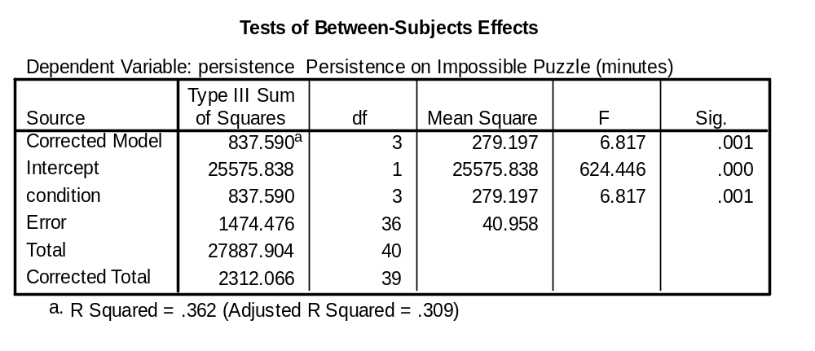
ANOVA
If you did not know the sample size or number of groups, how could you work this out from this table?
What is critical F at .05; What about .01?
What two values were divided to give obtained F?
Is obtained F larger than critical F at .05? What about .01?
How could we determine which groups are significantly different from which other groups?
Notes:
treatment df = number of groups – 1
number of groups = treatment df + 1 = 3 + 1 = 4
sample size = (corrected total df + 1) / k = (39 + 1) / 4 = 40/4 = 10
F crit.05(3,36) =2.86
F crit.01(3,36) =4.38
279.197/40.958 = 6.82
Yes and yes
Post-hoc tests

Slide 36
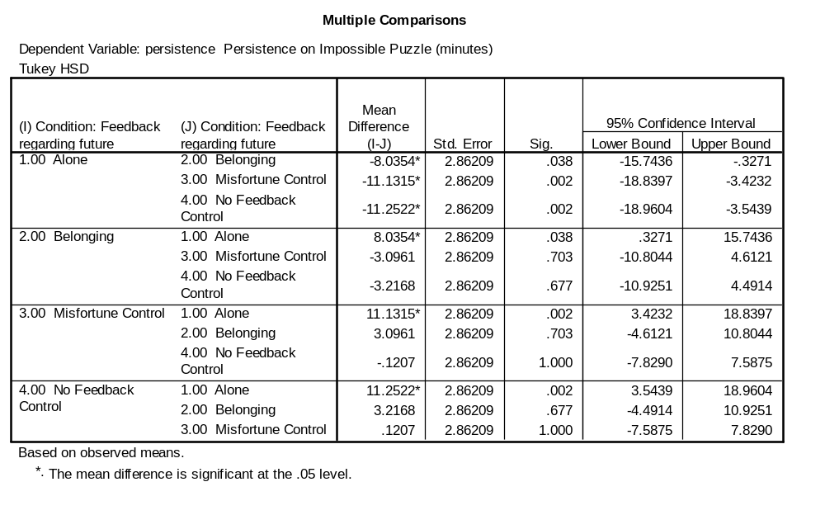
Post-hoc tests
What is Tukey’s HSD value .05?
Which pairs of groups are significantly different at .05?
Notes:
No df error = 36 shown in table so next most conservative value: Q. .05 with 4 groups and df error = 30 =3.85
HSD = 3.85 * sqrt(40.958/10) = 3.85* 2.02 = 7.777
Alone vs belonging
Alone vs misfortune
Alone vs no feedback

