Slide 1

Introductions Introduction to R Workshop
Dr Jeromy Anglim
Deakin University
jeromy.anglim@deakin.edu.au
If you have not already done so, files for workshop can be downloaded from:
https://github.com/jeromyanglim/acpid-2019-rtraining/archive/master.zip
If you are on Windows, make sure to properly unzip; Don’t navigate inside the zip file.
If you have issues accessing wi-fi or with installation, let me know.
If you have not already installed R, RStudio, and additional packages, go to
https://github.com/jeromyanglim/acpid-2019-rtraining

Slide 2
Overview of the day
Time | Activity
10:00 – 11:30 (90 minutes) | Workshop: Morning session
11:30 – 11:45 (15 minutes) | Break: Morning
11:45 – 1:00 (75 minutes) | Workshop: Noon session
1:00 – 2:00 (60 minutes) | Break: Lunch
2:00 – 3:30 (90 minutes) | Workshop: Afternoon session
3:30 – 3:45 (15 minutes) | Break: Afternoon
3:45 – 5:00 (75 minutes) | Workshop: Final session
Housekeeping
Toilets
Internet / Wi-Fi
Power
Food / Drinks
Laptop security
Feel free to ask questions

Slide 3
Aims of workshop
By the end of this workshop you should have a basic understanding of
What R can do
Whether you want to use R in the future
How the language works
How to perform standard data analysis activities with R such as importing, manipulating, graphing, and modelling data

Slide 4
Your Aims
What is your existing level of experience with R?
What do you want to get out of today?

Slide 5
Overview of content
Sessions 1
Introductions
What can R do? Why and when would you want to use R?
Overview of a project
How to get help; Working with RStudio
Core Language
Data types, functions, operations, loading data, saving data
R Packages (installing, loading, using)
Session 2
Data manipulation
Graphs (base, lattice, ggplot2)
Standard statistical functions: Descriptive statistics, correlations, linear regression
Brief Overview of what is possible
Generalised linear models, multilevel modelling, structural equation modelling, Bayesian analysis, bootstrapping, meta-analysis
Session 3 and 4
lavaan

Slide 6
Workshop format
Slides
I will present some slides
Most content will be covered in the interactive presentations
Interactive presentations
I will introduce many concepts by demonstrating functionality in R and RStudio
You are encouraged to open these script files and run them on your laptop as I work through them
Exercises
There will be regular points where you are given brief exercises where you asked to apply the concepts presented

Slide 7
What is R?
"R is a free software environment for statistical computing and graphics" - http://www.r-project.org
It is a full-featured statistical analysis package (e.g., like SAS, Stata, SPSS, etc.) that allows you to:
Import and export data in a wide range of formats
Manipulate data
Analyse data
Graphically represent data
It is a full-featured programming language designed for data analysis
Why the name "R"?
First letter of two originators: Ross Ihaka and Robert Gentleman
Built on a earlier language called "S"

Slide 8
Why use R?
R is free
R is open source
R runs on Windows, OSX, Linux
R has a huge library of user-contributed packages (over 6,000 on CRAN)
Functionality not available in other software
Only need to learn the new bits of the specific package; i.e., you can use the same graphics, data manipulation, data simulation, programming tools across analysis tasks
R is flexible
R facilitates reproducible research
R makes data analysis fun
Popular in academia and industry: lots of free online resources

Slide 9
Challenges of using R?
R involves writing scripts; it does not have a GUI like SPSS, SAS, Stata, etc.
R is more interactive
In SPSS and SAS you choose a command and get piles of output which you wade through
R is a conversation: You interactively request relevant output
Mental model for R has links with formal statistics, unix, and programming

Slide 10
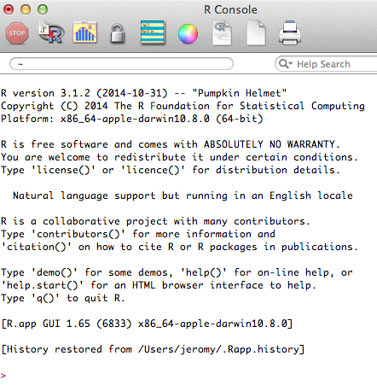
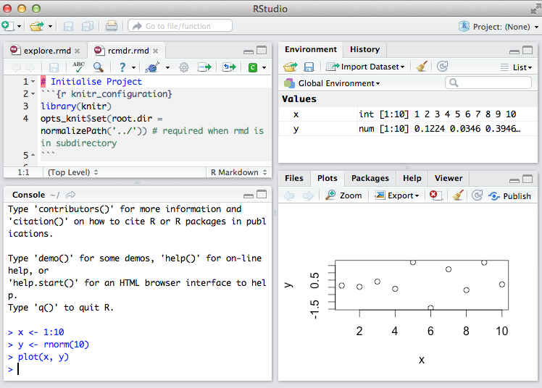
Installing R and RStudio
Install base R
http://www.r-project.org
Install RStudio
http://www.rstudio.com
Install additional R packages
Use RStudio or
install.packages("packagename")
Some R functionality requires other (free) software to be installed
Various compilers, command-line tools, etc.
RTools for Windows http://cran.r-project.org/bin/windows/Rtools
Xcode for OSX http://developer.apple.com/xcode
Python: http://www.python.org/downloads
Java SE JDK: http://www.oracle.com/technetwork/java/javase/downloads/index.html
Perl: http://www.perl.org/get.html
pandoc: http://pandoc.org/installing.html
TeX/LaTeX: http://latex-project.org/ftp.html

Slide 11
RStudio
http://www.rstudio.com
There are many interfaces to R
RStudio
Best general interface to R
Improving rapidly
Free and open source
Recommended Options
Set “General – Save workspace to .RData on exit” to “Never”
Deselect “R Markdown – show output inline for all R Markdown documents”

Slide 12
Dialects of R
Base R versus contributed packages
Base R versus tidyverse
Data manipulation: tidyverse versus Base R
datasets: tibbles versus data.frames
pipes versus standard assignment
Graphics: ggplot2 , Base, lattice

Slide 13
A quick tour of a Data Analysis Project in Rstudio
Let’s have a look at a complete data analysis project
“introductory-example/standard-version”
Aims
File types: Overview of common file types
Rstudio interface: scripts, console, file navigator, environment, history, etc.
Rmarkdown files: setup block, code chunks, useful shortcut keys
Workflow: How a basic data analysis project can be organized
But see also my preferred workflow: “ProjectTemplate”:
http://jeromyanglim.blogspot.com/2014/05/customising-projecttemplate-in-r.html

Slide 14
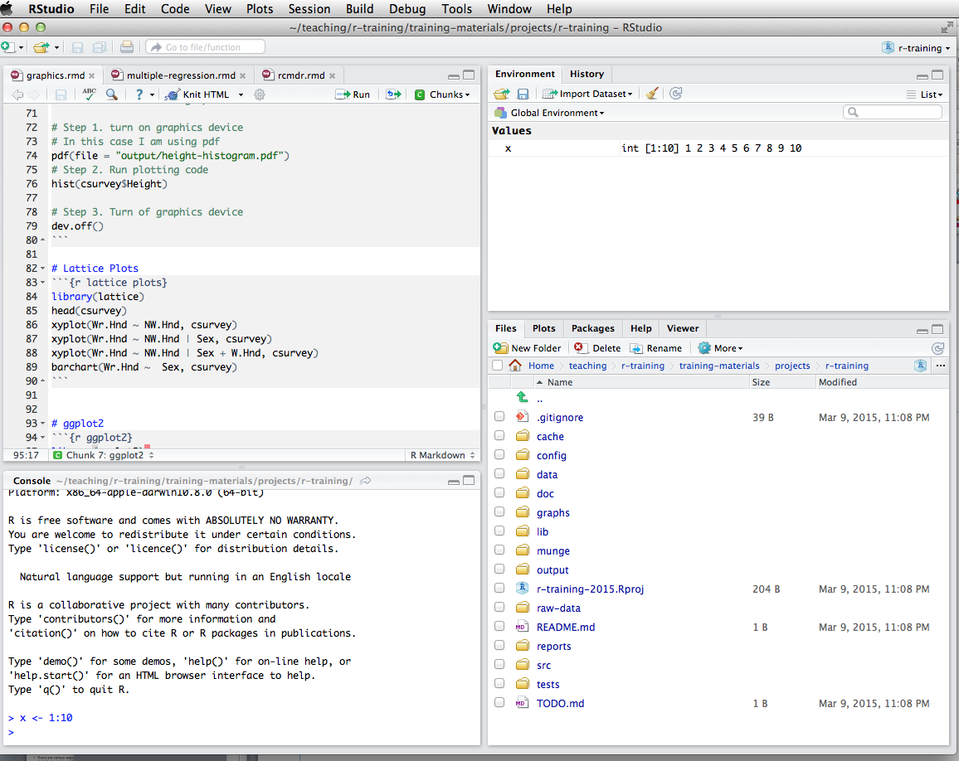
RStudio
R Scripts and source code
Environment: Lists objects in the workspace (e.g., data you've created or imported)
History: list of commands run on console
Console:
Commands can be entered directly or sent from the script pane (e.g., control/command + enter)
Files: quick access typically to files in your working directory
Plots: View current and previous plots you've created
Packages: Helps with loading and installing packages
Help: Show built-in help and allow searching for help

Slide 15
Overview of common file extensions
R Specific file formats
.r : R script files
.rmd : RMarkdown files
.Rproj : RStudio project files
.rdata : Native format in r for saving R objects
Other relevant formats
.md : Markdown file
.csv : comma separated value data file

Slide 16
RStudio Projects
It is good practice to store all files related to a particular analysis project within a single directory on your computer that stores only files related to that project
Such files include scripts, data files, configuration files, figures, exported tables, etc.
You may also store such files in subdirectories (e.g., store data in a subdirectory called data)
If you work with Rstudio it is helpful to make this folder an Rstudio Project (Go to: File – New Project)
This will generate a file with an "Rproj" extension (e.g., myproject.Rproj)
You can then double click on this file to open the project

Slide 17
Benefits of RStudio Projects
Ensures that the working directory is the same as the project directory. Thus, when you load or save files, you can have confidence that your script will work.
The file pane is opened in the working directory, so it's easy to access other files in the project
RStudio will re-open previous open scripts

Slide 18
Core Language Features
Open "training-exercises/introduction-to-r-workshop.Rproj" in Finder or Explorer
Open "1-core-language.rmd"
Review RStudio User Interface
Topics
Assignment
Workspaces
Data types
Getting Help
Packages
Missing Data
Data Summaries
Functions
Importing / Export Data
Random Variables
Functions

Slide 19
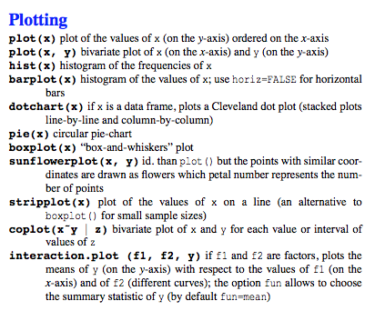
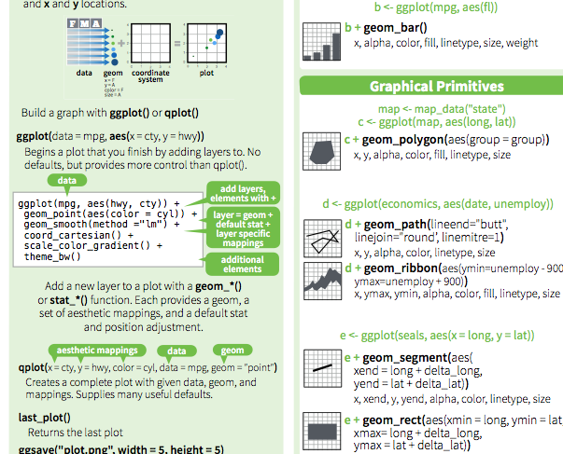
Graphics and Data Manipulation
Review RStudio User Interface
Open 2-graphics-data-manipulaion.rmd
Topics
Base graphics
Lattice graphics
ggplot2
See cheat sheets

Slide 20
Statistical models
Open 3-statistical-models.rmd
Topics
Correlations
Regression models
Formula notation
Factors: Categorical predictors
Illustration of applications
Generalized linear model / logistic regression
Multilevel modelling
Meta analysis
Bootstrapping

Slide 21
Concluding Remarks Introduction to R Workshop
Dr Jeromy Anglim
Deakin University
jeromy.anglim@deakin.edu.au

Slide 22
Reflections
The aim of this introductory training has been to get you oriented with R.
By installing R, RStudio, and related packages you overcame the first obstacle.
We have gone over the nuts and bolts of the language
Data manipulation and graphics are common tasks across all data analysis projects
We have illustrated R's functionality using common statistical models.

Slide 23
My Example Personality Projects on OSF
My Profile: https://osf.io/d5gfc/
All projects have complete R scripts with data that may provide useful demos of personality research projects.
Anglim, J., Sojo, V., Ashford, L. J., Newman, A., & Marty, A. (2019). Predicting Employee Attitudes to Workplace Diversity from Personality, Values, and Cognitive Ability. Journal of Research in Personality, 83, 103865. https://osf.io/xdfq8/
Anglim, J., Morse, G., Dunlop, P., Minbashian, A., Marty, A. (2019). Predicting Trait Emotional Intelligence from HEXACO Personality: Domains, Facets, and The General Factor of Personality. Journal of Personality. https://osf.io/uwdgs/
Anglim, J., Lievens, F., Everton, L., Grant, S. L., Marty, A. (2018). HEXACO Personality Predicts Counterproductive Work Behavior and Organizational Citizenship Behavior in Low- Stakes and Job Applicant Contexts. Journal of Research in Personality. 77, 11-20. https://osf.io/wa6yj/
Anglim, J., Morse, G., De Vries, R, E., MacCann, C. & Marty, A. (2017). Comparing Job Applicants to Non-Applicants Using an Item- Level Bifactor Model on the HEXACO Personality Inventory. European Journal of Personality, 31, 669-684. https://osf.io/9e3a9/
Anglim, J., & Grant, S. (2016). Predicting Psychological and Subjective Well-Being from Personality: Incremental Prediction from 30 Facets Over the Big 5. Journal of Happiness Studies, 17, 59-80. https://osf.io/cdh6a/
Anglim, J., Weinberg, M. K., & Cummins, R. A. (2015). Bayesian Hierarchical Modeling of the Temporal Dynamics of Subjective Well-Being: A 10 Year Longitudinal Analysis. Journal of Research in Personality, 59, 1-14. https://osf.io/qcfnk/
Horwood, S., & Anglim, J. (2019). Problematic smartphone usage and subjective and psychological well-being. Computers in Human Behavior, 97, 44-50. https://osf.io/4kc9g/
Horwood, S. & Anglim, J. (2018). Personality and Problematic Smartphone Use: A Facet-Level Analysis using the Five Factor Model and HEXACO Frameworks. Computers in Human Behavior, 85, 349-359. https://osf.io/nxv7z/

Slide 24
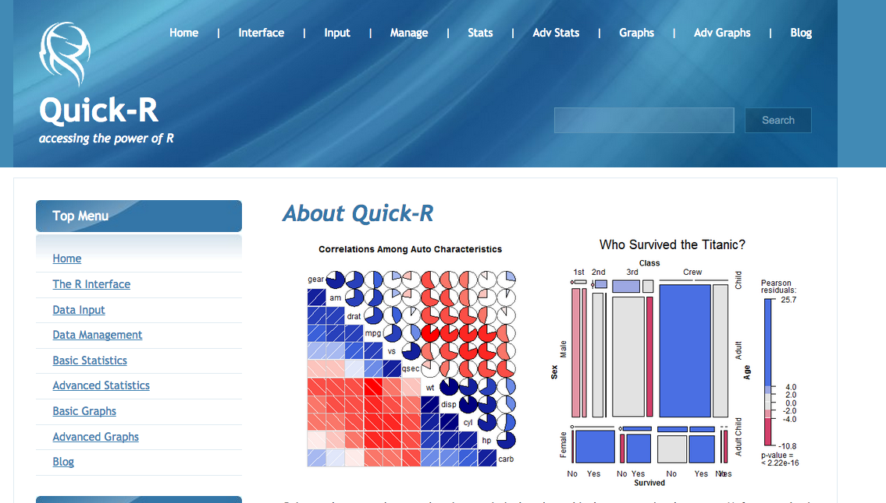
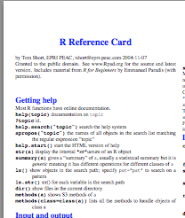
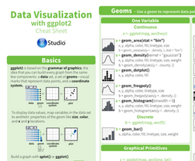
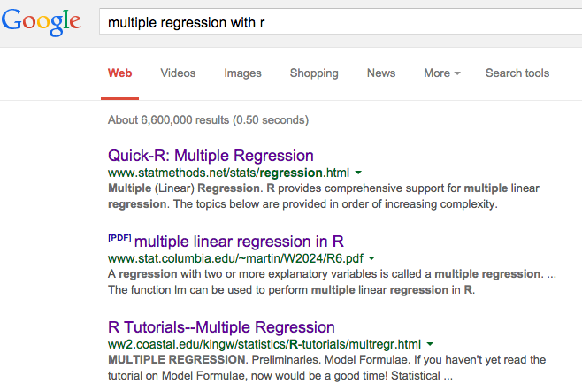
Getting Help Online
Quick-R website:
Excellent website with code templates for common tasks
http://www.statmethods.net
Reference Cards: See particularly Tom Short's
Print out and gradually expand your R vocabulary
See particularly Tom Short's http://cran.r-project.org/doc/contrib/Short-refcard.pdf
RStudio cheatsheetshttp://www.rstudio.com/resources/cheatsheets/
Google usually has the answer
Generally adding "with R" or "in R" to a statement of what you want to do should suffice: e.g., "multiple regression with R"
Or use dedicated R search engine: http://rseek.org

Slide 25
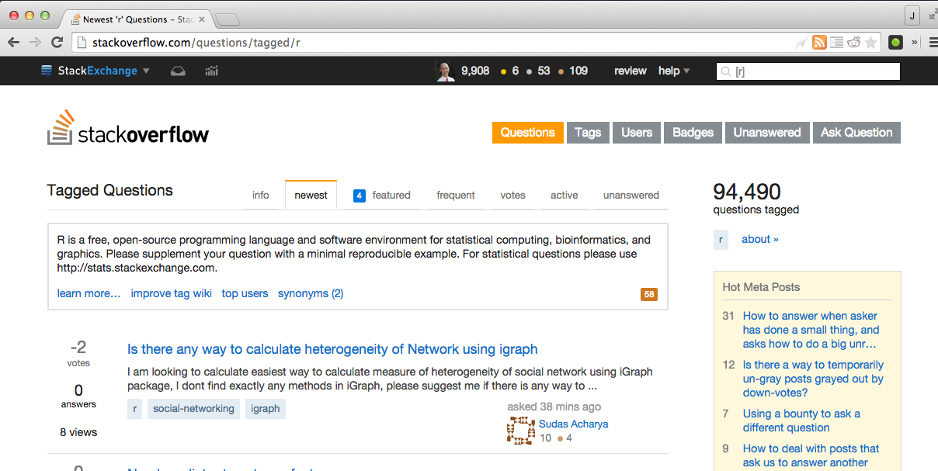
Ask Specific Questions on StackOverflow
StackOverflow with the R tag
http://stackoverflow.com
http://stackoverflow.com/questions/tagged/r
How to ask question?
Search to see whether question has already been asked
Click Ask Question
Include the R tag
Try to make the example reproducible (e.g., include minimal data)
Also see
http://stats.stackexchange.com where the emphasis is on statistical interpretation

Slide 26
Future Use of R
Hopefully, at this point you have a sense of whether R might be something you can use. Perhaps one of these use cases will fit:
You may realise that R is not for you. It's not for everyone.
You may be in an environment, where you don't have access to paid statistics packages and you need a free tool.
R may be a tool that you occasionally use when you need particularly functionality not offered by your regular statistics package.
R can be your primary statistics package for data analysis.
R is a tool that becomes more useful over time.
You acquire scripts that you can re-use.
Learning new statistical models becomes easier over time as you learn the conventions in R.
R ultimately makes data analysis more fun.

Slide 27
Next Steps
If you are keen to make R your main platform for data analysis, then there are lots of options for learning more.
Start applying R to a project that you are working on
Have a read through some of the contributed documentation
http://cran.r-project.org/other-docs.html
Get a book on R relevant to your area
http://www.r-project.org/doc/bib/R-books.html
Check out video tutorials on Coursera, YouTube, Lynda
Follow recent developments in R
https://twitter.com/hashtag/rstats?src=hash
http://www.r-bloggers.com

