Slide 1
Week 7: PM Review
Darren Tay
Jeremy Ong
Nabilah Banu
Shu Wen
Zhi Hui
G3T3

Slide 2
Functionalities
Project Schedule
Metrics
Roles & Responsibilities
PP Team & Rotation Plans
T3
Required Functionalities:
Login
Bootstrap
Basic App Usage Report
Top-k App Usage Report
Smartphone Overuse Report
Dual interfaces
Loading location data
Deletion of data
Smartphone Usage Heatmap
Social Activeness Report
No Add/ Drop

Slide 3
Functionalities
Project Schedule
Metrics
Roles & Responsibilities
PP Team & Rotation Plans
Bird-eye view of project
ITERATION 1
28/8/2015 12/9/2015
ITERATION 2
12/9/2015
25/09/2015
ITERATION 3
25/09/2015
09/10/2015
Project Planning
Sequence Diagram
Use Case Diagram
ER Diagram
Bootstrap
Class Diagram
Sequence Diagram
Delete Location
Login/Logout
Basic App Report
SmartPhone Usage Heatmap
Sequence Diagram
Notes:
No white font

Slide 4
Functionalities
Project Schedule
Metrics
Roles & Responsibilities
PP Team & Rotation Plans
Bird-eye view of project
ITERATION 4
09/10/2015
23/10/2015
ITERATION 5
23/10/2015
05/11/2015
ITERATION 6
05/11/2015
End
Overuse Report
Top –K Report
Social Activeness
Test new ‘Test Cases’
Buffer
Debugging
Deploy to OpenShift
Seek loopholes
Final Presentation
Submission

Slide 5
Functionalities
Project Schedule
Metrics
Roles & Responsibilities
PP Team & Rotation Plans
Buffer time
Iteration 5: 1st half of the Iteration
1
2
3
4
5
6
Notes:
Numbers change black font

Slide 6
Functionalities
Project Schedule
Metrics
Roles & Responsibilities
PP Team & Rotation Plans
Week 13 [Iteration 6] : Project Submission
Milestones
Week 7 [Iteration 3]: Technical Documents completed
Week 5 [Iteration 2] : Start Coding
Week 11[Iteration 5] : Application ready for UAT

Slide 7
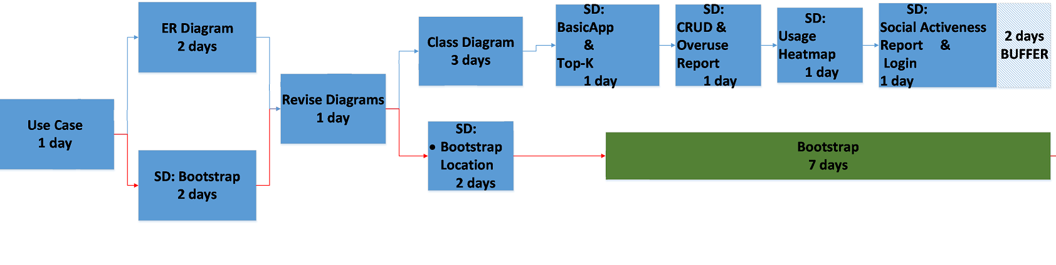
Functionalities
Project Schedule
Metrics
Roles & Responsibilities
PP Team & Rotation Plans
Critical Path ---------
Notes:
TEST LOCALLY>> Integrate>> DEPLOY>> TEST on openshift

Slide 8
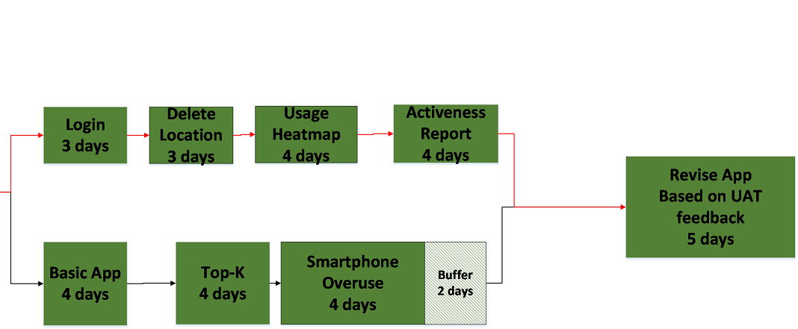
Functionalities
Project Schedule
Metrics
Roles & Responsibilities
PP Team & Rotation Plans
Along the path: Test Locally >> Integrate >> Deploy >> Regression Testing
---------

Slide 9
Functionalities
Project Schedule
Metrics
Roles & Responsibilities
PP Team & Rotation Plans
Task Metrics
Bug Metrics
90.5%
Time-Boxing
IMPACT
Low 1Point | Not important [typo, alignment etc.]
High 5 Points | System runs but some functions not working. Fix during planned debugging
Critical 10 Points | System down. Fix before continue
Burndown Chart
[Actual task/ estimated task]
Score = 1 x num(low)
+ 5 x num(high)
+10 x num(critical)
Notes:
Current value for each metrics
any action based on mitigation plan
https://docs.google.com/spreadsheets/d/1Sp80UyYZO_gT89sFfwVYJIofxsbHAiiVybEl8Qu1xrA/edit#gid=0

Slide 10
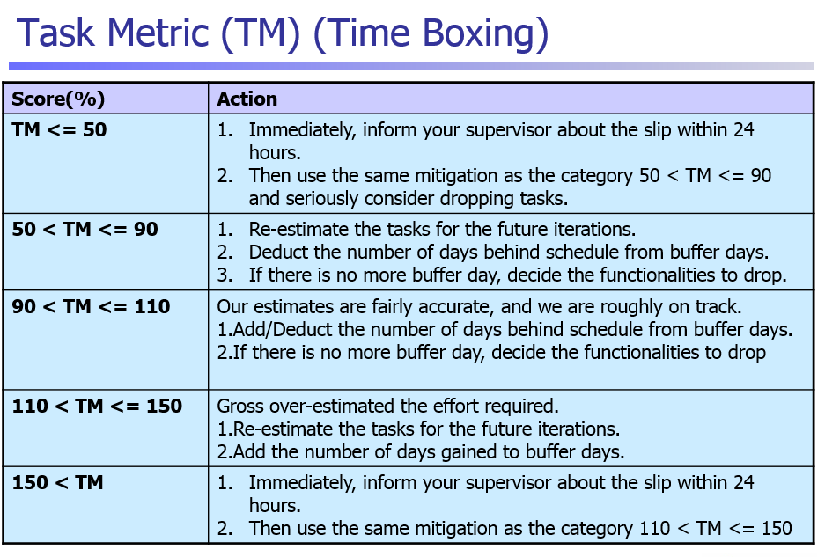

Slide 11
Functionalities
Project Schedule
Metrics
Roles & Responsibilities
PP Team & Rotation Plans
Notes:
Rotation plan
wgich pm which milestone

Slide 12
Who is Doing What
ITERATION 1
PM: Jeremy
Use Case Diagram
Domain Diagram
Pair 1: Darren + Shu Wen
ER Diagram
Pair 2: Zhi Hui + Nabilah
Sequence Diagram
Notes:
Title add color

Slide 13
Who is Doing What
ITERATION 2
PM: Zhi Hui
Supervisor Meeting 1 Slides
Task metrics & Test plan
Pair 1: Darren + Nabilah
Sequence Diagram
Bootstrap
Pair 2: Jeremy + Shu Wen
Sequence Diagrams
Class diagram
Test cases: Bootstrap
Test files

Slide 14
Who is Doing What
ITERATION 3
PM: Nabilah
PM Review Slides
Prepare Test Cases
Regression Testing
Pair 1: Darren + Shu Wen
Bootstrap (Cont.)
Basic App Report
Deploy to Openshift
Pair 2: Jeremy + Zhi Hui
Login Logout
Delete Location
Usage Heatmap

Slide 15
Who is Doing What
ITERATION 4
PM: Darren
Supervisor Meeting 2 Slides
Update diagrams
Deploy to Openshift
Regression Testing
Pair 1: Jeremy + Zhi Hui
Social Activeness Report
Pair 2: Nabilah + Shu Wen
Top-K Report
Overuse Report

Slide 16
Who is Doing What
ITERATION 5
PM: Shu Wen
Supervisor Meeting 3 Slides
Prepare for UAT
Pair 1: Jeremy + Nabilah + Pair 2: Darren + Zhi Hui
Testing of possible new Test Cases for the Overall System
-in preparation of UAT

Slide 17
Who is Doing What
ITERATION 6
PM: Jeremy
Match final submission with requirements
Final presentation slides
Deploy application to OpenShift
Pair 1: Darren + Zhi Hui
Thorough debugging
Pair 2: Shu Wen + Nabilah
Seek loopholes in test cases
Buff up test cases to look for new bugs

Slide 18
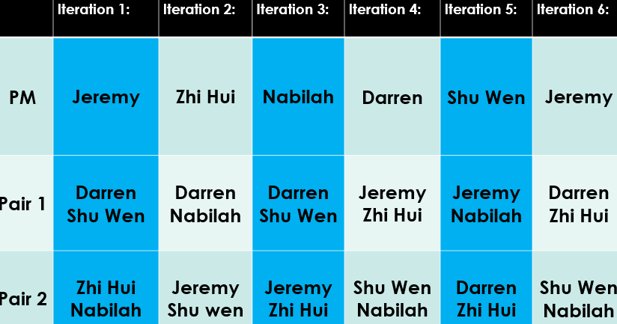
Functionalities
Project Schedule
Metrics
Roles & Responsibilities
PP Team & Rotation Plans
Notes:
Rotation plan
wgich pm which milestone

Slide 19
End of Presentation
Q & A

Slide 20
Appendix
 | Iteration 1: | Iteration 2: | Iteration 3: | Iteration 4: | Iteration 5: | Iteration 6:
PM | Jeremy | Zhi Hui | Nabilah | Darren | Shu Wen | Jeremy
Pair 1 | Darren Shu Wen | Darren Nabilah | Darren Shu Wen | Jeremy Zhi Hui | Jeremy Nabilah | Darren Zhi Hui
Pair 2 | Zhi Hui Nabilah | Jeremy Shu wen | Jeremy Zhi Hui | Shu Wen Nabilah | Darren Zhi Hui | Shu Wen Nabilah
Notes:
Remove dates and weeks . Title.. Black box white font, bolded.

Slide 21
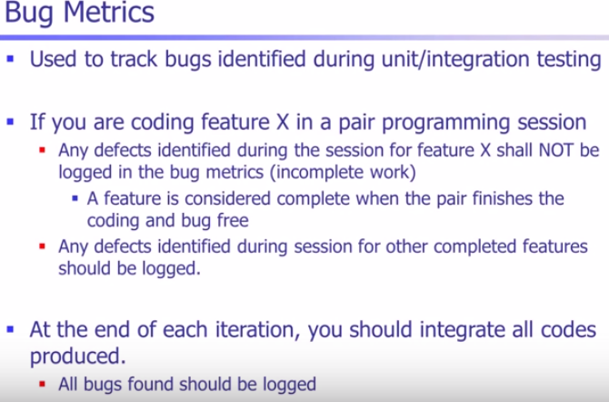
Appendix

