Slide 1
Exploring Large Language Models for Direct Trajectory Generation in Robotic Manipulation
LLM-Driven Zero-Shot Pick-and-Place with the Sawyer Robot
Jun · Sergio · David · Cadavid · Jossua Ruiz
Robotics — Politecnico di Torino

Slide 2
Why Large Language Models for Robotics?
Traditional robotic manipulation relies on hand-crafted trajectories: a programmer must explicitly define every waypoint, every gripper angle, every timing parameter. This process is slow, error-prone, and breaks whenever the environment changes.
Recent work (Kwon et al., Liang et al., Vemprala et al.) has shown AI capable of generate robot code from natural language
Instead of predicting joint angles or torques, these models generate Python code that calls robotics libraries (IK solvers, motion planners, perception pipelines). This makes the output interpretable, debuggable, and safe.
Our goal: apply this paradigm to a Sawyer robot in simulation, using a locally-run LLM (Qwen2.5-Coder 3B) to generate pick-and-place trajectories from user-provided natural language instructions.
Key insight: the LLM acts as a code generator, not a motion predictor — it writes programs, not trajectories.

Slide 3
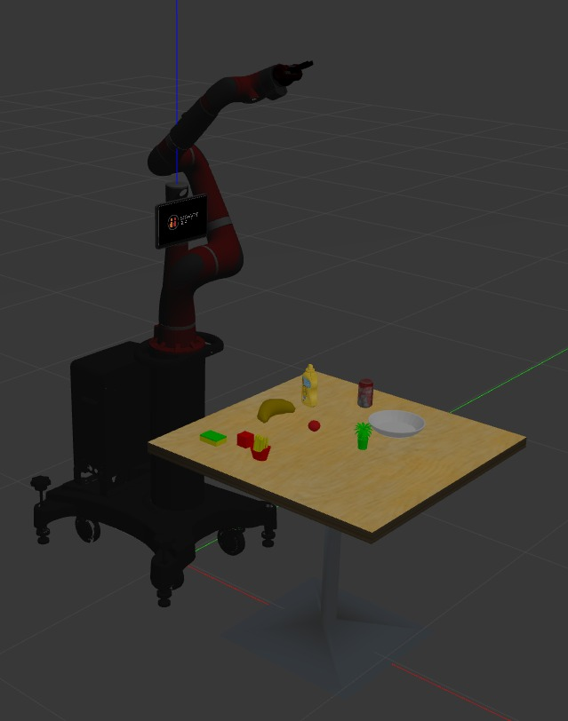
System Architecture
The system is divided into five sequential stages. Each stage produces the input for the next, forming a complete pipeline from user instruction to robotic action.
SIMULATION
PERCEPTION
LLM
Gazebo + Sawyer Objects spawning Safe pose & scan
→
YOLOv8 detection frame2world 2D → 3D coords
→
System prompt Qwen2.5-Coder Code generation
MOTION
ROBOT
TRAC-IK solver Waypoint execution Gripper control
→
intera_interface Joint publishers ROS topics

Slide 4
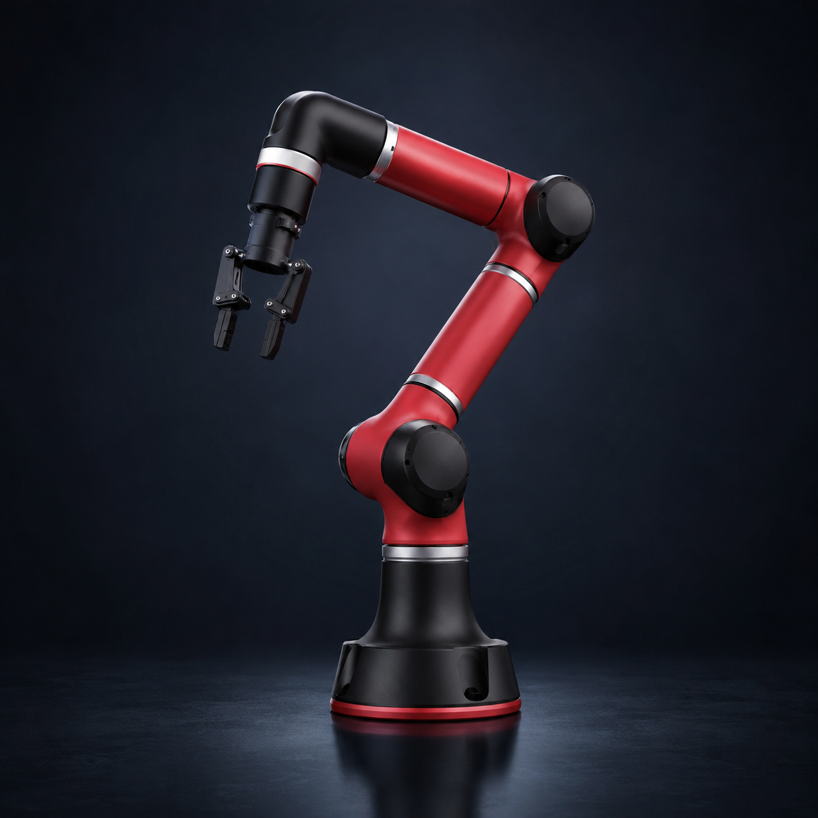
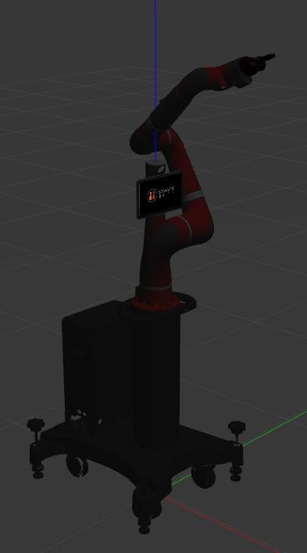
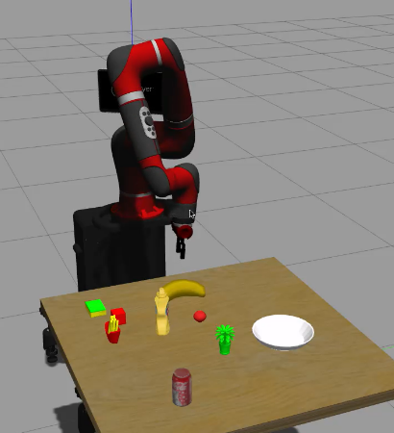
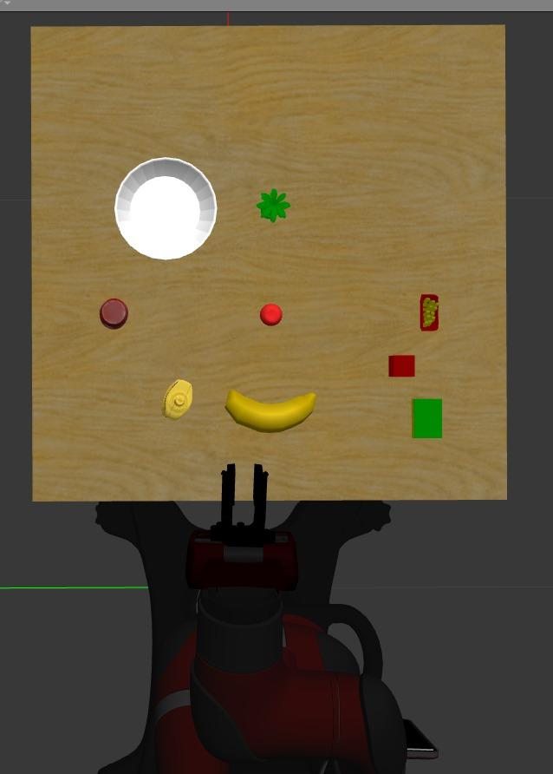
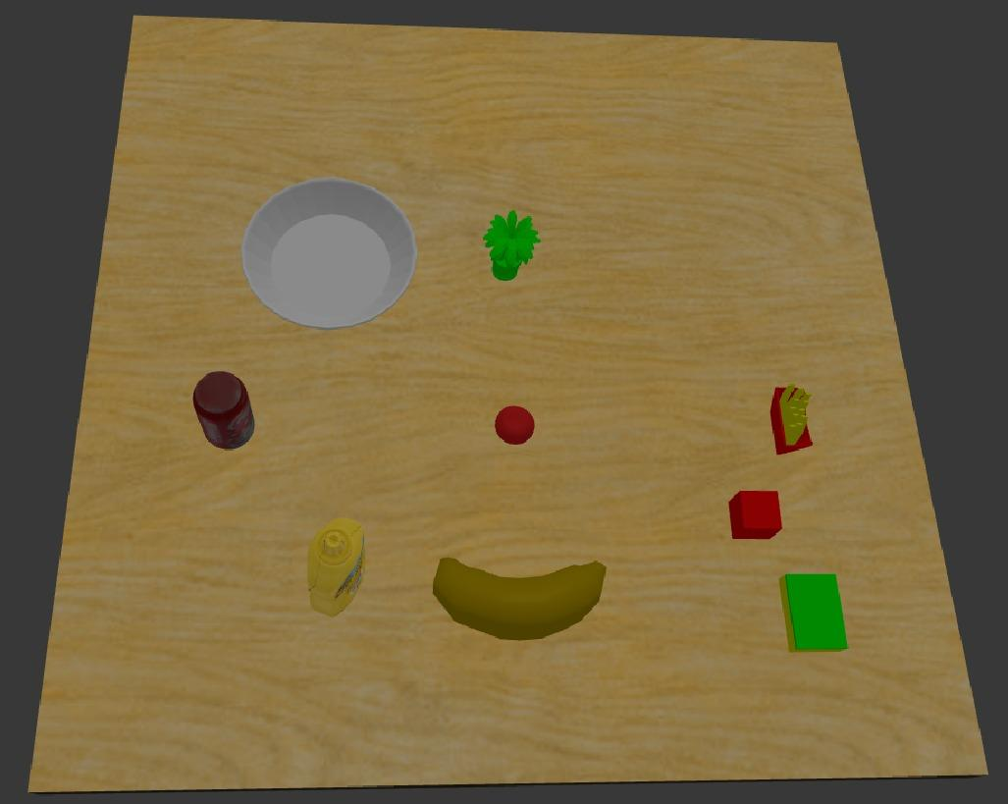
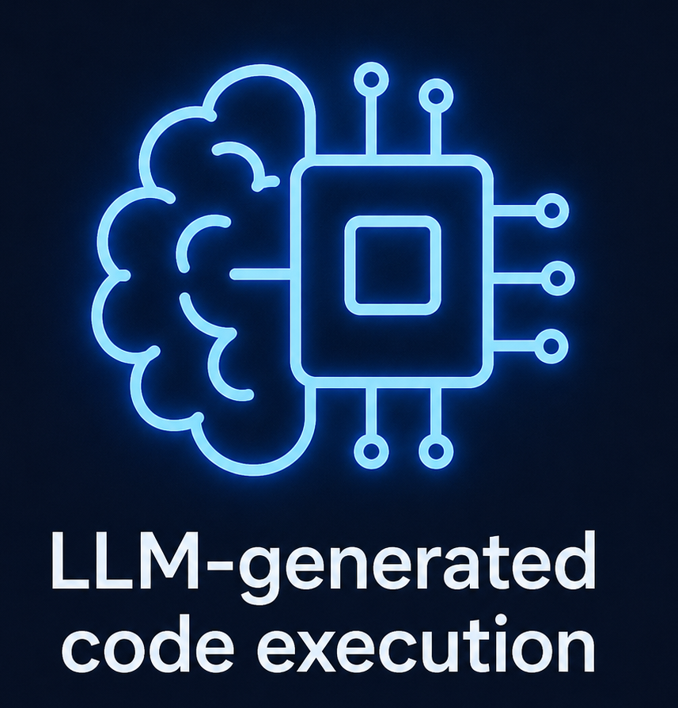
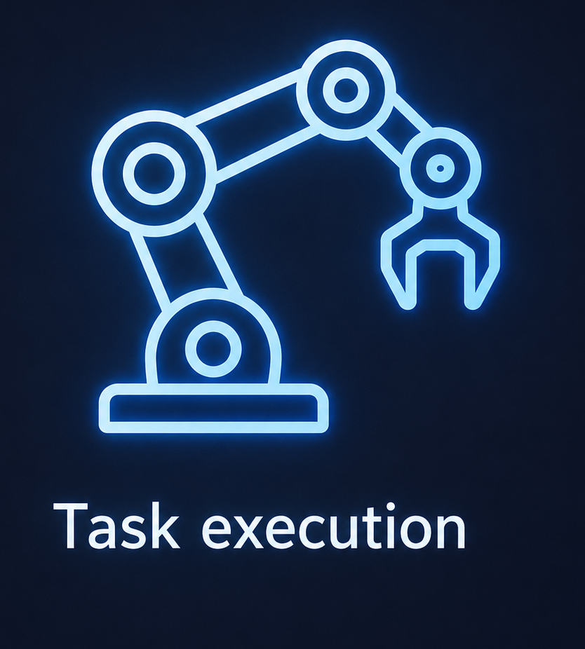
Simulation Environment
Simulation Platform Overview
Startup Sequence (Orchestrated Launch)
Initialization Result
System Ready for Perception
and Task Execution
Custom launch file: sawyer_david.launch
Orchestrates the startup sequence
This staged initialization ensures the scene is ready, the arm is initialized, and the camera has a clear top-down view before LLM-generated code runs.
1
2
3
4
0 s:
18 s:
35 s:
70 s:
Top-down camera view
Launch
simulation
spawn_pick_
place_scene.py
send_safe_
pose.py
go_to_top_
hand_camera_
pos.py
Populate the table
with 9 objects
(blocks, cans, boxes
of different sizes
and colors)
Move the arm to
a neutral / safe
posture
Move the hand
camera above the
workspace for
top-down perception
Gazebo
Sawyer & hand camara
Physics simulation
and rendering
7-DOF arm
Top-down view
ROS
Parallel-jaw gripper
Communication
and integration
Electric gripper
LLM-generated
code execution
Task
execution
⏱
Timing Summary
0s
launch
18 s
objects
(populated)
35 s
safe pose
(arm ready)
70 s
camera scan
ready
◎
Ready for perception
and task execution

Slide 5
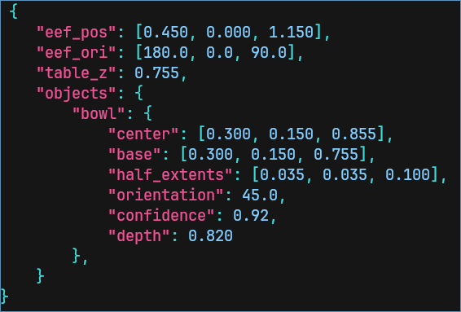
Scene Perception
Before the robot can manipulate objects, it needs to know where they are. The perception pipeline starts with make_scene(), which captures an RGB image and a synchronized depth frame from the hand-mounted camera.
A YOLO26n model (trained on the object set) detects each visible object and returns 2D bounding boxes with class labels. The detector runs in real time and can handle partial occlusions and varying lighting conditions in simulation.

Slide 6
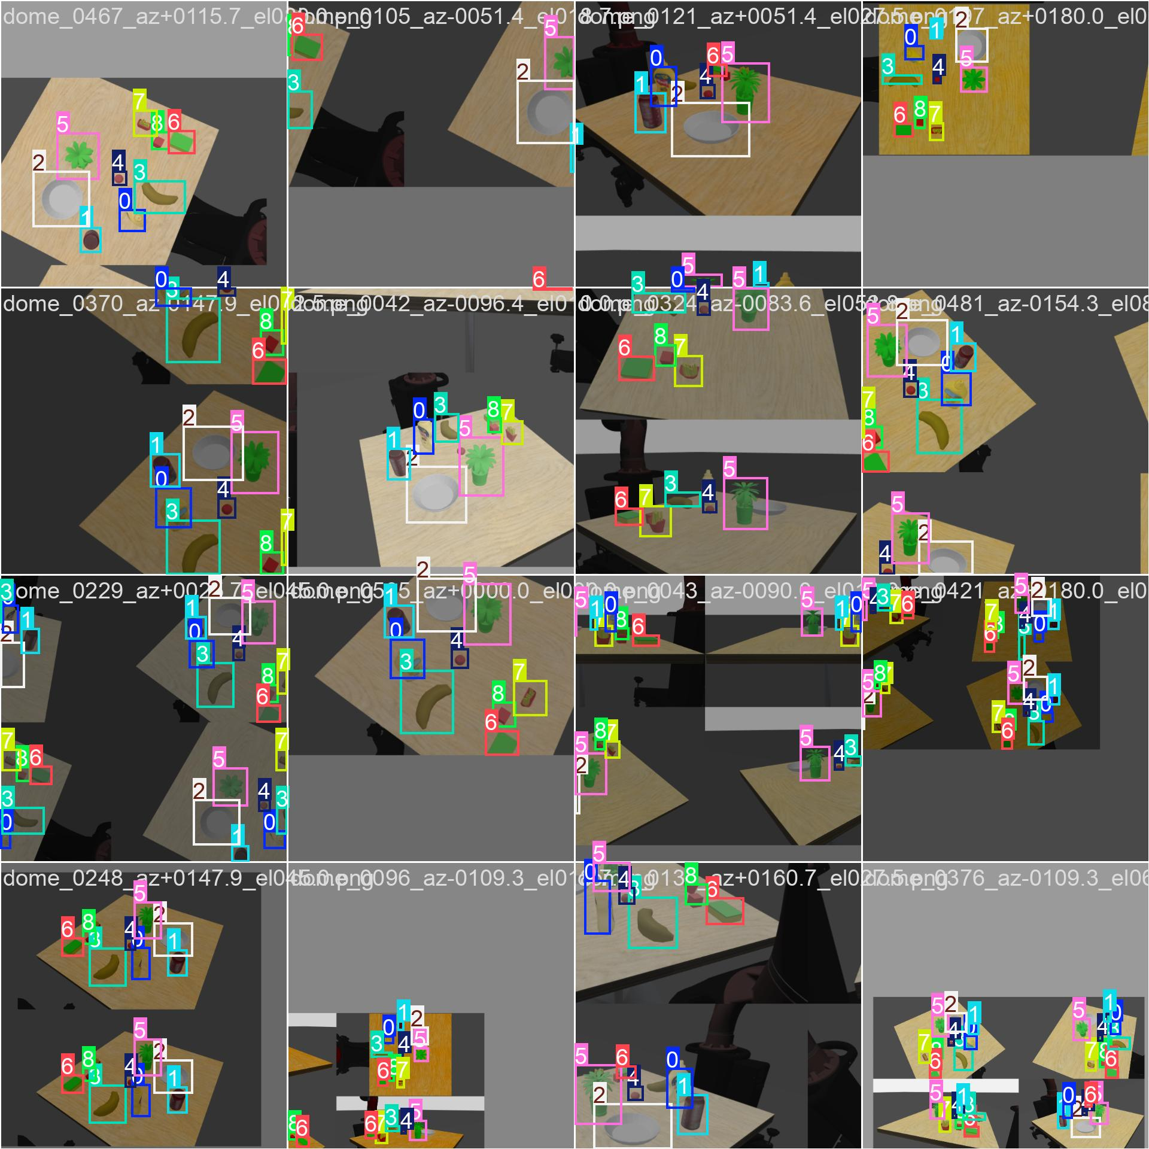
Model Training

Slide 7
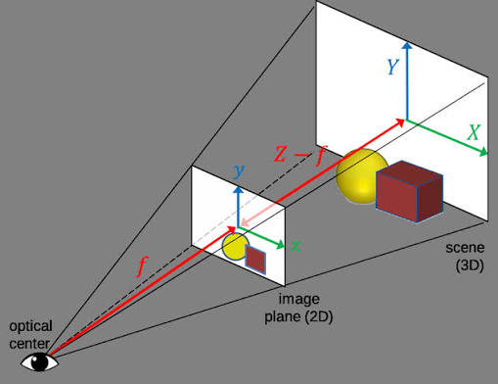
Scene Perception
The 2D detections are meaningless for manipulation — the robot needs 3D coordinates. The frame2world.py module takes each bounding box center, samples the depth image at that pixel, and back-projects the 2D point into 3D world coordinates using the camera intrinsics and the known hand-eye transformation.
The output is a Python dictionary mapping object names to their pose: {object_name: (x, y, z, yaw)}. This dictionary is passed to the LLM-generated code, which uses it to plan approach vectors and grasp targets.
Output: {object_name: (x, y, z, yaw)} — used directly by the motion planner.

Slide 8
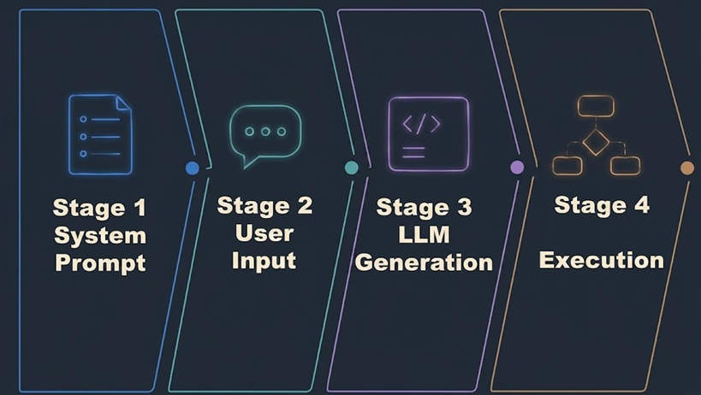
LLM Code Generation
Model
Why Local
Qwen2.5-Coder 3B — code-specialized LLM running locally via Ollama at localhost:11434
Eliminates API latency, privacy risks, and inference costs — critical for iterative robotics research
The System Prompt
Orchestration
A system_prompt.md defines the full robot API, acting as the LLM's instruction manual.
Captures user input, queries Ollama, writes generated code, reloads the module, and executes execute_task(). Built-in retry logic ensures robustness.
Output
Generates a complete, executable Python script (generated_task.py) from raw natural language.
Notes:
At the heart of the system is the LLM code generator. We use Qwen2.5-Coder 3B, a 3-billion-parameter code-specialized language model, running locally via Ollama on localhost:11434. Running locally eliminates latency, privacy concerns, and API costs.
The LLM receives a carefully crafted system prompt (system_prompt.md, 117 lines) that defines the robot's API: available functions (make_scene, execute_waypoints, adjust_grasp_waypoints), their signatures, return types, and usage patterns. This prompt acts as the "instruction manual" for the LLM.
The user provides a natural language task description (e.g., "pick the red block and place it on the blue box"). The LLM generates a complete Python script (generated_task.py) that calls the API functions in the correct order to accomplish the task.
The user provides a natural language task description (e.g., "pick the red block and place it on the blue box"). The LLM generates a complete Python script (generated_task.py) that calls the API functions in the correct order to accomplish the task.
run_task.py orchestrates the process: it captures the user input, sends it to the LLM with the system prompt, writes the generated code to disk, reloads the module dynamically, and executes execute_task(). Error handling and retry logic ensure robustness.
Model: Qwen2.5-Coder 3B (Ollama, temp=0.7) — locally hosted, no cloud dependency.

Slide 9
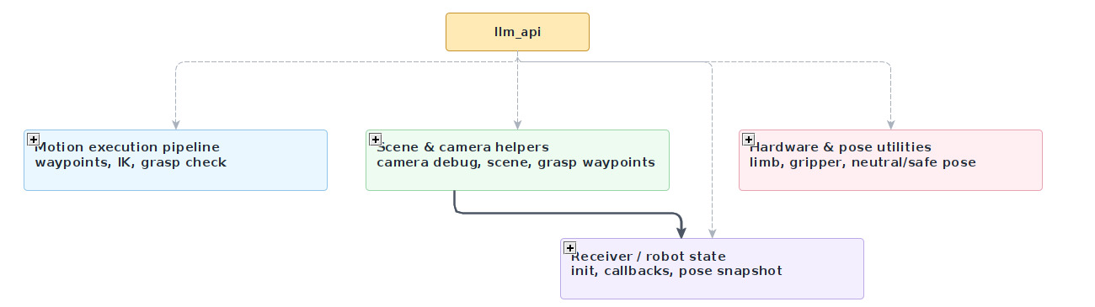
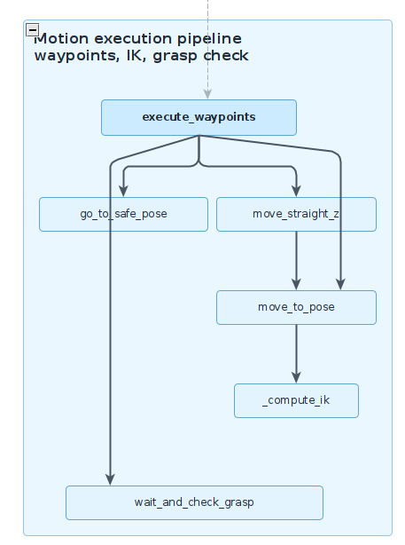
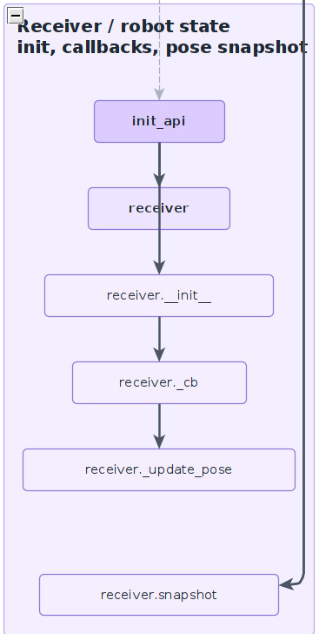
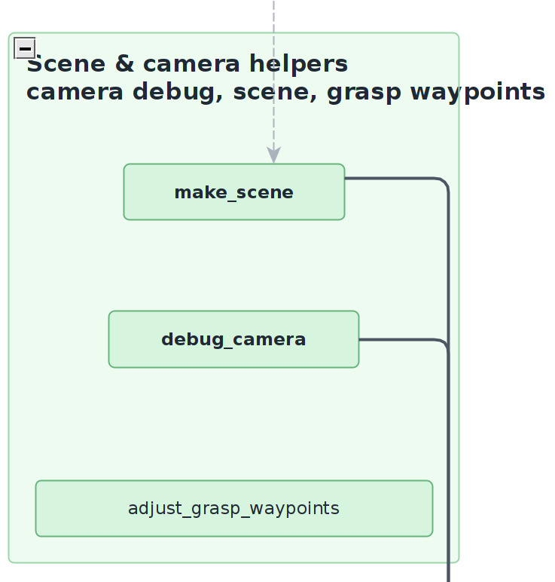
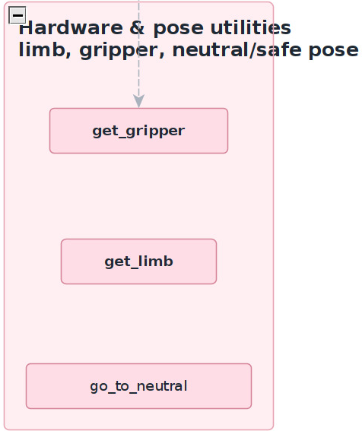
Motion Control
The motion layer transforms LLM-generated waypoints into executable robot actions. The system is organized into four modules: motion execution, scene and camera helpers, hardware control utilities, and robot state monitoring.
Motion Execution Pipeline
• Executes LLM-generated waypoints
• Computes inverse kinematics with TRAC-IK
• Performs vertical approach and retreat motions
• Validates grasp success before continuing
Receiver / Robot State
• Tracks joint states continuously
• Estimates end-effector pose
• Maintains robot state snapshots
• Synchronizes planning and execution
Scene & Camera Helpers
• Builds the scene representation
• Stores object positions and orientations
• Refines grasp targets
• Aligns grasp poses with detected objects
Hardware & Pose Utilities
• Controls Sawyer joints and gripper
• Provides neutral and safe poses
• Handles motion execution parameters
• Enforces safety constraints

Slide 10
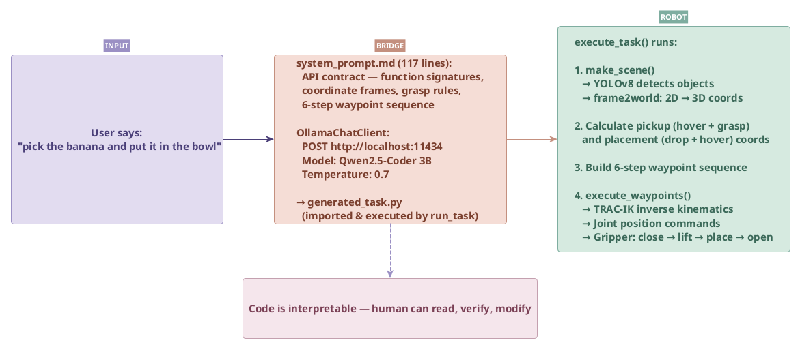
Integration & Results
The complete pipeline runs end-to-end: the user types a natural language instruction, the LLM generates task-specific code, and the Sawyer robot executes the pick-and-place operation in simulation. No manual trajectory programming, no fine-tuning, no task-specific code changes.
Demo video available — see the project submission.

Slide 11
Integration & Results
Key differences from the reference paper
 | Kwon / Liang et al. | This project
Robot | Franka Emika Panda | Sawyer
Environment | Real robot | Gazebo Simulation using ROS
LLM | GPT (Cloud) | Qwen2.5-Coder 3B (local)
Cost | API key/ Paid service | Free, 100% local
Privacy | – | Localhost

Slide 12
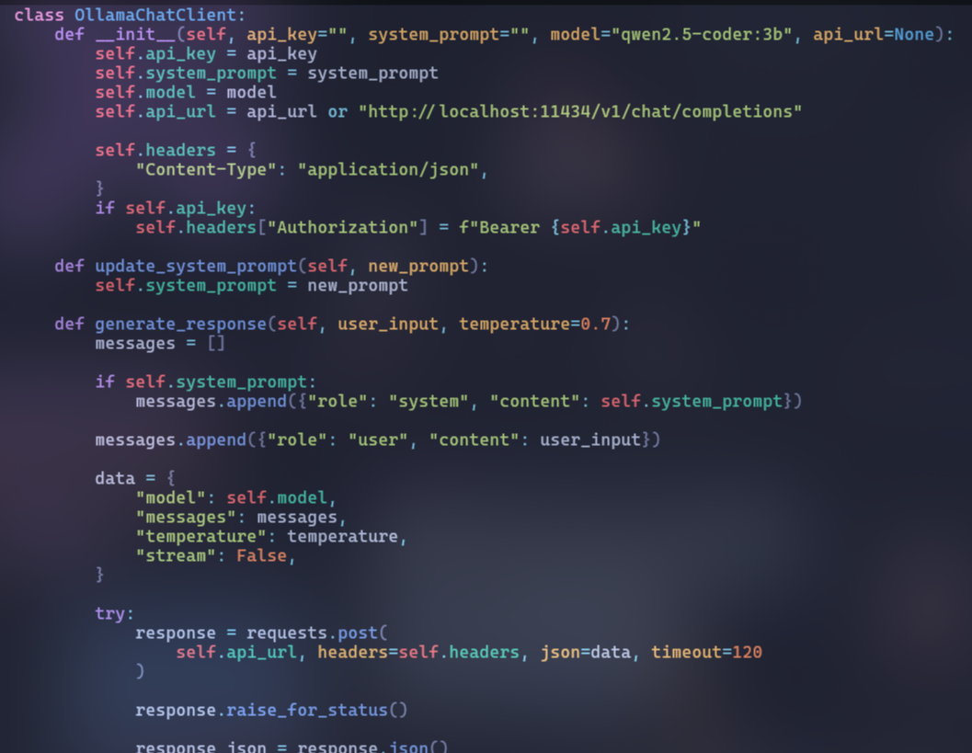
Integration & Results
Code of API bridge to and from Ollama

Slide 13
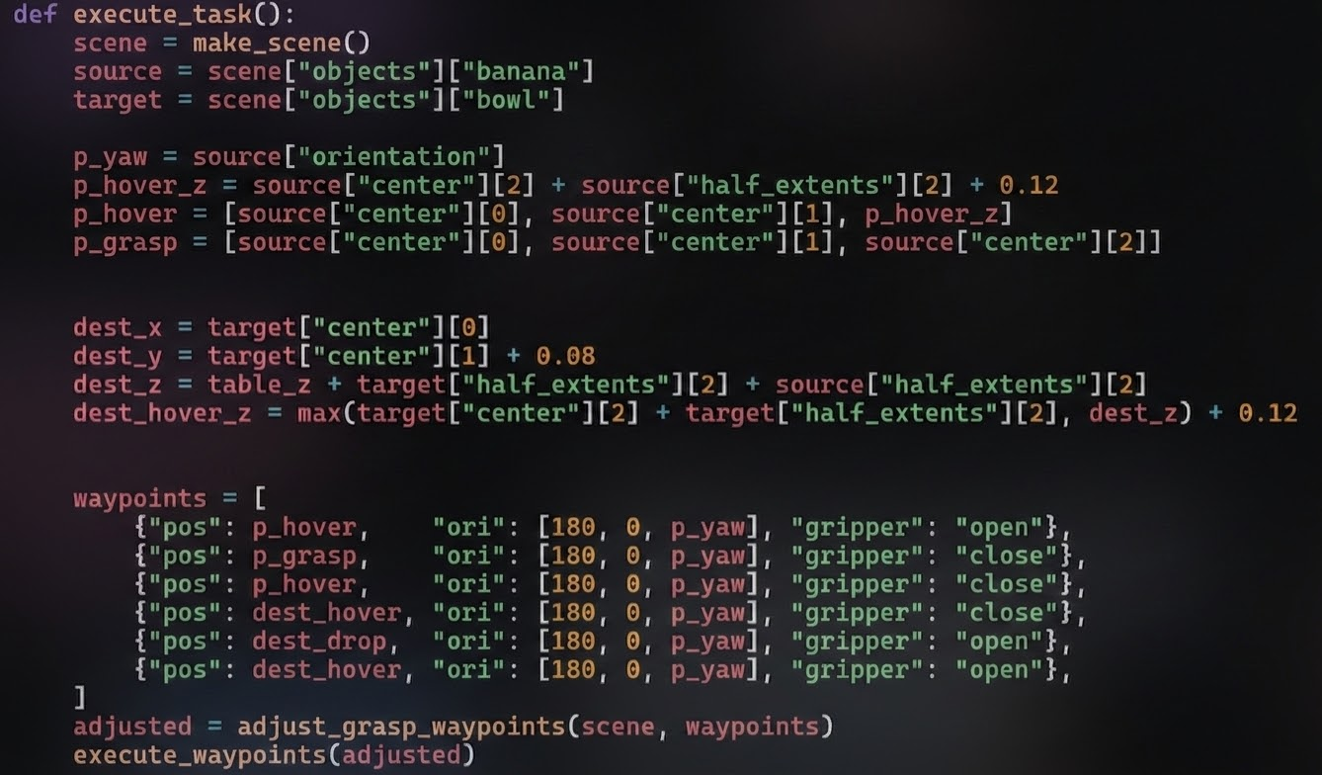
Integration & Results
Code of the routine generated by the LLM to perform a task

Slide 14
Results
✓ Successes:
- Handles varying object positions
- Multiple object types (blocks, cans, boxes)
- Multi-step instructions
- Code is human-readable and modifiable
✗ Limitations:
- Static scenes only (no moving objects)
- Limited to pick-and-place primitives
- Occasional syntax errors → retry
→ Future work:
- Dynamic scene handling
- Error recovery
- More complex task primitives

Slide 15
References & Related Work
Kwon, T., Kim, B., Lee, Y., and Choo, J. "Language Models as Zero-Shot Trajectory Generators." RSS 2023 Workshop on Learning for Task and Motion Planning. — The foundational paper showing that LLMs can generate executable trajectory code from language instructions.
TRAC-IK: Beeson, P. and Ames, B. "TRAC-IK: An Open-Source Library for Improved Inverse Kinematics of Humanoid Robots." IEEE-RAS 2015. — Fast IK solver used for real-time motion generation.
Ultralytics YOLOv8: Jocher, G. et al. "Ultralytics YOLOv8." 2023. — Real-time object detection model used for scene perception.
Vemprala, S., Bonatti, R., Bucker, A., and Kapoor, A. "ChatGPT for Robotics: Design Principles and Model Abilities." Microsoft Research, 2023. — Provides design principles for integrating LLMs into robotic systems, emphasizing prompt engineering and API design.
Liang, J., Huang, W., Xia, F., Xu, P., Hausman, K., Ichter, B., Florence, P., and Zeng, A. "Code as Policies: Language Model Programs for Embodied Control." ICRA 2023. — Introduces the concept of using LLMs to generate robot control programs ("code as policies") with hierarchical code reuse.

Slide 16
Thank You
Questions?
Jun · Sergio · David · Cadavid · Jossua
Robotics — Politecnico di Torino

