Slide 1
A Multi-Platform Mobile World with Xamarin
Jerrel Blankenship
.NET Engineering Lead – Dynamit
@TheJerrel

Slide 2

Which One Do I Choose?

Slide 3
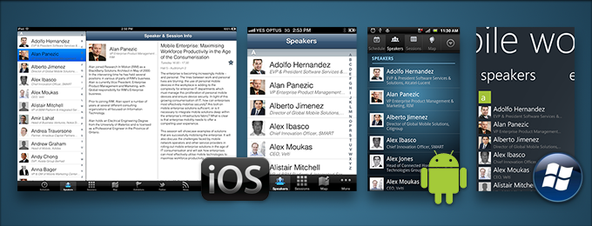
Xamarin

Slide 4
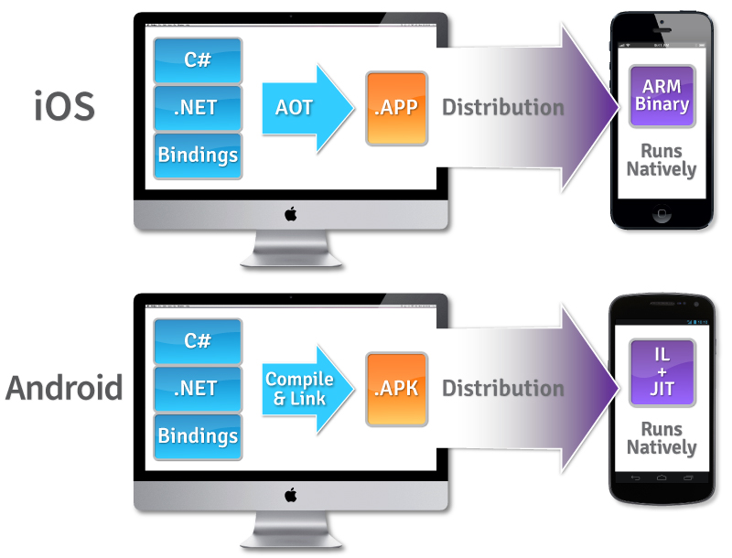
Details
Cross-platform development with C# via Mono
One shared codebase
Separate platform-specific UIs (C#)
Complies to Native Binary
Use Native APIs to create native apps
Platform APIs are available as C# class libraries
Use any existing .NET Libraries
Notes:
which is bundled with your app
memory management, reflection, and the .NET base class libraries
not cross-compiled, and not interpreted.
Visual Studio Integration
The Xamarin compiler bundles the .NET runtime and outputs a native ARM executable, packaged as an iOS or Android app.
iOS => Ahead-of-Time compilation
Android => Just In Time Compilation

Slide 5
Xamarin vs. Xamarin Forms
iOS
Android
Windows Phone
iOS
Android
Windows Phone
Shared UI Code
Shared C# Backend (PCL)
Shared C# Backend (PCL)

Slide 6
Xamarin Forms
UI Toolkit
Provides native UI abstraction
Uses native components at runtime
Most logic in PCL
Can use XAML or C#
Helps with cross-platform code sharing

Slide 7
Model-View-ViewModel (MVVM)
Common pattern used in Xamarin and in particular Xamarin Forms development.
Application is broken down as:
Model == Data
View == UI
ViewModel == Logic
Separates concerns in the application
Used in Databinding
Don’t look up!

Slide 8
Components & Add-Ons
Pre-Built Components
Allows you to quickly add functionality
Some Examples:
Azure Mobile Services
Dropbox Sync
Facebook Sync
SQLite.NET
RestSharp
Xamarin Test Cloud
Automated testing
Continuous Integration
Jenkins
Physical Devices
Support for BDD
Notes:
Components:
Azure mobile Services
DropBox Sync (Apple)
Facebook SDK
RestSharp – Simple REST Client

Slide 9
Questions?
jerrel@jerrelblankenship.com
Twitter: @TheJerrel

