Slide 1
Using BDD to Build .NET Web Applications
By: Jerrel Blankenship
Email: jerrel@jerrelblankenship.com
Twitter: @TheJerrel
Blog: www.jerrelblankenship.com

Slide 2
About Me
Software Engineer at RelayHealth
Certified Scrum Master
Author: Pro Agile .NET Development with Scrum
Cleveland Sports Fan
Father to awesome little boy (Tyler)

Slide 3
What is BDD?
Next step in TDD
Centered on the behavior of a system
Seeks a clearer understanding of the system
Written in a natural language
Outside-in development

Slide 4
Outside – In Development
Focuses on Acceptance criteria
Diving force of the design of your system
Goal: produce software for the stake holder that they want and need.

Slide 5
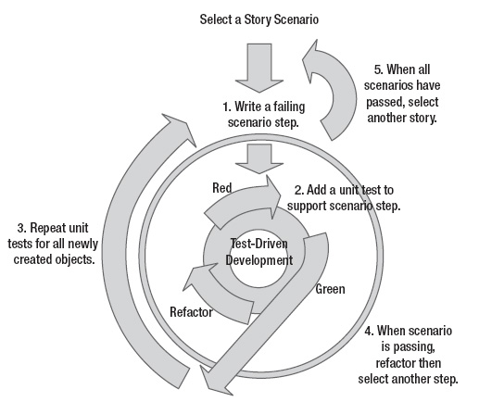

Slide 6
What is SpecFlow?
Open-source BDD framework developed for the .NET Framwork
Takes defined features or behaviors and generates scenarios that can be tested.
Written in the Gherkin Language

Slide 7
Gherkin Language
Tool developed as adjunct to Cucumber(Ruby)
Given/When/Then format
Given: Setup of test
When: action performed by test
Then: assertions that validate test

Slide 8
What is WatiN
Testing framework used for Web Application Testing.
Inspired by Watir(Ruby)
Is .NET equivalent of Watir
Allows a way to interact with the browser in your tests.

Slide 9
On To The Code

Slide 10
?

Slide 11
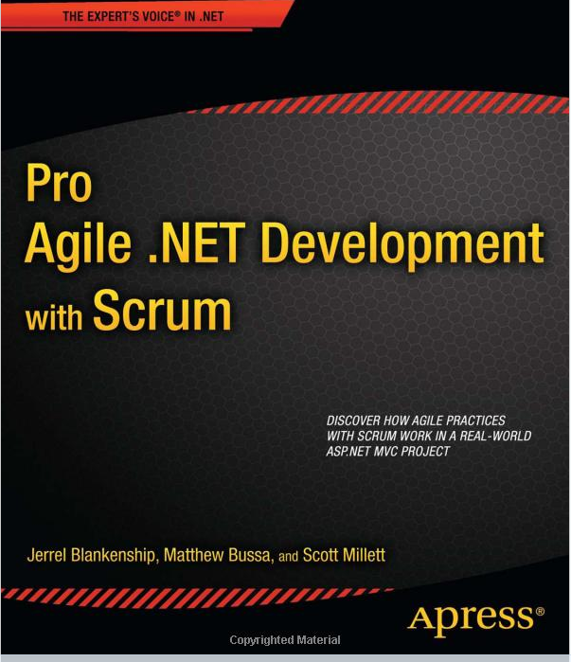
Pro Agile .NET Development with Scrum
Co Author: Matthew Bussa
Available now from Apress & Amazon

Slide 12
Links
SpecFlow: www.specflow.org
WatiN: www.watin.org
Resharper: www.jetbrains.com/resharper
GitHub: www.github.com/jerrelblankenship
SpeakerRate: http://spkr8.com/s/17810

