Slide 1
I Only Want to Write My App Once: Using Xamarin to Build Multi-Platform Mobile Apps
Jerrel Blankenship
@TheJerrel
Stir Trek 2014

Slide 2
A Little About Me
Software Engineer at RelayHealth
Husband, Father, Author
Striving Software Craftsman
Certified Scrum Master

Slide 3

Which One Do I Choose?

Slide 4
Frameworks to the Rescue
Xamarin
PhoneGap
Appcelerator Titanium
AppBuilder (Icenium)

Slide 5
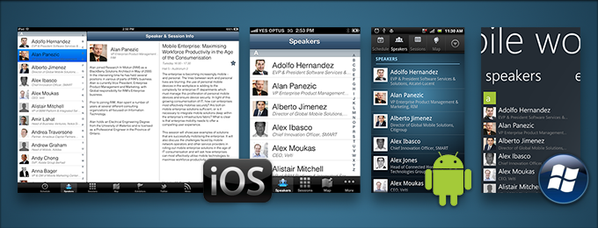
Xamarin

Slide 6
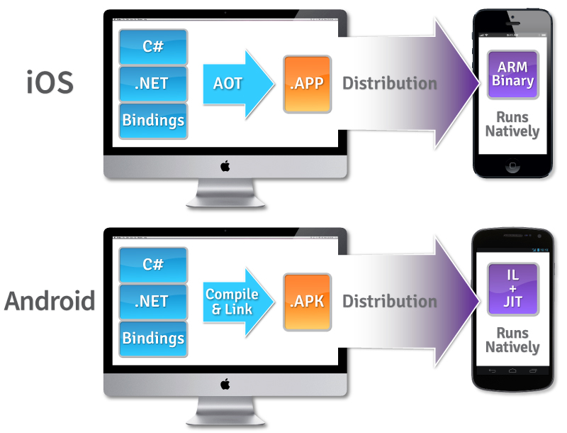
Details
Cross-platform development with C# via Mono
One shared codebase
Separate platform-specific UIs (C#)
Complies to Native Binary
Use Native APIs to create native apps
Platform APIs are available as C# class libraries
Use any existing .NET Libraries
Notes:
which is bundled with your app
memory management, reflection, and the .NET base class libraries
not cross-compiled, and not interpreted.
Visual Studio Integration
The Xamarin compiler bundles the .NET runtime and outputs a native ARM executable, packaged as an iOS or Android app.
iOS => Ahead-of-Time compilation
Android => Just In Time Compilation

Slide 7
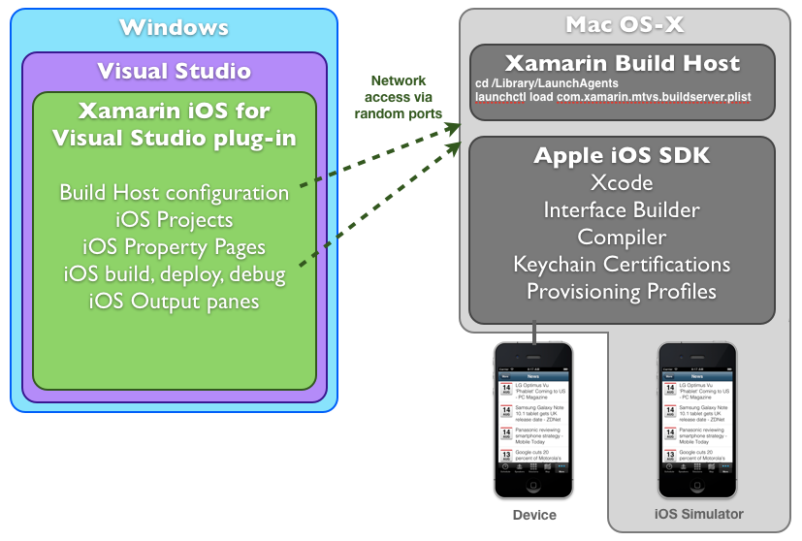
Building iOS Apps
Requires network connected Mac
Deployed app runs in a simulator or device on machine
Xamarin Build Host (Mac)
handles the communication between VS and the Mac
Can use Virtual Machines
Cannot edit Storyboards & XIB files in visual studio
User Interface Builder in Xamarin Studio for Mac
Cannot use Xamarin Studio on Windows

Slide 8


Xamarin Studio & Visual Studio
Notes:
Transition to Code

Slide 9
Xamarin Forms
UI Toolkit
Cross-platform ( share one UI between each platform)
Rendered as Native Controls
Can be all or partial
Can be created in code or via XAML

Slide 10
Components & Add-Ons
Pre-Built Components
Allows you to quickly add functionality
Some Examples:
Azure Mobile Services
Dropbox Sync
Facebook Sync
SQLite.NET
RestSharp
Xamarin Test Cloud
Automated testing
Continuous Integration
TFS
Team City
Physical Devices
Support for BDD
Notes:
Components:
Azure mobile Services
DropBox Sync (Apple)
Facebook SDK
RestSharp – Simple REST Client

Slide 11
Strengths/Challenges
Native App Experience
Performance
Maintainability
Testing
Cost
iOS Development
Native UIs
Notes:
Reverse list
Strengths & Challenges slide

Slide 12
Questions?
Notes:
A cleaner way to have a different user interface per platform, easily making your apps seem much more targeted per environment and therefore enhancing the user experience.
And with that, your excuse to not write your mobile app is gone!

Slide 13
Contact Me
Jerrel@jerrelblankenship.com
@TheJerrel
www.jerrelblankenship.com

Slide 14
Xamarin Pricing
Starter – Free
Small Apps – Cannot P/Invoke third-party libraries
Deploy to Device & App Stores
Indie - $299 dev/platform/year
Unlimited app Size
Business - $999 dev/platform/year
Visual Studio Integration, Headless builds
Enterprise - $1899 dev/platform/year
Support from Xamarin, prime components

Slide 15
Image Attributions
Smart Phone, Tablet, and PC – The Droid Guy

