Slide 1
I Only Want to Write My App Once: Using Xamarin to Build Multi-Platform Mobile Apps
Jerrel Blankenship
@TheJerrel
CodeMash 2014

Slide 2
A Little About Me
Software Engineer at RelayHealth
Author: Pro Agile .NET Development with Scrum
Striving Software Craftsman
Certified Scrum Master

Slide 3

Which One Do I Choose?

Slide 4
Frameworks to the Rescue
Xamarin
PhoneGap
AppMobi
Appcelerator
Titanium
Icenium

Slide 5
Xamarin

Slide 6
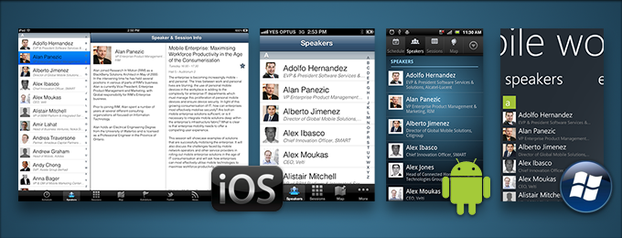
Details
Cross-platform development with C#
One shared codebase
Separate platform-specific UIs (C#)
Use Native APIs to create native apps
Use any existing .NET Libraries
Notes:
Xamarin contains a fully functional implementation of the .NET runtime, called Mono, which is bundled with your app so that your code executes with all of the power of C# and .NET, including memory management, reflection, and the .NET base class libraries
iOS requires network connection to Mac
Xamarin's binding technology exposes all of the APIs available in iOS and Android to your applications as regular C# class libraries.
This means your Xamarin application can do anything a platform, or device, offers, with native user interface and excellent performance.
Xamarin compiles your app to a native binary, not cross-compiled, and not interpreted.
Visual Studio Integration

Slide 7
Xamarin Studio
Notes:
Transition to Code

Slide 8
Visual Studio

Slide 9
Components & Add-Ons
Pre-Built Components
Allows you to quickly add functionality
Some Examples:
Azure Mobile Services
Dropbox Sync
Facebook Sync
SQLite.NET
RestSharp
CoverFlowView
Notes:
Components:
Azure mobile Services
DropBox Sync (Apple)
Facebook SDK
CoverFlowView – Add CoverFlow to your app (apple)
RestSharp – Simple REST Client
Transition to Code

Slide 10
Strengths/Challenges
Native App Experience
Performance
Maintainability
Testing
Cost
iOS Development
Native UIs
Notes:
Reverse list
Strengths & Challenges slide

Slide 11
Questions?
Notes:
A cleaner way to have a different user interface per platform, easily making your apps seem much more targeted per environment and therefore enhancing the user experience.
And with that, your excuse to not write your mobile app is gone!

Slide 12
Contact Me
Jerrel@jerrelblankenship.com
@TheJerrel
www.jerrelblankenship.com

Slide 13
Image Attributions
Smart Phone, Tablet, and PC – The Droid Guy

Slide 14
Xamarin Pricing
Starter – Free
Small Apps – Cannot P/Invoke third-party libraries
Indie - $299 dev/year
Unlimited app Size
Business - $999 dev/year
Visual Studio Integration, Headless builds
Enterprise - $1899 dev/year
Support from Xamarin, prime components

