Slide 1
Having Your Coffee in the .NET World
By: Jerrel Blankenship
jerrel@jerrelblankenship.com
@TheJerrel
www.jerrelblankenship.com

Slide 2
A Little About Me
.NET Developer
Aspiring Craftsman
Author: Pro Agile .NET Development with Scrum
Cleveland Sports Fan
Husband & Dad

Slide 3
What is CoffeeScript
Web Language
Written in CoffeeScript
A way to expose the good parts of JavaScript
In a simple way and more maintainable way
Compiles into JavaScript
1 to 1 compilation into equivalent JavaScript
Will pass through jsLint with no errors
Works with all JavaScript runtimes & libraries
Notes:
Written in CoffeeScript using the jison parser generator
No interpretation at runtime
Tends to run faster than handwritten JavaScript

Slide 4
CoffeeScript Examples: Variable Assignment
CoffeeScript
Equivalent JavaScript
conference = "devLink"
speaker = "Jerrel"
isSpeaking = true
var conference, isSpeaking, speaker;
conference = "devLink";
speaker = "Jerrel";
isSpeaking = true;

Slide 5
CoffeeScript Examples: Methods
CoffeeScript
Equivalent JavaScript
add (x,y) -> x + y
addToString (original, stringToAdd) ->
"#{original}, #{stringToAdd}"
addPlus1(x,y) -> add(x,y) + 1
add(function(x, y) {
return x + y;
});
addToString(function(original, stringToAdd) {
return original + ", " + stringToAdd;
});
addPlus1(x, y)(function() {
return add(x, y) + 1;
});

Slide 6
CoffeeScript Examples: Objects & Arrays
CoffeeScript
Equivalent JavaScript
primeNumbers = [2, 3, 5, 7, 11, 13]
alphas = ["a", "b", "c", 1, 2, 3]
superHeroes =
heroName: "Spiderman“
comicCompany: "Marvel“
normalName: "Peter Parker“
age: 16
primeNumbers = [2, 3, 5, 7, 11, 13];
alphas = ["a", "b", "c", 1, 2, 3];
superHeroes = {
heroName: "Spiderman",
comicCompany: "Marvel",
normalName: "Peter Parker",
age: 16
};
Notes:
Although suppressed within this documentation for clarity,
all CoffeeScript output is wrapped in an anonymous function: (function(){ ... })(); This safety wrapper, combined with the automatic generation of the var keyword, make it exceedingly difficult to pollute the global namespace by accident.
If you'd like to create top-level variables for other scripts to use, attach them as properties on window

Slide 7
Incorporating CoffeeScript
Can use within .NET web application
Visual Studio Extentsions
Web Essentials 2012
Mindscape Web Workbench

Slide 8
CODE!
Notes:
Show what happens when syntax error in coffeeScript
Can we debug CoffeeScript inside VisualStudio
Show what happens when you make changes to the javascript outside of coffeeScript file

Slide 9
Limitations of Integration
Cannot use in a Windows Phone application
TypeScript can be used instead
Cannot use in Windows “Metro” HTML5 or JavaScript applications

Slide 10
?

Slide 11
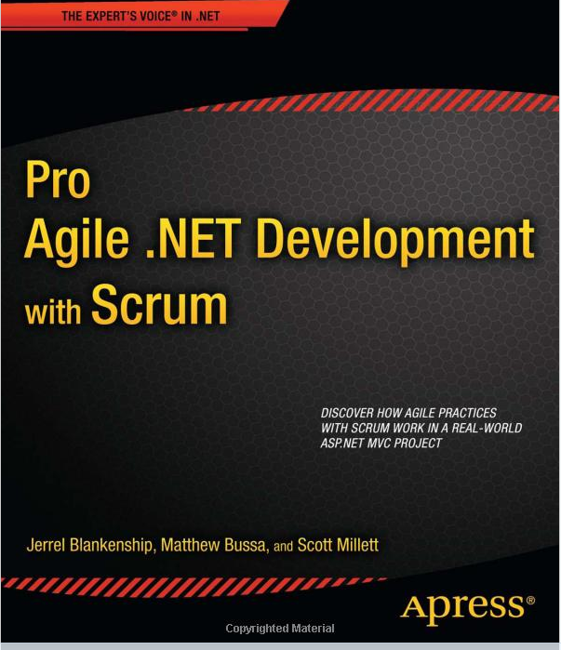
Pro Agile .NET Development with Scrum

Slide 12
Links
CoffeeScript: http://coffeescript.org/
Mindscape Web Workbench: http://bit.ly/poXJkB
Web Essentials 2012: http://vswebessentials.com/
“CoffeeScript Accelerated JavaScript Development” by Trevor Burnham : http://pragprog.com/book/tbcoffee/coffeescript
Slides & Code: https://github.com/jerrelblankenship/Presentations/

