Slide 1
Behavior-Driven Development for Windows Phone Developers
By: Jerrel Blankenship
Email: jerrel@jerrelblankenship.com
Twitter: @TheJerrel
Blog: www.jerrelblankenship.com

Slide 2
About Me
Senior Programmer Analyst at Heuristic Solutions LLC
Certified Scrum Master
Author: Pro Agile .NET Development with Scrum
Cleveland Sports Fan
Father to awesome little boy (Tyler)

Slide 3
What is BDD?
Next step in TDD
Centered on the behavior of a system
Seeks a clearer understanding of the system
Written in a natural language
Outside-in development

Slide 4
BDD vs. TDD
TDD
Centered on the inner workings of a system
Geared towards developers
BDD
Centered on behavior of a system
Geared towards steakholders

Slide 5
Outside – In Development
Focuses on Acceptance criteria
Diving force of the design of your system
Goal: produce software for the steak holder that they want and need.

Slide 6
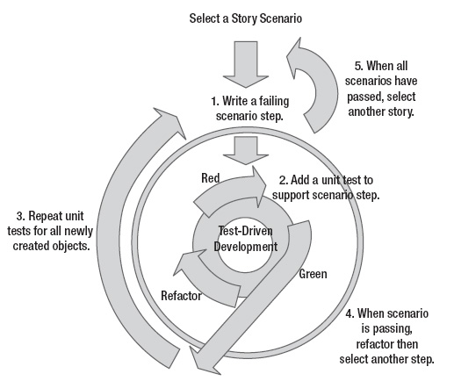

Slide 7
What is SpecFlow?
Open-source tool geared towards .Net development
Takes defined features or bahaviors and generates scenarios that can be tested.
Written in the Gherkin Language

Slide 8
Gherkin Language
Tool developed as adjunct to Cucumber(Ruby)
Given/When/Then format
Given: Setup of test
When: action performed by test
Then: assertions that validate test

Slide 9
On To The Code

Slide 10
?

Slide 11

Pro Agile .NET Development with Scrum
Co Author: Matthew Bussa
Available now from Apress & Amazon

Slide 12
Links
SpecFlow: www.specflow.org
SpecFlow for WP7: https://github.com/techtalk/SpecFlow/wiki/Windows-Phone-7-Support
Silverlight Unit Test Framework Binaries: http://www.jeff.wilcox.name/2011/06/updated-ut-mango-bits/
Evercraft Kata By: Guy Royse (@guyroyse) & George Walters II (@walterg2) : https://github.com/walterg2/EverCraft-Kata

