Slide 1
JERRELL HAWKINS | IT SUPPORT PORTFOLIO
ServiceDesk Simulator
Help Desk Projects
Six hands-on incidents resolved through remote support, documentation, secure access workflows, and clear ticket closure.
DISPLAY | TIME SETTINGS | NETWORK PRINTING | PASSWORD RESET | VPN | SHARED DRIVES

Slide 2
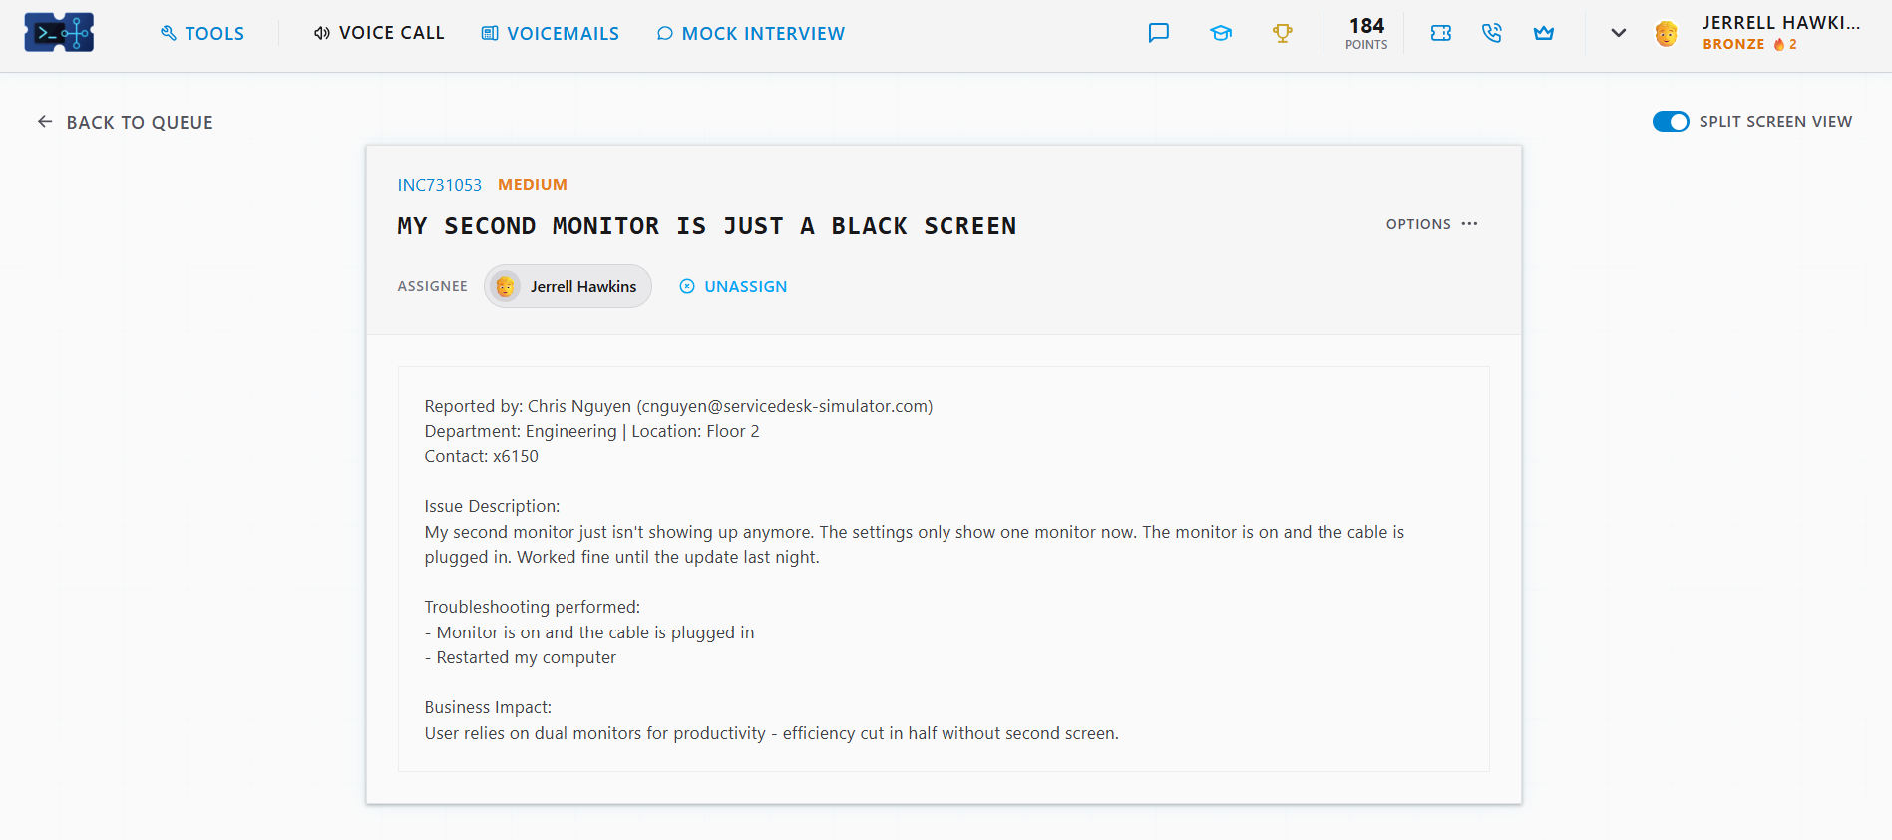
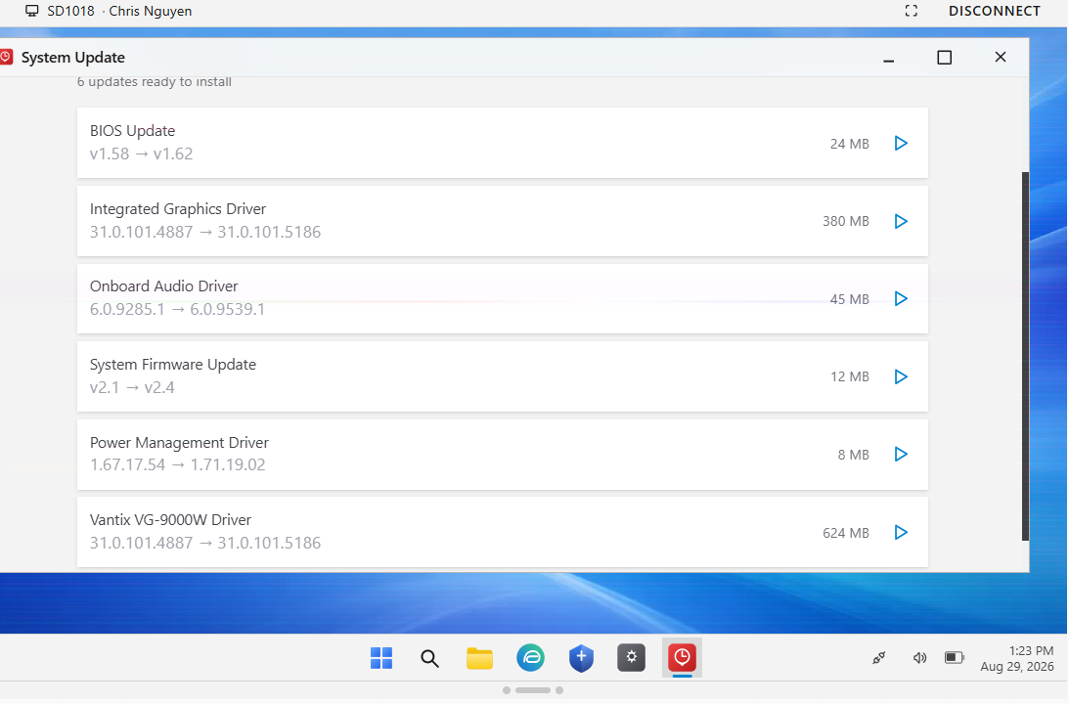
A driver update restored the second monitor
ISSUE
After an overnight update, the user's second monitor remained black and Windows detected only one display.
ACTIONS
• Connected to the workstation through remote support.
• Installed BIOS, graphics, firmware, power-management, and device-driver updates.
• Restarted the PC and documented the resolution.
OUTCOME
The second display returned and the ticket was closed.
RDP | BIOS & DRIVERS | RESTART VALIDATION | TICKET NOTES
JERRELL HAWKINS | IT SUPPORT PORTFOLIO
02

Slide 3
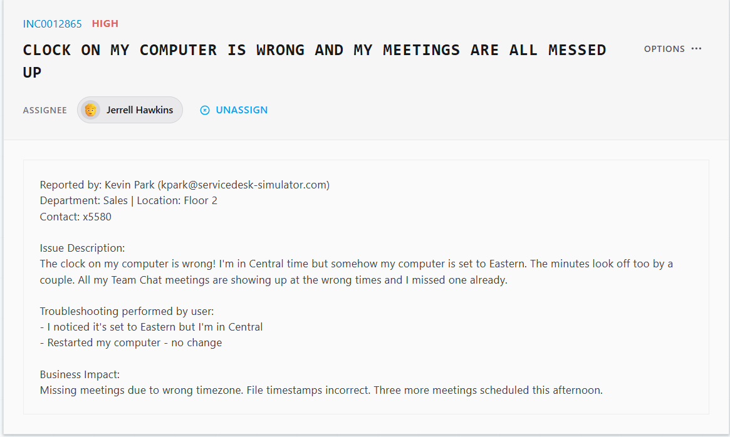
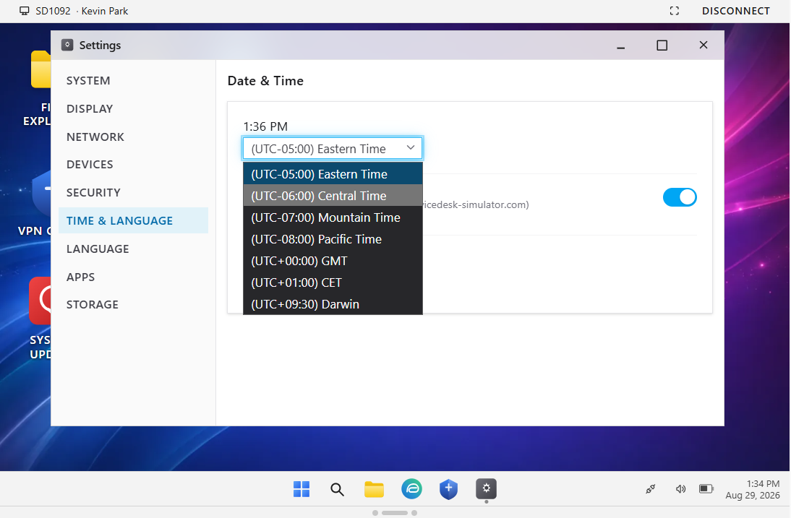
Correct time zone restored meeting accuracy
ISSUE
A remote sales user's PC was set to Eastern Time instead of Central, causing missed meetings and incorrect timestamps.
ACTIONS
• Connected remotely and opened Date & Time settings.
• Changed the workstation from Eastern to Central Time.
• Verified the corrected clock and documented closure.
OUTCOME
Meeting times and file timestamps displayed correctly again.
REMOTE SUPPORT | WINDOWS SETTINGS | USER IMPACT | VERIFICATION
JERRELL HAWKINS | IT SUPPORT PORTFOLIO
03

Slide 4
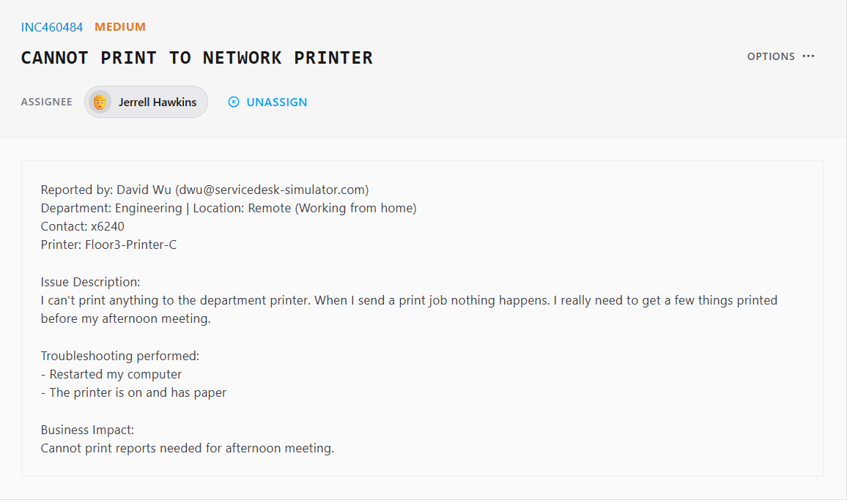
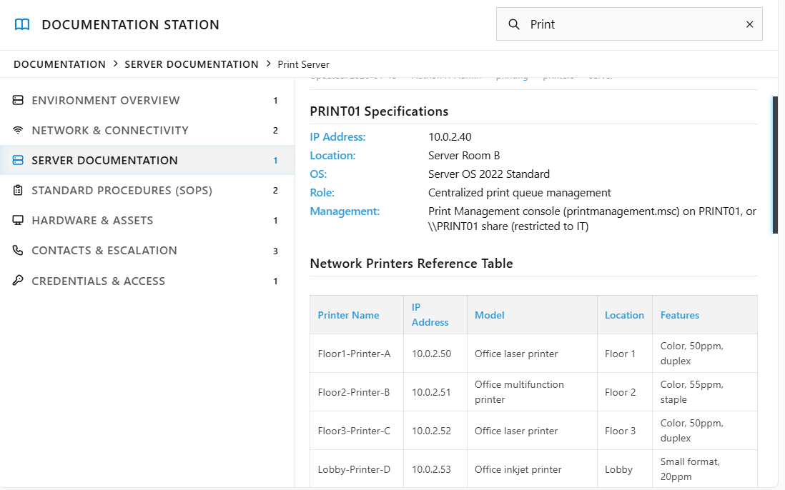
Documented IP restored network printing
ISSUE
A remote engineering user could not print because the network printer was configured with the wrong IP address.
ACTIONS
• Checked the knowledge base for Floor3-Printer-C.
• Confirmed the correct address: 10.0.2.52.
• Replaced the incorrect configuration and ran a test print.
OUTCOME
The test page printed successfully and access was restored.
KNOWLEDGE BASE | TCP/IP PRINTING | REMOTE SUPPORT | TESTING
JERRELL HAWKINS | IT SUPPORT PORTFOLIO
04

Slide 5
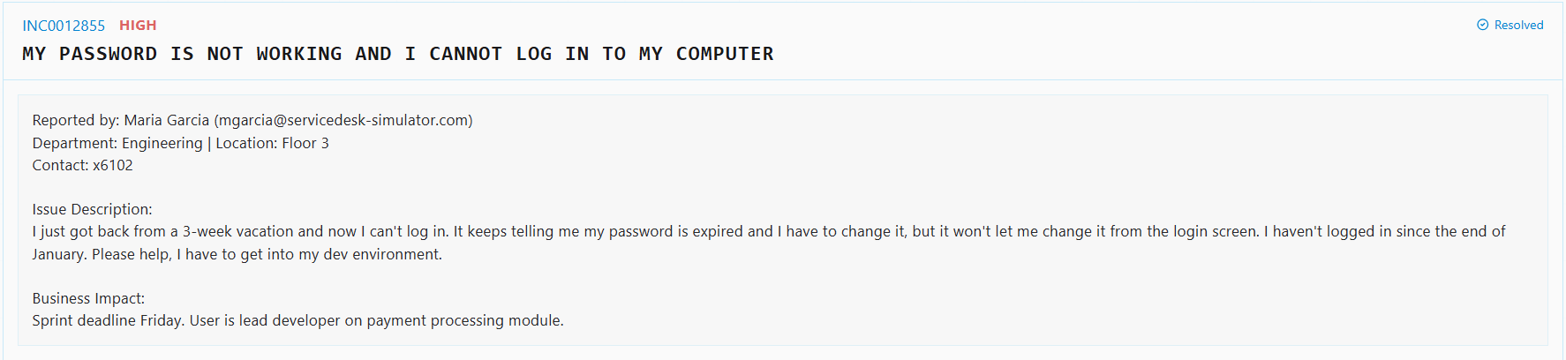
Secure reset restored access at first login
ISSUE
An expired password prevented a lead developer from signing in to a time-sensitive development environment.
ACTIONS
• Located the account in directory tools and sent a one-time verification code.
• Reset the expired password after identity verification.
• Shared the temporary credential through Team Chat and required a change at first login.
SECURE WORKFLOW
Verify identity
Reset temporary credential
Require change at first login
OUTCOME
The user regained access through a verified and secure handoff.
IDENTITY VERIFICATION | DIRECTORY TOOLS | PASSWORD RESET | SECURE HANDOFF
JERRELL HAWKINS | IT SUPPORT PORTFOLIO
05

Slide 6
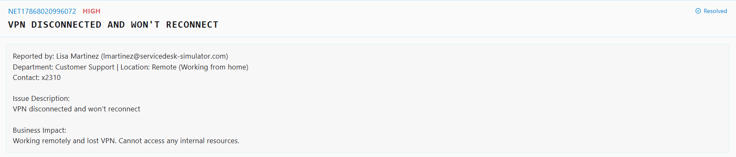
DNS flush and reboot restored the VPN tunnel
ISSUE
A remote employee lost VPN access and could no longer reach internal resources.
ACTIONS
• Connected through remote support and opened Terminal.
• Ran ipconfig /flushdns, restarted the workstation, and re-established the authenticated session.
• Reconnected the VPN client and verified the tunnel returned online.
KEY COMMAND
OUTCOME
ipconfig /flushdns
Reboot | reconnect | verify
Secure access to internal resources was restored.
DNS CACHE | TERMINAL | VPN TROUBLESHOOTING | POST-REBOOT VALIDATION
JERRELL HAWKINS | IT SUPPORT PORTFOLIO
06

Slide 7
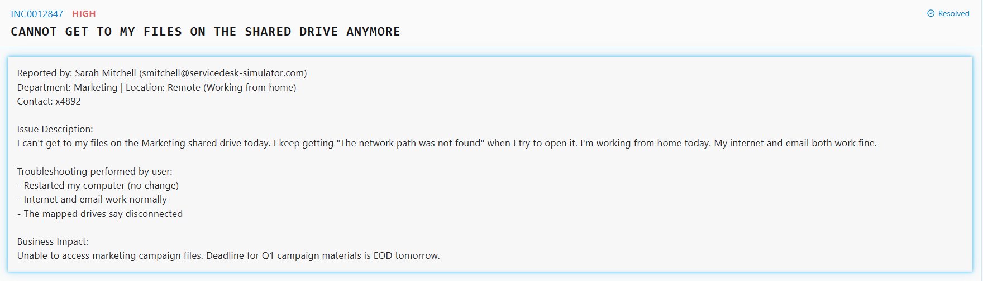
VPN and UNC mapping restored shared-drive access
ISSUE
A remote Marketing user received 'network path not found' while email and internet access continued to work.
ACTIONS
• Reconnected the VPN client to restore the internal network path.
• Used file-server documentation to locate the approved Marketing UNC path.
• Mapped the share as drive D: and confirmed the files opened.
RESTORED PATH
VPN connected
Marketing UNC path mapped to D:
Files opened successfully
OUTCOME
The Marketing shared drive was available before the campaign deadline.
VPN | UNC PATHS | FILE-SERVER DOCUMENTATION | DRIVE MAPPING
JERRELL HAWKINS | IT SUPPORT PORTFOLIO
07

