Slide 1
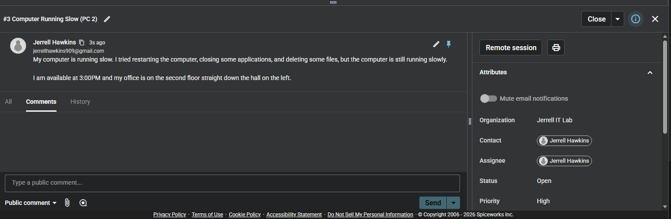
IT PORTFOLIO PROJECT
Spiceworks Help Desk
Ticketing Lab
Simulated Service-Desk Workflow
Jerrell Hawkins
Lab objective
Ticket intake | Troubleshooting | User communication | Resolution | Escalation
Practice the complete support lifecycle: capture the problem, document work, communicate clearly, resolve when possible, and escalate with useful evidence.

Slide 2
PROJECT OVERVIEW
The Lab Simulated the Work Behind a Tier 1 Ticket Queue
Environment
Scenarios
Spiceworks Cloud Help Desk configured as Jerrell IT Lab with simulated requester, technician, and assignee roles.
Slow workstation, failed printer output, and loss of access to a department shared drive.
Workflow
Support judgment
Created and categorized tickets, recorded user details, added public updates and internal notes, and documented outcomes.
Resolved a known printer condition and recognized when a shared-drive issue required escalation beyond basic troubleshooting.
02

Slide 3
TICKET INTAKE AND TRIAGE
I Captured the Issue and the User's First Actions
What good intake provides
- A searchable, specific summary.
- The user's symptoms and attempted fixes.
- Contact and scheduling details.
- Ownership, category, status, and priority fields.
- Enough context to begin troubleshooting without repeating questions.
Ticket #3: Computer Running Slow
The request records the symptom, steps already attempted, user availability, and physical location. The ticket is assigned, categorized as Hardware, and left Open for investigation.
Triage standard
Priority should reflect business impact and urgency. A single slow PC is not automatically high priority.
03

Slide 4
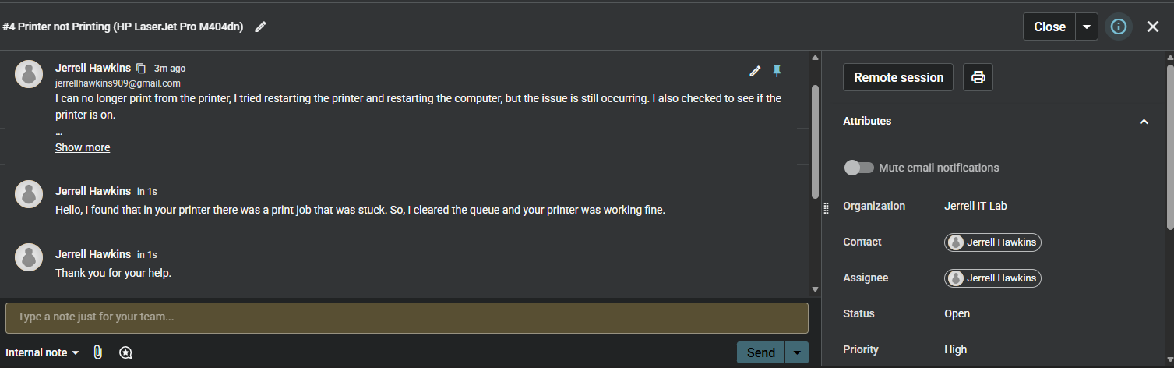
CUSTOMER COMMUNICATION AND RESOLUTION
I Documented the Printer Resolution
Support behaviors shown
- Replied in the ticket instead of using an undocumented side channel.
- Explained the root cause without unnecessary info.
- Recorded the corrective action and restored service.
- Received user acknowledgment before final closure.
Public update
Evidence note
The response explains the cause in plain language: a stuck print job was cleared from the queue and printing resumed. The requester then acknowledged the help.
The screenshot still displays Status: Open. It proves the resolution was documented, but not that the status was changed to Closed.
04

Slide 5
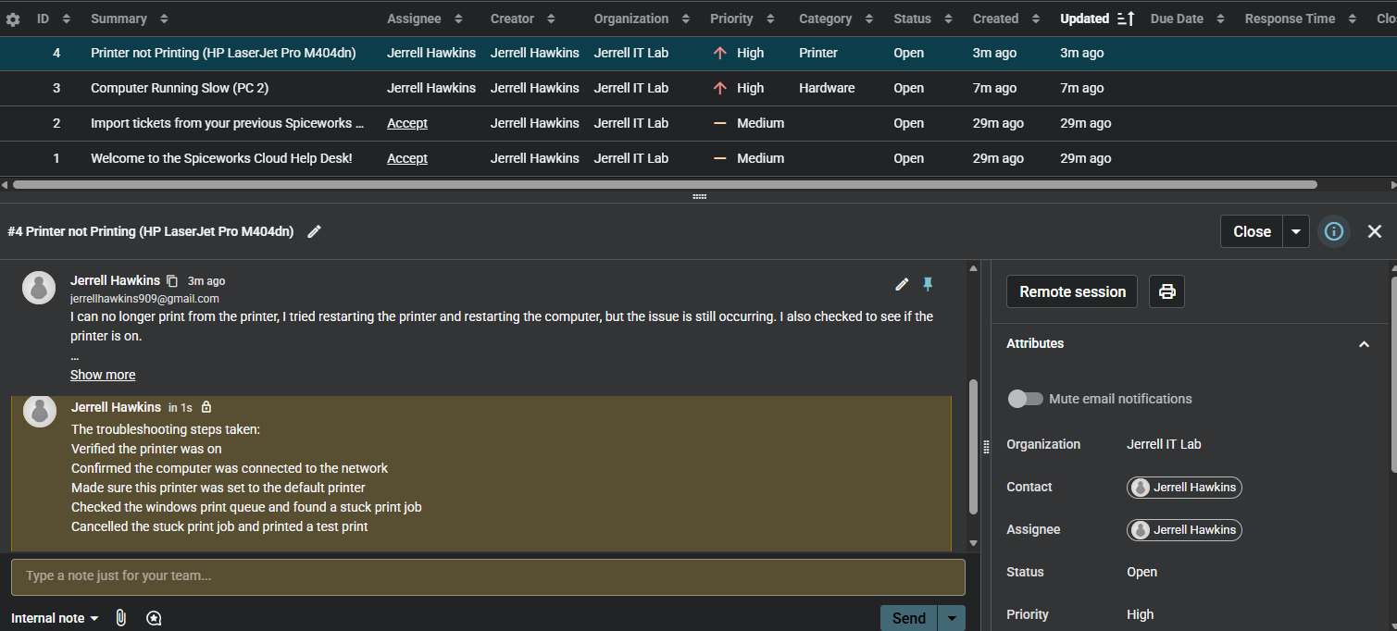
INTERNAL TROUBLESHOOTING DOCUMENTATION
I Separated Technical Notes From the Public Conversation
Internal note captured
- Verified the printer was powered on.
- Confirmed the workstation had network connectivity.
- Checked that the correct printer was set as default.
- Inspected the Windows print queue and found a stuck job.
- Canceled the job and completed a test print.
Why internal notes matter
Result: A repeatable record of what was checked, what was found, and what fixed the incident.
It makes it easier for another technician without exposing unnecessary technical detail to the requester.
05

Slide 6
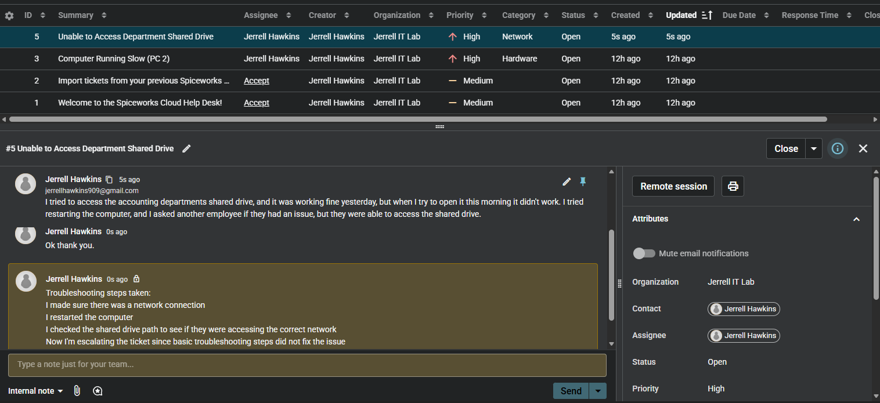
ESCALATION AND HANDOFF
I Documented the Limits of Tier 1 Troubleshooting
Ticket #5: Department Shared Drive
- Confirmed the workstation had network connectivity.
- Restarted the computer.
- Verified the shared-drive path and target network.
- Compared impact with another employee who could still connect.
- Recorded that basic troubleshooting did not resolve the issue.
Escalation decision
Evidence boundary: The internal note says the ticket will be escalated, but the screenshot does not show reassignment to another technician or support group.
The evidence supports preparing a higher-tier handoff because the issue persisted and appeared isolated to one user's access or permissions.
06

Slide 7
WORKFLOW SUMMARY
A Consistent Lifecycle Guided Every Ticket
01
02
03
04
Intake
Triage
Work
Finish
Capture symptoms, impact, requester details, and prior attempts.
Set category, owner, status, and priority from impact and urgency.
Troubleshoot methodically and document technical findings internally.
Resolve and confirm with the user, or escalate with a complete handoff.
Core principle
A useful ticket tells the next technician what happened without requiring the user to start over.
07

Slide 8
PROFESSIONAL TICKETING STANDARDS
Future Project Improvement's
Impact-based priority
Clear role separation
Use urgency and business impact instead of assigning every incident High priority.
Use distinct requester and technician test accounts so the conversation mirrors a real service desk.
Complete closure proof
Visible escalation handoff
Capture the final Closed or Resolved status after confirming service with the requester.
Show the new assignee or support group, reason for escalation, completed checks, and expected next action.
08

Slide 9
SKILLS DEVELOPED
What I Learned from the Lab
Ticket quality
Customer communication
How a precise summary, structured fields, and complete description improve ownership and response time.
How to acknowledge symptoms, explain a fix plainly, and keep the requester informed through the ticket.
Technical documentation
Escalation judgment
How internal notes create a reusable troubleshooting history and support a smooth technician handoff.
How to recognize the limits of Tier 1 support and escalate only after recording completed checks and results.
09

Slide 10
End
Summary
Spiceworks Help Desk Ticketing Lab | Simulated Environment
- Created and managed simulated support tickets in Spiceworks Cloud Help Desk for workstation performance, printer, and shared-drive access incidents.
- Documented requester symptoms, prior actions, troubleshooting steps, technical findings, public updates, and internal technician notes throughout the ticket lifecycle.
- Resolved a printer issue by identifying and clearing a stuck print job, then prepared a shared-drive incident for escalation after basic troubleshooting did not restore access.
Skills: Spiceworks Cloud Help Desk, ticket intake, incident documentation, troubleshooting, customer communication, ticket resolution, escalation
10

