Slide 1
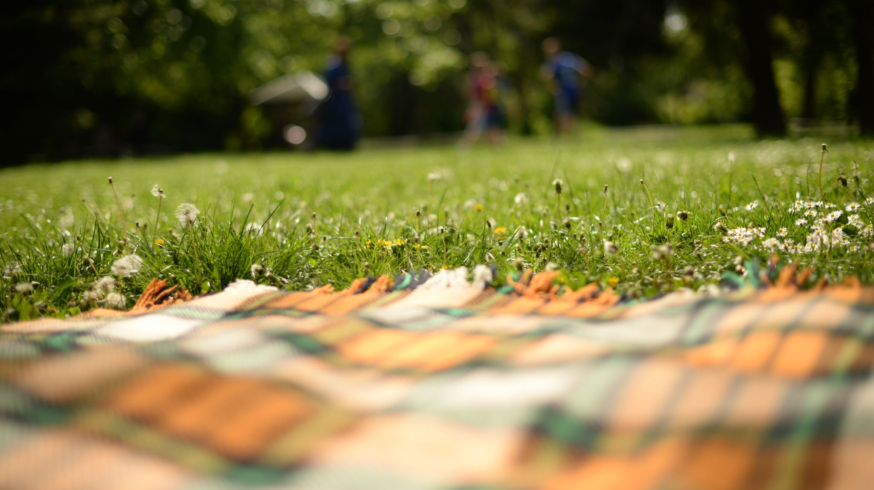
Camp Adventures
Jerren Myers
1510:web development
Final project B

Slide 2
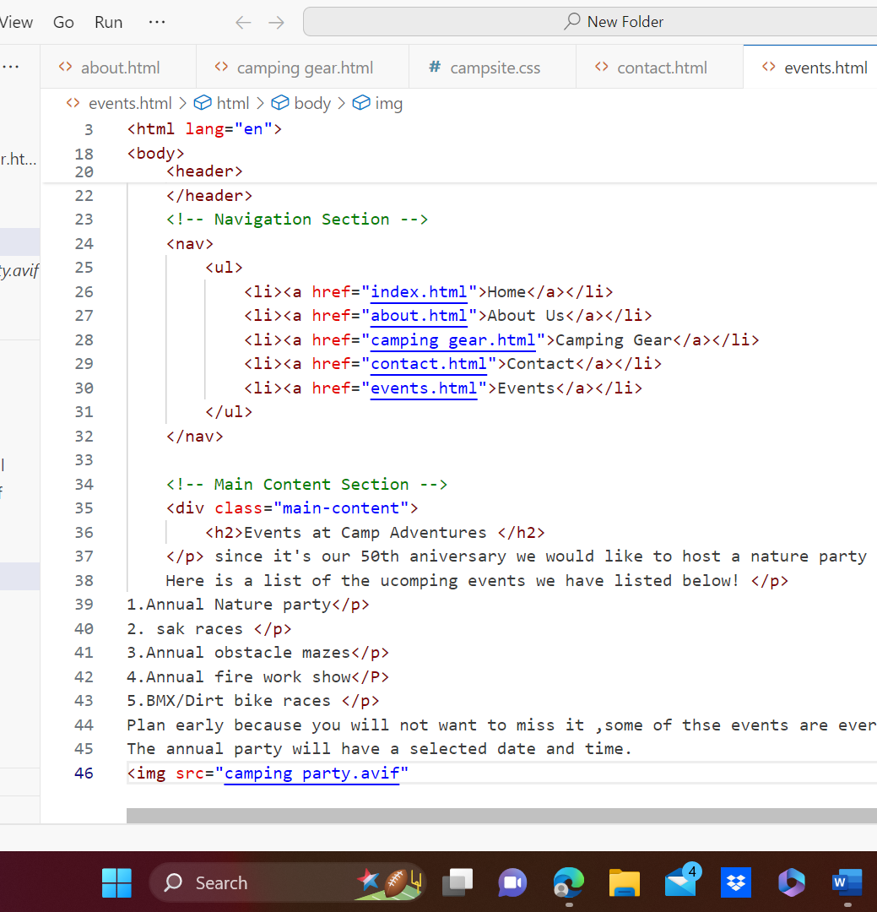
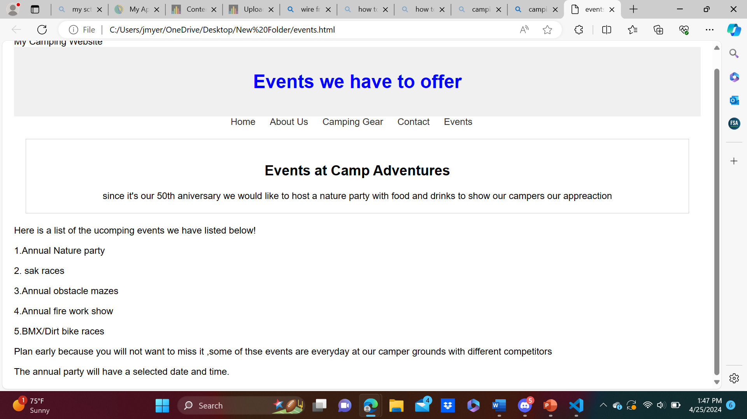
Index. Html
The way I want to plan to design my home page was with,a unique style that stands outs with pictures.
To make these proper designs I will have to usen visual studio code
My home page will have a simple intriguing catchphrase that makes you want to take a look at our website

Slide 3
About.html
The about page just gives our campers a brief detailed description about our camping grounds .
The about us page also consist of giving our campers history about our camp grounds
It also has a list of ammenties we have here, with pictures detailed

Slide 4
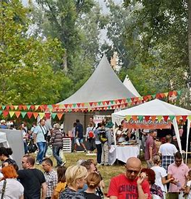
Events.html
The events page has a list of daily and annual events we have going on at Camp adventures
Our mission is to make sure campers have a blast on our grounds so we provide our campers with fun and friendly events to enjoy your time
I will design this page in studio visual code I will have to first create a new text file and save it as Events.html and from there I will type in the code and go from there.

Slide 5
Contacts. Html
The contact page will consits of a list of contacts for our camp grounds
It also will have the hours listed
I will have to create a new text file save as contact.html and type int the correct code I want for my page layout

Slide 6
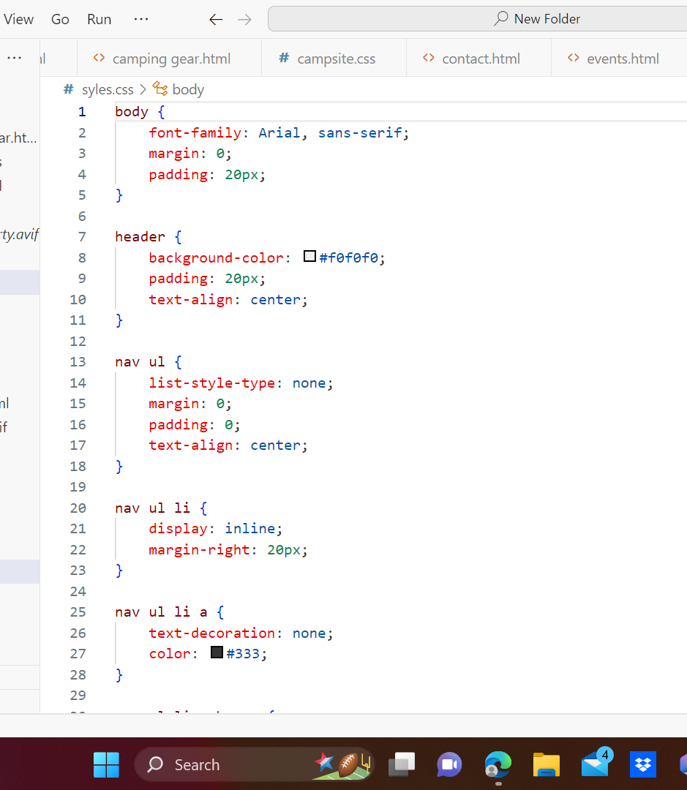
Styles.css
The styles.css page is basically where I will add all my designs and color, the size and padding and also the website lay out here is an example of the styles.css page

Slide 7
