Slide 1

Optimization of quadcopter frame using generative design and comparison with DJI F450 drone frame
Authors :
Suryaprakash R¹
Jerrin Bright¹
Akash S¹
Dr A. Giridharan¹
¹School of Mechanical Engineering, Vellore Institute of Technology Chennai, Tamilnadu, India

Slide 2
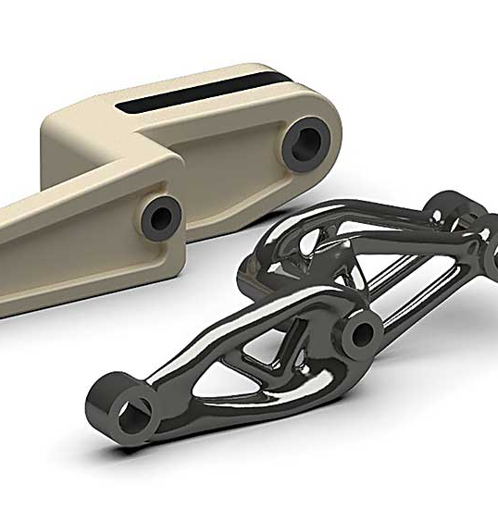
What is Generative design?
Iterative Design exploration process
Uses AI to generate multiple Design in a single computation
GAN is used to generate surfaces between constraints
Mainly used for mass reduction and structural optimization

Slide 3
Steps involved in Generative Design
Define
Generate
Explore
Define preserved Boundaries
Define Fixed Geometry
Define material
Define obstacle boundary
Define AM technique
Generate All possible outcomes
Remove all Under defined outcomes
Define the loading conditions
Check for the best possible design with optimized properties
Smoothen the surface using form tools

Slide 4
Loading conditions
Component | Number of individual components | Weight of individual component (g) | Net Weight of individual component (g)
RS2205S Motor | 4 | 28.8 | 115.2
Pixhawk FC | 1 | 73 | 73
M8N GPS | 1 | 32 | 32
5'' Propeller | 4 | 4 | 16
BL Heli ESC | 4 | 14 | 56
PC Hub PDB | 1 | 8.5 | 8.5
Camera | 1 | 12 | 12
Telemetry | 1 | 15 | 15
IA6B Receiver | 1 | 14.6 | 14.6
LIPO Battery | 1 | 200 | 200
TOTAL | 19 |  | 542.3
Approx. weight of Frame 250g
By 15% buffer we get a total mass of 1000g
M=1000g=1Kg
F=M*g=10N
So for hovering condition we need a minimum of 10N thrust from 4 Motors

Slide 5
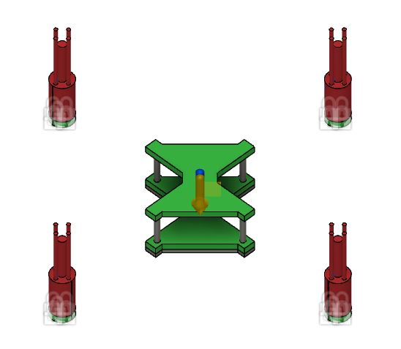
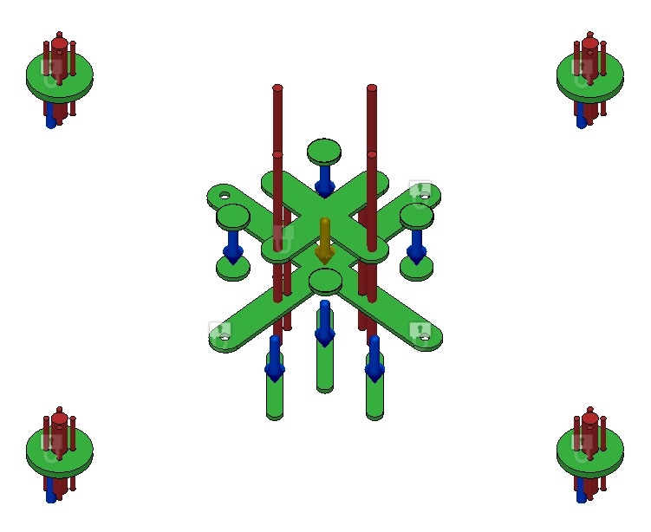
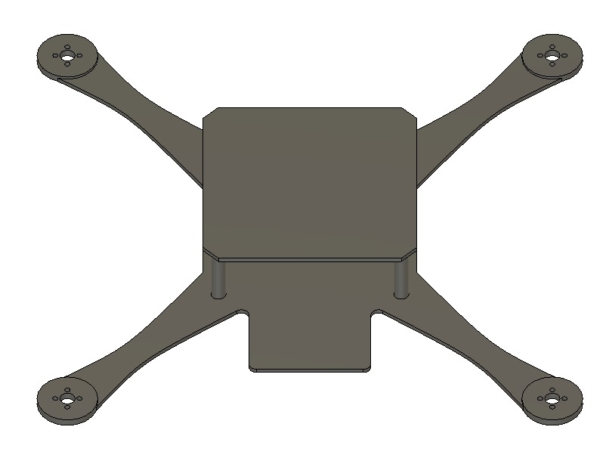
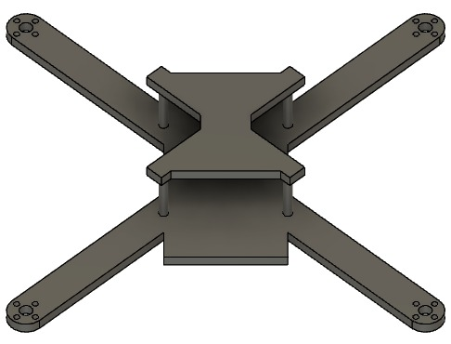
Defining a Generative design model
DRONE SPECS:
350 mm Size
True X
Centre of mass maintained at the exact center
Symmetric in nature
MODEL-1
MODEL-2
RED COLOUR OBSTACLE BOUNDARY
GREEN COLOUR PRESERVED BOUNDARY

Slide 6
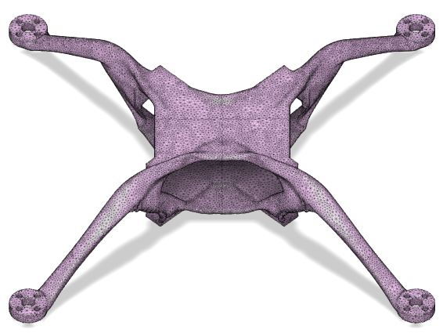
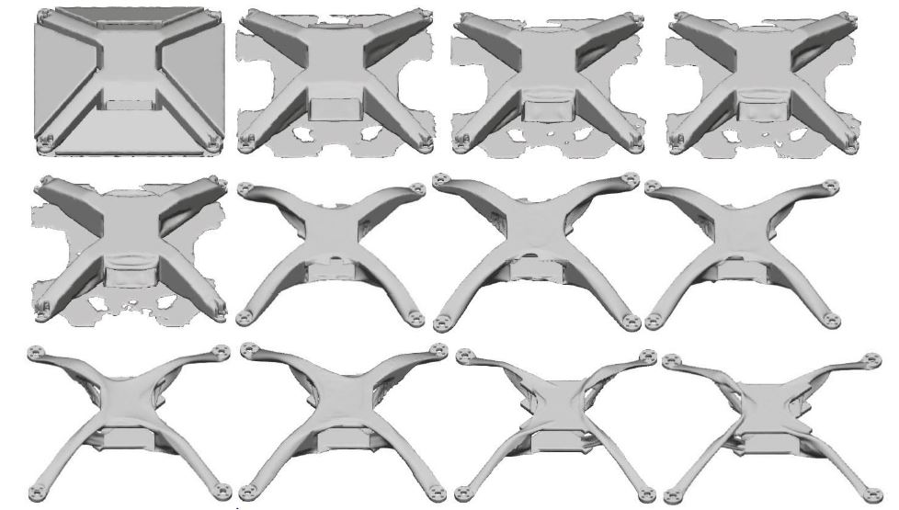
ITERATIONS
GAN creates surfaces and overhangs
The iterative mechanism removes mass from the surfaces while optimizing mechanical properties
Final model is converged when no mass can be removed while having maximum mechanical strength

Slide 7
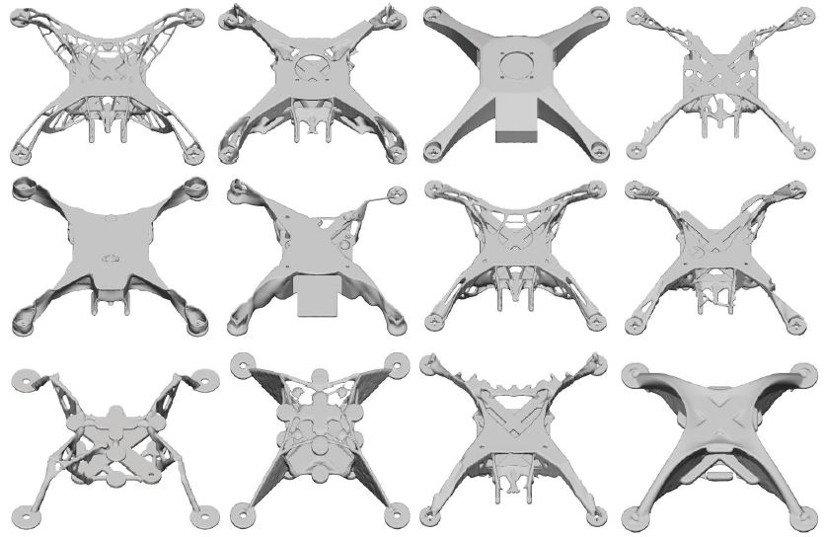
OUTCOMES
Total of 74 designs were generated throughout the experiment
Fusion 360 autonomously classifies the models based upon mass ,FOS, Von Misses Stress Etc.
Best model is chosen based upon the mechanical properties

Slide 8
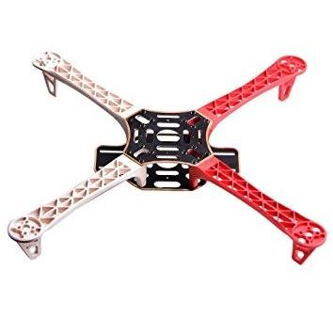
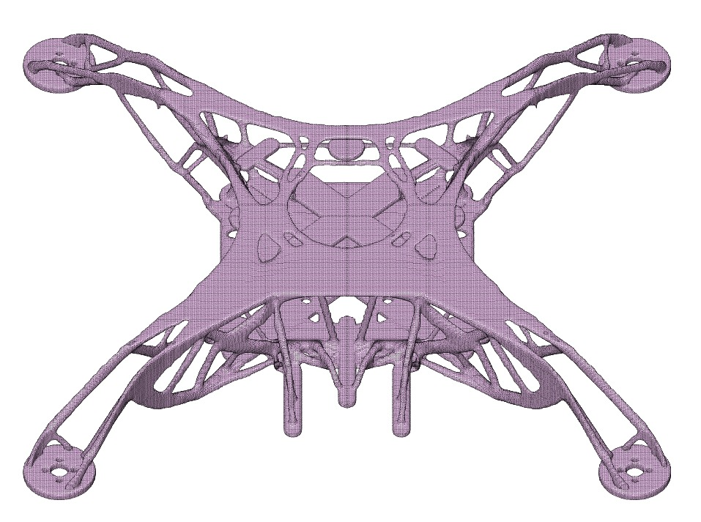
RESULTS
Model 1
Model 2
DJI F450 FRAME​
Mechanical properties of generatively designed frame in comparison with DJI F450 Drone frame
ABS plastic is used for Additive manufactured Drone frame
FACTORS | MODEL 1 | MODEL 2 | DJI F450
Mass of the frame(g) | 267 | 227 | 330
Minimum FOS | 133 | 13.3 | 3.301
Manufacturing Method | Additive Manufacturing | Additive Manufacturing | Advanced Manufacturing
Maximum Von Mises stress(MPa) | 17.11 | 1.5 | 21.33
Maximum Displacement Global(mm) | 0.01 | 6.22 | 4.016
Material used | ABS | ABS | Polyamide Nylon

Slide 9
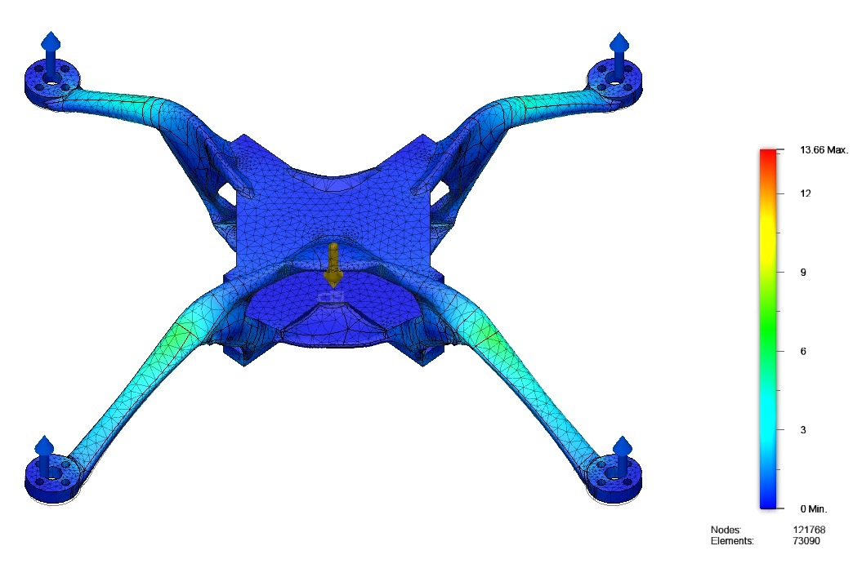
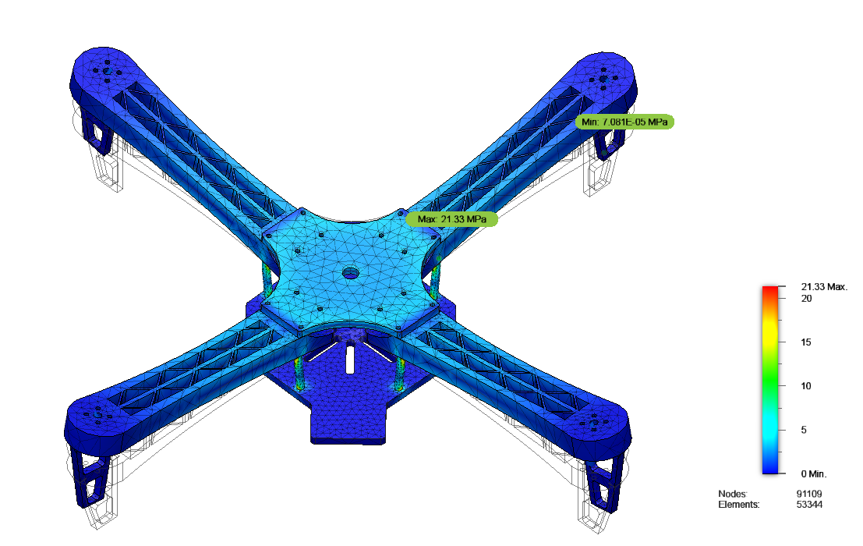
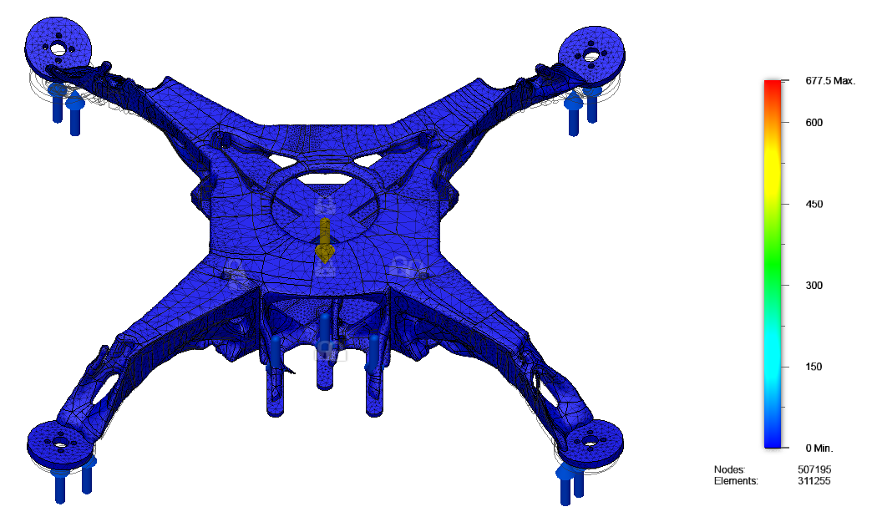
STRESS ANALYSIS

Slide 10
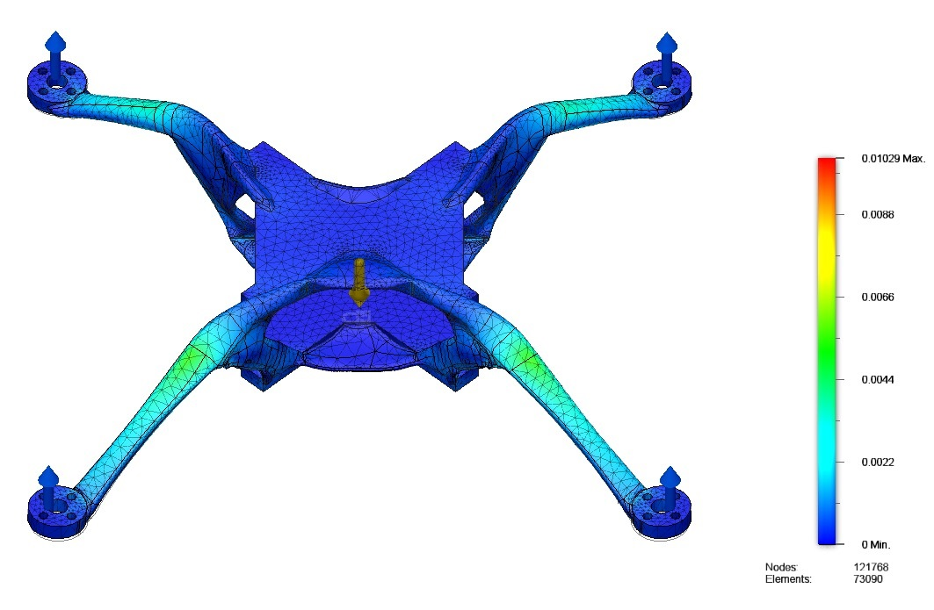
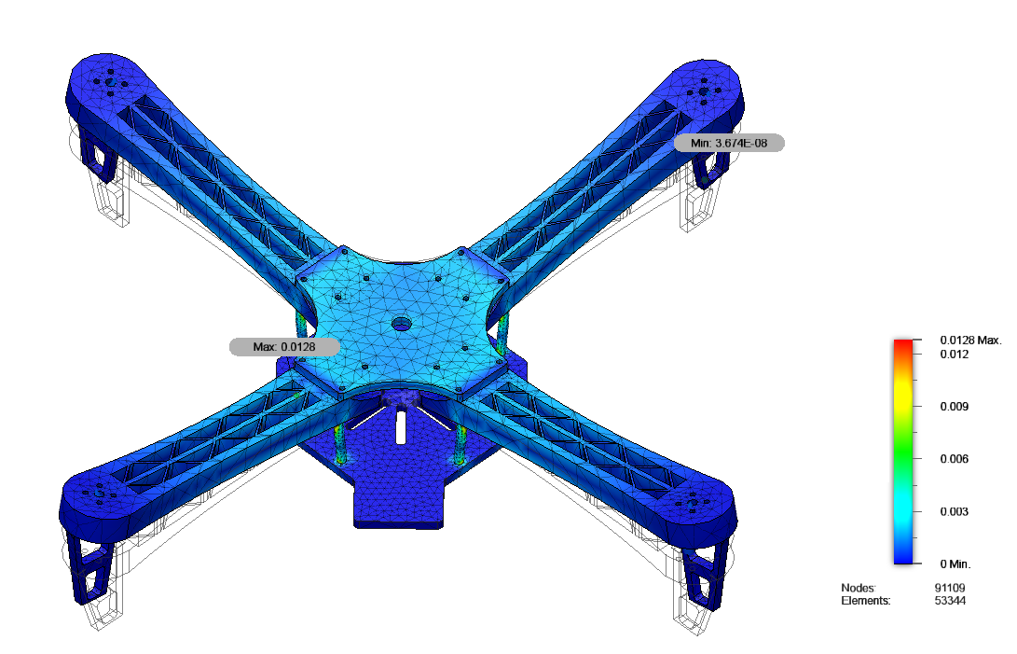
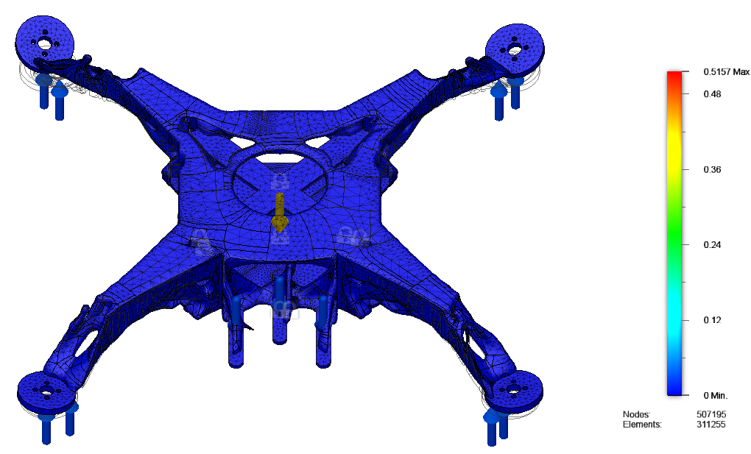
STRAIN ANALYSIS

Slide 11
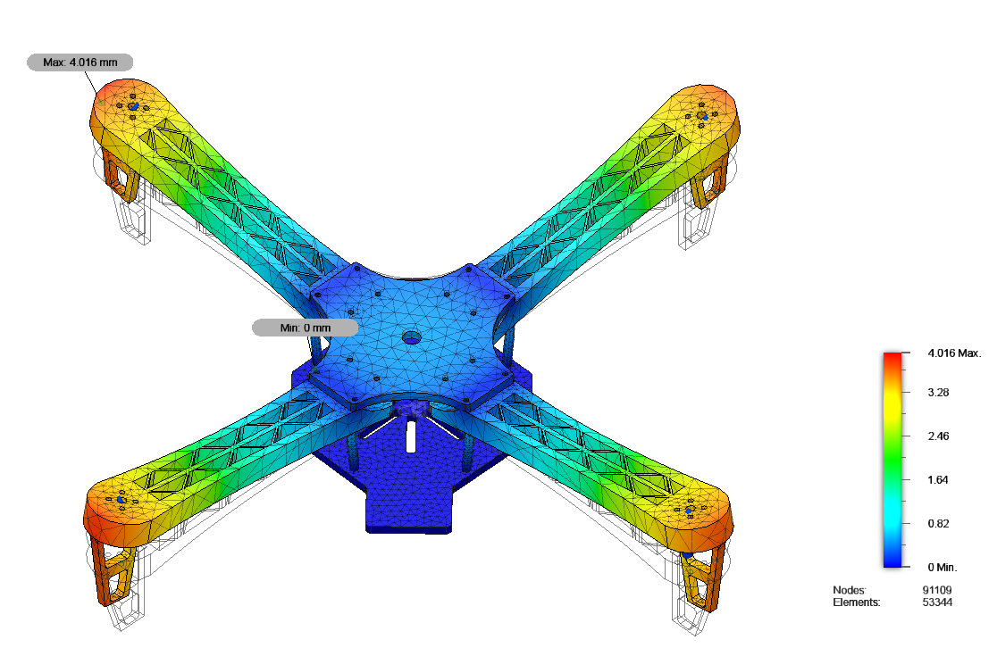
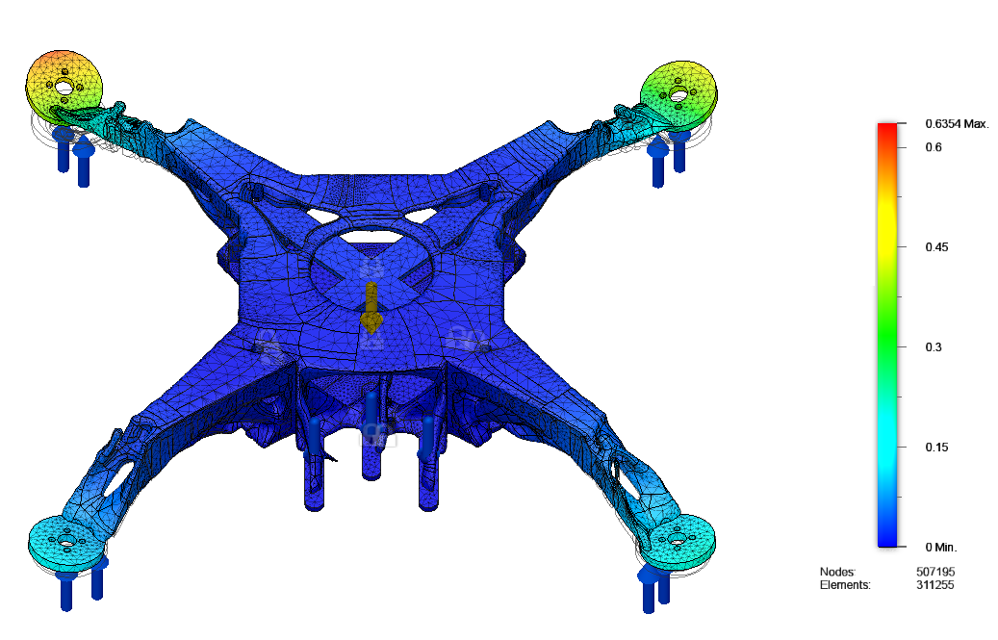
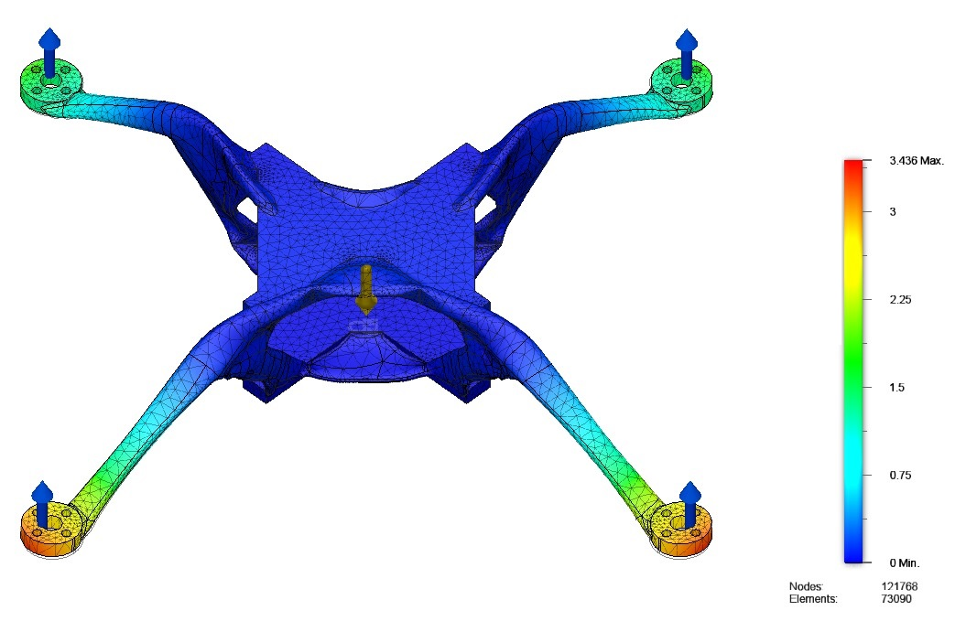
DISPLACEMENT ANALYSIS

Slide 12
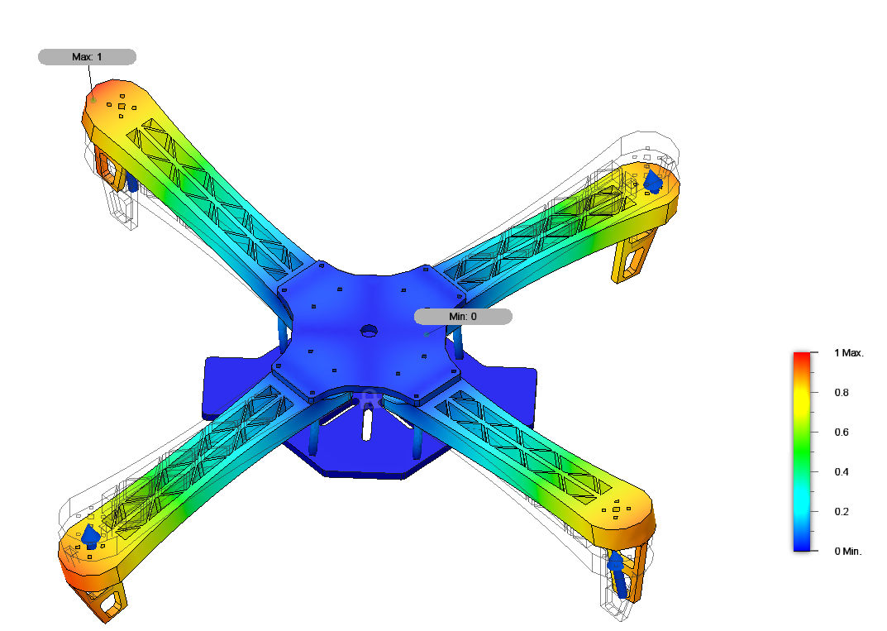
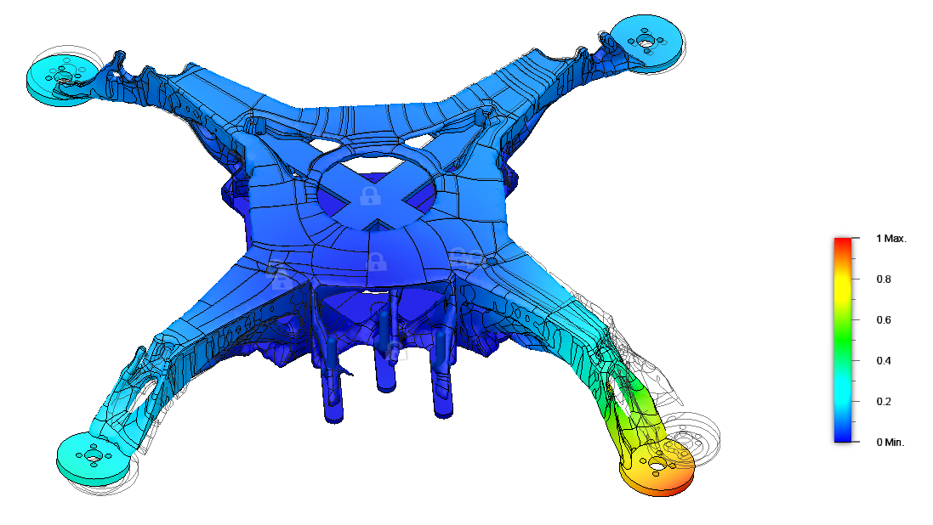
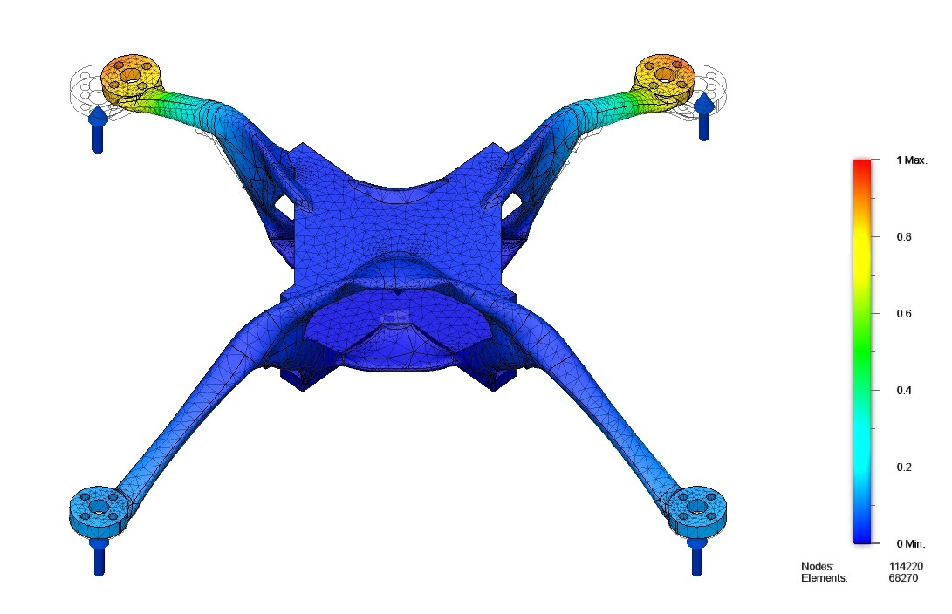
FREQUENCY ANALYSIS AT 300 Hz

Slide 13
Conclusion
All the designs generated are within the saftey limit
Mass is comparitively less for generatively designed frames when compared to Traditionaly designed drone frame
Factor of saftey of model 1 is almost 40 times of DJI F450 Drone frame
Maximum displacement of model 2 is just about 0.1 mm under the loading conditions which is 400 times when comparedto DJI Drone frame
Von misses stress is 11.4 times less for the model 2 frame in comparison to DJI F450 Frame
Model 1 and 2 can withstand cyclic load and can survive from failure for a longer period of time

Slide 14
Refrences
.Buelow PV. (2002) Using evolutionary algorithms to aid designers of architectural structures. p. 315–36.
McKnight, M. (2017) Generative Design: What it is? How is it being used? Why it’s a game changer. KNE Eng., 2, 176–181.
Wu, Jun & Qian, Xiaoping & Wang, Michael. (2019). Advances in generative design. Computer-Aided Design. 116. 102733. 10.1016/j.cad.2019.102733.
Ahmed, Md & Zafar, Mohd & Mohanta, Jagadish. (2020). Modeling and Analysis of Quadcopter F450 Frame. 196-201. 10.1109/IC3A48958.2020.233296.
Sun, H.; Ma, L. (2020) Generative Design by Using Exploration Approaches of Reinforcement Learning in Density-Based Structural Topology Optimization. Designs 2020, 4, 10.
Janssen P. A generative evolutionary design method Digital Creativity 2006; 17(1):49–63.
Sosnovik, I.; Oseledets, I (2019) Neural networks for topology optimization. Russ. J. Numer. Anal. Math. 34, 215–223.

Slide 15
Thank you

