Slide 1

Optimization of Quadcopter Frame using Generative Design and Comparison with DJI F450 Drone Frame
Authors :
Jerrin Bright¹
Suryaprakash R¹
Akash S¹
Dr A. Giridharan¹
¹School of Mechanical Engineering, Vellore Institute of Technology Chennai, Tamil Nadu, India.

Slide 2
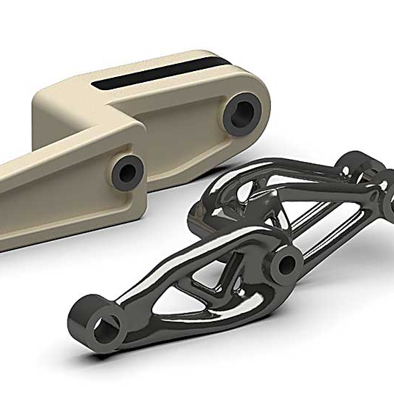
What is Generative Designing?
Iterative Design exploration process
Uses AI to generate multiple Design in a single computation
GAN is used to generate surfaces between constraints
Mainly used for mass reduction and structural optimization

Slide 3
Steps involved in Generative Design
Define
Generate
Explore
Define preserved boundaries
Define fixed Geometry
Define material
Define obstacle boundaries
Define AM technique
Generate all possible outcomes
Remove all under defined outcomes
Define the loading conditions
Check for the best possible design with optimized properties
Smoothen the surface using form tools

Slide 4
Loading conditions
Component | Number of individual components | Weight of individual component (g) | Net Weight of individual component (g)
RS2205S Motor | 4 | 28.8 | 115.2
Pixhawk FC | 1 | 73 | 73
M8N GPS | 1 | 32 | 32
5'' Propeller | 4 | 4 | 16
BL Heli ESC | 4 | 14 | 56
PC Hub PDB | 1 | 8.5 | 8.5
Camera | 1 | 12 | 12
Telemetry | 1 | 15 | 15
IA6B Receiver | 1 | 14.6 | 14.6
LIPO Battery | 1 | 200 | 200
TOTAL | 19 |  | 542.3
Approx. weight of frame = 250g
15% buffer in tot. mass = 1000g
M = 1000g = 1Kg
F = M * g = 10N
So for hovering,
A minimum of 10N thrust from all 4 motors is required.

Slide 5
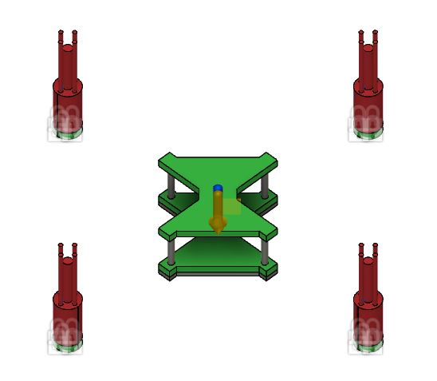
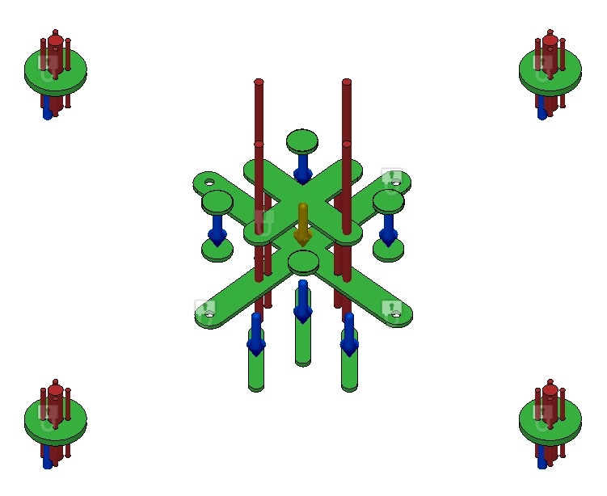
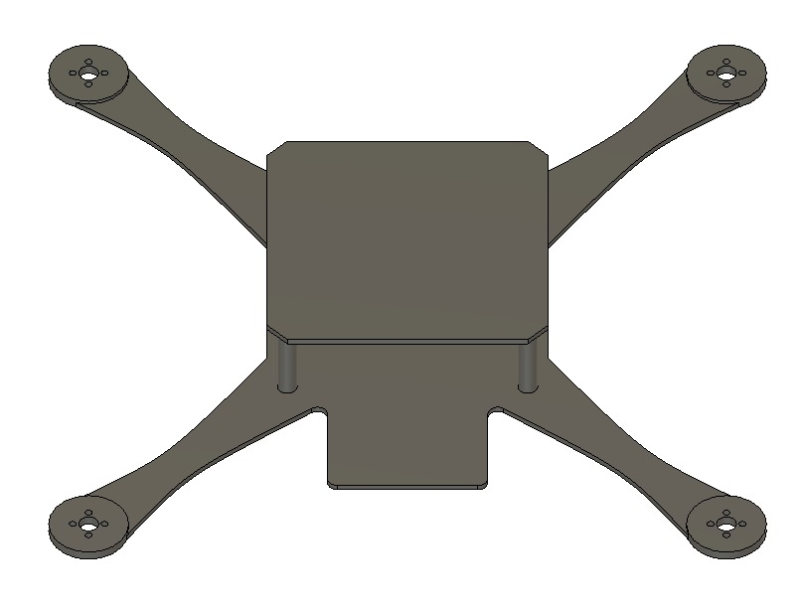
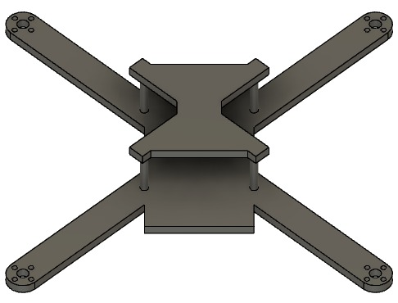
Defining of our Generative Design Models
QUAD SPECS:
450mm size.
True X shape.
Centre of mass. maintained at the center of Quad.
Symmetric in nature.
MODEL-1
MODEL-2
RED COLOUR OBSTACLE BOUNDARY
GREEN COLOUR PRESERVED BOUNDARY

Slide 6
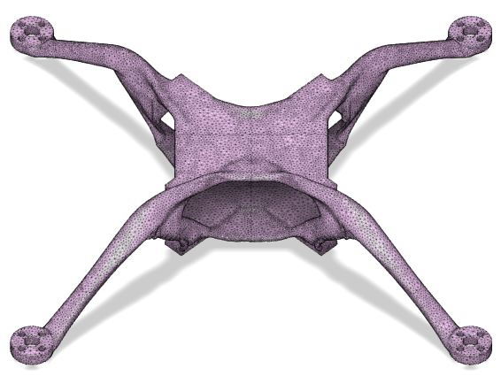
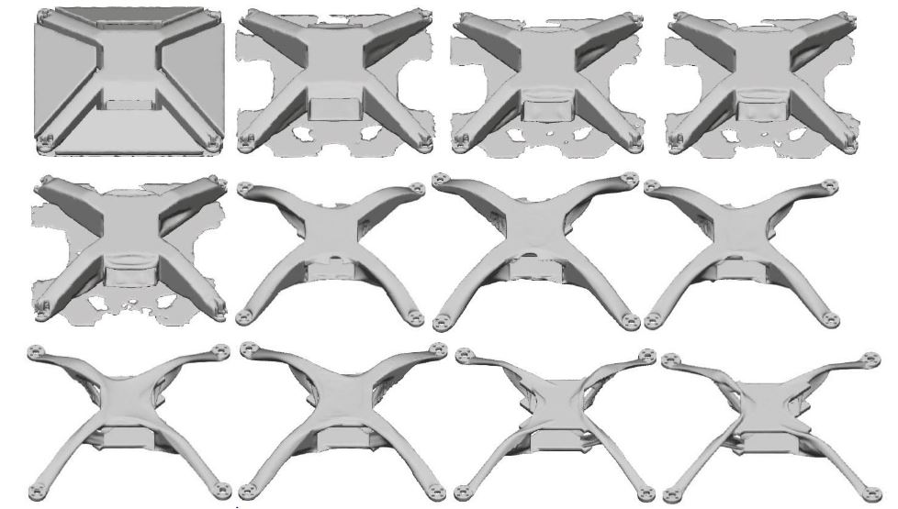
ITERATIONS
GAN creates surfaces and overhangs.
The iterative mechanism removes mass from the surfaces while optimizing mechanical properties.
Final model is converged, that is, no mass can be removed while having maximum mechanical strength at that particular iteration.

Slide 7
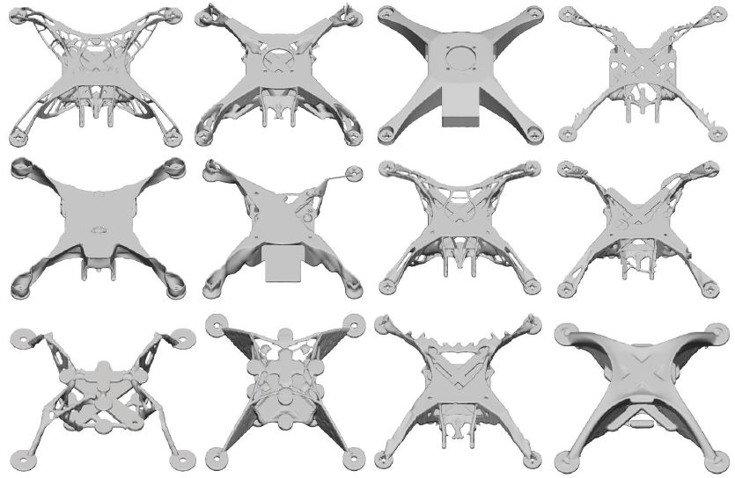
OUTCOMES
A total of 74 designs were generated throughout the experimentation.
Fusion 360 autonomously classifies the models based upon Mass, FOS, Von Misses Stress, etc.
The best model is chosen based upon its mechanical properties.

Slide 8
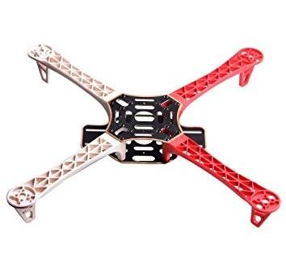
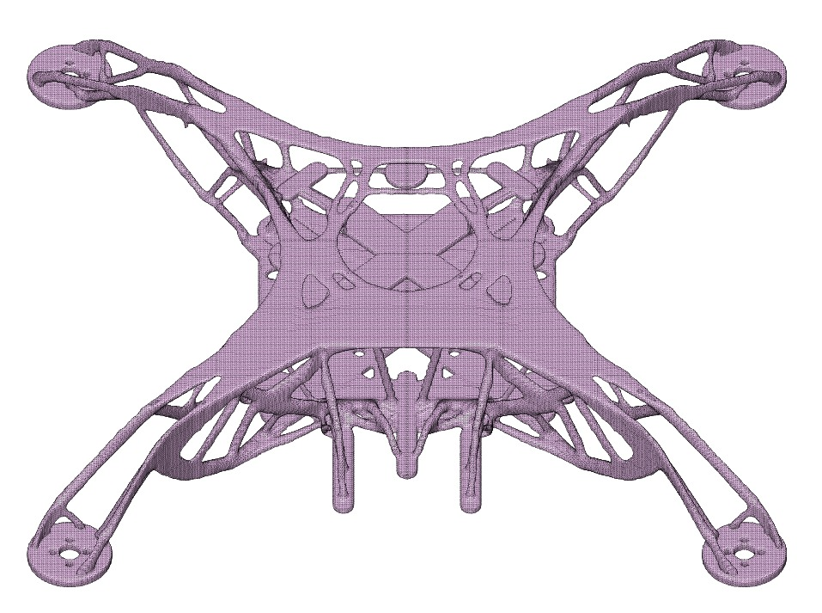
RESULTS
Model 1
Model 2
DJI F450 FRAME​
Mechanical properties of generatively designed frame in comparison with DJI F450 Drone frame
ABS plastic is used for Additive manufactured Drone frame
FACTORS | MODEL 1 | MODEL 2 | DJI F450
Mass of the frame(g) | 267 | 227 | 330
Minimum FOS | 133 | 13.3 | 3.301
Manufacturing Method | Additive Manufacturing | Additive Manufacturing | Advanced Manufacturing
Maximum Von Mises stress(MPa) | 17.11 | 1.5 | 21.33
Maximum Displacement Global(mm) | 0.01 | 6.22 | 4.016
Material used | ABS | ABS | Polyamide Nylon

Slide 9
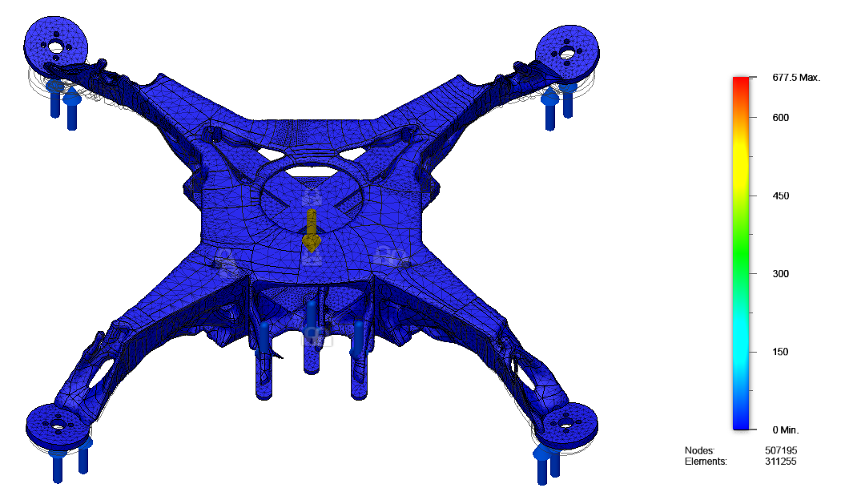
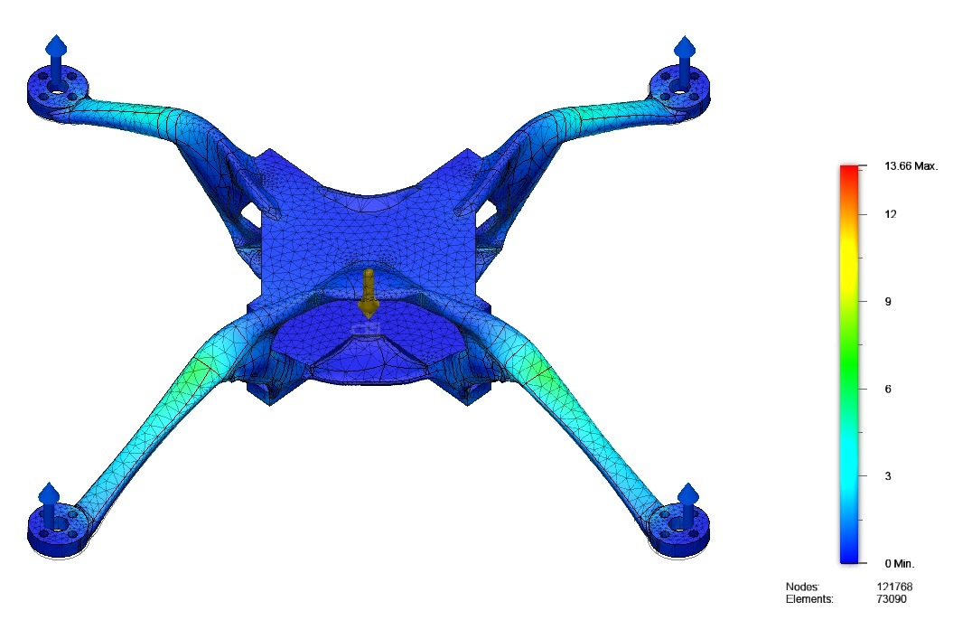
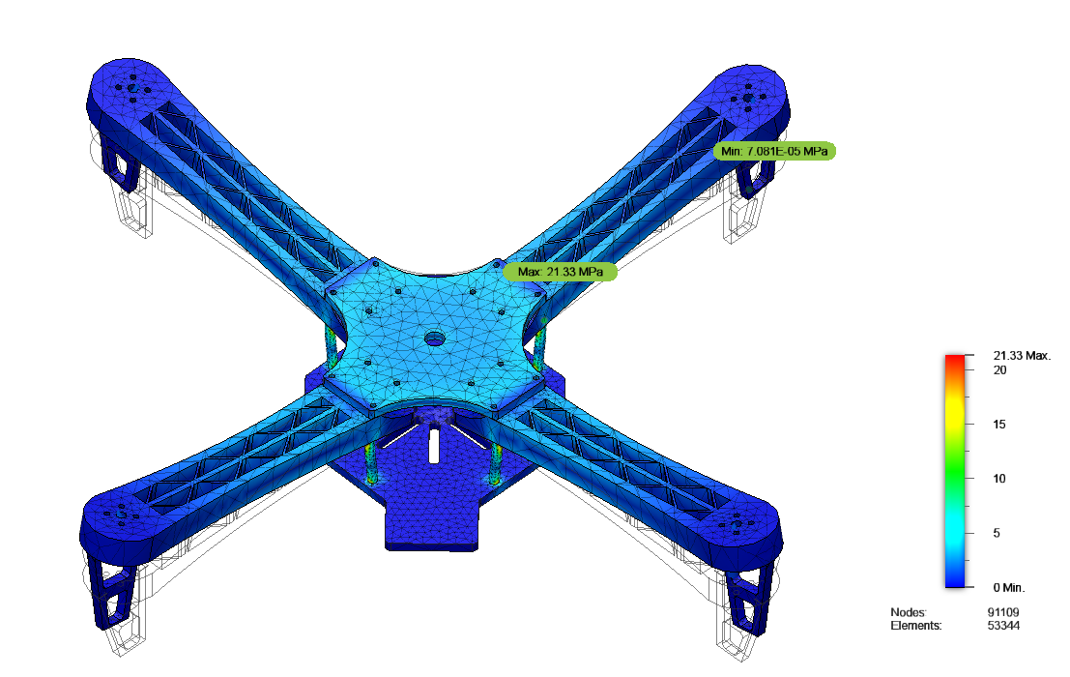
STRESS ANALYSIS

Slide 10
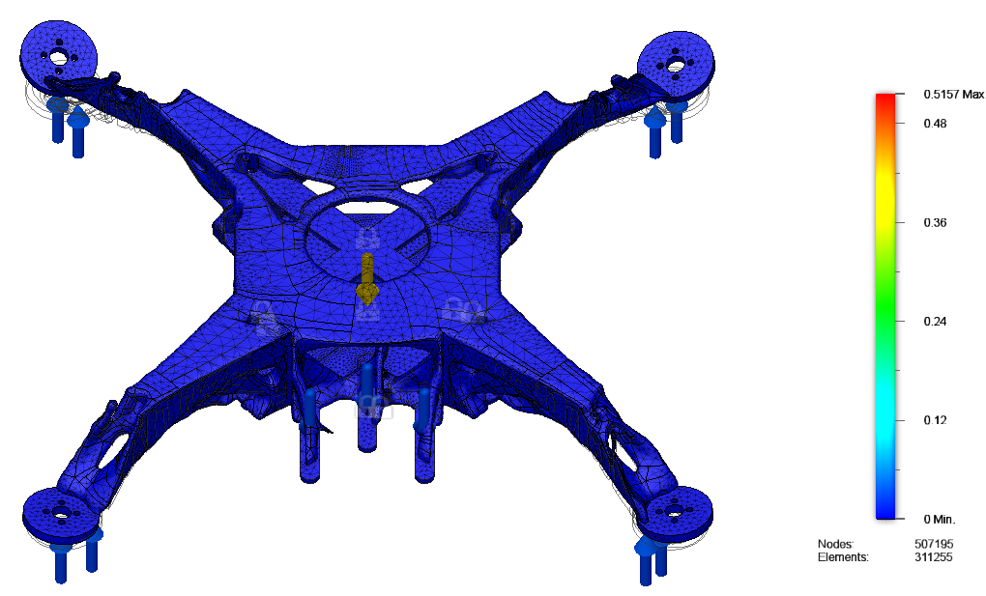
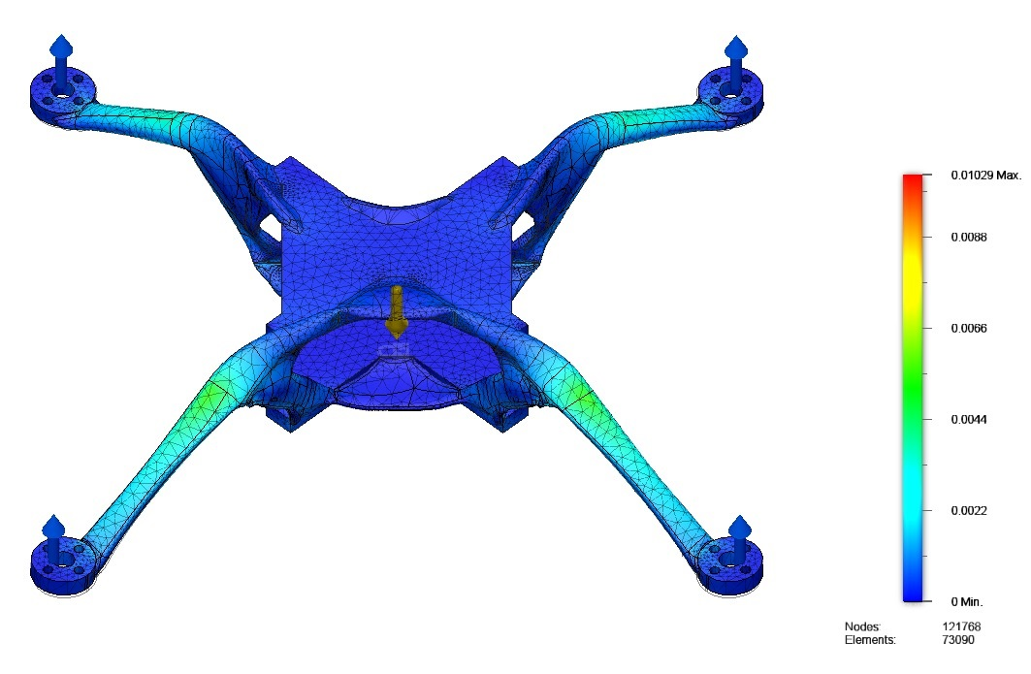
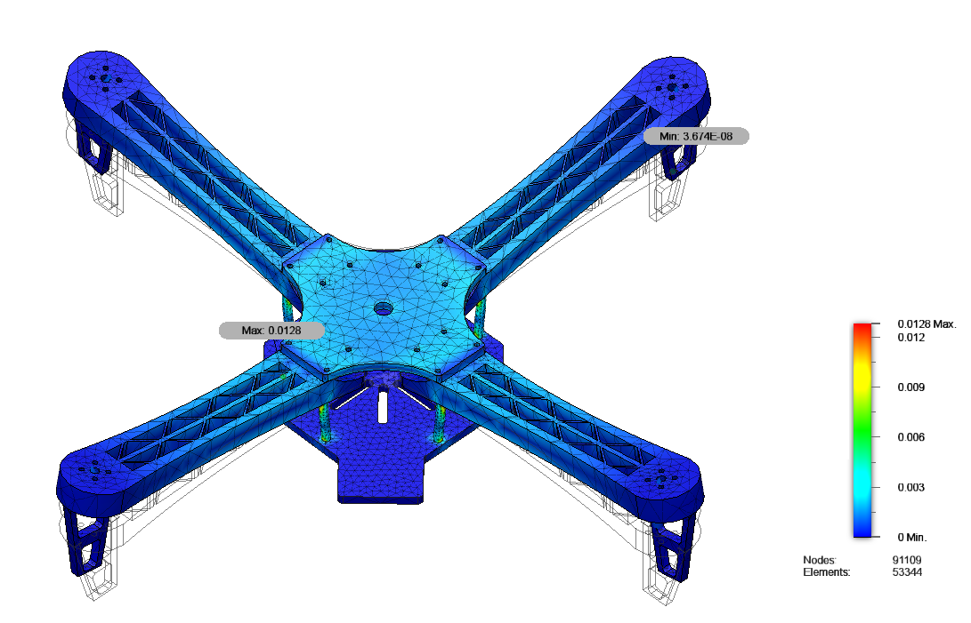
STRAIN ANALYSIS

Slide 11
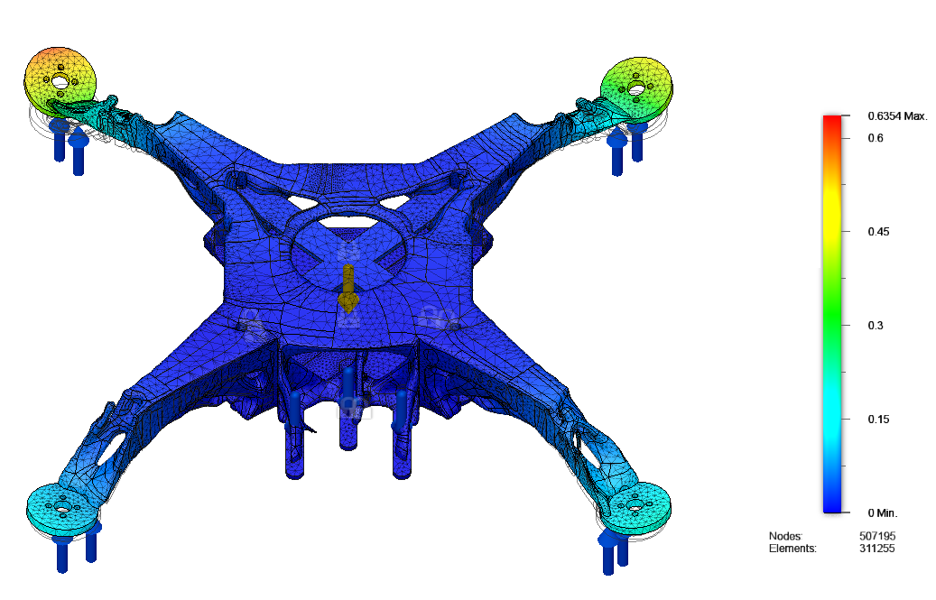
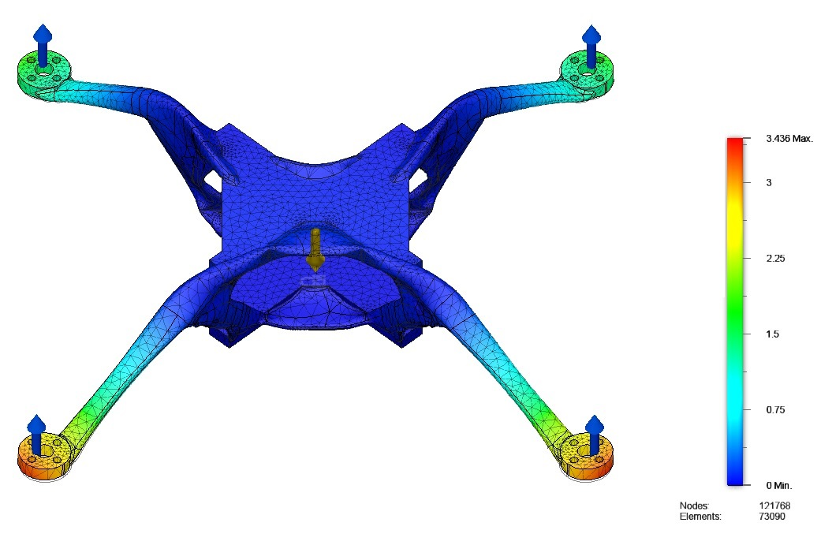
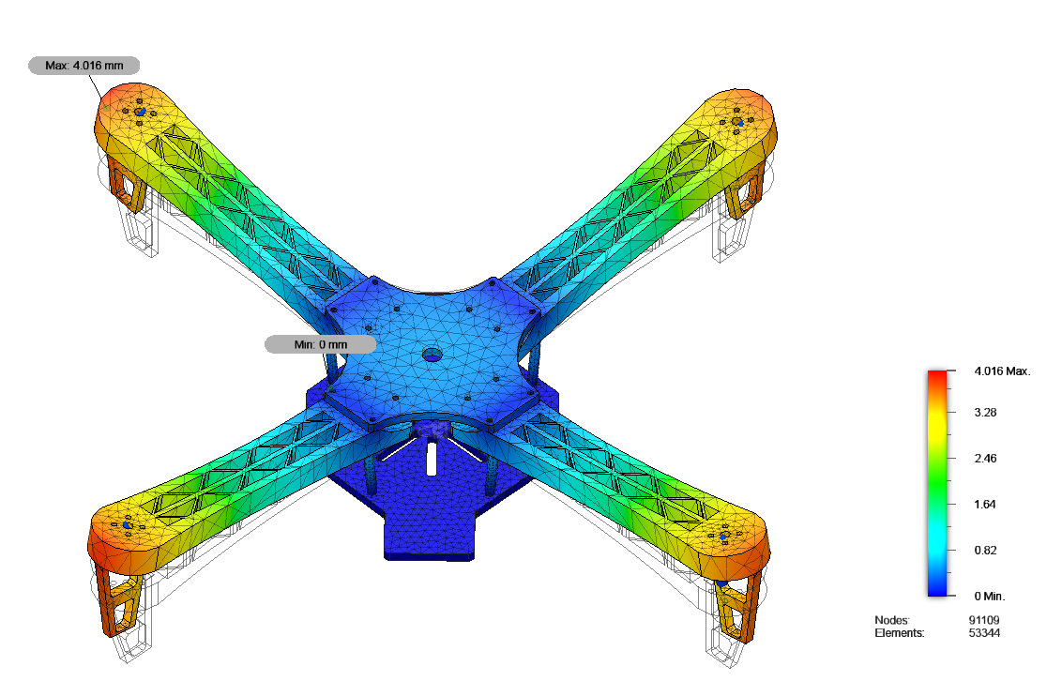
DISPLACEMENT ANALYSIS

Slide 12
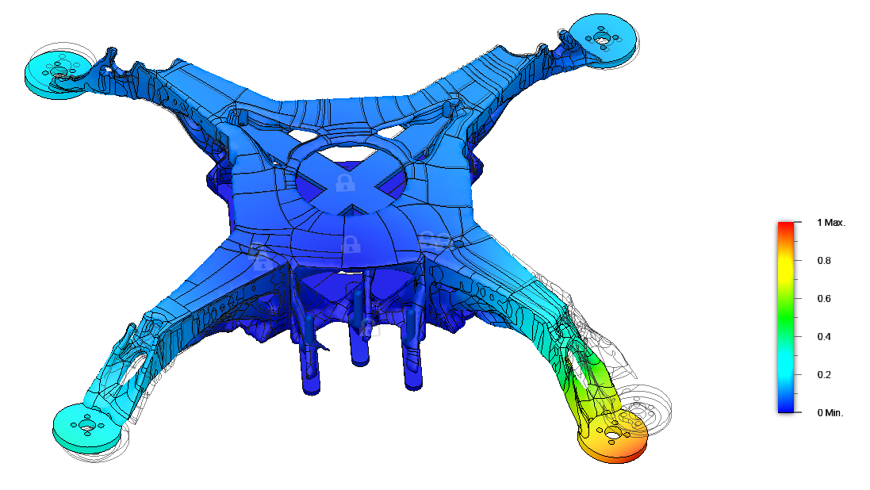
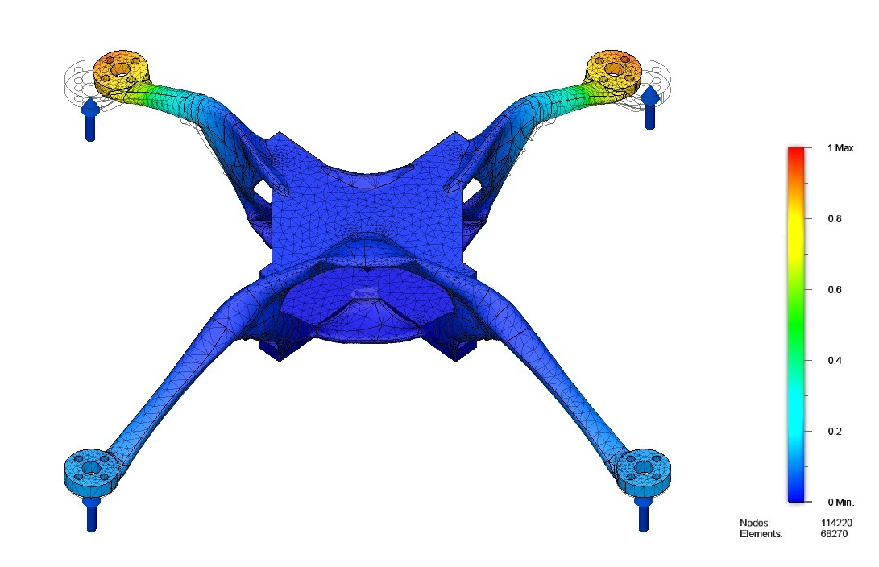
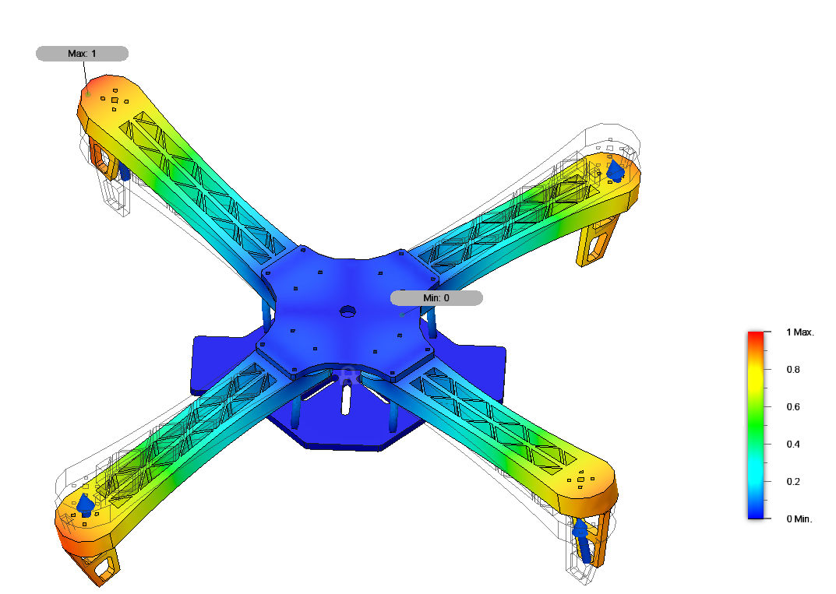
FREQUENCY ANALYSIS AT 300 Hz

Slide 13
CONCLUSION
All the designs generated are within the safety limits.
Mass is significantly less for generatively designed frames when compared to traditionally designed UAV frame.
Factor of Safety of model 1 is almost 40 times of DJI F450 frame.
Maximum displacement of model 2 is just about 0.1 mm under the loading conditions which is 400 times when compared to DJI frame.
Von Misses Stress is 11.4 times less for the model 2 frame in comparison to DJI F450 frame.
Model 1 and 2 can withstand cyclic load and can survive from failure for a longer period of time when compared to the F450 frame.

Slide 14
Refrences
.Buelow PV. (2002) Using evolutionary algorithms to aid designers of architectural structures. p. 315–36.
McKnight, M. (2017) Generative Design: What it is? How is it being used? Why it’s a game changer. KNE Eng., 2, 176–181.
Wu, Jun & Qian, Xiaoping & Wang, Michael. (2019). Advances in generative design. Computer-Aided Design. 116. 102733. 10.1016/j.cad.2019.102733.
Ahmed, Md & Zafar, Mohd & Mohanta, Jagadish. (2020). Modeling and Analysis of Quadcopter F450 Frame. 196-201. 10.1109/IC3A48958.2020.233296.
Sun, H.; Ma, L. (2020) Generative Design by Using Exploration Approaches of Reinforcement Learning in Density-Based Structural Topology Optimization. Designs 2020, 4, 10.
Janssen P. A generative evolutionary design method Digital Creativity 2006; 17(1):49–63.
Sosnovik, I.; Oseledets, I (2019) Neural networks for topology optimization. Russ. J. Numer. Anal. Math. 34, 215–223.

Slide 15
Thank you

