Slide 1

Ira A. Fulton Schools of Engineering
Collaborative Digital Modeling Simulation
Group-3
Jay Karhade
Jerrin Bright
Suryaprakash
Kumud Mittal
Amit Prakash

Slide 2
Background and Inspiration
Background
Building inspection and monitoring is a rather expensive and time-consuming process requiring specialized equipment and expertise.
Can we use Visual Computing and SLAM to tackle this problem?
Challenges
Current multi-agent SLAM systems work well ONLY in static environments.
Aim
To develop a distributed,scalable system with minimal human intervention requiring only monocular vision, and IMUs capable of working in dynamic environments.
Notes:
Add curriculum.

Slide 3
Proposed SLAM System
Monocular Image
Dynamic Object Removal
Multi-Agent
SLAM
Point-Cloud
Reconstruction
Monocular Depth Prediction
Modularity maintained!

Slide 4
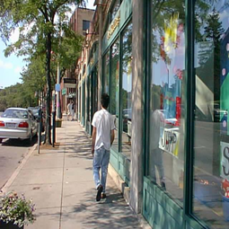
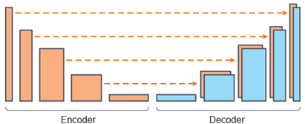
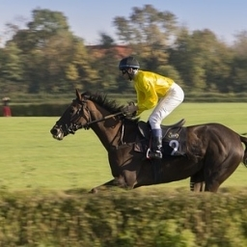

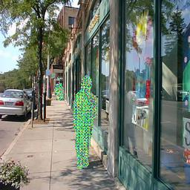
Dynamic Object Removal Block
We treat this as a segmentation+image inpainting problem
Dense U-Net Backbone for Semantic Segmentation
Can be replaced with any standard segmentation architecture. - DeepLabv3 is promising.
Notes:
Add curriculum.

Slide 5
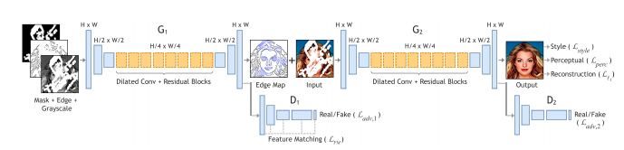
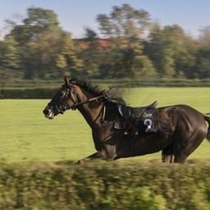
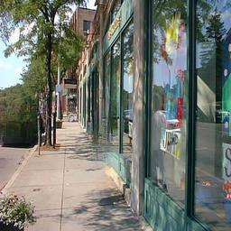
Dynamic Object Removal Block
We treat this as a segmentation+image inpainting problem
Edge Connect for image inpainting
Again can be replaced with any standard inpainting architecture.
Notes:
Add curriculum.

Slide 6
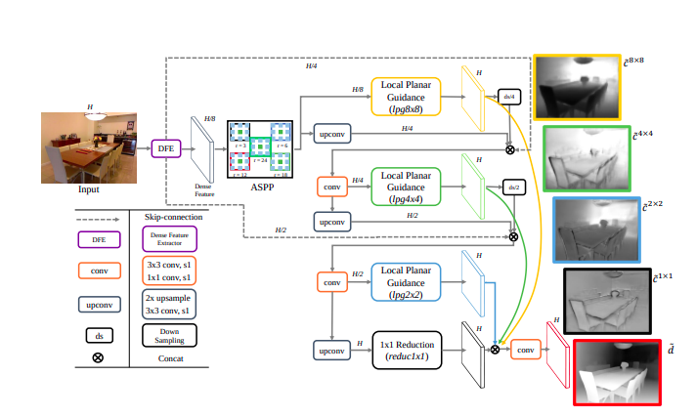
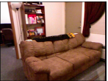
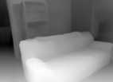


Monocular Depth Prediction Block
Perform Monocular Depth Prediction on processed image
Big To Small Monocular Depth Prediction
Notes:
Add curriculum.

Slide 7
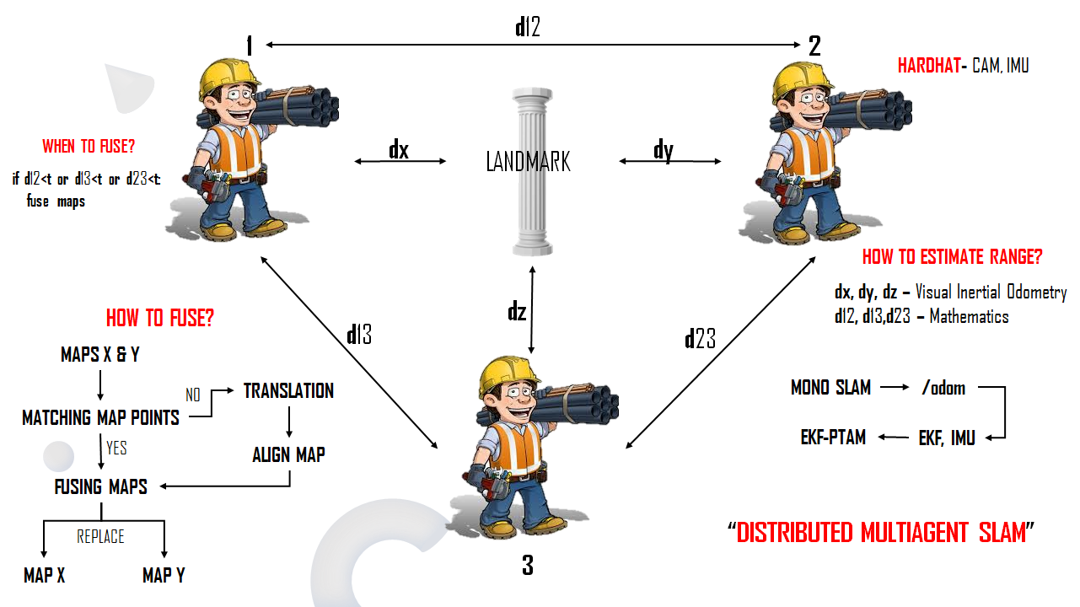
Proposed SLAM Architectures
Notes:
Add curriculum.

Slide 8
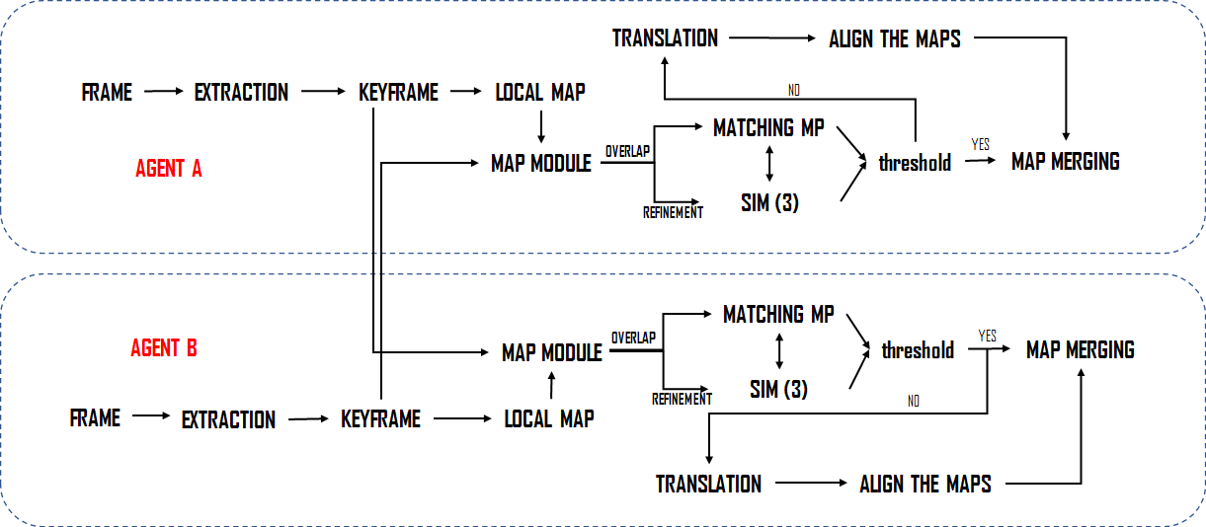
Proposed SLAM Architectures
Notes:
Add curriculum.

Slide 9
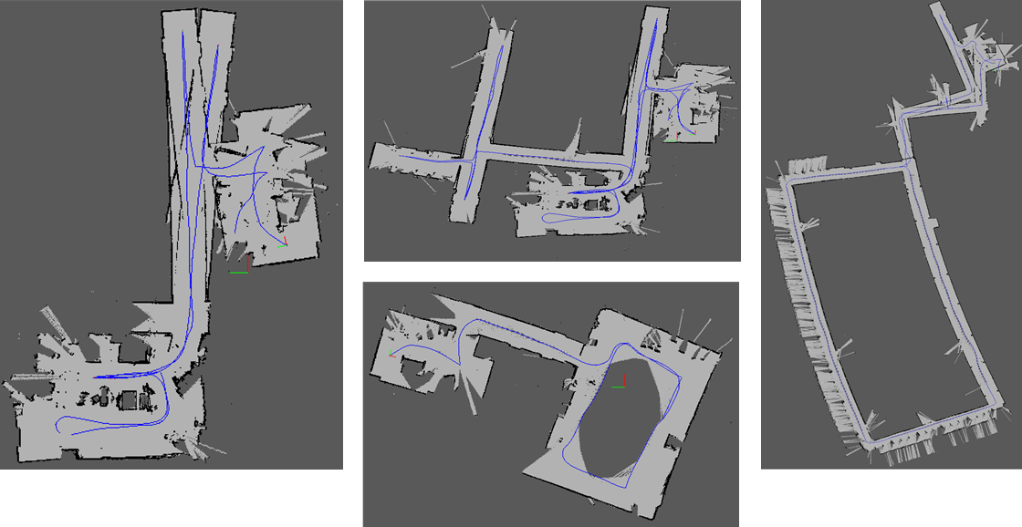
RTABMap Multi-Session Simulation
MAPS
Notes:
Add curriculum.

Slide 10
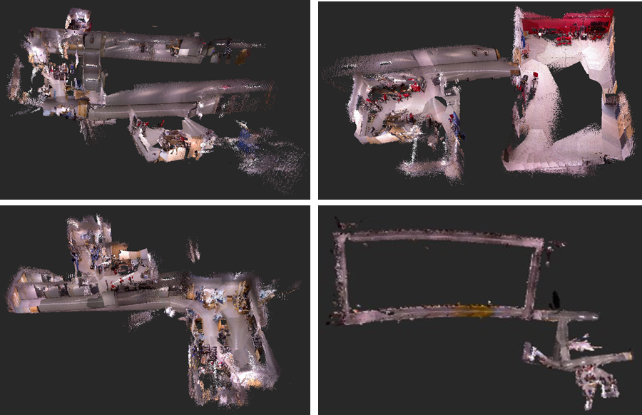
RTABMap Multi-Session Simulation
POINT CLOUDS
Notes:
Add curriculum.

Slide 11
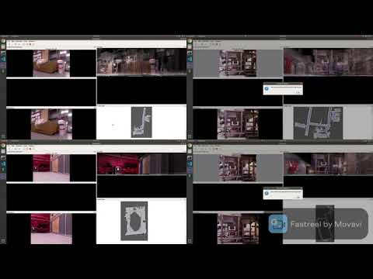
RTABMap Multi-Session Simulation
VISUALIZATION
Notes:
Add curriculum.

Slide 12
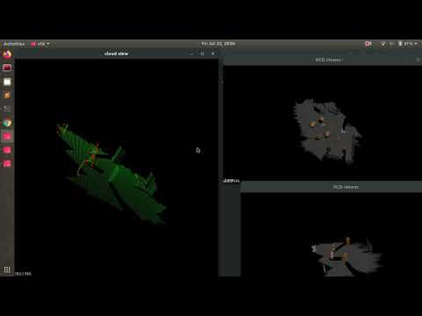
CUSTOM RTABMAP SIMULATION
Notes:
Add curriculum.

Slide 13
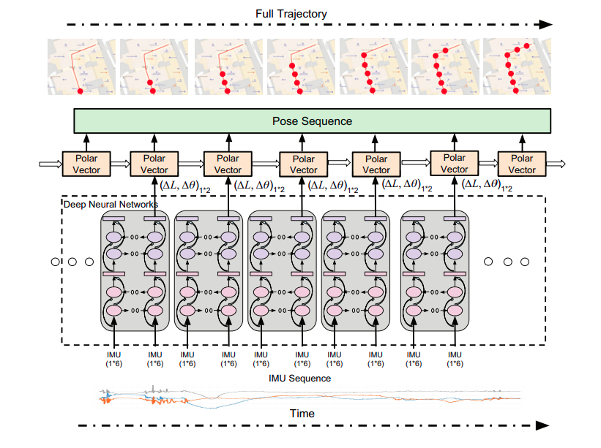
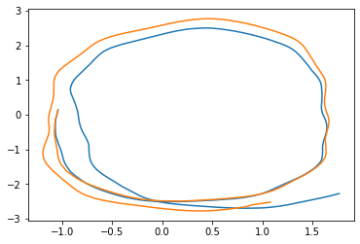
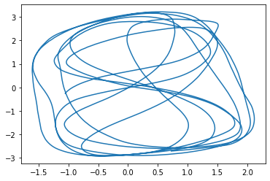
Off-beat experiments
OxIOD Dataset for improving inertial and visual-inertial odometry
Can be used for redundancy in cases of temporary feature-loss for lower drift
Notes:
Add curriculum.

Slide 14
Future Work
We develop a modular system for slam in dynamic environments, such that each part is modular and can be modified individually for better results. In the near future, we aim to perform comparative and ablation studies to test the best module and examine its robustness.
The segmentation model requires a pre-knowledge of the classes, we aim to develop a self-supervised/semi-supervised approach for segmenting dynamic objects coupled with optical flow information.
For multi-agent SLAM, we aim to also develop a system for feature matching and registration in low-overlap conditions, taking inspiration from PREDATOR.
Explore ways of knowledge distillation for reducing number of parameters and making the network faster.
Explore the possibilities of an E2E training fashion, something like gradSLAM.
How and When to update map? Lifelong SLAM vs Threshold based change.
Notes:
Add curriculum.

