Slide 1
Subaquatic Hybrid Inspection and Visual Reconstruction System
-Jerrin Bright[18BME1004]
-Rohith R[18BME1020]
-Nishanth R[18BME1024]

Slide 2
PREVIOUS INSPECTION
In 1990s, this inspection task as said was done by professional divers. It will be very difficult to find the exact defect from each and every part of the bridge.
In early 2000s, the inspection was instigated by semi autonomous robots which will be constrained by a boat or ship like vehicle thereby making movement of the ROUV limited.
Currently, the inspection system has been enhanced by USV like robots which can move along with the ROUV communicating between them efficiently and accurate inspection is established.

Slide 3
ABSTRACT
Robotic inspection systems (RIS) have been a very stimulating robotic research and development area in this era ranging from the ocean to sky. In general, this inspection is done using a skilled professional. But it entails high skill and expense failing which it probabilistically will lead to huge devastation. Thus, came autonomous inspection systems where a robot is used to accomplish certain inspection tasks. Amongst all the structures to be inspected, subaquatic bridges have tended to be the most challenging, dangerous and expensive system to keep track of. Thus I propose the Unmanned Subaquatic Hybrid Robotic Inspection System (USHRIS), a RIS that can detect the defects (cracks) along with the dimensional analysis of the defect for the ease of monitoring. The design of the system is as follows: The Unmanned Surface Vehicle (USV) will be connected via an umbilical to the Remotely Operating Underwater Vehicle (ROUV) which will monitor inside aquatic regions using camera, sonar and instruments as such. The system is also designed to navigate in GPS prone surfaces without any turbulences. Also, changes in the edifice of the bridges are monitored using recurrent inspection as a result of mapping. Thus, encompassing all the above-mentioned facts into one controlling system I propose the ‘USHRIS’.

Slide 4
OBJECTIVE
Enables navigation without instabilities in GPS-deprived locations that’s maybe when the USV is under a bridge and the Satellite fails to capture its relative position.
Dimensional Analysis of defects that’s the crack for precise positioning and monitoring for future inspection. This ultimately helps to keep track of the change in the defect dimension over time for analysis and preventing failures of the structure.
Remote perception in hazardous operation zones where humans can’t be able to monitor regularly thereby preventing potential failures.
Capturing change in the structure from recurrent inspection from the mapping techniques adapted by USHRIS. This will help monitoring of influencing defects in the structure.

Slide 5
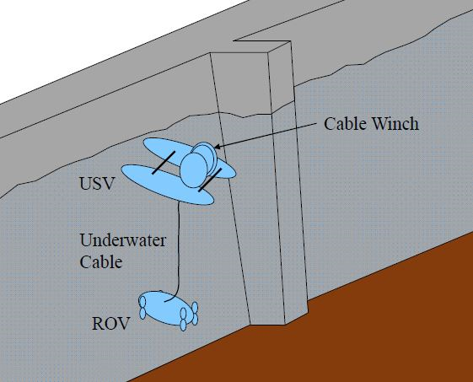
Mechanical

Slide 6
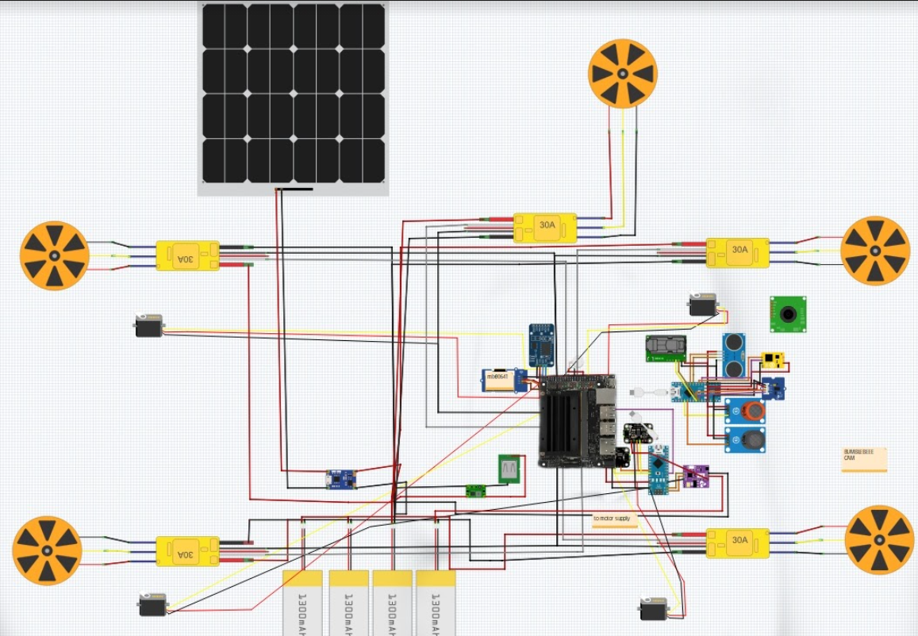
Electronics

Slide 7
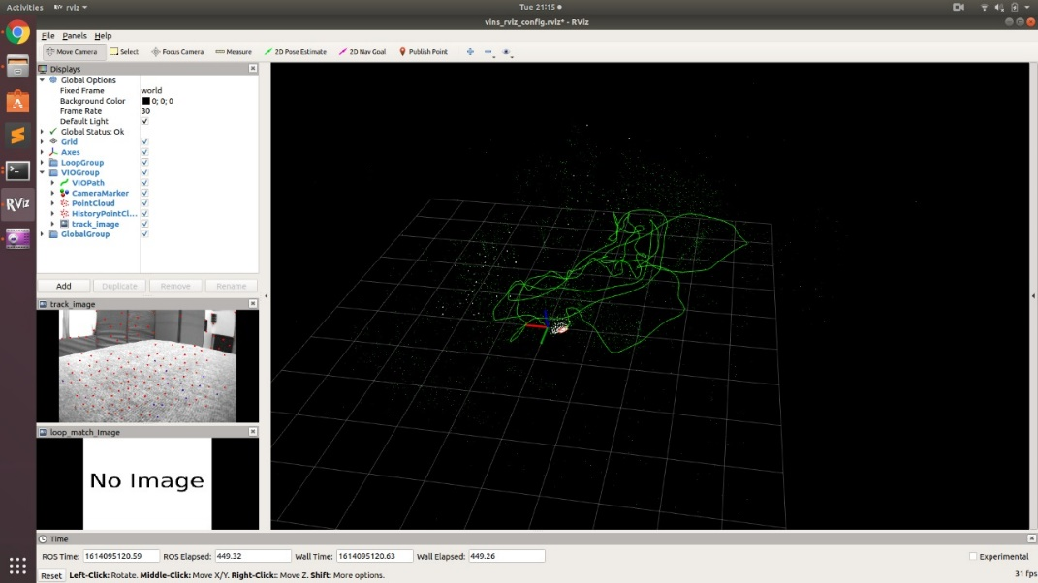
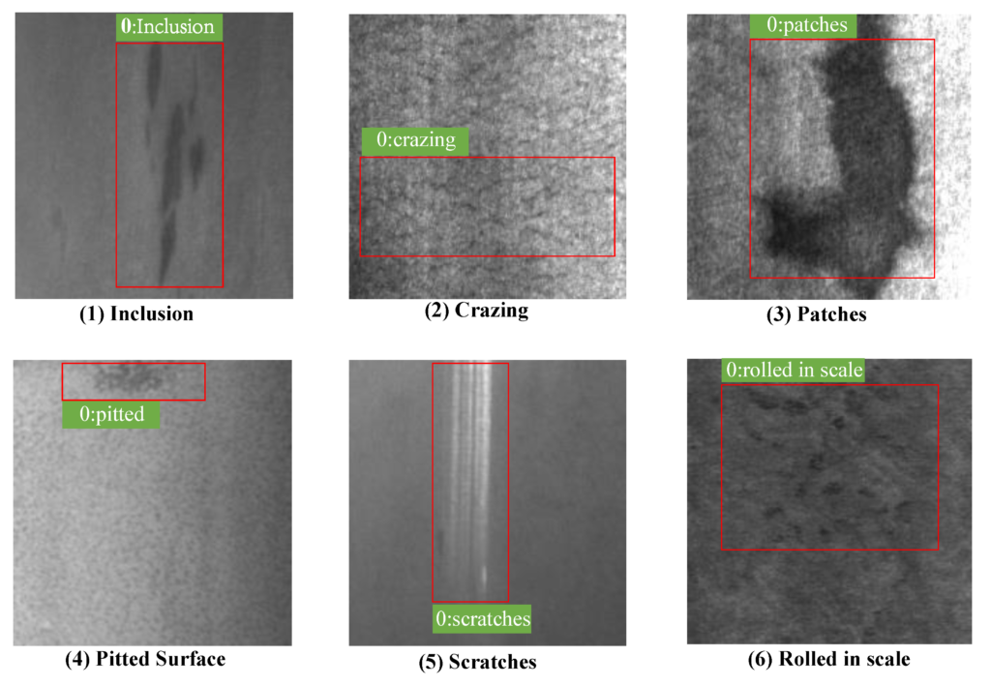
Computer
SLAM
COMPUTER VISION
A B

Slide 8
REFERENCES
S. Shimono, S. Toyama and U. Nishizawa, "Development of underwater inspection system for dam inspection: Results of field tests," OCEANS 2016 MTS/IEEE Monterey, Monterey, CA, USA, 2016, pp. 1-4
Jung, Dong-Wook & Hong, Seung-Min & Lee, Jae-Heon & Cho, Hyunjoon & Choi, Hyeung-Sik & The Vu, Mai. (2018). A Study on Unmanned Surface Vehicle Combined with Remotely Operated Vehicle System. Proceedings of Engineering and Technology Innovation. 9. 17-24.
Murphy, R.R., Steimle, E., Hall, M. et al. Robot-Assisted Bridge Inspection. J Intell Robot Syst 64, 77–95 (2011). https://doi.org/10.1007/s10846-010-9514-8

Slide 9
Thank You!

