Slide 1
IEEE HACKATHON
Team Name: ATOM ROBOTICS
Theme: Surveillance, Mapping for disaster management
Target: Aiming to aide rescue operations in GPS denied areas with aerial robots to navigate autonomously irrespective the terrain or environment (Indoor-Outdoor). Majorly used when finding the trapped as a result of debris, forest fire operations, examining damaged infrastructures, warehouse monitoring, etc.
Team Members: Jerrin Bright; Suryaprakash R

Slide 2
OBJECTIVE
PROBLEMS
GPS
FRAME
FEATURES
Accurate navigation in GPS-restricted environments using the State-of-the-Art visual SLAM technique.
Removal of dynamics features thus making suitable for real-time test scenarios as most of the drone enthusiasts consider working in static scenarios.
Dynamic Obstacle Avoidance using Panoptic and Optical Flow.
Optimization of drone frame using Generative Designing technique.

Slide 3
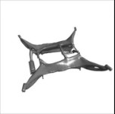
DESIGNING OF THE FRAME
GENERATIVE DESIGNING
LOAD CONDITIONS
Component | Pieces | Net Weight (gm) | Cost (INR)
RS2205S Motor (2700kv) | 4 | 115.2 | 3000
Pixhawk FC | 1 | 73 | 5000
M8N GPS | 1 | 32 | 2000
5” Propeller | 4 | 16 | 300
BL Heli ESC (40A) | 4 | 56 | 4000
PC Hub PDB | 1 | 8.5 | 700
Camera | 2 | 900 | 4000
Telemetry | 1 | 15 | 2000
LiPo Battery (5200mah) | 1 | 200 | 5000
Onboard Custom CPU | 1 | 400 | 20,000
TOTAL | 18 | 1815.7 | 50,000
Iterative design exploration process
Uses AI to generate multiple design
Mass reduction and structural optimization

Slide 4
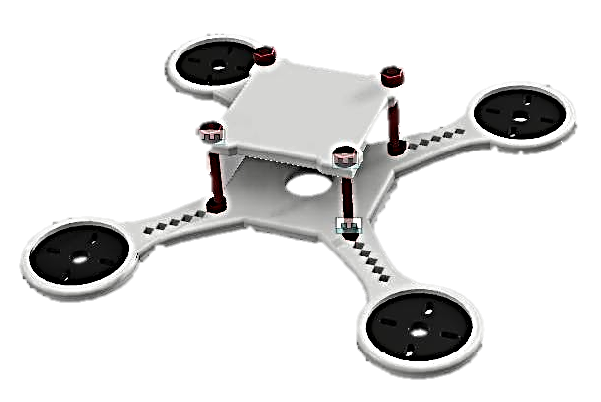
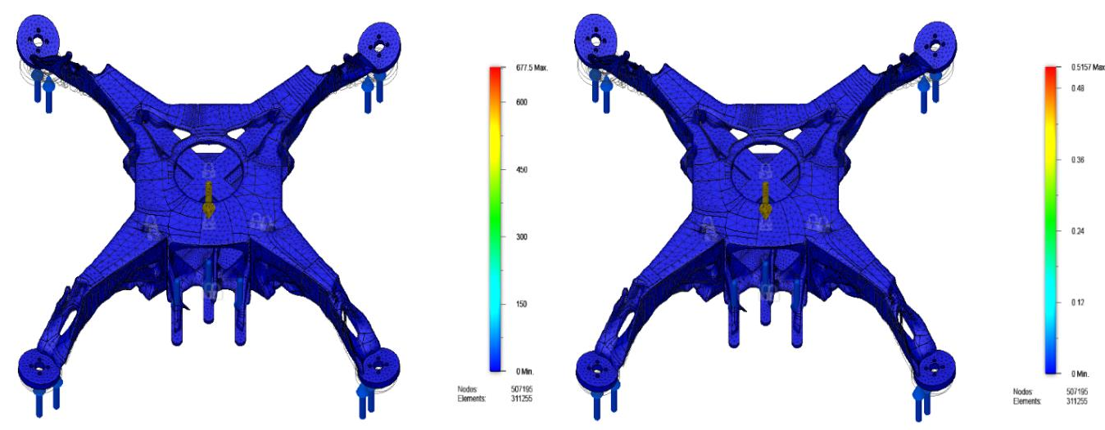
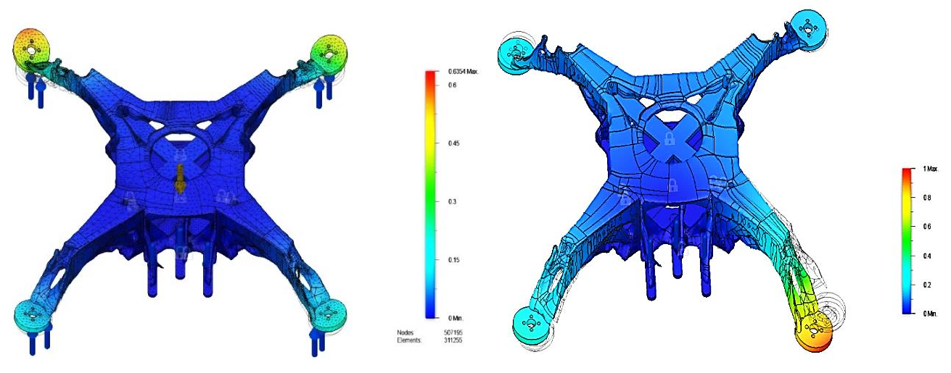
SIMULATION RESULTS
BEFORE GENERATIVE DESIGNING
AFTER GENERATIVE DESIGNING
VON-MISES STRESS STATIC STRAIN
Mass of Frame (Lf)= 400gms
External Load (Le)= 1800gms
M = Lf + Le = 2200gms = 2.2kg
F = M x g = 22N
Wheelbase = 450mm
This implies that each and every motor should have a thrust of 22N/4 = 5.5N.
DISPLACEMENT MODULAR FREQUENCY

Slide 5
Generative Designing (GD) Technique
All the designs generated are within the safety limit
Mass is comparatively less for generatively designed frames when compared to traditionally designed drone frame
Factor of safety of our frame is almost 4 times of DJI F450 Drone frame
Maximum displacement of our frame is just about 0.6 mm under the loading conditions which is 10 times when compared to DJI Drone frame
Von misses stress is 11.4 times less for our frame in comparison to DJI F450 Frame
Our frame can withstand cyclic load and can survive from failure for a longer period of time
Link for our paper: https://iopscience.iop.org/article/10.1088/1757-899X/1012/1/012019

Slide 6
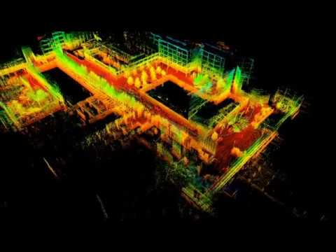
WHAT IS SLAM?
WHY VISUAL SLAM?
Computing pose and the map of environment simultaneously
Localization – estimating the robot’s location
Mapping – building a map and
SLAM – building a map and localizing the robot simultaneously
 | CAMERA | LIDAR | RADAR
Computation | 3 | 1 | 2
Weight | 1 | 3 | 2
Cost | 1 | 3 | 2
Weather Dependency | 2 | 3 | 1
Heat | 1 | 3 | 2
Range | 3 | 2 | 1
A B

Slide 7
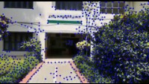
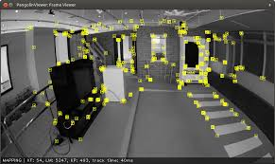
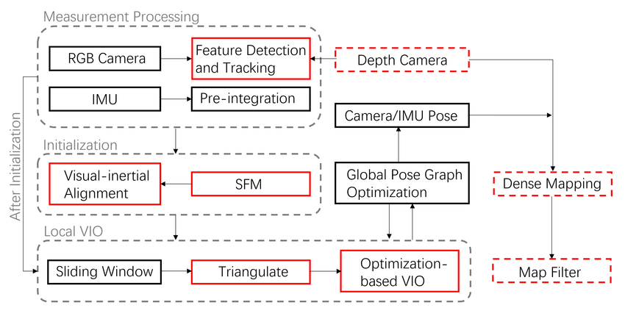
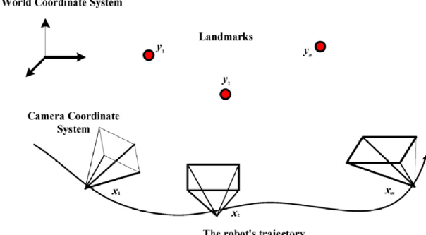
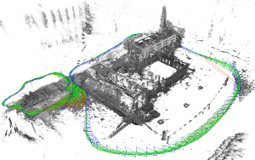
ARCHITECTURE OF VINS

Slide 8
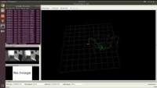
IMPLEMENTATION OF VINS

Slide 9
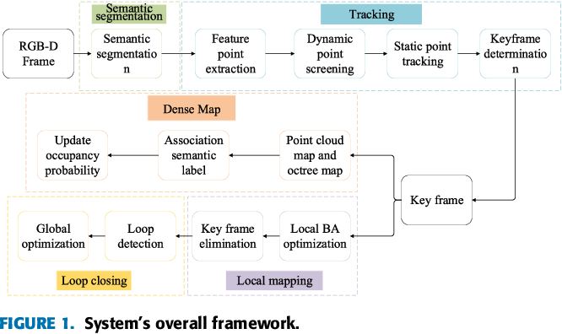
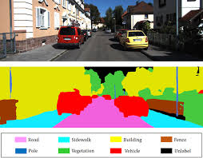
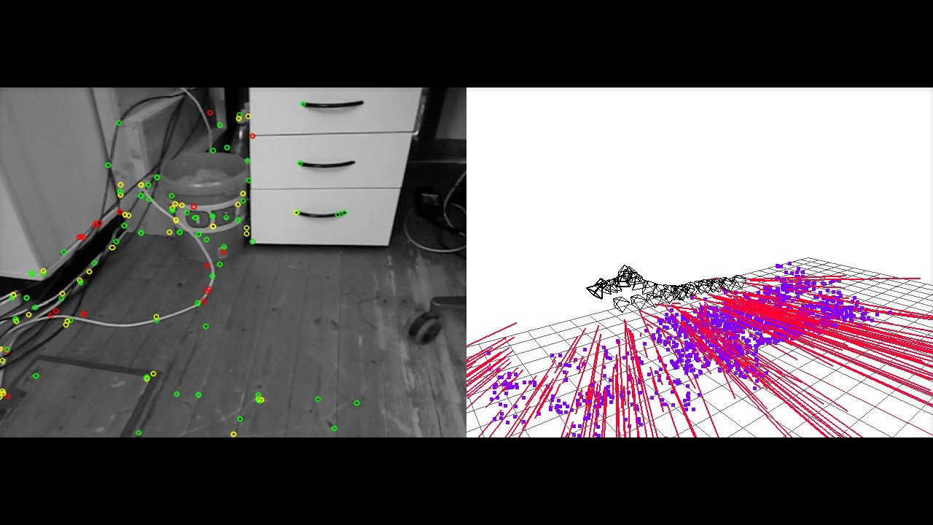
DYNAMIC FEATURE REMOVAL

Slide 10
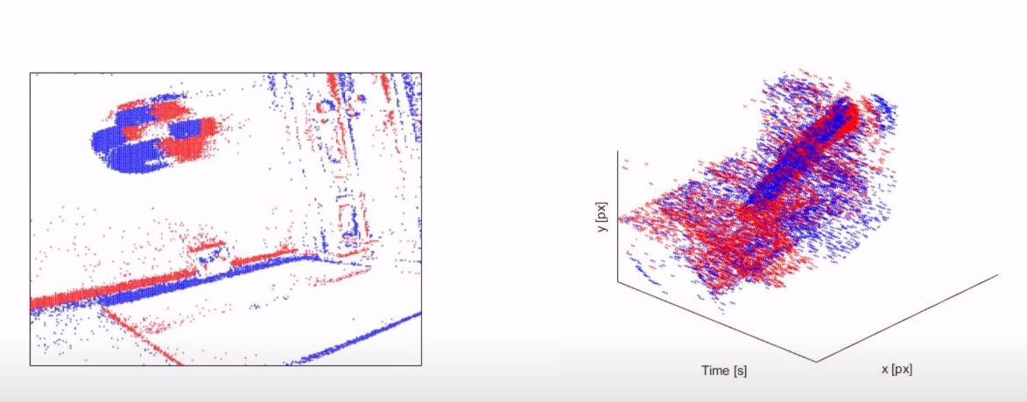
DYNAMIC OBSTACLE AVOIDANCE
Using,
Optical Flow
Panoptic Segmentation

Slide 11
Concluding Note
Navigation in GPS-denied environments
Dynamic features Removal
Optimized drone frame
Dynamic Obstacle Avoidance.
Used for:
finding the trapped as a result of debris,
forest fire operations,
examining damaged infrastructures,
warehouse monitoring, etc.

Slide 12
REFERENCES
T. Qin, P. Li and S. Shen, "VINS-Mono: A Robust and Versatile Monocular Visual-Inertial State Estimator," in IEEE Transactions on Robotics, vol. 34, no. 4, pp. 1004-1020, Aug. 2018, doi: 10.1109/TRO.2018.2853729.
S. Han and Z. Xi, "Dynamic Scene Semantics SLAM Based on Semantic Segmentation," in IEEE Access, vol. 8, pp. 43563-43570, 2020, doi: 10.1109/ACCESS.2020.2977684.
Hell, Peter & Varga, Peter. (2019). Drone Systems for Factory Security and Surveillance. Interdisciplinary Description of Complex Systems. 17. 458-467. 10.7906/indecs.17.3.4.
Jerrin Bright et al 2021 ”Optimization of quadcopter frame using generative design and comparison with DJI F450 drone frame” IOP Conf. Ser.: Mater. Sci. Eng. 1012 012019

Slide 13
Thank You!
Atom Robotics

