Slide 1

Challenge #3 Recruitment and Outreach
Created by Jerry Breda, Donjana Allgood and Tiger Menser

Slide 2
Overview
Texas Southern University wants to increase its recruitment efforts to local Houston high schools.
To achieve this goal, we were tasked to identify the factors that influence high school students to choose computer science as a major.
To help get a further understanding of the correlation between the factors that were provided, we made graphs using python to help illustrate the relationship between the factors and high school students that are interested in computer science.

Slide 3
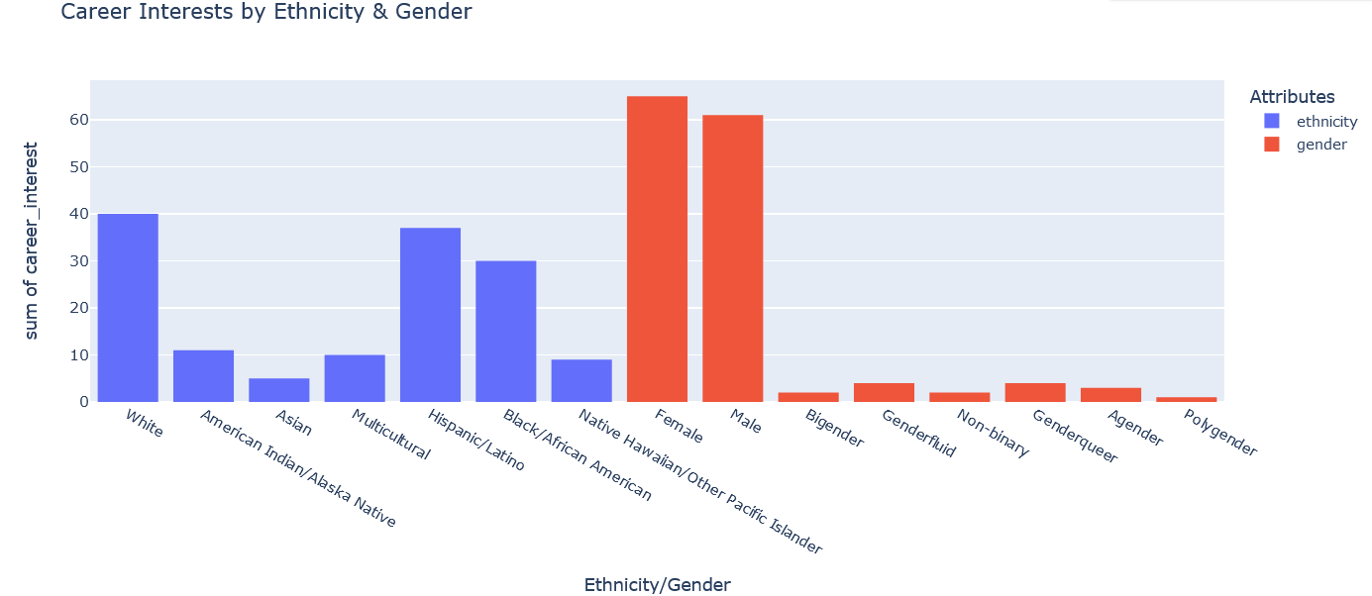
The factors: Ethnicity/Gender
Male and Female Dominant
White people are the majority with 40 people
Asians are the minority
Hispanics are the 2nd leading ethnicity, followed by Black people

Slide 4
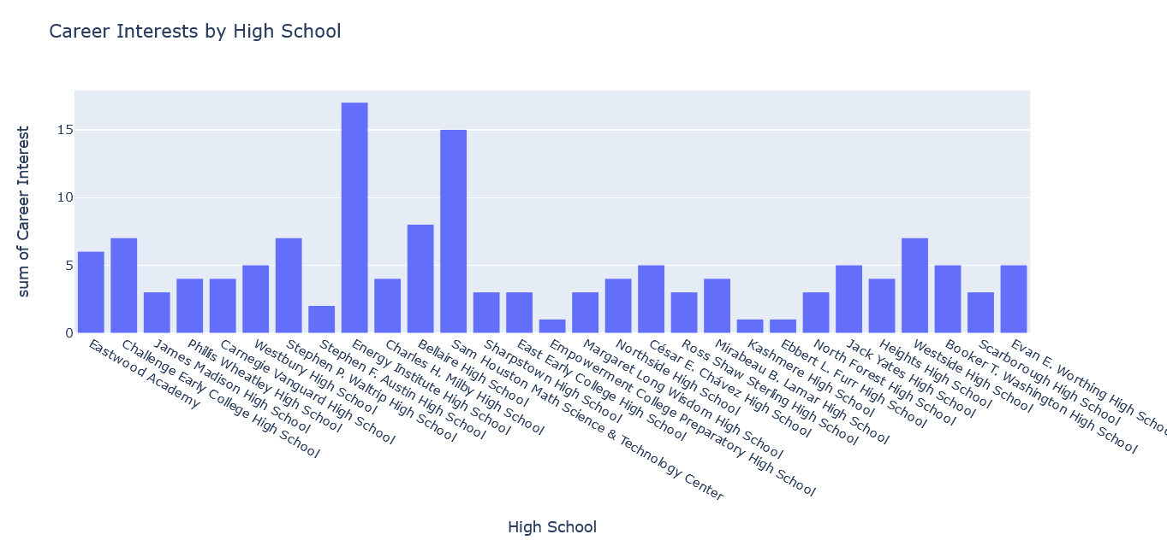
The Factors: High schools
Energy institute Highschool and Sam Houston Math Science & Technology Center have the highest number of kids that are interested.
The schools that provide STEM programs have higher numbers of kids that are interested
There is no direct correlation between high-school rating and interest in computer science.

Slide 5
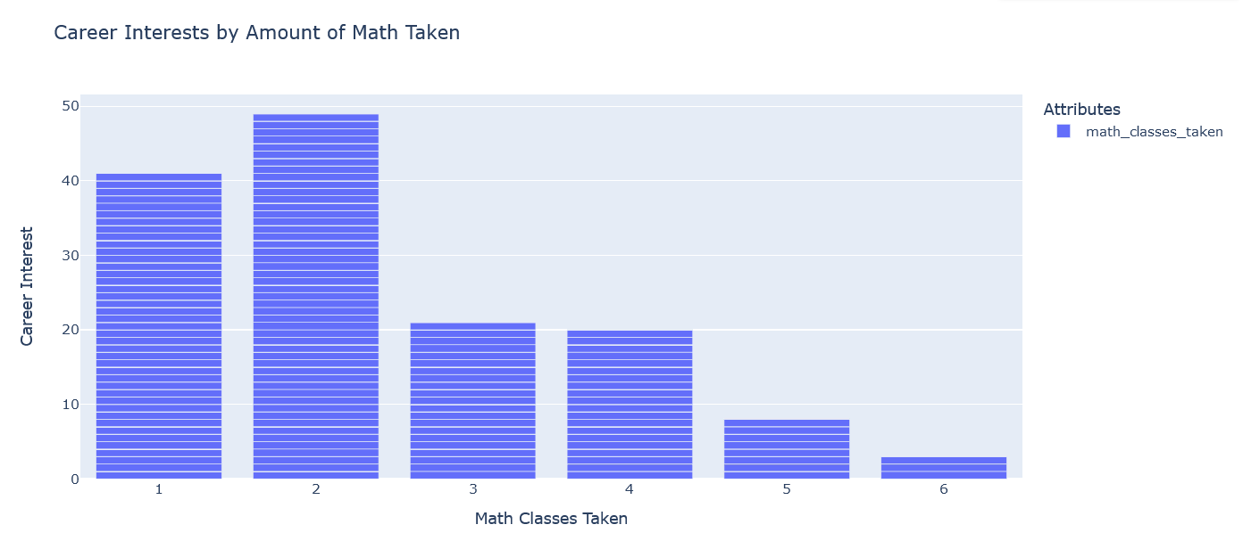
The Factors: Math classes taken
Students who took less math classes have had more interest in computer science
Students who took six math classes are the least interested, while students who took two are more interested.
There is a negative correlation relationship between students who are interested in computer science and students who took a higher number of math classes

