Slide 2
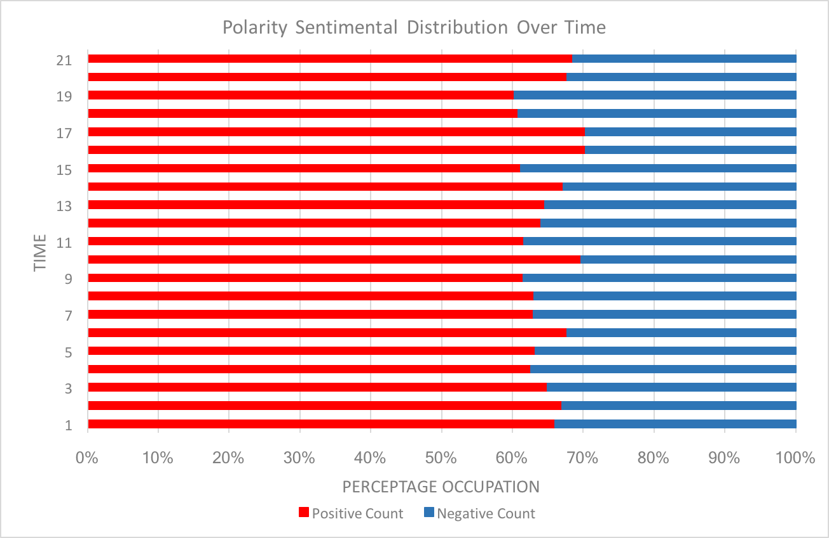
Real-time Tweets
Spark Streaming API
Processed Word Lists
Twitter Streaming API
Sequence of Data Frames
Visualize Word Sentiment
Tweet String Stream
Kafka
Cluster

