Slide 1
Modular L1-to-RL Manipulation Stack
with Route-Curriculum Extension
ENPM690 Final Project · Che-Jung Chuang · May 2026 · Robot Brain Trainer

Slide 2
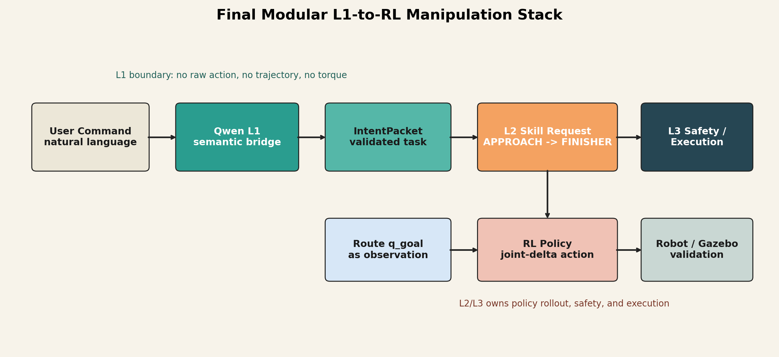
Problem Setup
Kitchen tasks combine semantics, motion, and execution safety.
A plate/tray task needs object, source, target, pose, and constraints.
A monolithic end-to-end loop hides failure causes.

Slide 3
Original L1/L2/L3 Architecture
L1: Qwen semantic intent and structured tool calls.
L2: learned RL skill policy.
L3: deterministic execution and safety boundary.
The LLM/VLM never outputs raw joint commands.

Slide 4
Phase 1 Baseline
Gymnasium environment, training loop, and deterministic eval were operational.
Approach and dock policies had isolated progress.
Switched integration was unreliable.
VLM/Qwen layer had not started.
Phase 1 proved infrastructure, not final integrated behavior.

Slide 5
Phase 2 Simplification
Explored Dock-Coarse, Bridge, classifier, acceptance map, and finisher adaptation.
Ablation showed extra modules could degrade clean handoff states.
Final mainline simplified to Approach -> Finisher.

Slide 6
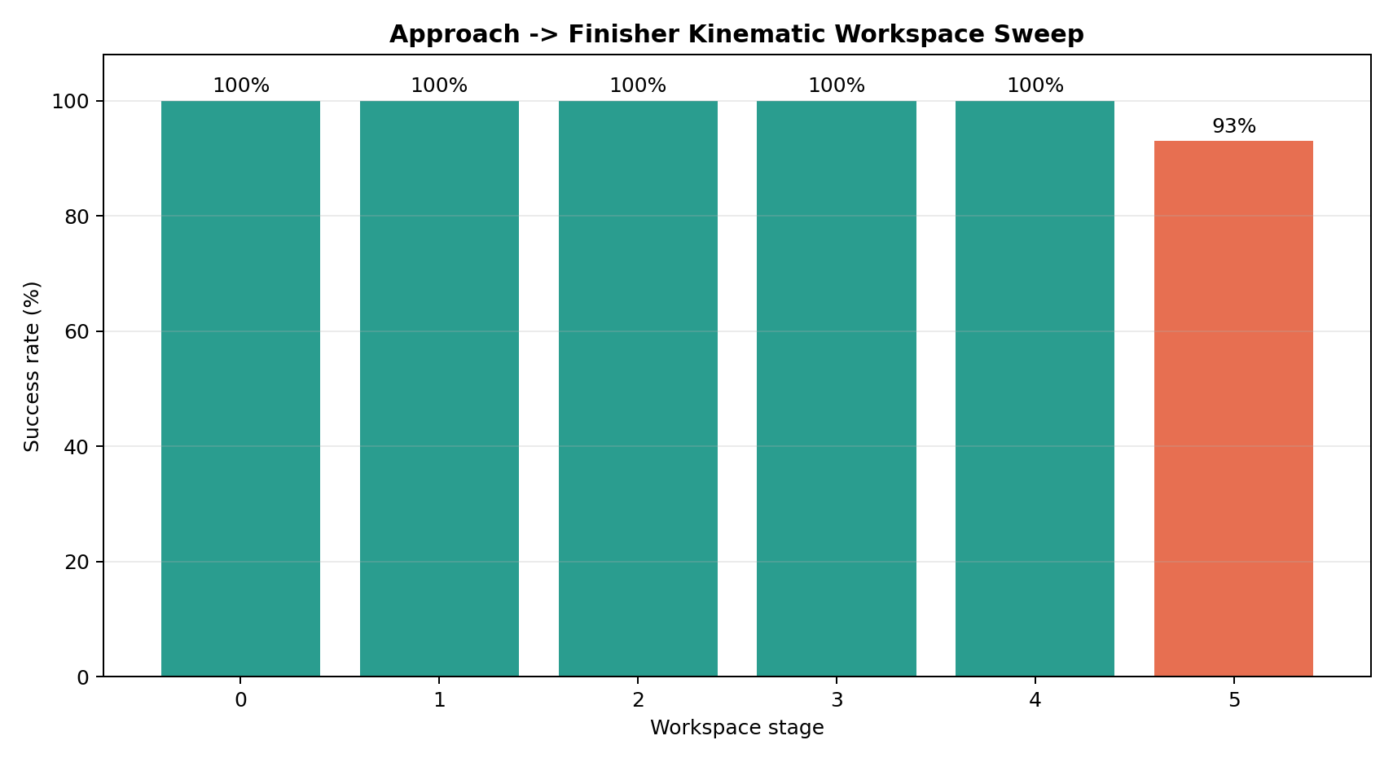
Kinematic Skill Result
Hardest current workspace stage reaches 93% success.
Stage 5 success: 0.93
Final position error: 2.89 mm
Final orientation error: 0.0208 rad
Skill stack works in trained kinematic workspace.

Slide 7
Qwen L1 Bridge
Command: move tray1 from shelf_A1 to shelf_B1.
Qwen calls resolve_intent_packet.
Bridge returns IntentPacket and APPROACH -> FINISHER request.
Qwen does not emit raw joint actions.

Slide 8
Route Curriculum Motivation
The policy was precise locally but failed scene-level transport.
Dense q_goal is used as target observation, not command.
Original full route success: 0.0435.
Original longest prefix: 21.

Slide 9
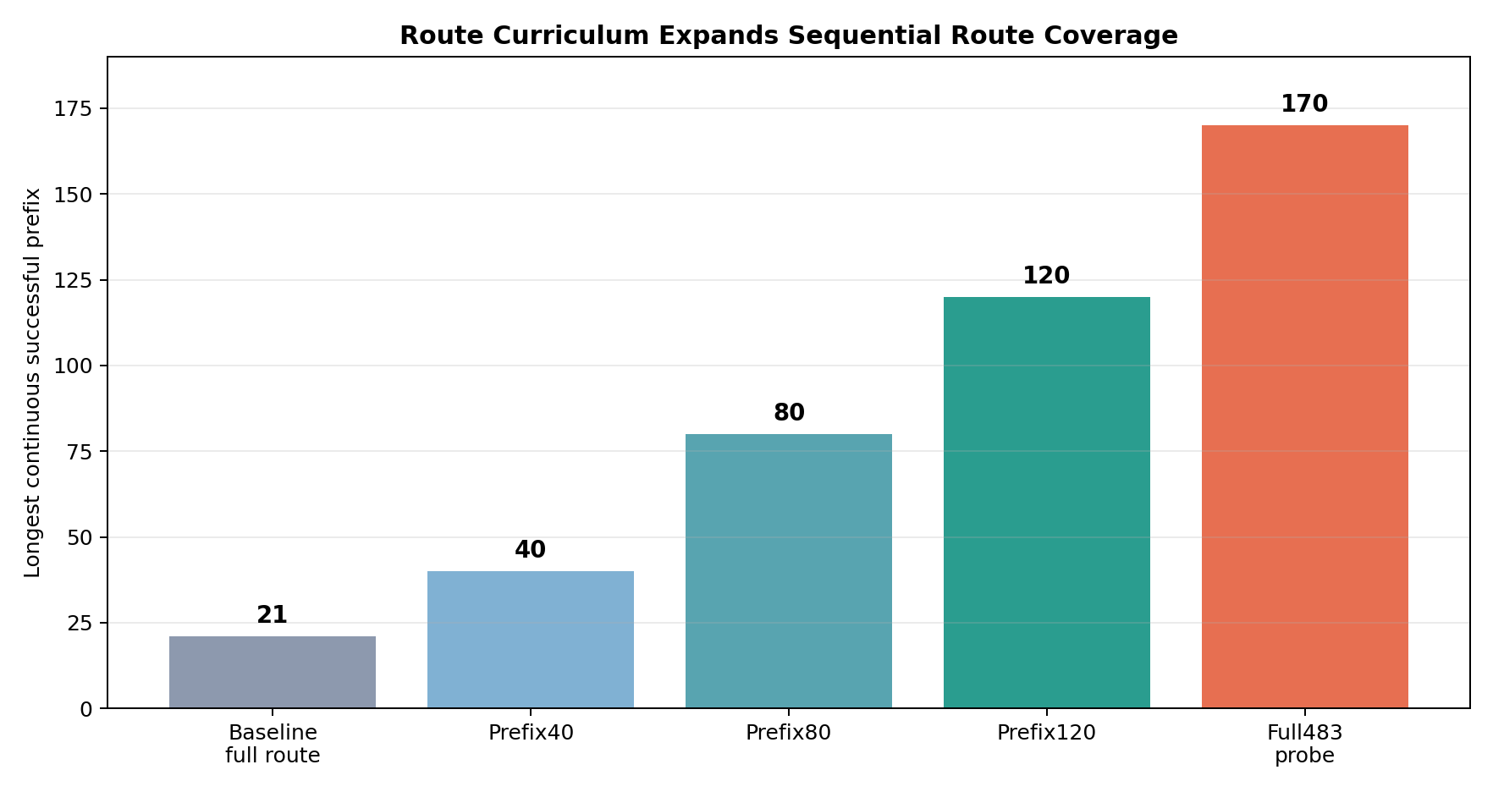
Route Curriculum Result
Prefix120 sequential success: 1.0
Full probe success: 0.4741
Full probe longest prefix: 170
Route curriculum expands reliable route coverage.

Slide 10
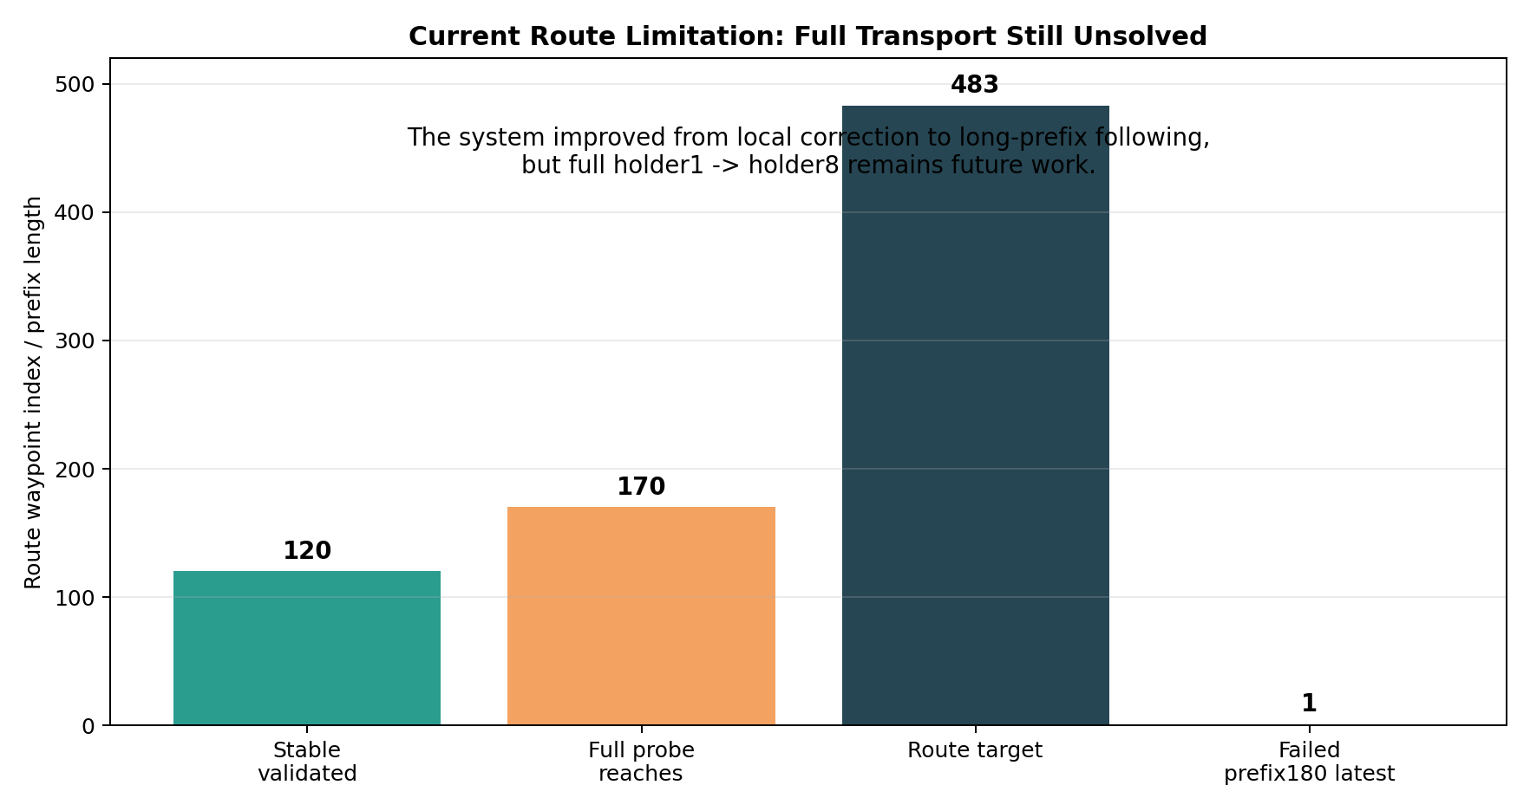
What Still Fails
Full 483-waypoint route is not solved.
Prefix180 fine-tuning can forget early route behavior.
Sampled success can be misleading.
Need sequential-gated checkpoint selection.

Slide 11
Demo Structure
Demo 1: Qwen bridge -> structured IntentPacket.
Demo 2: kinematic Approach -> Finisher skill stack.
Demo 3: route curriculum numeric validation.
Each demo has a runnable script and fallback summary.

Slide 12
Conclusion
Modular L1-to-RL stack demonstrated.
Approach -> Finisher works in trained kinematic workspace.
Qwen bridge validates semantic-to-RL interface.
Route curriculum extends local correction to long-prefix route following.
Full Gazebo kitchen transport remains future work.

Slide 13
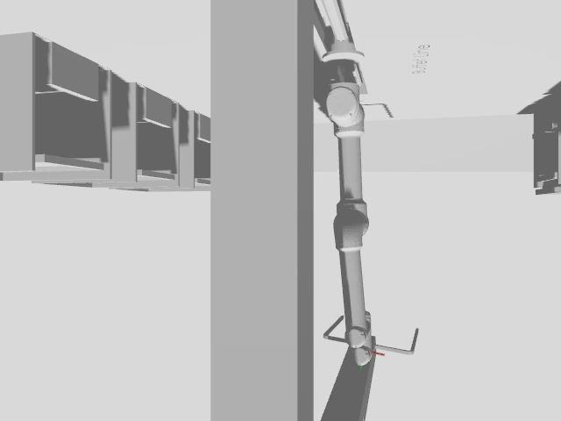
Real Gazebo Evidence
Recorded from Gazebo camera topic /v5/cam/side/rgb.
Frozen Approach -> Finisher sends goals through ROS action path.
60/60 controller goals executed successfully.
Visible-workspace stress success: 0.333.
This validates sim motion, not full tray transport yet.
Video: report/videos/real_gz_camera_phase3a_controlled_sim.mp4

