Slide 1


Travuel.AI
Team Members: Laura Cheng, Kelly Xie, Jerry Hsieh, Simon Zheng

Slide 2
Table of contents
01
02
03
05
04
Introduction
Datasets
Technology
Functions
Product Demo

Slide 3

01
Introduction

Slide 4



Introduction
Travuel.ai is an AI-powered travel assistant designed to redefine how travelers plan their trips.
By leveraging advanced artificial intelligence and real-time data, our chatbot provides highly personalized travel recommendations, helping users discover the best activities, hotels, restaurants, events, and cultural experiences based on their preferences.

Slide 5
02
Datasets

Slide 6
Datasets
Night & Outdoor Activities
2. Cultural Experience
Nightlife (Clubs, Bars)
Outdoor (scenic views, parks, nature trails)
Museums
Markets
Art galleries
Cultural Districts
3. Hotel & Restaurant
4. Events
Restaurant
Budget
Mid-range
Luxury.
Cultural & Arts Events
Food & Drink Experiences
Outdoor & Wellness Activities
Community and Social Gatherings

Slide 7
03
Technology

Slide 8
Four Core API
1. Guide Agent (RAG-Based Retrieval & Summarization)
User Input: Receives a text-based travel question.
Retrieves relevant information from Pinecone index, which contains:
Events
Cultural landmarks
Attractions
Hidden gems
Filters and ranks the top 10 most relevant results.
Uses OpenAI GPT-4o Turbo to generate a structured travel guide.
Extracts "name" attributes from the results and passes them to the Route Plan Agent.
2. Route Plan Agent (Interactive & Optimized Itinerary)
3. Currency Conversion Agent (User-Selected Home Currency)
4. Weather Agent (Real-Time 7-Day Forecast)
Hotels
Nightspots
Restaurants

Slide 9
Tech Stack & Tools
Component | Tool/Framework
Vector DB | Pinecone
LLM Processing | OpenAI GPT-4o Turbo
UI Interface | Streamlit
Mapping & Routing | Google Maps API /
Weather Forecast | OpenWeather API / WeatherAPI
Currency Exchange | Open Exchange Rates / ExchangeRate-API / XE

Slide 10
04
Functions

Slide 11
Functions
Travel Recommendations
Multi Destination Planner
Real-time Weather Updates
Real-time Currency Converter
Measure and refine

Slide 12
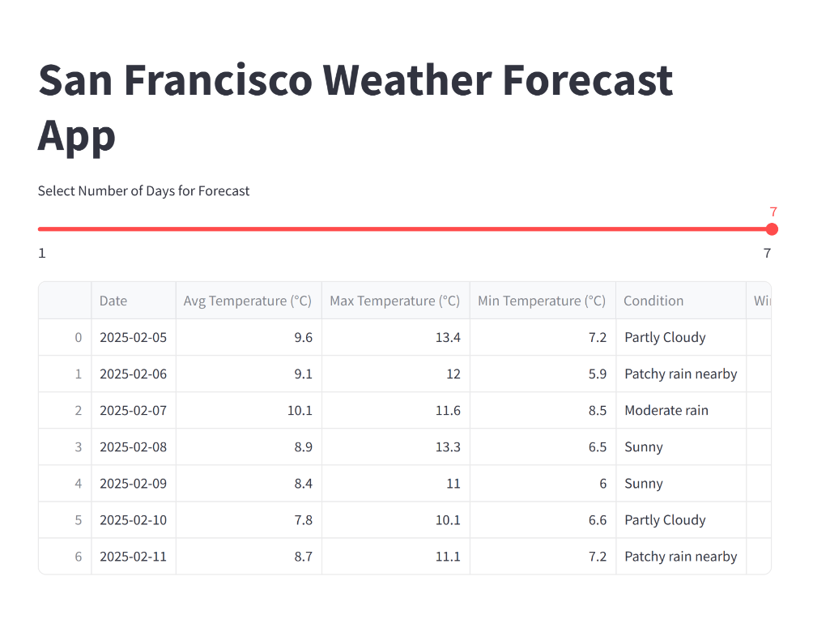
Real-time Weather Updates
Provides real-time and forecasted weather updates for up to 7 days.
Users can select the number of days to view the temperature trends and weather conditions.
Helps users plan outdoor activities effectively.
Supports travelers and locals with updated weather insights.

Slide 13
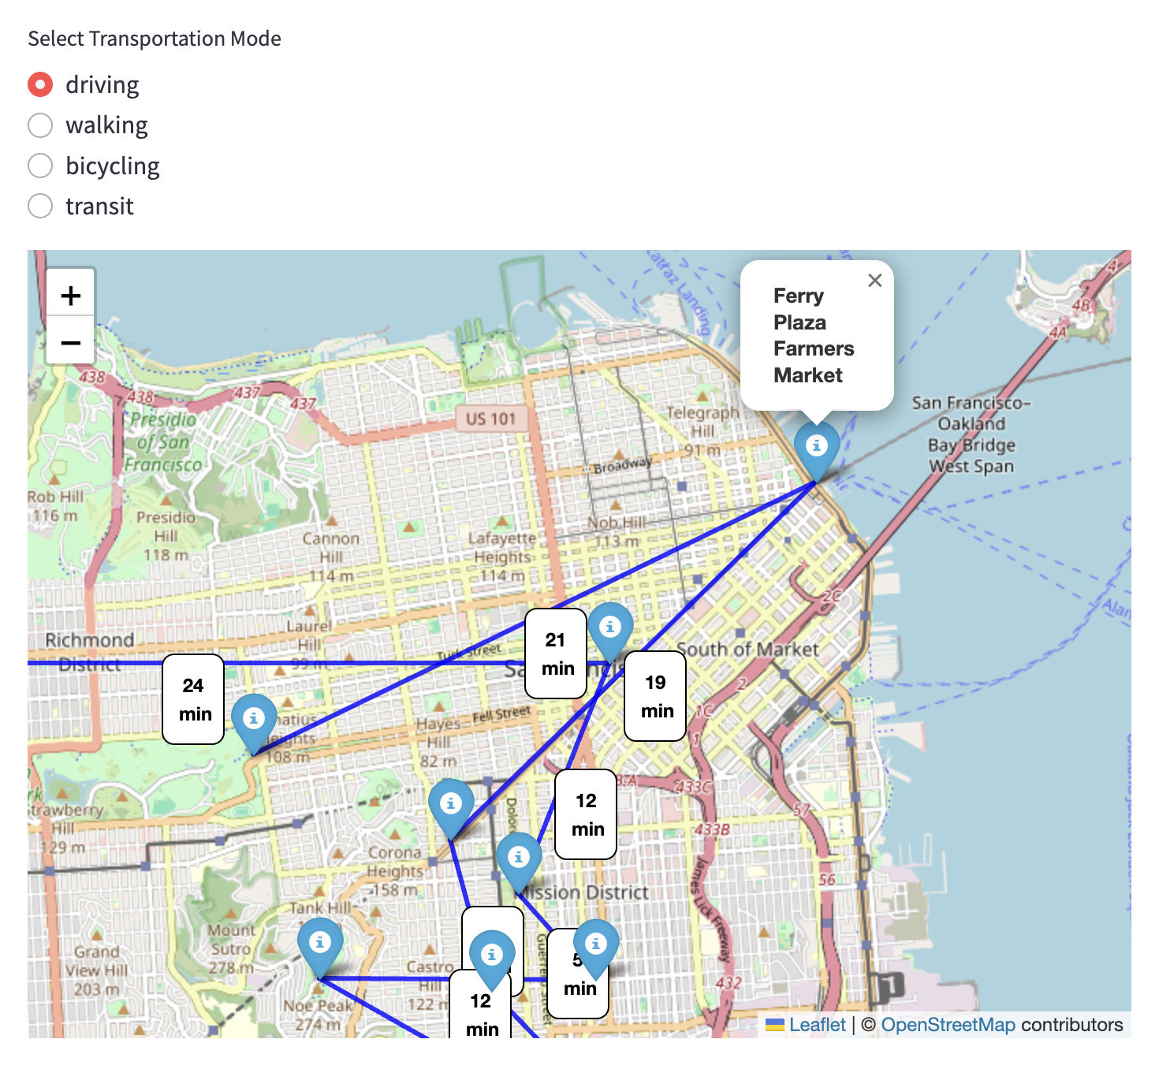
Multi-Destination Planner
AI-powered system implementing Google Maps API to fetch real-time travel times for up to date routes.
Used advanced algorithms Dijkstra's and Traveling Salesman Problem (TSP) to optimize multi-stop routes and calculate best routes based on users’ preferences.
Interactive visualization with marker for each stop based on transportation, real-time travel times, and informative pop-ups for stop descriptions.
Notes:
This is an AI-powered travel planner that simplifies multi-stop trip planning. It implement Google Maps API to fetch real-time travel times for up to date routes. By utilizing advanced algorithms Dijkstra and TSP to find the most efficient order of stops in multi stop routes.
Then, an interactive visualization will show with markers for each stop. On the top, users can select their transportation mode, as shown on the picture here. By choosing different transportation method, different real-time travel times will be displayed along the routes.
Dijkstra: an algorithm for finding the shortest paths between nodes in a weighted graph
TSP: finds the best way to visit multiple locations while minimizing travel distance

Slide 14
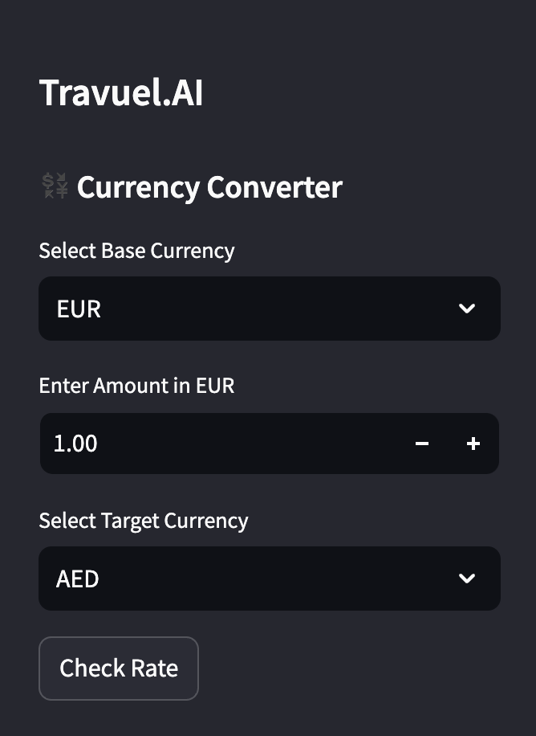
Real-time Currency Converter
Integrated real-time exchange rate APIs to provide accurate currency conversion for travelers.
Supports multiple global currencies, ensuring seamless budgeting and financial planning.
Includes an offline mode that stores recent exchange rates for use without internet access.

Slide 15
Difference Between Using ChatGPT and Travuel.AI
ChatGPT
Travel.AI
Trained on a broad dataset (web, books, general knowledge).
Provides generalized responses with limited domain-specific accuracy.
Cannot directly integrate with external data sources like live APIs.
Responses rely on pre-trained knowledge
Uses a custom vector database (Pinecone DB) for accurate, real-time travel recommendations.
Integrates live data sources
Delivers highly accurate, structured recommendations rather than generic responses.

Slide 16
05
Demo

Slide 17
Thanks for watching
Does anyone have any questions?

