Slide 1
測試
Testing
revised:2020/10

Slide 2
軟體生命週期
Software Life Cycle
1
計畫階段Planning
維護階段
Maintenance
2
6
分析階段Analysis
3
4
實作階段
Implementation
5
測試階段
Testing
設計階段Design
軟體需求規格文件SRS,PEP
系統設計書
SDD
使用者手冊
User Manual
測試計劃文件
Test Document

Slide 3
測試
Testing
測試
Testing
程式開發者
Software developer
Unit Testing
(單元測試)
Integration Testing
(整合測試)
測試結果報告
Testing Report
測試計劃
Testing Plan
獨立測試小組
Independent testing team
測試案例的結果
Test Case Result
系統測試
System Testing
驗收測試
Acceptance Testing

Slide 4
測試計畫書之內容架構
Test Plan Content Structure
測試計劃書 Test Plan
軟體需求規格文件 (SRS)
系統設計書(SDD)
1.Introduction
2.Test Environments
排程
Schedule
3.Test Schedule, Procedure, and Responsibility
測試生成
Testing Development
4.Test Case (測試案例)
4.1 Unit/
4.2 Integration/
4.3 System
GN 4-1~4-3/GN 4-5/GN 4-4
功能性測試
Functional Testing
非功能性測試
Non-functional Testing
GN4-2
5.Traceability

Slide 5
相關用語
Terminology
Application/System Under Test (AUT/SUT) 將要被測試的程式或系統 The Application or system that will be evaluated
Test Input 將提供給 AUT/SUT 的測試資料 Data will be provided to the AUT/SUT
Expected Output 程式或系統預期的執行結果 Answer that we expect to see from the app/system
Test Case Test Inputs + Expected Outputs
Test Suite 許多 Test Case 的集合 Collection of test cases

Slide 6
測試計畫書
Test Plan
目的 (Goals) :
藉由遵循測試計畫書內的標準作業程序，較利於軟體測試之進行 Follow the standard operating procedures listed in the test plan will make software testing smoother
透過測試計畫書制度化的呈現方式，可讓測試人員之間的溝通更加順利暢通 Communications between the testers will be smoother by organized and well-formatted test plan
測試計畫書可使軟體測試以自動化系統的方式進行，易於測試作業之追蹤管理。 Test plan allows software testing to be performed in an automated system, tracking and managing test will be easier

Slide 7
測試案例設計
Test Case Design
Documents needed:
軟體需求規格文件 System Requirement Specification or SRS
系統設計書 System Design Document or SDD
 | SRS | SDD | codes
System Test | ✓
Integration Test | ✓ | ✓
Unit Test | ✓ | ✓ | ✓

Slide 8
單元測試
Unit Test
單元測試以物件的函式為單位進行測試 Unit tests are tested in units of functions in objects
範圍較小的測試較易準確的更正錯誤 且能減少複雜度 Tests with smaller range are easier to correct errors accurately and reduce test complexity
測試的範圍都是獨立的，可以同時進行 The scope of every test is independent and can perform simultaneously

Slide 9
Test case design- Unit Test
Black-box testing 在不知道程式內容的條件下所進行的測試 Testing without knowing the contents of the program
White-box testing 知道程式碼所有內容 Know all the contents of the code
SDD
案例挑選(黑箱) Case selection (black box)
GN4-1
測試案例
Test Cases
Codes
案例挑選(白箱) Case selection (white box)
GN4-2

Slide 10
Exhaustive Testing
How long would it take to test the following function exhaustively?
int add(int num0, int num1) { return num0 + num1; }
Assume int is a 32-bit data type
There are 2³² * 2³² = 2⁶⁴ = 1,884,744,073,709,151,616 cases
If we can do one test per one nanosecond, it will take about 600 years to complete the test!
Exhaustive Testing is impractical for testing practical software systems
Possible input combinations and logical paths can be very large even if the program is small
So we have to do selective testing!

Slide 11
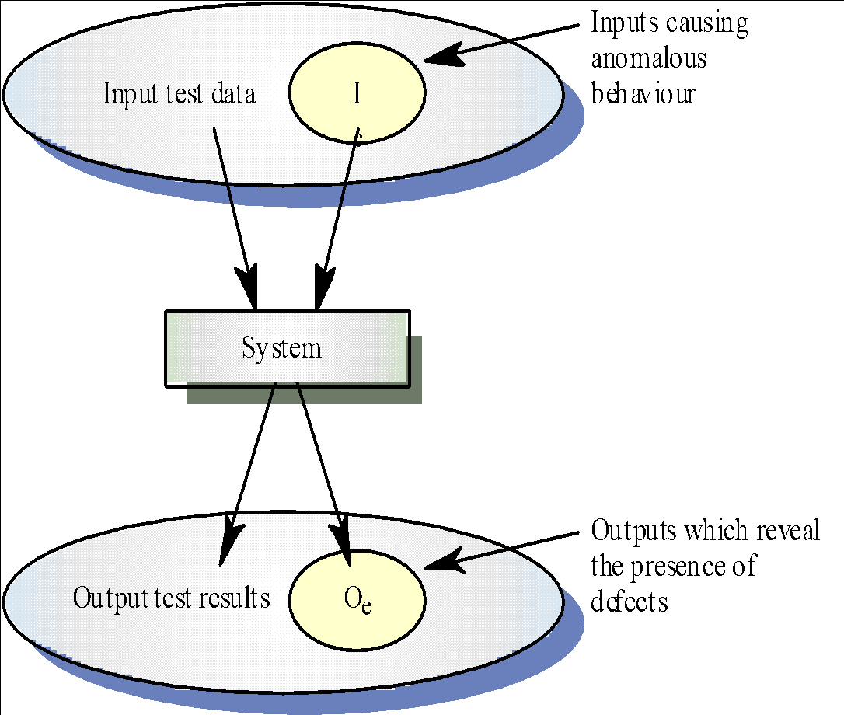
Black-box test
Objectives:
Check if the implementation fulfills the design
是否有不正確或遺漏了的功能? Are there any features that are incorrect or missing?
輸出是否正確 Is the output correct?
Actions: input vs output
Notes:
因此，在black-box testing的方法中，由於程式被視為一個黑盒子，
所以測試個案的設計是以系統規格為主。相較於white-box testing
是從程式碼來設計測試個案的作法，black-box testing的測試計畫
可以在軟體流程較早的階段開始，一旦規格設計出來就可以用來設計
test case。
Therefore, in the black-box testing method, since the program is treated as a black box, the design of the test case is based on system specifications. Compared to white-box testing, Is to design test cases from the code, black-box testing test plan can be started at an early stage of the software process, once the specification is designed, it can be used to design test case.
不過黑箱測試一個最主要的問題在於測試個案中輸入資料的選擇，
若是沒辦法找出一個關鍵性以及具有代表性的輸入資料，會導致測試
不完整，這非常依賴測試工程師的經驗，當然也有一些較為系統化的
測試資料設計方法，如：對等切割(equivalent partitions)，這將會在
後面的內容中做詳細的介紹。
However, one of the main problems in black box testing is the choice of input data in the test case.
If there is no way to find a key and representative input, it will lead to testing.
Incomplete, this is very dependent on the experience of the test engineer, of course, there are some more systematic test data design methods, such as: equivalent partitions, which will be a detailed introduction will be given later.

Slide 12
Test Case Design Principle – Black box Test (1/4)
Single parameter EX: bool isExisted(Key input)
正確的資料 Correct input
函式 Function
正確的輸出 Correct output
錯誤的資料 Wrong input
函式 Function
錯誤的輸出 Wrong output
Two parameters EX: int search(List list, Key input)
正確的資料
Correct input
錯誤的資料 Wrong input
函式 Function
正確的輸出 Correct output
函式 Function
錯誤的輸出 Wrong output
正確的資料
Correct input
正確的資料
Correct input
正確的資料
Correct input
錯誤的資料 Wrong input
函式 Function
錯誤的輸出 Wrong output
函式 Function
錯誤的輸出 Wrong output
錯誤的資料 Wrong input
錯誤的資料 Wrong input

Slide 13
Test Case Design – Black box Test (2/4)
Equivalence partitioning 對等切割
同區塊的資料效力視為等價 Data in the same block are treated as equivalent classes
所有範圍都需要被測試 - 一個等價區塊一個測試案例 Every range needs to be tested - A test case for each equivalent class
Boundary Value Analysis (BVA) 邊界值分析
比起在特定範圍中央，錯誤更容易在輸出入資料的邊界發生 Errors are prone to occur at boundaries of an input/output range than in the center of the range
除了選擇在等價區塊中的邊界值，也需要測試區塊外的邊界值 Besides selecting data inside an equivalence class, BVA selects data at the edges of the equivalence class.
對等切割只以輸入建立測資，邊界值分析同時使用輸入和輸出 Unlike equivalence partitioning only derive test cases by input conditions, BVA derives test cases from both input and output
Less than 3 | Between 3 and 6 | More than 6
2
3
BVA
6
7

Slide 14
Equivalence Partitioning
Equivalence partitioning
Divide the input domain into classes of data
Derive test cases based on these partitions
Test case design for equivalence partitioning is based on an evaluation of equivalence classes for an input domain
Can be defined by these guidelines:
If a range is specified in an input condition, 1 valid and 2 invalid equivalence classes are defined
If a specific value is required in an input condition, 1 valid and 2 invalid equivalence classes are defined.
If a member of a set is specified in an input condition, 1 valid and 1 invalid equivalence classes are defined.
If a boolean is given as an input condition, 1 valid and 1 invalid equivalence classes are defined.
If 3 < x < 10 :
Less than 3 | Between 3 and 6 | More than 6
2
5
7

Slide 15
Test Case Design – Black box Test (2/4) Example
Ex: bool ValidateUserID(const char* userID, char [] sequence)
//判斷註冊帳號為1~6字元，並確認不與已註冊帳號重複
//The length of a valid userID for registration should be 1~6 characters, and is not duplicate with existing accounts. Case: 為使產生重複帳號我們將sequence 放入”Nill”一個userID Case : In order to generate duplicate accounts, we will put an userID "Nill" into sequence
3. 合格ID
qualified ID
5. 重複ID
duplicate ID
1.null user ID
2. 合格ID
(lower bound)
4.合格ID
(upper bound)
6.不合理ID
not qualified ID
帳號為空 empty
帳號為規定範圍 specified range
帳號為不符規定 not qualified
帳號長度 < 1 length < 1 | 帳號長度 >= 1 AND 帳號長度 <= 6 length >= 1 and length <= 6 | 帳號長度 > 6 length > 6
0
1
4
4
6
7
Test data: 空字串 C Bill Nill Office William empty string
合理但重複帳號
qualified but duplicate

Slide 16
Test Case Design – Black box Test (3/4)
測試案例 (Test Case)
測試案例就是設計一個情況（Condition），然後軟體程式在這種情況下能夠依循運作並且達到預期的執行結果（Expected Result）。
"Test case" is, design a condition, and the software program can run with the condition to achieve expected result.
測試資料 (Test Data)
從測試案例中產生系統測試用的實際入資料與預期輸出結果
Make actual input data and the expected output result for testing the system from test cases.
bool ValidateUserID(const char* userID, char [] sequence)
Case | userID | sequence
1 | Null | one element
2 | Valid userID(lower bound) | one element
3 | Valid userID | one element
4 | Valid userID (upper bound) | one element
5 | Invalid userID (Existed ID) | one element
6 | Invalid userID | one element
Case | Input userID | Input sequence | Expected
1 | {} | {Nill} | False
2 | {C} | {Nill} | True
3 | {Bill} | {Nill} | True
4 | {Office} | {Nill} | True
5 | {Nill} | {Nill} | False
6 | {William} | {Nill} | False
Notes:
列出所有可能的狀況 並依照這些狀況來設計TEST CASE
一個TEST CASE不一定只會產生一個TEST DATA
而是有可能會一個TEST CASE 產生出多個TEST DATA
List all possible conditions and design TEST CASE according to these conditions
A TEST CASE does not necessarily produce only one TEST DATA
It is possible that a TEST CASE will generate multiple TEST DATA

Slide 17
Test Case Design – Black box Test (4/4)
寫好一個物件的測試功能 Write a test function for an object
以測試計畫test data為測試資料 Use test data described in test plan as test data
由測試碼進行測試 Test it by test code
/* 帳號的長度限定為 1 到 6 個字元*/ /* The length is limited to 1 to 6 characters*/
class system{
bool ValidateUserID(char* userID){
int num = strlen(userID);
return (num >= 1 )&& (num <= 5 );
}
}
Test Case |  | Validate
userID | Return | 測試結果 Test Result | 確認
{} | False | False | ○
C | True | True | ○
Bill | True | True | ○
Office | True | False | ×
William | False | False | ○
測試結果第四項目不符合表示程式有錯 The fourth result of the test result is not the same as expected “Return” in test case, indicating that the program run into problem.
Notes:
去DB比對
寫基本資料
Go to DB comparison
Write basic information

Slide 18
White-box Testing
根據程式架構推導出測試案例 Test cases are designed by the program flow
白箱測試對軟體產品之內容細節進行仔細地檢查。透過測試資料以檢查特定條件或迴圈，來測試軟體的邏輯路徑，同時檢查重要的資料結構。 White-box testing will check the details of the software product carefully. Logical path, specific conditions, loops, and important data structures will be tested by test data.
白箱測試設計與執行是程式開發人員 Executed by developer

Slide 19
白箱測試方法 White Box Testing
By white-box testing, we can derive test cases that
Guarantee that all independent paths in a module have been exercised at least once
Exercise all logical decisions on their true/false sides
Exercise all loops at their boundaries and within their operational bounds.
Exercise internal data structure to assure their validity.
Make sure the software operates accroding to specifications and designs

Slide 20
白箱測試方法 White Box Testing
Approaches of white box testing:
Branch coverage
Path testing
Branch coverage v.s. Path coverage
Statement Coverage
The test case will be executed in such a way that each statement of the code is executed at least once.

Slide 21
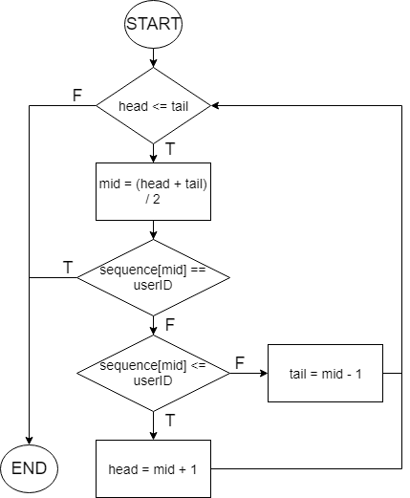
Branch coverage
目的:選擇足夠的 TEST CASE，讓程式中每一個分支都至少被執行一次 Goal : Select enough TEST CASE to have each branch in the program be executed at least once
為了使程式中的分支都被執行最少一次 那我們用 In order to make the branches in the program be executed at least once, then we use
Input :
case 1: useID = {Office} sequence={Nill}
case 2: useID = {C} sequence={Nill}
case 3: useID = {Nill} sequence={Nill}
優點:可以檢查所有的node是否有遺漏的問題 PROS: Able to check missing of any node
缺點:沒辦法看出程式是否正確 CONS: Not able to determine the program is correct or not

Slide 22

Branch coverage
Node
檢查:是否所有的TEST CASE能讓程式中每一個分支都至少被執行一次
Check: If all TEST CASE can make every branch in the program be executed at least once
Arc: the flow of control
1
head > tail
2
 | Branch
 | 2-9 | 2-3 | 4-5 | 4-6 | 6-7 | 6-8
Case 1: useID = {Office} sequence={Nill} |  | V |  | V | V
Case 2: useID = {C} sequence={Nill} |  | V |  | V |  | V
Case 3: useID = {Nill} sequence={Nill} |  | V | V
Case 4: useID = {Nill} sequence={} | V
 | Branch
 | 2-9 | 2-3 | 4-5 | 4-6 | 6-7 | 6-8
Case 1: useID = {Office} sequence={Nill} |  | V |  | V | V
Case 2: useID = {C} sequence={Nill} |  | V |  | V |  | V
Case 3: useID = {Nill} sequence={Nill} |  | V | V
head <= tail
3
4
=userID
5
6
<=userID
>userID
7
8
9

Slide 23
路徑測試 Path testing
目的 (Objective)
最終目標是要對每個程式路徑作測試 The objective of path testing is to ensure that the set of test cases is such that each path through the program is executed at least once
程式控制流程 (Program flow graphs)
每個分支當做個別的路徑 Each branch as an individual path
Loop 結束後則指回 loop 起始條件的 node An arrow will loop back to the node of initial condition after the end of loop
Example
循環複雜度 Used as a basis for computing the cyclomatic complexity
Notes:
這裡接著要介紹white-box testing中的另一個測試方法，
稱為「路徑測試」(path testing)，路徑測試也是結構化測試的一種技巧，
其重點如下：
Path testing的主要目的是確定透過一組測試個案的執行，
可以讓程式中每個可能路徑至少執行過一次
因此，要進行path testing的話，首先要瞭解的是「程式流程圖」
(program flow graph)，可以使用nodes來表示程式的決策動作，
以及arcs來表示控制的流程
亦即程式中的條件敘述都成為流程途中的nodes
因此，當程式中有條件敘述時，在程式流程圖中才會出現分歧的情形，
而藉由這些分歧的狀況可以列出這些不同路徑的測試個案。隨著程式碼的增大，
此程式碼的路徑數目會成等比例的增加，所以當很多模組組合成一個系統時，
使用路徑測試就顯得不太實用了。所以路徑測試是最常用於單元測試(unit testing)
的技巧之一。
路徑測試通常不會測試所有路徑的可能組合，特別像是回圈(loop)的情形，有時候
錯誤是執行了好幾個回圈之後才發生，而且不一定是固定幾次，這說明了即使所有
的程式碼通過了path testing之後，錯誤仍然可能存在。
Here is another introduction to the test method in white-box testing, called "path testing", path testing is also a technique for structured testing.
The key points are as follows:
The main purpose of Path Testing is to determine the execution of a set of test cases. Can make every possible path in the program execute at least once
Therefore, to perform path testing, the first thing to understand is the "program flow chart" (program flow graph), you can use nodes to represent the decision action of the program. And arcs to represent the flow of control
That is, the conditional narrative in the program becomes the nodes in the process.
Therefore, when there is a conditional narrative in the program, there will be divergence in the program flow chart.
With these divergent situations, test cases for these different paths can be listed. As the code increases, the number of paths in this code will increase proportionally, so when many modules are combined into one system, using a path test is not very practical. So path testing is most commonly used for unit testing one of the tricks.
Path testing usually does not test possible combinations of all paths, especially in the case of loops, sometimes the error occurs after several loops have been executed, and it is not necessarily fixed several times, which means that even if after all the code passed the path testing, the error may still exist.

Slide 24
Construct the program control flow
Node
public class accountConfirm {
public static ValidateUserID(const char* userID, char [] sequence)
{
int head = 0 ;
int tail = sequence.length - 1 ;
int mid ;
r.found = false ;
r.index = -1 ;
while (head <= tail)
{
mid = (head+tail) / 2 ;
if (sequence[mid] == userID)
{
r.index = mid ;
r.found = true ;
break ;
} else {
if (sequence[mid] <= userID) {
head= mid + 1 ;
}
else{
tail = mid -1 ;
}
} // if
} // while loop
return r.found;} // return
} // Sequence
1
Arc: the flow of control
1
head > tail
2
2
3
head <= tail
4
3
5
4
=userID
6
5
6
<=userID
>userID
7
7
8
8
9
9

Slide 25
Cyclomatic complexity
Cyclomatic complexity表示出要測試所有所需進行的path test數量 Cyclomatic complexity shows the number of path tests required to test all statements
Cyclomatic complexity定義了獨立路徑個數的上限，而這些測試的設計與執行保證涵蓋所有程式碼 Cyclomatic complexity defines the max number of independent paths, and the design and execution of these tests guarantee to cover all the code
提供了整個程式複雜度的一個量化衡量值 Provides a quantitative measure to know the complexity of the program
CC(G) = Number (edges) – Number (nodes) + 2
即使測完全部路徑，所有的路徑組合仍沒執行(依然有風險存在) Even if every path is tested, not every path combinations is executed (Still risky)
1
head > tail
2
head <= tail
3
等於userID equal to userID
不等於userID
not equal to userID
4
5
6
<=userID
>userID
8
7
9
Notes:
因此，path testing有牽涉到一個很重要的方法，稱為「循環複雜度」，
其用來計算出一個程式流程圖中可以發掘的獨立路徑的數目，其意義如下：
其表示測試的數目，亦即要所有流程控制敘述所需的測試數目等於循環複雜度的值
循環複雜度也等於程式中的條件敘述的數目
這個循環複雜度的使用上要很小心，因為其不代表測試本身是否恰當。
即使所有的路徑都被執行過，但不代表所有可能路徑的組合都被執行過。
對於一個程式流程圖(G)，其循環複雜度(CC)等於edges的數目減去nodes的數目
然後加2，另外也有一種算法，就是對於沒有goto的程式，其CC等於條件敘述的數目加1，
另外，有多重條件敘述的語法時(如：switch)，每一個測試都算一個條件敘述。
Therefore, path testing involves a very important method called "loop complexity".
It is used to calculate the number of independent paths that can be explored in a program flow diagram. The meanings are as follows:
It indicates the number of tests, that is, the number of tests required for all flow control statements equals the value of the cycle complexity.
The loop complexity is also equal to the number of conditional narratives in the program.
This loop complexity should be used with care because it does not represent whether the test itself is appropriate.
Even if all the paths have been executed, it does not mean that all possible combinations of paths have been executed.
For a program flow diagram (G), its loop complexity (CC) is equal to the number of edges minus the number of nodes
Then add 2, there is also an algorithm, that is, for a program without goto, its CC is equal to the number of conditional statements plus one,
In addition, when there are multiple conditional grammars (such as: switch), each test is counted as a conditional statement.

Slide 26
Program flow graph of binary search
CC(G) = Number(edges) – Number(nodes) + 2
Ans：11-9+2=4
1
head > tail
2
head <= tail
Path 1: 1- 2- 9
Path 2: 1- 2- 3- 4- 5- 9
3
Path 3: 1- 2- 3- 4- 6- 7- 2-…
等於userID equal to userID
不等於userID
not equal to userID
4
Path 4: 1- 2- 3- 4- 6- 8- 2-…
5
<=userID
6
>userID
對每個路徑準備可強制執行該路徑的測試案例 Prepare a test case that can force the path to be tested for every path
userID=Input account, sequence=已存在帳號
userID=Input account, sequence=Existing account
7
8
9
Case | Input userID | Input sequence | r.found | Path
2 | {C} | {Nill} | False | Path 4
3 | {Bill} | {Nill} | False | Path 4
4 | {Office} | {Nill} | False | Path 3
5 | {Nill} | {Nill} | True | Path 2
7 | {C} | {} | False | Path 1
Notes:
基於前面的公式，這裡使用前面二元搜尋法的Java程式來做為例子，
依據程式碼所繪製出來的程式流程圖如上面所示。
其edges數目為11，nodes數目為9，所以「循環複雜度」CC(G)=11-9+2=4，
表示有四條完全不同的路徑。
Test cases should be derived so that all of these paths are executed (從獨立路徑推導出所有可能的路徑組合)
A dynamic program analyser may be used to check that paths have been executed (可能藉由外部工具分析路徑是否已執行)
Based on the previous formula, here is the Java program using the previous binary search method as an example.
The program flow chart drawn according to the code is as shown above.
The number of edges is 11, and the number of nodes is 9, so "loop complexity" CC(G)=11-9+2=4,
Indicates that there are four completely different paths.
Test cases should be derived so that all of these paths are executed (deriving all possible path combinations from independent paths)
A dynamic program analyzer may be used to check that paths have been executed (may analyze whether the path has been executed by an external tool)

Slide 27
獨立路徑 Independent path
一個獨立路徑是一條程式的路徑，其中至少引進一段新的程序性程式碼或一個新的條件(也就是說，一個獨立路徑至少有一段路徑是前面找到的獨立路徑所沒有的) An independent path is a path of program, with at least a new piece of procedural code or a new condition. (that is, an independent path have at least one part of path which can not be found in other independent paths)
Examples:
Path 1: 1-2-9
Path 2: 1-2-3-4-6-7-2-9
Path 3: 1-2-3-4-6-8-2-9
Path 4:
1-2-3-4-6-7-2-3-4-6-8-2-9
(not an independent path)
1
head > tail
2
independent
paths
head <= tail
3
等於userID equals to userID
不等於userID
not equal to userID
4
5
6
<=userID
>userID
8
7
9

Slide 28
Branch coverage V.S. Path coverage
1
foo(int x) { if (x>0) { // clap } else { // stump } if (x is even) { // dance } else { // sing } }
Now, two inputs x=2 and x = -3, provide full branch coverage for this program (every branch is taken in some execution over some input). However, full path coverage is not achieved, because the paths that would follow "clap and sing" or "stump and dance" are never exercised.
1
2
3
2
3
4
4
5
6
5
6
7
7

Slide 29
Test Case Design – Error guessing
可以透過參考常見的錯誤和過去的經驗輔助 Test Cases 的設計 Common errors and experience will be useful when designing test cases.
一些常見可能或容易發生錯誤的狀況： Some common errors or error-prone situations:
除數為 0 Divided by 0
負數 Negative Number
空字串或陣列、容器 Empty String, Array or Containers
空指標、沒有 instance Null pointer, no instance
字串中有空白或者會造成問題的特殊字元 (例如無法印出的字元) White spaces in string or special characters (for example, non-printing characters)

Slide 30
Integration Test
(Incremental integration)
目的：檢驗軟體結構中各模組的的每個功能與性能介面功能是否正常。
Goal: Verifying every function and performance interface in each module are working properly.
步驟：根據整合測試計畫逐步將單元測試完成整合成系統
Steps: Integrate unit tests to a system step-by-step by the integration test plan
常用的整合方式有：
Commonly used integration methods are :
1.由上而下的增值方式 (Top-down)
2.由下而上的增值方式 (Bottom-up)
3.混合增值方式 (Sandwich)
B
A
C

Slide 31
Top-down
將模組依據系統的程式結構，沿控制層次由上而下進行整合。
The modules are integrated from top to bottom along the control level according to the program structure of the system.
整合流程 (Integration process)
主要的控制模組作為測試的驅動者，殘根(stub)取代控制模組之下的模組
The main control module acts as the test driver, and stubs replace the modules below the control module.
根據採用的是深度優先或廣度優先的，下面的殘根依序一個一個地被真實模組所替代
According to the method chosen, depth-first or breadth-first, the stubs below are replaced by real modules one by one.
當一個模組被整合進來，即進行測試
Run the test right after a module is integrated.
當一組測試完成，另一殘根就被真實模組所替代
When the test of a set completes, another stub will be replaced by the real module.
從步驟2開始重複，直到整個架構建立完成
Repeat from step 2 until the entire architecture is built.
M1
top module is tested with stubs
M2
M3
M4
stubs are replaced one at a time
M5
M6
M7
as new modules are integrated, some subset of tests is re-run
M8

Slide 32
殘根
Stub
殘根：用來代替所測模組呼叫的子模組
Stub: Submodule to replace which called by the test module
main(){
//do something
getinput();
sort();
}
stub:
getinput(){
//do someting
return{1,6,7,5}
}
main()
M1
M2
M3
getinput()
sort()

Slide 33
Depth-first v.s. Breadth-first
例子(example):
f1:
B
A
C
深度優先
Depth first
IT1: IT2: IT3:
廣度優先
Breadth first
IT1: IT2: IT3:
A
A
A
A
A
A
B
C
B
C
B
C
B
C
B
C
B
C
C
C
C
C
C
C

Slide 34
Bottom-up
從程式結構的最底層模組開始組裝和測試
Start assemble and test from the lowest-level module of the program structure.
因為元件由下往上整合，對從屬於某一階層元件所必要的處理總是可以利用的，並且可以消除對虛擬模擬的需要。
Because the components are integrated from the bottom up, the lower-level submodule needed by the higher-level module is always available, and the needs to create stubs is eliminated.
模組的測試過程需要從子模組得到的資訊可以直接執行子模組得到。
The information needs to get from submodules in the testing process of a module can be obtained by directly run the submodule.
M_{c}
M_{a}
M_{b}
D1
D2
D3
Cluster
1
Cluster
3
Cluster 2

Slide 35
Sandwich
因為由上而下增值方式和由下而上增值方式各有優缺點，而混合增值方式(三明治法)就是把由上而下和由下而上這兩種增值方式結合起來進行整合和測試。
Since top-down and bottom-up methods both have their pros and cons, the sandwich method combines both ways to do integration and test.
使用兩個方式的優點，但是屏除其缺點。
The sandwich method makes use of the advantages of two methods, and eliminate the disadvantages of them.

Slide 36
Automated Unit Test
單元測試應為可自動化的流程； 測試無需人為介入就可以執行並確認結果。 Unit tests should be automated; tests should be able to run and check the results without human intervention.
使用自動化測試框架(如 JUnit)來撰寫並執行自動化單元測試。 Use test automation framework(such as Junit) to write and run automated unit tests.
通常包含用測試案例初始化系統(Arrange)、 呼叫待測函數(Act)和判斷結果是否符合預期(Assert)三個部份。* Typically contains three parts including initialize the system with the test case(Arrange), call the function under test(Act), and assert whether output is expected or not(Assert).
* https://docs.microsoft.com/en-us/visualstudio/test/unit-test-basics?view=vs-2017#write-your-tests

Slide 37
Integration Test
 | Top-down | Bottom-up | Sandwich
介紹 Introduction | 將模組依據系統的程式結構，沿控制層次由上而下進行整合。 The modules are integrated from top to bottom along the control level according to the program structure of the system. | 從程式結構的最底層模組開始組裝和測試。 Start assemble and test from the lowest-level module of the program structure. | 結合Bottom-up跟Top-down方法進行測試 Tested in conjunction with Bottom-up and Top-down methods
優點 Advantage | 最高階層的介面最先被測試，且被測試的機會最多。 The interface at the highest level will be tested first and will be most frequently tested. 系統的錯誤若在上階層，則可及早發現。 Problems of the system can be found earlier if it is located on higher level. | 易於測試案例的設計，且不用殘根。 Test cases are easier to design, and no stubs needed. 可重複使用。 Reusable. 系統錯誤如果在下方，則可及早發現。 Problems of the system can be found earlier if it is located on lower level. 最低階的測試較徹底。 More thorough tests at the lowest level. | 同時擁有前二者的優點 Have the advantages of top-down and bottom-up
缺點 Disadvantage | Logistical problems can raise 需要寫一個測試殘根(耗成本) Need to write a test stub (may be costly) | 主要的設計錯誤會在最後才出現 Major design errors will not show up until the end. | 摒除前二者的缺點 Eliminate the shortcomings of top-down and bottom-up

Slide 38
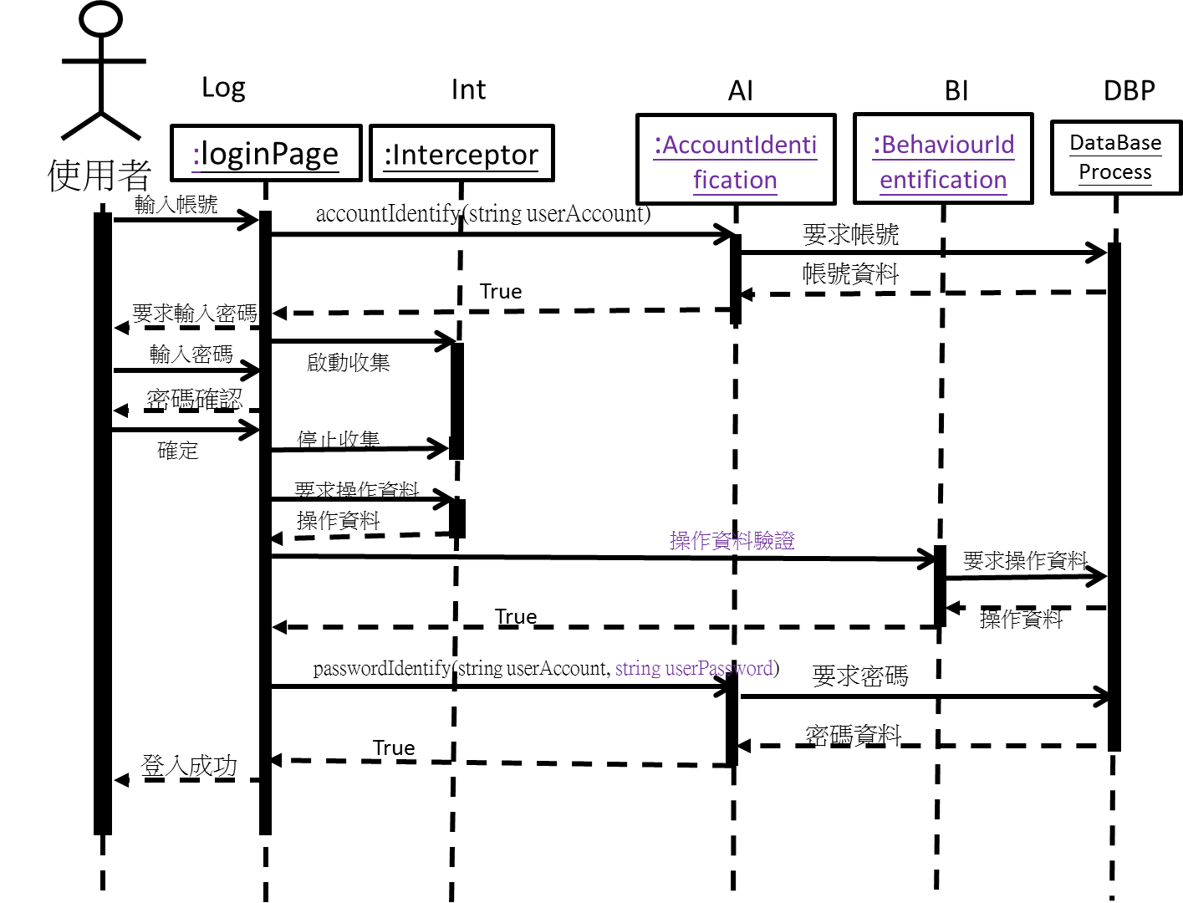
Integration Test Procedure
系統整合主要考量設計階段sequence diagram，
將Sequence diagram 中所需要module進行整合元件測試
System integration mainly considers the sequence diagram in the design stage and will do an integration test with modules required by sequence diagram.
使用者登入循序圖
User login sequence diagram

Slide 39
Integration Test Procedure
依流程進行整合測試: IT1、IT2…
Do integration test according to the procedure: IT1, IT2...
Log: LoginPage Int.: Interceptor
AI: AccountIdentification DBP: DataBaseProcess
BI: BehaviourIdentification
Log
IT1:
AI
Int.
BI
AI
DBP
DBP
DBP

Slide 40
Integration Test Procedure
Log
AI
Int.
BI
AI
IT2:
DBP
DBP
DBP
…
Log
AI
Int.
BI
AI
IT7:
DBP
DBP
DBP

Slide 41
Test Procedure
程序依序為整合測試與接受測試。
The test procedure is: do integration test first, then do the acceptance test.
系統測試: 驗證是否能完成需求規格文件中所述之Use Cases。
驗收測試:
An acceptance test to verify whether the use cases described in the Software Requirement Specification were done or not.

Slide 42

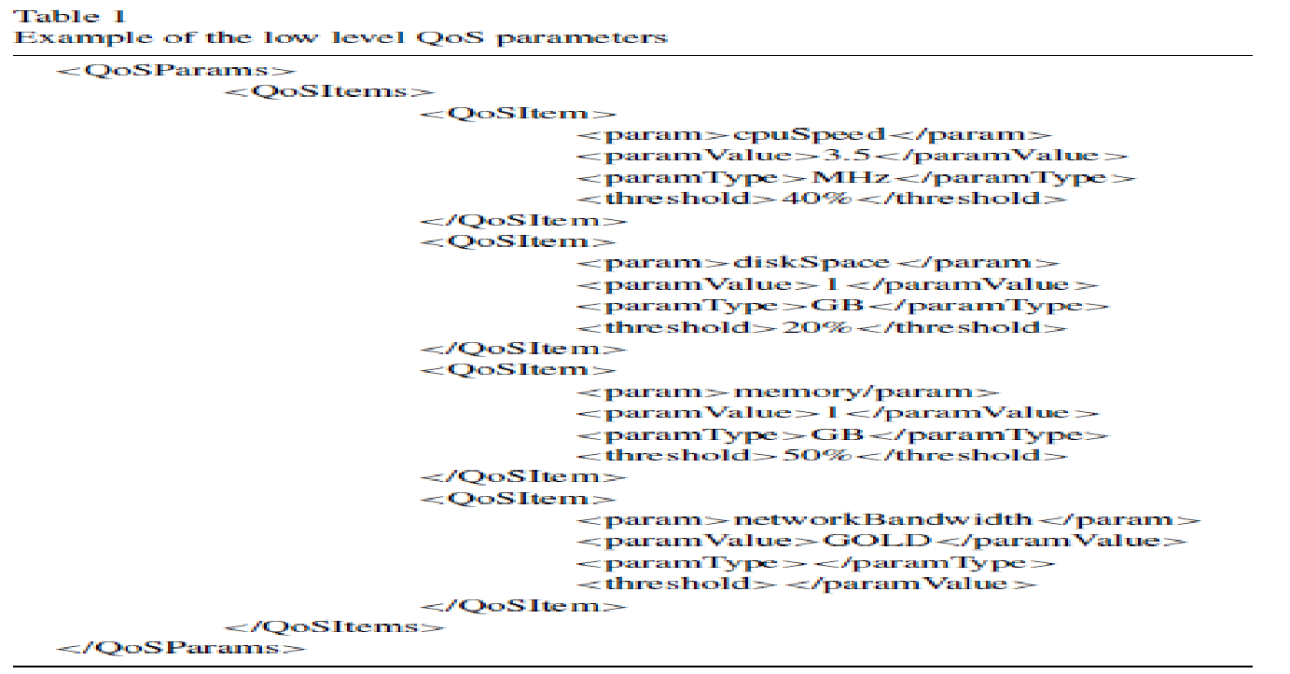
System Test (1/2)
系統測試包含檢驗軟體本身的各種功能與介面操作是否正常的 Functional test (功能性測試) ，以及檢驗軟體本身強度、性能、相容性等相關品質方面的指標non-functional test (非功能性測試)。
System Test mainly does Functional Tests that include functions of the software itself and UI operation, and Non-functional Tests including quality-related indexes such as robustness, performance, and compatibility.
System Test
Acceptance Test
getClassDetail(Sequence, Element): ClassDetail[]
ID | Sequence | Element
1 | Single class | Not in sequence
2 | Single class | In sequence
加入語音服務
Wouldn’t it be nice to have a voice input?
LMS Portal Site
using
Specs
test
畫面操作不夠直觀
GUI design is not friendly enough
Notes:
顧客自己根本無法正確描述他想要的需求。
System test 是依照SRS document的功能描述來進行測試。

Slide 43
System Test (2/2) & User Testing
常見的非功能性系統測試還包含壓力測試， 透過以超過正常負荷的方式操作系統來測試其行為。 Common non-functional tests including Stress Test, which overload the system to test the system’s behavior.
使用者測試透過以使用者的環境執行系統， 取得使用者的建議並了解系統的可用和可靠性。 User Testing get users’ feedback and learn about the system’s usability and reliability by running the system on the environment of users.
常見的使用者測試包含 由開發團隊與特定測試者以預定使用方式進行的 Alpha 測試和 讓使用者取得、自行操作軟體並回報問題的 Beta 測試 Common user testing includes Alpha testing which developers and specific testers operate the system as expected, and Beta testing that users get the software and operate the system by themselves.
Notes:
顧客自己根本無法正確描述他想要的需求。

Slide 44
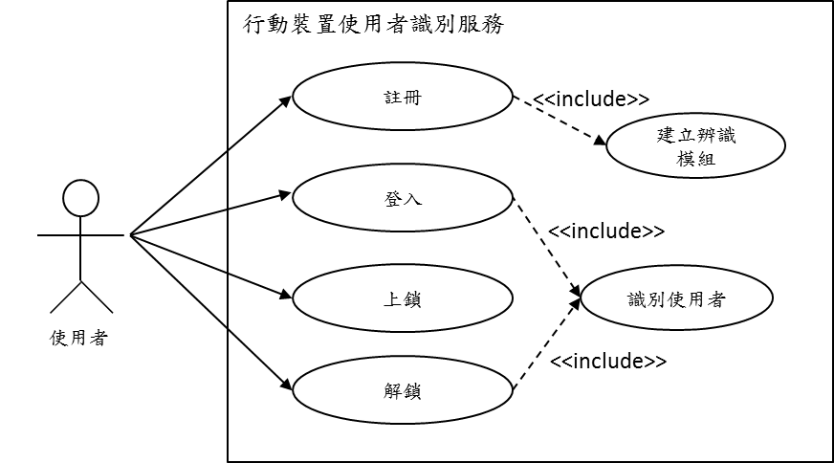
Test cases design for System Test
所有使用案例
test cases shall covers all use cases specified in SRS
Mobile device user identification service
register
註冊
ST-1
register
create recognition module
login
登入
ST-2
lock
identify user
login
user
unlock
…

Slide 45
Test cases design for System Test
隱形三代鎖
Mobile locks

Slide 46
系統測試案例 (System Test Cases)-1/4
ST2 Use Case description
使用案例編號 Use case number | MSS-UC-02
使用案例名稱 Use case name | 登入 Login
目標 Goals | 使用者登入 User login
主要行為者 Main Actor | 使用者 User
前提 Preconditions | 使用者已註冊完畢 User has already registered
結束狀態 End state | 成功登入 Successful login
其他關連 Other related | Extend 之使用案例 (Extend Use Cases): Include 之使用案例 (Include Use Cases): 識別使用者 (Use Case) Generalization 之使用案例 (Generalization Use Cases):
正常程序 Procedures | 1. 使用者輸入帳號名稱 User enter account name 2. 確認帳號資料後，系統啟動識別機制 After confirming the account information, the system starts the recognition mechanism. 3. 使用者輸入密碼，完成後按確認 The user enters the password and presses the confirmation button when done. 4. 系統取得使用者操作行為，辨別密碼和行為資料，告知使用者登入成功 The system will obtain the user's operation behavior, then identify the password and behavior data, and inform the user that the login is successful.
例外程序 Exception procedure | 1. 登入帳號不存在 Login account did not exist 告知該帳號不存在，請使用者重新輸入 Inform the account that it did not exist, please user enter the username again 2. 登入失敗，系統回到原頁面 Login failed, the system returns to the original screen 登入密碼不符 Login password does not match 密碼輸入行為不符 Password input behavior does not match

Slide 47
系統測試案例 (System Test Cases)-2/4
以登入use case 選出可測試資料組合
Select testable data sets of the use case “Login”
正常程序 Normal procedure | 使用者輸入帳號名稱 User enter account name 確認帳號資料後，系統啟動識別機制 After confirming the account information, the system starts the recognition mechanism. 使用者輸入密碼，完成後按確認 The user enters the password and presses confirmation button when done. 系統取得使用者操作行為，辨別密碼和行為資料，告知使用者登入成功 The system obtains the user's operation behavior, identifies the password and behavior data, and informs the user that the login is successful.
例外程序 Exception procedure | 2. 登入帳號不存在 Login account does not exist 告知該帳號不存在，請使用者重新輸入 Informs the account does not exist, please user try again 4. 登入失敗，系統回到原頁面 Login failed, the system returns to the original page 登入密碼不符 Login password does not match 密碼輸入行為不符 Password input behavior does not match
帳號輸入
account entry
正確
correct
錯誤
error
密碼輸入
password input
帳號不存在
account inexistent
ST2-01
密碼正確
行為正確
password is correct
correct behaviour
密碼正確
行為錯誤
password is correct
wrong behaviour
密碼錯誤
行為正確
wrong password
correct behaviour
密碼錯誤
行為錯誤
wrong password
wrong behaviour
ST2-02
ST2-03
ST2-04
ST2-05

Slide 48
系統測試案例 (System Test Cases)-3/4
AT1 SRS
測試案例編號 Test case number | MMS-ST2-01 02
測試案例名稱 Test case name | 登入測試 Login test
測試目的 Testing purposes | 測試二代隱形鎖帳號、密碼、行為正確登入 Using correct account, correct password, and correct behavior to login with the second generation of invisible lock
前置條件 Preconditions | 使用者已註冊完畢，測試人與註冊人需同一人 The user has already registered, the tester and the registrant must be the same person.
事前準備 Preparations | 1. 使用者以帳號：Nick / 密碼：1234註冊完畢 User registered with account: Nick / Password: 1234 2. 開啟使用者識別服務程式 Open the user identification service program 3. 點選”登入” Click "Login"
步驟 Procedures | 測試程序 test program | 預期結果 expected result
 | 1.使用者輸入帳號: Nick，完成後按確認鈕 User enters the account number: Nick, press the confirmation button when done. | 顯示密碼輸入介面，啟動攔截器 Display password input interface, start interceptor
 | 2.使用者滑動螢幕輸入 User sliding screen input 密碼:1234, Password: 1234, 按確認鈕結束 Press the confirmation button to end | 停止攔截器收集，並以此為使用 者行為，顯示註冊成功 Stop the interceptor collection and use this as the user behavior to display the registration success.
結束狀態 End state | 登入成功 Loginsuccessfully
1. 使用者輸入帳號名稱
User enter account name
2. 確認帳號資料後，系統啟動識別機制
After confirming the account information, the system starts the recognition mechanism.
3. 使用者輸入密碼，完成後按確認
The user enters the password and presses the confirmation button when done.
4. 系統取得使用者操作行為，辨別密碼和行為資料，告知使用者登入成功
The system obtains the user's operation behavior, identifies the password and behavior data, then informs the user that the login is successful.

Slide 49
系統測試案例 (System Test Cases)-4/4
AT1 Test Case
測試案例編號 Test case number | MMS-ST2-02 01
測試案例名稱 Test case name | 登入測試 Login test
測試目的 Testing purposes | 測試二代隱形鎖帳號錯誤登入回應 Test Login Failed Response of the second generation of invisible lock
前置條件 Preconditions | 使用者已註冊完畢，測試人與註冊人需同一人 The user has already registered, the tester and the registrant must be the same person.
事前準備 Preparations | 1. 使用者以帳號：Nick / 密碼：1234註冊完畢 User registered with account: Nick / Password: 1234 2. 開啟使用者識別服務程式 Open the user identification service program 3. 點選”登入” Click "Login"
步驟 Procedures | 測試程序 test procedure | 預期結果 expected result
 | 使用者輸入帳號: Nook，完成後確認鈕 User input account: Nook, click the confirmation button after completion | 顯示帳號不存在，回到帳號輸入頁面 Display ‘the account does not exist’ and return to the account input screen.
結束狀態 End state

Slide 50
Non-functional Requirement Test Cases
(Test Procedure)
在先前SRS文件中提及Non-functional Requirement (如:效能需求MSS-NFR-01)，因此我們也需進行本系統之非功能性需求測試
In the previous SRS file, Non-functional Requirements (such as: performance requirements MSS-NFR-01) are mentioned, so we also need to perform non-functional requirement tests of the system
SRS非功能性需求 Non-functional requirements:
效能需求 Performance requirement
需求編號 Requirement Number | 優先 Priority 順序 Order | 需求描述 Requirements
MSS-NFR-01 | 1 | 在無網路延遲的情況下，分析結果應於4秒內將分析結果處理完並開始傳送給使用者 Analyze results should be done and started to send the result to the user in 4 seconds when there was no network latency.
Test plan:
Test Procedure
測試案例編號 Test case number | 測試項目名稱 Test case name | 測試項目說明 Test item description
MMS-NFT-01 | 使用者識別機制的系統效能 System performance of user identification mechanism | 測試系統能否在4秒內完成使用者的驗證動作 Can the test system complete the user identification action within 4 seconds?

Slide 51
Non-functional Requirement Test Cases (Test case)
參照Test Procedure對Test Case 進一步描述目標、方法等
Refer to the Test Procedure to describe the target, method, etc. of the Test Case further.
Test Procedure
測試案例編號 Test case number | 測試項目名稱 Testcase name | 測試項目說明 Test item description
MMS-NFT-01 | 使用者識別機制的系統效能 System performance of user identification mechanism | 測試系統能否在4秒內完成使用者的驗證動作 Can the test system complete the user's verification action within 4 seconds?
Test Case
測試案例編號 Test case number | MMS-NFT-01
測試案例名稱 Test case name | 使用者識別機制的系統效能 System performance of user identification mechanism
預期目標 Expected result | 驗證系統必須在4秒內完成10位使用者(個人樣本數:500)的驗證動作 The verification system must complete the verification action of 10 users (personal sample number: 500) within 4 seconds.
環境設定 Environment | 1台雲端VM，安裝server端使用者識別&管理程式。 (單核心Windows Server 2003 R2; 25GB HD; 2GB RAM) 並在同一台雲端VM上安裝模擬手機發request的程式。 1 cloud VM, install server-side user identification & management program. (single core Windows Server 2003 R2; 25GB HD; 2GB RAM) And install the program that simulates the mobile phone to send a request on the same cloud VM.
測試方法 Test Methods | Step1:啟動server端使用者識別&管理程式 Start the server-side user identification & management program Step2:啟動模擬手機發request的程式 Start the program that simulates the mobile phone to send a request Step3:紀錄發送開始時間，發送模擬10位使用者操作手機的行為紀錄 Record the start time of the transmission, send a record of the behavior of simulating 10 users to operate the mobile phone Step4:紀錄回傳訊息收到時間 Record the time when the returning message was received

Slide 52
Test Case Result
測試案例編號(對映測試計畫書編號) Test Case
通過/失敗 Result(Pass/Fail)
失敗說明 Comment
Test Case | Result(Pass/Fail) | Comment
MSS-ST2-01 | Pass
MSS-ST2-02 | Pass
…
…

