Slide 1
Autoware Safety Island
Building a Fail-Safe Companion with nano-ros

Slide 2
1. Why a Safety Island?
The main compute runs hundreds of nodes on Linux — complex, non-deterministic, hard to certify.
If it hangs, who stops the car?
An independent MCU that monitors the main compute and brings the vehicle to a controlled stop.
 | Main Compute | Safety Island
Hardware | Cortex-A (Orin, x86) | Cortex-M/R (MCU)
OS | Linux | RTOS / bare-metal
Complexity | Millions of LOC | Single binary
Certification | QM–ASIL B | ASIL C/D target
Failure mode | Detectable | Must not fail
Industry practice: NVIDIA DRIVE [1], Apex.AI [2], eSOL eMCOS [3] all use this pattern.

Slide 3
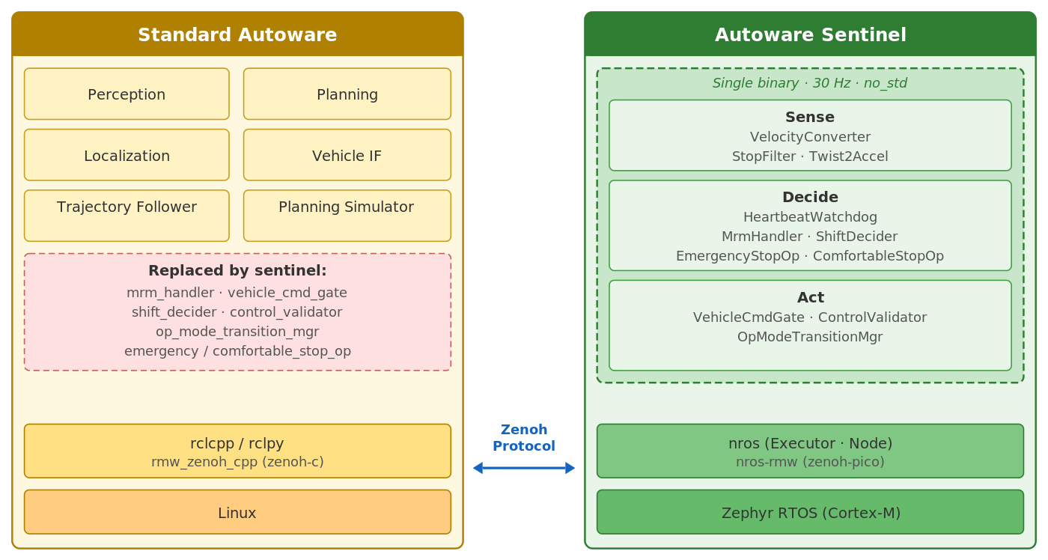
2. Autoware Sentinel — Our Reference Implementation
A single #![no_std] Rust binary replacing 7 Autoware safety nodes. 30 Hz deterministic loop. Zero heap allocation.
Heartbeat watchdog detects main compute failure (500 ms)
MRM handler activates emergency or comfortable stop
Vehicle command gate enforces rate/jerk limits
Control validator checks safety bounds
5 topics in, 30 topics out
Connected via Zenoh (rmw_zenoh)

Slide 4
3. nano-ros: The Foundation
A no_std ROS 2 runtime for embedded real-time systems. API compatible — same programming model across languages.
// Rust (rclrs-compatible)
let mut node = executor.create_node("safety")?;
let pub_ = node.create_publisher::<Control>("/cmd")?;
let _sub = node.create_subscription(
"/vel", |msg: VelocityReport| { ... })?;
// C (rclc-compatible)
nros_node_t node;
nros_publisher_t pub;
nros_create_node(&node, &exec, "safety");
nros_create_publisher(&pub, &node, "/cmd", ts);
Category | Support
Languages | Rust, C, freestanding C++14
Platforms | POSIX, Zephyr, FreeRTOS, NuttX, ThreadX, bare-metal
RMW | zenoh-pico, DDS-XRCE
Transport | TCP, UDP, serial (UART), IVC
Dev/test | Full stack runs in QEMU — no hardware needed

Slide 5
4. Why Rust for Safety-Critical Embedded?
no_std + alloc-free = bare-metal native. No runtime, no GC, no hidden allocations.
async/await with vendored runtime — the runtime is a library, not the language:
// RTIC: interrupt-driven tasks with async/await on Cortex-M
#[task(local = [executor], priority = 1)]
async fn net_poll(cx: net_poll::Context) {
loop {
cx.local.executor.spin_once(0); // non-blocking I/O
Mono::delay(10.millis()).await; // yields to lower-priority work
}
}
#[task(local = [publisher], priority = 2)] // preempts net_poll
async fn publish(cx: publish::Context) {
// This task runs at higher priority — guaranteed to meet deadline
publisher.publish(&Control { velocity: 0.0 })?;
}
Rich ecosystem: 4,000+ no_std crates on crates.io. Community-maintained HAL traits, drivers, and board support packages.

Slide 6
5. The Bare-Metal Software Stack
“How can a program run without an OS?” On a microcontroller, your binary is the only software. No kernel, no scheduler, no main() that returns to a shell. The hardware boots straight into your code.
Application
Sentinel: watchdog, MRM, gate, validator
Linux + ROS 2 vs. Bare-metal + nano-ros
Layer | Linux | Bare-metal
App | ROS nodes | Sentinel
Middleware | rclcpp/rclrs | nano-ros
Transport | DDS (millions) | zenoh-pico (30k)
Scheduler | Linux kernel | RTIC (zero-cost)
Boot | U-Boot/GRUB | HAL + startup
nano-ros
ROS 2 API: Node, Publisher, Subscriber, Executor
RTIC framework
Priority scheduler — maps tasks to HW interrupts
Hardware Abstraction Layer
Rust PAC/HAL: GPIO, UART, SPI, Ethernet, Timer
Linux stack ~10M+ lines of code Non-deterministic QM–ASIL B
Bare-metal stack ~50k lines of code Deterministic ASIL C/D certifiable
Cortex-M / Cortex-R hardware
NVIC, SysTick, MPU, DMA
Each layer is small and auditable. No virtual memory, no syscalls. Every function call is a direct branch.

Slide 7
5.2 How RTIC Replaces an RTOS
A traditional RTOS provides: (1) a scheduler, (2) synchronization primitives, (3) memory management. RTIC eliminates all three by leveraging hardware interrupt priorities directly.
Concept | Traditional RTOS | RTIC
Task | OS thread (dedicated stack) | Interrupt handler (shared stack)
Scheduling | Software scheduler (tick-driven) | Hardware NVIC (zero-latency)
Priority | Software priority queue | Hardware priority register
Mutex | Runtime lock (can deadlock) | Priority ceiling (deadlock-free)
Context switch | Kernel save/restore (~μs) | HW interrupt entry (~12 cycles)
Footprint | Kernel + per-thread stacks (KB) | No kernel, single stack (~1 KB)
Key insight: On Cortex-M, the NVIC (Nested Vectored Interrupt Controller) already implements a hardware priority-based preemptive scheduler. RTIC maps tasks onto interrupt vectors. The compiler statically verifies deadlock-freedom via the Stack Resource Policy (SRP) [5].

Slide 8
5.3 Anatomy of a Bare-Metal Application
#[rtic::app(device = stm32f4xx_hal::pac,
dispatchers = [SPI1, SPI2])]
mod app {
#[shared]
struct Shared {
executor: Executor, // nano-ros pub/sub
watchdog_ok: bool, // heartbeat status
}
#[init]
fn init(cx: init::Context) -> (Shared, Local) {
let dp = cx.device; // raw peripherals
let executor = Executor::open(&config).unwrap();
control_loop::spawn().unwrap();
(Shared { executor, watchdog_ok: true },
Local { led, timer })
}
#[task(shared = [executor], priority = 1)]
async fn net_poll(mut cx: net_poll::Context) {
loop {
cx.shared.executor.lock(|e| e.spin_once(0));
Mono::delay(1.millis()).await;
}
}
#[task(shared = [executor, watchdog_ok], priority = 2)]
async fn control_loop(mut cx: ...) { /* 30 Hz */ }
#[task(shared = [watchdog_ok], priority = 3)]
async fn brake_check(mut cx: ...) { /* highest */ }
}
#[shared]
Resources accessed across tasks. Locked via priority ceiling — deadlock-free by construction.
#[init]
Runs once at boot. Configures hardware, creates executor, spawns tasks.
Priority 1: net_poll
Lowest priority. Handles Zenoh I/O in idle time. Preemptible by everything.
Priority 2: control_loop
30 Hz control cycle. Preempts net_poll, yields to brake_check.
Priority 3: brake_check
Highest priority. Never delayed by any other task. Checks heartbeat deadline.

Slide 9
5.4 Runtime Behavior & Benefits
Time ──────────────────────────────────────────────────────────────►
Priority 3 ·········█·····················█·················█···
(brake) ↑ preempts ↑ preempts
Priority 2 ···██████·█████████████████████·███████████████··████
(control loop, runs every 33ms)
Priority 1 ██·····························█████████████████···
(net_poll, runs when higher priorities are idle)
All three tasks share one stack — no per-task stack allocation needed. • brake_check (P3) always preempts • control_loop (P2) preempts net_poll • net_poll (P1) fills the gaps
Certification
• One compilation unit
• No OS kernel to qualify
• Static stack bounds
• HW-bounded latency
Reliability
• No heap → no OOM
• No threads → no deadlock
• No dynamic dispatch
• SRP-proven [5]
Performance
• ~12 cycle context switch
• No syscall overhead
• Fits in 64–256 KB
• Boot < 10 ms
Development
• Rust async/await syntax
• cargo test on host
• QEMU integration tests
• No HW needed early

Slide 10
6. Formal Verification: Miri, Kani, Verus
Three tools, three scopes — all run on the actual Rust source code.
Miri — runtime UB detector. Catches: use-after-free, uninitialized reads, unbounded loops.
Kani — bounded model checking (exhaustive)
Verus — unbounded deductive proofs (zero cost)
#[kani::proof]
#[kani::unwind(301)]
fn convergence_from_20_mps() {
let mut op = EmergencyStopOperator::new(
Params::default());
op.set_initial_velocity(20.0); // 72 km/h
op.operate(true);
let dt = 1.0 / 30.0;
let mut step = 0u32;
while op.velocity() > 0.0 && step < 300 {
op.update(dt);
step += 1;
}
assert!(op.velocity() == 0.0);
// ← proved for ALL f32 paths
}
proof fn ramp_phase_terminates(
s: DecelState)
requires
s.acceleration_mms2
> TARGET_ACCEL_MMS2,
ensures ({
let next = decel_step(s);
next.acceleration_mms2
< s.acceleration_mms2
|| next.acceleration_mms2
== TARGET_ACCEL_MMS2,
})
// Verus proofs verify end-to-end:
// reliability, latency bounds,
// state machine invariants
Proofs live alongside production code. Verus compiles away — zero runtime cost.

Slide 11
7. Network Safety & Target Platforms
TSN: Deterministic Network Guarantees
Standard | What it does | Safety value
802.1AS | Sub-microsecond time sync | Coordinated scheduling
802.1Qbv | Scheduled traffic windows | Provable worst-case latency
802.1Qci | Per-stream policing | Babbling idiot protection (FFI)
802.1CB | Frame replication | Seamless redundancy
ThreadX + NetX Duo [6] provides a complete TSN stack. Hardware: TSN-capable Ethernet MAC (NXP S32K3 [7], i.MX RT1180). IEEE 802.1DG-2025 defines the automotive TSN profile [8]. nano-ros adds E2E CRC-32 + sequence tracking (AUTOSAR E2E [9]).
Target Platforms
Platform | MCU | Transport | Status
QEMU MPS2-AN385 | Cortex-M3 | Ethernet / Serial | Working (dev/test)
Zephyr native_sim | x86_64 | POSIX sockets | Working (CI)
NVIDIA Orin SPE | Cortex-R5F | IVC (shared memory) | Planned
NXP S32K3 | Cortex-M7 lockstep | TSN Ethernet | Planned (ASIL D)

Slide 12
8. Discussion
Open questions for the working group:
References:
Which Autoware nodes belong on the safety island?
What ASIL level should the safety island target?
Preferred hardware platform? (Orin SPE vs. NXP S32K3 vs. both)
TSN adoption timeline?
Integration with Autoware CI?
[1] NVIDIA, "DRIVE OS 6.0 Safety," 2024
[2] Apex.AI, "Apex.OS — ISO 26262 ASIL D," AWF TSC 2021
[3] eSOL, "eMCOS POSIX — ASIL D RTOS"
[4] RTIC Framework — rtic.rs
[5] Baker, "Stack-Based Resource Allocation," IEEE RTSS 1990
[6] Eclipse ThreadX NetX Duo (MIT)
[7] NXP S32K3 — Cortex-M7 lockstep, ASIL D
[8] IEEE 802.1DG-2025 — Automotive TSN Profile
[9] AUTOSAR E2E Protocol Spec R22-11
Resources:
nano-ros: github.com/nicosio2/nano-ros
Safety island study: docs/research/autoware-safety-island-architecture.md
TSN assessment: docs/research/tsn-safety-island-assessment.md
ISO 26262 gap analysis: docs/research/autosar-iso26262-gap-analysis.md

