Slide 1
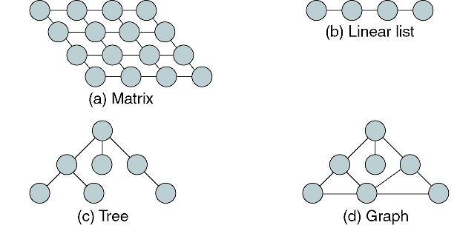
What is Data Structure ?
A combination of elements in which each is either a data type or another data structure
A set of associations or relationships (structure) involving the combined elements
Example : Consider the concept of a list, there are at least 4 data structures can support a list

Slide 2
Home Work
Review the concept of pointer, address, reference, linked list, struct (or class in C++)

