Slide 1
Chapter 1
Basic Concepts
Objectives
Upon completion you will be able to:
Use pseudocode in the development of algorithms
Understand the need for Abstract Data Type (ADT)
Understand the implementation of ADTs
Use void pointers and pointer to functions
Understand the role of Big-O notation
Data Structures: A Pseudocode Approach with C, Second Edition

Slide 2
1-1 Pseudocode
Pseudocode is an English-like representation of the algorithm logic. It consists of an extended version of the basic algorithmic constructs: sequence, selection, and iteration.
Algorithm Header
Purpose, Condition, and Return
Statement Numbers
Variables
Statment Constructs
Algorithm Analysis
Data Structures: A Pseudocode Approach with C, Second Edition

Slide 3
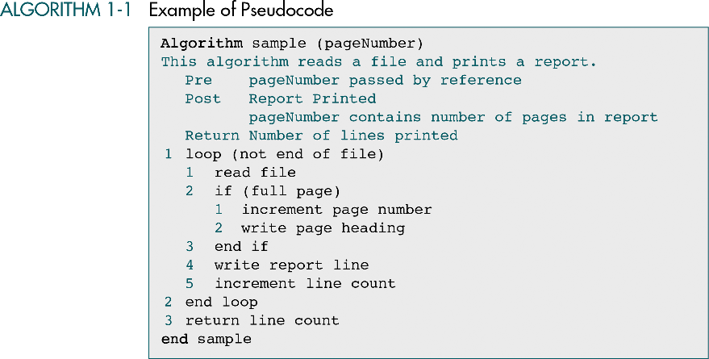
Algorithm header
Purpose
Pre-condition
Post-condition
Return
Statement #
Variable
Statement
Construct
Data Structures: A Pseudocode Approach with C, Second Edition

Slide 4
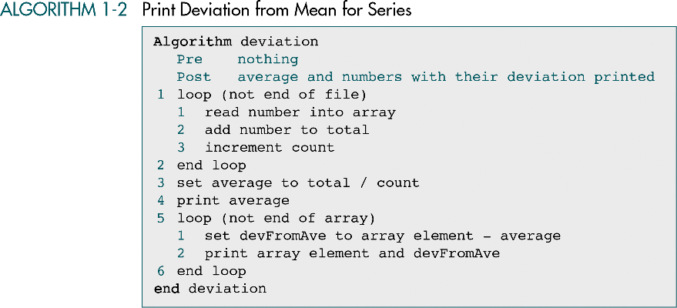
Algorithm header
Pre-condition
Post-condition
Statement
Construct
Variable
Statement #
Variable
Statement
Construct
Data Structures: A Pseudocode Approach with C, Second Edition

Slide 5
1-2 The Abstract Data Type
An ADT consists of a data declaration packaged
together with the operations that are meaningful
on the data while embodying the structured
principles of encapsulation and data hiding
Atomic Data and Composite Data
Data Type
Data Structure
Abstract Data Type
Data Structures: A Pseudocode Approach with C, Second Edition

Slide 6
Atomic Data and Composite Data
Atomic data: data that consist of a single piece of information
  E.g., integer value, floating point value
Composite Data : data that can be broken out into subfields that have meaning
  E.g., telephone number (area code + exchange code + number within the exchange)
Data Structures: A Pseudocode Approach with C, Second Edition

Slide 7
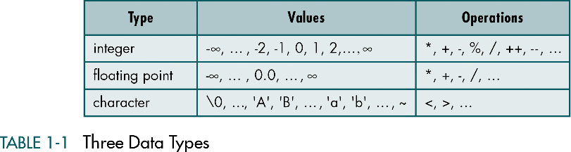
Data Type
A data type consists of two parts
  A set of values
  A set of operations on values
For examples:
Data Structures: A Pseudocode Approach with C, Second Edition

Slide 8
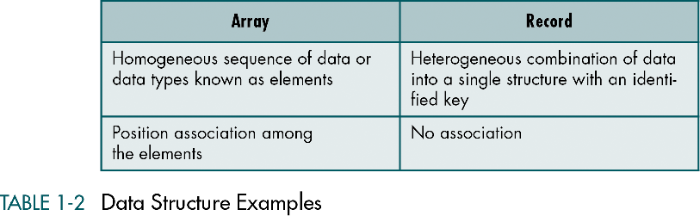
Data Structure
A combination of elements in which each is either a data type or another data structure
A set of associations or relationships (structure) involving the combined elements
For examples:
Data Structures: A Pseudocode Approach with C, Second Edition

Slide 9
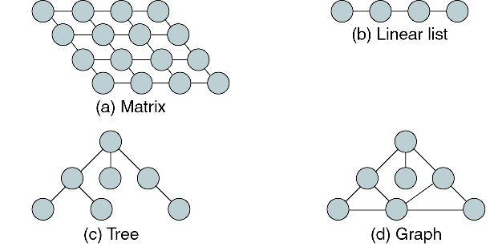
Abstract Data Type (ADT)
A ADT consist of a set of definitions that allow programmers to use the functions while hiding the implementation
With a ADT users are not concerned with how the task is done but rather with what it can do
Example 1: Consider the concept of a list, there are at least 4 data structures can support a list
Data Structures: A Pseudocode Approach with C, Second Edition

Slide 10
Abstract Data Type (conti.)
If we place a list in an ADT, user should not be aware of the structure we use while they can insert and retrieve data
Example 2: consider the system analyst who need to simulate the waiting line of a bank
  A simulation of queue is required
  Basic queue operations (enqueue, dequeue) are required
Two potential solutions to the above problem
  Write a program that simulate the queue analyst needs
  Write a queue ADT that can solve any queue problem
A typical ADT should
  Declaration of data
  Declaration of operations
  Encapsulation of data and operation on the data
  Hide them from the user
Data Structures: A Pseudocode Approach with C, Second Edition

Slide 11
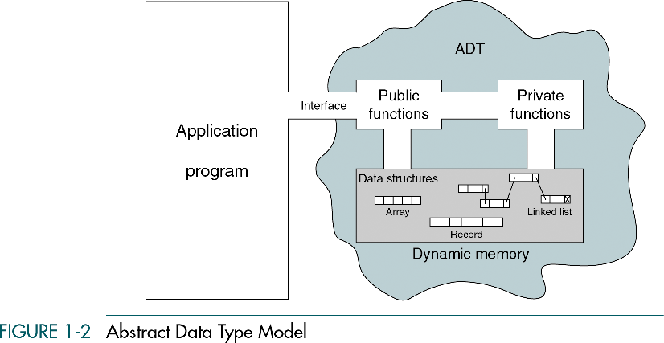
1-3 Model for an Abstract Data Type
ADT data structure: ADT for stacks, queues, lists, tree…….
ADT operations
  Data are entered , accessed, modified through the external interface
  Only the public functions are accessible through the interface
  For each ADT operation there is an algorithm that perform it’s task
  Only the operation name and parameters are available to the app.
Data Structures: A Pseudocode Approach with C, Second Edition

Slide 12
1-4 ADT Implementations
There are two basic structures we can use to
implement an ADT list: arrays and linked lists.
In this section we discuss the basic
linked-list implementation.
Array Implementation
Linked List Implemenation
Data Structures: A Pseudocode Approach with C, Second Edition

Slide 13
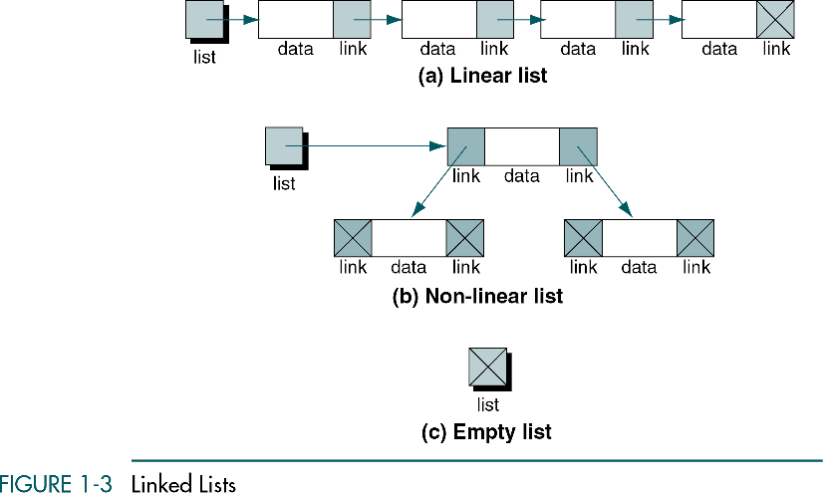
Linked List Implementation for List
Data Structures: A Pseudocode Approach with C, Second Edition

Slide 14
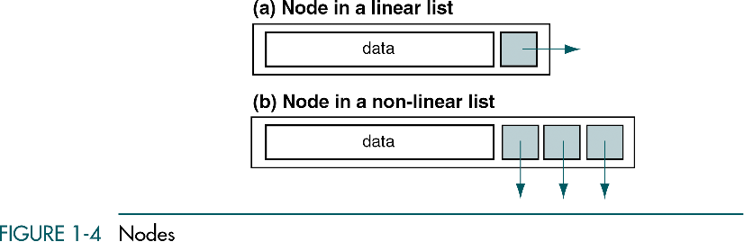
Linked List − Nodes
Data Structures: A Pseudocode Approach with C, Second Edition

Slide 15
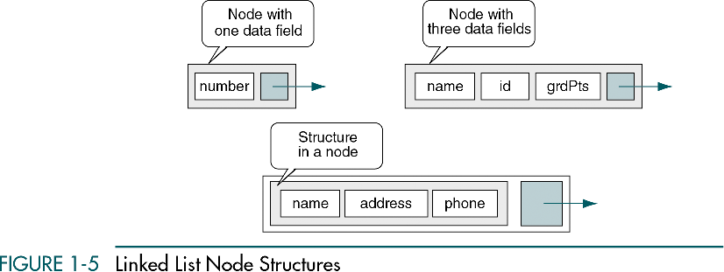
Linked List − Nodes
Data Structures: A Pseudocode Approach with C, Second Edition

Slide 16
1-5 Generic Code for ADT
In this section we discuss and provide examples
of two C tools that are required to implement
an ADT
Pointer to Void
Pointer to Function
Data Structures: A Pseudocode Approach with C, Second Edition

Slide 17
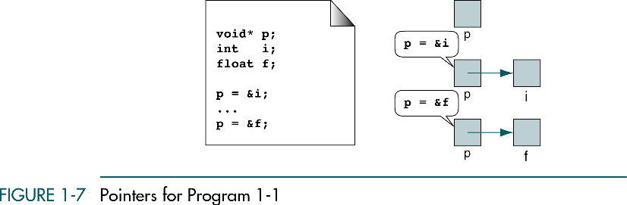

Pointer to “void”
A pointer to void is a generic pointer that can be used to represent any data type during compilation or run time
A pointer to void is not a null pointer; it is pointing to a generic data type
Data Structures: A Pseudocode Approach with C, Second Edition

Slide 18
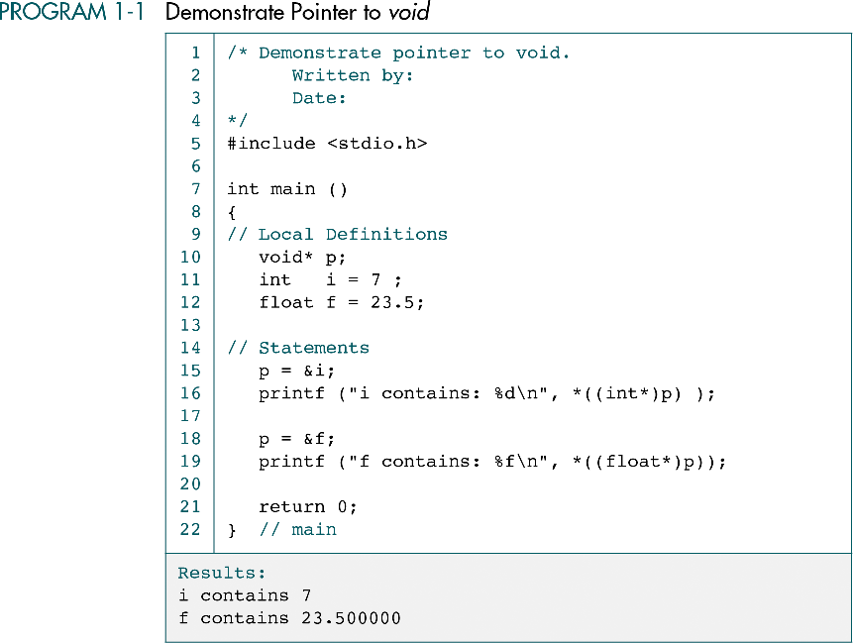
A pointer to void cannot be dereferenced
Data Structures: A Pseudocode Approach with C, Second Edition

Slide 19
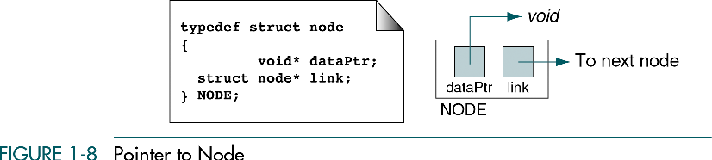
Pointer to Node
The node structure has two fields
  Link field is a pointer to the node structure (self-reference)
  Data field can be any type: integer, floating point, string, or even another structure
Data Structures: A Pseudocode Approach with C, Second Edition

Slide 20
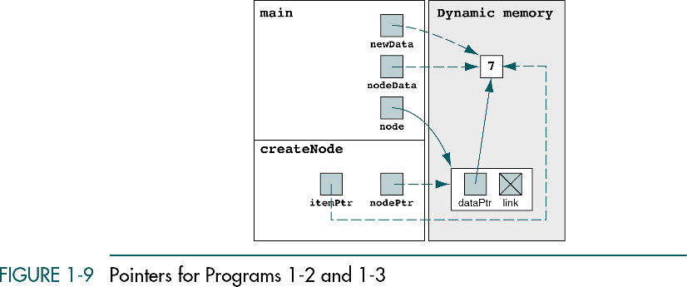
Example 1
Goal: Write a program that calls a function that accepts a pointer to data of any type and create a node that stores the data pointer and a link pointer
1
6
User Application
2
5
3
Generic ADT Code
4
Data Structures: A Pseudocode Approach with C, Second Edition

Slide 21
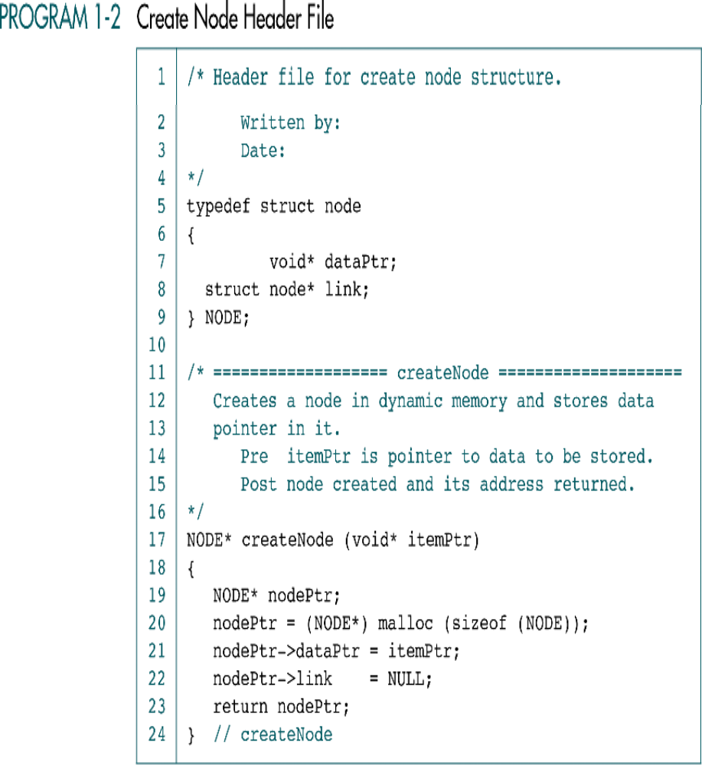
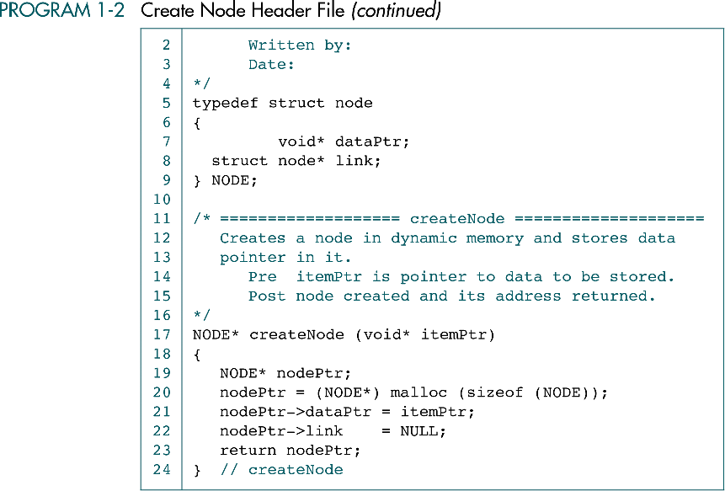
Create Node Function
Call-by-reference
Dynamic memory allocation
Data Structures: A Pseudocode Approach with C, Second Edition

Slide 22
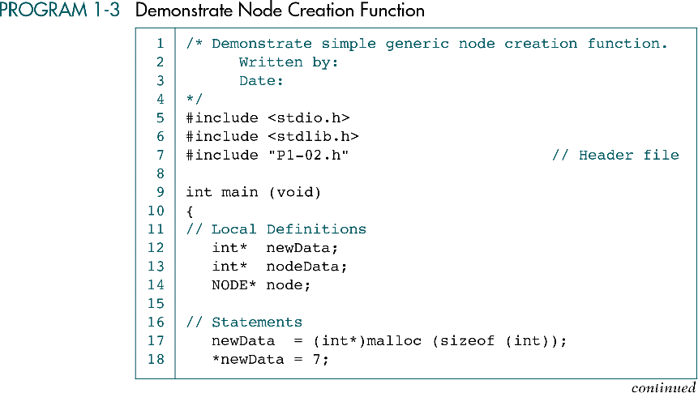
Main Program
Data Structures: A Pseudocode Approach with C, Second Edition

Slide 23
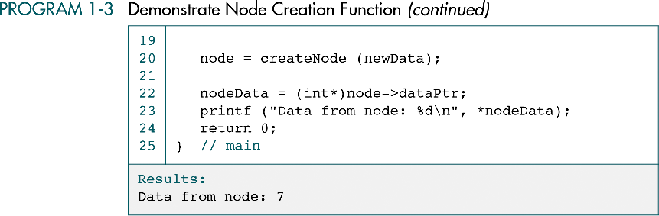
Main Program (conti.)
Be careful !
Data Structures: A Pseudocode Approach with C, Second Edition

Slide 24
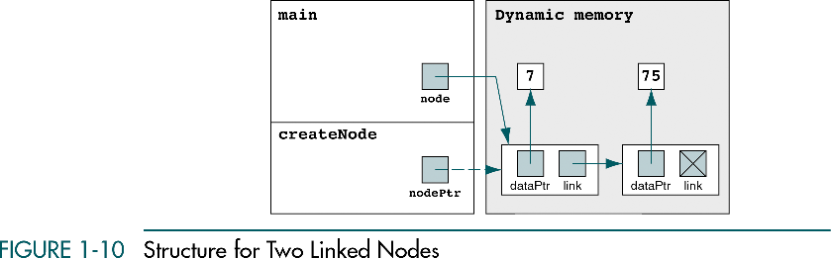
Example 2 − Two Linked Nodes
Data Structures: A Pseudocode Approach with C, Second Edition

Slide 25
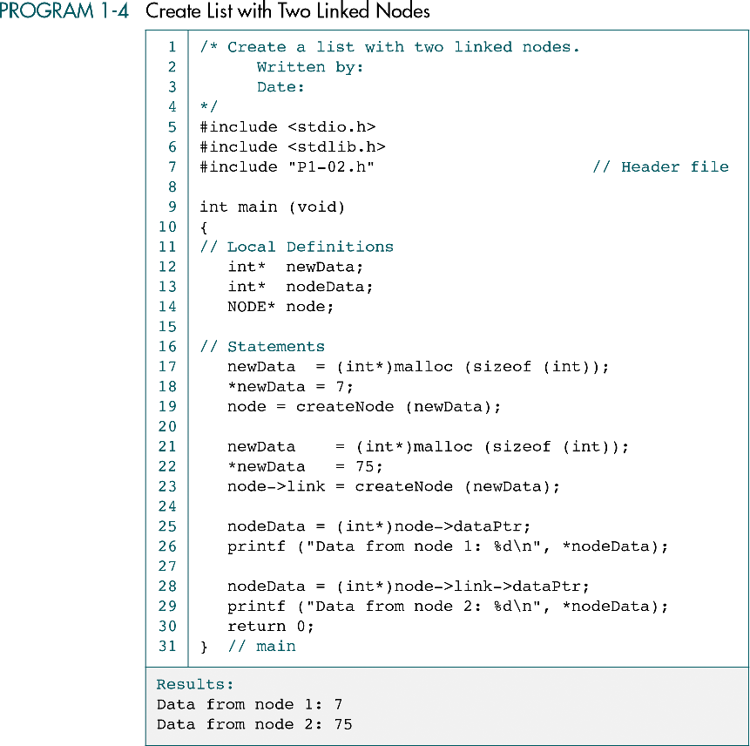
Data Structures: A Pseudocode Approach with C, Second Edition

Slide 26
(Continued)
Data Structures: A Pseudocode Approach with C, Second Edition

Slide 27
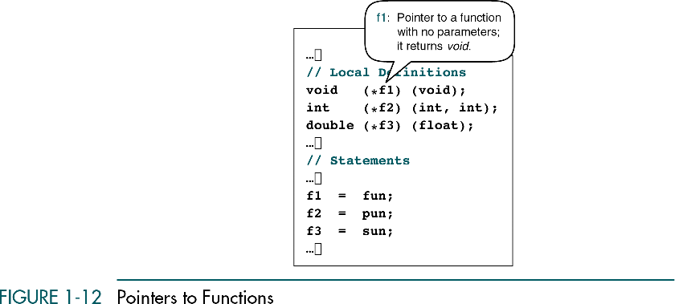
Pointer to Function
Note: Function name is a pointer to its code in memory
Main
int main (void)
fun
f1
void fun (void)
pun
f2
int pun (int, int)
sun
f3
double sun (float)
Pointer to
function
Data Structures: A Pseudocode Approach with C, Second Edition

Slide 28
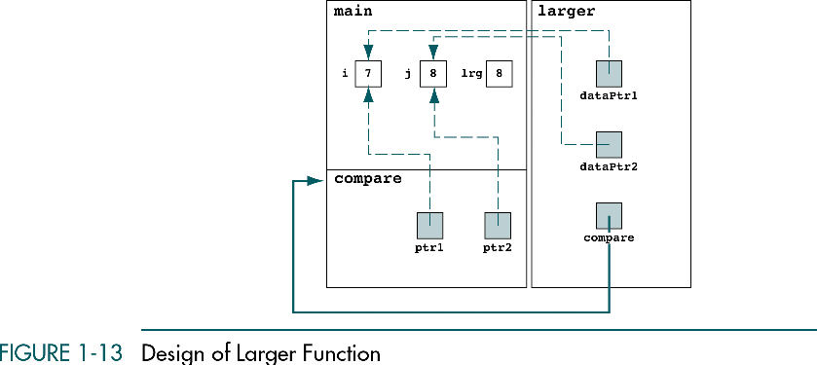
Example of Pointer to Function
Goal: Compare two number (integer or floating point or character)
1
User Application
6
2
Generic ADT Code
4
5
3
User Application
Pointer to
function
Data Structures: A Pseudocode Approach with C, Second Edition

Slide 29
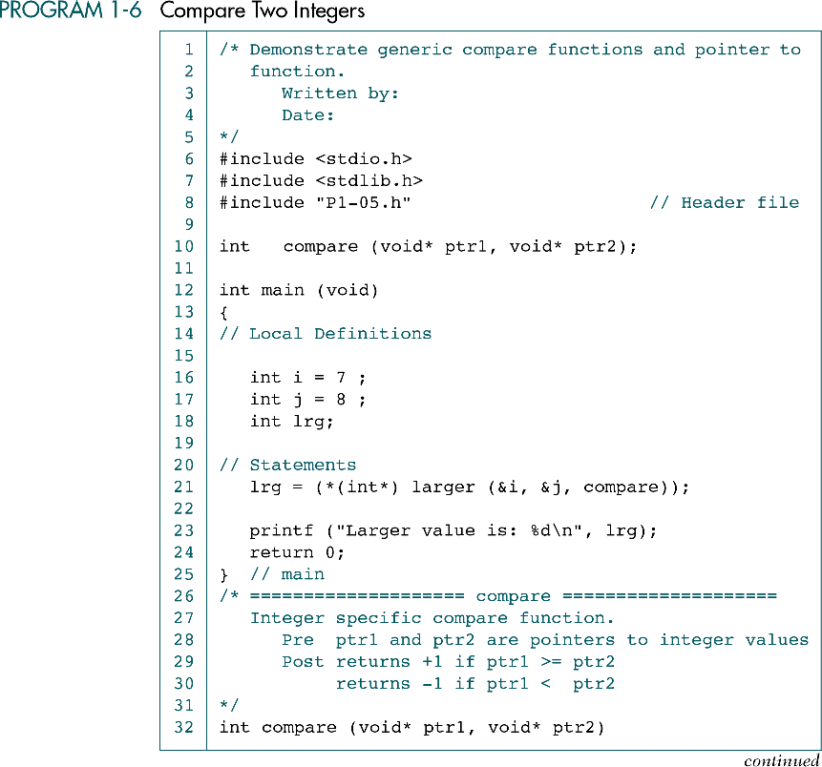
Notice !
Data Structures: A Pseudocode Approach with C, Second Edition

Slide 30
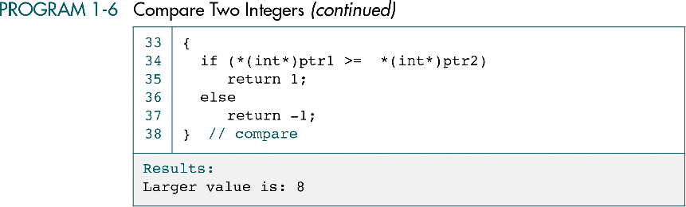
Notice !
Data Structures: A Pseudocode Approach with C, Second Edition

Slide 31
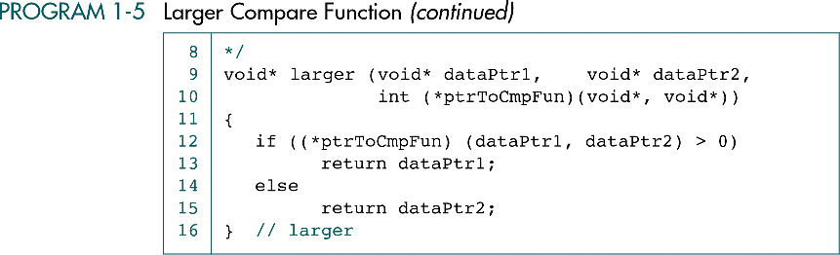
Larger Compare Function
Data Structures: A Pseudocode Approach with C, Second Edition

Slide 32
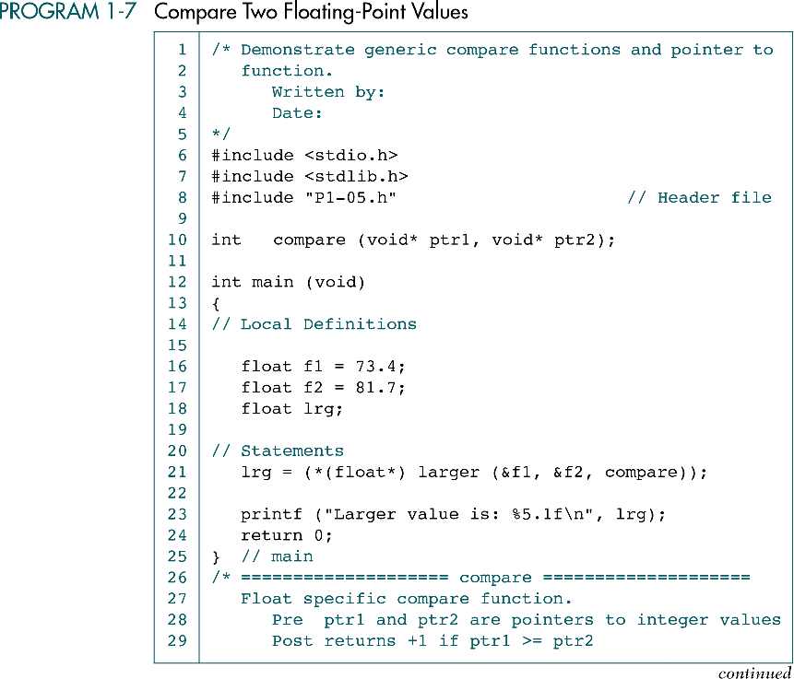
Data Structures: A Pseudocode Approach with C, Second Edition

Slide 33
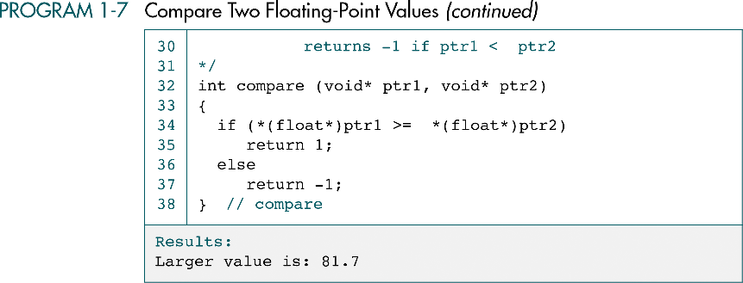
Data Structures: A Pseudocode Approach with C, Second Edition

Slide 34
1-6 Algorithm Efficiency
To design and implement algorithms, programmers
must have a basic understanding of what
constitutes good, efficient algorithms. In this
section we discuss and develop several principles
that are used to analyze algorithms.
Linear Loops
Logarithmic Loops
Nested Loops
Big-O Notation
Standard Measurement of Efficiency
Data Structures: A Pseudocode Approach with C, Second Edition

Slide 35
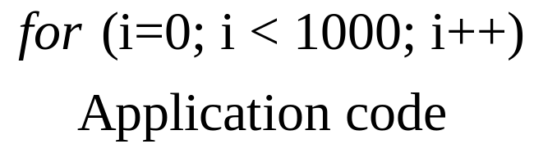
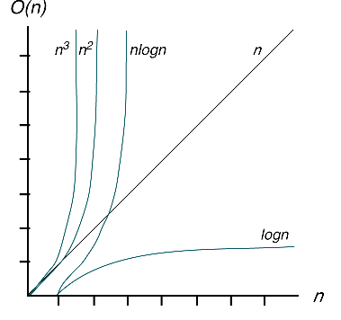
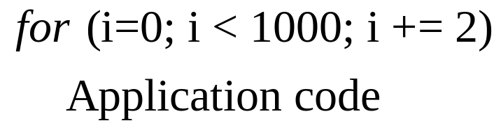
Linear Loops
Example 1:
f (n)
If f (n) = efficiency, then f (n) = n
n/2
Example 2:
f (n) = n/2
Data Structures: A Pseudocode Approach with C, Second Edition

Slide 36
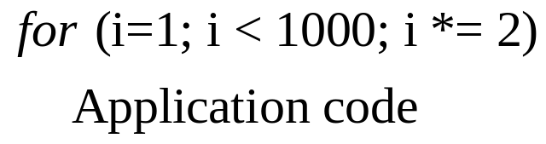
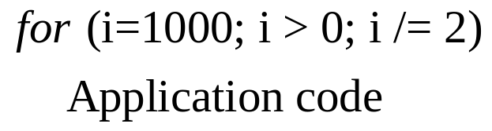
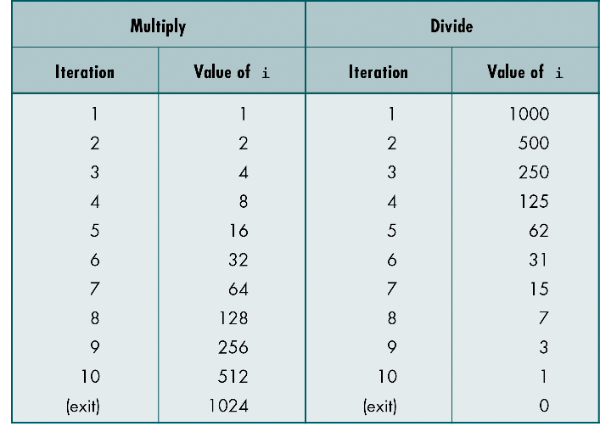
Logarithmic Loops
f (n) = log2n
Data Structures: A Pseudocode Approach with C, Second Edition

Slide 37

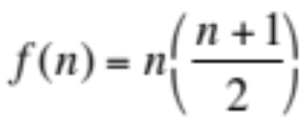
Linear Logarithmic & Square Loops
for (i=0; i<10; i++)
for(j=0; j<10; j*=2)
Application code
f (n) = 10logn210 => nlogn
for (i=0; i<10; i++)
for(j=0; j<10; j++)
Application code
for (i=0; i<10; i++)
for(j=0; j<i; j++)
Application code
n+1
n
Data Structures: A Pseudocode Approach with C, Second Edition

Slide 38
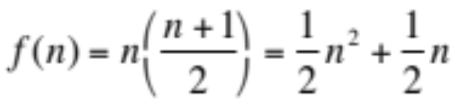



Big-O Notation
Big-O of n ( O(n) ) = “on the order of n “
The Big-O can be derived from f (n) using the following steps
  Set the coefficient of each term to 1
  Keep the largest term in the function and discard the others
  Terms are ranked from lowest to highest as shown below
For example: calculate the big-O for
  Remove all coefficients =>
  Remove the smaller factors =>
Data Structures: A Pseudocode Approach with C, Second Edition

Slide 39
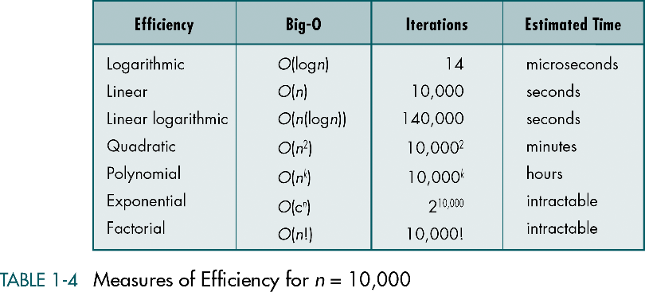
Measures of Efficiency for n=10,000
Data Structures: A Pseudocode Approach with C, Second Edition

Slide 40
Plot of Efficiency Measures
Data Structures: A Pseudocode Approach with C, Second Edition

Slide 41
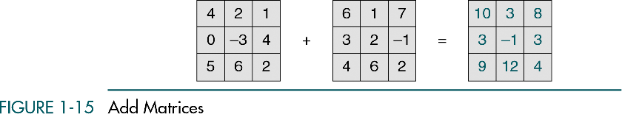
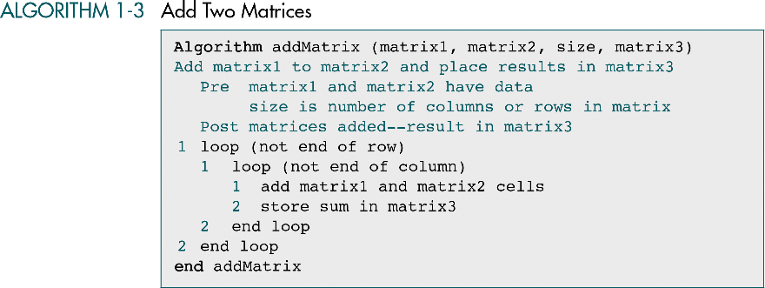

Big-O Analysis Example-Add Matrix
Data Structures: A Pseudocode Approach with C, Second Edition

Slide 42
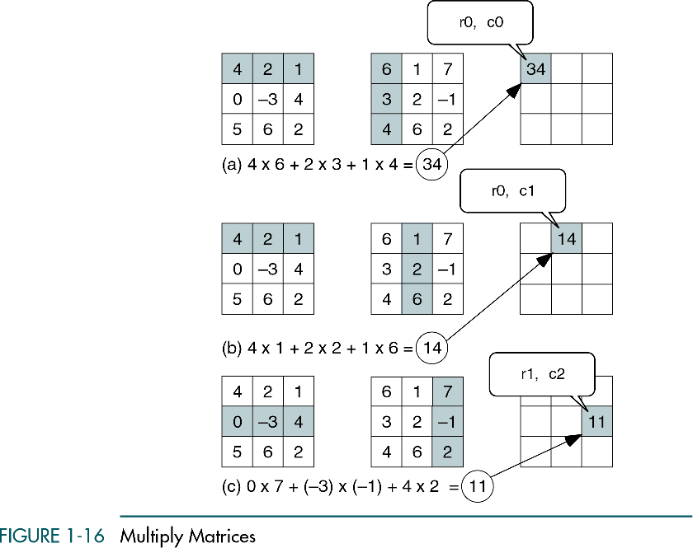
Big-O Analysis Example - Multiply Matrix
Data Structures: A Pseudocode Approach with C, Second Edition

Slide 43
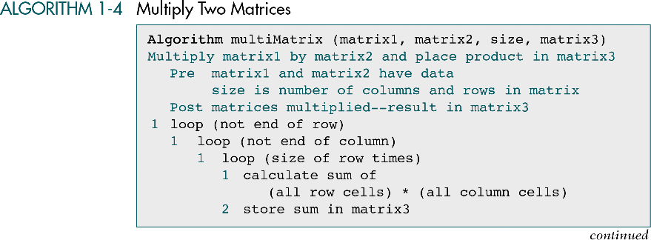


Big-O Analysis - Multiply Matrix (conti.)
Data Structures: A Pseudocode Approach with C, Second Edition

