Slide 1
Chapter 2
Recursion
Objectives
Upon completion you will be able to:
Explain the difference between iteration and recursion
Design a recursive algorithm
Determine when an recursion is an appropriate solution
Write simple recursive functions
Data Structures: A Pseudocode Approach with C, Second Edition

Slide 2
2-1 Factorial - A Case Study
We begin the discussion of recursion with a case study and use it to define the concept.
This section also presents an iterative and a recursive solution to the factorial algorithm.
Recursive Defined
Recursive Solution
Data Structures: A Pseudocode Approach with C, Second Edition

Slide 3
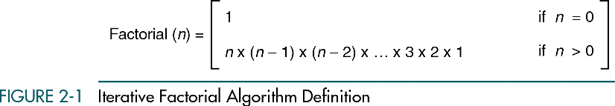
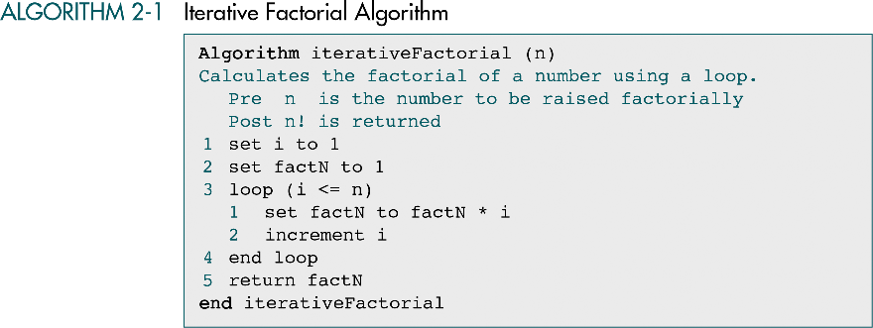
Iterative Factorial Algorithm
Data Structures: A Pseudocode Approach with C, Second Edition

Slide 4
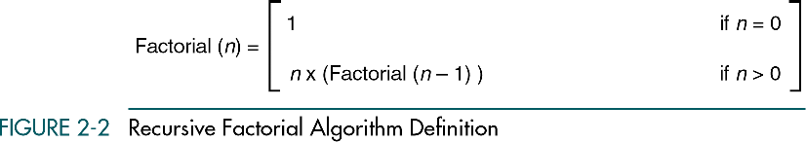
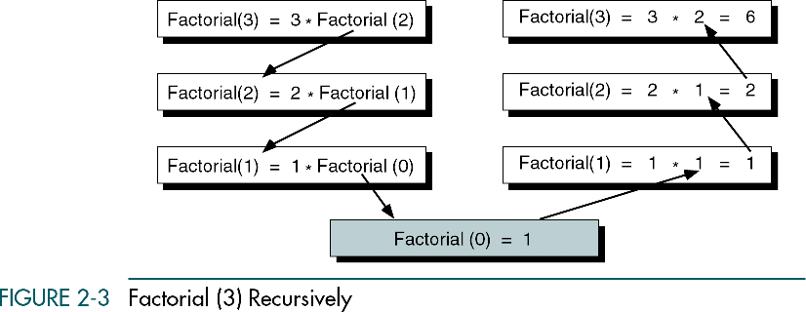
Recursive Factorial Algorithm
Data Structures: A Pseudocode Approach with C, Second Edition

Slide 5
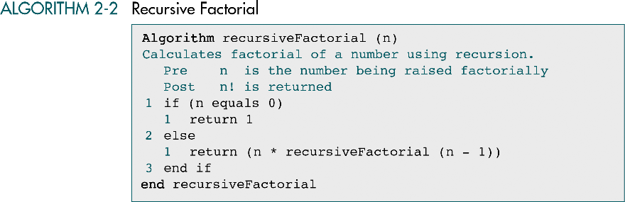
Recursive Factorial Program
Data Structures: A Pseudocode Approach with C, Second Edition

Slide 6
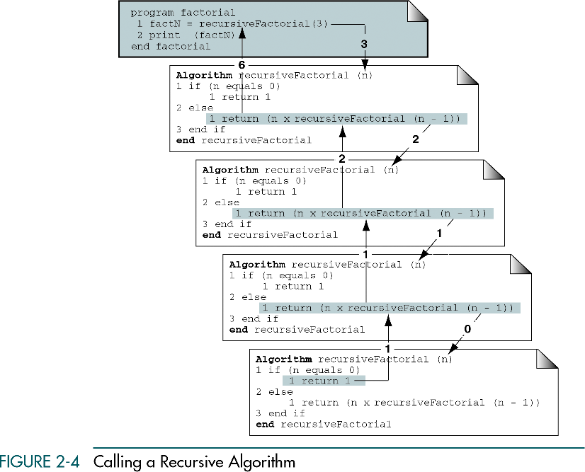
Data Structures: A Pseudocode Approach with C, Second Edition

Slide 7
2-2 Designing Recursive Algorithms
In this section we present an analytical approach to designing recursive algorithms.
We also discuss algorithm designs that are not well suited to recursion.
The Design Methodology
Limitation of Recusion
Design Implemenation
Data Structures: A Pseudocode Approach with C, Second Edition

Slide 8
Recursive Design Methdology
Rules for designing a recursive algorithm
  Determine the base case (e.g., factorial(0)=1)
  Determine the general case (e.g., factorial (n) = n x factorial (n-1))
  Combine the base case and the general cases into an algorithm
Each call must reduce the size of the problem and move it toward the base case
The base case, when reached, must terminate without a call to the recursive algorithm (must execute a return)
Data Structures: A Pseudocode Approach with C, Second Edition

Slide 9
Limitations of Recursive
Recursive solutions involve extensive overhead (time & memory)
  Each call takes time to execute !
Should NOT use recursion when
  The algorithm or data structure is not naturally suited (e.g., tree structure) to recursion
  Recursive solution is not shorter and more understandable
  Recursive solution does not run within acceptable time and space limits
Data Structures: A Pseudocode Approach with C, Second Edition

Slide 10
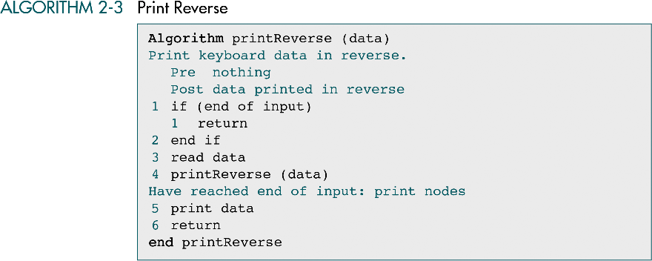
Reverse Keyboard Input
Data Structures: A Pseudocode Approach with C, Second Edition

Slide 11
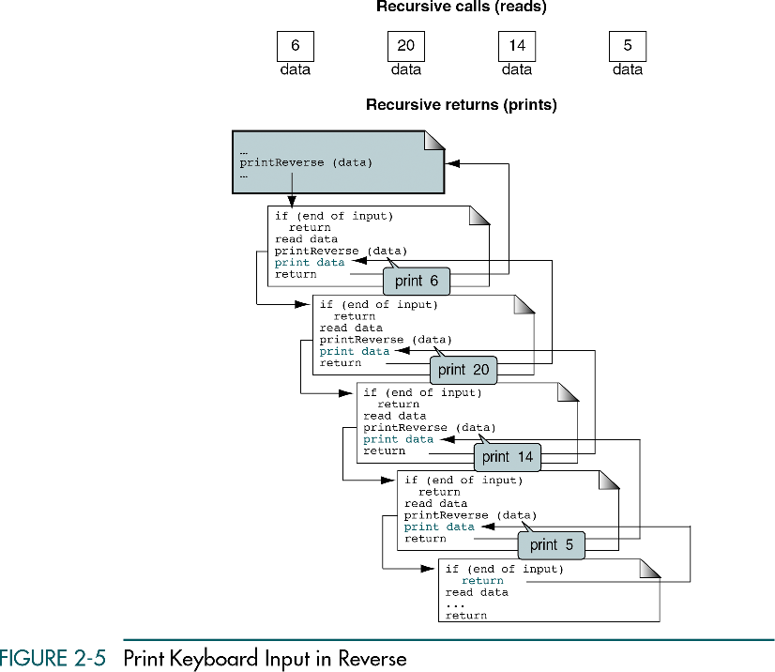
Is it naturally suited for recursion ?
  No (list structure)
Is it shorter and more understandable
  Yes
Does it run within acceptable time and space limits
  No ( O(n) )
Data Structures: A Pseudocode Approach with C, Second Edition

Slide 12
2-3 Recursive Examples
Four recursive programs are developed and analyzed. Only one, the Towers of Hanoi, turns out to be a good application for recursion.
Greatest Common Divisor
Fiboncci Numbers
Prefix to Postfix Conversion
The Towers of Honoi
Data Structures: A Pseudocode Approach with C, Second Edition

Slide 13
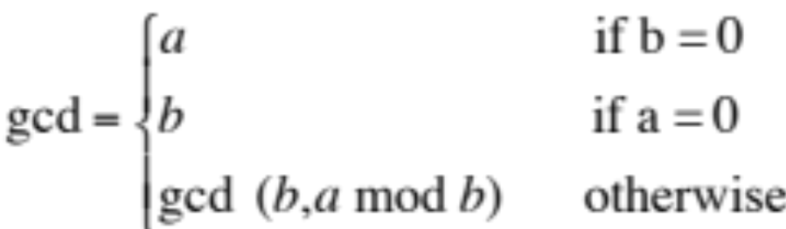
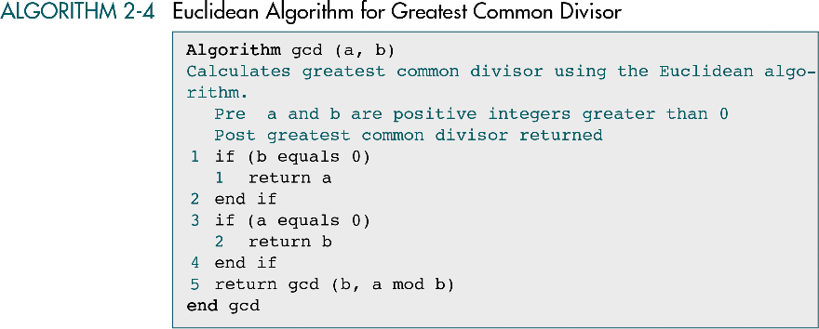
Greatest Common Divisor Recursive
Data Structures: A Pseudocode Approach with C, Second Edition

Slide 14
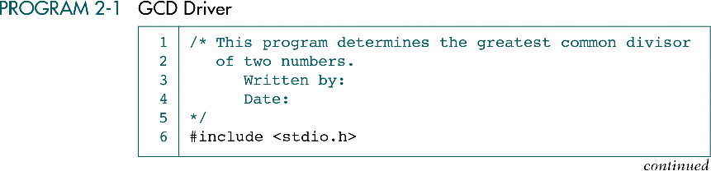
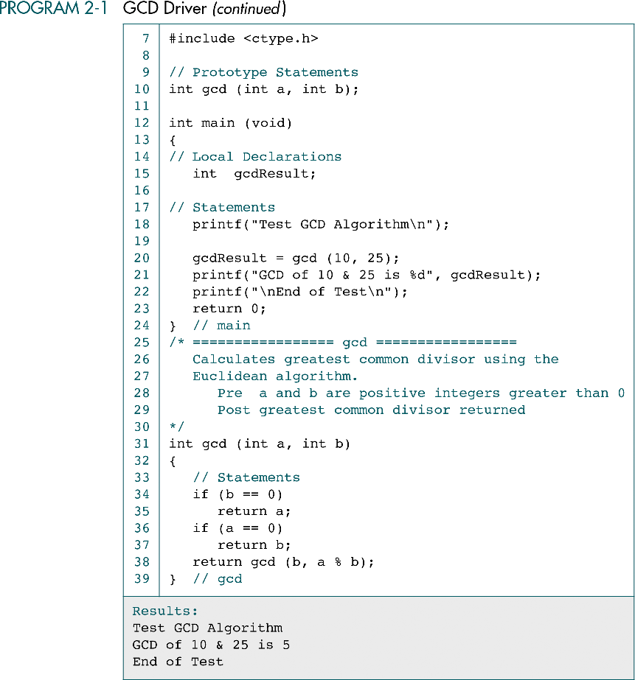
Data Structures: A Pseudocode Approach with C, Second Edition

Slide 15
Data Structures: A Pseudocode Approach with C, Second Edition

Slide 16
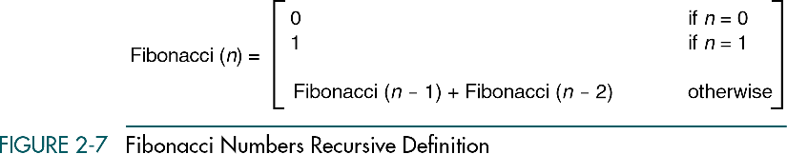
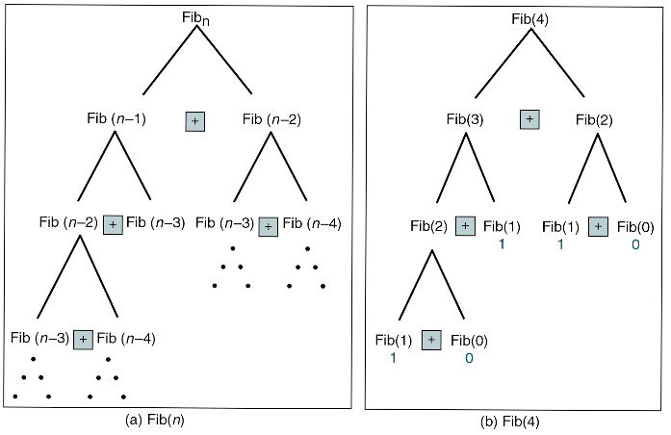
Fibonacci Number Recursion
For example: 0, 1, 1, 2, 3, 5, 8, 13,……
Data Structures: A Pseudocode Approach with C, Second Edition

Slide 17
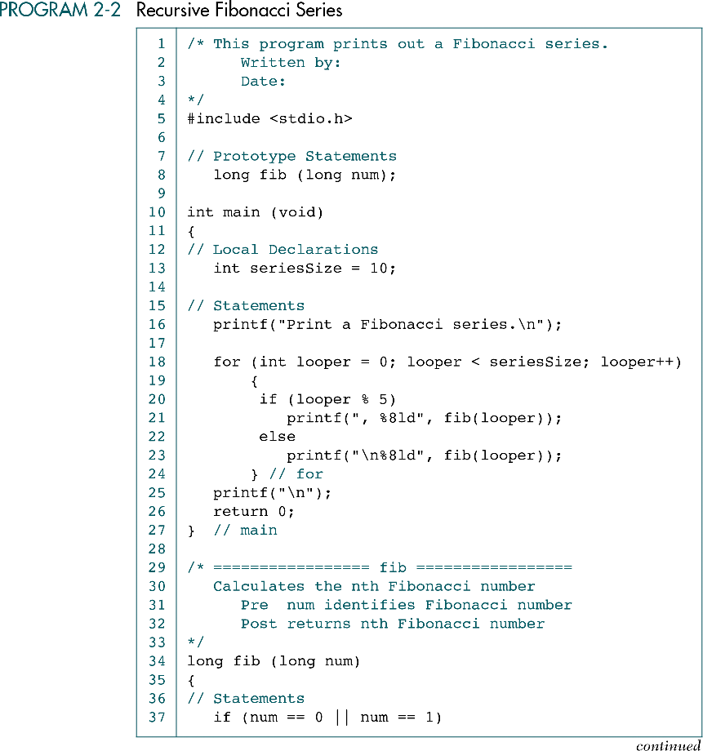
Data Structures: A Pseudocode Approach with C, Second Edition

Slide 18
(Continued)
Data Structures: A Pseudocode Approach with C, Second Edition

Slide 19
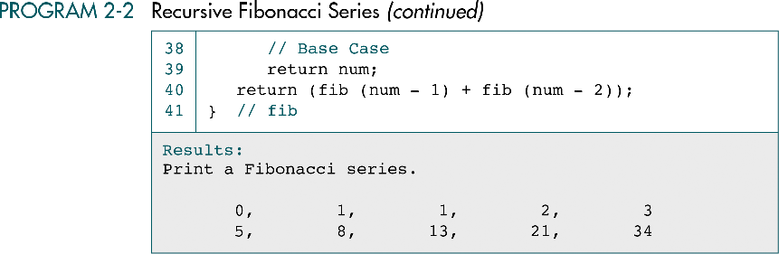
Data Structures: A Pseudocode Approach with C, Second Edition

Slide 20
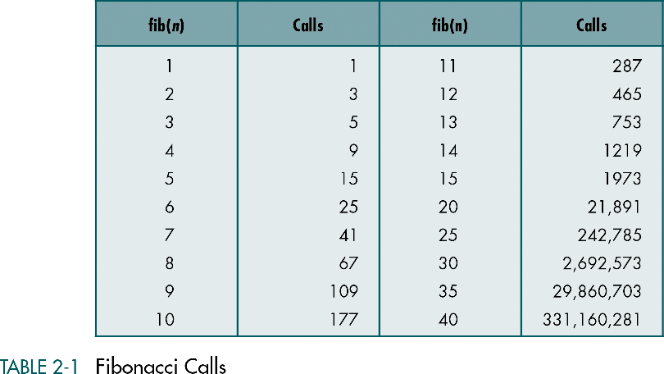
Fibonacci Calls
A recursive solution to calculate Fibonacci number
is not efficient for large number !
Data Structures: A Pseudocode Approach with C, Second Edition

Slide 21
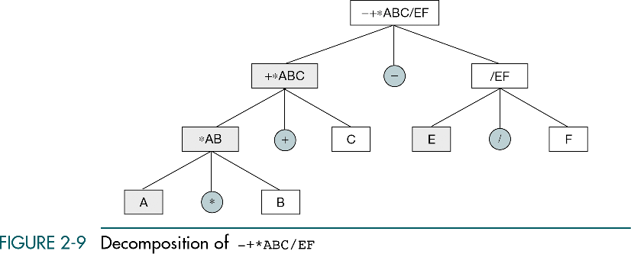
Prefix to Postfix Conversion
Prefix: + A B
Infix: A + B
Postfix: A B +
Note in Prefix: the operator is always the
first character in the prefix string
Data Structures: A Pseudocode Approach with C, Second Edition

Slide 22
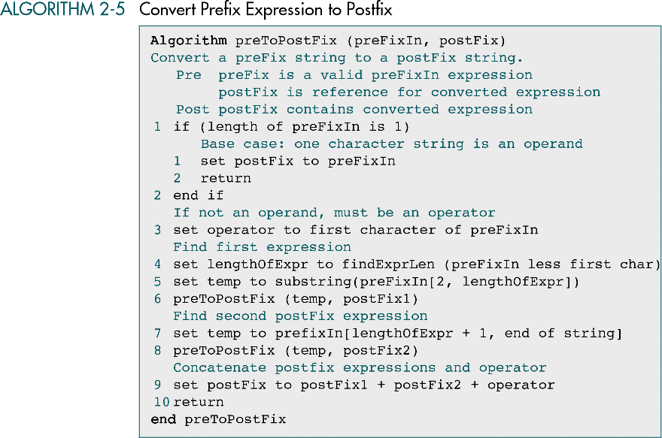
Data Structures: A Pseudocode Approach with C, Second Edition

Slide 23
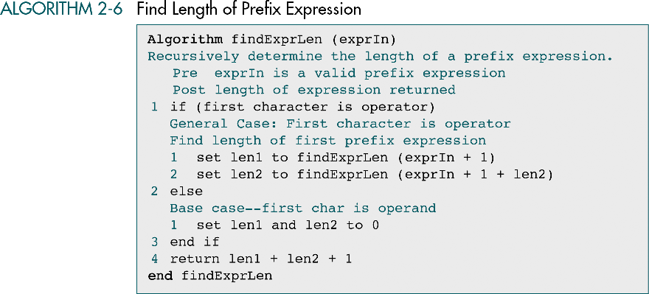
Data Structures: A Pseudocode Approach with C, Second Edition

Slide 24
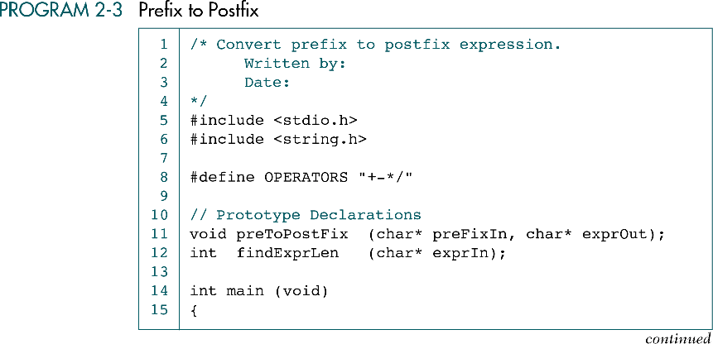
Data Structures: A Pseudocode Approach with C, Second Edition

Slide 25
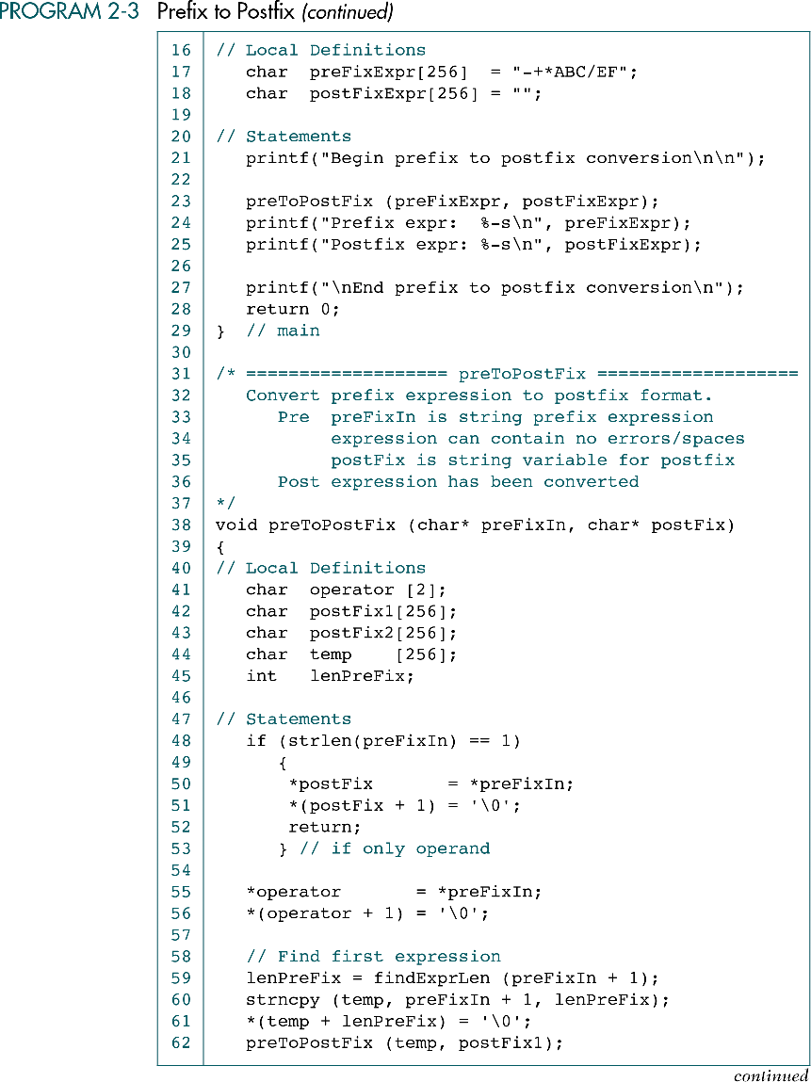
Data Structures: A Pseudocode Approach with C, Second Edition

Slide 26
Data Structures: A Pseudocode Approach with C, Second Edition

Slide 27
Data Structures: A Pseudocode Approach with C, Second Edition

Slide 28
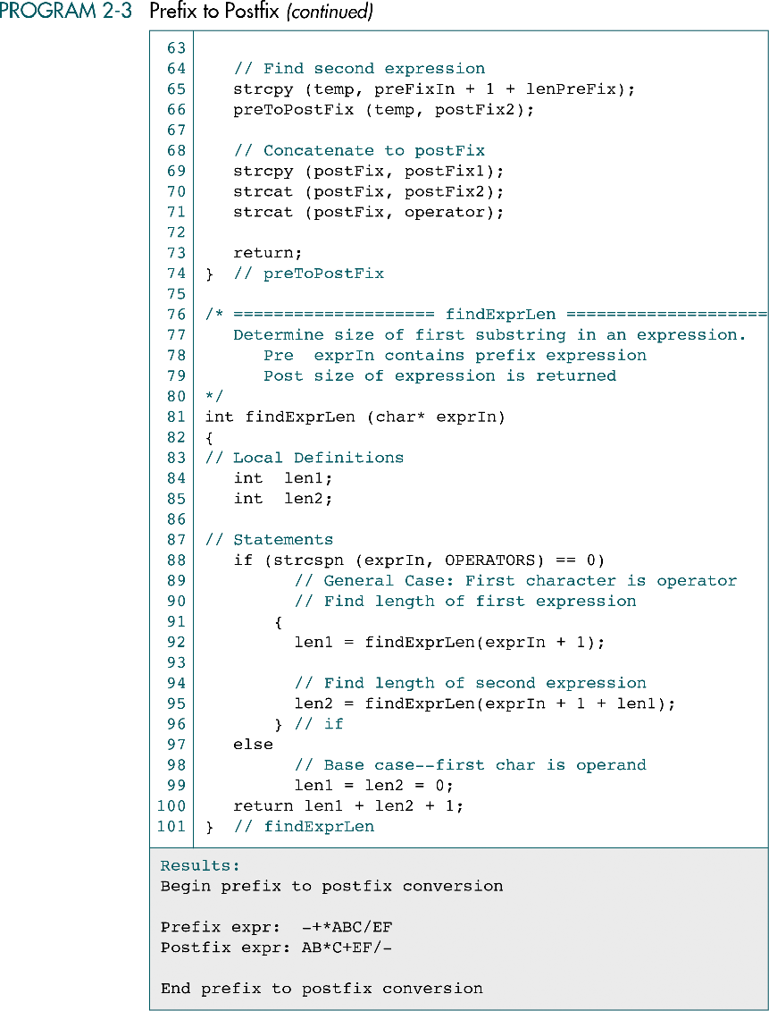
Data Structures: A Pseudocode Approach with C, Second Edition

Slide 29
Data Structures: A Pseudocode Approach with C, Second Edition

Slide 30
Data Structures: A Pseudocode Approach with C, Second Edition

Slide 31
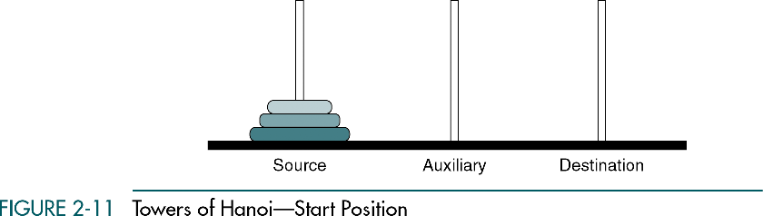
Towers of Hanoi
Only one disk could be moved at a time and a larger disk must never be stacked above a smaller one
One and only one auxiliary needle could be used for the intermediate storage of disks
Data Structures: A Pseudocode Approach with C, Second Edition

Slide 32
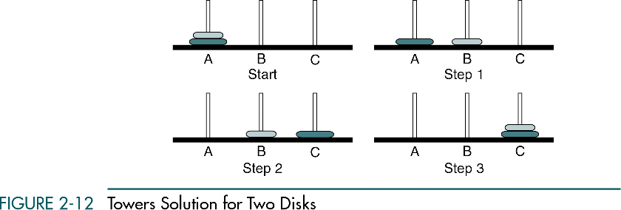
Towers Solution for Two Disks
Source
Aux.
Dest.
Data Structures: A Pseudocode Approach with C, Second Edition

Slide 33
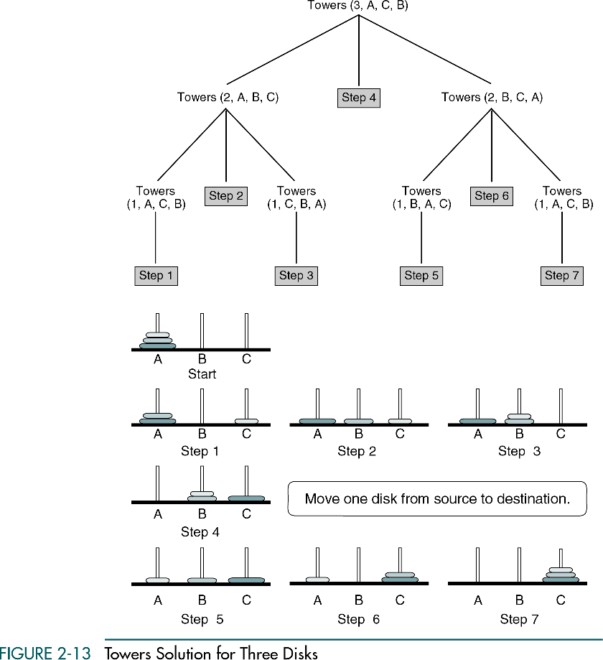
Towers Solution for Three Disks (cont.)
Move 2 disks from A (source) to B (dest.)
Move one disk from A to C
Move 2 disks from B (source) to C (dest.)
Data Structures: A Pseudocode Approach with C, Second Edition

Slide 34
Towers Solution for N Disks
Generalization of the problem
  General case: Move n-1 disks from source to auxiliary
  Base case: Move one disk from source to destination
  General case: Move n-1 disks from aux. to destination
Four parameters for the algorithm “Towers”
  The number of disks to be moved
  The source needle
  The destination needle
  The auxiliary needle
Pseudocode note:Tower (num,source, destination, auxiliary)
Call Towers (n-1, source, auxiliary, destination)
Move one disk from source to destination
Call Towers (n-1, auxiliary, destination, source
Data Structures: A Pseudocode Approach with C, Second Edition

Slide 35
Towers Solution for Three Disks
Data Structures: A Pseudocode Approach with C, Second Edition

Slide 36
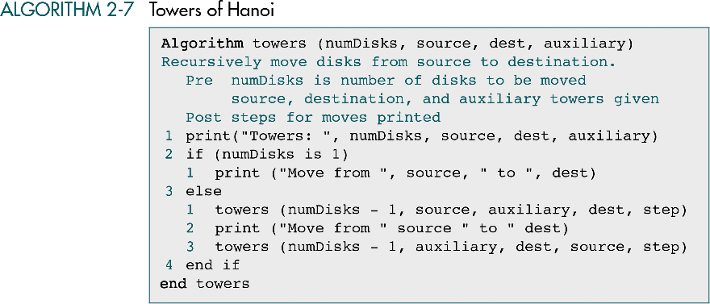
Data Structures: A Pseudocode Approach with C, Second Edition

Slide 37
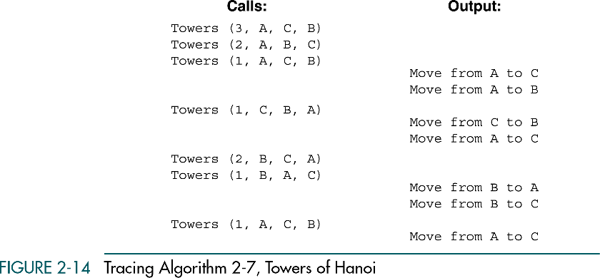
Data Structures: A Pseudocode Approach with C, Second Edition

Slide 38
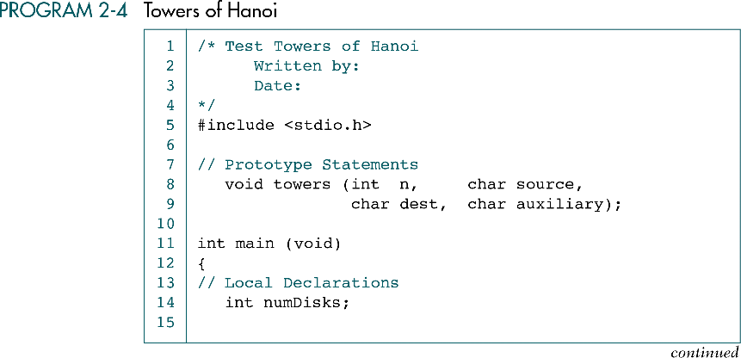
Data Structures: A Pseudocode Approach with C, Second Edition

Slide 39
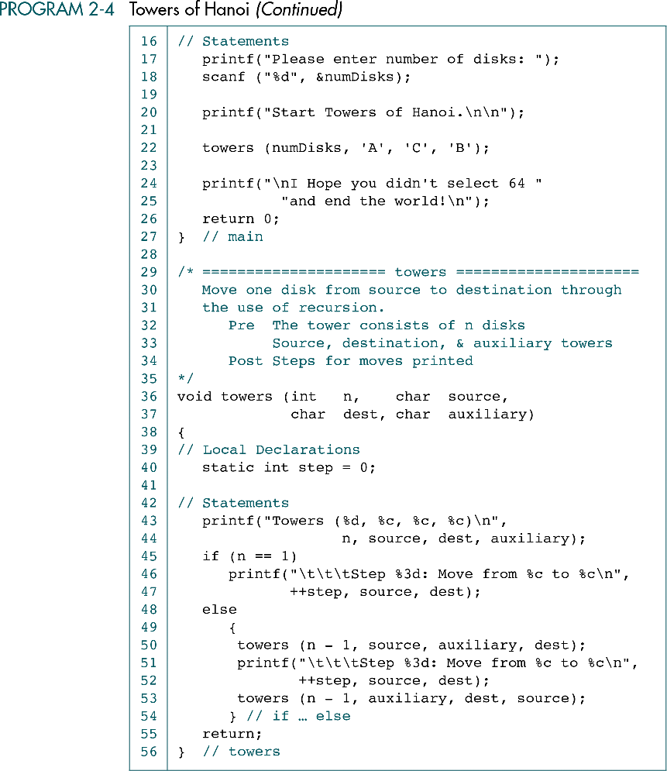
Data Structures: A Pseudocode Approach with C, Second Edition

Slide 40
Data Structures: A Pseudocode Approach with C, Second Edition

Slide 41
Data Structures: A Pseudocode Approach with C, Second Edition

