Slide 1
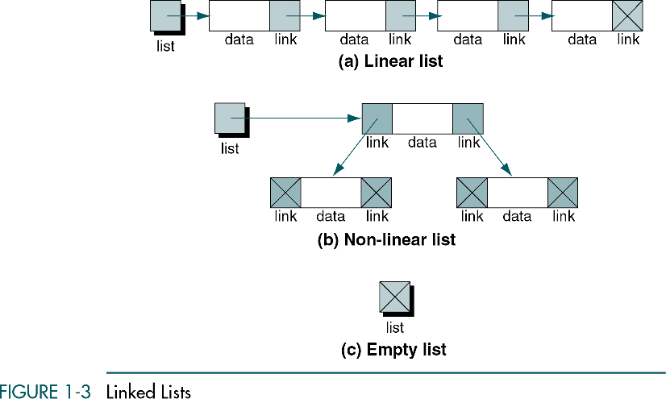
Unit 1: Introduction and basic concepts (Chap. 1, 2)
Unit 2: Linear lists
Stacks (chap. 3)
Queues (chap. 4)
General linear lists (chap.5)
Unit 3: Non-Linear Lists (Chap. 6, 7, 8, 9, 10, 11)
Unit 4: Sorting (Chap. 12)
Unit 5: Searching (Chap. 13)
Restricted list: addition and deletion of data are restricted to the ends of the list
  Stack: last in-first out (LIFO)
  Queue: first in-first out (FIFO)
General list: data can be inserted and deleted anywhere in the list
Data Structures: A Pseudocode Approach with C

Slide 2
Chapter 3
Stacks
Objectives
Upon completion you will be able to
Explain the design, use, and operation of a stack
Implement a stack using a linked list structure
Understand the operation of the stack ADT
Write application programs using the stack ADT
Discuss reversing data, parsing, postponing and backtracking
Data Structures: A Pseudocode Approach with C

Slide 3
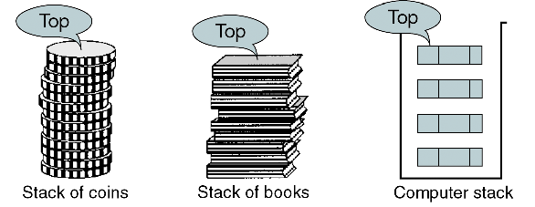
What is Stack ?
A stack is a last in-first out data structure in which all insertions and deletions are restricted to one end, called top
Data Structures: A Pseudocode Approach with C

Slide 4
3.1 Basic Stack Operations
The stack concept is introduced and three basic stack operations are discussed.
3.2 Stack Linked List Implementation
In this section we present a linked-list design for a stack. After developing the data structures, we write pseudocode algorithms for the stack ADT.
3.3 C Language Implementations
This section presents a simple non-ADT implementation of a stack. We develop a simple program that inserts random characters into the stack and then prints them.
3.4 Stack ADT
We begin the discussion of the stack ADT with a discussion of the stack structure and its application interface. We then develop the required functions.
3.5 Stack Applications
Three basic application problems-parsing, postponement, and backtracking-are discussed and sample programs developed. In addition, several other stack applications are presented, including the classic Eight Queens problem.
3.6 How Recursion Works
This section discusses the concept of the stack frame and the use of stacks in writing recursive software
3-1 Basic Stack Operations
The stack concept is introduced and three basic stack operations are discussed.
Push
Pop
Stack Top
Data Structures: A Pseudocode Approach with C

Slide 5
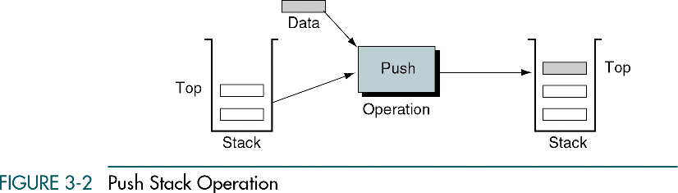
Push Stack Operation
If there is not enough room, the stack is in an overflow state and the item cannot be added
Data Structures: A Pseudocode Approach with C

Slide 6
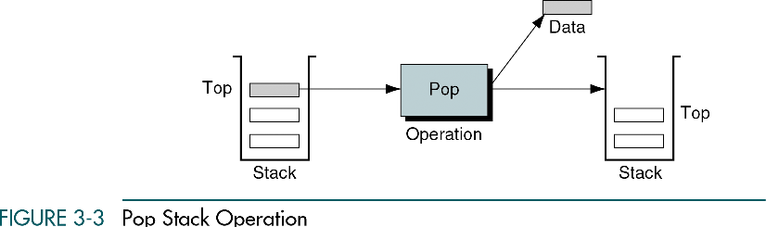
Pop Stack Operation
If pop is called when the stack is empty, it is in an underflow state
Data Structures: A Pseudocode Approach with C

Slide 7
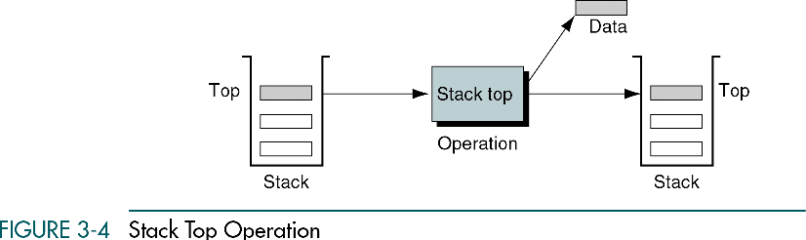
Stack Top Operation
Stack top copies the item at the top of stack but does not delete it
Stack top can also result in underflow if the stack is empty
Data Structures: A Pseudocode Approach with C

Slide 8
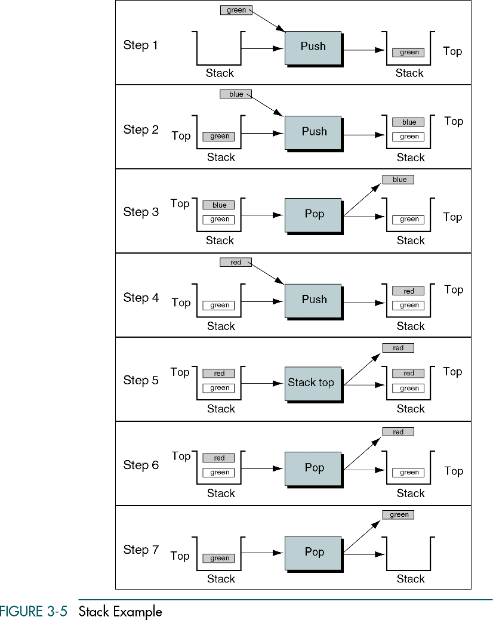
Stack Example
Data Structures: A Pseudocode Approach with C

Slide 9
3-2 Stack Linked List Implementation
In this section we present a linked-list design for a stack. After developing the data structures, we write pseudocode algorithms for the stack ADT.
Data Structure
Algorithms
Data Structures: A Pseudocode Approach with C

Slide 10
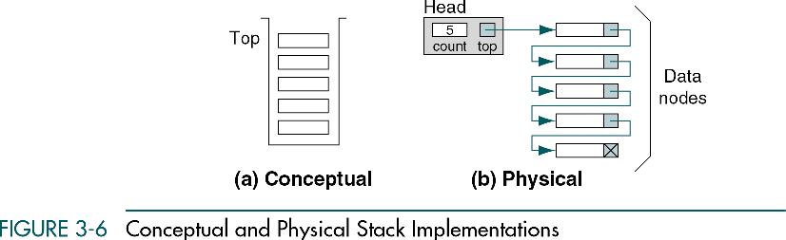
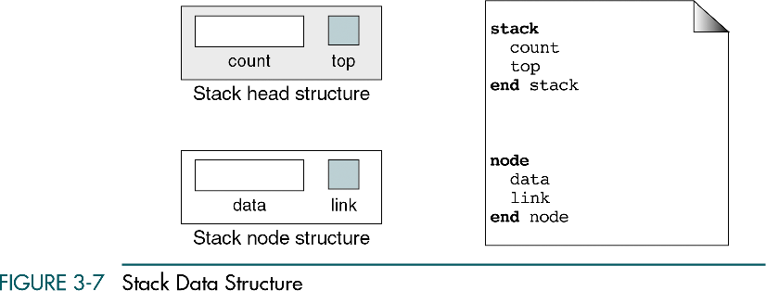
Conceptual & Physical Stack Implementation
Implement the stack as linked list
Need two different data structures: head & data node
pointer
data
Data Structure
Data Structures: A Pseudocode Approach with C

Slide 11
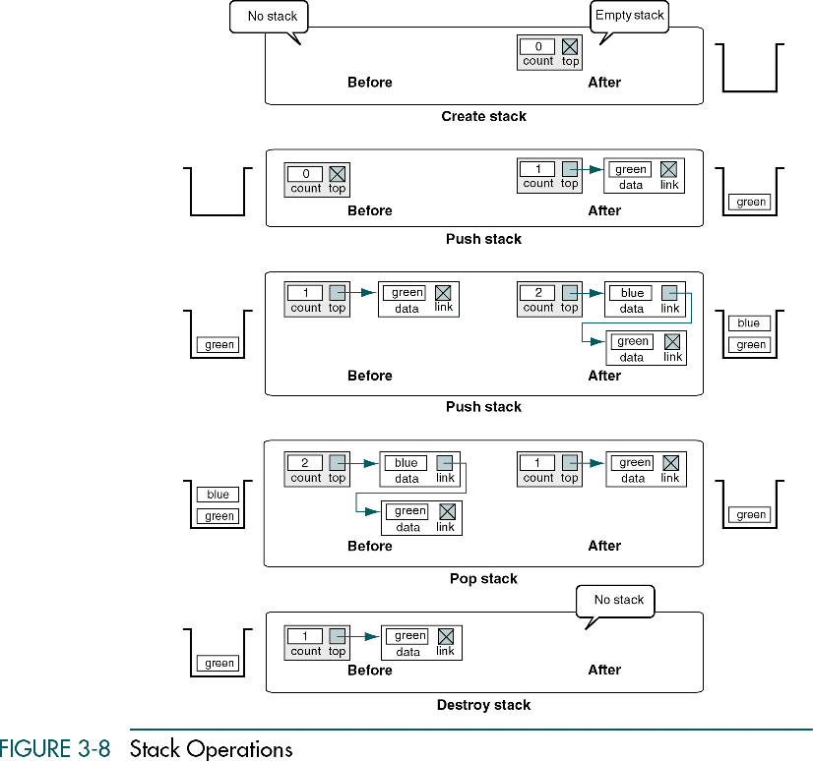
Stack Operations
Data Structures: A Pseudocode Approach with C

Slide 12
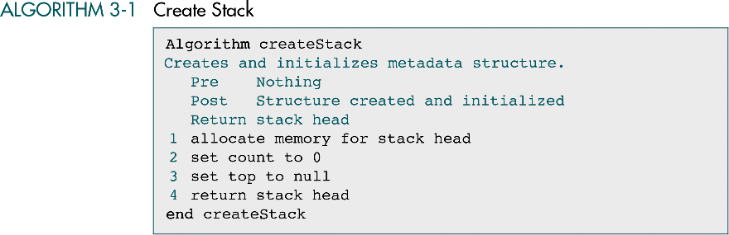
Create Stack Algorithm
Data Structures: A Pseudocode Approach with C

Slide 13
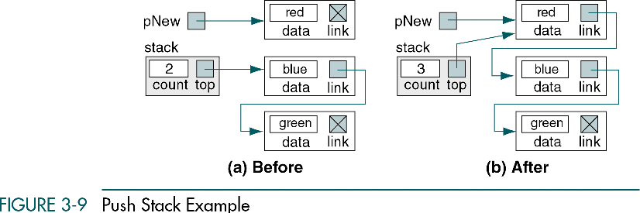
Push Stack Example
Three conditions should be considered
  Insertion into an empty stack
  Insertion into a stack with data
  Insertion into a stack when the available memory is exhausted
Null
Null
Null
Data Structures: A Pseudocode Approach with C

Slide 14
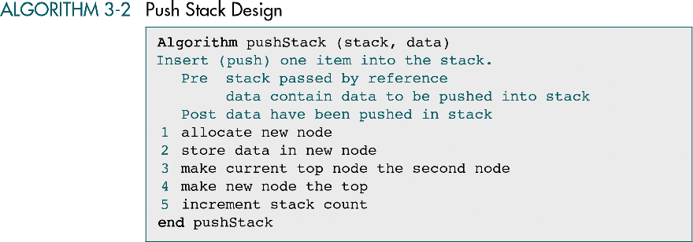
Push Stack Algorithm
Data Structures: A Pseudocode Approach with C

Slide 15
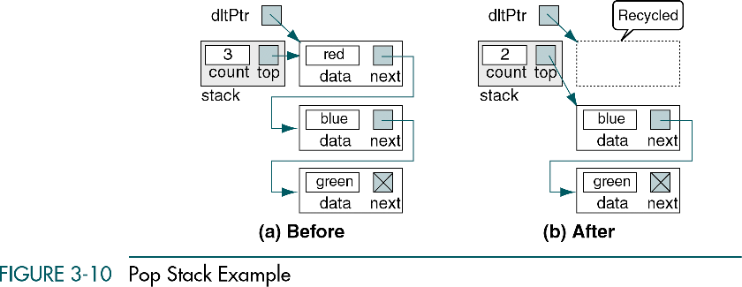
Pop Stack Example
Data Structures: A Pseudocode Approach with C

Slide 16
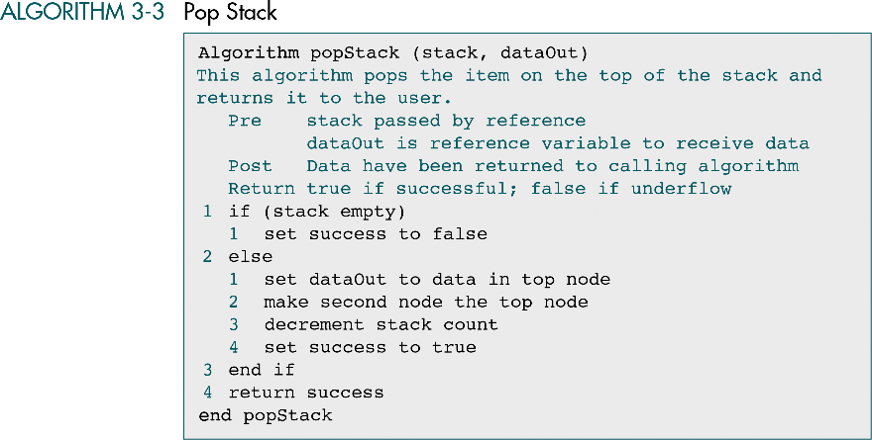
Pop Stack Algorithm
Data Structures: A Pseudocode Approach with C

Slide 17
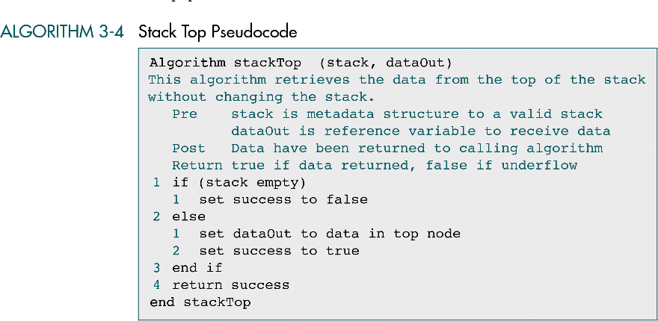
Stack Top Algorithm
Data Structures: A Pseudocode Approach with C

Slide 18
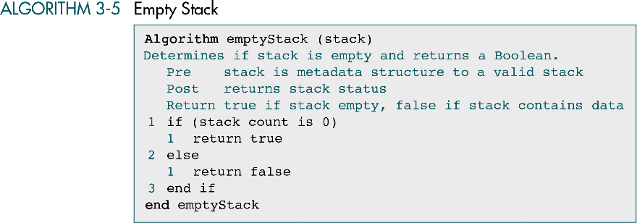
Empty Stack
Data Structures: A Pseudocode Approach with C

Slide 19
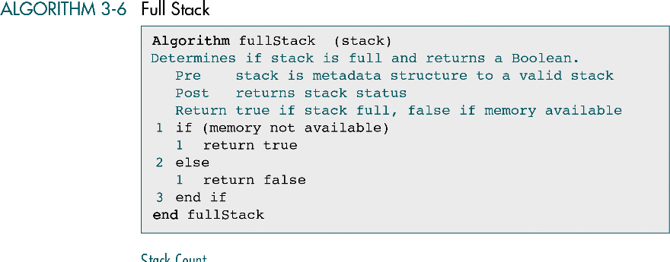
Full Stack
Data Structures: A Pseudocode Approach with C

Slide 20
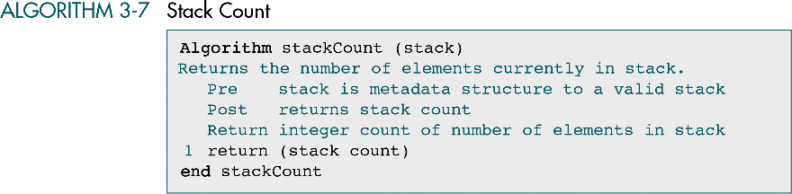
Stack Count
Data Structures: A Pseudocode Approach with C

Slide 21
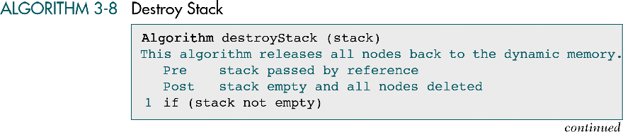
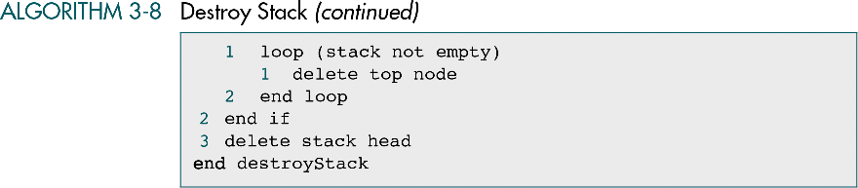
Destroy Stack
Data Structures: A Pseudocode Approach with C

Slide 22
3-4 Stack ADT
We begin the discussion of the stack ADT with a discussion of the stack structure and its application interface. We then develop the required functions.
Data Structure
ADT Implementation
Data Structures: A Pseudocode Approach with C

Slide 23
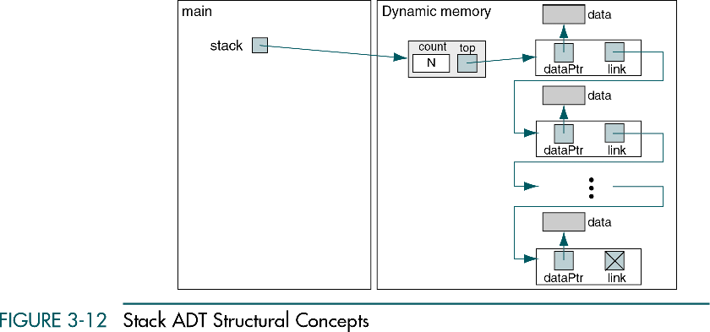
Stack ADT Structural Concepts
Data Structures: A Pseudocode Approach with C

Slide 24
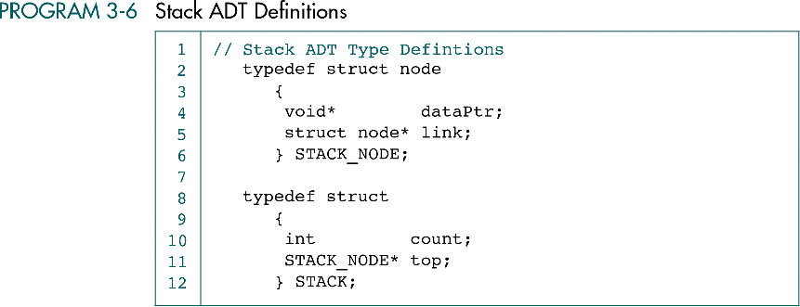
Stack ADT Definitions
Stack head structure
Data Structures: A Pseudocode Approach with C

Slide 25
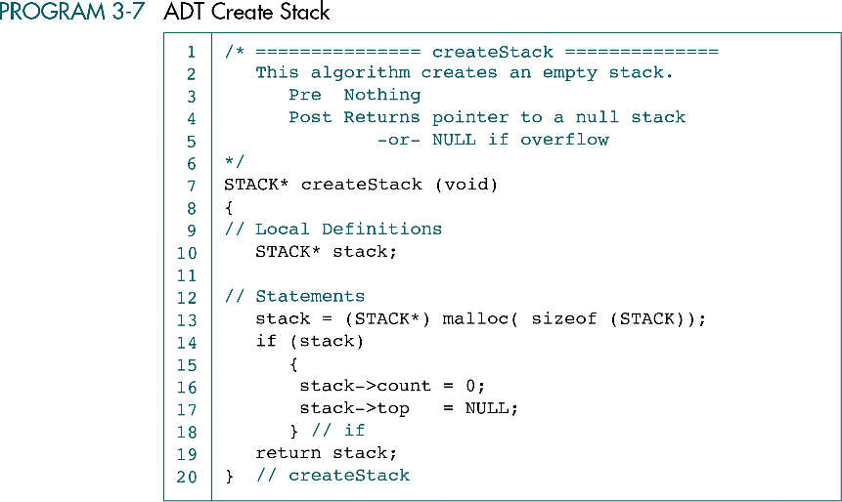
ADT Create Stack
Allocate a stack head node, initializes the top pointer to null, and zeros the count field
The call to create a stack must assign the return pointer value to a stack pointer as: stack = creatstack()
main
Dynamic memory
stack
count
top
0
Data Structures: A Pseudocode Approach with C

Slide 26
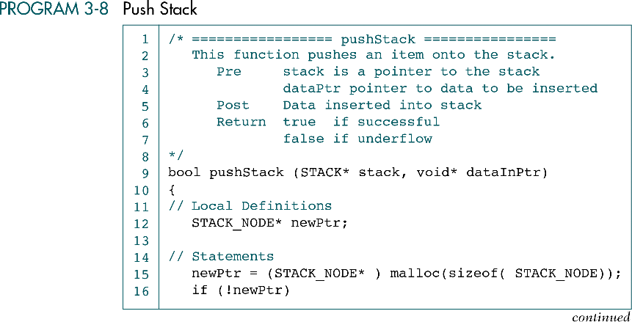
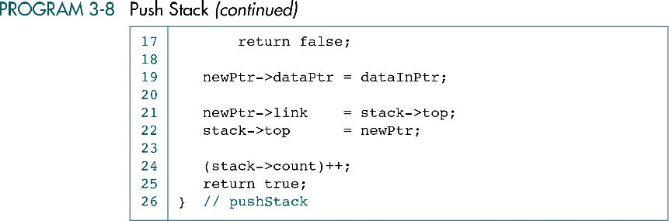
Push Stack
dataInPtr
Data
main
newPtr
stack
dataPtr
link
count
top
2
Data
3
dataPtr
link
Data
dataPtr
link
Data Structures: A Pseudocode Approach with C

Slide 27
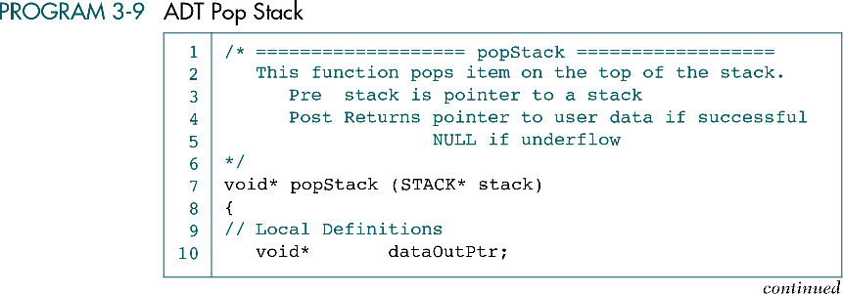
ADT Pop Stack
Data Structures: A Pseudocode Approach with C

Slide 28
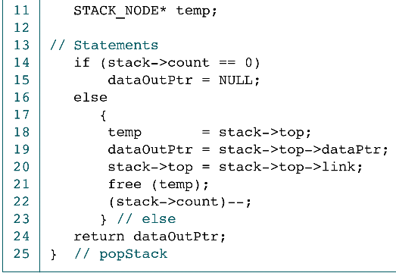
ADT Pop Stack (conti.)
dataOutPtr
main
temp
Data
stack
count
top
Free
(recycle)
3
link
2
dataPtr
Data
dataPtr
link
Data
dataPtr
link
Data Structures: A Pseudocode Approach with C

Slide 29
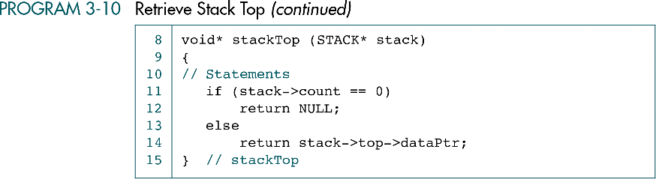
Retrieve Stack Top
Data Structures: A Pseudocode Approach with C

Slide 30
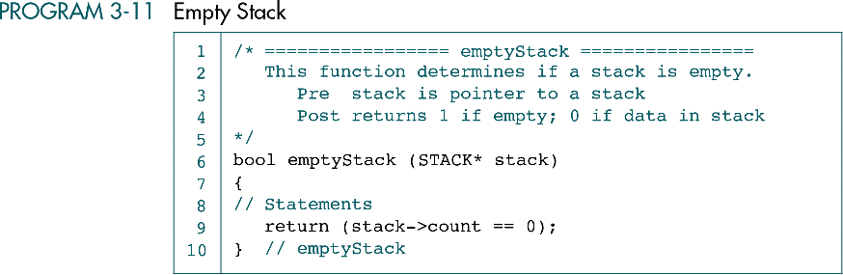
Empty Stack
Data Structures: A Pseudocode Approach with C

Slide 31
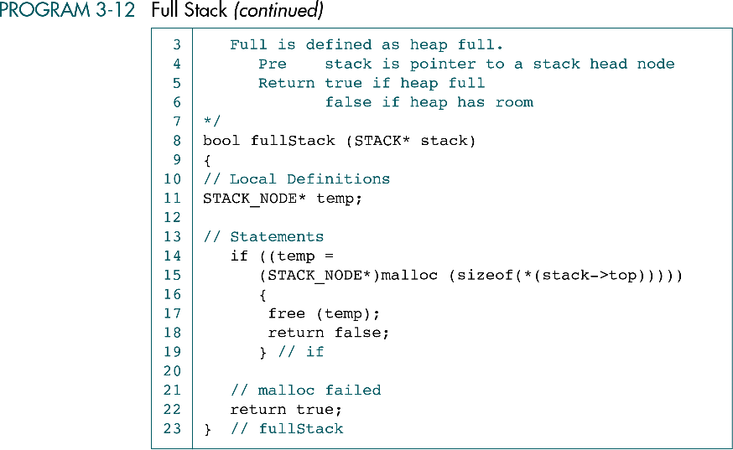
Full Stack
Data Structures: A Pseudocode Approach with C

Slide 32
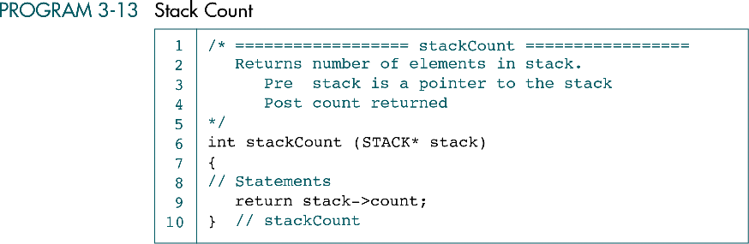
Stack Count
Data Structures: A Pseudocode Approach with C

Slide 33
Destroy Stack
main
NULL
Free
Data
stack
count
top
Free
Free
3
dataPtr
link
Free
Data
temp
Free
dataPtr
link
Free
Data
Free
dataPtr
link
Data Structures: A Pseudocode Approach with C

Slide 34
3-5 Stack Applications
Three basic application problems-parsing, postponement, and backtracking-are discussed and sample programs developed. In addition, several other stack applications are presented, including the classic Eight Queens problem.
Reversing Data
Converting Decimal to Binary
Parsing
Postponement
Backtracking
Data Structures: A Pseudocode Approach with C

Slide 35
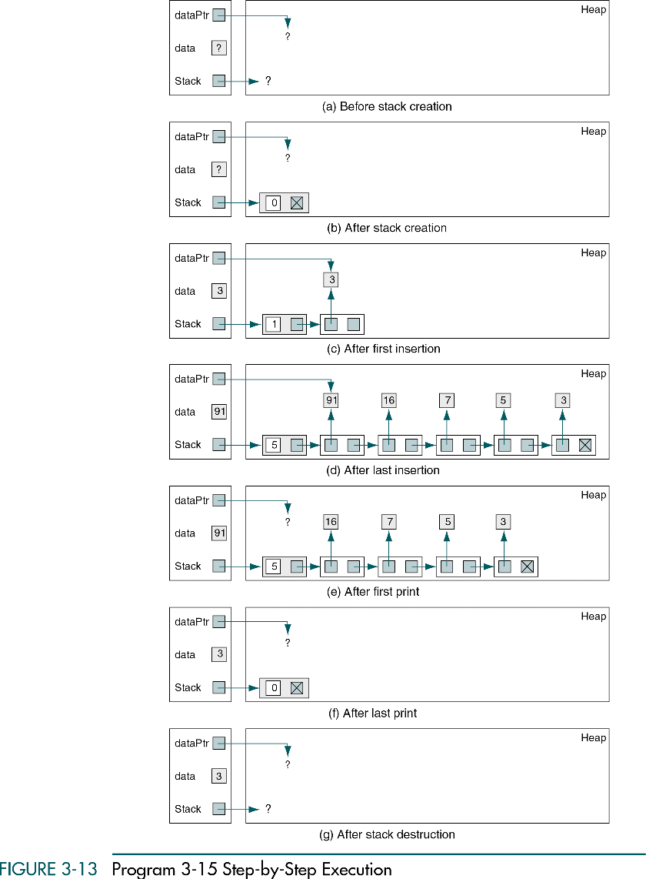
Reverse a Number Series
Data Structures: A Pseudocode Approach with C

Slide 36
Reverse a Number Series (cont.)
Data Structures: A Pseudocode Approach with C

Slide 37
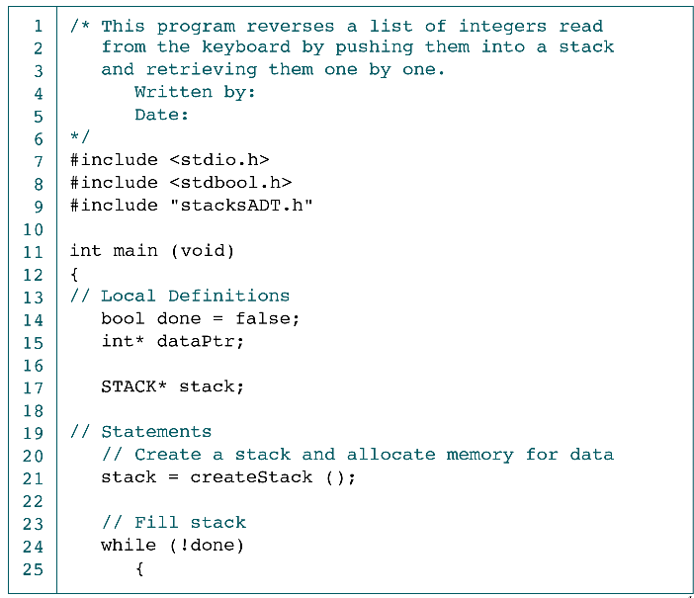
Reverse a Integer List: Program
Data Structures: A Pseudocode Approach with C

Slide 38
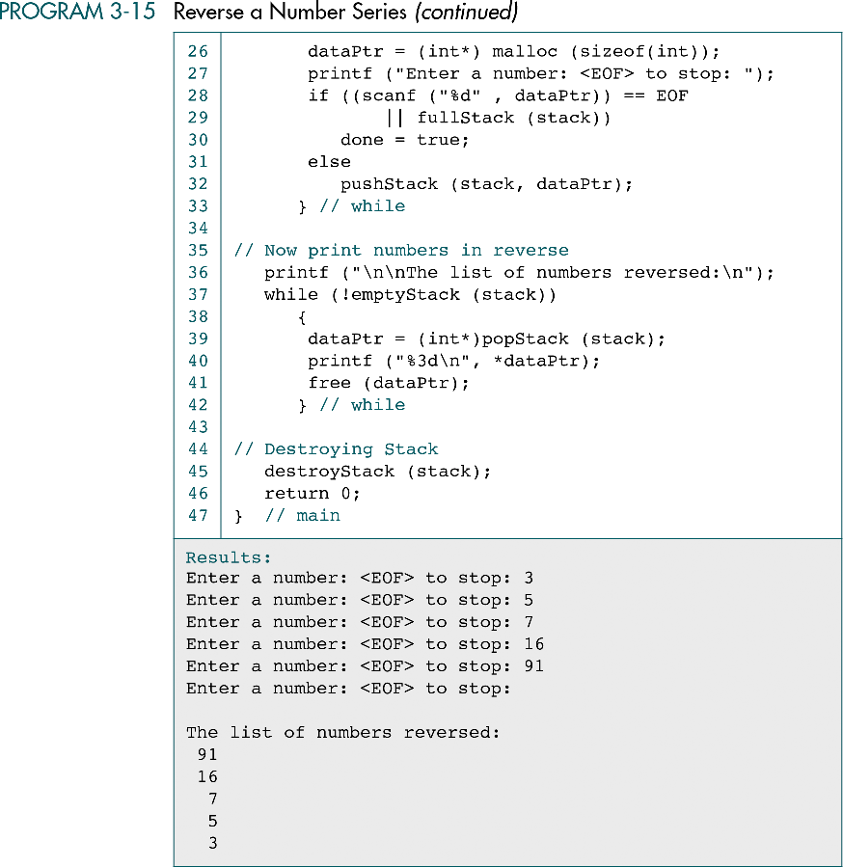
Reverse a Integer List: Program (cont.)
Data Structures: A Pseudocode Approach with C

Slide 39
Reverse a Integer List: Program (cont.)
Data Structures: A Pseudocode Approach with C

Slide 40
Convert Decimal to Binary
read (number)
loop (number > 0)
  set digital to number modulo 2
  print (digital)
  set number to quotient of number / 2
end loop
For example: Number = 10
loop 1: digital = 10 mod 2 = 0 output → 0
number = 5
loop 2: digital = 5 mod 2 = 1 output → 01
number = 2
loop 3: digital = 2 mod 2 = 0 output → 010
number = 1
loop 4: digital = 1 mod 2 = 1 output → 0101
number = 0 end loop
Note: output should be 1010 instead of 0101
Data Structures: A Pseudocode Approach with C

Slide 41
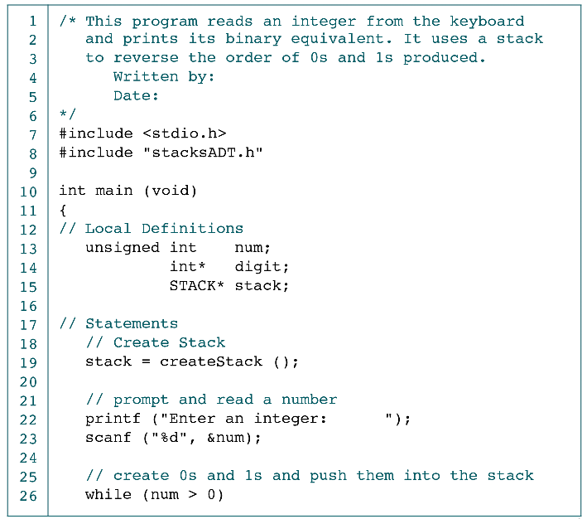
Decimal to Binary: Using Stack
Data Structures: A Pseudocode Approach with C

Slide 42
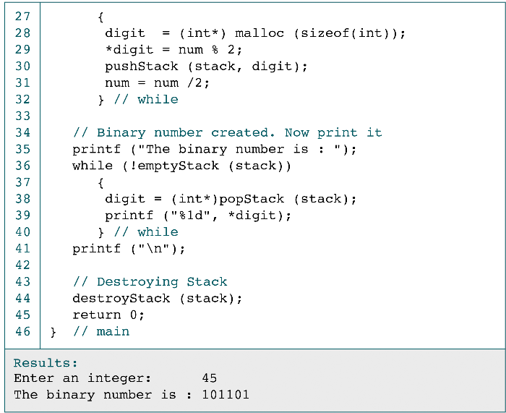
Decimal to Binary: Using Stack (cont.)
Data Structures: A Pseudocode Approach with C

Slide 43
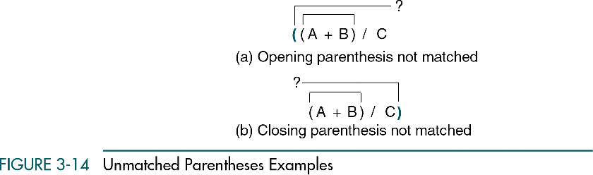
Parsing
Parsing is any logic that breaks data into independent pieces for futher processing
  E.g., compiler translate a source program to machine language by parseing the program into keywords, names, and tokens
Unmatched parentheses examples
Data Structures: A Pseudocode Approach with C

Slide 44
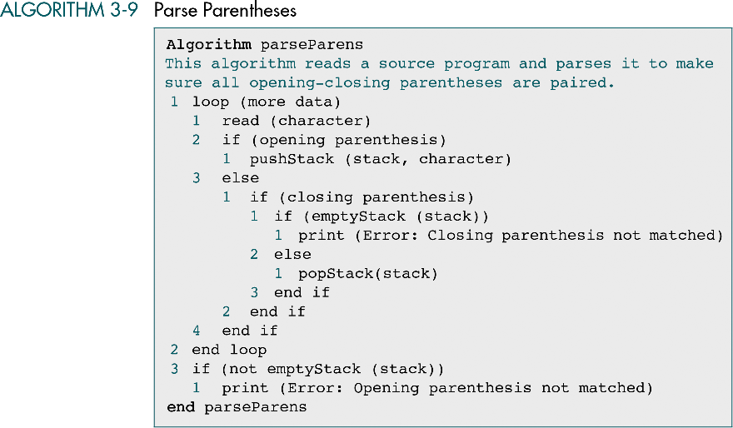
Parse Parentheses
Data Structures: A Pseudocode Approach with C

Slide 45
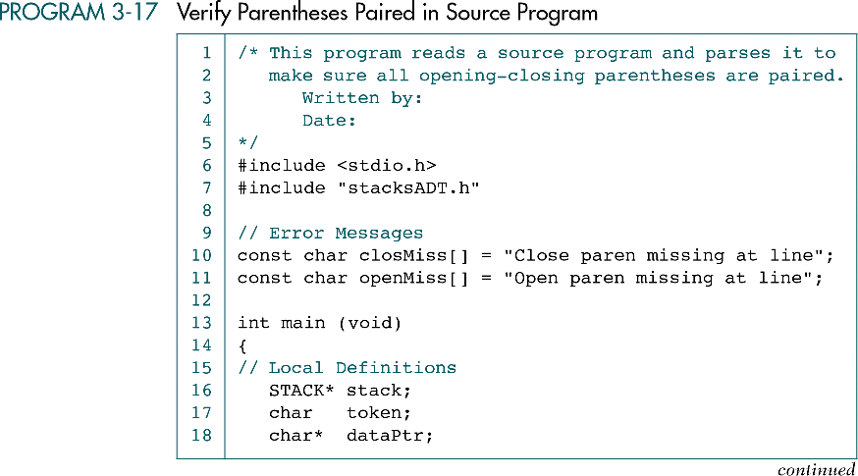
Verify Parentheses Paired
Data Structures: A Pseudocode Approach with C

Slide 46
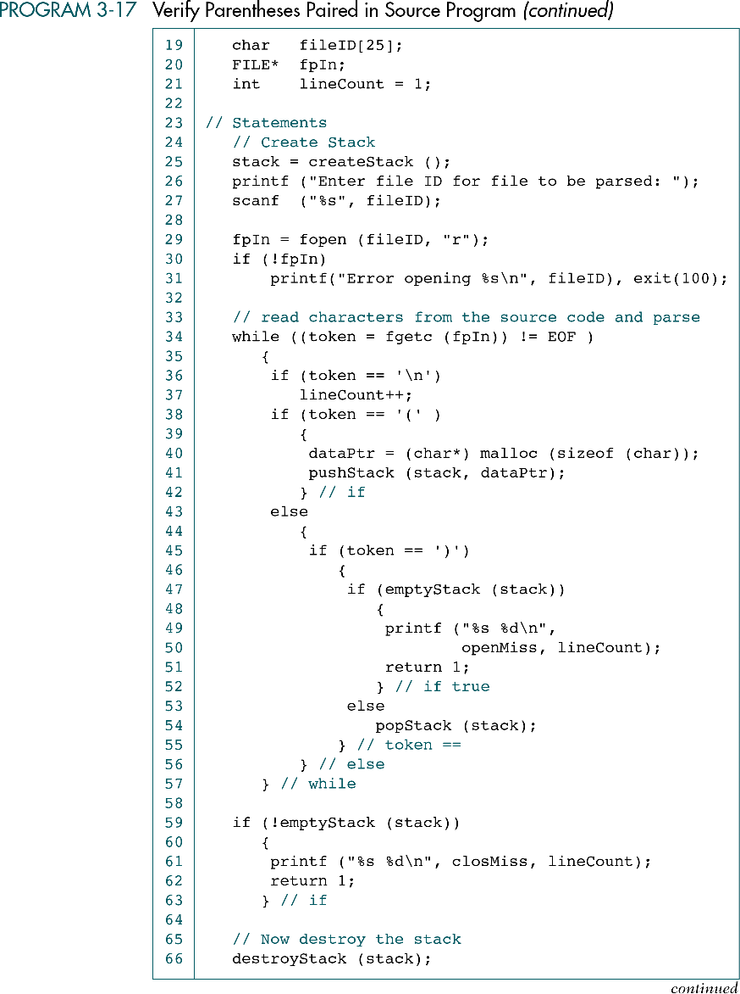
Verify Parentheses Paired (cont.)
Data Structures: A Pseudocode Approach with C

Slide 47
Verify Parentheses Paired (cont.)
Data Structures: A Pseudocode Approach with C

Slide 48
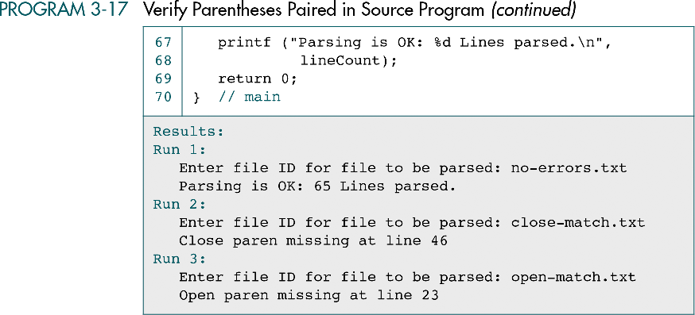
Verify Parentheses Paired (cont.)
Data Structures: A Pseudocode Approach with C

Slide 49
Postponement: Infix to Postfix
Manual Transformation
Example 1: A + B * C
Step 1: ( A + ( B * C ) )
Step 2: ( A + ( B C *) )
Step 3: ( A ( B C * ) + )
Example 2: ( A + B ) * C + D + E * F – G
Step 1: ( ( ( ( ( A + B ) * C ) + D ) + ( E * F ) ) – G )
Step 2: ( ( ( ( ( A B + ) C * ) D + ) ( E F * ) + ) G – )
Step 3: A B + C * D + E F * + G –
Algorithm transformation
A * B → A B * : push operator * into stack and pop the stack after the
whole infix expression has been read
A * B + C → A B * C + : push operator * into stack and pop the stack
before we get another operator +
A + B * C → A B C * + : ?
Data Structures: A Pseudocode Approach with C

Slide 50
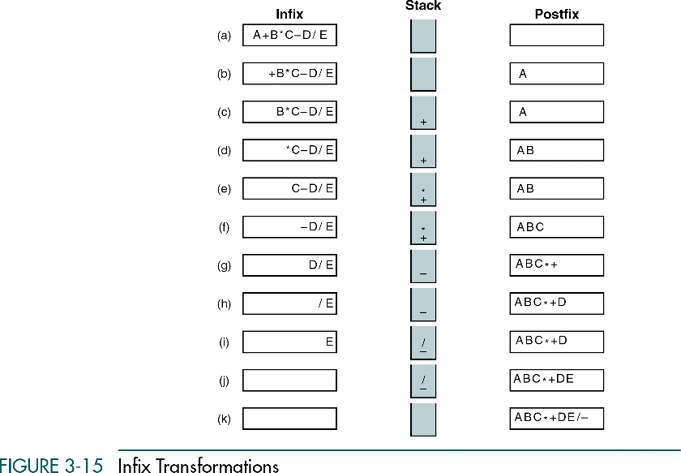
Postponement: Infix to Postfix
A + B * C → A B C * +
Copy operand A to output expr.
Push operator + into stack
Copy operand B to output expr.
Push operator * into stack (priority of * is higher than +)
Copy operand C to output expr.
Pop operator * and copy to output expr.
Pop operator + and copy to output expr.
Note 1: several operators may be popped before pushing the new operator into stack
Note 2: Priority order
Priority 2: * /
Priority 1: + -
Data Structures: A Pseudocode Approach with C

Slide 51
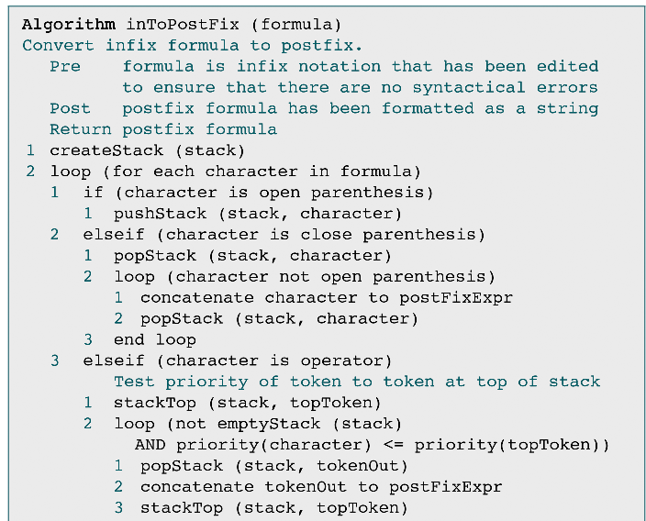
Convert Infix to Postfix
Data Structures: A Pseudocode Approach with C

Slide 52
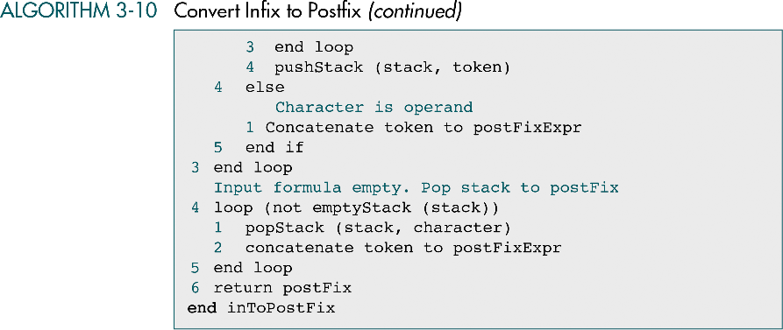
Convert Infix to Postfix (cont.)
Data Structures: A Pseudocode Approach with C

Slide 53
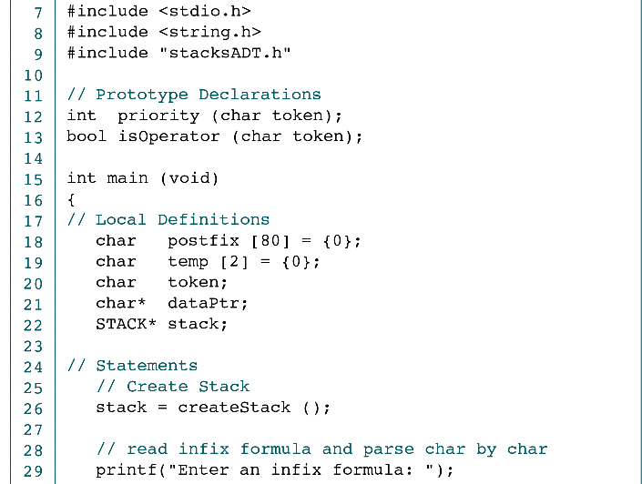
Convert Infix to Postfix in C
Data Structures: A Pseudocode Approach with C

Slide 54
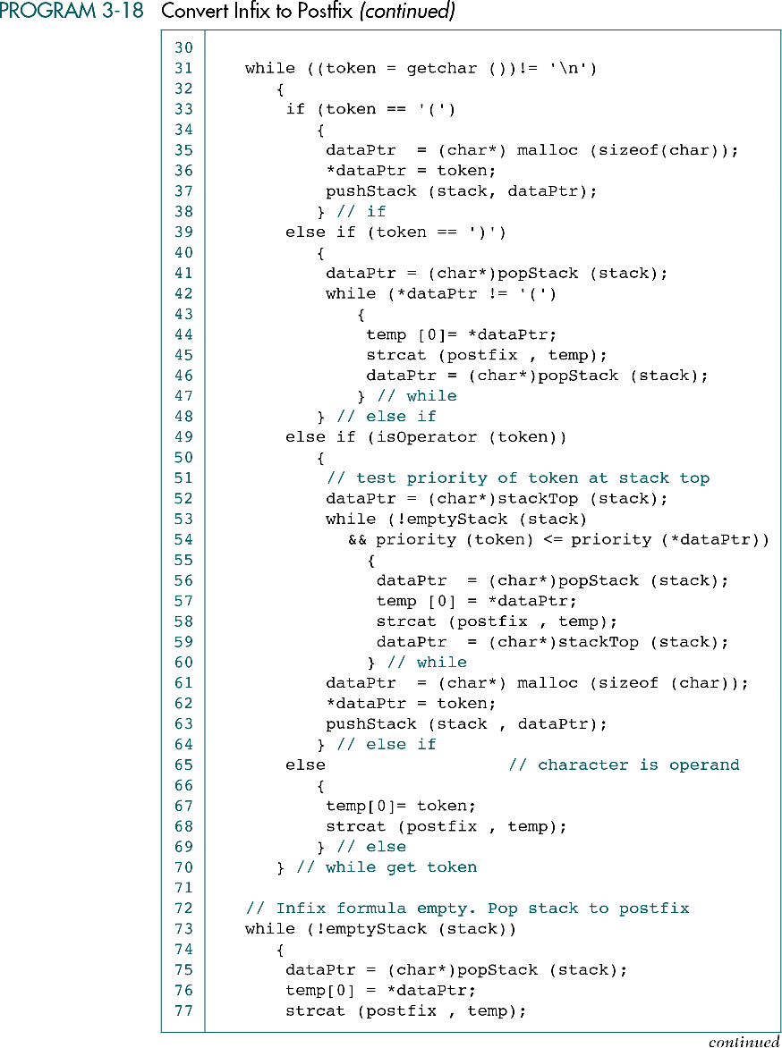
Convert Infix to Postfix in C (cont.)
Data Structures: A Pseudocode Approach with C

Slide 55
Convert Infix to Postfix in C (cont.)
Data Structures: A Pseudocode Approach with C

Slide 56
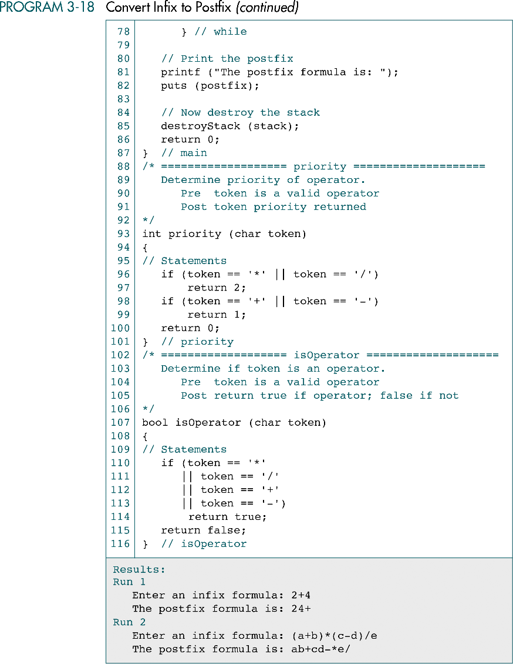
Convert Infix to Postfix in C (cont.)
Data Structures: A Pseudocode Approach with C

Slide 57
Convert Infix to Postfix in C (cont.)
Data Structures: A Pseudocode Approach with C

Slide 58
Convert Infix to Postfix in C (cont.)
Data Structures: A Pseudocode Approach with C

Slide 59
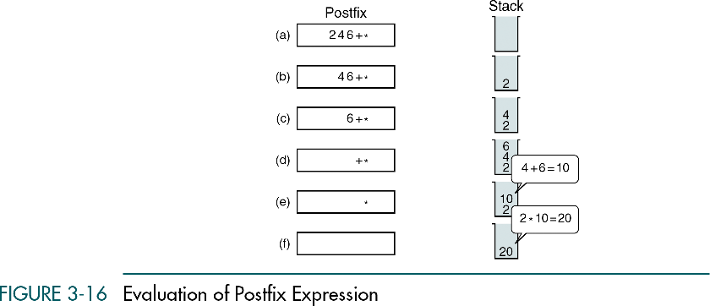
Evaluation of Postfix Expression
Consider postfix expression A B C + * with A = 2, B = 4, and C = 6
Put the operands (values), instead of operators, into stack
Pop two operands at top of the stack and perform the operation
Push the value back into the stack
Q: how to convert postfix to infix ?
Data Structures: A Pseudocode Approach with C

Slide 60
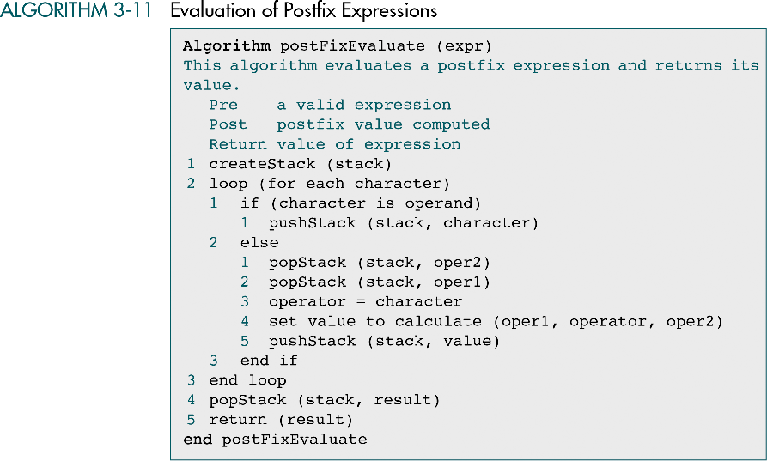
Evaluation of Postfix Expression
Data Structures: A Pseudocode Approach with C

Slide 61
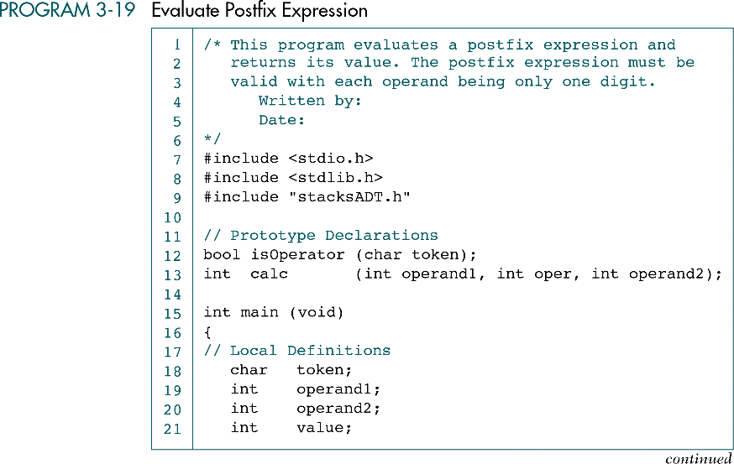
Evaluation of Postfix Expression in C
Data Structures: A Pseudocode Approach with C

Slide 62

Evaluation of Postfix Expression in C
Data Structures: A Pseudocode Approach with C

Slide 63
Evaluation of Postfix Expression in C
Data Structures: A Pseudocode Approach with C

Slide 64
Evaluation of Postfix Expression in C
Data Structures: A Pseudocode Approach with C

Slide 65

Evaluation of Postfix Expression
Data Structures: A Pseudocode Approach with C

Slide 66
Evaluation of Postfix Expression
Data Structures: A Pseudocode Approach with C

Slide 67
Convert Prefix to Infix using Stack
Example: - + *A B C / E F → A * B + C – E / F
Prefix
Stack
Prefix
Stack
- + *A B C / E F
/ E F
A * B + C
-
*
+
-
E F
/
A * B + C
-
A B C / E F
A
*
+
-
E
/
A * B + C
-
B C / E F
F
B
A
*
+
-
F
E
/
A * B + C
-
C / E F
C / E F
A * B
+
-
E / F
A * B + C
-
C
A * B
+
-
/ E F
A*B+C-E/F
Data Structures: A Pseudocode Approach with C

Slide 68


Backtracking: Goal Seeking
Data Structures: A Pseudocode Approach with C

Slide 69

Goal Seeking Program
Data Structures: A Pseudocode Approach with C

Slide 70
Goal Seeking Program (cont.)
Data Structures: A Pseudocode Approach with C

Slide 71

Eight Queens Problem
For example: four queens problem and solution
Data Structures: A Pseudocode Approach with C

Slide 72

Four Queens Step-by-Step Solution
Data Structures: A Pseudocode Approach with C

Slide 73
4 Queens Step-by-Step Solution (cont.)
Data Structures: A Pseudocode Approach with C

Slide 74

Eight Queens Problem
Data Structures: A Pseudocode Approach with C

Slide 75

Design for Eight Queens
Data Structures: A Pseudocode Approach with C

Slide 76


Eight Queens: Mainline
Data Structures: A Pseudocode Approach with C

Slide 77
Eight Queens: Mainline (cont.)
Data Structures: A Pseudocode Approach with C

Slide 78


Eight Queens: Get Board Size
Data Structures: A Pseudocode Approach with C

Slide 79
Eight Queens: Get Board Size (cont.)
Data Structures: A Pseudocode Approach with C

Slide 80

Eight Queens: Fill Board
Data Structures: A Pseudocode Approach with C

Slide 81

Eight Queens: Fill Board (cont.)
Data Structures: A Pseudocode Approach with C

Slide 82
Eight Queens: Fill Board (cont.)
Data Structures: A Pseudocode Approach with C

Slide 83

Eight Queens: Guarded
Data Structures: A Pseudocode Approach with C

Slide 84
Eight Queens: Guarded (cont.)
Data Structures: A Pseudocode Approach with C

Slide 85

Eight Queens: Print Board
Data Structures: A Pseudocode Approach with C

Slide 86
Eight Queens: Print Board (cont.)
Data Structures: A Pseudocode Approach with C

Slide 87

Eight Queens: Print Board (cont.)
Data Structures: A Pseudocode Approach with C

Slide 88
3-6 How Recursion Works
This section discusses the concept of the stack frame and the use of stacks in writing recursive software
Data Structures: A Pseudocode Approach with C

Slide 89

Call and Return
A stackfrme contains four different elements
The parameters to be processed by the called algorithm
The local variables in the calling algorithm
The return statement in the calling algorithm
The expression that is to receive the return value( if any)
Data Structures: A Pseudocode Approach with C

Slide 90

Recursive Power Algorithm
Data Structures: A Pseudocode Approach with C

Slide 91

Stackframes for Power (5, 2)
Data Structures: A Pseudocode Approach with C

