Slide 1
Chapter 4
Queues
Objectives
Upon completion you will be able to:
Explain the design, use, and operation of a queue
Implement a queue using a linked list structure
Understand the operation of the queue ADT
Write application programs using the queue ADT
Explain categorizing data and queue simulation
Data Structures: A Pseudocode Approach with C

Slide 2
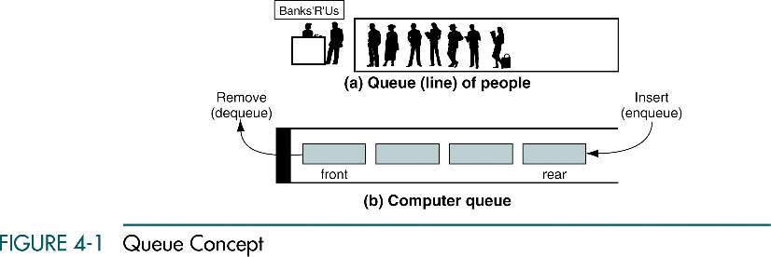
Queue Concept
A queue is a linear list in which data can only be inserted at one end, and deleted from the other end
A queue is a first in-first out (FIFO) restricted data structure
Data Structures: A Pseudocode Approach with C

Slide 3
4-1 Queue Operations
This section discusses the four basic queue operations. Using diagrammatic figures, it shows how each of them work. It concludes with a comprehensive example that demonstrates each operation.
Enqueue
Dequeue
Queue Front
Queue Rear
Queue Example
Data Structures: A Pseudocode Approach with C

Slide 4
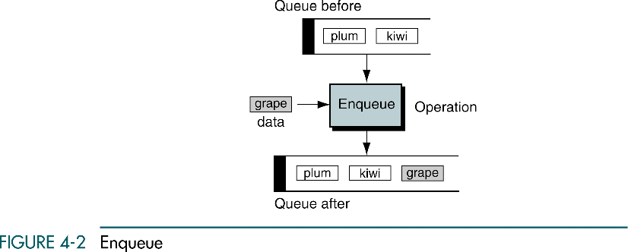
Enqueue
Potential problem with enqueue is overflow
Data Structures: A Pseudocode Approach with C

Slide 5
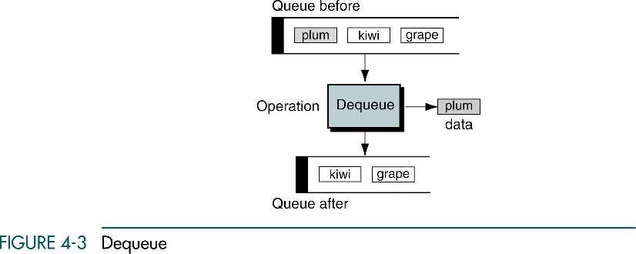
Dequeue
Potential problem with dequeue is underflow
Data Structures: A Pseudocode Approach with C

Slide 6
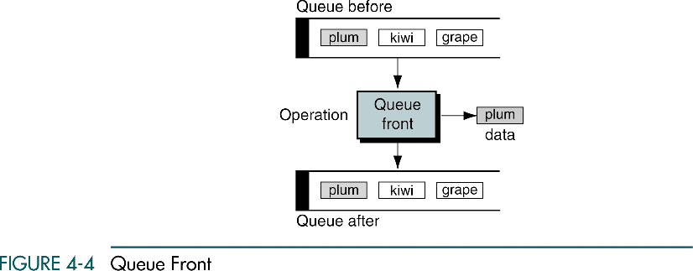
Queue Front
Potential problem with queue front is underflow
Data Structures: A Pseudocode Approach with C

Slide 7
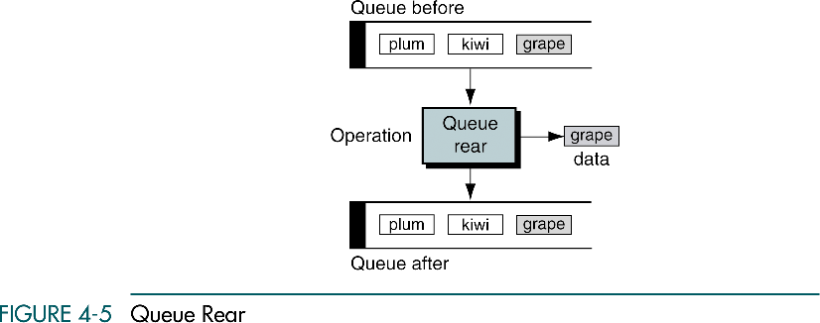
Queue Rear
Potential problem with queue rear is underflow
Data Structures: A Pseudocode Approach with C

Slide 8
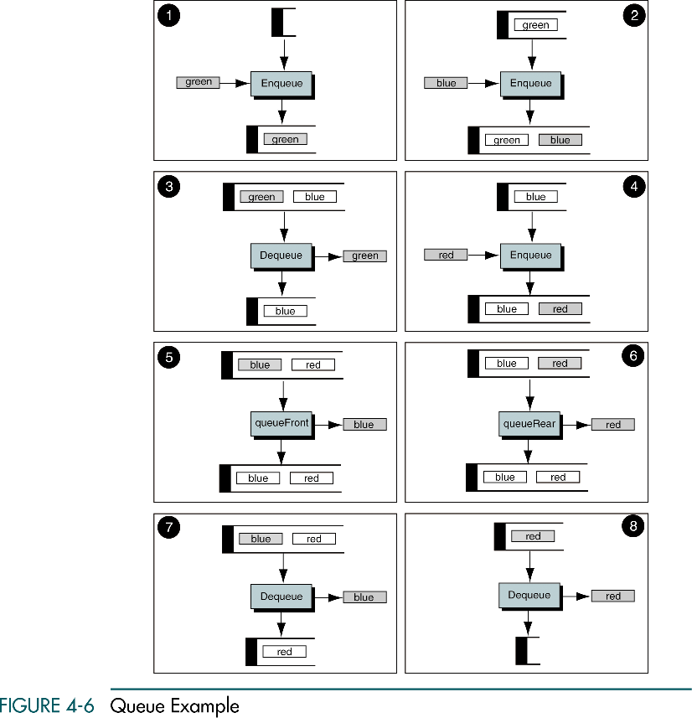
Queue Example
Data Structures: A Pseudocode Approach with C

Slide 9
Queue Example (cont.)
Data Structures: A Pseudocode Approach with C

Slide 10
4-2 Queue Linked List Design
We first discuss the data structure for a linked-list implementation.
We then develop the eight algorithms required to implement a queue.
Data Structure Queue
Algorithms
Data Structures: A Pseudocode Approach with C

Slide 11
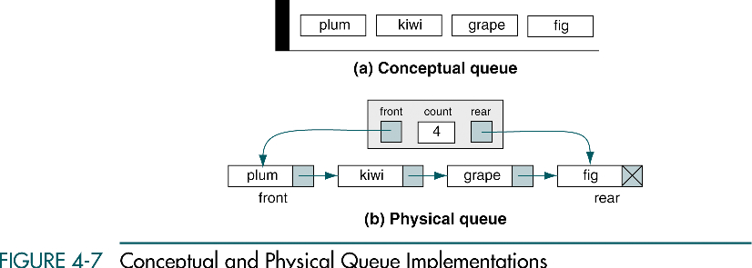
Conceptual and Physical Queue Implementations
Data Structures: A Pseudocode Approach with C

Slide 12
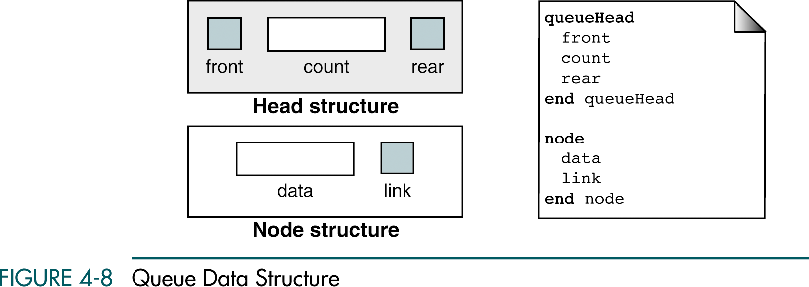
Queue Data Structure
Data Structures: A Pseudocode Approach with C

Slide 13
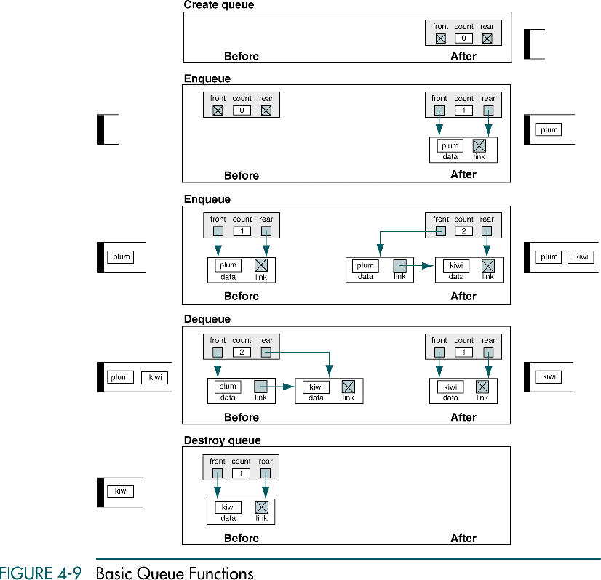
Basic Queue Functions
Data Structures: A Pseudocode Approach with C

Slide 14
Basic Queue Functions (cont.)
Data Structures: A Pseudocode Approach with C

Slide 15
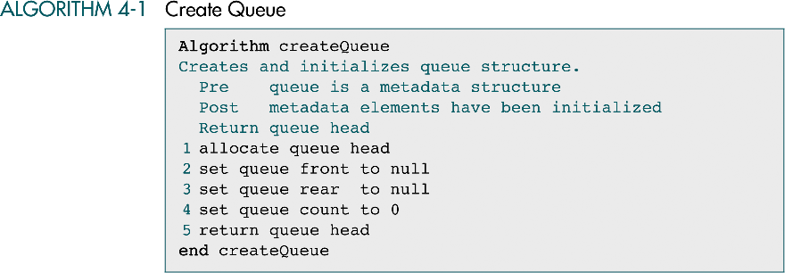
Create Queue: Pseudocode
Data Structures: A Pseudocode Approach with C

Slide 16
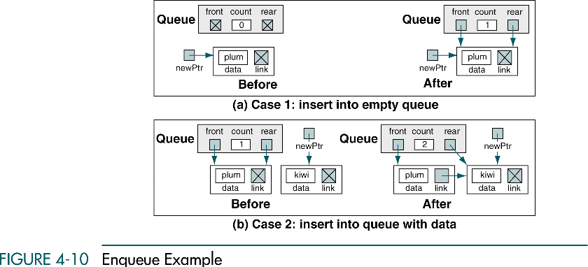
Enqueue Design
Data Structures: A Pseudocode Approach with C

Slide 17
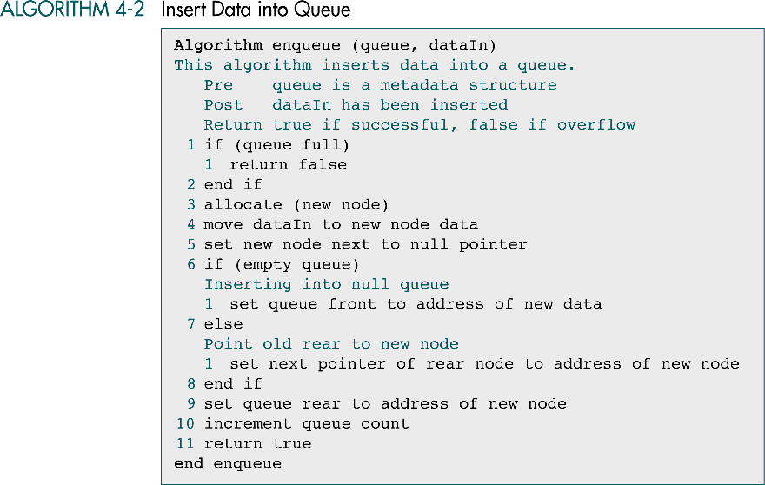
Enqueue: Pseudocode
Data Structures: A Pseudocode Approach with C

Slide 18
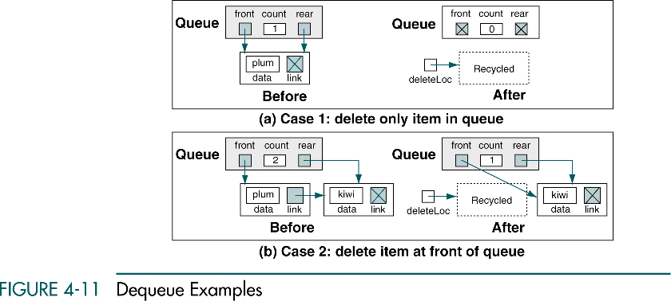
Dequeue Design
Data Structures: A Pseudocode Approach with C

Slide 19
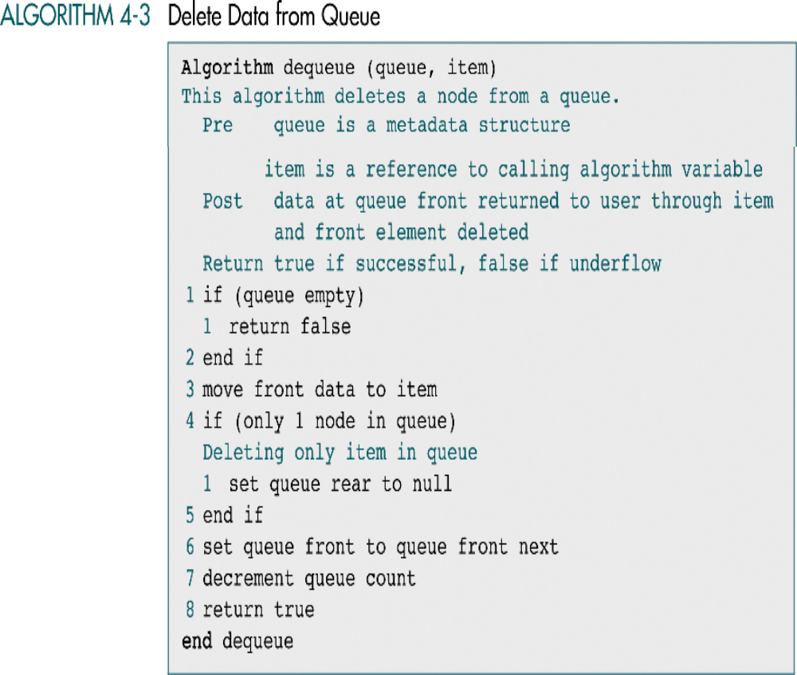
Dequeue: Pseudocode
Data Structures: A Pseudocode Approach with C

Slide 20
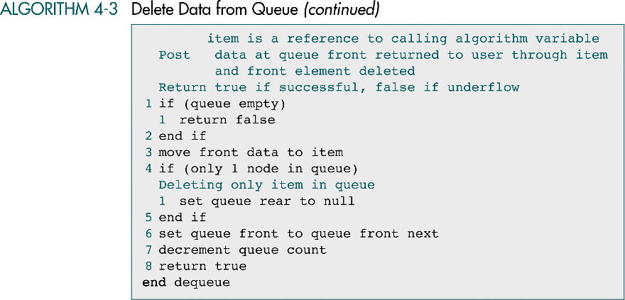
Dequeue: Pseudocode (cont.)
Data Structures: A Pseudocode Approach with C

Slide 21
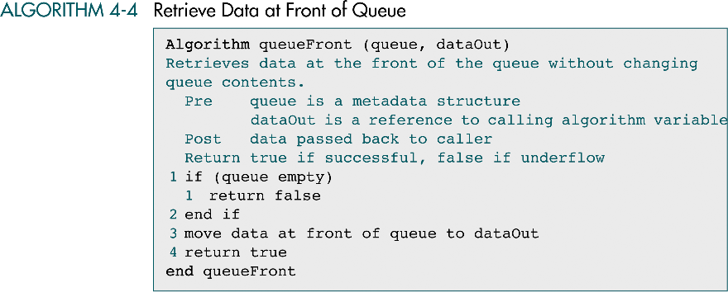
Retrieve Data at Front of Queue
Data Structures: A Pseudocode Approach with C

Slide 22
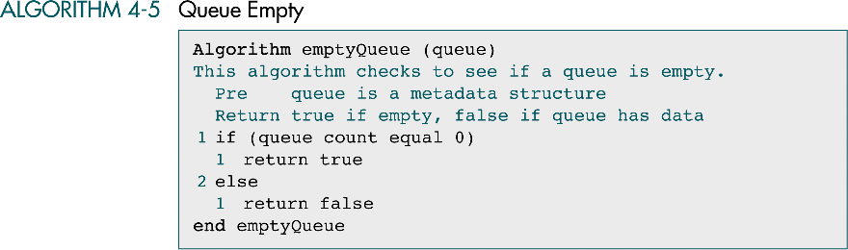
Queue Empty
Data Structures: A Pseudocode Approach with C

Slide 23
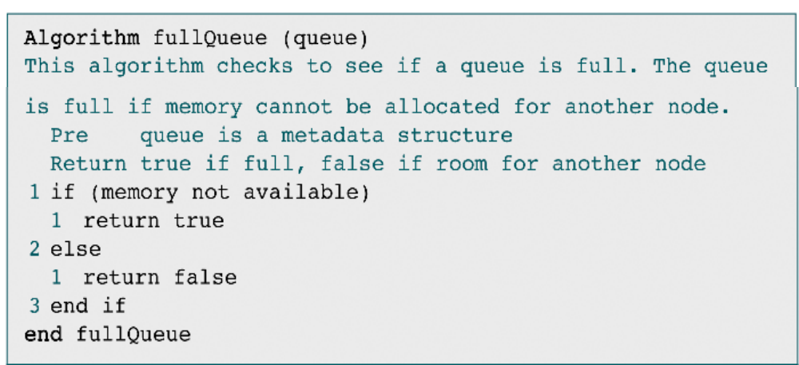
Full Queue
Data Structures: A Pseudocode Approach with C

Slide 24
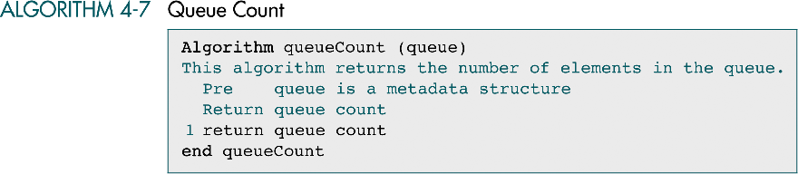
Queue Count
Data Structures: A Pseudocode Approach with C

Slide 25
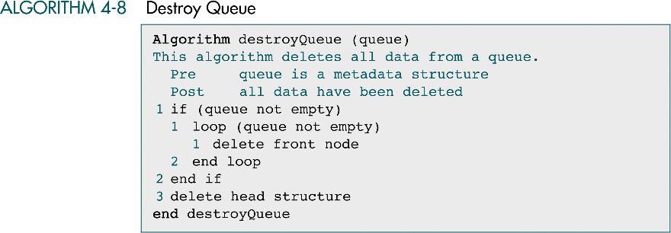
Destroy Queue
Data Structures: A Pseudocode Approach with C

Slide 26
4-2.5 Parameter Passing for Functions
Call by value (C and C++)
Call by address (C and C++)
Call by reference (C++)
Call by constant reference (C++)
Call by Pointer to pointer (C and C++)
Call by Reference to pointer (C++)
Data Structures: A Pseudocode Approach with C

Slide 27
Call by Value (C an C++)
Main copies the value 10 to bump which does not change the value of num
void bump (int m) {
++m; // increment by one
<< m << endl; // displays 11
}
void Main {
int num = 10;
bump(num); // call by value
cout<< num << endl; // displays 10
}
Data Structures: A Pseudocode Approach with C

Slide 28
Call by Address (C and C++)
Main copies the address of memory containing 10 to bump
Still a type of call by value in which the value is the address
void bump (int *p) {
++*p; // increment by one
<< *p << endl; // displays 11
}
void Main {
int num = 10;
bump(&num); // call by value
cout<< num << endl; // displays 11
}
p
00001
00000
00001
11
num
10
&num
00010
00001
Data Structures: A Pseudocode Approach with C
00011

Slide 29
Call by Reference (C++)
Same results as call by address did but simplyfy the program writing
void bump (int & m) {
++m; // increment by one
<< m << endl; // displays 11
}
void Main {
int num = 10;
bump(num); // call by value
cout<< num << endl; // displays 11
}
00000
m
00001
10
num
11
00010
Data Structures: A Pseudocode Approach with C
00011

Slide 30
Call by Constant Reference (C++)
#include <iostream.h>
const int MaxBuf = 20;
struct block {
char buf[MaxBuf];
int used;
};
int main() {
void display(const block &); // prototype for display()
block data;
int i;
data.used = 5;
for (i = 0; i < data.used; i++) // assign some values
data.buf[i] = i + 'a' ;
display(data); // call by reference
data.used = MaxBuf;
Data Structures: A Pseudocode Approach with C

Slide 31
Call by Constant Reference (C++)
for (i = 0; i < data.used; i++)
data.buf[i] = i + 'a';
display(data); // call by reference
return 0;
}
void display(const block & blockref) {
for (int i = 0; i < blockref.used; i++)
cout << blockref.buf[i] << ' '; cout << endl;
}
--------------------------------------------------------------
Reault:
a b c d e
a b c d e f g h i j k l m n o p q r s t
Compiler reports errors if function display modifies a data member
Efficient (no local copies) and Safe (no modifications)
Data Structures: A Pseudocode Approach with C

Slide 32
Call by Address Does NOT Work ?
// exchange pointers to integers in place using pointers
#include <iostream.h>
int main() {
int a = 43, b = 56;
int *pa = &a, *pb = &b;
void pxchg(int *, int *);
cout << *pa << ' ' << *pb << endl;
pxchg(pa, pb);
cout << *pa << ' ' << *pb << endl;
return 0; }
void pxchg(int *p, int *q){
int *pt ;
pt = p;
p = q;
q = pt; }
---------------------------------------------------------
Result: 43 56 43 56
p
pt
00001
pa
00011
00001
00000
00001
43
a
pb
00001
00011
00010
00011
56
b
q
00011
00001
Data Structures: A Pseudocode Approach with C

Slide 33
Call by Pointer to pointer (C and C++)
// exchange pointers to integers in place using pointers
#include <iostream.h>
int main() {
int a = 43, b = 56;
int *pa = &a, *pb = &b;
void pxchg(int **, int **); // double indirect pointers
cout << *pa << ' ' << *pb << endl;
pxchg(&pa, &pb); // pass pointers to pointers
cout << *pa << ' ' << *pb << endl;
return 0; }
void pxchg(int **p, int **q){ // double indirect pointers
int *pt;
pt = *p; // exchange pointers
*p = *q;
*q = pt; }
---------------------------------------------------------
Result: 43 56 56 43
p
pt
01111
00001
&pa
pa
*p
00000
01111
01111
00001
00011
00001
43
a
&pb
pb
*q
00011
00010
01100
00011
00001
00011
56
b
q
01100
Data Structures: A Pseudocode Approach with C
00001

Slide 34
Data Structures: A Pseudocode Approach with C

Slide 35
Call by Reference to Pointer (C++)
// exchange pointers to integers in place using pointers
#include <iostream.h>
int main() {
int a = 43, b = 56;
int *pa = &a, *pb = &b;
void pxchg(int *&, int *&); // reference to pointers
cout << *pa << ' ' << *pb << endl;
pxchg(pa, pb);
cout << *pa << ' ' << *pb << endl;
return 0; }
void pxchg(int *& p, int *& q){ // reference to pointers
int *pt;
pt = p; // exchange pointers
p = q;
q = pt; }
---------------------------------------------------------
Result: 43 56 56 43
pt
00001
pa
p
00000
00011
00001
00001
43
a
pb
q
00010
00011
00001
56
b
00011
Data Structures: A Pseudocode Approach with C
00001

Slide 36
4-3 Queue ADT
This section develops the data structures and C code to
implement a Queue ADT. The first program contains
the data structure declarations and a list of the prototypes
for all of the functions. We then develop the C code for
the algorithms discussed in Section 4.2
Queue Structure
Queue ADT Algorithms
Data Structures: A Pseudocode Approach with C

Slide 37
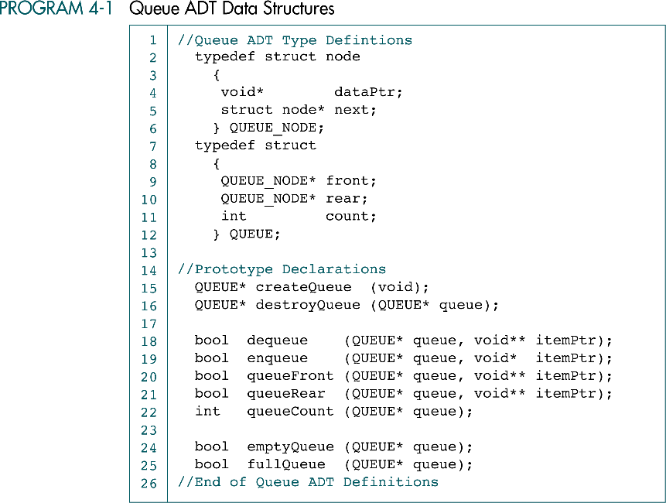
Queue ADT Data Structures
Data Structures: A Pseudocode Approach with C

Slide 38
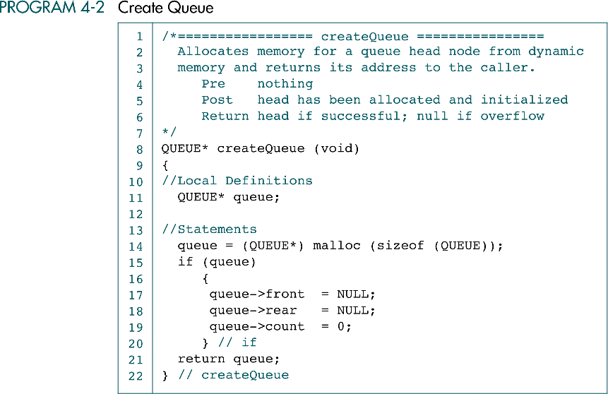
Create Queue in C
Data Structures: A Pseudocode Approach with C

Slide 39
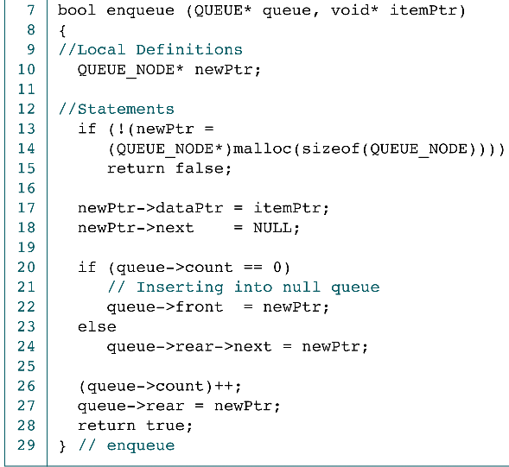
Enqueue in C
main
queue
front
count
rear
0
1
ItemPtr
Data
newPtr
dataPtr
link
main
front
count
rear
queue
1
2
newPtr
Data
Data
ItemPtr
dataPtr
link
dataPtr
link
Data Structures: A Pseudocode Approach with C

Slide 40
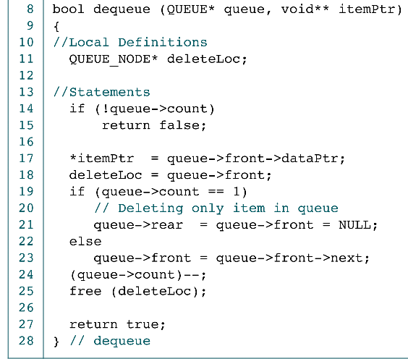
Dequeue in C
main
queue
front
count
rear
1
2
ItemPtr
Data
Data
*ItemPtr
Free
deleteLoc
dataPtr
link
dataPtr
link
main
NULL
queue
front
count
rear
1
0
ItemPtr
Data
*ItemPtr
Free
deleteLoc
dataPtr
link
Data Structures: A Pseudocode Approach with C

Slide 41
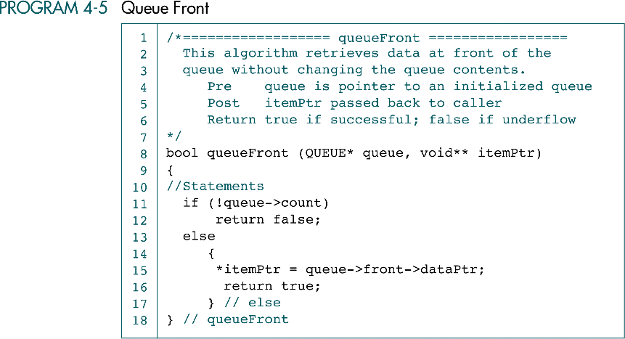
Queue Front in C
Data Structures: A Pseudocode Approach with C

Slide 42
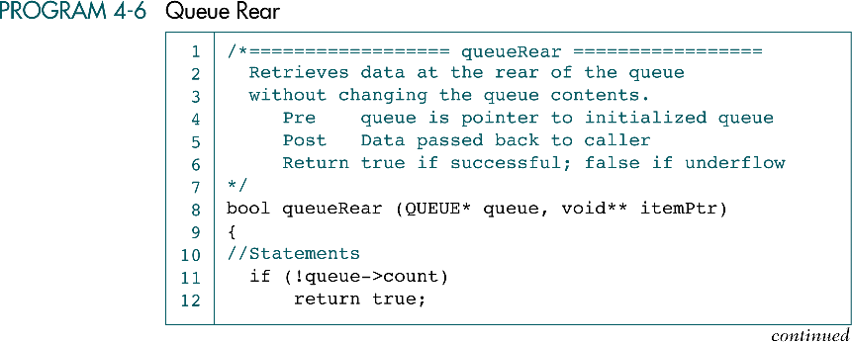
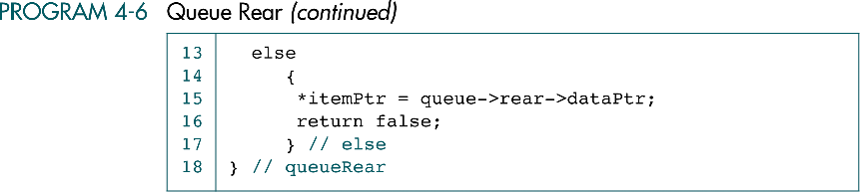
Queue Rear in C
Data Structures: A Pseudocode Approach with C

Slide 43
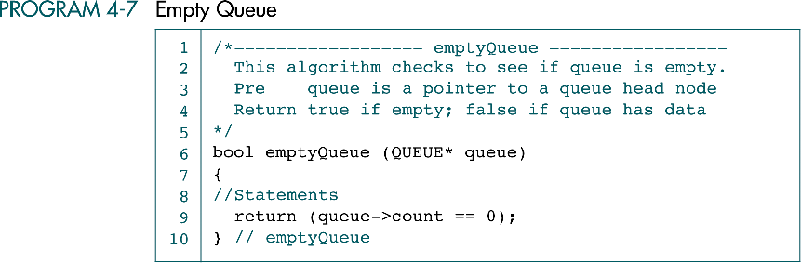
Empty Queue in C
Data Structures: A Pseudocode Approach with C

Slide 44
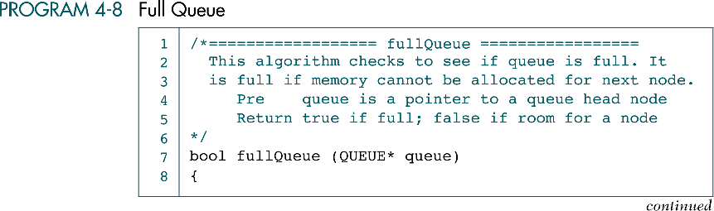
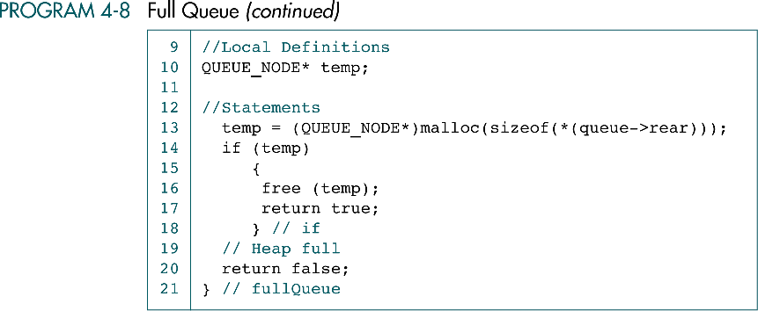
Full Queue in C
Data Structures: A Pseudocode Approach with C

Slide 45
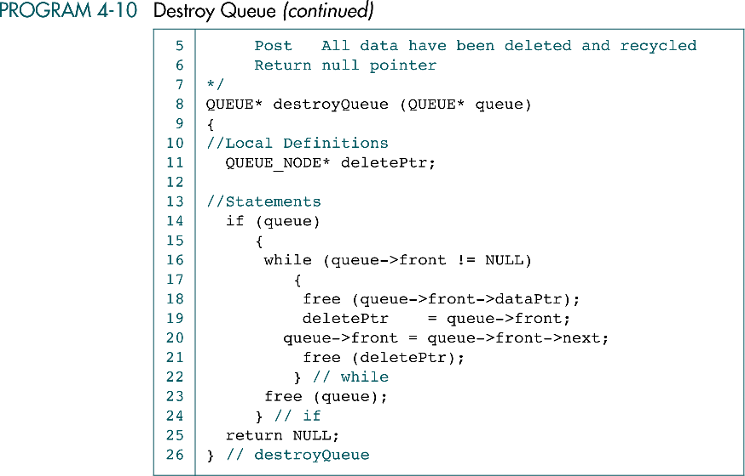
Destroy Queue in C
Data Structures: A Pseudocode Approach with C

Slide 46
4-5 Queue Applications
We develop two queue applications. The first shows how to use a
queue to categorize data. The second is a queue simulator,
which is an excellent tool to simulate the performance and to
increase our understanding of its operation.
Categorizing Data
Queue Simulation
Data Structures: A Pseudocode Approach with C

Slide 47
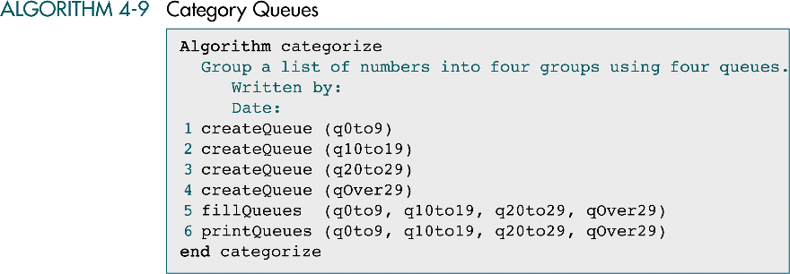
Category Queues
Data Structures: A Pseudocode Approach with C

Slide 48
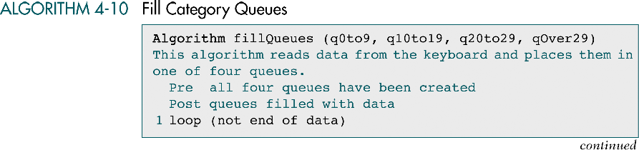
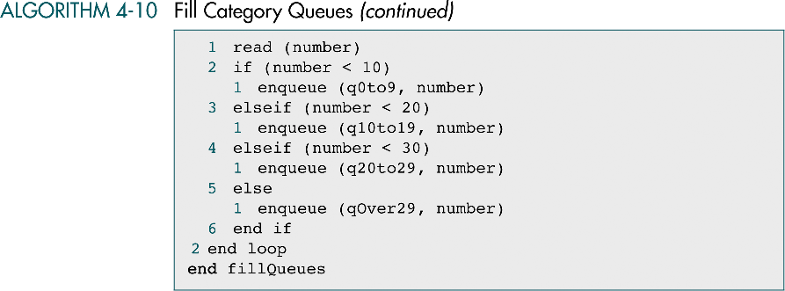
Fill Category Queues
Data Structures: A Pseudocode Approach with C

Slide 49
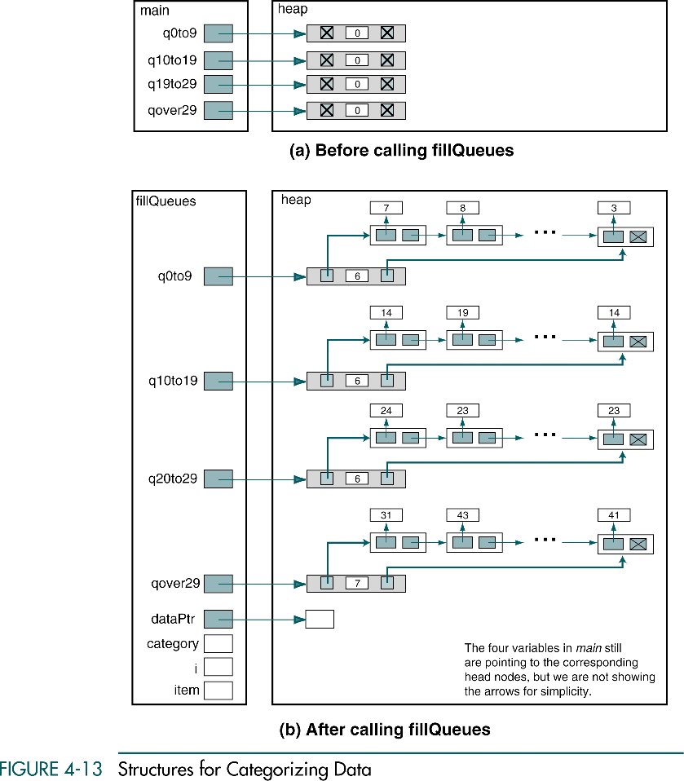
Structures for Categorizing Data
Data Structures: A Pseudocode Approach with C

Slide 50
Structures for Categorizing Data (cont.)
Data Structures: A Pseudocode Approach with C

Slide 51
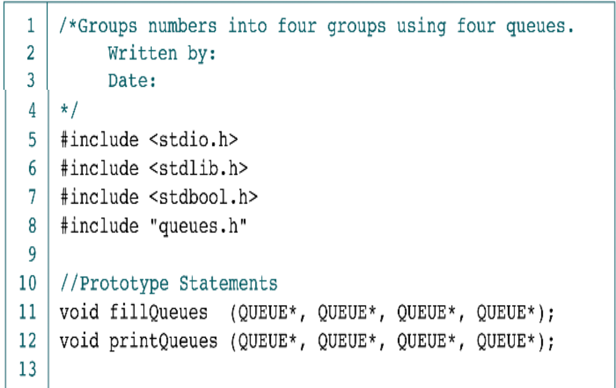
Categorizing Data Machine
Data Structures: A Pseudocode Approach with C

Slide 52
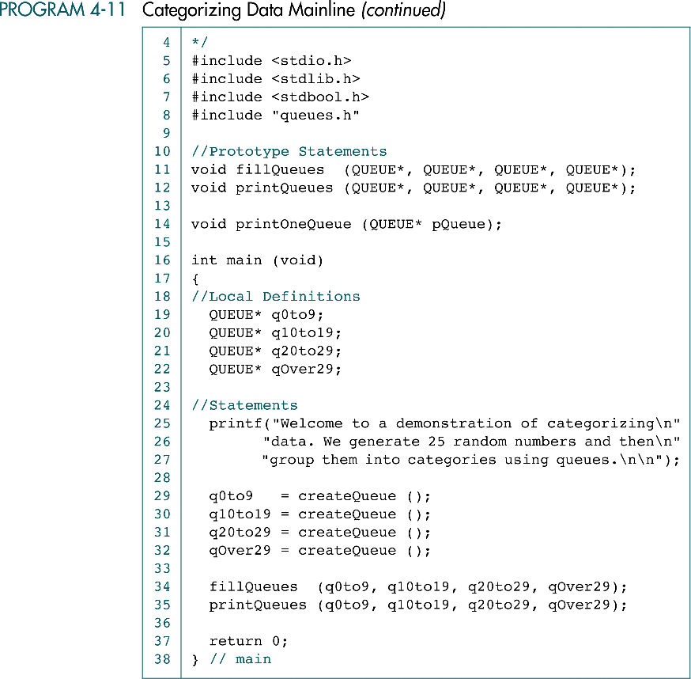
Categorizing Data Machine (cont.)
Data Structures: A Pseudocode Approach with C

Slide 53
Categorizing Data Machine (cont.)
Data Structures: A Pseudocode Approach with C

Slide 54
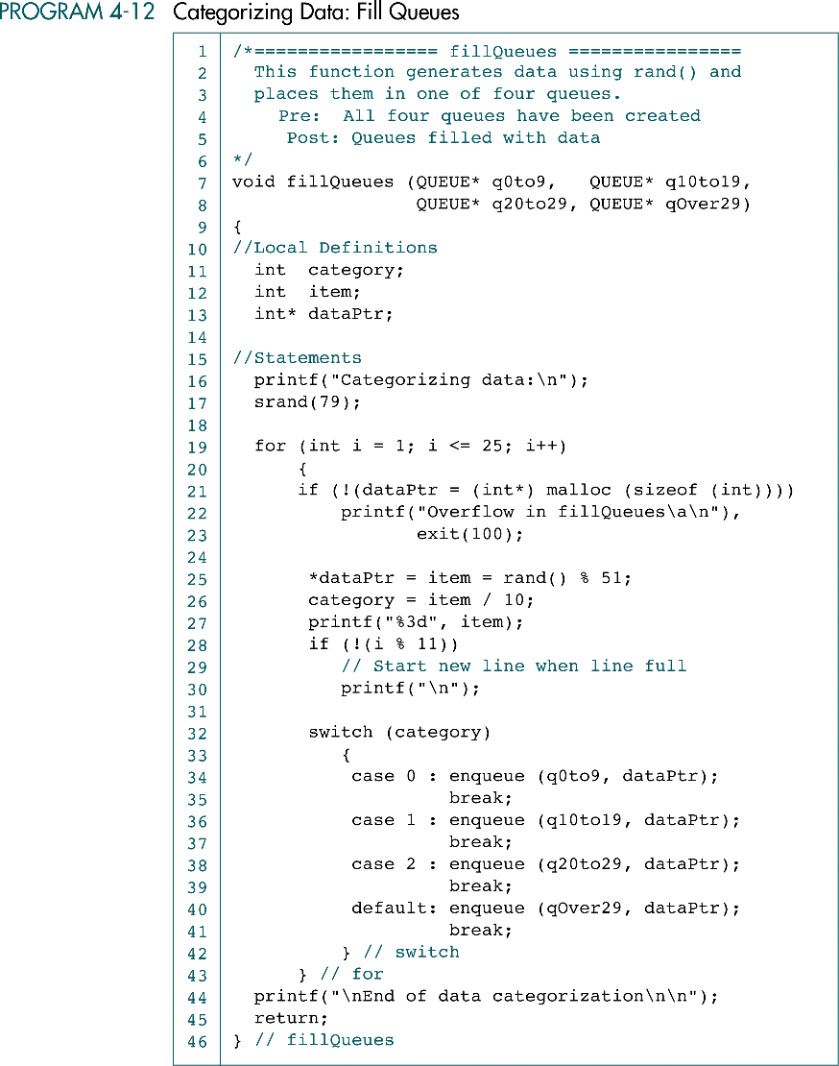
Categorizing Data : Fill Queues
Data Structures: A Pseudocode Approach with C

Slide 55
Categorizing Data : Fill Queues (cont.)
Data Structures: A Pseudocode Approach with C

Slide 56
Categorizing Data : Fill Queues (cont.)
Data Structures: A Pseudocode Approach with C

Slide 57
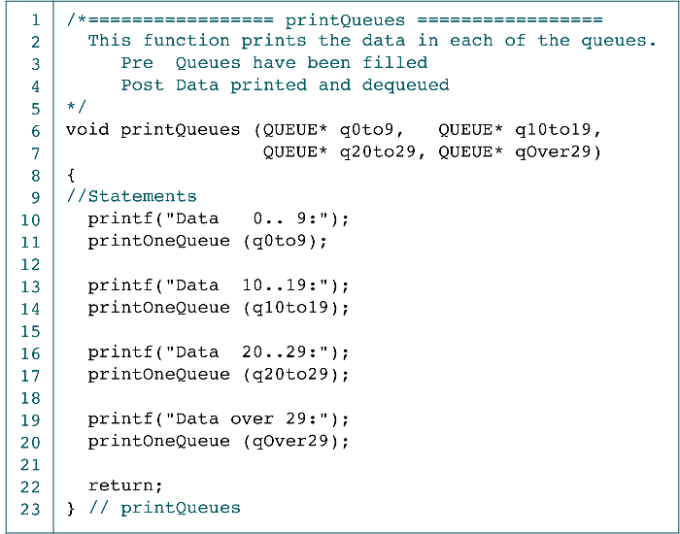
Categorizing Data : Print Queues
Data Structures: A Pseudocode Approach with C

Slide 58
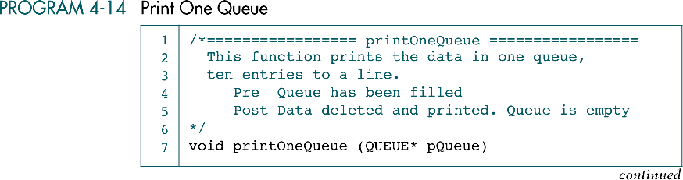
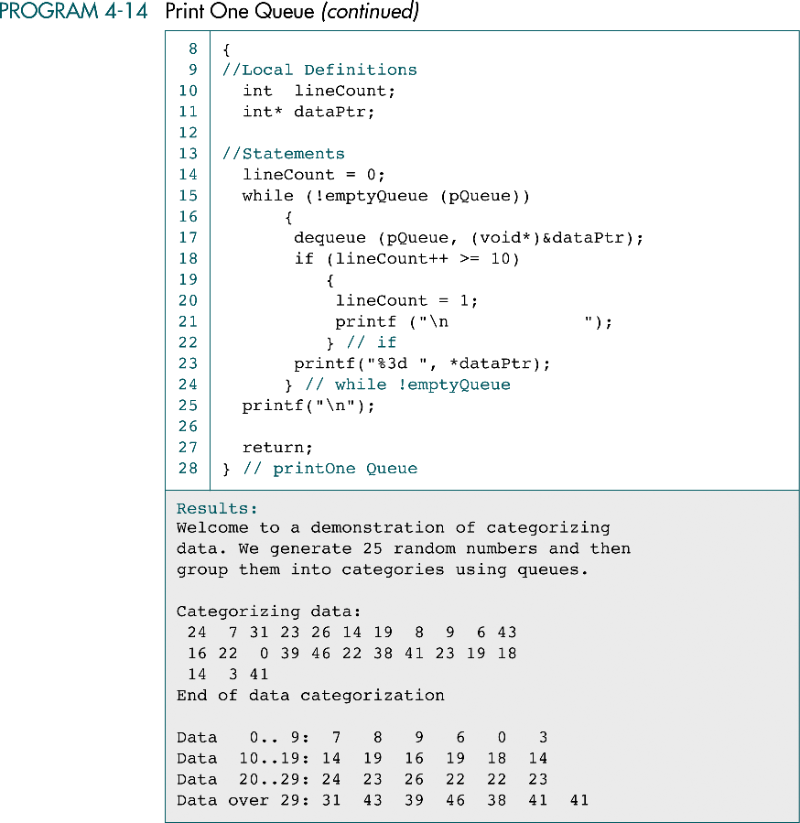
Print One Queue
Not necessary !
Data Structures: A Pseudocode Approach with C

Slide 59
Categorizing Data Result
Data Structures: A Pseudocode Approach with C

Slide 60
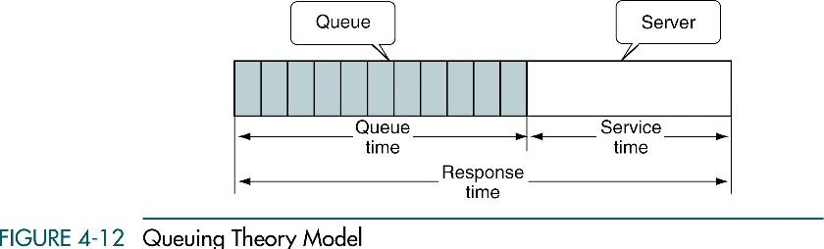
Queue Simulation
Data Structures: A Pseudocode Approach with C

Slide 61
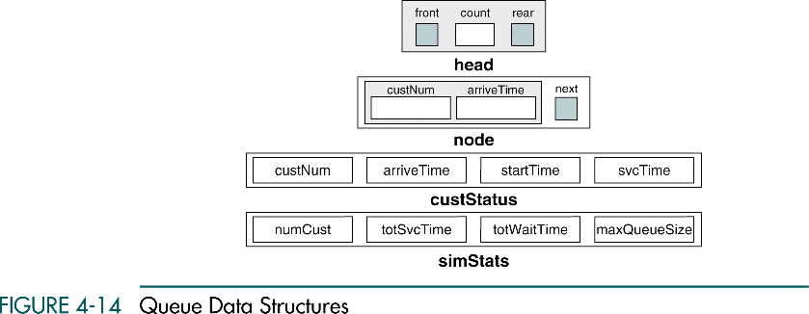
Queue Data Structures
Customer
Data
(queue head)
Serial #
(customer in queue)
(status of current processed customer)
Total # of
customers
(overall simulation status)
Data Structures: A Pseudocode Approach with C

Slide 62
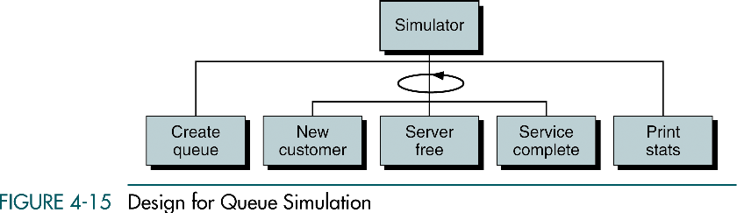
Design for Queue Simulation
Simulation Events
Data Structures: A Pseudocode Approach with C

Slide 63
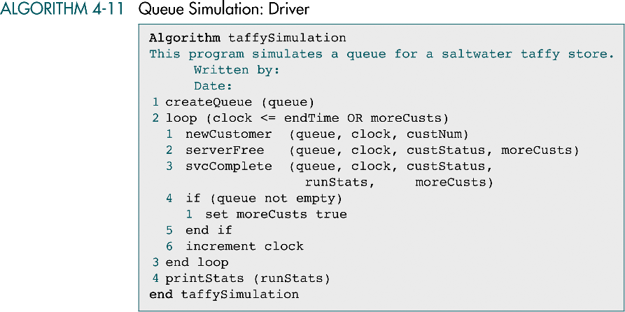
Queue Simulation: Driver
Customer is being served or
customers are waiting in the queue
If server is idle,
set moreCusts = true
Data Structures: A Pseudocode Approach with C

Slide 64
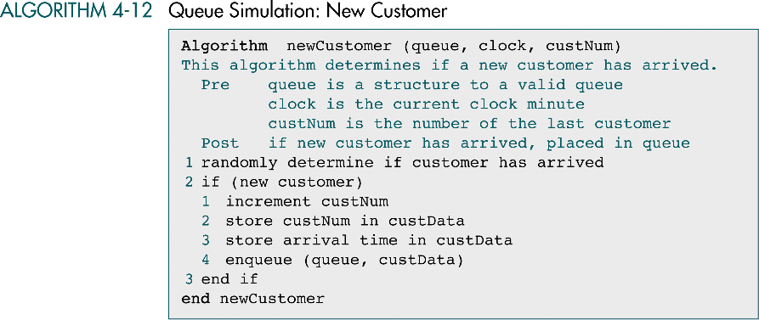
Queue Simulation: New Customer
Data Structures: A Pseudocode Approach with C

Slide 65
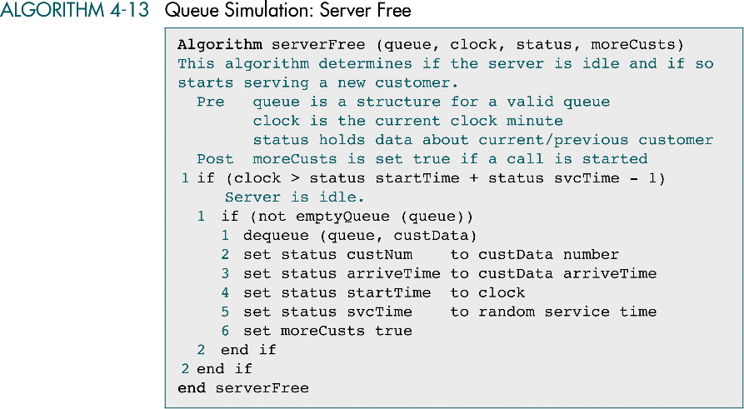
Queue Simulation: Server Free
Data Structures: A Pseudocode Approach with C

Slide 66
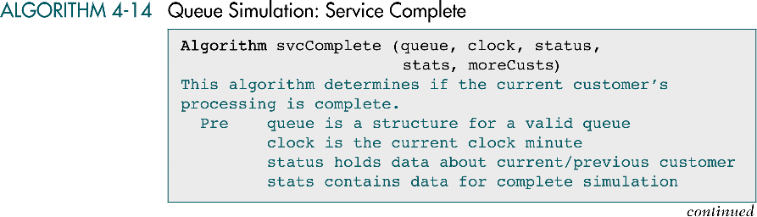
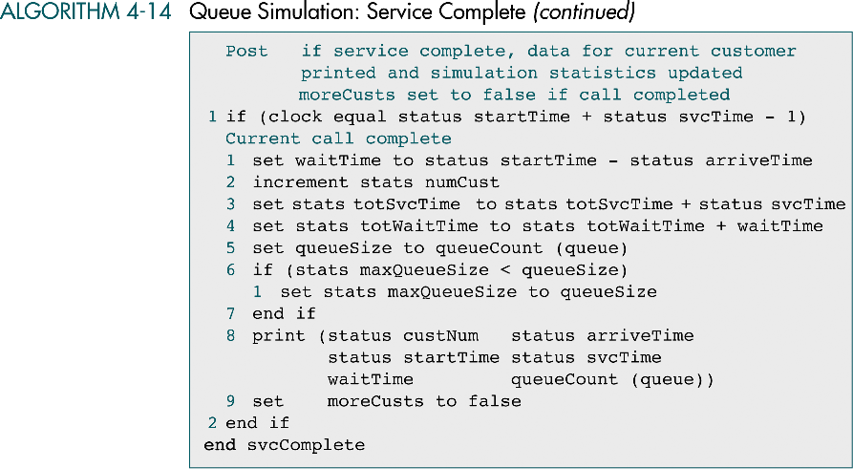
Queue Simulation: Service Complete
Data Structures: A Pseudocode Approach with C

Slide 67
Queue Simulation: Service Complete
Data Structures: A Pseudocode Approach with C

Slide 68
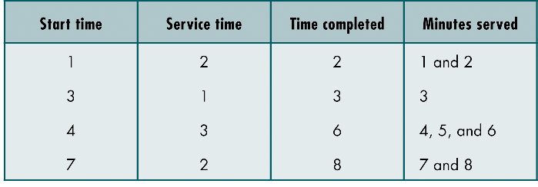
Hypothetical Simulation Service Times
Data Structures: A Pseudocode Approach with C

Slide 69

Queue Simulation: Print Statistics
Data Structures: A Pseudocode Approach with C

